Slide 1
The case for A Library Assistant
and more curriculum engagement for the Library

Slide 2
Overview
The objective of this proposal is to place the library, not just at the heart of reading in TGS but also at the heart of inquiry.
The IBO view inquiry based learning, supported by the library and librarian, as central to their programs
The OECD’s Future of Education and Skills program also has an inquiry based model at it’s heart (AAR) and a focus on digital literacy
In order to achieve the collaboration between teaching staff and the library it is necessary to remove the administrative tasks from the Librarian’s role.
Employing an apprentice gains time for the Librarian and provides a training opportunity in a fulfilling career.

Slide 3
What do we want the Library to be?
Moving beyond being a reading space & becoming a space for inquiring minds
The Library is ‘A school’s physical and digital learning space where reading, inquiry, research, thinking, imagination, and creativity are central to students’ information-to-knowledge journey and to their personal, social, and cultural growth.’ (IFLA, 2015, p.16)
‘The library/ian supports all learners’ and teachers’ progress towards becoming better inquirers, consumers and creators of information. This support requires good vision, solid planning and consistent collaboration. It also requires clear communication of how inquiry, in particular, is promoted in the school community.’ (IBO, 2018, Pg.2)
‘Self directed learning exponentially increases the importance of the Library, not only as the first point of research, but as a source of wisdom on the nature or inquiry and research.’ (IBO, 2018, Pg.9)
‘The IB strongly recommends that the library system of people, places, collections and services—or what is referred to as the library/ian—be designed to support and energize academic learning, service learning, and social and emotional support for the community. The library/ian should be directly represented in curriculum planning and development in the school community.’ (IBO, 2018, Pg.12)

Slide 4
How does this support the school’s strategic vision for 2026?
‘Preparing our students for a world we can only imagine’ (Senge, 2015)
Enable the Library to collaborate with, not just support, teachers to embed inquiry into their schemes of work in order to teach students how to question, evaluate, connect, express and reflect on the world around them, skills that reach across the curriculum and out into the word beyond school.
By incorporating the Framework Of Skills for Inquiry Learning (FOSIL) which provides a framework for collaboration between the Library and teaching staff in order to build constructive and structured inquiry throughout the school.
FOSIL seems a natural partner for the OECD’s Future of Education and Skills project. The AAR cycle (OECD, 2019) clearly relates to the FOSIL Cycle (Toerien, n.d.) providing a concrete approach to embedding AAR skills into our schemes of work

Slide 5
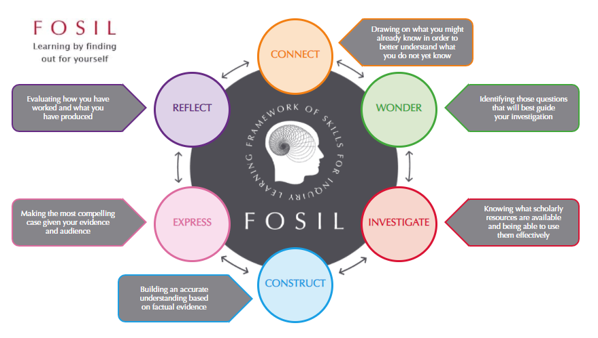
What is required to achieve this goal for the Library?
Initially the Library would work with 3 departments, to build a full inquiry based program using FOSIL (English, Geography and Computer science possibly)
Attend curriculum meetings to understand the requirements of the schemes of work
Build on Darryl Toerien’s work (2021) to integrate FOSIL with the IB’s MYP ATLs. in order to ensure that the information and digital literacy skills, a core component of the OECD’s compass (OECD, 2018) are embedded into our teaching.
Continue to work with the VI form team to apply FOSIL to the Extended Essay program and encourage students to follow the cycle of connecting, wondering, investigating, constructing, expressing and reflecting in order to get the most from the EE component of the Diploma.

Slide 6
How would a Library apprentice facilitate this?
An apprentice would complete the administrative tasks of the library which are estimated to take 2/3rd of the day. The would enable the Librarian to attend meetings and work with teachers to create inquiry focused lessons.
Day to Day book management
Cataloguing
Circulation
Repairs / Covering /
Stocktaking and managing the shelving
Managing and updating the Research Portal
Creating reading lists and subject based resources in collaboration with the Librarian
Adding news to the portal and keeping it relevant
Displays and screens
Updating the display boards in the Library
Updating information for the screens
Help run book clubs and events

Slide 7
References
IBO, 2018. Ideal Libraries: A Guide for schools, Cardiff: International Baccalaureate Organisation.
OECD, 2018. The OECD Learning Compass 2030. [Online] Available at: https://www.oecd.org/education/2030-project/teaching-and-learning/learning/# [Accessed 08 05 2020].
OECD, 2019. Conceptual Learning Framework; Anticipation-Action-Reflection Cycle for 2030. [Online] Available at: https://www.oecd.org/education/2030-project/teaching-and-learning/learning/aar-cycle/AAR_Cycle_concept_note.pdf [Accessed 08 05 2020].
Senge, P., 2015. Keynote. The Hague, IB: Africa, Europe and Middle East Regional Conference.
Toerien, D., 2021. Integrating FOSIL with MYP ATLs. [Online] Available at: https://fosil.org.uk/forums/topic/integrating-fosil-with-myp-atls/ [Accessed 08 05 2021].
Toerien, D., n.d. FOSIL Cycle. [Online] Available at: https://fosil.org.uk/fosil-cycle/ [Accessed 08 05 2020].

