Slide 1
FOSIL: Developing and Extending the Stripling Model of Inquiry
IFLA World Library and Information Congress 2022
Global Action for School Libraries on Models of Inquiry in the Digital Age
23 July 2022
Darryl Toerien | Head of Inquiry-Based Learning | Blanchelande College
toeriend@blanchelande.sch.gg
Notes:
Thank you, and our deepest regrets that we are not able to join you in person.
A special thank you to CCT College for hosting us, to Barbara and Dianne, without whose vision and drive we would not be here, to our fellow authors, some of whom are presenting today, and to Janine / De Gruyter for bringing our work to publication.

Slide 2
FOSIL: Building on a Solid Foundation
Notes:
FOSIL, which stands for Framework Of Skills for Inquiry Learning, is based on Barbara Stripling’s work as reflected in the Empire State Information Fluency Continuum.
I had no meaningful experience of inquiry as an instructional approach to learning, either as student or as a teacher, in both South Africa and the UK. Furthermore, education and training for librarianship in the UK does not allow for a specialisation in school librarianship. FOSIL, therefore, represents an ongoing personal inquiry into teaching and learning through inquiry as a natural educational learning process to which the school library is integral.
Design features/ notes:
The FOSIL tagline – Learning by finding out for yourself – expresses both an end – students who are willing and able to learn independently – and a means to that end.
Descriptions of the stages in the FOSIL Inquiry Cycle reflect my growing experiential understanding of the distinct learning processes that combine in and produce the broader inquiry learning process.
Colour in FOSIL, therefore, serves a twofold instructional purpose: (1) some effort was made to choose colours that could be associated with the learning process involved in their respective stages; (2) colours helped students locate themselves within and navigate their way through the inquiry learning process.
The FOSIL ‘head’ represents an iterative thought process. This does not reduce the inquiry learning process to a merely cognitive process. Rather, the inquiry process, properly understood, engages and involves the student as inquirer, and, therefore, encompasses metacognitive, cognitive, emotional, social and cultural dimensions of their development.
The double-headed arrows between the stages of the FOSIL Inquiry Cycle, like in Stripling’s Model of Inquiry, indicate that the inquiry process is dynamic and recursive, rather than static and linear.
As with the ESIFC, FOSIL is freely available under Creative Commons.

Slide 3
Stripling Model of Inquiry: 1988 - Present
1988 | Research as a Thinking Process & REACTS Taxonomy
2003 | Stripling Model of Inquiry
2005-9 | New York Information Fluency Continuum (NYCIFC)
Includes graphic organisers for priority skills
2010- | Specific focus on inquiry in a digital environment
2011 | FOSIL
2012 | Empire State Information Fluency Continuum (ESIFC)
Includes Inquiry & Design Thinking, Social & Civic Responsibility, Personal Growth & Agency
2019 | FOSIL Group
2019 | Reimagined ESIFC
Adds Multiple Literacies
2020- | Weekly meeting with Barbara Stripling
2022 | Digital inquiry strand within ESIFC
2022 | Alignment of digital inquiry strand with digital fluency standards
Also social and emotional well being, and cultural responsiveness framework
2022 | Portraits of an Engaged & Empowered Learner at Grades 2, 5, 8, 12
2022 | Digital Fluency Alignments, Assessments & Products
Notes:
Daniel Callison makes the point that the evolution of inquiry in and through the school library – and the school library as a learning centre because of inquiry – can be traced back to the early 1960s. Barbara Stripling’s ongoing work in this regard marks a number of significant milestones along the way.
Of particular note:
The early evolution from a research process model to an inquiry process model.
A comprehensive underlying PK-12 framework/ continuum of inquiry learning skills with accompanying graphic organisers for priority skills, which encompasses whole-child development – the student as an engaged and empowered inquirer.
An early concern with inquiry in a digital environment leading to a specific focus on digital inquiry.
Ongoing evolution/ development around the model due to ever-deepening understanding of inquiry as teaching and learning stance and process, which includes collaboration on and around FOSIL.

Slide 4
FOSIL as Inquiry Mind Set / Stance & PK-12 Process
FOSIL (2011)
FOSIL Simplified for PK-8 (2022)
Notes:
FOSIL as an inquiry mind set/ stance/ attitude of wonder and puzzlement, which gives rise to the inquiry process of coming to know and understand, is best reflected for us in Seymour Papert’s observation that we cannot teach students everything that they need to know, so the best we can do is position them where they can find what they need to know when they need to know it – and therefore, the kind of knowledge children most need is knowledge that will help them get more knowledge.
In the context of school, this requires, in Barbara’s words, not only a framework/ model of the inquiry process, but also “structuring teaching around a framework/ continuum of the literacy, inquiry, critical thinking, and technology skills that students must develop at each stage of inquiry over their years of school and in the context of content area learning”.
This observation crystalised our understanding of inquiry as an instructional approach to content are teaching and learning, rather than merely a framework for standalone projects more or less divorced from content area teaching and learning.
Moving to a PK-12 school is allowing us to develop FOSIL more purposefully within both a secondary and primary school context.

Slide 5
FOSIL as Inquiry Skill Sets
Notes:
FOSIL started simply as an attempt to understand the systematic and progressive development of the skill of citing and referencing in preparation for the IB Diploma Programme Extended Essay, which in the ESIFC is located in the Academic Integrity skill set within the Express Stage of the inquiry learning process.
Being inquisitive by nature, this led naturally to wondering about where and how the Express stage fitted into the broader inquiry process, and ultimately an abiding concern with inquiry as an instructional approach to teaching and learning.

Slide 6
FOSIL as PK-12 Continuum of Inquiry Skills
Notes:
This a small sample of the framework/ continuum of skills underlying the FOSIL Inquiry Cycle and drawn from the ESIFC.
This shows the Construct stage, which comprises the following skill sets:
Organisation of information to construct meaning
Interpretation and synthesis of information
Conclusions
Claims/ opinions/ points of view
Skills within these skills sets are then developed systematically and progressively from PK-12, although in this case from Grade 6 - Grade 8, with skills in bold being priority skills with associated graphic organisers. This is the case for all stages in the inquiry learning process.

Slide 7
FOSIL as Inquiry Tool Sets
Notes:
In the ESIFC, graphic organisers are focussed on individual priority skills, which are available from within FOSIL.
FOSIL graphic organisers, however, tend to focus on combinations of skills from within one or more stages of the inquiry learning process.
Our presentation at 2.20pm today will illustrate this more fully.
Both ESIFC and FOSIL graphic organisers serve instructional and formative assessment purposes.

Slide 8
FOSIL as Community of Inquiry <fosil.org.uk>
Notes:
The FOSIL Group started out and remains an attempt to share the our journey with colleagues who were on a similar journey, regardless of whether they were using FOSIL or not.
Everything on the site is free, although registration, which is also free, is required to participate in the forum discussions.
Membership of the FOSIL Group represents more than 30 countries.
Regardless of your particular path, we wish you well on your inquiry learning journey.

Slide 9
FOSIL: Deep Collaboration by Teacher and Librarian to Develop an Inquiry Mindset
IFLA World Library and Information Congress 2022
Global Action for School Libraries on Models of Inquiry in the Digital Age
23 July 2022
Jenny Toerien | Librarian & EPQ Coordinator | Blanchelande College
toerienj@blanchelande.sch.gg

Slide 10
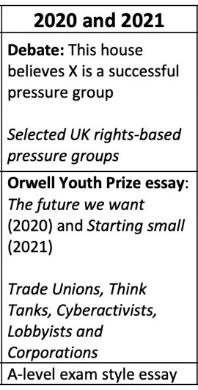
Summary of inquiry
Four-year collaboration between a school librarian and an A-level Politics teacher
Led to three-week Pressure Groups inquiry unit run every May/June since 2019
Based on Framework Of Skills for Inquiry Learning (FOSIL) instructional model
https://fosil.org.uk/forums/topic/pressure-groups-inquiry-a-level-politics/
Notes:
10x 50 minute lessons and 3x 2hour prep tasks

Slide 11
Key resources: https://fosil.org.uk/resources/

Slide 12
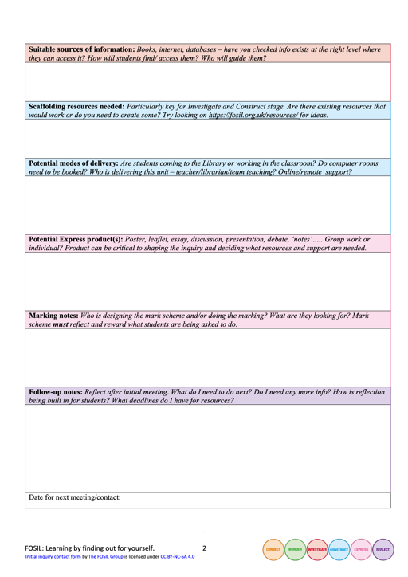
1. Mutual respect and agreeing joint goals and parameters
Initial inquiry planning form
Notes:
The Initial inquiry planning form rose out of this collaboration, to get future collaborations off to a good start and to support other Library colleagues.
Successful collaboration requires mutual respect between teacher and librarian for the different expertise and skillsets that they each bring. It must begin with a clear and open discussion to agree joint goals and parameters (including timescale, learning and assessment objectives and roles of teacher and librarian). In this case we completely revised the second stage of the inquiry the second time that we ran it because we felt it did not achieve our learning objectives clearly enough.

Slide 13
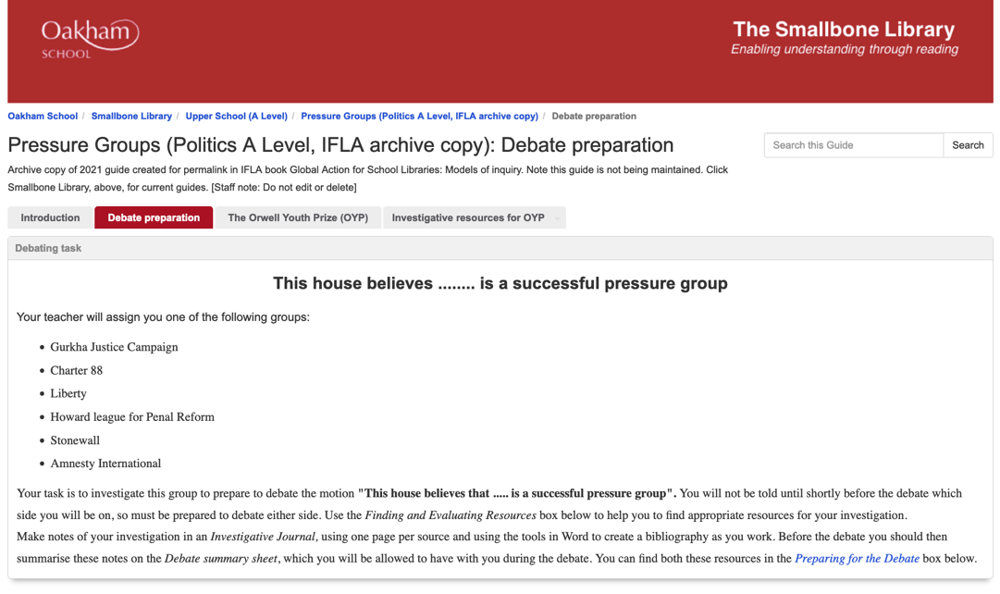
2. Content delivery AND skill development
https://oakham-rutland.libguides.com/IFLA/PG
Pressure Groups inquiry journal 2020 (p.6)
Notes:
We wanted to demonstrate that inquiry can be a very effective method of content delivery as well as skills development. This is often a barrier to persuading teachers to undertake inquiry with exam classes. You can see from the resources how we carefully targeted the points from the specification that we needed students to investigate. In this case we found it a more effective way to embed case studies required for important external school-leaving assessments than more didactic classroom teaching because students felt more ownership of the individual case studies.

Slide 14
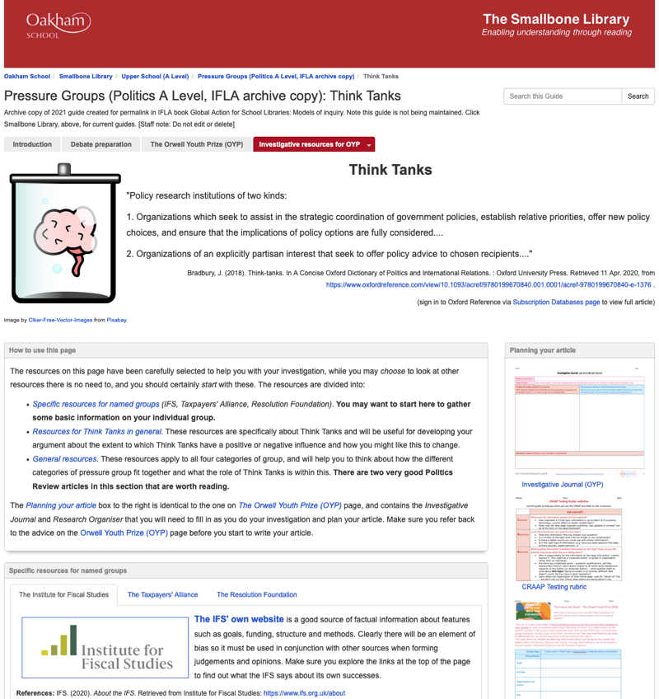
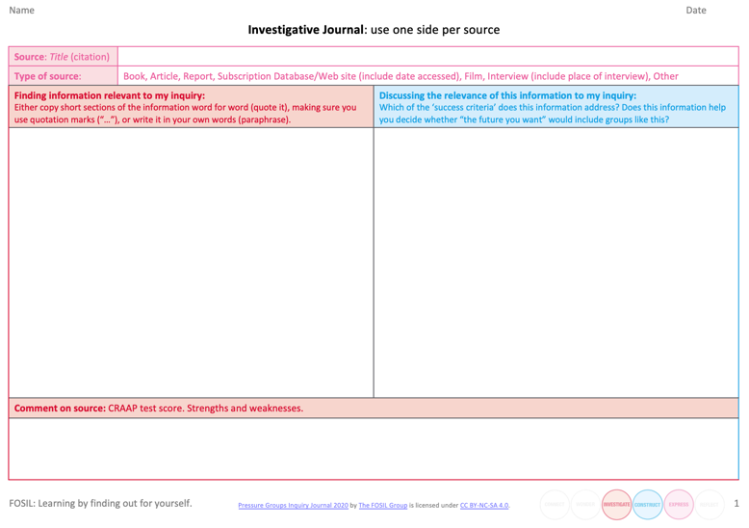
3. Importance of supporting the Investigate stage effectively
Investigative Journal
https://oakham-rutland.libguides.com/IFLA/PG

Slide 15
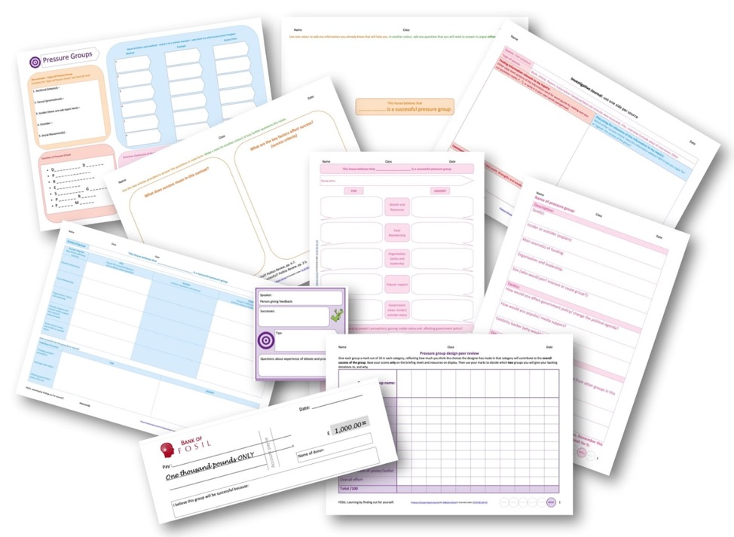
4. Clear and structured timetable supported by graphic organisers
Pressure Groups inquiry journal & Pressure Groups inquiry journal 2020

Slide 16
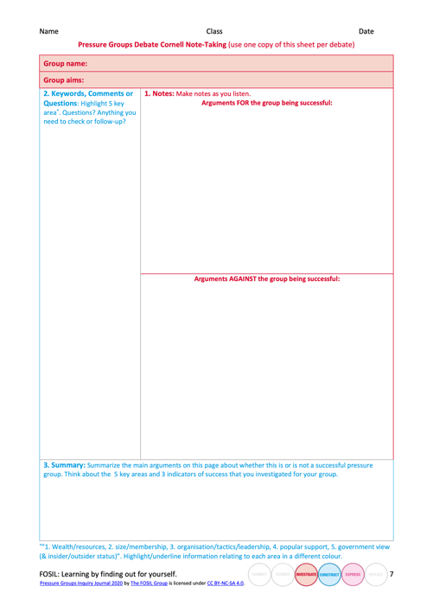
5. Carefully designed graphic organisers with familiar colour scheme can reduce cognitive load
Pressure Groups inquiry journal & Pressure Groups inquiry journal 2020

Slide 17
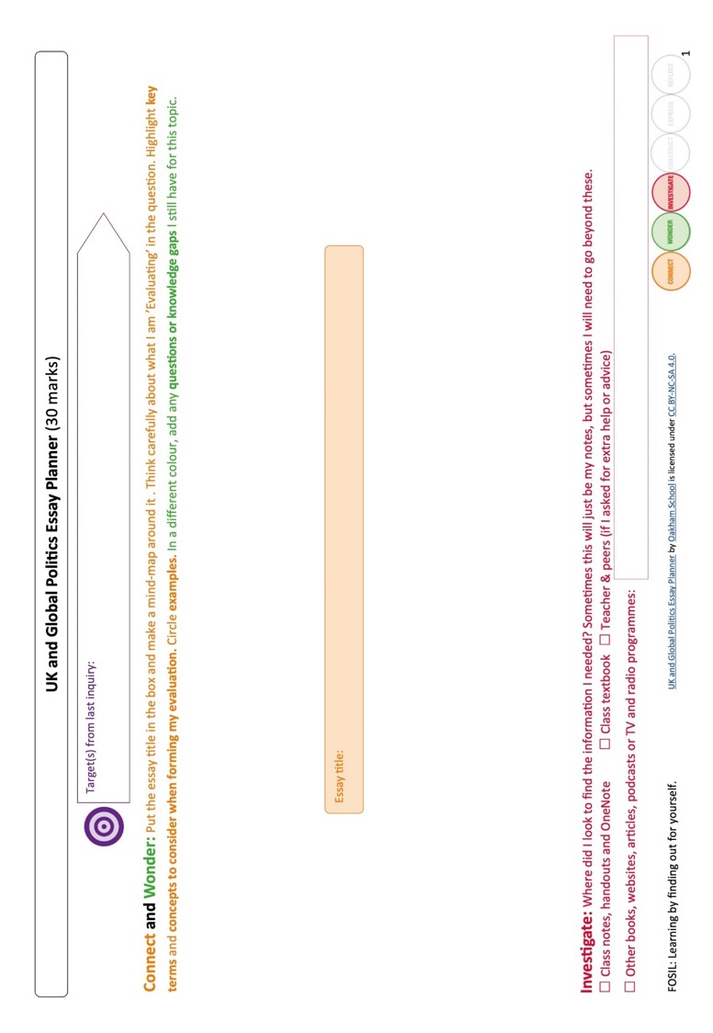
UK and Global Politics Essay Wrap
& Political Ideas Essay Wrap

Slide 19
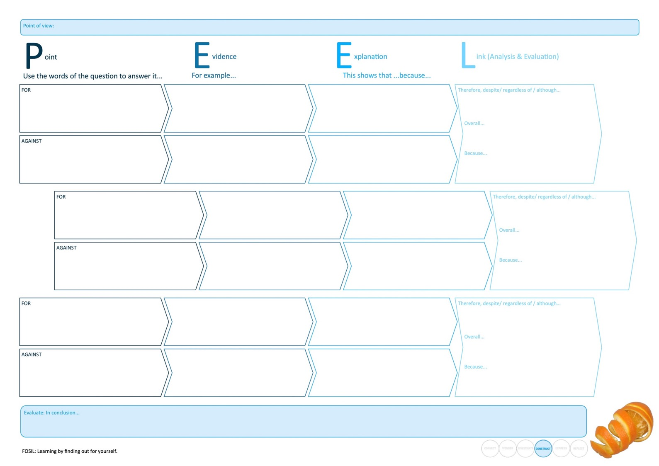
Notes:
Focus stage is Construct – developing the higher order analysis and evaluation skills. To use Barabra Stripling’s language, these are graphic organisers not worksheets or writing frames. Tools for thinking with and for formative assessment because they make thinking processes explicit. Not worksheets with right answers that need to be filled in for the sake of it.

Slide 20
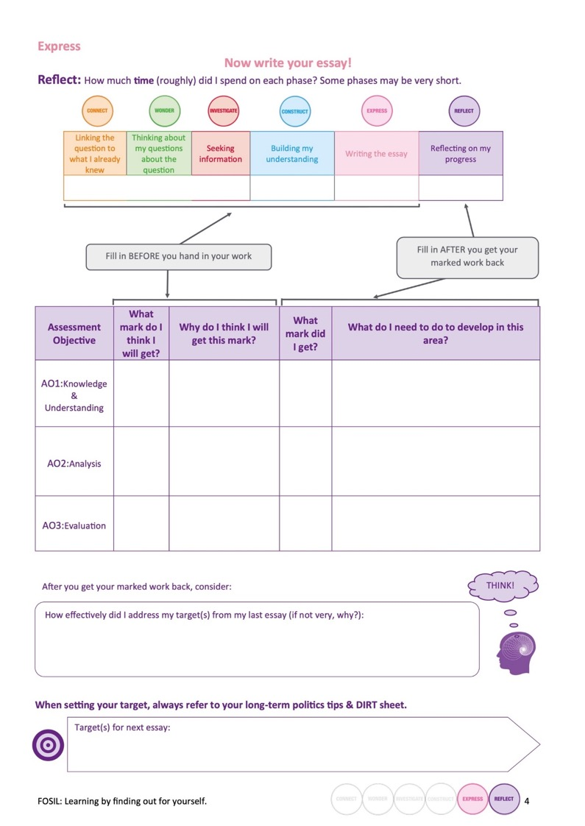
Notes:
Metacognition. Important to capture the process. Joe can use timings and student estimates of their marks to gage their understanding of the criteria and set targets.

Slide 21
Outcomes
Improved student knowledge retention, and analysis and evaluation skills for the unit itself and within the Politics course more broadly
Wider impact on teaching and learning in a range of subjects across the school
Continued close collaboration with Politics department

