Slide 1
Inquiry and Curriculum Essential Questions
Blanchelande College HODs INSET
16 May 2022
Darryl & Toerien
toeriend@blanchelande.sch.gg

Slide 2
Developing Inquiry within the Curriculum (DT)
The importance and value of approaching the curriculum through essential questions.
To question means to lay open, to place in the open. Only a person who has questions can have [real understanding].
Hans-Georg Gadamer, Truth and Method, 1994, p. 365
Given particular subject matter or a particular concept, it is easy to ask trivial questions....It is also easy to ask impossibly difficult questions. The trick is to find the medium questions that can be answered and that take you somewhere.
Jerome Bruner, The Process of Education, 1960, p. 40

Slide 3
An Essential Feature of a Liberal Education
Disciplinary study is focused by engagement with big questions, both contemporary and enduring
These big questions also balance the knowledge required of the discipline with the skills required by the discipline
Because these big questions essentially define academic disciplines, we may refer to them as essential questions
This curriculum stance on essential questions and the process of answering them makes inquiry an essential pedagogical feature of a liberal education

Slide 4
Two types of Essential Questions
Topical essential questions are concerned with uncovering what is most important about the topic being studied in a unit of work, and so may recur in the same topic in later years
WWI, for example: Why did the world go to war in 1914?
Overarching essential questions are concerned with uncovering what is of broader disciplinary concern, and so may occur in other topics in the same year or recur in the same topic in later years
WWI, for example: Why do nations go to war?
Entry questions are simple, thought-provoking questions that open a unit of work – they spark discussion as a lead-in to the unit of work and its essential questions
WWI, for example: Why did the “war to end all wars” not end war?

Slide 5
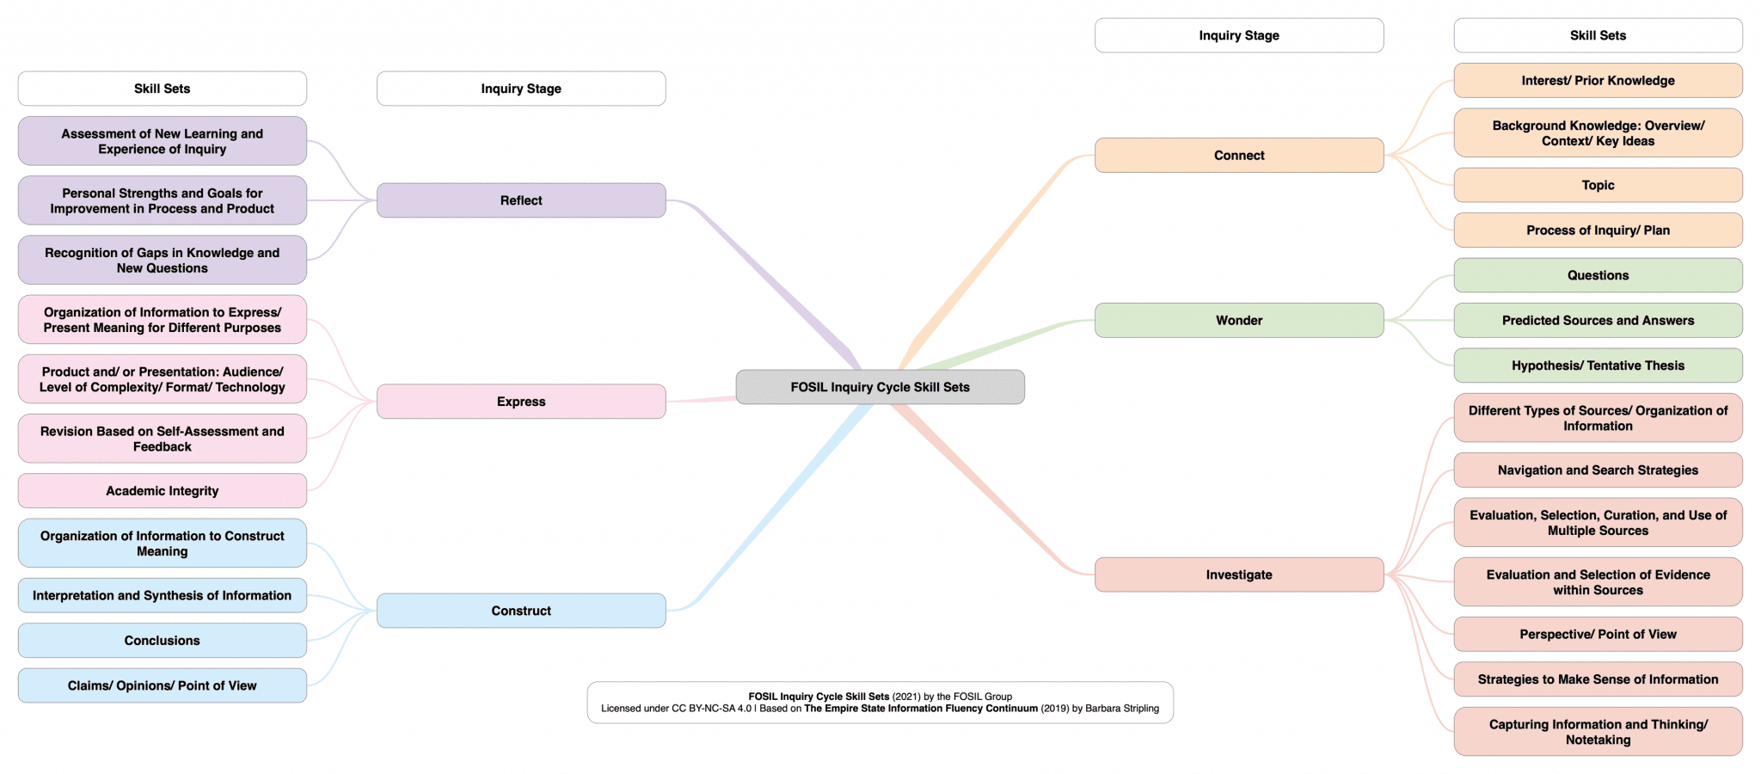
Developing Inquiry within the Curriculum (DT)
The importance and value of enabling the process of exploring essential questions.

Slide 6
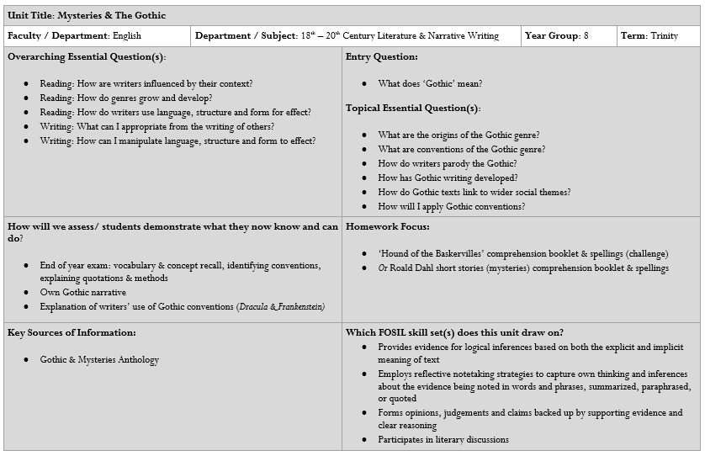
Mapping Inquiry as Stance and Process in the Curriculum
FOSIL Skill Sets
Strategies to Make Sense of Information (Investigate)
Capturing Information and Thinking/ Notetaking (Investigate)
Claims/ Opinions/ Points of View (Construct)
Organization of Information to Express/ Present Meaning for Different Purposes (Express) | Multimedia Literacy: Reader/ Viewer Experience and Response to Literature

