Slide 1

Signature Work
A Hallmark of Liberal Education
Blanchelande College Staff INSET
5 September 2022
Darryl Toerien
toeriend@blanchelande.sch.gg

Slide 2
“Do not block the way of inquiry”.
“Upon this first, and in one sense this sole, rule of reason – that in order to learn you must desire to learn, and in so desiring not be satisfied with what you already incline to think – there follows one corollary which itself deserves to be inscribed upon every wall of the city of philosophy: Do not block the way of inquiry”.
Charles Sanders Pierce, The Scientific Attitude and Fallibilism, (1955, p. 54)

Slide 3
Signature Work
Signature Work is a defining feature of a liberal education
Signature Work is
  an inquiry-based exploration of an essential question or problem
    (contemporary or enduring)
  that the individual student identifies and defines
  that is conducted over an extended period
  and that involves substantial [age-appropriate] writing and reflection
Termed Signature Work to reflect the high level of personalization and individual initiative involved, consequently bearing the distinctive imprint of the interests, commitments, and cumulative learning of the student

Slide 4
Inquiry
A stance of wonder and puzzlement that …
… gives rise to a dynamic [learning] process …
… of coming to know and understand …
… the world and ourselves in it …
… as the basis for responsible participation in community

Slide 5
Building a Community of Inquiry
While inquiry necessarily involves “personal struggles to find the right questions and assemble mosaic tiles of information to tell the tale coherently … acquiring knowledge is a conversation, not a destination ... a process [or] journey we take together, not alone [because] others are always involved {both living and dead}”.
Jonathan Rauch, The Constitution of Knowledge: A Defence of the Truth (2021, pp. 3-4)

Slide 6
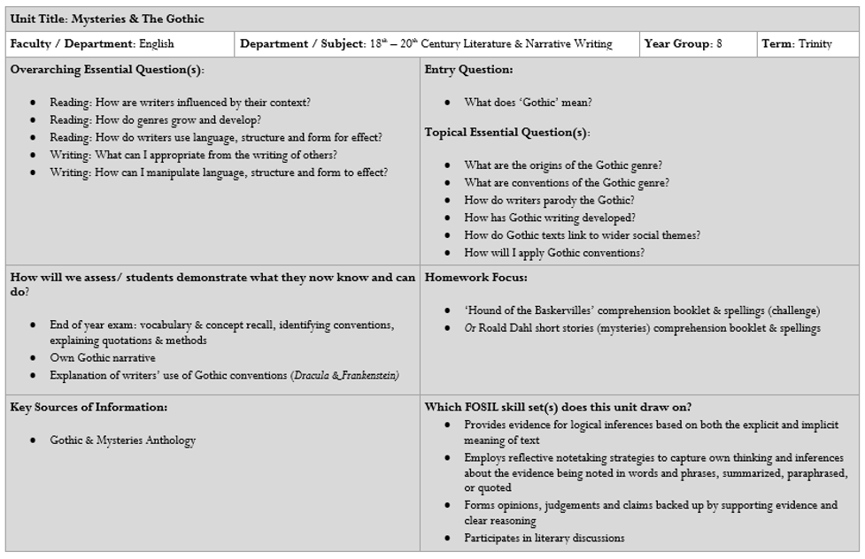
As we begin, … (stance)
“Only a person who has questions can have [real understanding].” (1)
“It is easy to ask trivial questions … It is also easy to ask impossibly difficult questions. The trick is to find the medium questions that can be answered and that take you somewhere.” (2)
“[Despite being a supergenius]…he needs twenty years of schooling before he can ask the right questions and understand the answers.” (3)
References
Hans-Georg Gadamer, Truth and Method, 1994, p. 365.
Jerome Bruner, The Process of Education, 1960, p. 40.
Robert A. Heinlein, Have Spacesuit – Will Travel, 1978, p. 125.

Slide 7
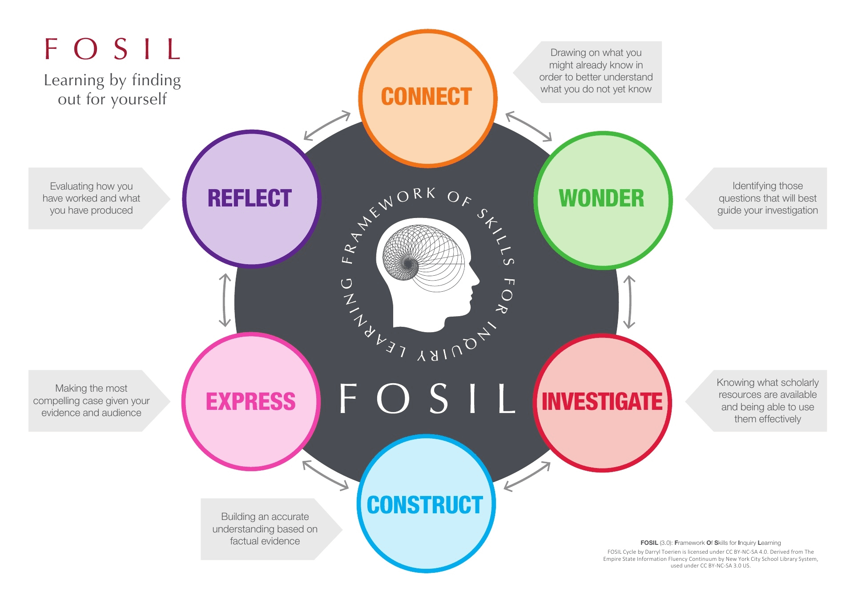
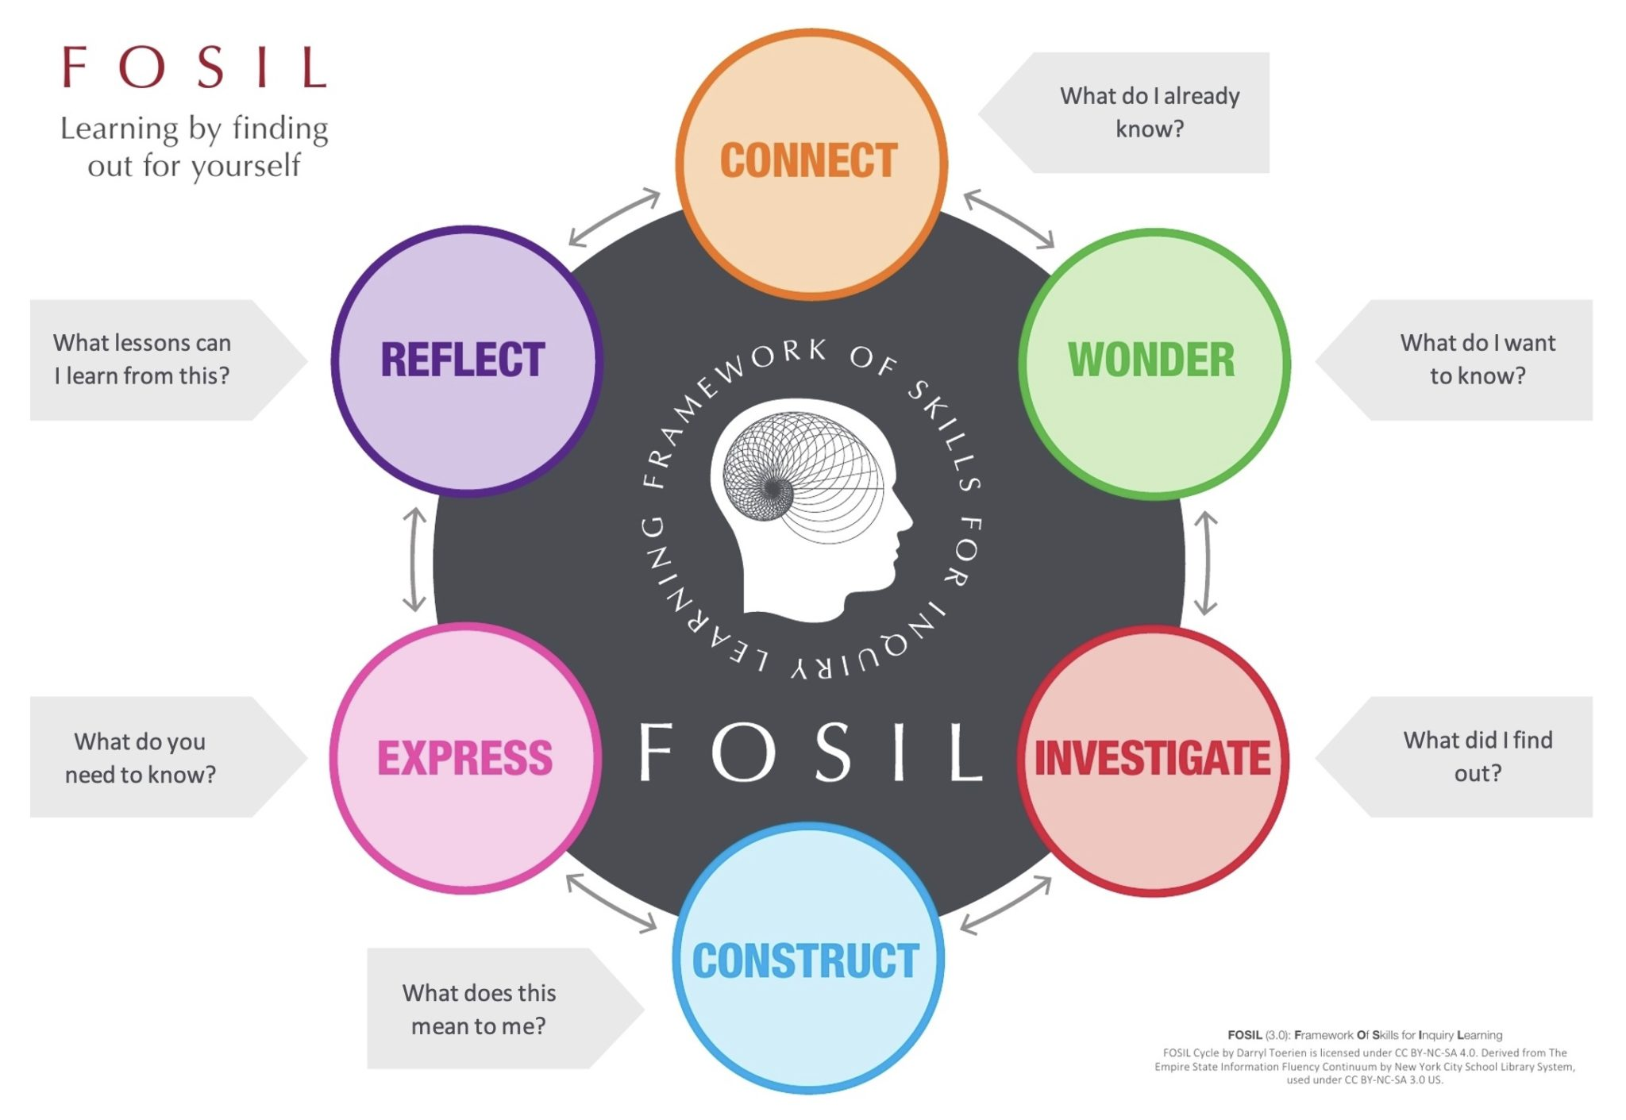
… so we go (process)

Slide 8
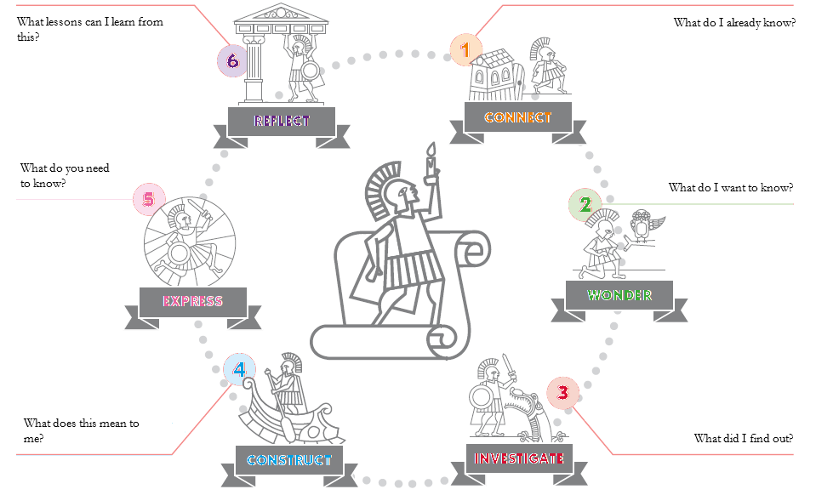
Heroic Inquiry

Slide 9
Inquiry Within and Beyond the Curriculum
Curricular Inquiry
Extracurricular Inquiry
“Providing a [model] of the inquiry process is only the first step in empowering students to pursue inquiry on their own. The next step is to structure teaching around a framework of the [inquiry] skills that students must develop at each phase of inquiry over their years of school and in the context of content area learning.” (1)
Can be a full inquiry/ Signature Work
Appropriate for all students
Inquiry that falls outside of content/ subject area learning, even though timetabled
Always a full inquiry/ Signature Work
For example, EPQ in Sixth Form
  Worth half an A-Level
  Requires 30 guided/ taught hours
    Timetabled
  Requires 90 independent hours
    Structured accountability, including but not limited to Independent Study Periods
  Not appropriate for all students
References
Barbara Stripling, Empowering Students to Inquire in a Digital Environment (2017, p. 52), in S. W. Alman (Ed.), School Librarianship: Past, Present, and Future.

Slide 10

Signalling Signature Work
Interrobang: a punctuation symbol ( ‽ ) that combines the symbol ! [what!] and the symbol ? [why?] (1)
Expresses wonder (!) and puzzlement (?) that gives rise to the dynamic process of coming to know and understand.
References
Cambridge Advanced Learner's Dictionary & Thesaurus © Cambridge University Press.

Slide 11
Towards a Signature Work in Each Phase
Human and Physical Resources
  Development of Junior Librarian, Senior & Sixth Librarian, EPQ & HPQ Coordinator roles (see below)
  Development of Junior Library
Literacy and Reading Promotion
  Integrate components of a whole-school reader development programme
Inquiry-Based Learning (includes Media & Information Literacy)
  Infants | For example, developing the Year 1 Accidental Zoo inquiry more fully
  Juniors | Year 6 Science-based interdisciplinary heat transfer inquiry, which, if done properly, could also result in at least a Bronze CREST Award for all students
  Seniors | Year 9 induction and inquiry skills programme leading to a Signature Work and a English Language Endorsement GCSE and optional HPQ [in Year 10]
  Sixth Form | Year 12 induction and inquiry skills programme leading to a Signature Work and optional EPQ

Slide 12
Signalling Signature Work
Interrobang: a punctuation symbol ( ‽ ) that combines the symbol ! [what!] and the symbol ? [why?] (1)
Expresses wonder (!) and puzzlement (?) that gives rise to the dynamic process of coming to know and understand.
References
Cambridge Advanced Learner's Dictionary & Thesaurus © Cambridge University Press.

Slide 13
Becoming knowledge-able
“…for the students, the goal of inquiry is making not learning, or as I put it above, working on an improvable object. Motivated and challenged by real questions and problems, their attention is on making answers and solutions. Under these conditions, learning is an outcome that occurs because the making requires the student to extend his or her understanding in action – whether the artefact constructed is a material object, a demonstration, explanation, or theoretical formulation.”
Gordon Wells in Action Talk & Text: Learning & Teaching Through Inquiry (2001, p. 190)

Slide 14
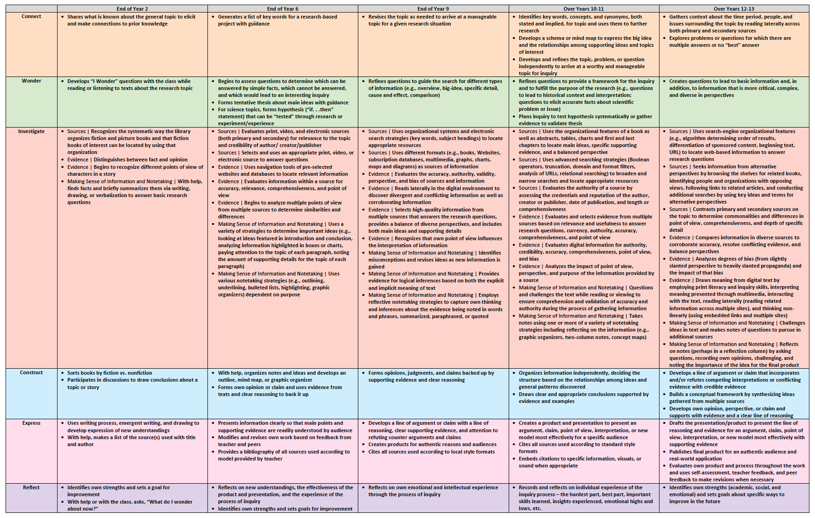
FOSIL Priority Skills in Transition Years

