Slide 1
No Mo FOFO Developing Inquiry Through Thoughtful Research Homework
Blanchelande College Staff INSET
4 January 2023
Darryl Toerien
toeriend@blanchelande.sch.gg

Slide 2
Liberal Education, Inquiry and Research
Inquiry is a defining feature of a liberal education
Inquiry is an engaged learning stance …
Upon the rule of reason: “in order to learn you must desire to learn, and in so desiring not be satisfied with what you already incline to think” (Peirce, 1955, p. 54).
… leading to a dynamic learning process
The corollary: “Do not block the way [or process] of inquiry” (Peirce, 1955, p. 54).
Not all learning is an inquiry, but inquiry [as stance and process] encompasses all learning.
Research is integral to inquiry and aims at “generating evidence for [answering] the chosen/ given question through empirical investigations of various kinds and/ or from consulting relevant [and reliable] sources” (Wells, 2001, p. 191).
Research is not FOFO; i.e., finding information that serves no thoughtful purpose.

Slide 3
“What we’ve got wrong about knowledge & curriculum”
Q: Bearing all of that in mind, what advice would you give to teachers interested in applying your ideas about powerful knowledge to how they interpret their school’s curriculum?
[A: The curriculum is not just a body of knowledge; it’s a group of communities we must encourage our students to join.]
[A: powerful knowledge is just a signpost towards some very difficult questions that everyone needs to think hard about.]
A: I would remind them of a point [Russian psychologist] Lev Vygotsky made: that acquiring knowledge in school has to be the voluntary act of a learner. You can’t actually teach anybody anything; they have to learn it. You can help them, but they’ve got to have that desire to know. …
A: If you haven’t encouraged students to engage in the process of acquiring knowledge, which is a very difficult process, then all you get is memorisation and reproduction in tests. …
A: The current interest in the curriculum overlooks this point. It’s so concerned with saying, “Have we got the knowledge?” that it forgets to ask, “How is the knowledge being acquired?”
Young, M. (2022, September 21). What we’ve got wrong about knowledge & curriculum. (G. Duoblys, Interviewer) Tes Magazine.

Slide 4
A Sound Model of the Information-to-Knowledge Process

Slide 5
Towards a Fundamental Purpose
Why? Because school “is the one institution in our society that is inflicted on everybody, and what happens in school makes a difference – for good or ill” (Postman & Weingartner, 1971, p. 12).
Evidence so far suggests ill. “Our system of education turns young people out of the schools able to read, but for the most part unable to weigh evidence or to form an independent opinion. They are then assailed, throughout the rest of their lives, by statements designed to make them believe all sorts of absurd propositions.” (Russell, 1922)
However, “if we embrace dystopia, if we embrace doomerism, we lose hope as a platform for action in the present. In assuming that incremental change is hopeless against entropy, we either embrace the darkness or put our faith in panaceas, magic potions, grifters, charlatans, and superhero teams who will emerge from the shadows and fix everything. We become locked in a stasis and fail to do anything at all. In other words, the failure to reimagine education – and our fundamental relationship to the future – becomes a self-fulfilling prophecy.” (Covington & McNutt, 2022)

Slide 7
Notes:
“Scientific method [which is the most common model of the inquiry process] is the only authentic means at our command for getting at the significance of our everyday experiences of the world in which we live” ( Dewey, 1938, p. 88).
{Britannica: "When faced with a problem, said Dewey, a person must logically examine the options open to him to find the best solution supported by the facts. This method of inquiry and testing should be applied to moral and social questions, as well as to technological and scientific ones." https://school.eb.co.uk/levels/intermediate/article/John-Dewey/273976}

Slide 8
Skills and Content: Investigate > Perspective / Point of View
Year 6
Begins to analyze multiple points of view from multiple sources to determine similarities and differences
Begins to identify the effect of point of view on the information
Year 5
With help, begins to examine why someone might have a different perspective
With help, begins to describe how a particular point of view can impact a nonfiction text
Year 4
Demonstrates understanding and respect for different points of view in fiction and explains some of the diverse perspectives presented
Begins to understand that different points of view are presented in nonfiction and that nonfiction does not equate to “true” because some of the information may be opinion or stated from only one point of view
Year 3
Recognizes different point of view of individuals and characters in a story
Identifies point of view by examining illustrations, text features, and opinion words in text
Year 2
Begins to recognize different points of view of characters in a story
With help, identifies point of view by examining illustrations, text features, and opinion words in text
Year 1
Recognizes that different people may believe different things
Recognizes that people have different backgrounds, families, homes, and needs
Reception
Recognizes that people are different

Slide 9
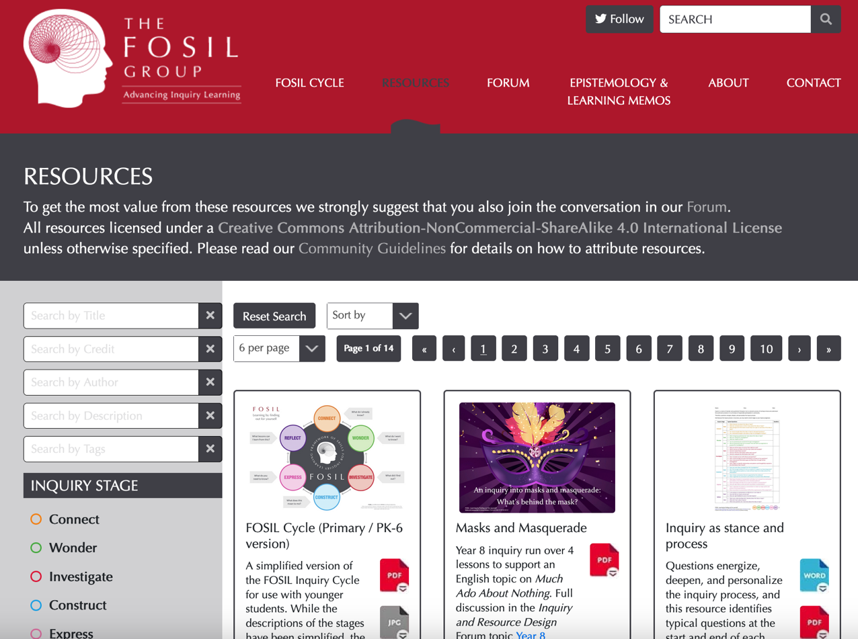
Where to find supporting resources
https://fosil.org.uk/resources/

Slide 10
References
Covington, N., & McNutt, C. (2022, December 1). fighting back against the future. Retrieved from Human Restoration Project: https://www.humanrestorationproject.org/writing/fighting-back-against-the-future
Peirce, C. S. (1955). The Scientific Attitude and Fallibilism. In J. Buchler (Ed.), Philosophical Writings of Peirce (pp. 42-59). New York, NY: Dover Publications.
Postman, N., & Weingartner, C. (1971). Teaching as a Subversive Activity. Harmondsworth: Penguin Books.
Russell, B. (1922). Free Thought and Official Propaganda. Retrieved from Project Gutenberg: https://www.gutenberg.org/files/44932/44932-h/44932-h.htm
Wells, G. (2001). The Case for Dialogic Inquiry. In G. Wells (Ed.), Action, Talk, & Text: Learning and Teaching Through Inquiry (pp. 171-194). New York, NY: Teachers College Press.
Young, M. (2022, September 21). What we’ve got wrong about knowledge & curriculum. (G. Duoblys, Interviewer) Tes Magazine.

