Slide 1
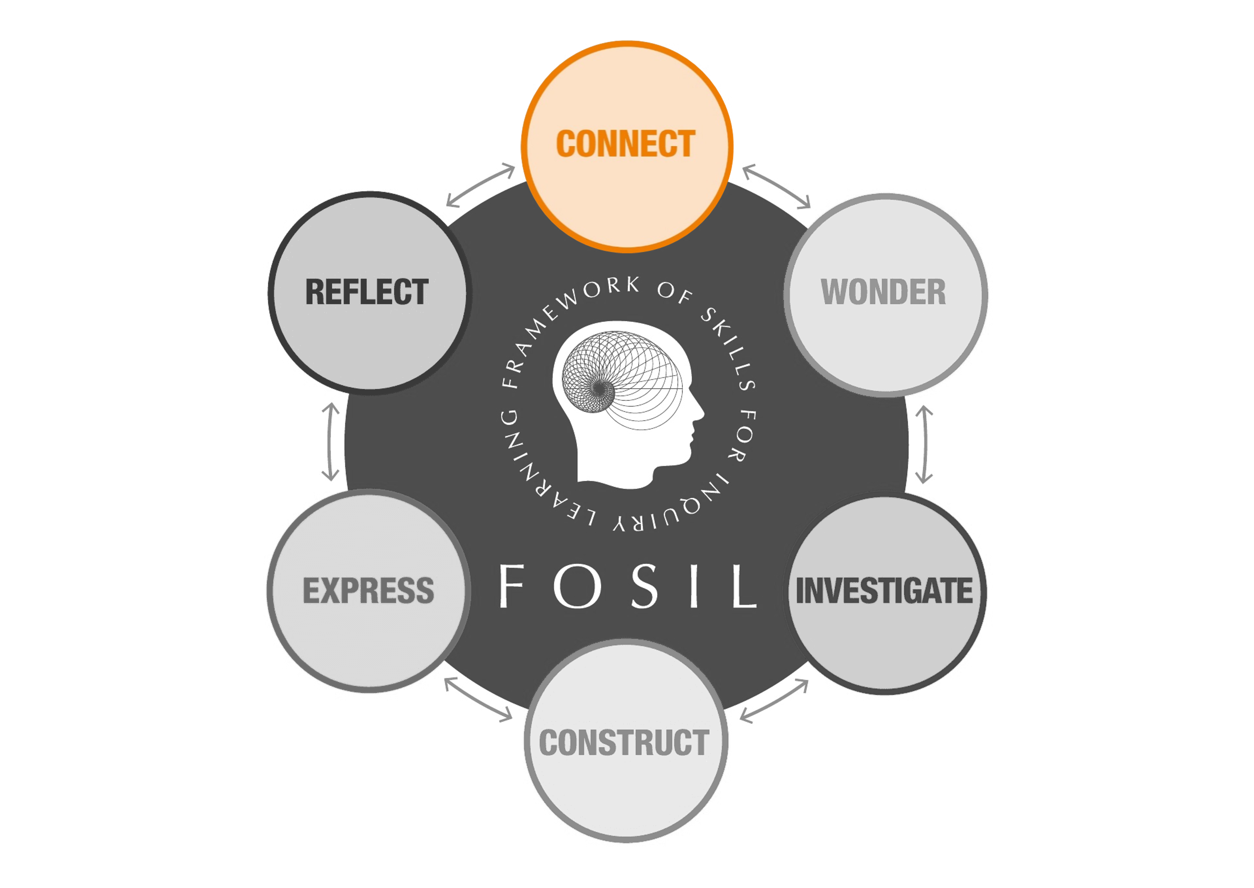
Year 12 Interrobang 1: Not the Average Child…
What interests you about your A-level subjects?
Why did you choose them?

Slide 2
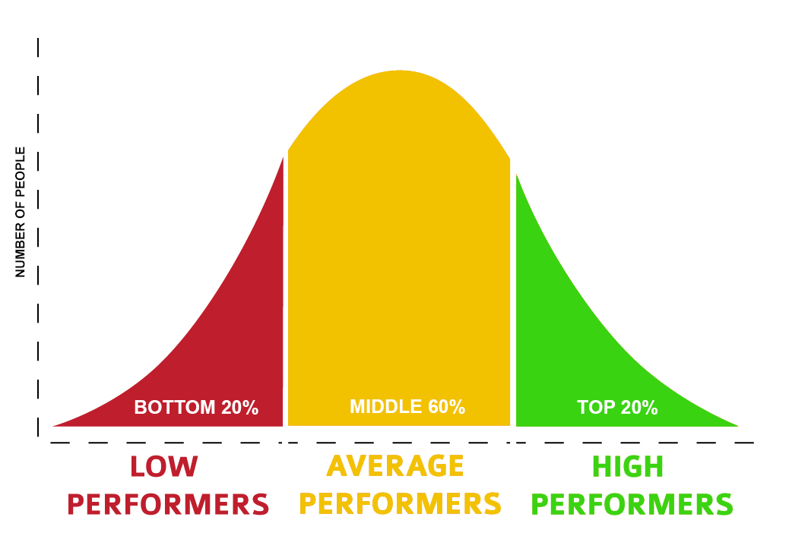
The Average Child Mike Buscemi
Not
^
I don’t cause teachers trouble.
My grades have been O.K. I listen to my classes And I’m in school every day
My parents think I’m average
My teachers think so too I wish I didn’t know that
Cause there’s lots I’d like to do
I’d like to build a rocket
I’ve a book that shows you how
Or start a stamp collection
Well no use starting now
Cause since I found I’m average
I’m just smart enough to see
To know there’s nothing special
That I should expect of me
I’m part of that majority
That hump part of the bell
Who spends his life unnoticed
In an average kind of hell!
Notes:
by Michael Buscemi, Quest Internationl
First presented at the 1979 National PTA Convention
https://www.pngkey.com/detail/u2q8u2e6e6e6y3o0_bell-curve-normal-distribution/

Slide 3
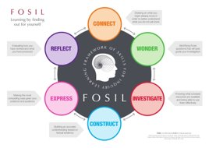
Year 12 Interrobang (inquiry skills course)
First half term: 6 sessions during PDC plus 6 ISPs
1. Not the average child...
2. No such thing as a silly question?
3. Does Google know everything?
4. Being part of the conversation
5. The information-to-knowledge journey
6. Sharing the love
Presentation
Reflection
Notes:
Ivan Illich, Austrian Philosopher: The principal lesson that school teaches is the need to be taught (Deschooling Society, 1971)

Slide 4
End product
Choose a topic relating to one of your A-level subjects
Find an interesting question to explore using at least one of our subscription databases and a book
Explain why you are interested in that topic
Create a poster presentation to share what you have found out
Time: 1 PDC session, plus 1 ISP every week until half term
Notes:
Ivan Illich, Austrian Philosopher: The principal lesson that school teaches is the need to be taught (Deschooling Society, 1971)

Slide 6
Notes:
Lesson starter – image? Article title? Connect to previous knowledge

Slide 7
Notes:
Exploding a question
Creating a hypothesis
KWL chart

Slide 8
Notes:
Reading articles or chapters from a textbook
Looking through catalogues to see what different materials cost
Comparing different recipes
Conducting an experiment
Watching different performances of the same scene of a play

Slide 9
Notes:
Creating comparison charts or tables
Summarising
Weighing up arguments
Plotting graphs of data

Slide 10
Notes:
Writing an essay
Creating a presentation
Baking a cake
Making an artefact
Making a poster
Doing a debate

Slide 11
Notes:
Self and peer assessment
Responding to feedback
Feeding forward!
Setting targets

Slide 12
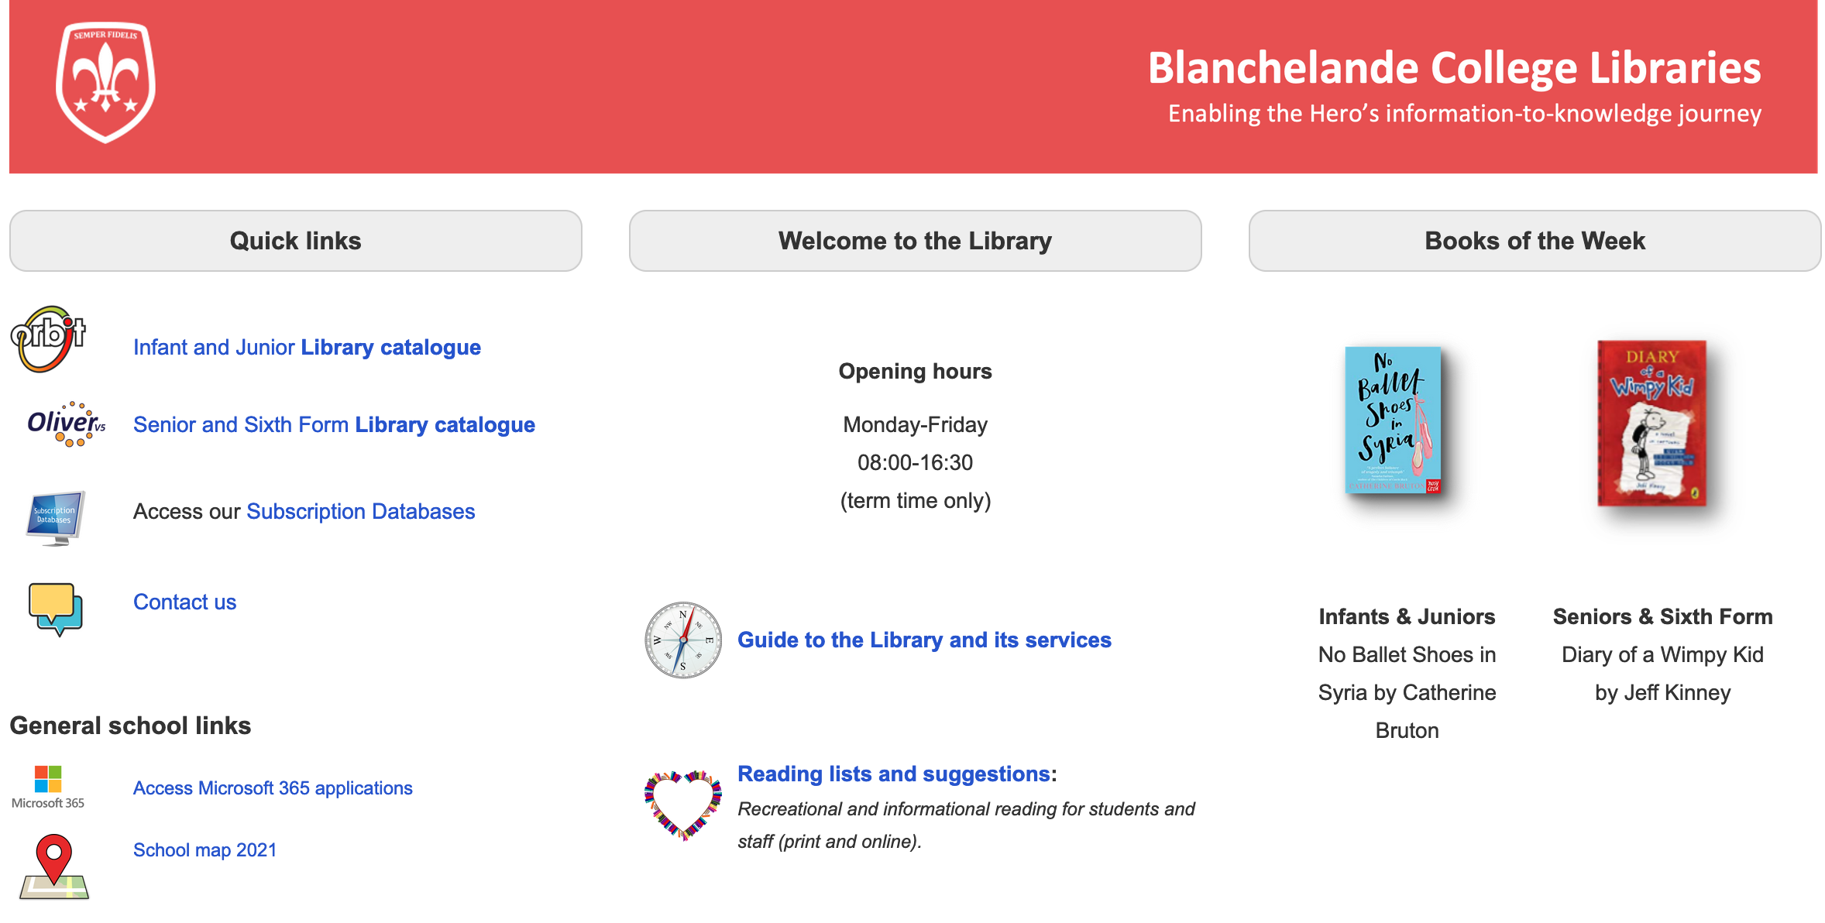
The virtual library
https://blanchelande.libguides.com/Library

Slide 13
Virtual resources

Slide 14
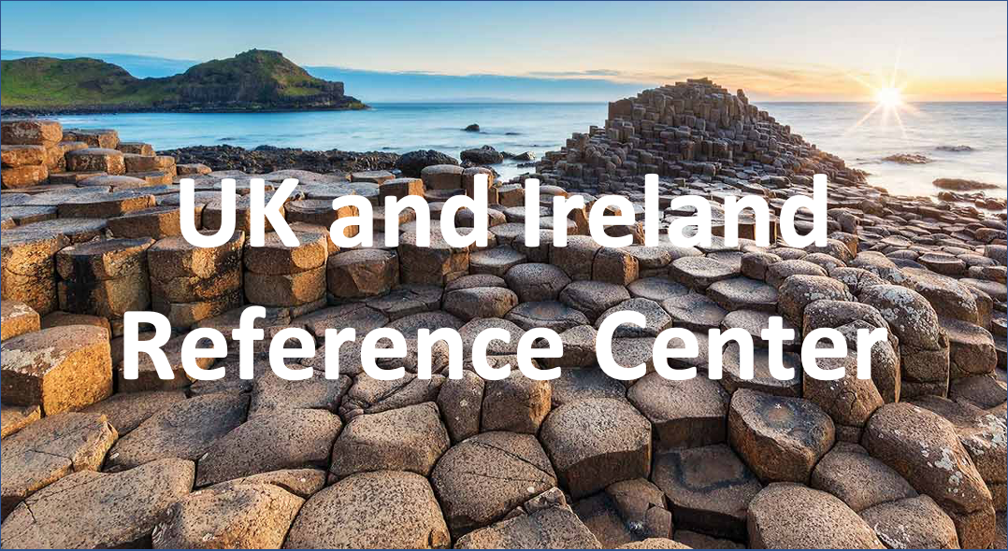
Virtual resources
EBSCO (journals)
Encyclopaedias
News
A-level magazines

Slide 15
Virtual resources

Slide 16
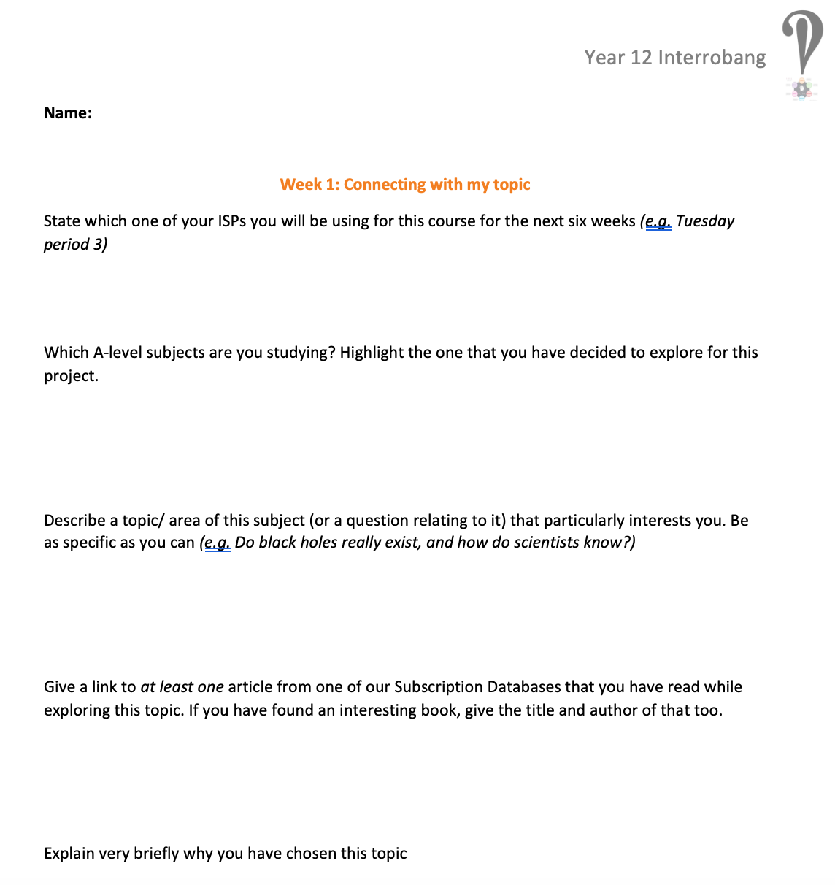
Your task
Identify one ISP you will use every week for this course
Explore Britannica, The Day OR Global Issues in Context to look for a topic linked to one of your A-level subjects you find interesting
Save at least one link to an interesting article and explain why it interests you
Submit on the
Sixth Form 2022-2024 Team
by 4pm next Wednesday

