Slide 1
Year 12 Interrobang 2: No such thing as a silly question?
Which topic have you chosen?
Why does this particular topic interest you?
Why should it interest me?

Slide 2
Assignment 1 Feedback
Check your returned assignment in Team for specific feedback
Some topics will need to be clarified or narrowed
Part of point was to explore databases!
Choose an ISP that is before Wednesday if possible
Upload assignment documents rather than putting OneDrive/Sharepoint links. I can’t always access links.
If you prefer to write your assignments you can upload a photo
Notes:
Ivan Illich, Austrian Philosopher: The principal lesson that school teaches is the need to be taught (Deschooling Society, 1971)

Slide 3
End product
Interesting question relating to one of your A-level subjects
Explore using at least one of our subscription databases and a book
Explain why you are interested in that topic
Poster presentation Thursday NOVEMBER 3RD
Notes:
Ivan Illich, Austrian Philosopher: The principal lesson that school teaches is the need to be taught (Deschooling Society, 1971)

Slide 4
Asking good questions
Share your topic with the person next to you
Let them ask you questions about it
Make a note of some of those questions (aim for at least 5)
X Put a cross by those that you already know the answer to
Highlight those that you think might be interesting to investigate
Underline any questions in your list which you think don’t have definite factual answers.
Notes:
Ivan Illich, Austrian Philosopher: The principal lesson that school teaches is the need to be taught (Deschooling Society, 1971)

Slide 5
Virtual resources
https://blanchelande.libguides.com/Library

Slide 6
Investigative Journal
Download this from Assignment 2 in the Team
Save it somewhere sensible (preferably on your OneDrive in a folder called Interrobang)
Whenever you start looking at a new source, use a new page
My article:
https://go.gale.com/ps/i.do?p=GIC&u=guernseysls&v=2.1&it=r&id=GALE%7CA634547220&inPS=true&linkSource=interlink&sid=bookmark-GIC

Slide 7
Question: Was Trump better for America than Obama?
Comparing the Trump and Obama Economies https://go.gale.com/ps/i.do?p=GIC&u=guernseysls&v=2.1&it=r&id=GALE%7CA634547220&inPS=true&linkSource=interlink&sid=bookmark-GIC
“Trump says he had the "greatest economy in history" during the GOP convention, a claim fact checkers quickly marked as false. A look at economic growth shows why.
The economy grew just shy of 1% in Obama's first term when the Great Recession took its toll. Growth improved to 2.3% in Obama's second term. Under Trump, the economy is on track to average slightly above zero in his first term because of the sharp losses from the pandemic.
Excluding 2020, growth in Trump's initial three years in office was 2.5% - barely above Obama and well below the growth under the Clinton, Reagan and Johnson administrations."

Slide 8
Question: Was Trump better for America than Obama?
Comparing the Trump and Obama Economies https://go.gale.com/ps/i.do?p=GIC&u=guernseysls&v=2.1&it=r&id=GALE%7CA634547220&inPS=true&linkSource=interlink&sid=bookmark-GIC
“Trump says he had the "greatest economy in history" during the GOP convention, a claim fact checkers quickly marked as false. A look at economic growth shows why.
The economy grew just shy of 1% in Obama's first term when the Great Recession took its toll. Growth improved to 2.3% in Obama's second term. Under Trump, the economy is on track to average slightly above zero in his first term because of the sharp losses from the pandemic.
Excluding 2020, growth in Trump's initial three years in office was 2.5% - barely above Obama and well below the growth under the Clinton, Reagan and Johnson administrations."
The US economy grew faster under Obama than Trump (2.3% vs 0%) BUT Trump had the pandemic. If you ignore that period Trump had a growth of 2.5%, which was more than Obama but not by much.
This suggests that Trump’s economic policies might have been better (if we ignore the pandemic)
Can Trump claim full credit for that growth? How quickly would his policies have had an effect?
What else might matter, as well as financial growth?

Slide 9
Comparing the Trump and Obama Economies https://go.gale.com/ps/i.do?p=GIC&u=guernseysls&v=2.1&it=r&id=GALE%7CA634547220&inPS=true&linkSource=interlink&sid=bookmark-GIC
“Trump says he had the "greatest economy in history" during the GOP convention, a claim fact checkers quickly marked as false. A look at economic growth shows why.
The economy grew just shy of 1% in Obama's first term when the Great Recession took its toll. Growth improved to 2.3% in Obama's second term. Under Trump, the economy is on track to average slightly above zero in his first term because of the sharp losses from the pandemic.
Excluding 2020, growth in Trump's initial three years in office was 2.5% - barely above Obama and well below the growth under the Clinton, Reagan and Johnson administrations."
The US economy grew faster under Obama than Trump (2.3% vs 0%) BUT Trump had the pandemic. If you ignore that period Trump had a growth of 2.5%, which was more than Obama but not by much.
This suggests that Trump’s economic policies might have been better (if we ignore the pandemic)
Can Trump claim full credit for that growth? How quickly would his policies have had an effect?
What else might matter, as well as financial growth?
Ignore this bottom box for now. We’ll look at that next week.

Slide 10
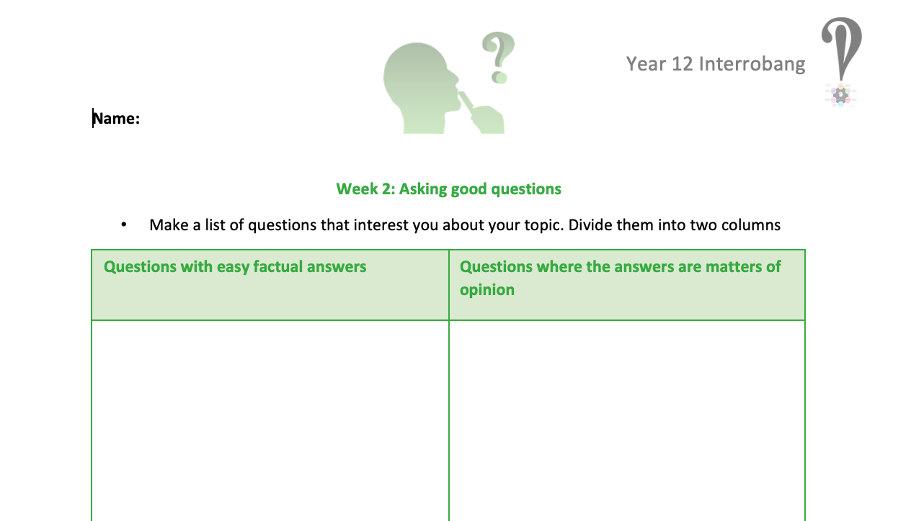
Your task
SUBMIT LAST WEEK’S ASSIGNMENT BY 1pm on FRIDAY IF NOT ALREADY DONE SO…
Make a list of questions that interest you about your topic. Divide them into two columns
Questions with easy factual answers | Questions that are matters of opinion
Choose one opinion question to focus on and put it in BOLD
Start making notes in your Investigative Journal to answer your question
Submit your list of questions AND your investigative journal on the
Sixth Form 2022-2024 Team
by 4pm next Wednesday

