Slide 1
Year 12 Interrobang 3: Cutting the C***P
How can we decide whether information that we find online is trustworthy?

Slide 2
Assignment 2 Feedback
Check your returned assignment in Team for specific feedback
Think about what a factual question really is
Excellent use of IJ – but make sure you have a focus question in mind
USE THE TEMPLATES!
Notes:
Ivan Illich, Austrian Philosopher: The principal lesson that school teaches is the need to be taught (Deschooling Society, 1971)

Slide 3
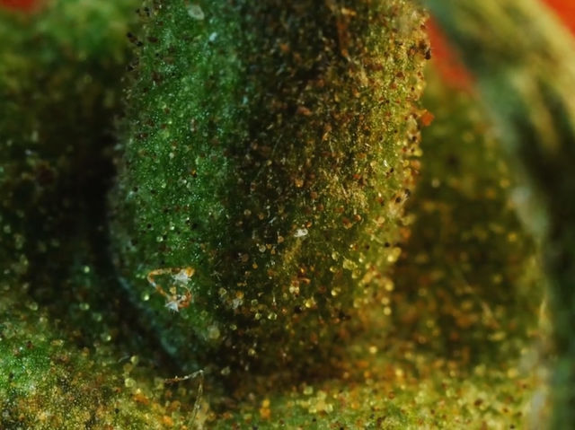
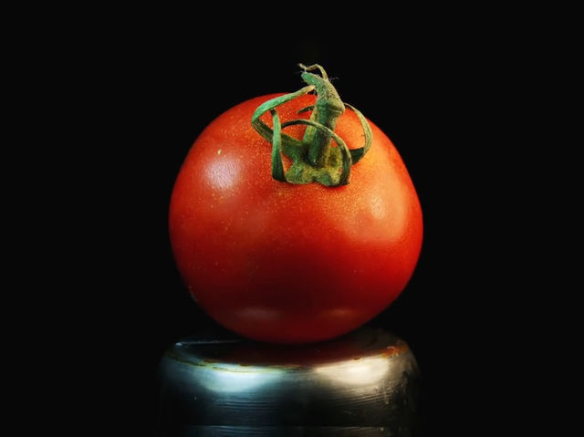
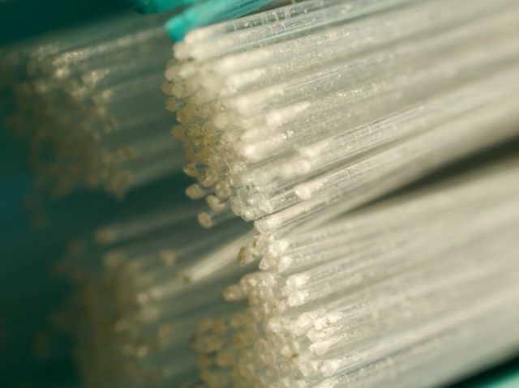
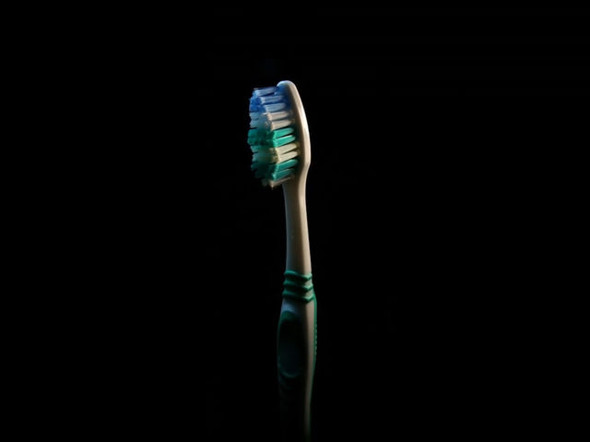
What do you see?
Notes:
https://www.thesun.co.uk/living/2092851/can-you-guess-what-these-objects-are-from-a-close-up-photo/

Slide 4
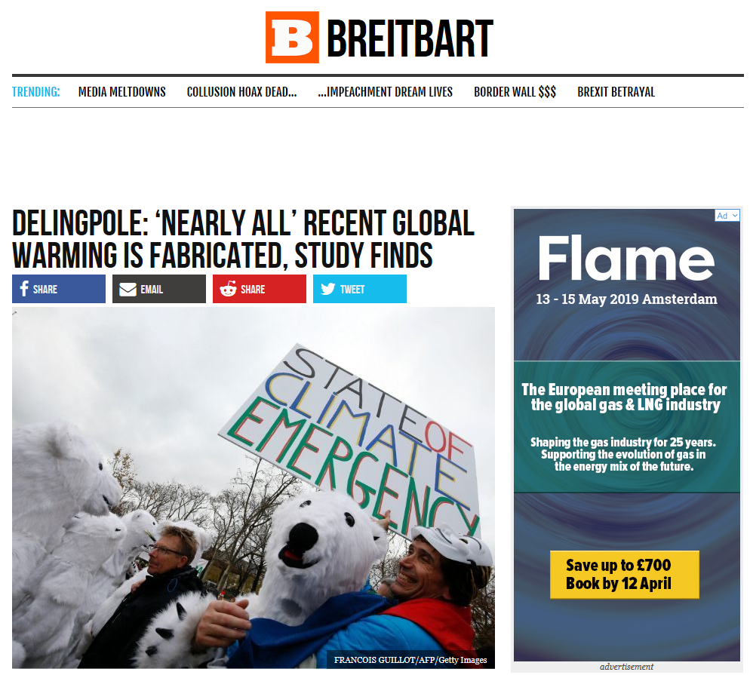
Year 9:
How much impact is climate change really having on our weather?

Slide 5
What do you see?
Green or blue – good signs. Things you would expect to see in a trustworthy source.
Yellow – questions. Things you would need to investigate.
Pink or orange – warning signs. Things that make you suspicious of this source.

Slide 6
Key indicators
Good signs
Cites and links to a peer-reviewed study
Fairly recent (last 2 years)
Detailed, labelled chart shown
Quotes a meteorologist by name
Questions
Who is the study by? Where was it published? What credentials do the authors have?
What is Breitbart and what reputation does it have?
Who is James Delingpole and what is his reputation?
Who is Joe D’Aleo and what is his reputation?
Warning signs
Tabloid style advertising and headlines
Whole article relies on one study, with no opposing view given
“alarmist organisations like NASA, NOAA, and the UK MET Office” Seriously???

Slide 7
What next?
Search for Breitbart on MediaBiasFactCheck
Search for Breitbart and Climate Change
Search for James Delingpole and Climate Change
Avoid any search results from Breitbart itself as they will not be independent.

Slide 8
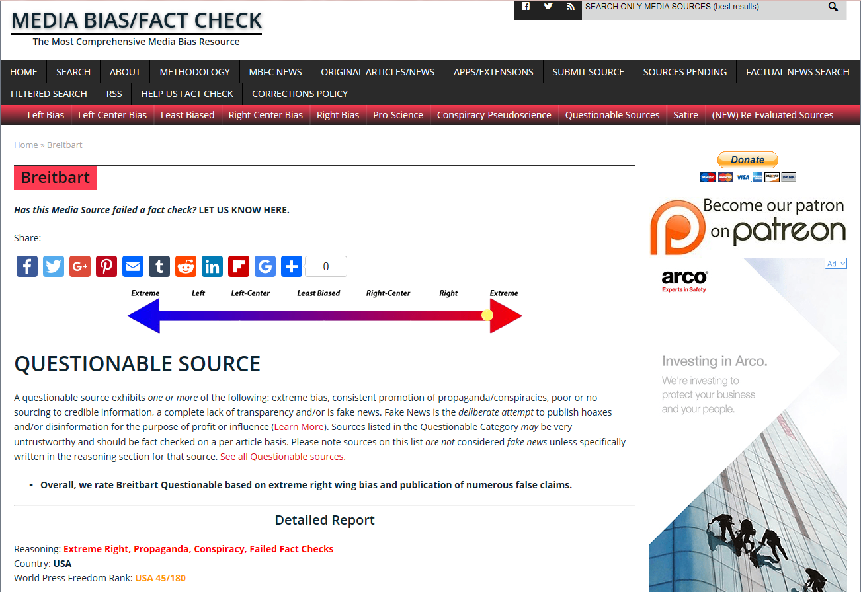

Slide 9
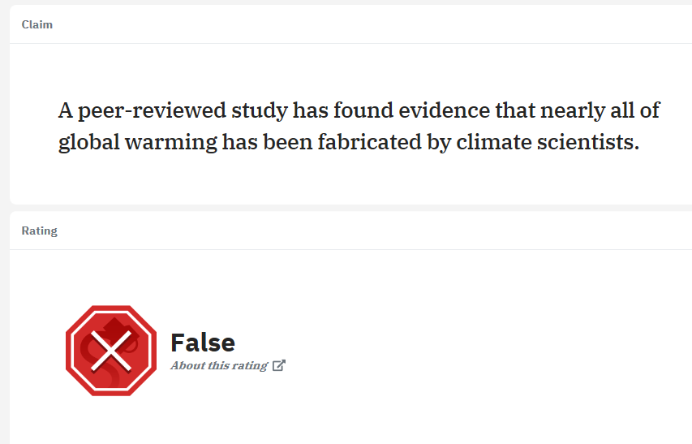

Slide 10
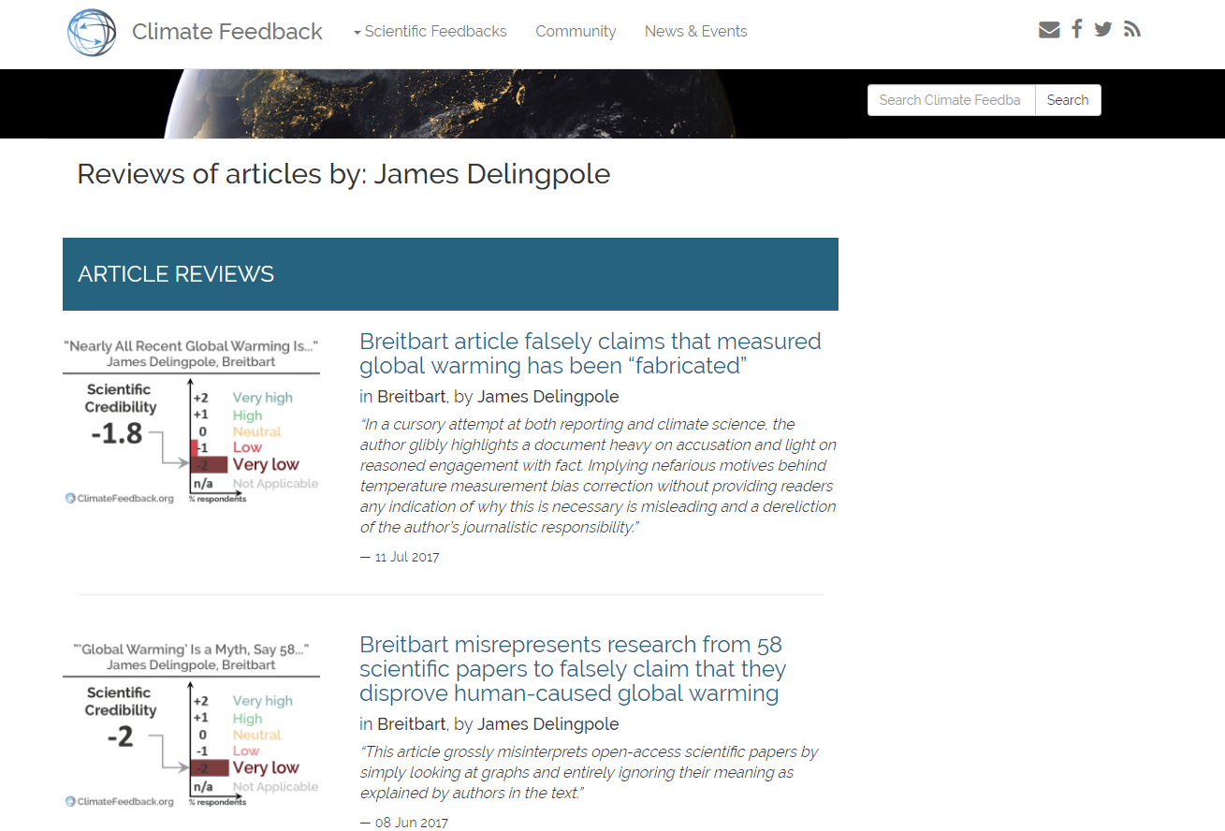

Slide 11
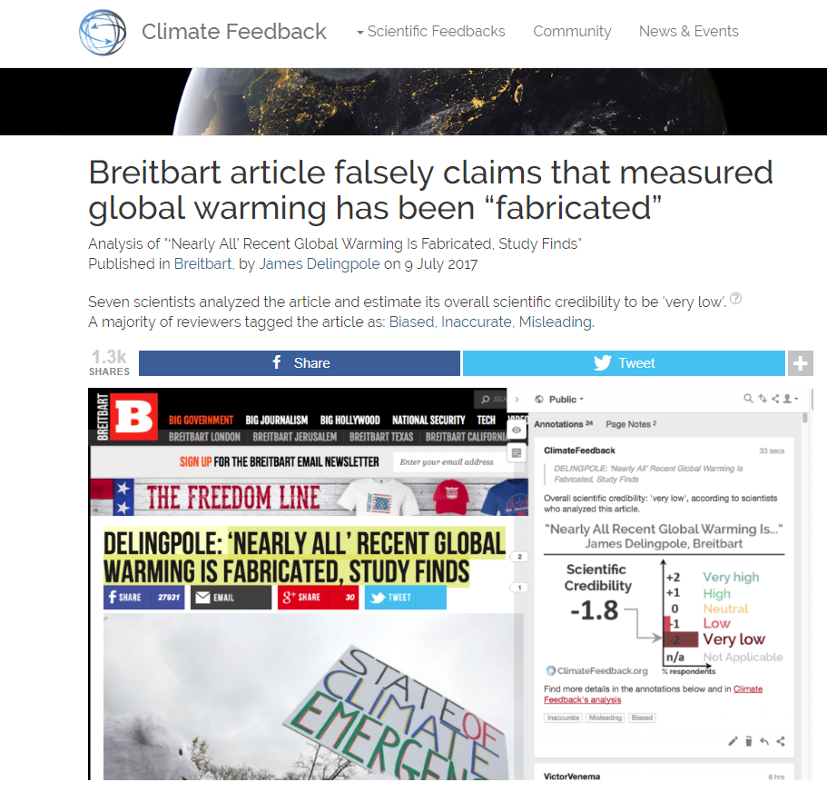

Slide 12
CRAAP Test: Currency
3
The site/article was created/updated within the last 2 years.
0 | 1 | 2 | 3
I can’t find out when this page was published or last revised. | The creation/last revision date is 5 or more years ago. | The site/article was created/updated between 2 and 5 years ago. | The site/article was created/updated within the last 2 years.

Slide 13
CRAAP Test: Relevance
2
This will addresses my question and will give me some useful information but isn’t quite what I am looking for.
0 | 1 | 2 | 3
The page may mention my topic but isn’t relevant to my question, or doesn’t have the type of information I need. | This gives some general background but doesn’t cover my main question. Or the level is too hard or too easy. | This will addresses my question and will give me some useful information but isn’t quite what I am looking for. | This gives me most of what I need to answer my question and is exactly the right type and level of information.

Slide 14
CRAAP Test: Authority
0 | 1 | 2 | 3
I either cannot find out who wrote this (person or organisation) or there is evidence that the author or the organisation has a history of being misleading on this topic. | The author is named but has nothing obvious that qualifies him/her to write about this topic). Or the organisation has questionable authority. | The author is named but the degree of expertise on this topic is not that high. Or the organisation is well-known but degree of expertise on this topic is unclear. | The author is a respected expert on this topic. Or the organisation is well-known and has a good reputation on this topic.
0
I either cannot find out who wrote this (person or organisation) or there is evidence that the author or the organisation has a history of being misleading on this topic.

Slide 15
CRAAP Test: Accuracy
0 | 1 | 2 | 3
Obvious spelling, grammar or layout errors. Or it isn’t clear where the information comes from – it might just be someone’s opinion. | Sources are mentioned vaguely, but not enough information is given to find them. Or sources are cited but they are clearly not trustworthy. | Sources that seem trustworthy are given for some but not all of the information. Some links may be broken, but I could probably find the original sources. Images may not be referenced. | Trustworthy sources clearly given to back up claims, including enough information to find the original sources easily. Any images/ photos are labelled.
0 | 1
Obvious spelling, grammar or layout errors. Or it isn’t clear where the information comes from – it might just be someone’s opinion. | Sources are mentioned vaguely, but not enough information is given to find them. Or sources are cited but they are clearly not trustworthy.

Slide 16
CRAAP Test: Purpose
0 | 1 | 2 | 3
The purpose is to sell or promote an idea or service. The page presents an unbalanced, biased view. It is not backed up with facts or they are distorted. A background check on the author or organisation may suggest strong bias. | The purpose may be to sell something or promote an idea, but the page also provides some clearly referenced, accurate factual information. Argument seems one-sided. | The purpose is to educate. There may be some bias (which may be acknowledged) but opinion is logical and backed by evidence. | The purpose is to provide high-quality scholarly information. Enough factual evidence is given to justify any opinions and may include graphs, charts, tables or statistics. Effort is made to address both sides of an argument.
0
The purpose is to sell or promote an idea or service. The page presents an unbalanced, biased view. It is not backed up with facts or they are distorted. A background check on the author or organisation may suggest strong bias.

Slide 17
CRAAP Test: Total
2/15
with zero for Authority, Accuracy or Purpose. A highly questionable source – do not use.

Slide 18
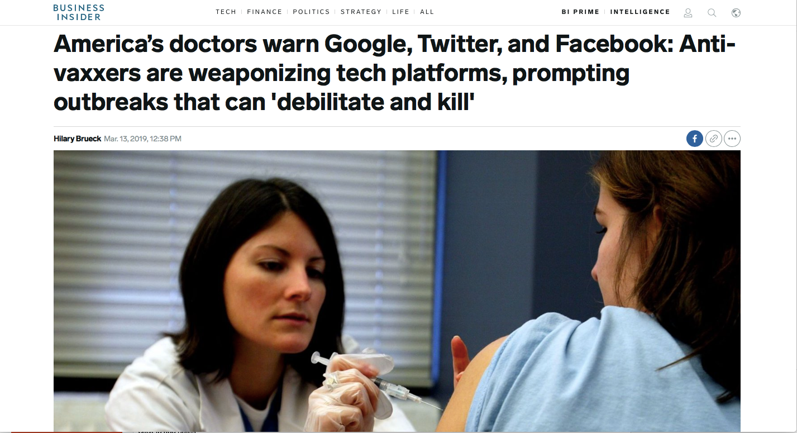
Your ability to tell when you are being not being told the whole truth will matter long after you have forgotten most of what you have learnt at school.
Take charge of your future!
The World belongs to me because I understand it!*
Notes:
*Honoré de Balzac paraphrased by Bellow, S. (1987). Foreword. In A. Bloom, The Closing of the American Mind (pp. 11-18). New York: Simon & Schuster Paperbacks.

Slide 19
CREDITS
Facts vs. Opinions by Oakham School is licensed under a Creative Commons Attribution-NonCommercial-ShareAlike 4.0 International License.
CRAAP test based on Thinking Critically about Web Information from the Ron E. Lewis Library and Evaluating information by Meriam Library

Slide 20
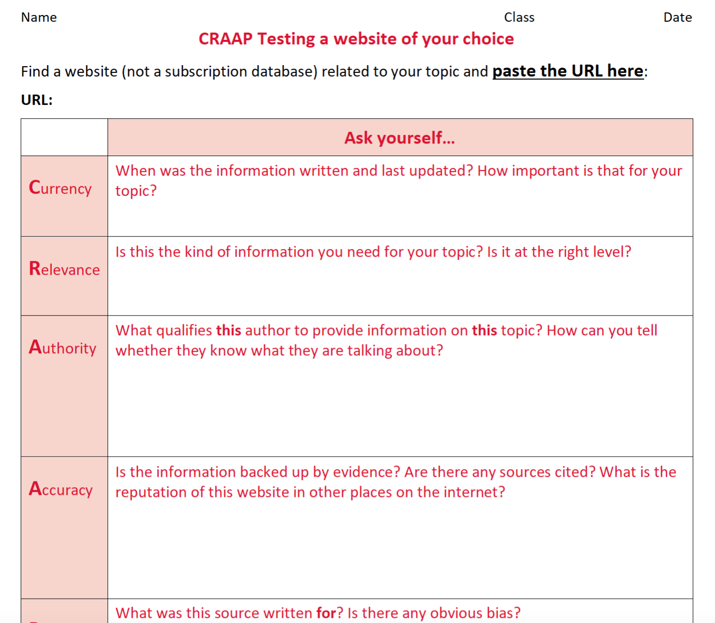
Your task
Find an article on the general internet (not a subscription database) linked to your topic. Use the CRAAP testing guide (PDF) and CRAAP test example (PDF) attached to this assignment to complete a CRAAP test of your own in the attached Word document. You don't need to give a numerical score (but you can if you want). Don't forget to paste the URL in at the start so that I can see the article you have chosen.
Submit your CRAAP test ON THE Sixth Form 2022-2024 Team by 4pm next Wednesday

