Slide 1
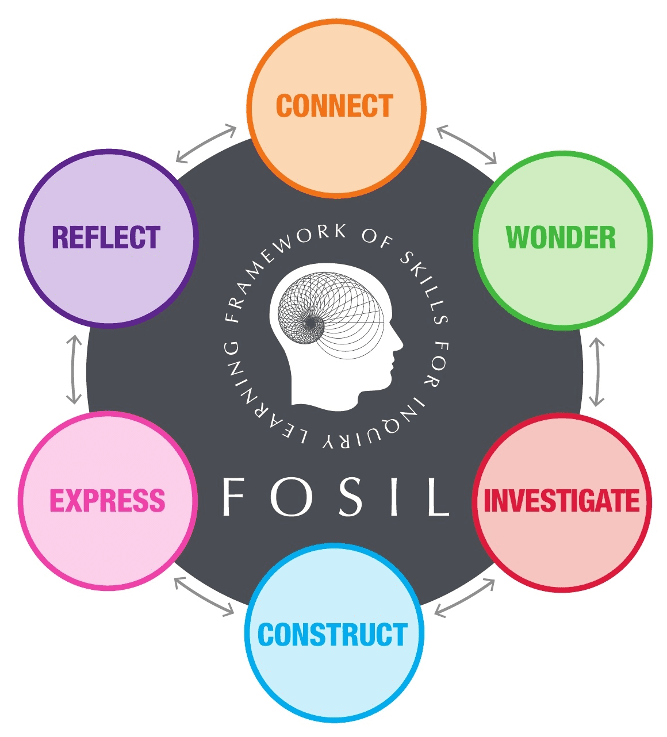
Year 12 Interrobang 4: Joining the conversation
How do we make it clear where we are ‘speaking’ and where we are giving a voice to someone else’s ideas?

Slide 2
Assignment 2 Feedback
Check your returned assignment in Team for specific feedback. Remember to click on the ‘rubric’ button for more detailed feedback.
The qualifications and reputation of the author/publication matter!
Notes:
Ivan Illich, Austrian Philosopher: The principal lesson that school teaches is the need to be taught (Deschooling Society, 1971)

Slide 3
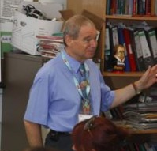
Academic Honesty
“Academic honesty smacks of citing sources because if we do not do this, we get punished. It is the choice of the writer. It could be poor work habits, ignorance, misunderstanding or other factors which lead to failure to cite sources, but in the academic world, plagiarism is plagiarism, intentional or not.”
​
Royce, J. (2020, July 9). The integrity of integrity. Retrieved February 10, 2022, from Honesty, honestly...: https://www.read2live.com/2020 /07/29/the-integrity-of-integrity/ ​
Notes:
Ivan Illich, Austrian Philosopher: The principal lesson that school teaches is the need to be taught (Deschooling Society, 1971)

Slide 4
Academic Integrity
“Academic integrity, though. There are no contexts with academic integrity. When we use the work [including images] of other people, we cite our sources without needing to think about it. We say, as a matter of honour, this is not mine. … [We] do it as a matter of honour, a courtesy and a thank you to the creator of the image. Researchers with integrity do not manipulate their measurements to ensure a straight-line graph...Researchers with integrity disclose affiliations so that readers may consider whether their sponsors might have vested interest in the outcomes of their research. Researchers with integrity are honest, whatever the situation, whatever the context. They cannot do other, they cannot be other. Integrity is what they are, it is who they are.”
​
Royce, J. (2020, July 9). The integrity of integrity. Retrieved February 10, 2022, from Honesty, honestly...: https://www.read2live.com/2020 /07/29/the-integrity-of-integrity/ ​
Notes:
Ivan Illich, Austrian Philosopher: The principal lesson that school teaches is the need to be taught (Deschooling Society, 1971)

Slide 5
Academic Integrity
… “integrity is doing the right thing even when nobody will be aware or care about what you have done; integrity is doing the right thing even though there are no consequences for doing anything else; integrity is doing the right thing because this is you, what you do, who you are, how you behave.”
​
Royce, J. (2020, July 29). The integrity of integrity. Retrieved February 10, 2022, from Honesty, honestly...: https://www.read2live.com/2020 /07/29/the-integrity-of-integrity/ ​
Notes:
Ivan Illich, Austrian Philosopher: The principal lesson that school teaches is the need to be taught (Deschooling Society, 1971)

Slide 6
Is it plagiarism/academic dishonesty?
Directly quoting someone else word-for-word
…is fine if you put it in quotation marks and reference your source
Copying a chunk of text or an image from the internet
…is fine if you put it in quotation marks and reference your source
Rewriting what someone else has said in your own words (paraphrasing)
…is fine if you reference your source. As long as you don’t either misrepresent their idea or stick to their wording too closely.
Basing a piece of work largely on a single source
…is rarely OK (except for very small assignments)
Working with another student (collaborating)
…can be OK for some assignments (check with your teacher) but you must always make it clear who did what
Getting help from a teacher or a parent
…can be OK for some assignments (check with your teacher) but you must always make it clear what help you received
Reusing work that you have already handed in for another assignment
…is rarely OK at school or university. Very rarely you may want to quote or paraphrase yourself and acknowledge the source
Notes:
Ivan Illich, Austrian Philosopher: The principal lesson that school teaches is the need to be taught (Deschooling Society, 1971)

Slide 7
Creating citations & references: Website
It has been suggested that “ integrity is about more than just writers being honest and citing their sources” (Royce, 2020).
Bibliography
Royce, J. (2020, July 29). The integrity of integrity. Retrieved February 10, 2022, from Honesty, honestly...: https://www.read2live.com/2020 /07/29/the-integrity-of-integrity/
Author(s). (Year, month day). Title of webPAGE. Retrieved Month day, year, from Title of webSITE.: URL

Slide 8
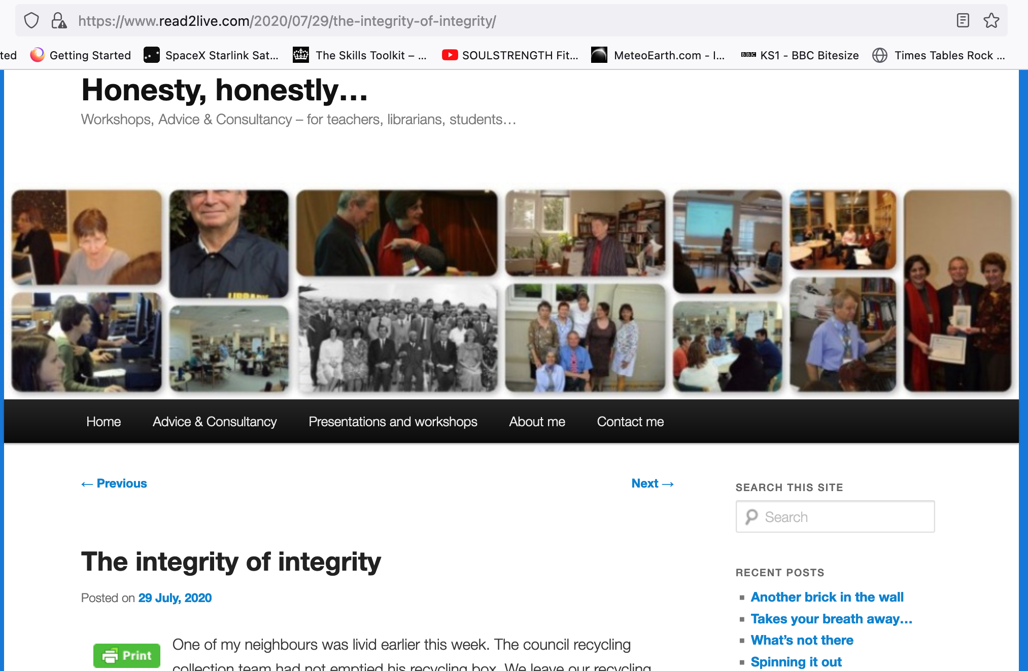
Optional
Bibliography
Royce, J. (2020, July 29). The integrity of integrity. Retrieved February 10, 2022, from Honesty, honestly...: https://www.read2live.com/2020 /07/29/the-integrity-of-integrity/

Slide 9
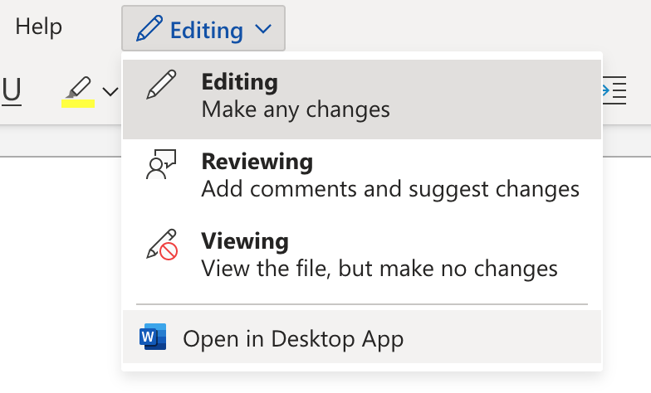
Creating citations & references in Word
Use the desktop app

Slide 10
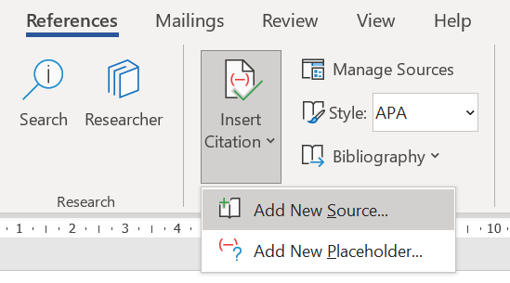
Mac
Windows

Slide 11
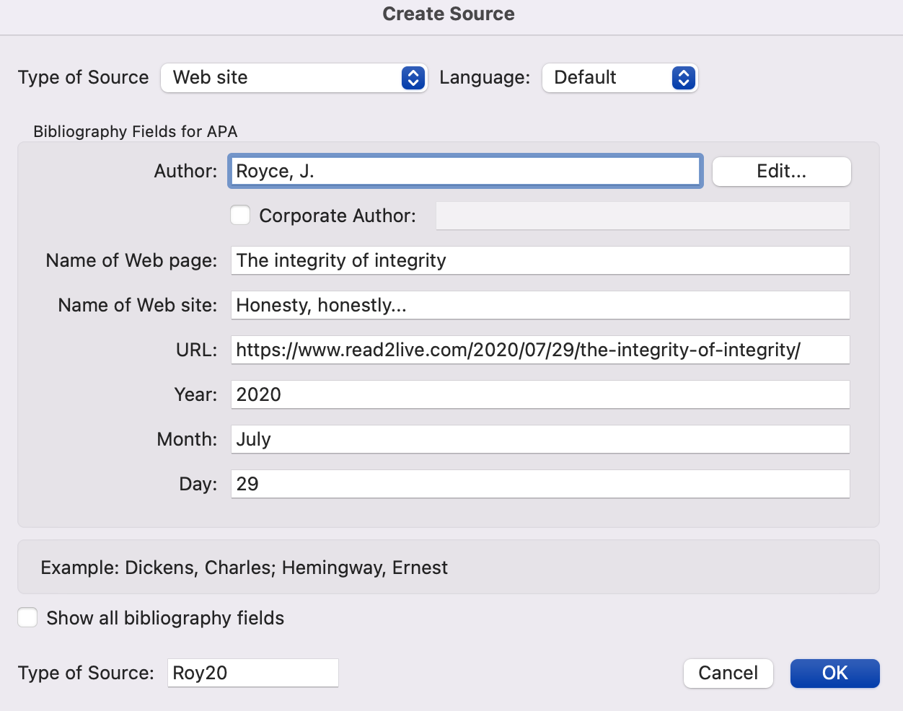

Slide 12
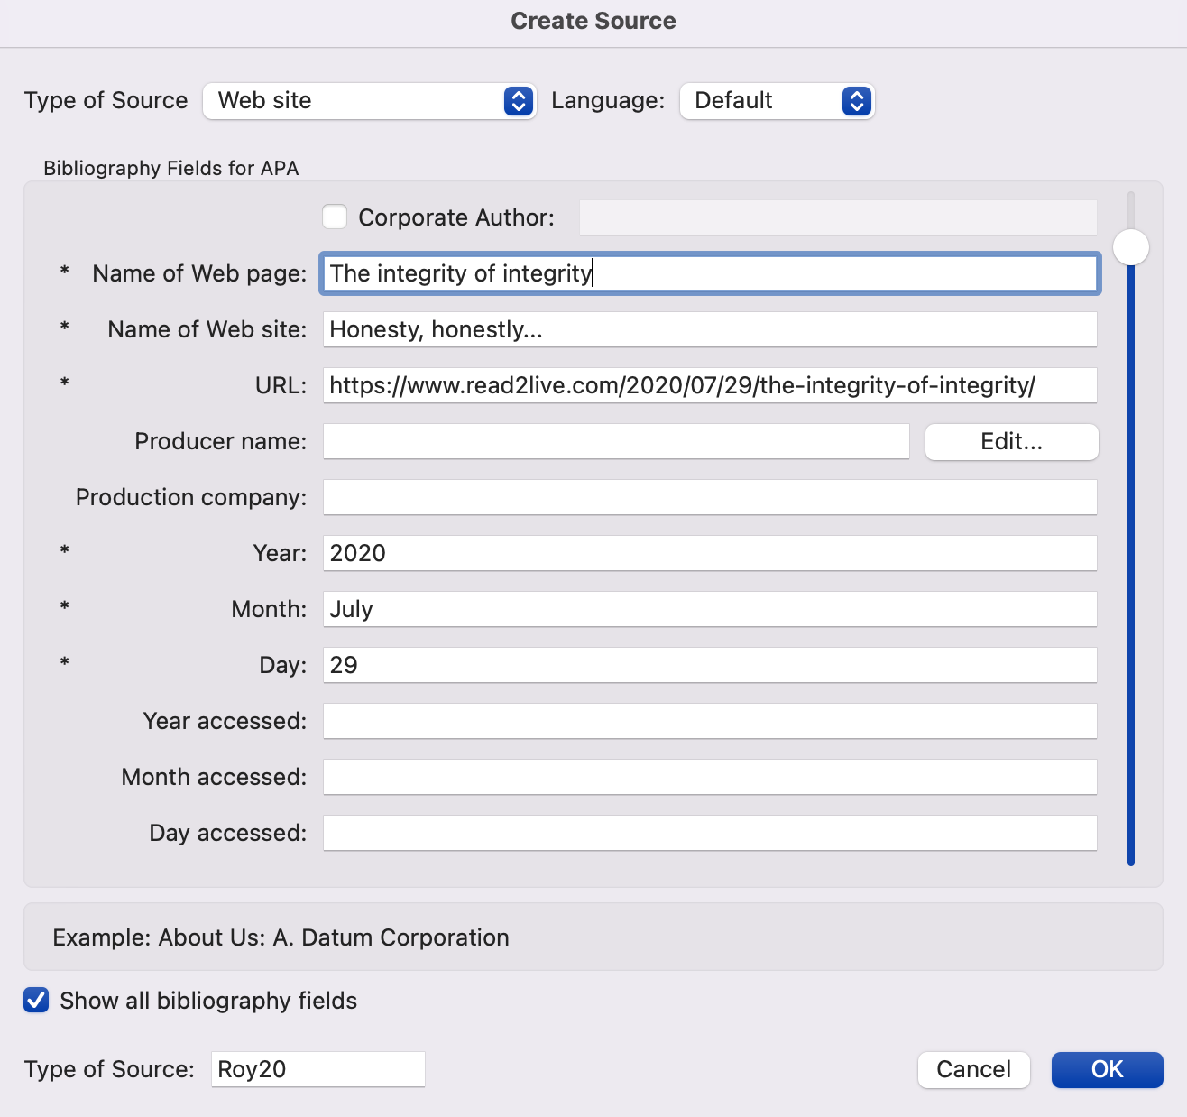
Today’s date (6 October)

Slide 13
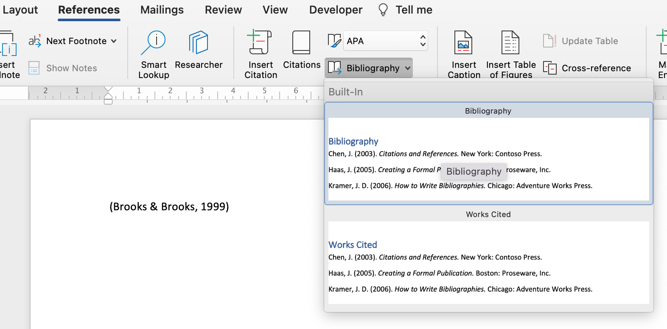
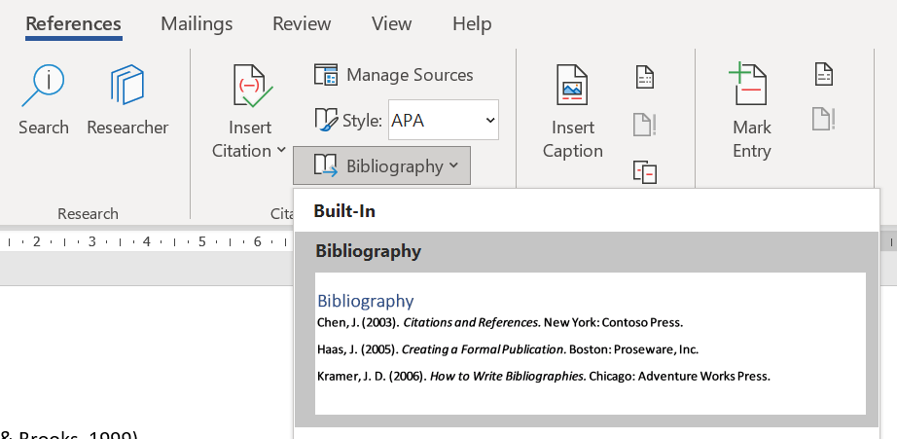

Slide 14
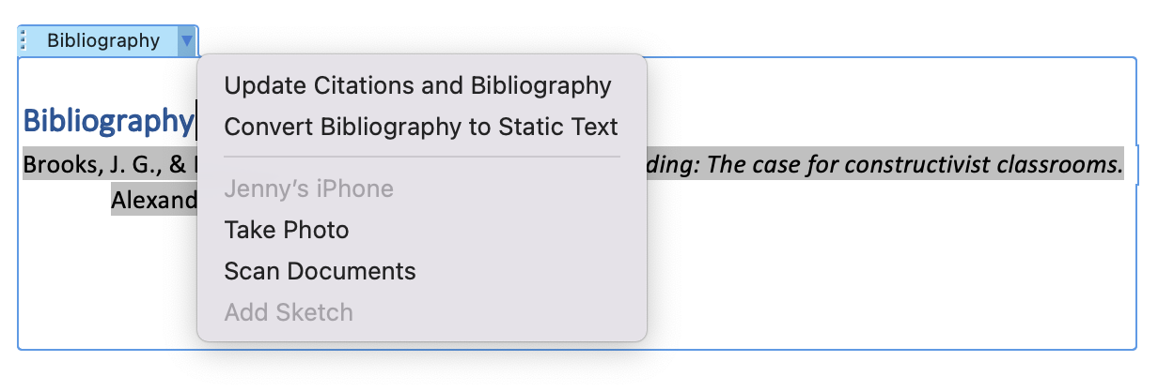

Slide 15
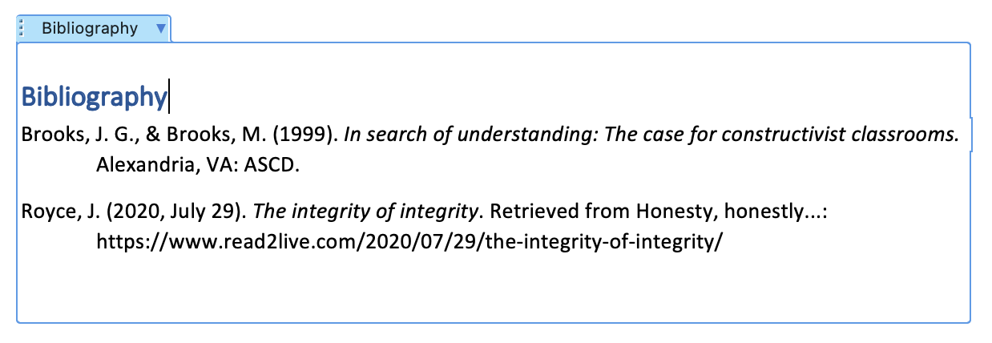

Slide 16
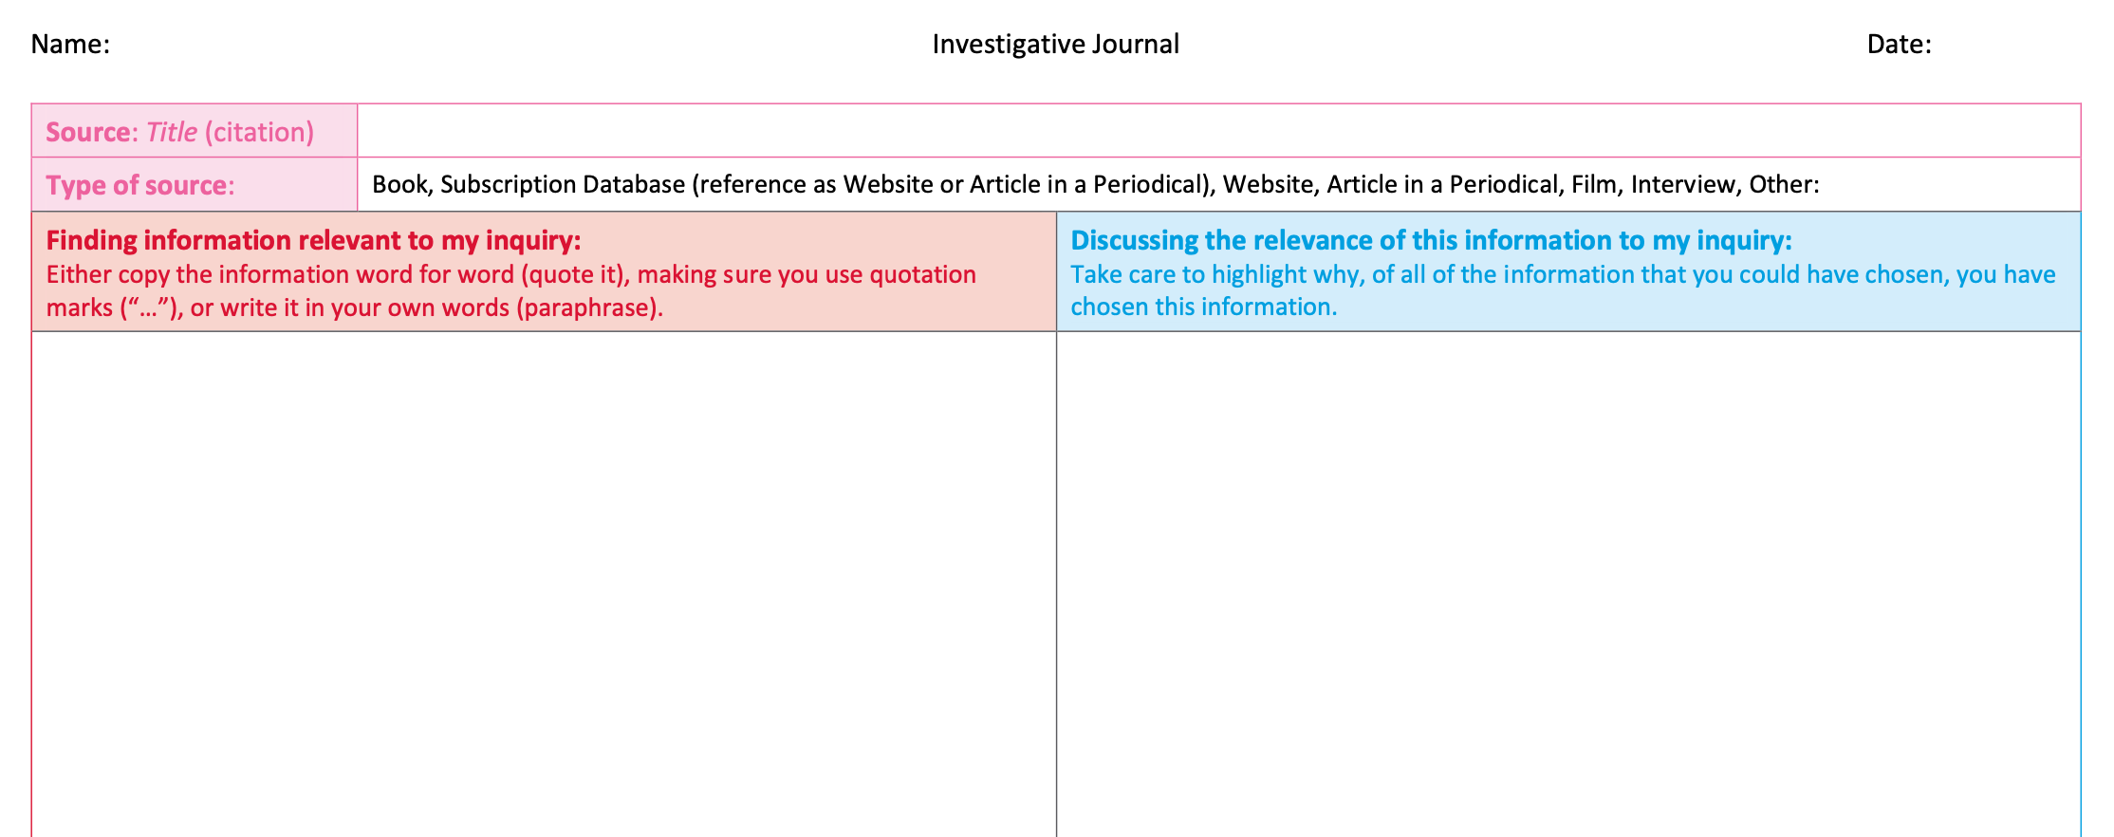
Your task
Have a go at referencing all the sources you have found so far that you intend to use IN YOUR INVESTIGATIVE JOURNAL from Assignment 2
Continue your research in your investigative journal, using whatever sources you think are suitable. Next week you will need to have enough information to produce a paragraph on your topic, so work towards that.
Submit your Investigative Journal ON THE Sixth Form 2022-2024 Team by 4pm next Wednesday

