Slide 1
Year 12 Interrobang 5: The information-to-knowledge journey
What do I know now that I didn’t know when I started?
How can I communicate this clearly in a way that will interest others?

Slide 2
Assignment 2 Feedback
A number of you didn't reference your sources at all
Make sure you look for a date – lots of websites do have them
Check you are putting SEMI-COLONS between authors
Notes:
Ivan Illich, Austrian Philosopher: The principal lesson that school teaches is the need to be taught (Deschooling Society, 1971)

Slide 4
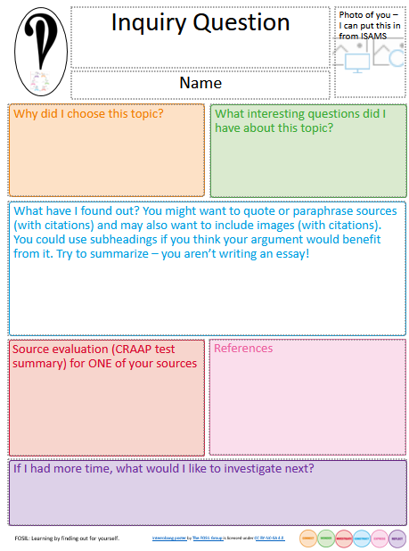

Slide 5
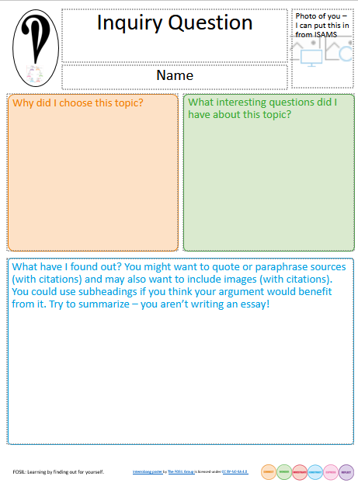
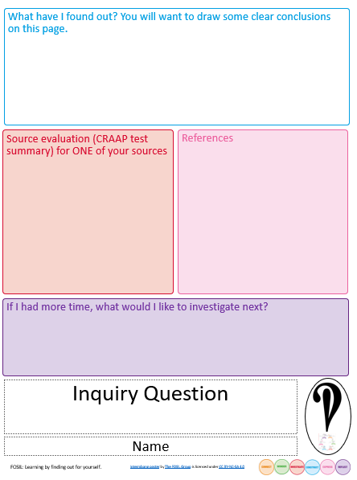

Slide 6
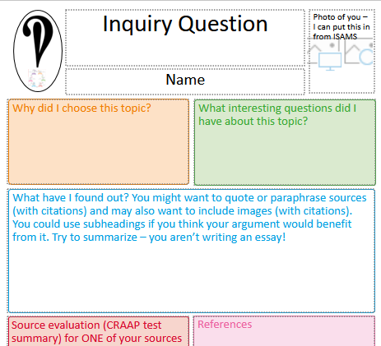
Your task
Choose EITHER the one page poster or the two page poster from the PPT and delete the other slides.
Create your poster by following the instructions in the boxes. You MUST produce a finished draft this week.
Keep the font size fairly similar to the ones I have used. Long titles might need shrinking.
Don't change the colours or delete any boxes. You may change the size of the boxes.
This will be printed out on A3 paper not displayed on a screen, so no animations!
Submit your poster ON THE Sixth Form 2022-2024 Team by 4pm next Wednesday

