Slide 1
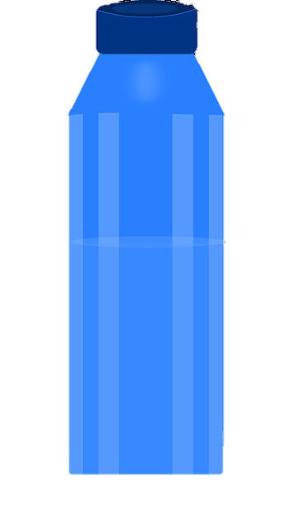
Name: Class:
Date:
Heat transfer notes
Read the articles and make some notes in each red box. Don’t forget to say which source you have got the information from (e.g. Source A). Then in the water bottle outline suggest how you can use what you have learnt to keep the contents of your bottle cool (or hot).
Heat and temperature
Convection
Conduction (and insulation)
Radiation

