Slide 1
Name:
Class:
Date:
Science, Maths & ICT: Reflection
What problems did I (or the group) have? (4.4)
What decisions did I (or the group) make? (4.2)
How did I overcome these problems? (4.4)
How did this affect the way my project turned out? (3.2)
What did I learn? If I had to do this again, how would I do it better next time? (3.3)
FOSIL: Learning by finding out for yourself.
Cool-water-reflection by The FOSIL Group is licensed under CC BY-NC-SA 4.0

Slide 2
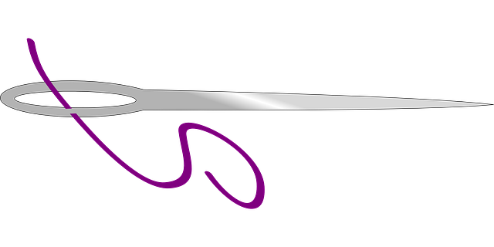
Name:
Class:
Date:
Art & DT: Reflection
What problems did I (or the group) have? (4.4)
What decisions did I (or the group) make? (4.2)
How did I overcome these problems? (4.4)
How did this affect the way my project turned out? (3.2)
What did I learn? If I had to do this again, how would I do it better next time? (3.3)
FOSIL: Learning by finding out for yourself.
Cool-water-reflection by The FOSIL Group is licensed under CC BY-NC-SA 4.0

