Slide 1
Plumbing the depths of the LMS
The role of the Library Management System in developing research competence
Notes:
Seeing the bigger picture: School Libraries in the learning agenda, School Libraries Group of the Chartered Institute of Library and Information Professionals National Conference 2009, Peterborough

Slide 2
Professional activity
According to Jesse Shera, the librarian’s uniquely professional activity consists of:
Assembling the best possible collection
Organising the collection for optimal use
Facilitating access to the collection

Slide 3
Assembling
We do the best we can with what we’re given
We tend to better at fiction and recreational non-fiction even though academic non-fiction is of primary importance
It is impossible to have subject-specific curricular knowledge of all subjects at all levels
Effective collaboration with academic colleagues in all other teaching departments is often something of a holy grail

Slide 4
Assembling
To the extent that it is possible to demonstrate the real value added to the business of teaching and learning, effective collaboration increases
A curriculum map as guide to developing the academic non-fiction collection
The more useful the collection, the more it is used; the more it is used, the greater the incentive to collaborate

Slide 5
Organising
Primarily the simplest and most logical physical arrangement of the collection
However, as Walter Benjamin reminds us, “if there is a counterpart to the confusion of a library, it is the order of the catalogue” – but only if the catalogue itself is ordered
To the extent that physical constraints result in non-optimal organisation, the catalogue is of supreme importance

Slide 6
Organising
Antonio Panizzi, eventual principal librarian of the British Museum Library, in developing a new catalogue for the British Museum ended up transforming the catalogue from an inventory into an instrument of discovery
In doing so, Panizzi was trying to produce not only a new kind of catalogue but a new kind of reader as well – one more independent, more knowledgeable of library systems

Slide 7
Facilitating
Physical and virtual dimensions of the library
Physical layout and organisation of collection
Virtual collection
Catalogue is virtual map to both collections
Pupils and staff need to be taught optimal use, central to which is the catalogue
While the map is not the territory, it is vital that the map is a reliable guide

Slide 8
Research and LMS
Example: A Level Economics
Excellent relationship with Department, particularly with one teacher
Highly responsive to teacher and pupil requests
Compulsory reading beyond curriculum
Compulsory book review (1 per term); typed, filed and on display with Economics books

Slide 9
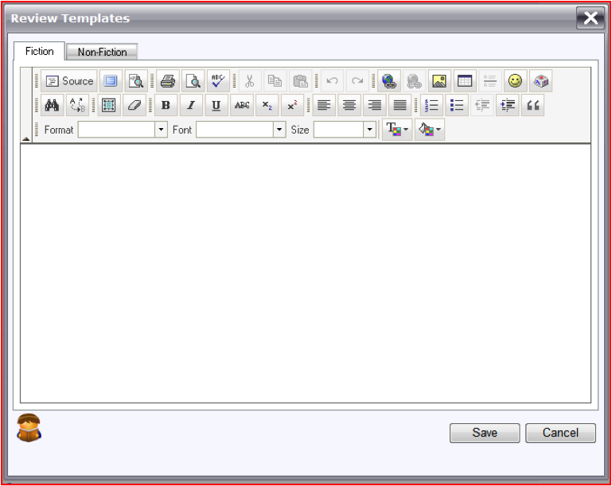
Book reviews (Eclipse.net)
Guidelines for fiction book reviews fairly straightforward
Pilot, including IB and/or A Level, Economics and/or Politics
Suggestions for academic non-fiction book reviews:
Subject (e.g. Economics)
Curricular level (e.g. IB6)
Curricular relevance (e.g. Macro-economics/International Development)
Strengths of book
Weaknesses of book
Recommended
Benefits
Focuses attention on the LMS
Structures reading
Increases accessibility of reviews
Peer-reviewed
Linked to “People who read this also read …” (see next slide)

Slide 10
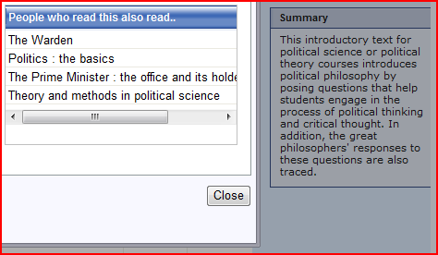
Book reviews (Eclipse.net)
Students tend to read less fiction as they progress up the school as the level of their academic non-fiction reading increases
As the LMS automatically records this data, so, over time, it is able to generate an increasingly useful profile of the academic non-fiction actually being read
Peer-influenced
Note, in addition, the summary of the original book

Slide 11
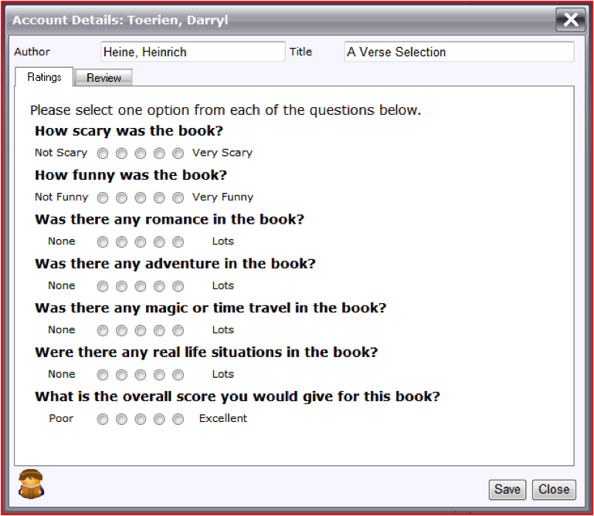
Book ratings (Eclipse.net)
Currently locked for editing, but requested of developers
Linked to guidelines for academic non-fiction book reviews
Suggestions:
Rate the subject relevance
Rate the curricular level
Rate the curricular relevance
Rate the interest level
Rate the wider appeal
Overall rating
Benefits
Focuses attention on the LMS
Encourages objective evaluation
Peer-reviewed
As the LMS automatically records this data, so, over time, it is able to generate an increasingly useful profile of the value students assign to the academic non-fiction actually being read

Slide 12
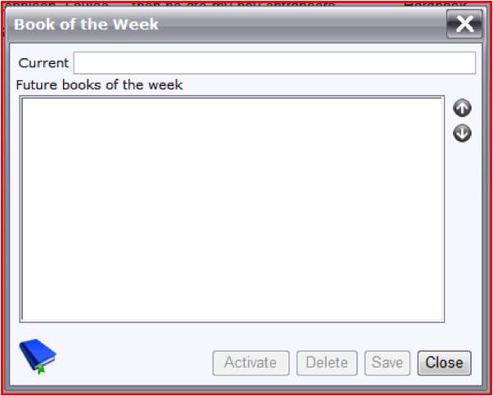
Book of the week (Eclipse.net)
Not limited to fiction; more useful and less onerous if it isn’t
Benefits
Focuses attention on the LMS
Regularly highlights new and relevant academic non-fiction
Fosters collaboration with other academic teaching staff

Slide 13
SDI (Oliver; not currently available in Eclipse.net)
Selective Dissemination of Information according to a user-defined profile
Usually recreational
Pilot, including IB and/or A Level, Economics and/or Politics
As part of lesson at the start of a topic, students set up a subject-specific SDI research profile according to agreed keywords
Keywords inform cataloguing
Students [and staff] are notified by email of all new resources matching their particular profile
Benefits
Focuses attention on LMS
Students [and staff] learn how to set up SDI profiles for themselves in other subjects
Notification of relevant academic non-fiction is pushed to students [and staff]

Slide 14
Conclusion
The textbook and the reserve collection … have too long dominated undergraduate, and even graduate, instruction … largely because the typical faculty member does not trust either the bibliographic mechanisms of the library or the competence of the librarians, while the librarians, for their part, have never developed a theory of the role of the library in the student’s intellectual experience. (Jesse Shera, 1972)

Slide 15
References
Battles, M. (2003). Library: an unquiet history. London: William Heinemann.
Baudrillard, J. (1994) Simulacra and simulation. Ann Arbor: University of Michigan Press.
Benjamin, W. (1999). Illuminations. London: Pimlico.
Shera, J.H. (1972). The foundations of education for librarianship. New York: Wiley-Becker and Hayes.

