Slide 1
Using sources in your writing
Year 13 English Coursework
16 January 2023
Blanchelande College Senior Library
toerienj@blanchelande.sch.gg

Slide 2
Contents
Citations vs references
Creating citations for common sources (in Word)
Website
Journal article
Book
Writing with sources

Slide 3
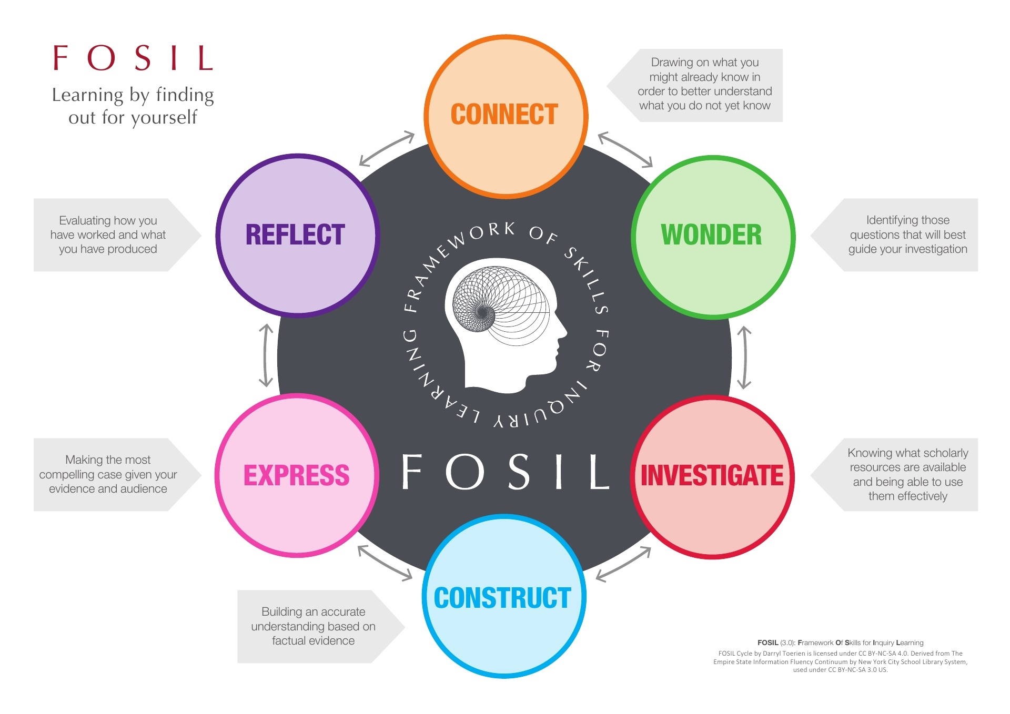
Notes:
FOSIL, which stands for Framework Of Skills for Inquiry Learning, is a case in point, being an adaption of the ESIFC that has been underway since 2011.
As an instructional model of the inquiry process, FOSIL closely resembles Stripling’s Model.
It expresses an inquiry stance – learning by finding our for (not by) yourself – that gives rise to a dynamic process that we have tried to make as self-explanatory as possible at a surface level.

Slide 4
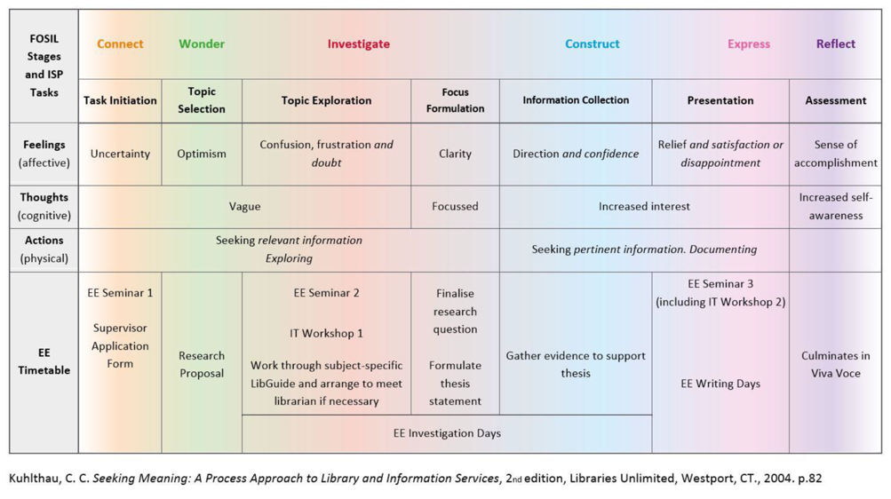
FOSIL and the Information Search Process

Slide 5
2. Citations vs References (Author, date)
It has been suggested that “ integrity is about more than just writers being honest and citing their sources” (Royce, 2020).
Bibliography
Royce, J. (2020, July 9). The integrity of integrity. Retrieved February 10, 2022, from Honesty, honestly...: https://www.read2live.com/2020 /07/29/the-integrity-of-integrity/
Citation
Reference

Slide 6
3. Creating citations & references: Book
Brooks & Brooks (1999) contend that “[e]ducators must invite students to experience the world’s richness, empower them to ask their own questions and seek their own answers, and challenge them to understand the world’s complexities” (p.5).
Bibliography
Brooks, J.G. & Brooks, M.G. (1999). In search of understanding: The case for constructivist classrooms. Alexandria, VA: ASCD.
.
Citation

Slide 7
3. Creating citations & references: Book
Brooks & Brooks (1999) contend that “[e]ducators must invite students to experience the world’s richness, empower them to ask their own questions and seek their own answers, and challenge them to understand the world’s complexities” (p.5).
Bibliography
Brooks, J.G. & Brooks, M.G. (1999). In search of understanding: The case for constructivist classrooms. Alexandria, VA: ASCD.
Author(s). (Year). Title. City of publication: Publisher.

Slide 8
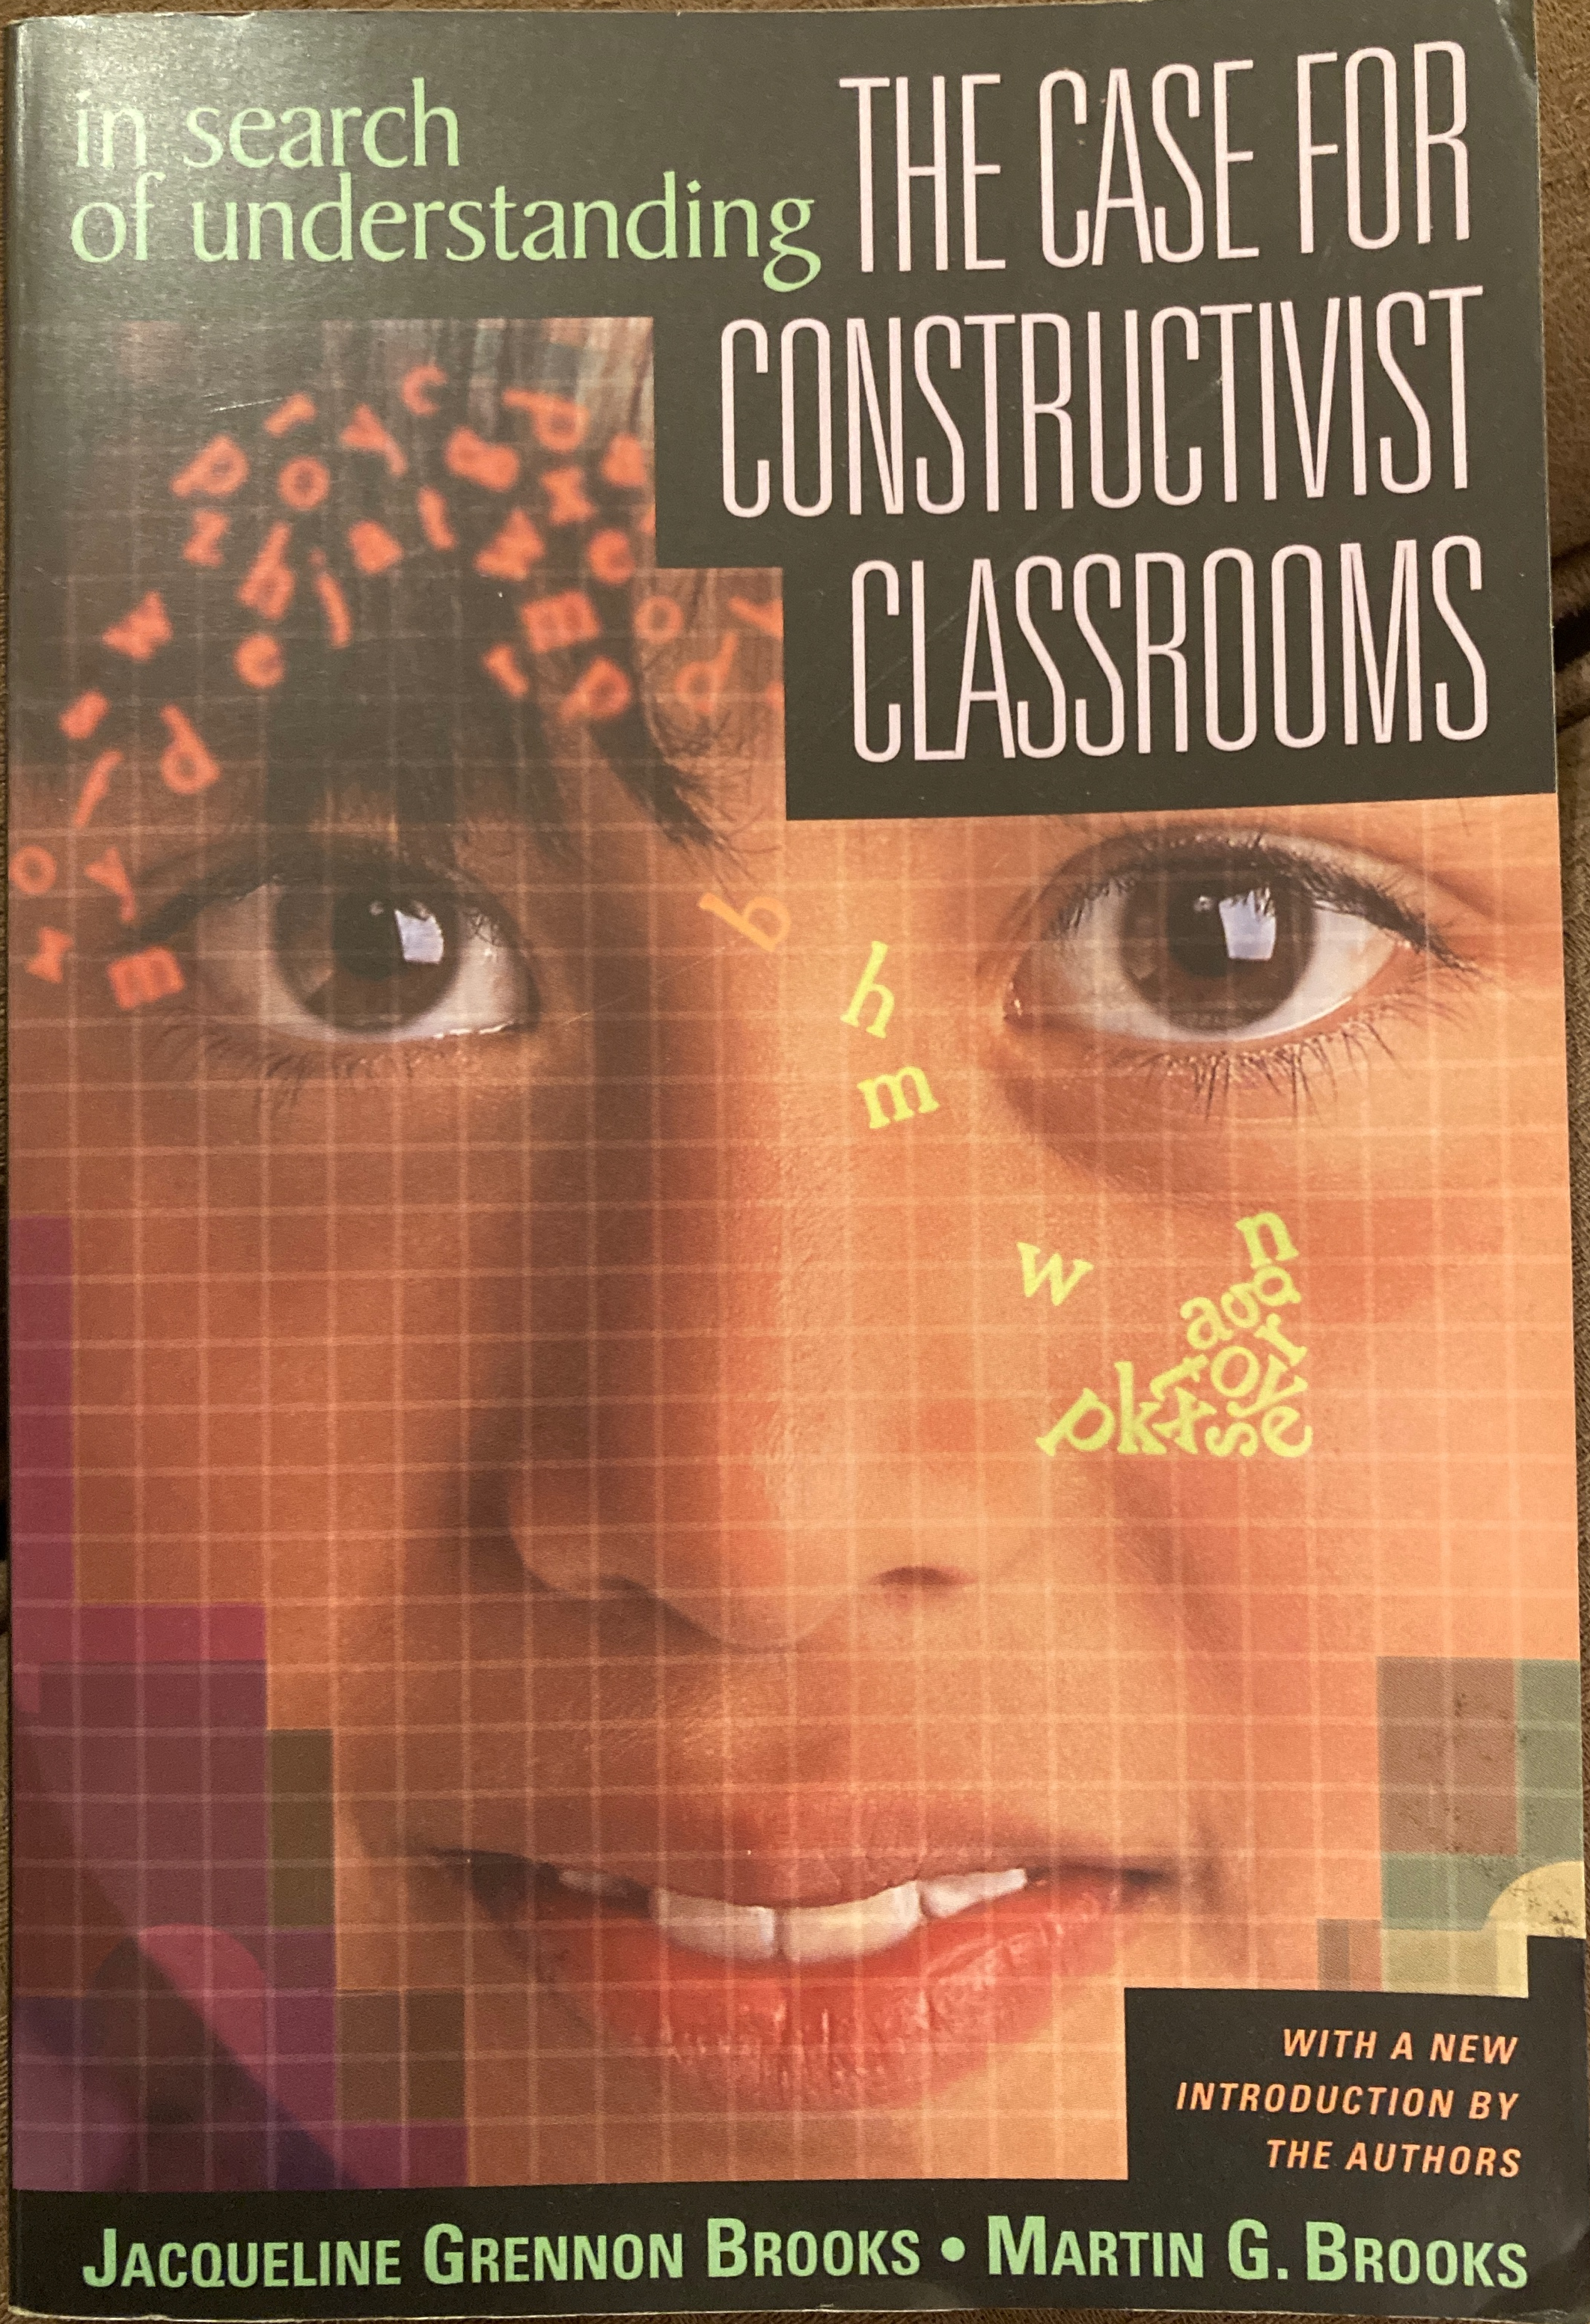
Brooks, J.G. & Brooks, M.G. (1999). In search of understanding: The case for constructivist classrooms. Alexandria, VA: ASCD.

Slide 9
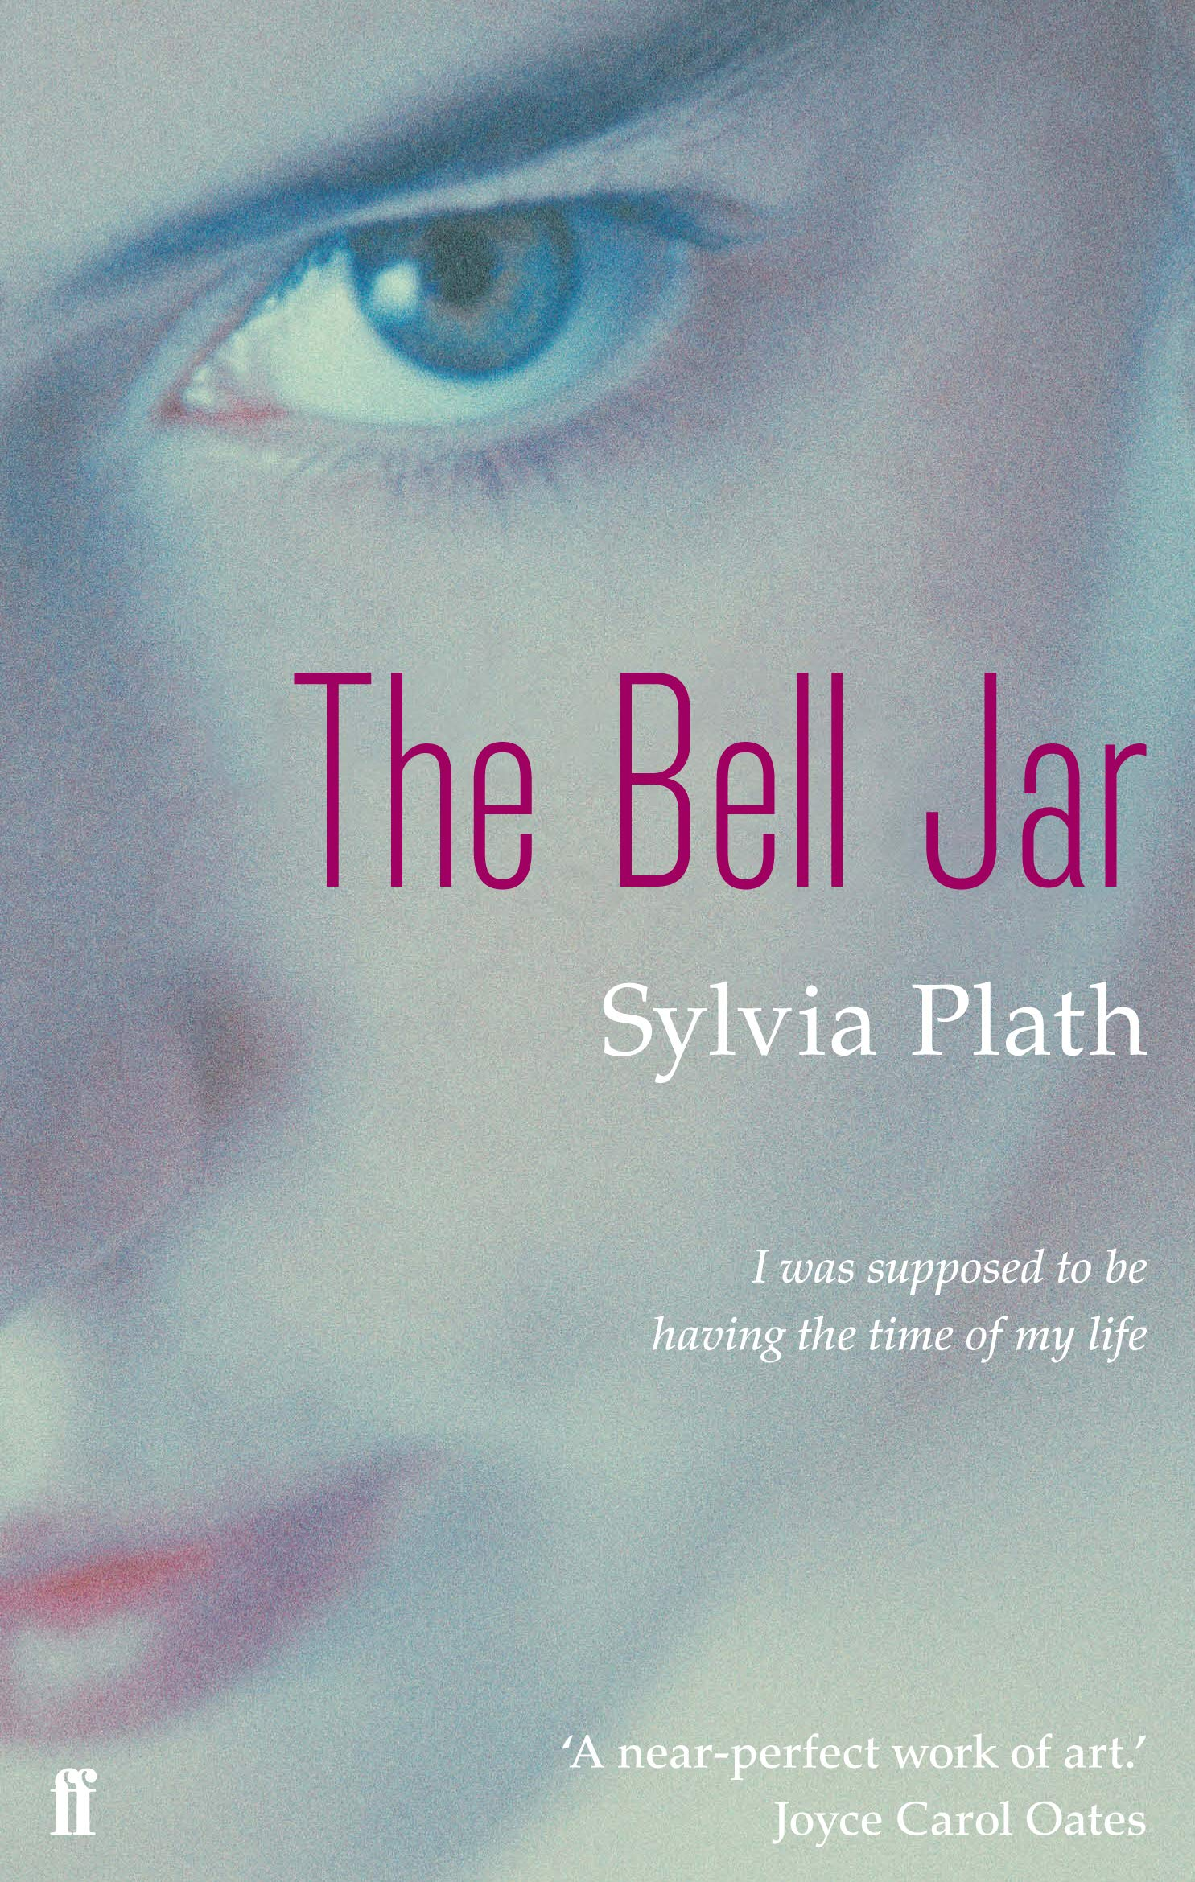
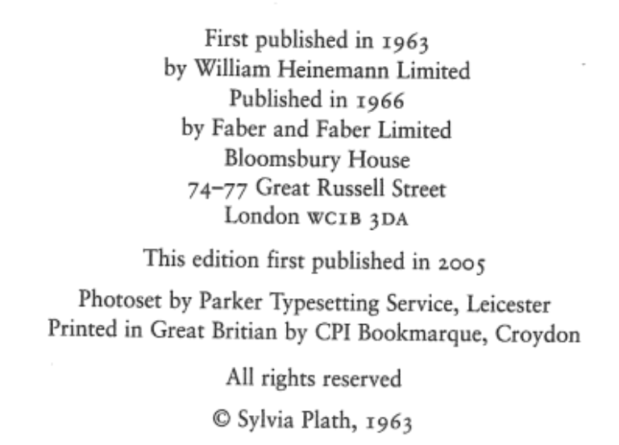
Publication dates for classic works
“I was supposed to be having the time of my life.” Plath (1963/2005, p.2)
Plath, S. (2005). The Bell Jar. London: Faber & Faber. (Original work published 1963).

Slide 10
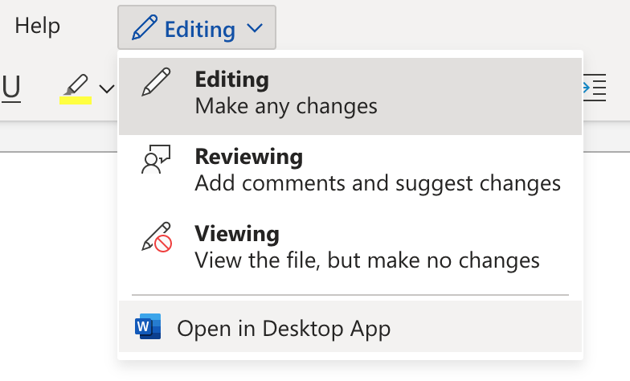
Creating citations & references in Word
Use the desktop app
Using an iPad Pro or a ChromeBook? Then you can’t use the tools in Word. Try an online app like Zotero instead.
I don’t recommend automatic tools like citethisforme or citationmachine. They aren’t always very accurate!

Slide 11
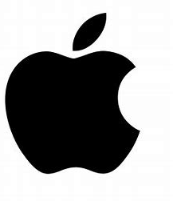
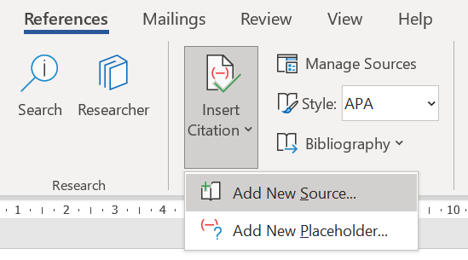
Mac
Windows

Slide 12
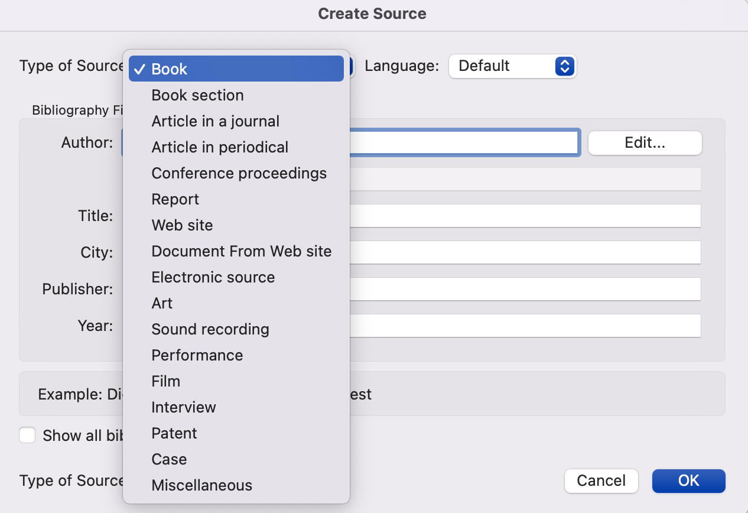

Slide 13
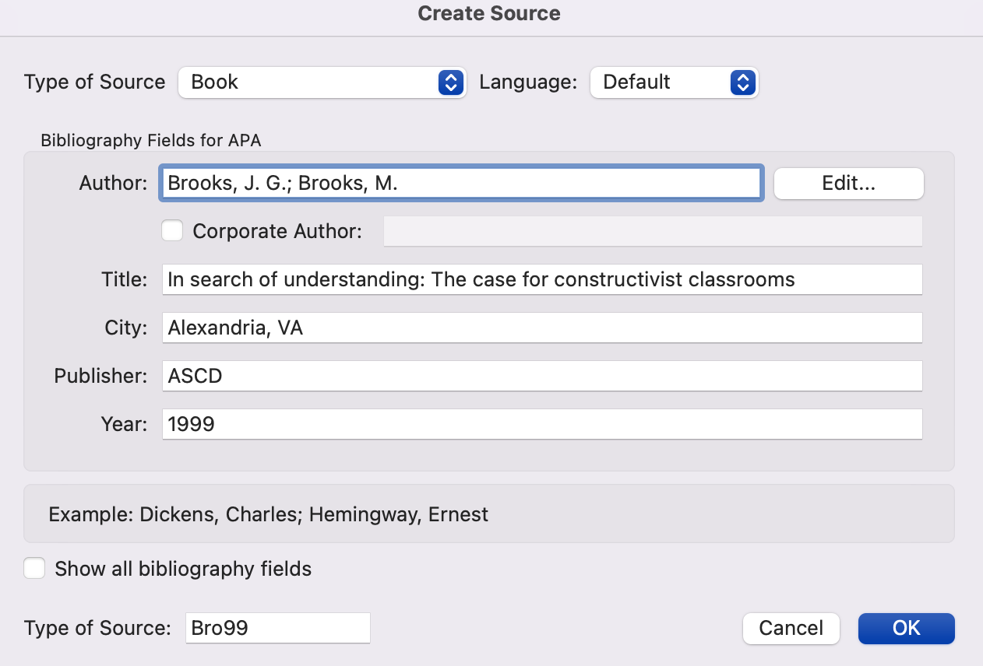

Slide 14
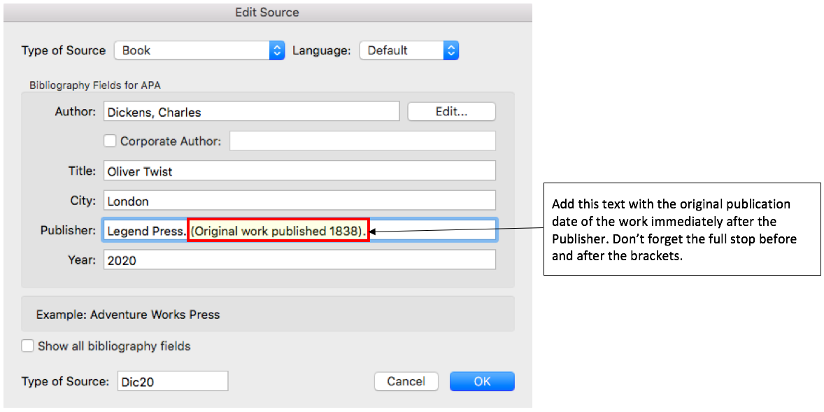
Classic sources?
You’ll need to delete the automatically generated in-text citation and type it manually…. Dickens (1838/2020)

Slide 15
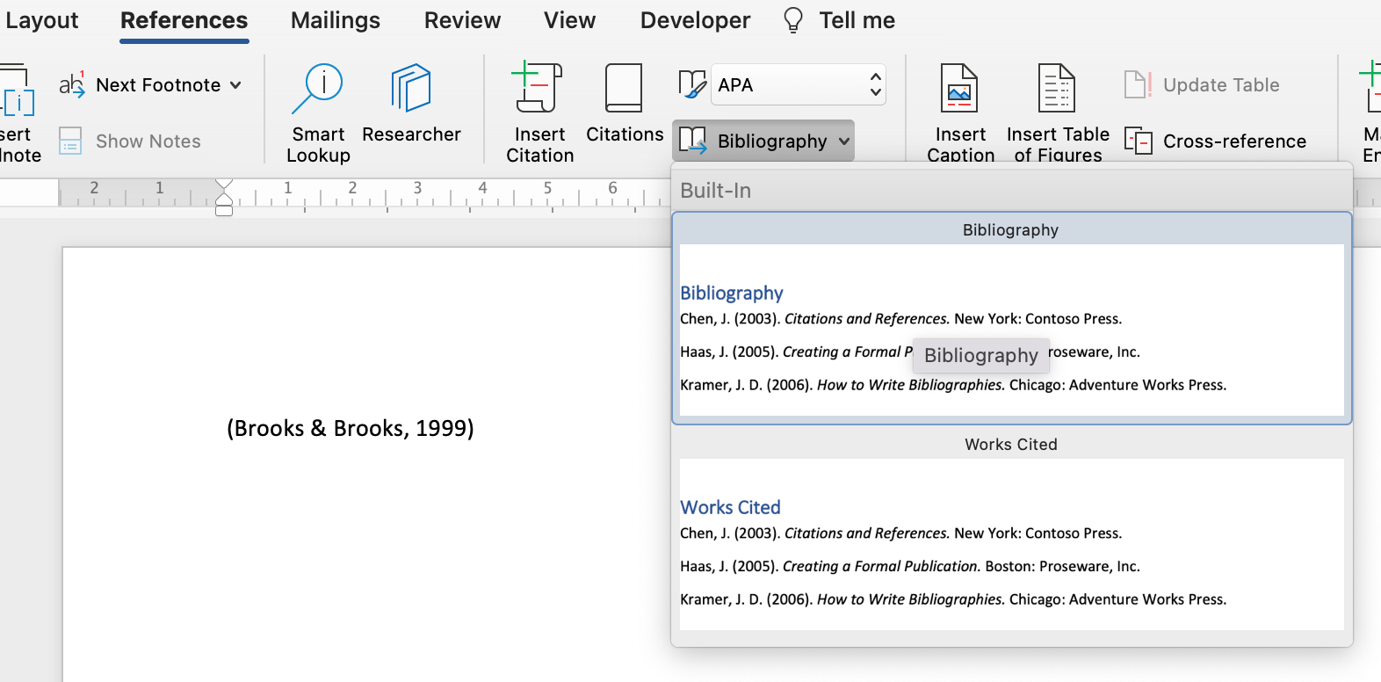
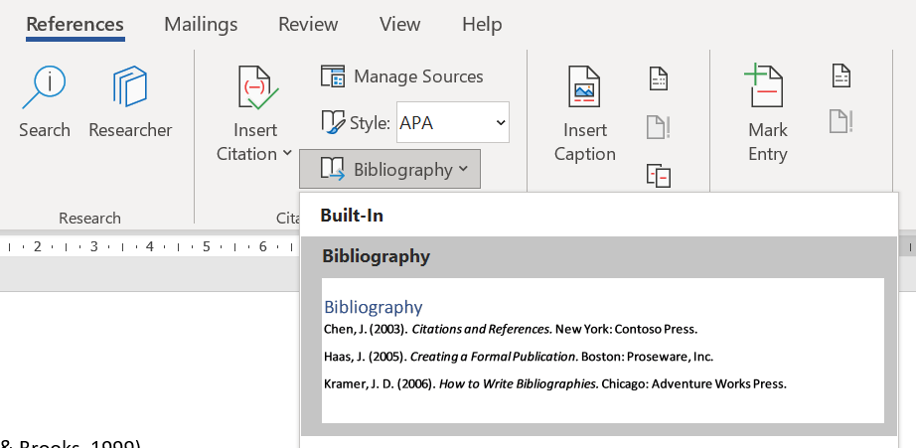

Slide 17
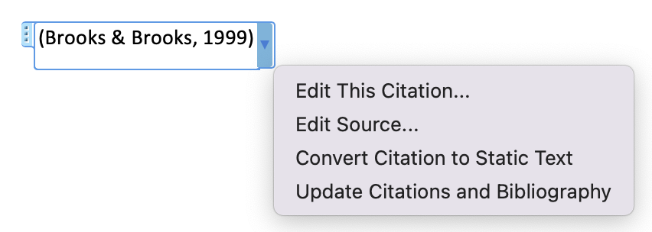
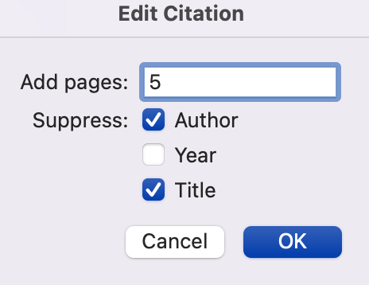

Slide 18
Your
turn!

Slide 19
3. Creating citations & references: Website
It has been suggested that “ integrity is about more than just writers being honest and citing their sources” (Royce, 2020).
Bibliography
Royce, J. (2020, July 9). The integrity of integrity. Retrieved February 10, 2022, from Honesty, honestly...: https://www.read2live.com/2020 /07/29/the-integrity-of-integrity/
Author(s). (Year, month day). Title of webPAGE. Retrieved Month day, year, from Title of webSITE.: URL

Slide 20
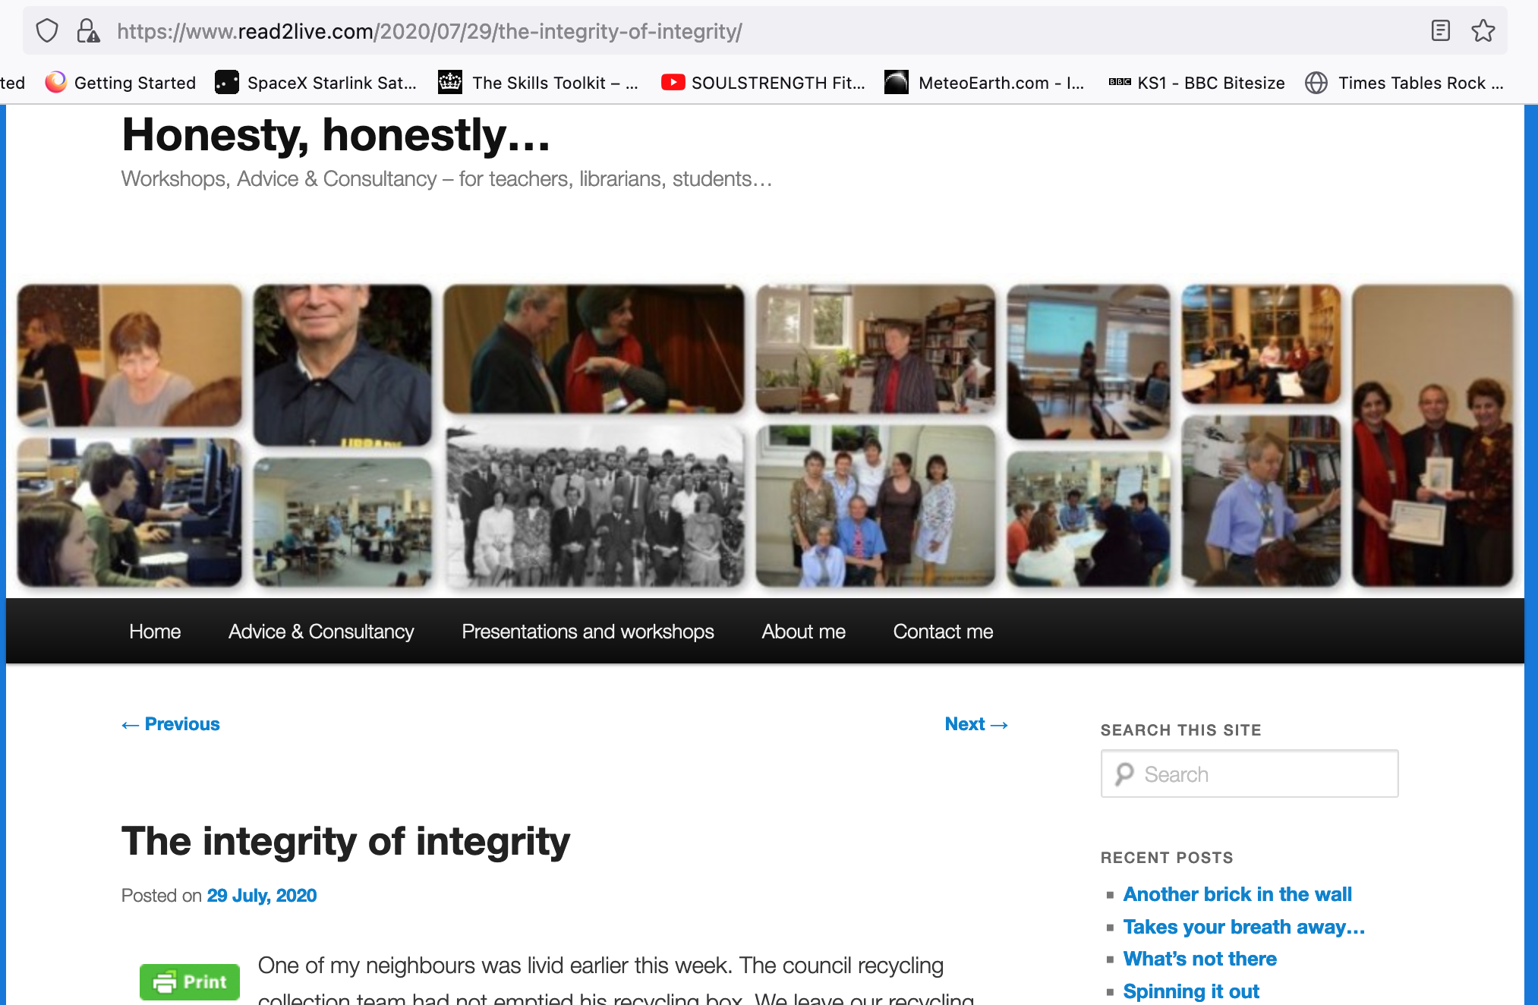
Optional
Bibliography
Royce, J. (2020, July 9). The integrity of integrity. Retrieved February 10, 2022, from Honesty, honestly...: https://www.read2live.com/2020 /07/29/the-integrity-of-integrity/

Slide 21
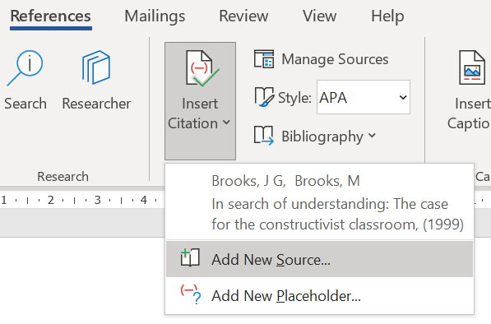
Mac
Windows

Slide 22
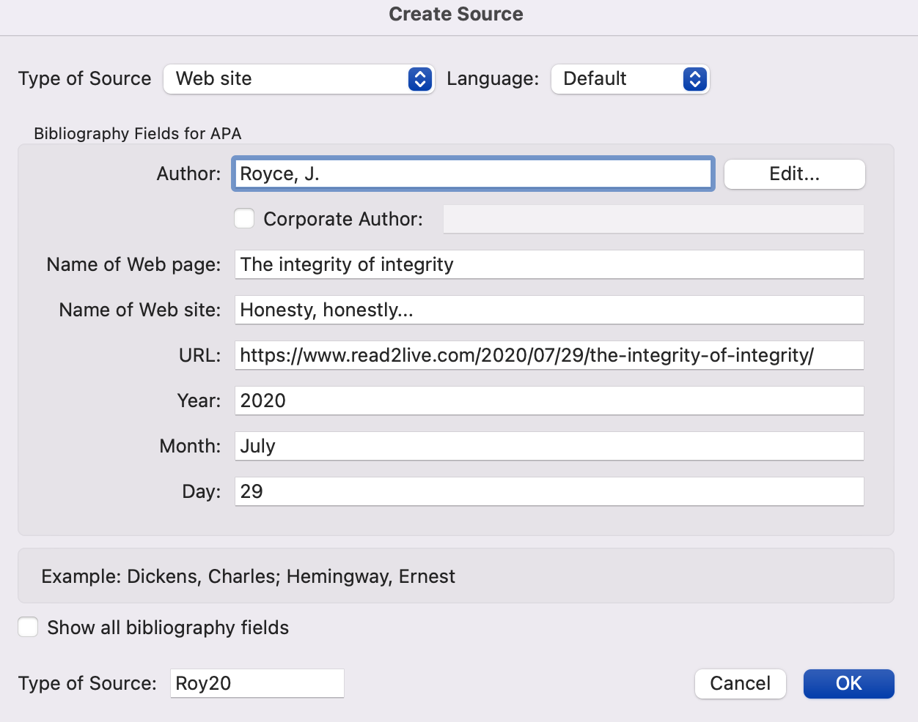

Slide 23
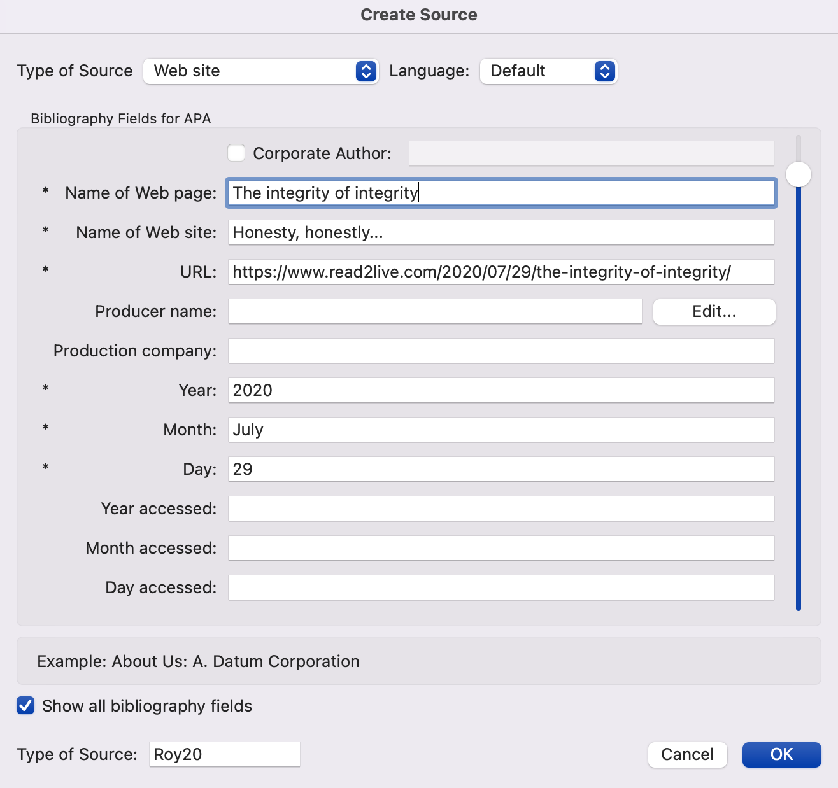

Slide 24
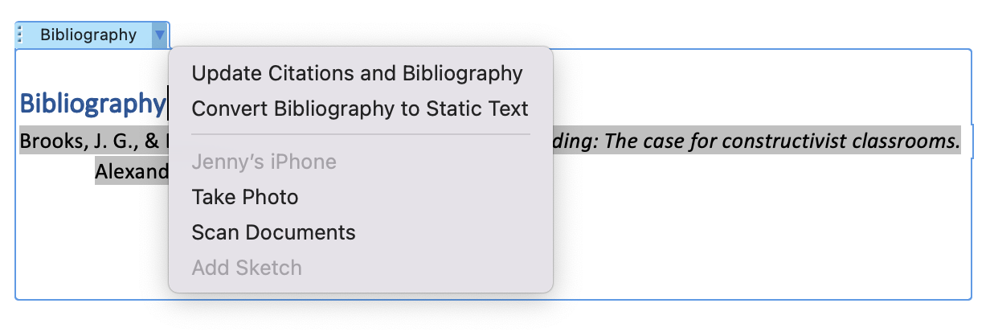

Slide 25
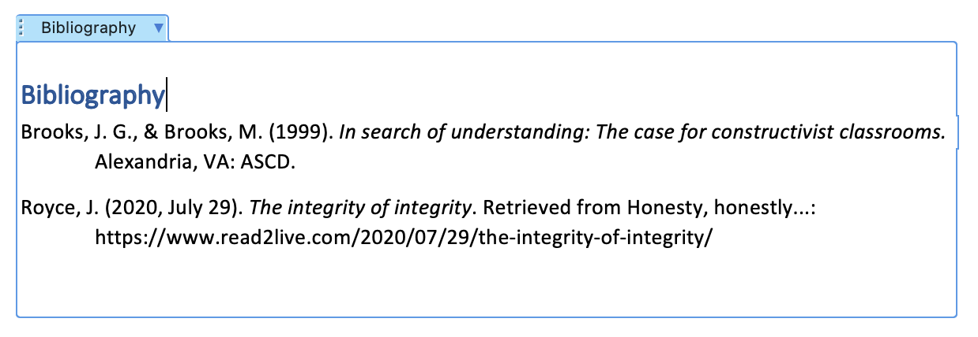

Slide 26
Your
turn!

Slide 27
3. Creating citations & references: Journal articles
Kuhlthau (1987) suggests that teachers are not always aware how difficult students find research, and that librarians can help by using their understanding of the research process and children’s cognitive development to shape research tasks appropriately.
Bibliography
Kuhlthau, C.C. (1987). Cognitive development and students’ research. School Library Journal, 33(11), 46. Retrieved February 10, 2022, from https://search.ebscohost.com/login.aspx?direct=true&db=lfh&AN=5733182&site=ehost-live
Author(s). (Year). Title of article. Title of Journal, Volume(Issue), page(s). Retrieved Month day, year, from: URL
Citation

Slide 28
Bibliography
Kuhlthau, C..C. (1987). Cognitive development and students’ research. School Library Journal, 33(11), 46. . Retrieved February 10, 2022, from https://search.ebscohost.com/login.aspx?direct=true&db=lfh&AN=5733182&site=ehost-live

Slide 29
Mac
Windows

Slide 30
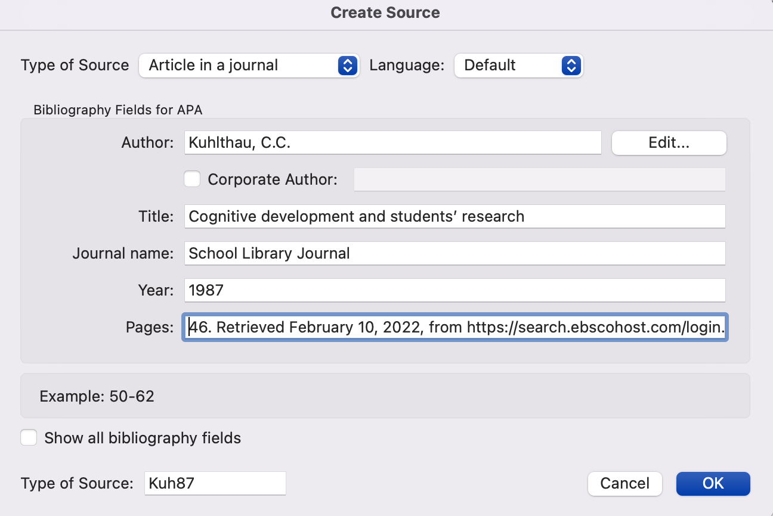
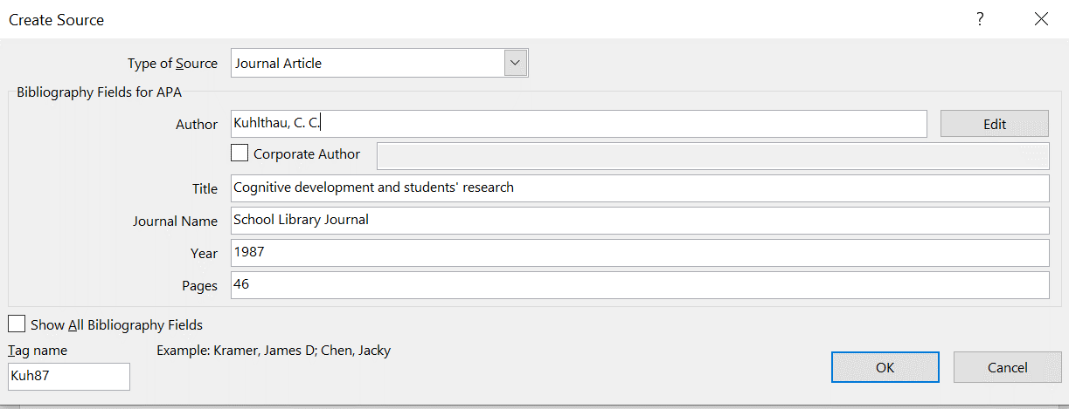

Slide 31
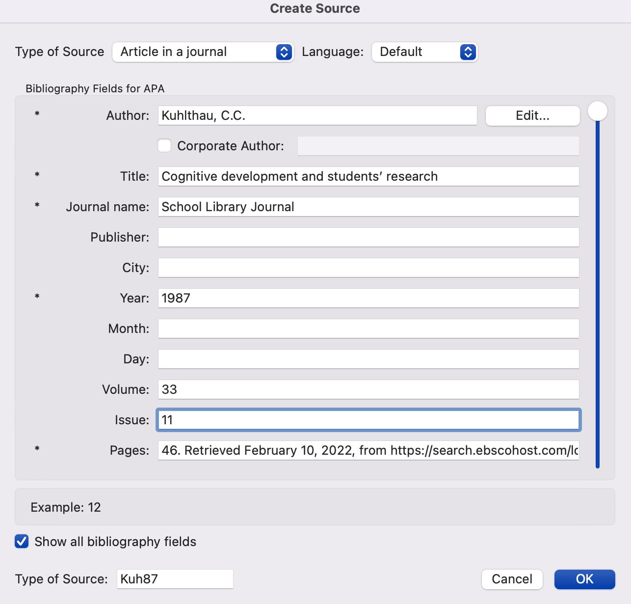
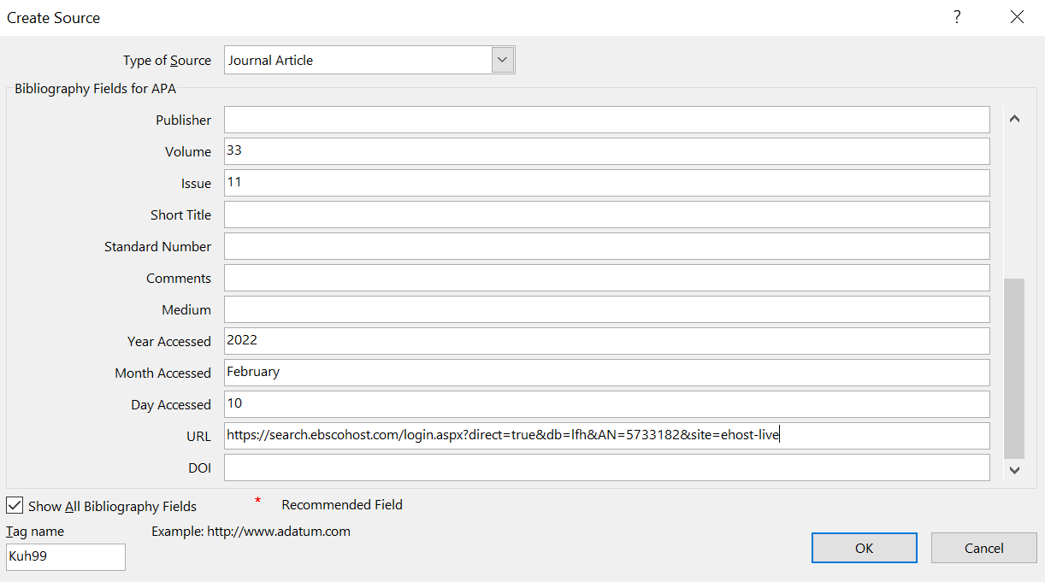

Slide 32
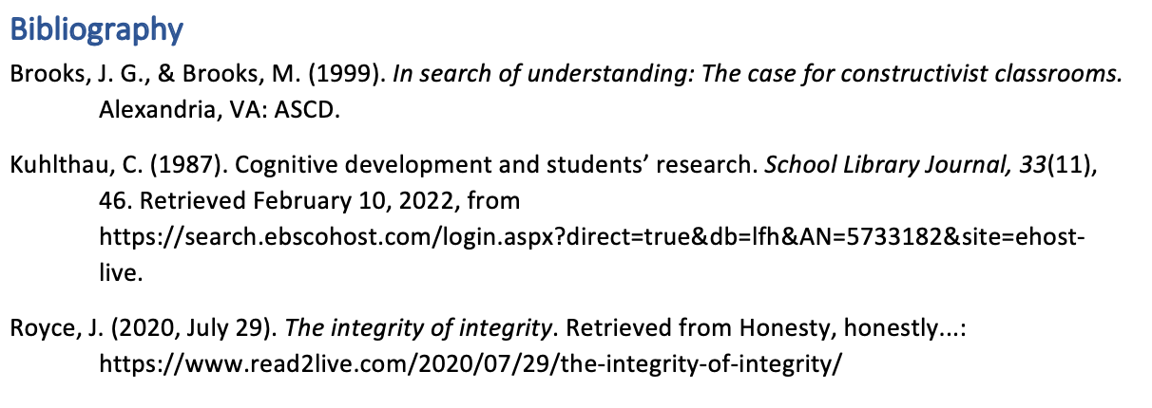

Slide 33
Your
turn!

Slide 34
3. Writing with sources: Quotations
The move from academic honesty towards academic integrity is important because “integrity is about more than just writers being honest and citing their sources” (Royce, 2020).
Royce (2020) points out that “integrity is about more than just writers being honest and citing their sources”.
Brooks & Brooks (1999) contend that “[e]ducators must invite students to experience the world’s richness, empower them to ask their own questions and seek their own answers, and challenge them to understand the world’s complexities” (p.5).

Slide 35
3. Writing with sources: Quotations
“But (academic) integrity is much more than just about (academic) honesty. Academic honesty smacks of citing sources because if we do not do this, we get punished. It is the choice of the writer. It could be poor work habits, ignorance, misunderstanding or other factors which lead to failure to cite sources, but in the academic world, plagiarism is plagiarism, intentional or not.
Academic integrity, though. There are no contexts with academic integrity. When we use the work of other people, we cite our sources without needing to think about it. We say, as a matter of honour, this is not mine. ”
Your
turn!
(Royce, 2020)

Slide 36
3. Writing with sources: Paraphrase & summary
“Educators must invite students to experience the world’s richness, empower them to ask their own questions and seek their own answers, and challenge them to understand the world’s complexities” (Brooks & Brooks, 1999)
Brooks & Brooks (1999) stress how important it is for educators to give students the opportunity to explore complex, real-world inquiries through their own authentic questions.
NOT:
Brooks & Brooks (1999) say that teachers must encourage pupils to experience how rich the world is, give them the power to ask questions for themselves and look for their own answers.

Slide 37
3. Writing with sources: paraphrase & summary
“But (academic) integrity is much more than just about (academic) honesty. Academic honesty smacks of citing sources because if we do not do this, we get punished. It is the choice of the writer. It could be poor work habits, ignorance, misunderstanding or other factors which lead to failure to cite sources, but in the academic world, plagiarism is plagiarism, intentional or not.
Academic integrity, though. There are no contexts with academic integrity. When we use the work of other people, we cite our sources without needing to think about it. We say, as a matter of honour, this is not mine. ”
Your
turn!
(Royce, 2020)

Slide 38
Further support
Ask in the Library
Try Purdue OWL (Look for APA 6th Edition in the menu on the lefthand side of the screen)
Try this guide I made at a previous school: https://oakham-rutland.libguides.com/APAReferencing

