Slide 1
Inquiry as Mindset, Skillset and Toolset
Year 13 French Individual Research Project
10 February 2023
Blanchelande College Senior Library
librarian@blanchelande.sch.gg

Slide 2
Paper 3: Individual Research Project

Slide 3
Paper 3: Individual Research Project

Slide 4
Paper 3: Individual Research Project

Slide 5
Paper 3: Individual Research Project

Slide 6
Paper 3: Individual Research Project

Slide 7
Paper 3: Individual Research Project
In Part two the student will present the findings of his or her research for up to two minutes. This will be followed by a discussion of the findings of the student’s research.
…
Students will provide in advance on the Research project form a list of headings to indicate the scope of their research and the sources used. Apart from the names of published sources, any headings must be in English. The teacher may help the student to complete the form. Students must use at least two sources and at least one of them must be an online source.
Apart from the two required sources, any remaining sources and/or headings must not exceed 80 words. Sources could be visual, audio or written (in any combination) and must be capable of leading to findings that will form the basis of a 9–10 minute discussion.

Slide 8
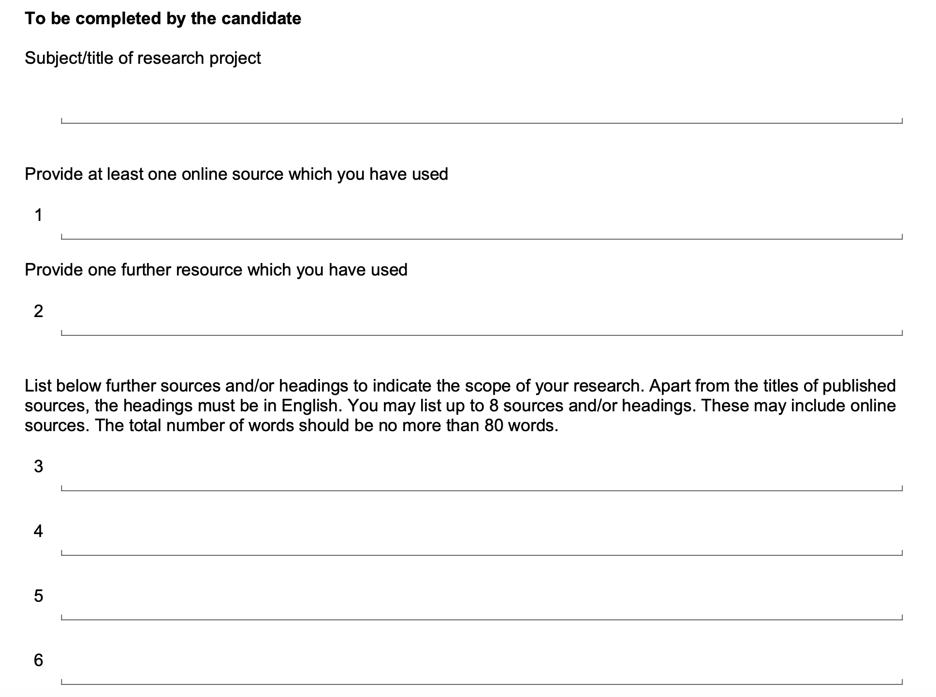
Use a site like https://tinyurl.com to shorten long URLs
During the presentation and discussion of their research project, students may only have access to their completed Candidate Record form. No other notes are allowed.

Slide 9
Paper 3: Individual Research Project

Slide 10
Paper 3: Individual Research Project
Have I thought about what questions I might be asked?
Have I been collecting interesting vocabulary and idiom during my research?
Have I used plenty of audio sources to improve my pronunciation?
Have I developed some arguments and drawn some evidence-based conclusions?

Slide 11
Paper 3: Individual Research Project
Am I ready to defend my arguments? What evidence will I use?

Slide 12
FOSIL as a mindset
Notes:
FOSIL is an instructional model of the inquiry process based on the work of Barbara Stripling as expressed in the ESIFC.
FOSIL as a dynamic process is the outworking of FOSIL as an inquiry stance as expressed in the tagline, Learning by finding out for yourself (and crucially not by yourself, which suggests minimal or no guidance and/ or interventions).

Slide 13
FOSIL as a skillset
Notes:
The aim of any formal inquiry is not just to assess what you have come to know and understand, but also how you have come to know and understand, which is dependent on skills. Being aware of these skills, and where they occur in the inquiry process, will help you through the process, which will both benefit your product and help you to reflect on the process.

Slide 14
Connect

Slide 15
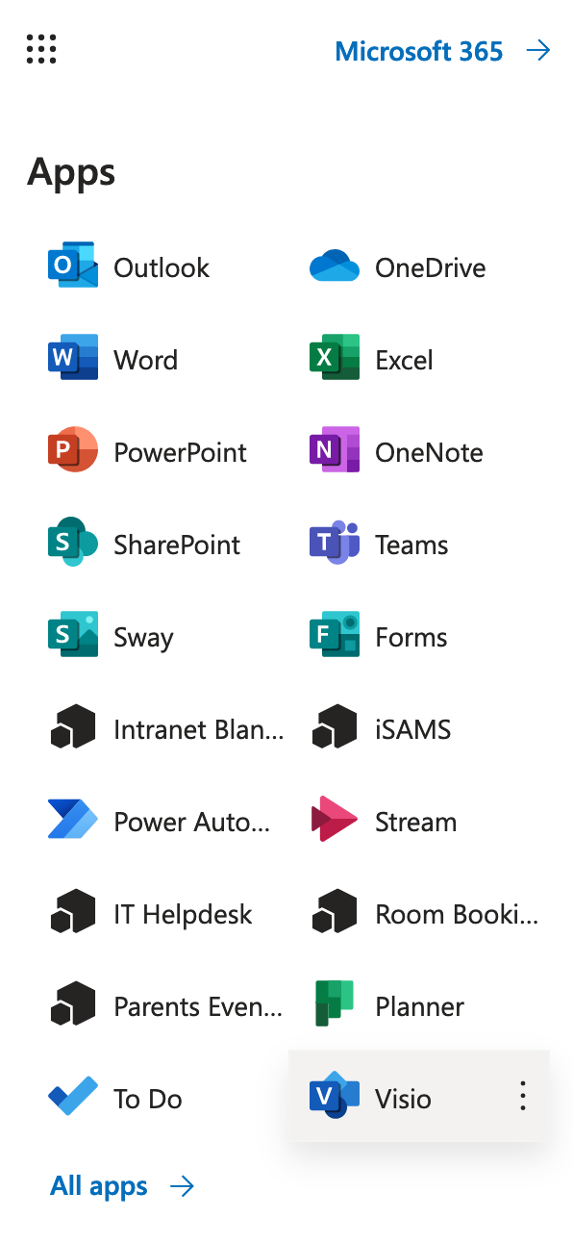
What should my topic headings be?

Slide 16
Wonder

Slide 17
What kinds of questions might the examiner ask me?
But some people believe ... what do you think of that?
What about....., for example?
When you say…what exactly do you mean?
Where did you find your information?
What was the most interesting thing you discovered in your research?
How do you react to that?
Why did you choose this topic?
Tell me more about...?
How do you feel about that?
What if I said that...?
Do you think that is really true?

Slide 18
Specific questions relating to my topic?

Slide 19
Investigate

Slide 20
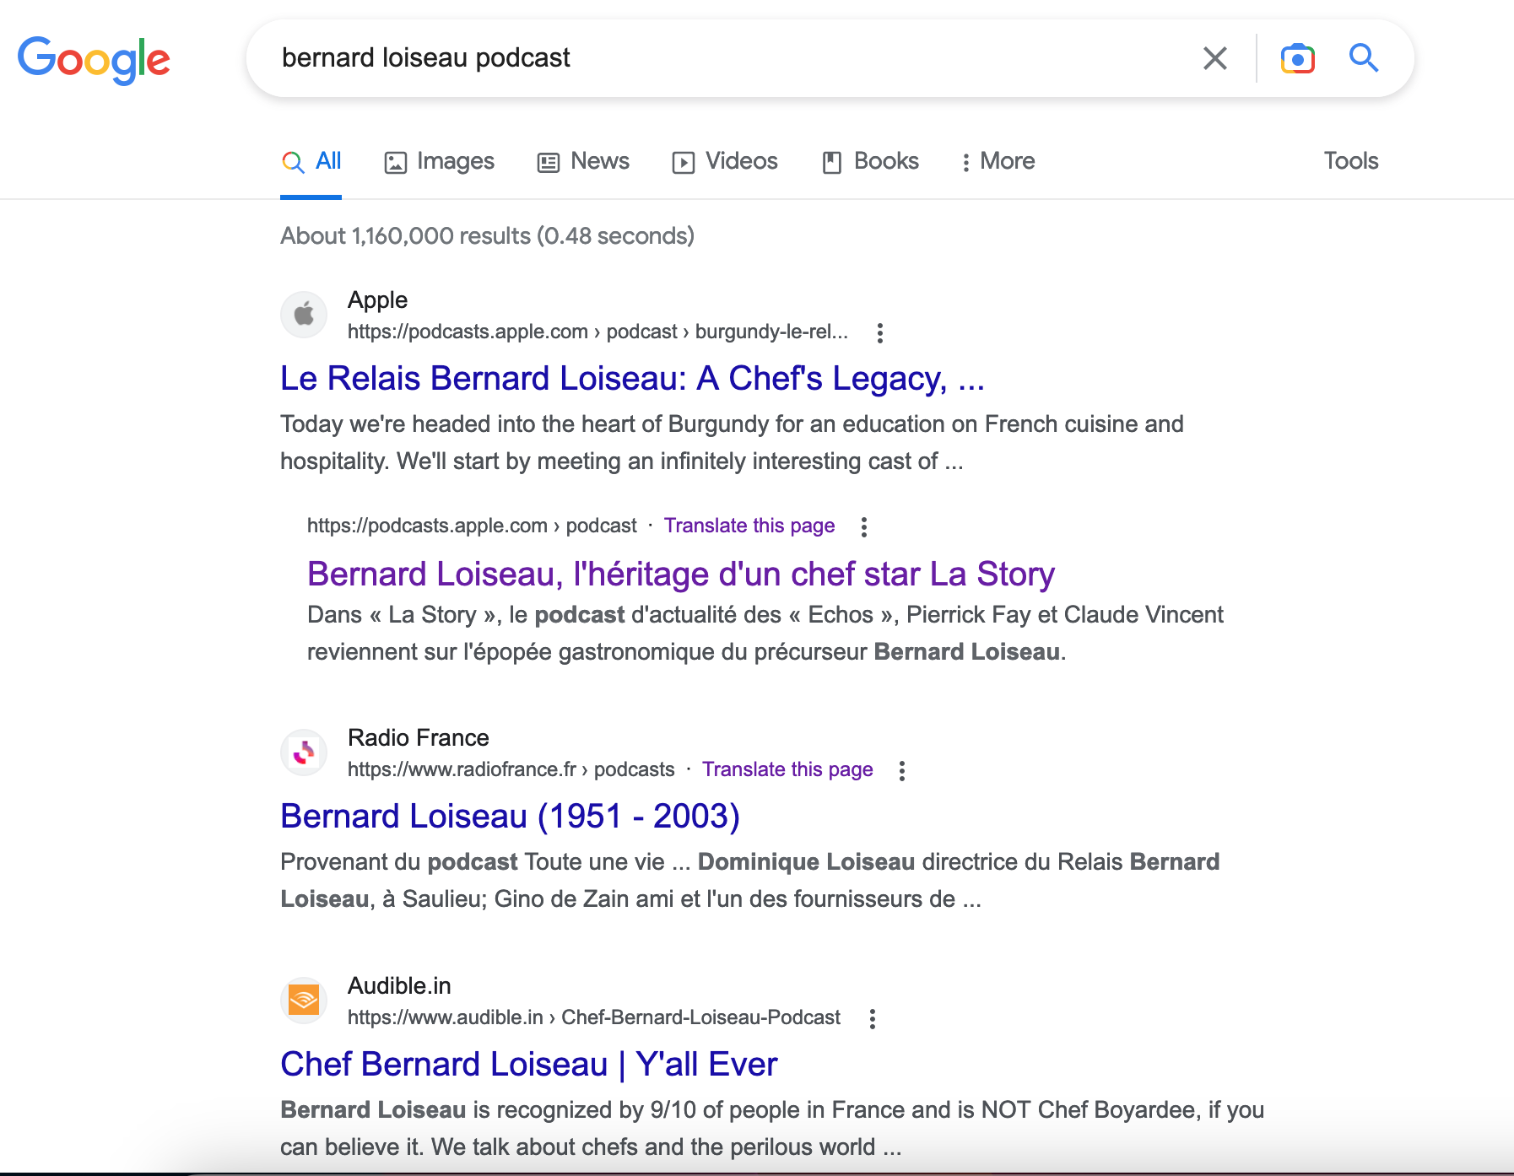
Investigative sources: podcasts

Slide 21
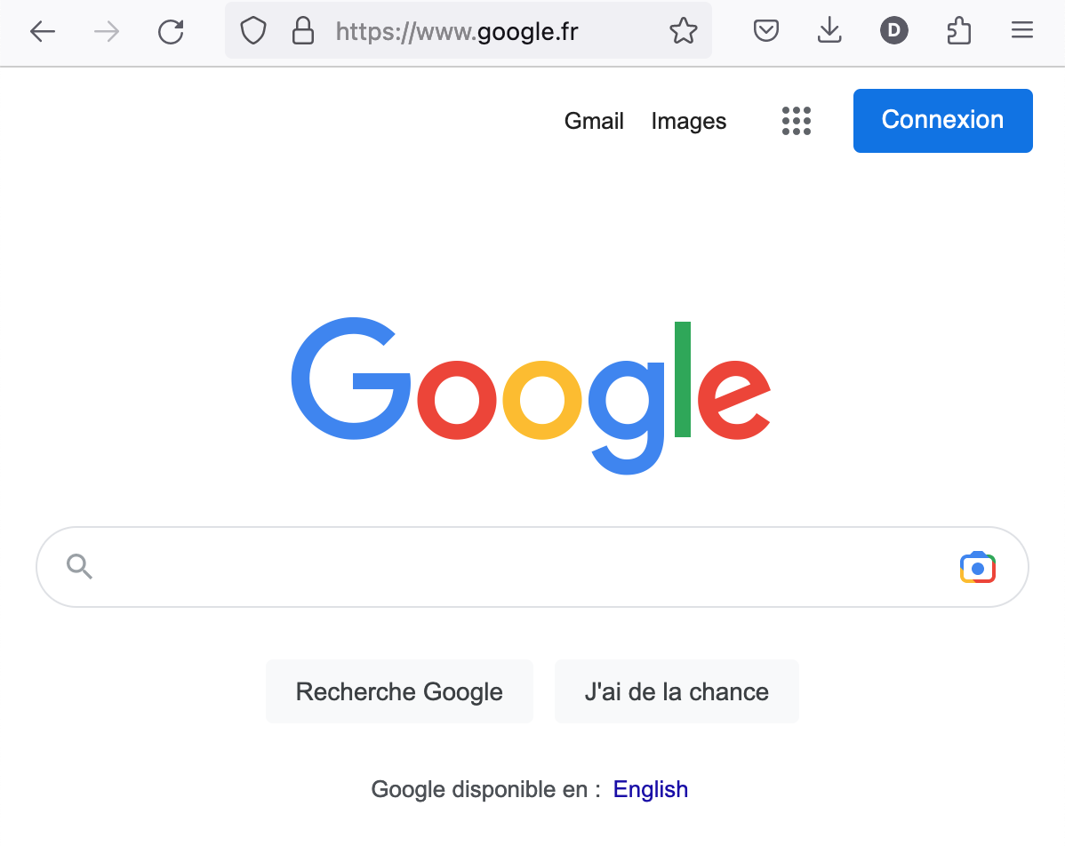
Investigative sources: French websites

Slide 22
Investigative sources: French websites

Slide 23
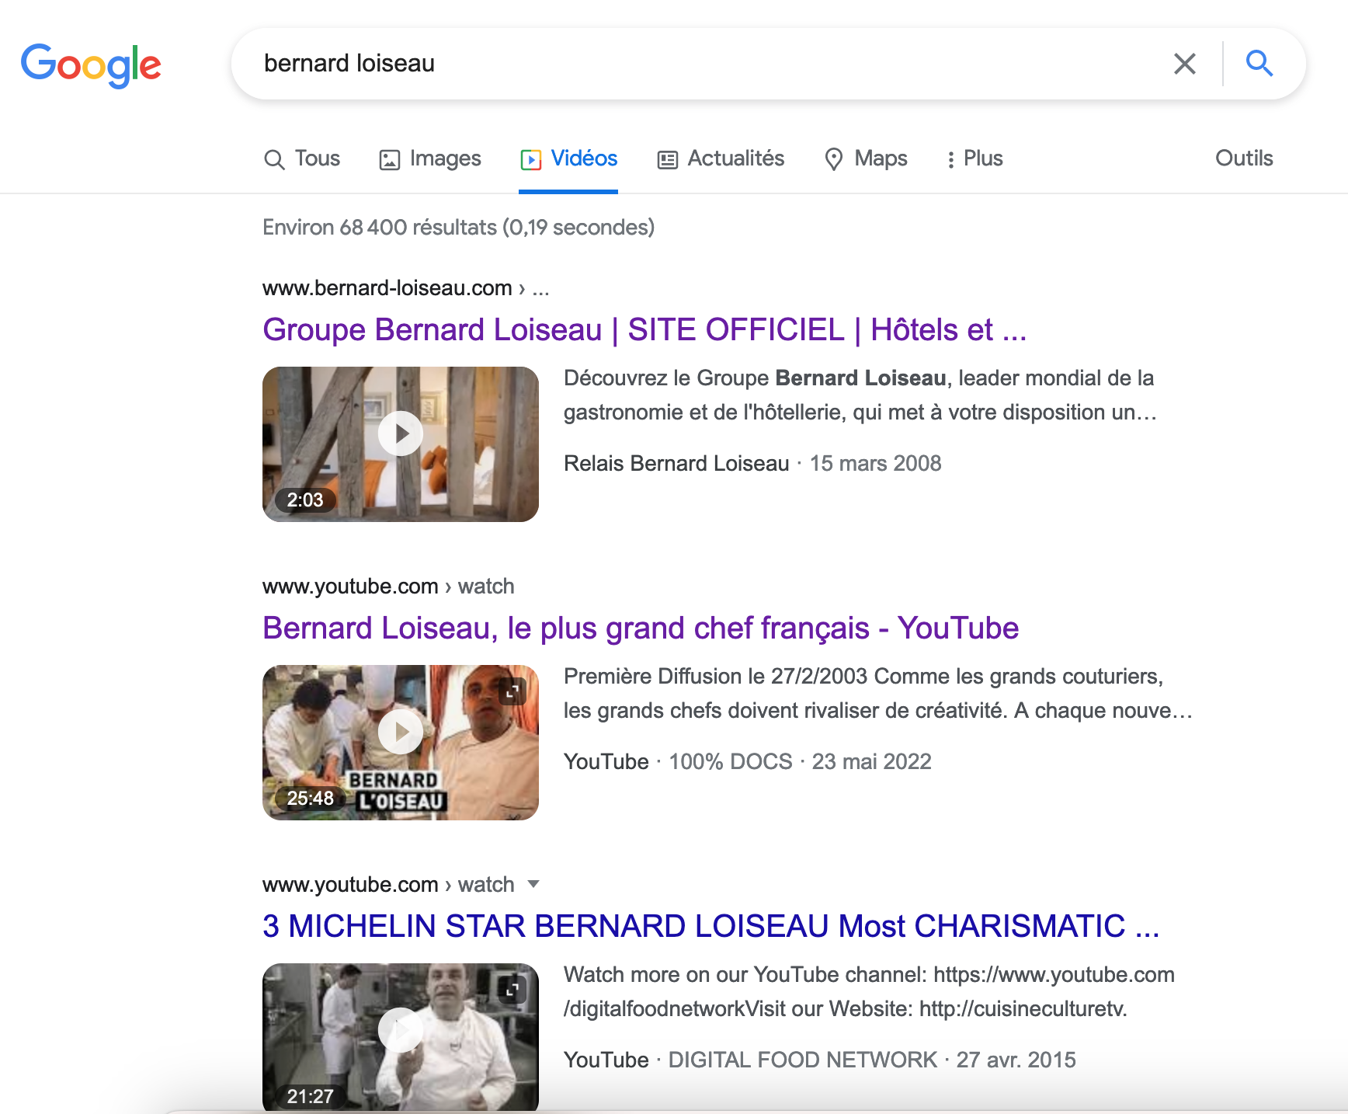
Investigative sources: French videos
Could you add other keywords to your search, relating to your headings?
Remember that if you are searching Google.fr these should be in French!

Slide 24
Investigative sources: Newspapers and magazines
https://blanchelande.libguides.com/Library/Home

Slide 25
Investigative sources: Newspapers and magazines

Slide 26
Investigative sources: Newspapers and magazines

Slide 27
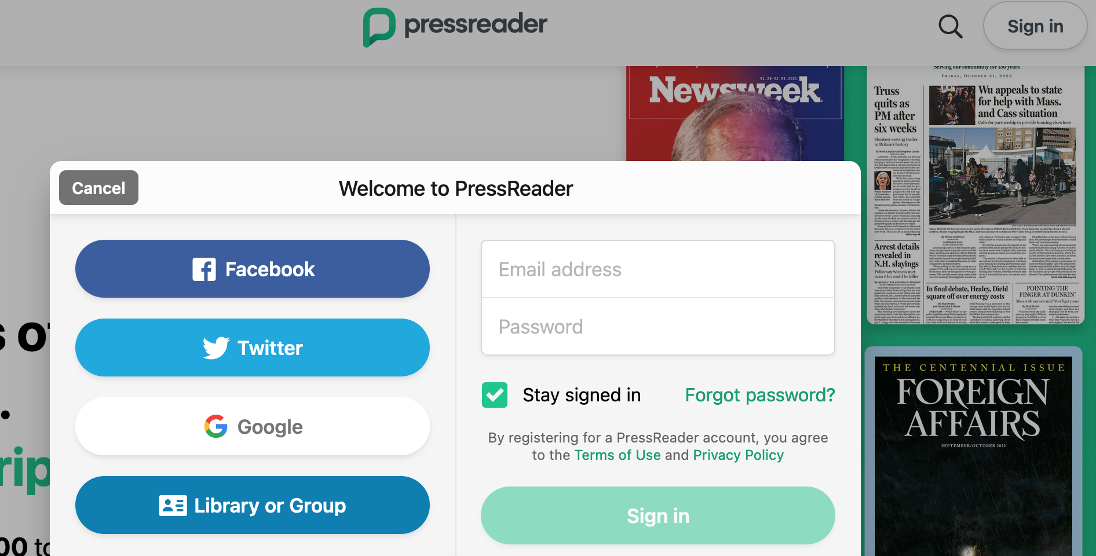
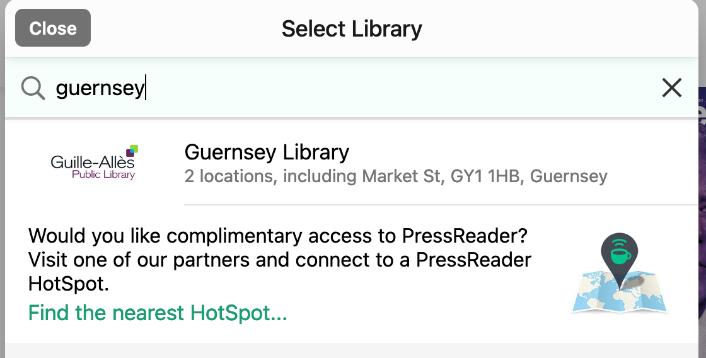
Investigative sources: Newspapers and magazines

Slide 28
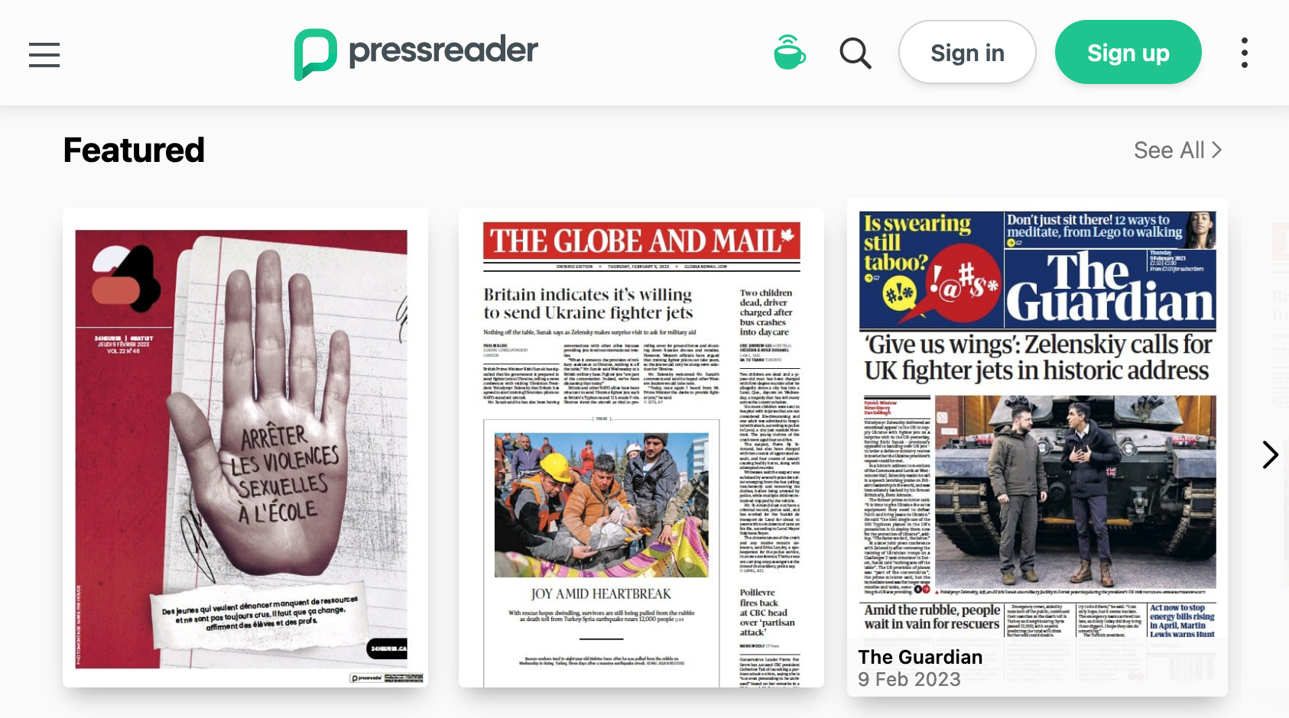
Investigative sources: Newspapers and magazines

Slide 29
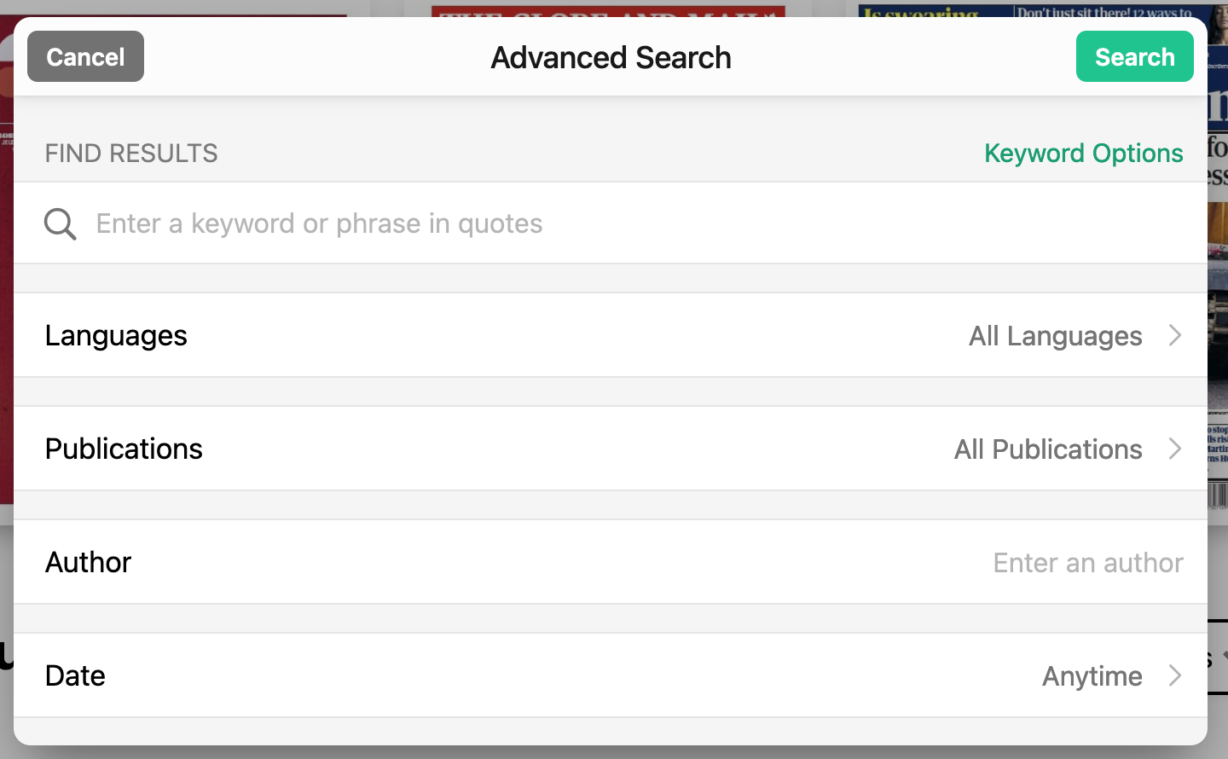
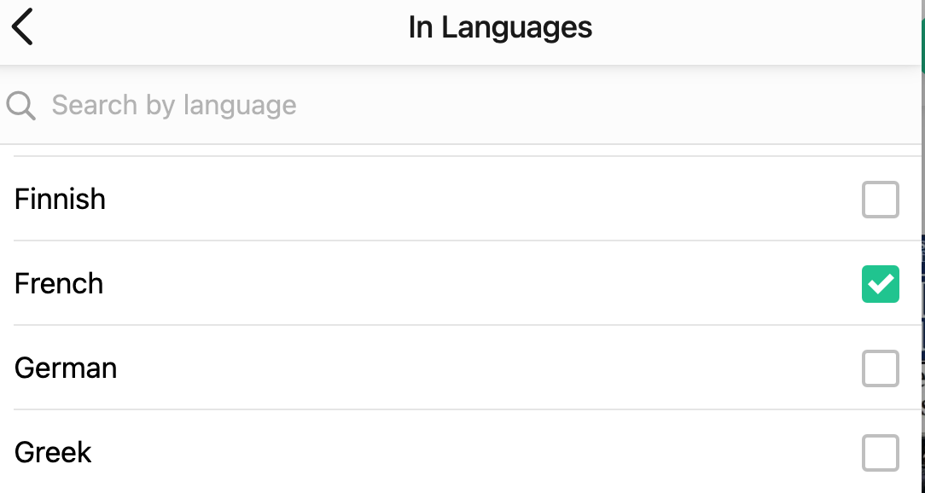
Investigative sources: Newspapers and magazines

Slide 30
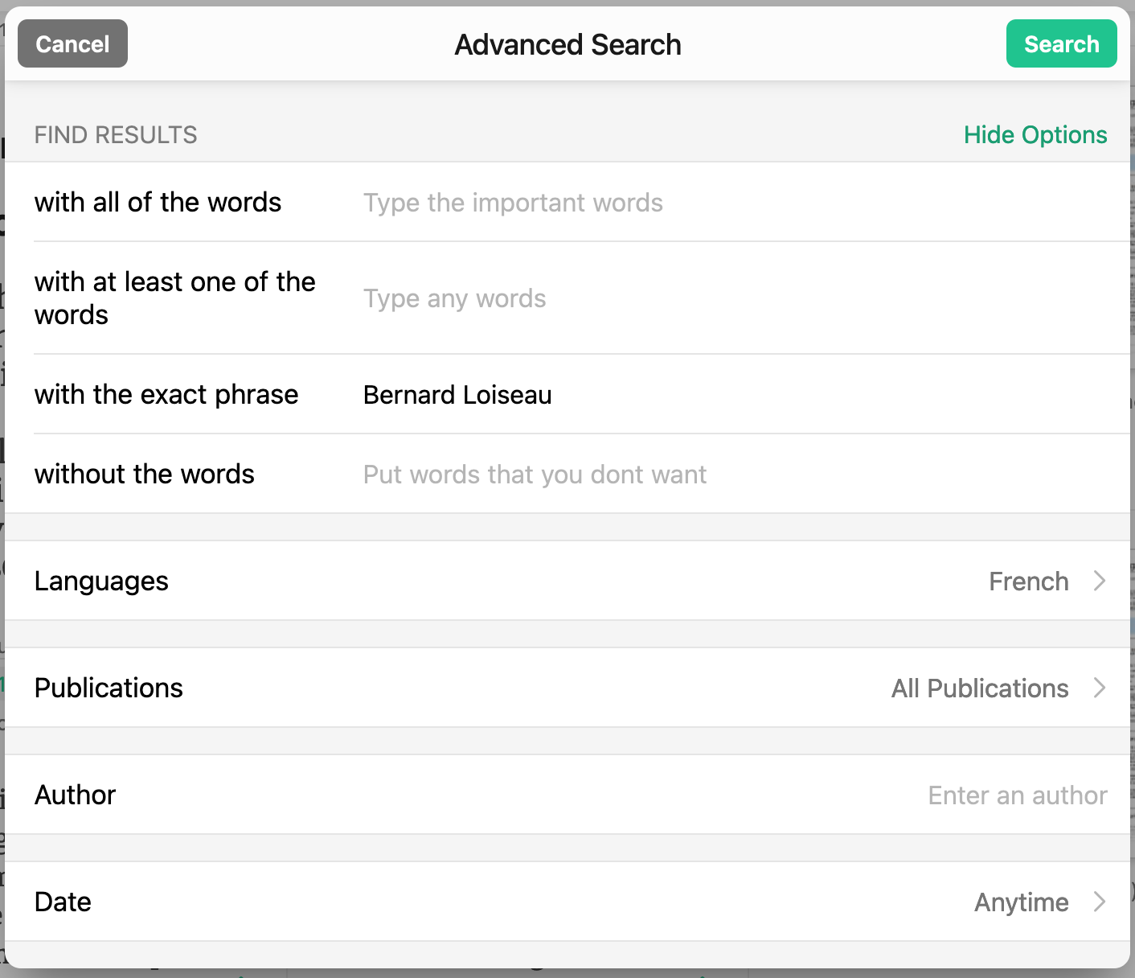
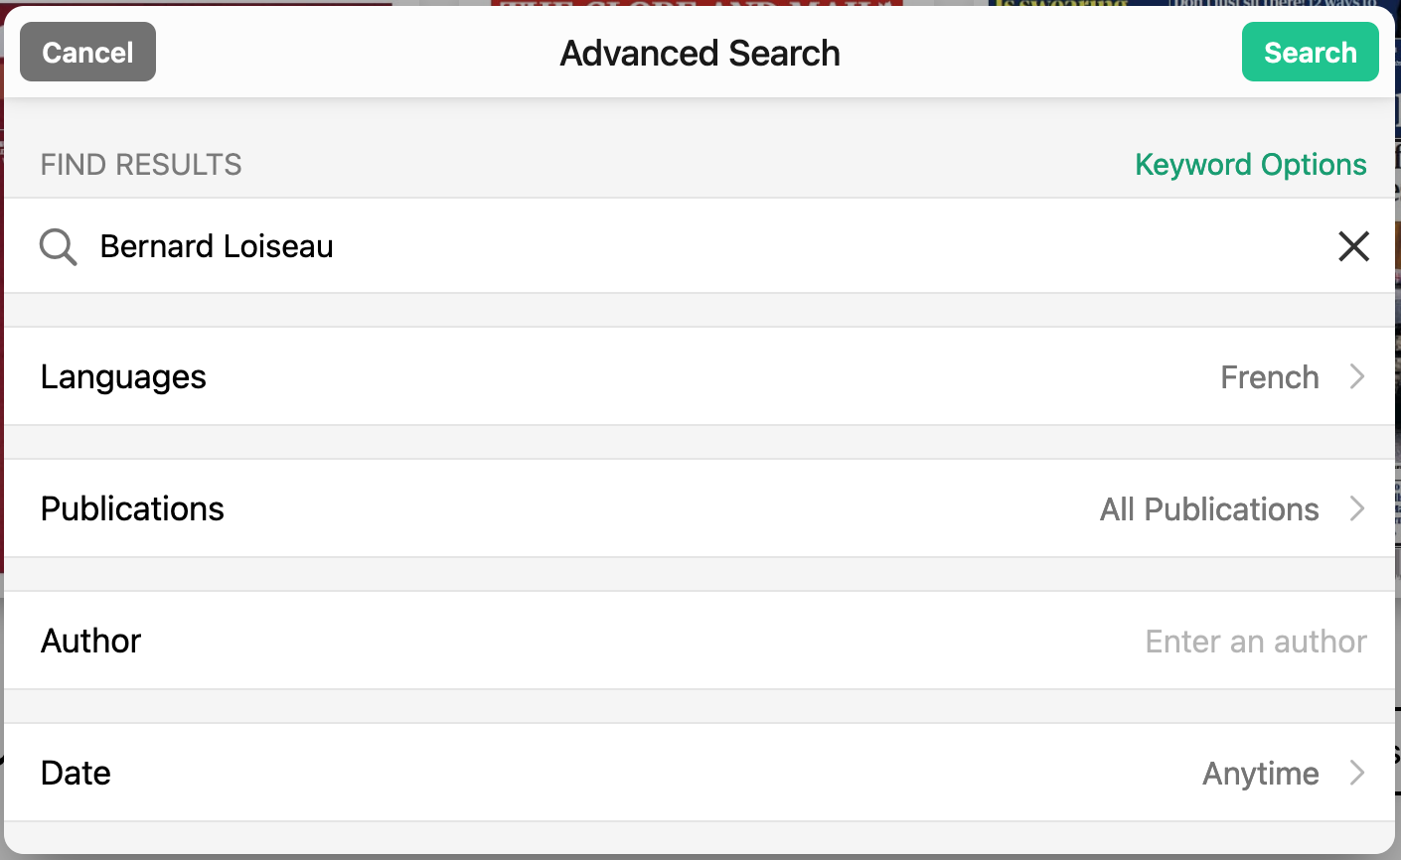
Investigative sources: Newspapers and magazines
15,071 results!!
Around 8,000 results!!

Slide 31
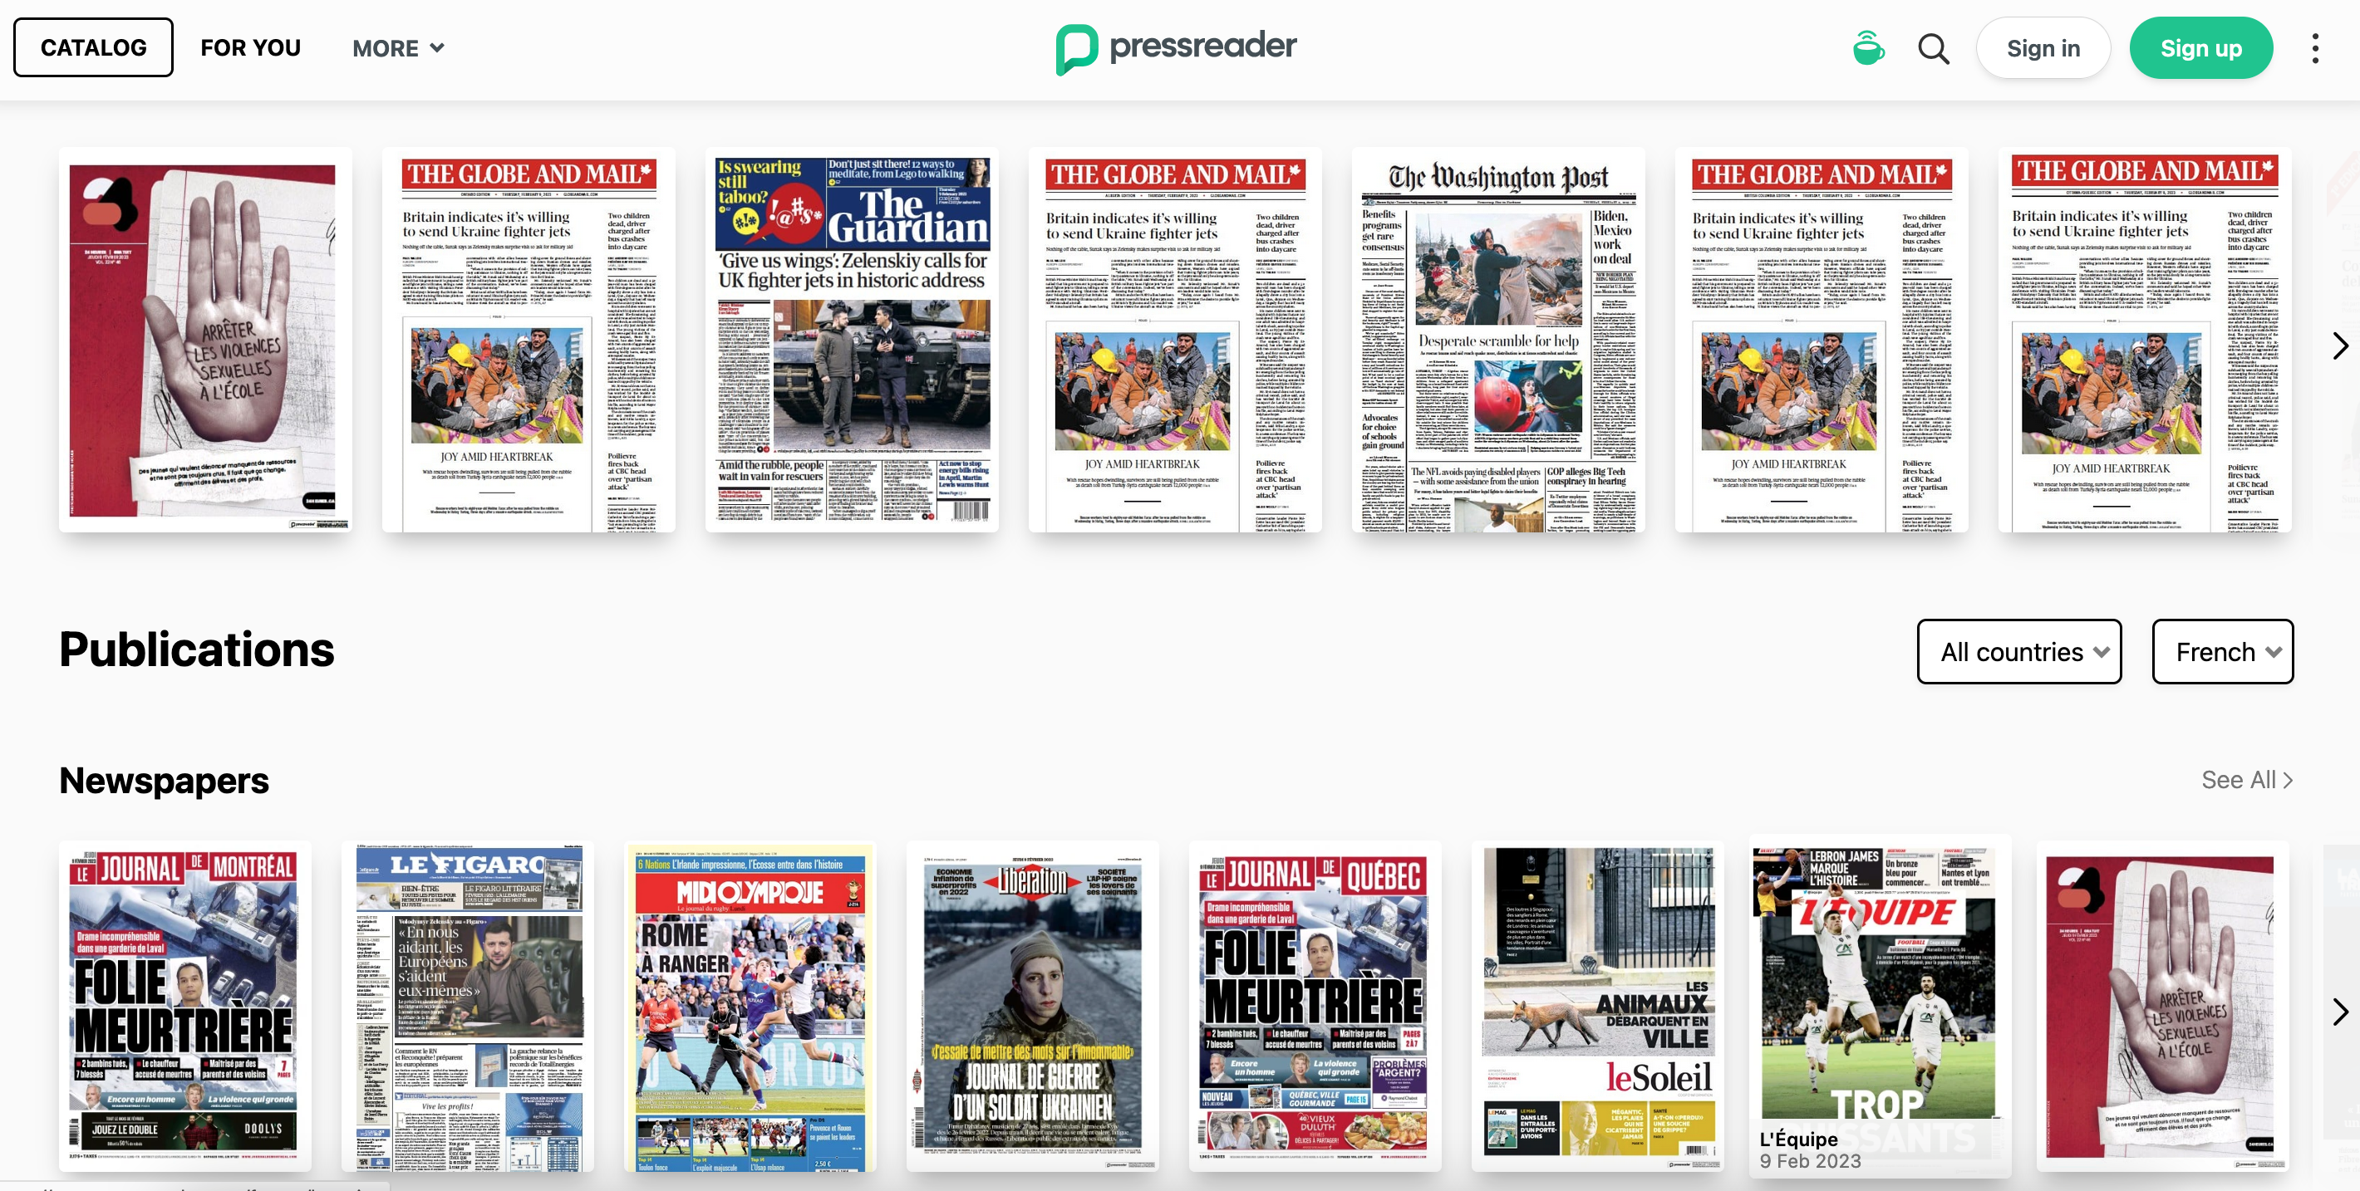
General browsing…

Slide 32
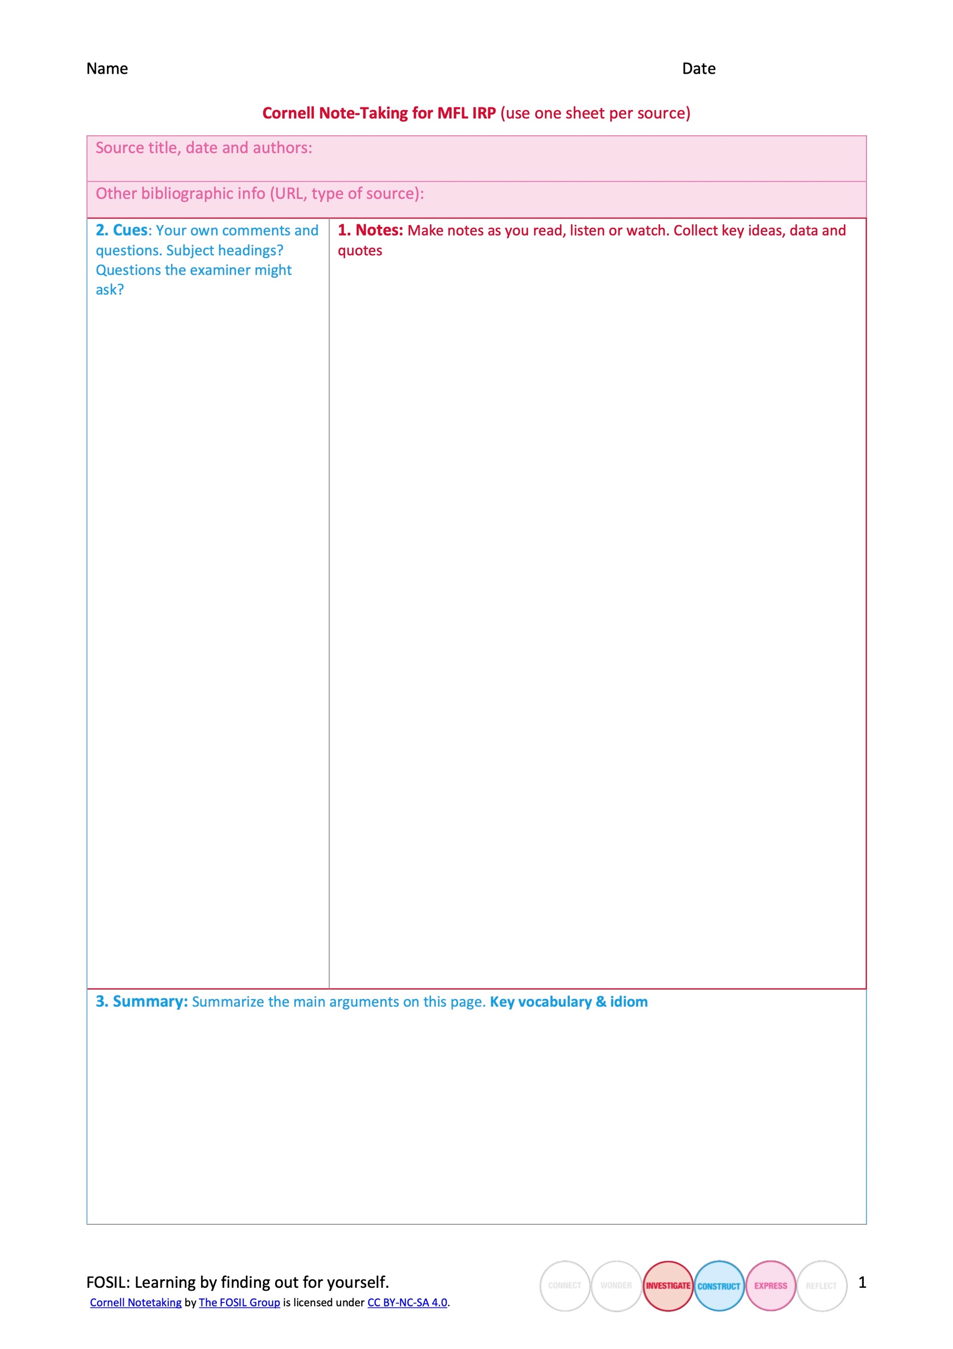

Slide 34
Construct

Slide 36
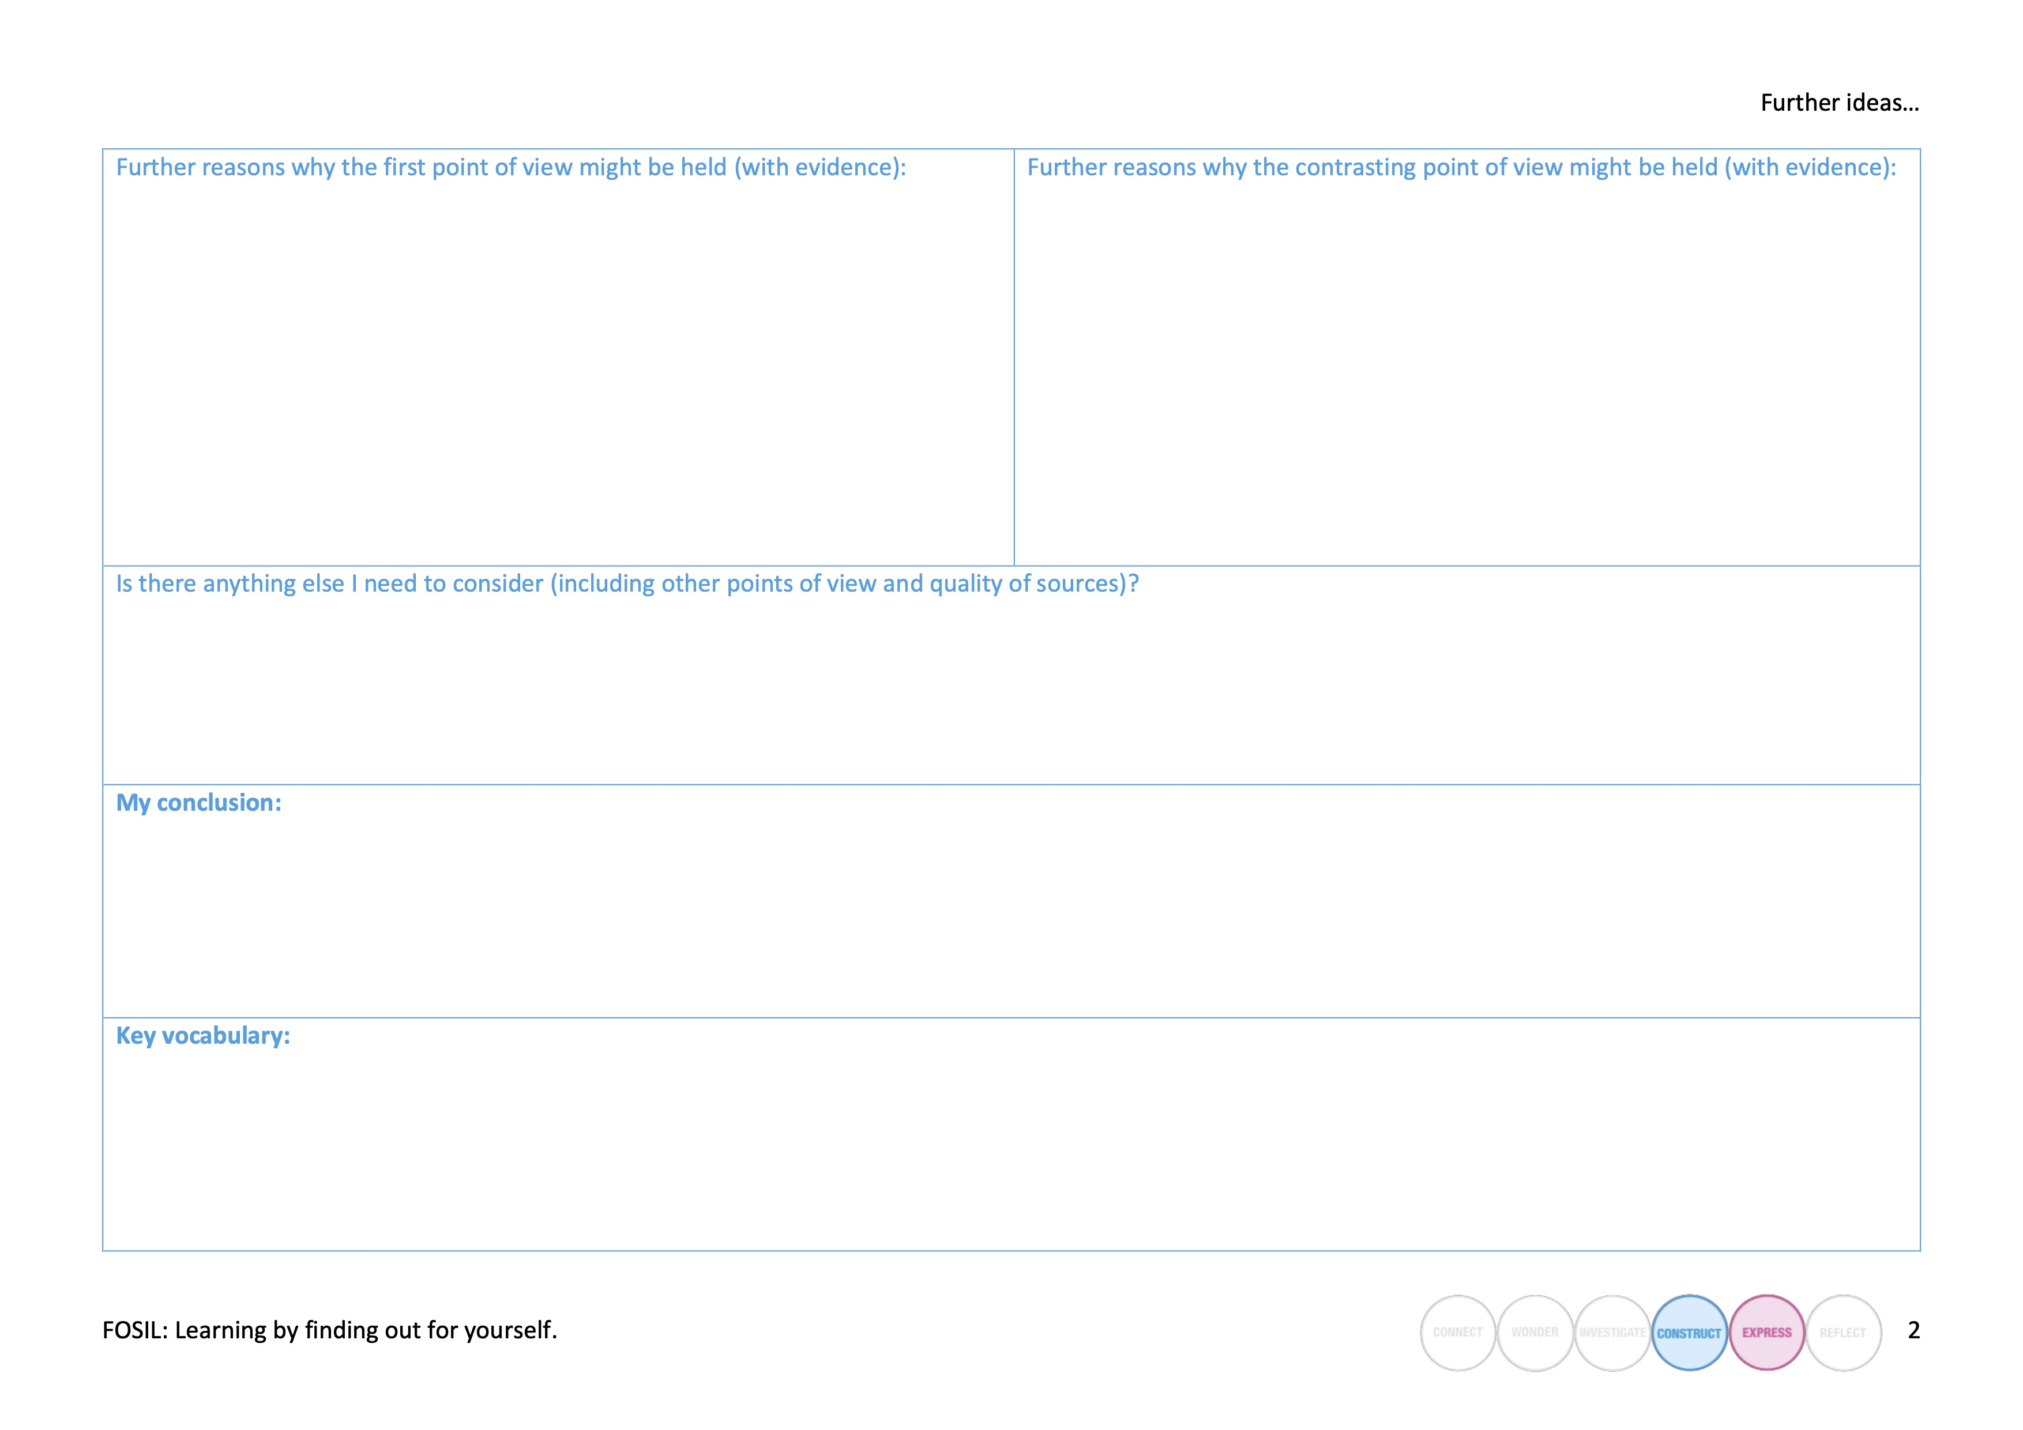

Slide 37
Express

Slide 38
Reflect

Slide 39
FOSIL and the Information Search Process

Slide 40
FOSIL as toolset
Key sources:
Search term Podcasts
https://google.fr , particularly video section
Press Reader (Guernsey Library login)
Use a site like https://tinyurl.com to shorten long URLs
Cornell notetaking
Research organiser
Click document image to download a copy!
Remember to also keep a record of:
Key topic headings
Questions the examiner might ask

