Slide 1
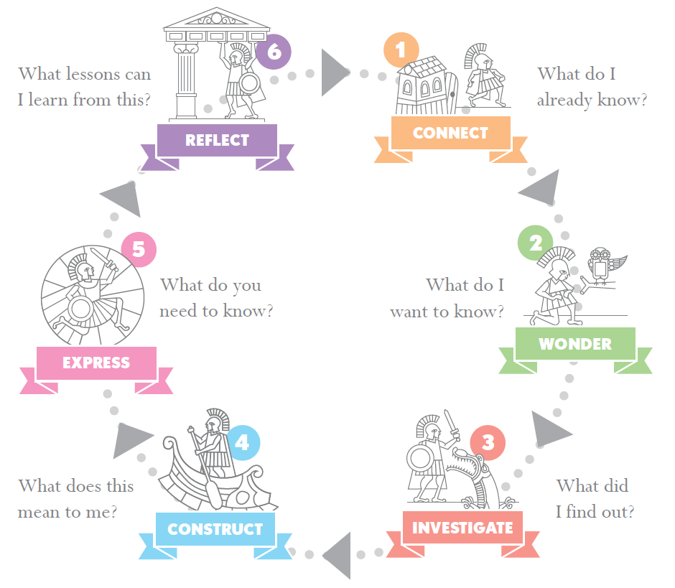
Y7 & Y8 Maths inquiries
Summer 2023

Slide 2
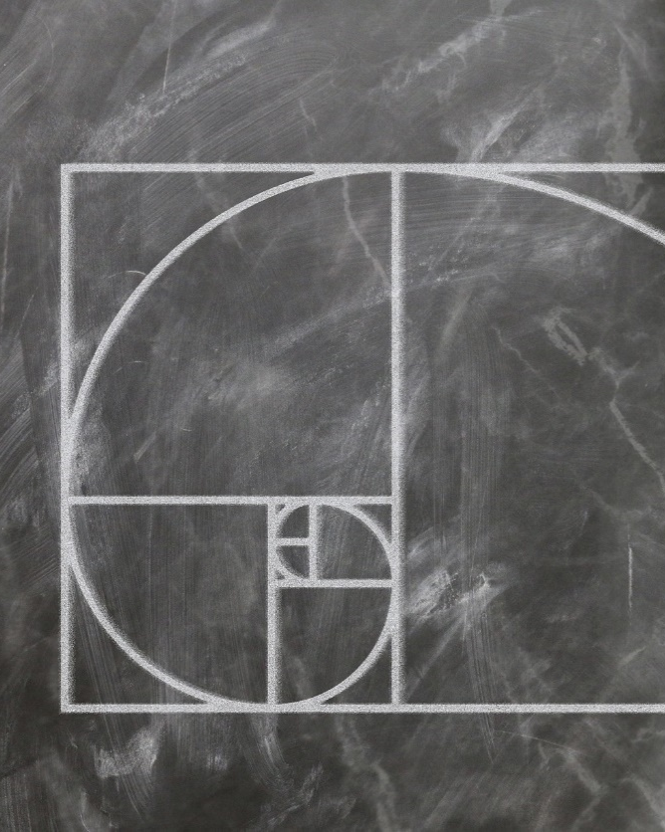
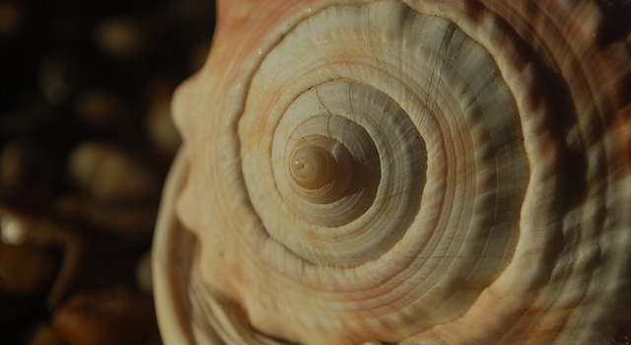
Year 7: Fibonacci
1 1 2 3 5 8 13 21 34 55 89 …
Can Maths help me get better at Art?
Notes:
Image by Gerd Altmann from Pixabay, Harald Landsrath from Pixabay, Dean Marston from Pixabay

Slide 3
Lesson 1 CONNECT | Introduction to Fibonacci sequence. Constructing sequence. Drawing Golden Spiral.
Lesson 2 CONNECT & WONDER | USING RESOURCES: Exploration of instances of Fibonacci sequence in nature (and art?) Looking at pictures in Library books or printed
Lesson 3 INVESTIGATE | OUTDOOR LEARNING: How many instances of Fibonacci numbers can you find outside? Counting petals and leaves, looking for snail shells
Lesson 4 INVESTIGATE | Introduce the Golden Ratio PRACTICAL INVESTIGATION: The Golden Ratio in the human body
Lesson 5 CONSTRUCT & EXPRESS | Design and make poster to answer the question ’Can Maths help me get better at Art?’, using what you have found out about Fibonacci sequences. Must all be hand drawn but could use printed images to copy. If any posters aren’t completed could keep them in the Library to work on for prep?
Lesson 6 REFLECT | Showcase of completed posters. Reflection/ peer marking on each others’ work and on inquiry question. Extension ideas: Writing a Fib poem, videos on Fibanacci sequence, Fibonacci & music

Slide 4
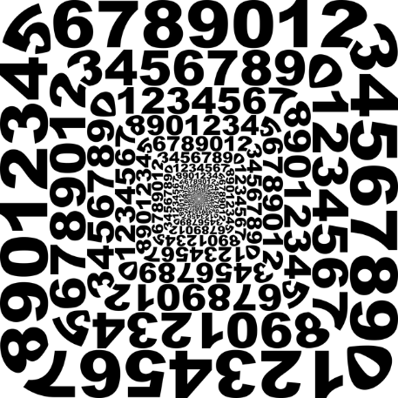
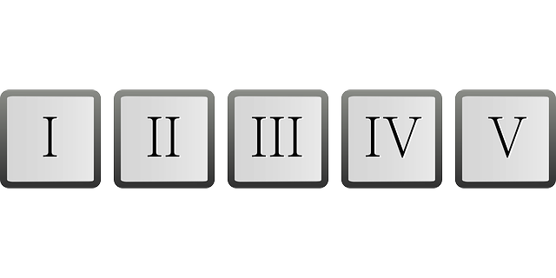
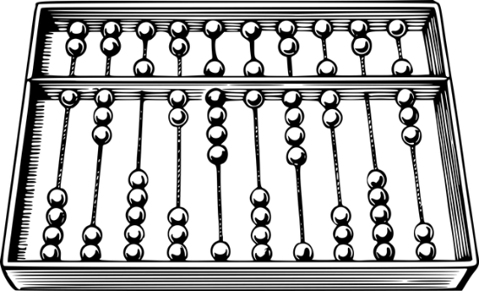
Year 8: International maths
Is Maths a universal language?
Notes:
Image by Yuri from Pixabay, Clker-Free-Vector-Images from Pixabay, Image by Tumisu from Pixabay, Image by OpenClipart-Vectors from Pixabay, Image by Gordon Johnson from Pixabay

Slide 5
Lesson 1 CONNECT & WONDER | Introduction to topic and generating questions. Investigating names for numbers in different languages. Could move on to different counting systems.
Lesson 2 CONNECT | Investigating different numerals and counting systems
Lesson 3 CONNECT & INVESTIGATE | Placing famous mathematicians from around the world on a map. Thinking about gender and time period as well. Choosing one mathematician to investigate (homework to gather resources – introduction to databases)
Lesson 4 INVESTIGATE | Investigating and making notes on their mathematician – how did their Maths influence the world? Do we still use it in our lives today?
Lesson 5 CONSTRUCT & EXPRESS | Use the evidence gathered to answer the question ‘Is maths a universal language?’ Produce a poster in a group (AND cue cards on their individual mathematician)
Lesson 6 EXPRESS & REFLECT | Poster showcase with short talks on each mathematician. Individual reflection.

