Slide 1
Recovering the Educational Promise of Inquiry IASL 2023 Extended Workshop 17 July 2023 Darryl Toerien​ | Jenny Toerien toeriend@blanchelande.sch.gg | toerienj@blanchelande.sch.gg
Blanchelande College Libraries
Enabling Heroic Inquiry

Slide 2
An Introductory and Concluding Question
What do you do that AI could not do, or could not do better.
Brother George Van Grieken
Secretary Coordinator of Lasallian Research and Resources for the Institute
https://lasallian.info/brother-george-van-grieken-to-lead-research-and-resources-in-rome/

Slide 3
Presenters
Darryl Toerien
Jenny Toerien
Head of Inquiry-Based Learning at Blanchelande College
MA (equivalent) in Philosophy​
Taught Computer Science and Religion & Philosophy​
MA Information & Library Management
Originator of FOSIL (2011), based on ESIFC (see next)
Originator of the FOSIL Group (2019)
Co-opted Board Member of the UK School Library Association (SLA)
Elected member of the IFLA School Libraries Section Standing Committee
Member of IASL
College Librarian and Project Qualifications Coordinator at Blanchelande College
MA in Mathematics​
Taught Physics​
MSc Information Science​
Collaborator on FOSIL (2011)
Founding member of the FOSIL Group (2019)
Member of the UK School Library Association (SLA)

Slide 4
Acknowledgements
Reuben Toerien
IASL 2019 and 2023

Slide 5
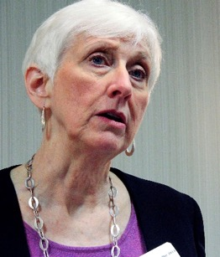
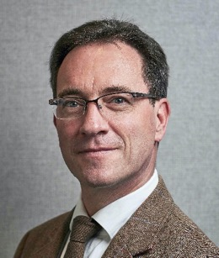
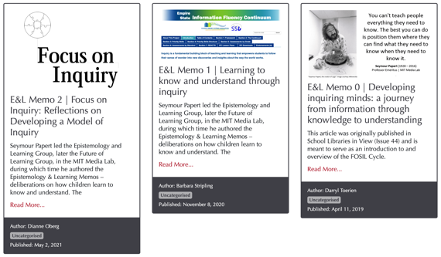
Collaborators
Barbara Stripling …
… Darryl Toerien
Professor Emerita, School of Information Studies, Syracuse University
Co-originator of the Research as a Thinking Process model and REACTS Taxonomies (1988)
Originator of Stripling’s Model (2003)
Originator of the Empire State Information Fluency Continuum (2009, reimagined 2019)
FOSIL Group member (2020)
Weekly meetings (2020 – Present)
The Day 2021
Thoughtful REACTionS to The Day: Framing Inquiry-Based Learning​
CILIP SLG 2021
Reading and the Information-to-Knowledge Learning Process​
UK SLA 2021 Keynote
Inquiry: An Educational and Moral Imperative
IFLA SLS Midyear Meeting 2022 Keynote
Our Evolving Understanding of Inquiry: 1988-Present
Global Action for School Libraries: Models of Inquiry (2022)
The Stripling Model of Inquiry
FOSIL: Developing and Extending the Stripling Model of Inquiry
Deep Collaboration by Teacher and Librarian to Develop an Inquiry Mindset
Routledge Research in Media Literacy and Education series
Media Literacy in the Context of Inquiry (book proposal)

Slide 6
A Library Integral to the Educational Process Through an Inquiry-Centred Instructional Program
Blanchelande College Libraries
Enabling Heroic Inquiry

Slide 7
UK SLA Enterprise of the Year Award Entry

Slide 8
Re-Thinking the Idea of a School Library …
… as integral to the educational process.
History is the consequence of ideas.
Jacques Ellul (1989)

Slide 9
Your Idea of a School Librarian?
…The old man was peering intently at the shelves. 'I'll have to admit that he's a very competent scholar.'
'Isn't he just a librarian?' Garion asked, 'somebody who looks after books?‘
'That's where all the rest of scholarship starts, Garion. All the books in the world won't help you if they're just piled up in a heap.'
David Eddings, King of the Murgos
(1989, pp. 89-90)
The Librarian: Image by Paul Kidby from www.paulkidby.com.

Slide 10
Inquiry as a [most] Potent Survival Strategy
“Of all the ‘survival strategies’ education has to offer, none is more potent or in greater need of explication than the ‘inquiry environment.’”
Neil Postman & Charles Weingartner (1969, p. 36)

Slide 11
Inquiry as Integral to Non-Trivial Schooling
“Non-trivial schooling can provide a point of view from which what is {reality} can be seen clearly, what was as a living present, and what will be as filled with possibility.”
Neil Postman (1996, p. x)

Slide 12
Inquiry as Integral to Success
Two [of four] fundamental questions:
What is reality {what is}?
What you have to deal with.
What is success?
Dealing with reality.
Dallas Willard (1998)

Slide 13
Inquiry as Integral to Liberal Democracy
The Constitution of Knowledge – our social system and its underlying values for turning information into knowledge, and arguments into facts, and upon which liberal democracy rests – requires a reality-based community of error-seeking inquirers.
Jonathan Rauch (2021)

Slide 14
Building a Community of Inquiry
While inquiry necessarily involves “personal struggles to find the right questions and assemble mosaic tiles of information to tell the tale coherently … acquiring knowledge is a conversation, not a destination ... a process [or] journey we take together, not alone [because] others are always involved {both living and dead}”.
Jonathan Rauch (2021, pp. 3-4)

Slide 15
Inquiry: An Overarching Imperative
“Upon this first, and in one sense this sole, rule of reason
– that in order to learn you must desire to learn, and in so desiring not be satisfied with what you already incline to think –
there follows one corollary which itself deserves to be inscribed upon every wall of the city of philosophy: Do not block the way of inquiry.”
Charles Sanders Pierce (1955, p. 54)

Slide 16
Inquiry: An Educational and Moral Imperative
UK School Library Association 2021 Keynote Address
12 June 2021
Barbara Stripling | Darryl Toerien

Slide 17
Our Educational and Moral Purpose
Our educational purpose may be broadly understood in terms of the student’s information-to-knowledge journey.
Our moral purpose may be broadly understood in terms of the student’s personal, social, and cultural growth.
Notes:
Our educational purpose may be broadly understood in terms of the student’s information-to-knowledge journey, and our moral purpose may be broadly understood in terms of the student’s personal, social, and cultural growth.
While the educational purpose of the school library and its moral purpose are equally important, we would argue that the educational purpose must be our primary concern, because this forms the frontline of the battle for the continued existence of school libraries, and if we fail to hold the frontline we fall.
Also, the educational purpose is fundamental to the moral purpose – if we fail students in their information-to-knowledge journey, then their personal, social and emotional growth is stunted, perhaps permanently.

Slide 18
The Means to an Educational & Moral End
Without a pedagogical program – a planned comprehensive offering of teaching and learning activities – a school library will not accomplish is educational purpose, and therefore, its moral purpose.
IFLA School Library Guidelines (p. 18)
Notes:
Ruth Ann Davies: ‘The school library media program becomes an instructional source and force for excellence only when it functions as an integral support component of the total teaching-learning enterprise. The library media program and the educational program are interdependent and inseparable. … Therefore, perspective in viewing the function and role of the school library media program begins logically by building a historical understanding of education itself.’ (p. 13)

Slide 19
Our Inquiry-Centred Instructional Programme
Core instructional activities:
Literacy & reading promotion
Media & information literacy
Can be included in inquiry-based learning
Inquiry-based learning
Includes media & information literacy
Encompasses all instructional activities
Technology integration
Professional development for teachers
IFLA School Library Guidelines (p. 8)

Slide 20
Portrait of an Engaged and Empowered Inquirer at Grade 12 (Year 13)

Slide 21
Breaking the Promise of Inquiry #1, #2 and #3
Divorcing inquiry as a dynamic process and skills from learning important content
Reducing inquiry to a mechanical process by divorcing it from a spirit of wonder and puzzlement
Neil Postman (1979, p. 214)
Divorcing inquiry from both a spirit of wonder and puzzlement and a dynamic process, thereby reducing it to a thoughtless fact-finding activity

Slide 22
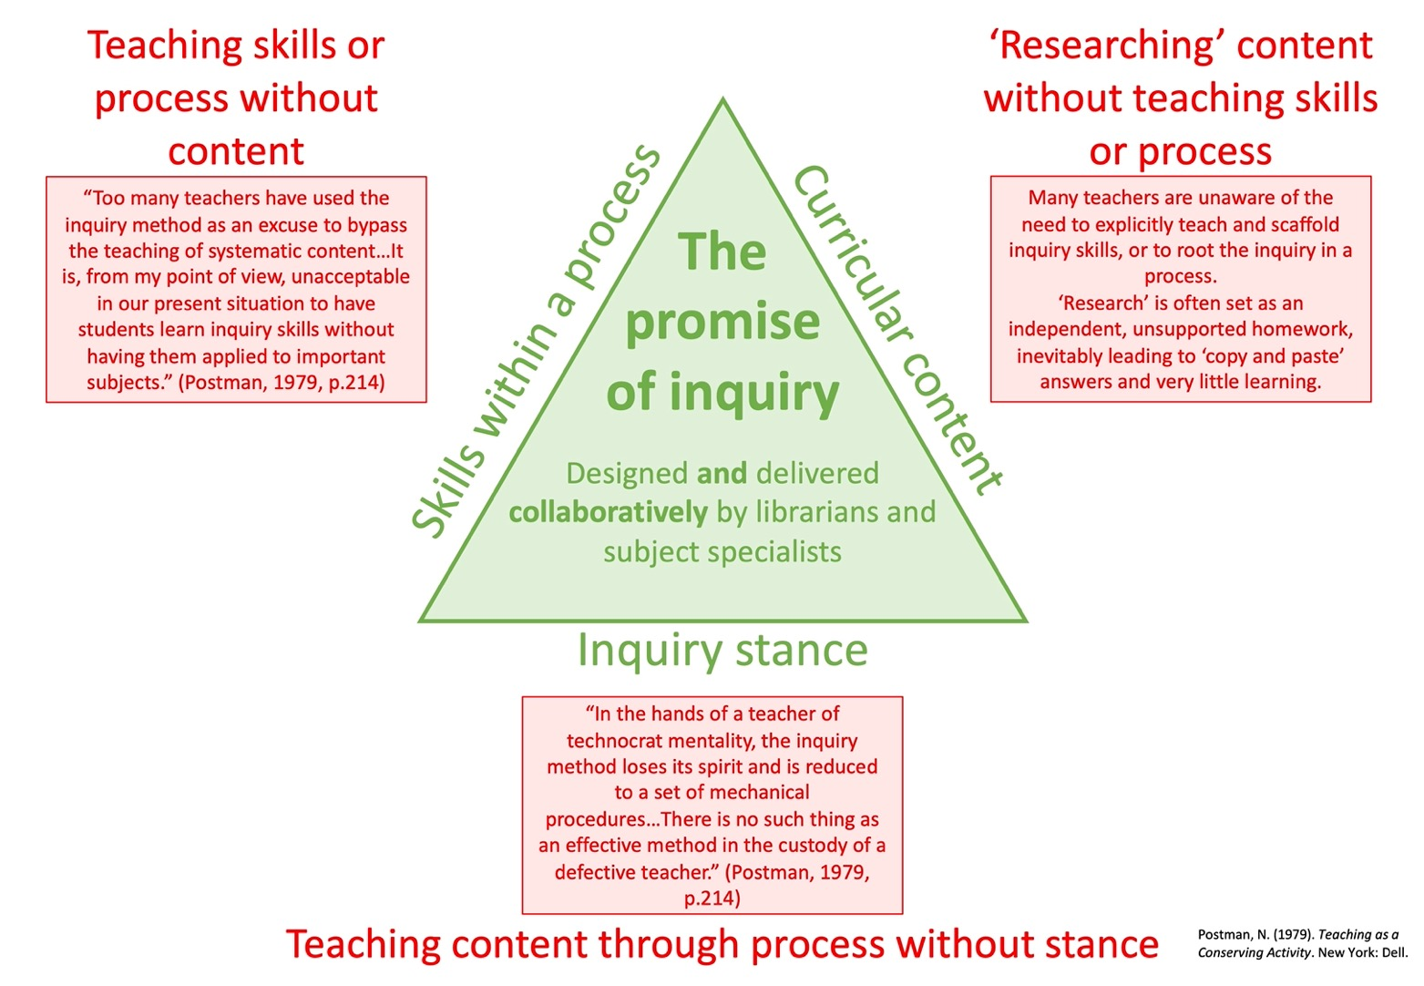
1.
3.
2.

Slide 23
Breaking the Promise of Inquiry #4
“The engineering of learning” through ever-more technical teaching methods based on ‘hard evidence’ from the field of cognitive science.
Neil Postman (1996, pp. 26-7)

Slide 24
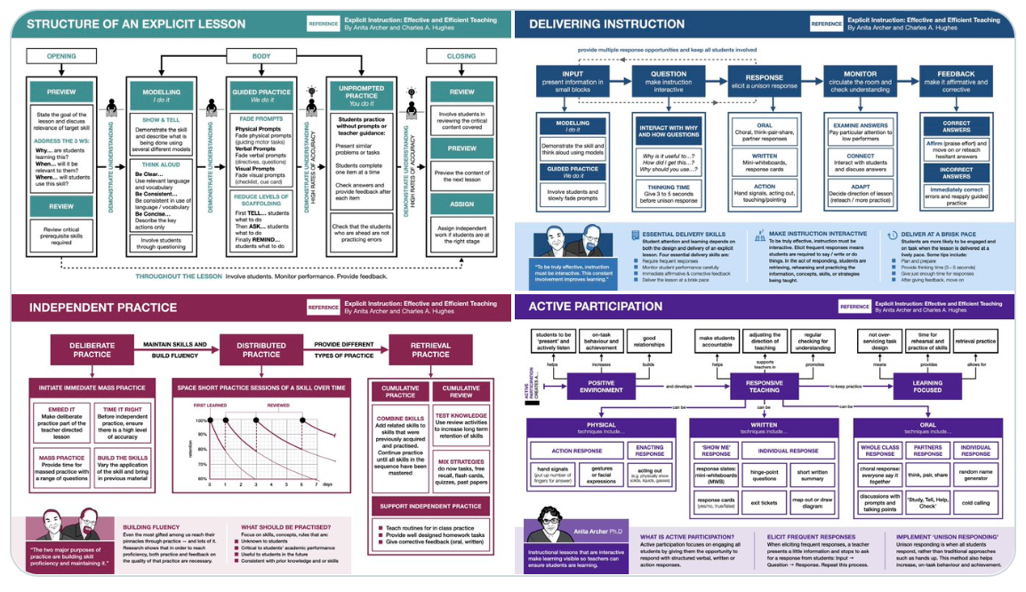
The Over-Engineering of Learning

Slide 25
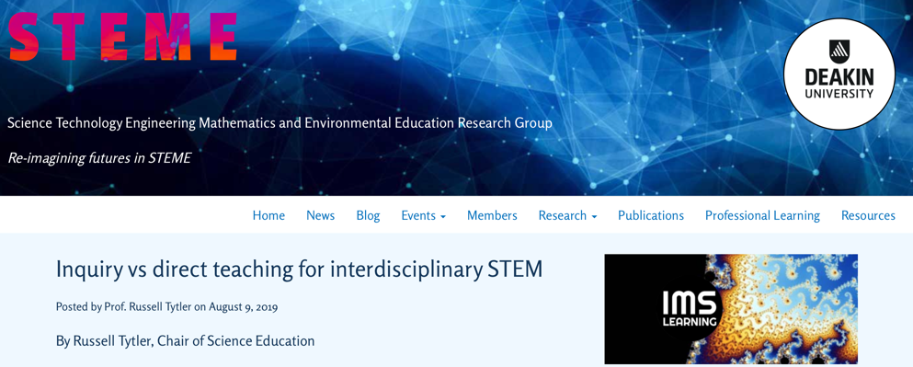
The Siren Song of Data
https://deakinsteme.org/blog/inquiry-vs-direct-teaching-for-interdisciplinary-stem/
https://data-smart-schools.net/2019/10/27/the-data-have-landed-michael-rosen/

Slide 26
“What we’ve got wrong about knowledge & curriculum”
Q: Bearing all of that in mind, what advice would you give to teachers interested in applying your ideas about powerful knowledge to how they interpret their school’s curriculum?
[A: The curriculum is not just a body of knowledge; it’s a group of communities we must encourage our students to join.]
A: I would remind them of a point [Russian psychologist] Lev Vygotsky made: that acquiring knowledge in school has to be the voluntary act of a learner. You can’t actually teach anybody anything; they have to learn it. You can help them, but they’ve got to have that desire to know. …
A: If you haven’t encouraged students to engage in the process of acquiring knowledge, which is a very difficult process, then all you get is memorisation and reproduction in tests. …
A: The current interest in the curriculum overlooks this point. It’s so concerned with saying, “Have we got the knowledge?” that it forgets to ask, “How is the knowledge being acquired?”
Young, M. (2022, September 21). What we’ve got wrong about knowledge & curriculum. (G. Duoblys, Interviewer) Tes Magazine.

Slide 27
Re-Thinking the Idea of a School Librarian
“a teacher of sense-making skills”
Barbara Stripling (2020)
"a teacher whose subject is learning itself”
Douglas M. Knight (1968) in Davies (1969)

Slide 28
Consequences of an Educational Disconnect
“The [ongoing] losses of school librarians [in the United States] are not solely based on school finances — a common reason for eliminating [them] ... a major contributor to those losses has been a ‘disconnect’ between school librarianship and the larger education community.”
Keith Curry Lance & Debra E. Kachel (2021)
Keith Curry Lance & Debra E. Kachel: Image from https://keithcurrylance.com/publishers-weekly-announces-slide/.
https://blogs.ifla.org/cpdwl/2021/06/07/an-interview-with-debra-e-kachel-and-keith-curry-lance-on-the-imls-project-related-to-slide-school-librarian-investigation-decline-or-evolution/

Slide 29
Establishing an Education Re-Connect
“The library media program and the educational program are interdependent and inseparable. … Therefore, perspective in viewing the function and role of the school library media program begins logically by building a historical understanding of education itself.”
Ruth Ann Davies (1979)

Slide 30
Inquiry as a Fundamental Instructional Approach
By definition, inquiry is “a dynamic process of being open to wonder and puzzlement and coming to know and understand the world and ourselves in it as the basis for responsible participation in community” (Stripling & Toerien, 2021). Rooted in work of…
Developing Inquiring Communities in Education Project (led by the Ontario Institute for Studies in Education at the University of Toronto, 1991-2001)
Conclusion: (p. 7). “the force that drives the enacted curriculum must be a pervasive spirit of inquiry, and the dominant purpose of all activities must be an increase in understanding … teacher and students together must become a community of inquiry with respect to all aspects of the life of the classroom and all areas of the curriculum”
Galileo Educational Network (professional learning arm of the School of Education at the University of Calgary, 1999-2022)
ESIFC (2009, 2019-present) & FOSIL Group (2011, 2019-present – 35 plus countries)

Slide 31
A Global Context for Inquiry-Based Instruction
IFLA publication provisionally titled Global Action for School Libraries: Models of Inquiry includes 5 instructional models:
Guided Inquiry Design (USA)
Stripling’s Model of Inquiry (USA)
FOSIL (UK)
Focus on Inquiry (Canada)
Informed Learning (Australia)
Notes:
Two of the most influential instructional models of the inquiry process were developed in 2003 (Stripling’s Model) and 2007 (Guided Inquiry), although they are rooted in work on the research process stretching back to the 1980s, which, in turn, was part of a broader evolution towards inquiry-based learning that had been underway since the 1960s – for example, the IB Diploma Programme, with its philosophy, structure, content and pedagogy being developed in 1962.
Of particular interest to us, from the perspective of FOSIL, is Stripling’s Model, and the Empire State Information Fluency Continuum (ESIFC) that it is integral to, both of which were made available under a Creative Commons licence, leading to both adoption and adaption beyond New York State.
As a matter of interest, of the 5 instructional models of the inquiry learning process included in the upcoming IFLA publication, two are more or less directly formative in the initial development of FOSIL, and three in its ongoing development.

Slide 32
Empire State Information Fluency Continuum
More than 3.2 million students in over 4,236 schools in New York State alone
Endorsed by
New York State Education Department / University of the State of New York
New York Library Association
Beyond New York State
Example, Rhode Island
Beyond United States
Example, British Columbia
Example, FOSIL Group

Slide 33
Stripling & FOSIL 1
Stripling’s Model of Inquiry
FOSIL 1: Framework for Oakham School Information Literacy

Slide 34
FOSIL 2: Framework Of Skills for Inquiry Learning
FOSIL Secondary
FOSIL Primary

Slide 35
Heroic Inquiry at Blanchelande College
Heroic Inquiry in Secondary
Heroic Inquiry in Primary

Slide 36
Heroic Inquiry in the Classroom

Slide 37
Spiral of Knowing and FOSIL Head
DICEPS Spiral of Knowing
FOSIL Inquiry Cycle and Head
https://tltjc.blogspot.com/2011/04/wells-2002-spiral-of-knowing.html

Slide 38
Focus on Inquiry and GID
Alberta Model
Guided Inquiry Design
https://fosil.org.uk/forums/topic/focus-on-inquiry/#post-34897
http://wp.comminfo.rutgers.edu/ckuhlthau/guided-inquiry-design/

Slide 39
Liberal Education, Inquiry and Research
Inquiry is a defining feature of a liberal education
Inquiry is an engaged learning stance …
Upon the rule of reason: “in order to learn you must desire to learn, and in so desiring not be satisfied with what you already incline to think” (Peirce, 1955, p. 54).
… leading to a dynamic learning process
The corollary: “Do not block the way [or process] of inquiry” (Peirce, 1955, p. 54).
Not all learning is an inquiry, but inquiry [as stance and process] encompasses all learning.
Research is integral to inquiry and aims at “generating evidence for [answering] the chosen/ given question through empirical investigations of various kinds and/ or from consulting relevant [and reliable] sources” (Wells, 2001, p. 191).
Research is not FOFO; i.e., finding information that serves no thoughtful purpose.
Notes:
In deciding to use a process approach to inquiry-based learning, school librarians and teachers face the same fundamental issue, no matter the size of their library and the nature of its collections and technology—how to influence, orient, and motivate the pursuit of learning using a process of discovery that encourages curiosity and the love of learning (p. 43, emphasis added).

Slide 40
“Research is Formalized Curiosity…*”
“*…It is poking and prying with purpose.” Zora Neale Hurston (1942) <https://journals.library.ualberta.ca/eblip/index.php/EBLIP/article/view/18901/14834>

Slide 42
Notes:
“Scientific method [which is the most common model of the inquiry process] is the only authentic means at our command for getting at the significance of our everyday experiences of the world in which we live” ( Dewey, 1938, p. 88).
{Britannica: "When faced with a problem, said Dewey, a person must logically examine the options open to him to find the best solution supported by the facts. This method of inquiry and testing should be applied to moral and social questions, as well as to technological and scientific ones." https://school.eb.co.uk/levels/intermediate/article/John-Dewey/273976}

Slide 43
Signature Work Inquiry
Signature Work is a defining feature of a liberal education
Signature Work is
an inquiry-based exploration of an essential question or problem
(contemporary or enduring)
that the individual student identifies and defines
that is conducted over an extended period
and that involves substantial [age-appropriate] writing and reflection
Termed Signature Work to reflect the high level of personalization and individual initiative involved, consequently bearing the distinctive imprint of the interests, commitments, and cumulative learning of the student

Slide 44
Becoming Knowledge-able
“…for the students, the goal of inquiry is making not learning, or as I put it above, working on an improvable object. Motivated and challenged by real questions and problems, their attention is on making answers and solutions. Under these conditions, learning is an outcome that occurs because the making requires the student to extend his or her understanding in action – whether the artefact constructed is a material object, a demonstration, explanation, or theoretical formulation.”
Gordon Wells in Action Talk & Text: Learning & Teaching Through Inquiry (2001, p. 190)

Slide 45
Inquiry Within and Beyond the Curriculum
Curricular Inquiry
Extracurricular Inquiry
“Providing a [model] of the inquiry process is only the first step in empowering students to pursue inquiry on their own. The next step is to structure teaching around a framework of the [inquiry] skills that students must develop at each phase of inquiry over their years of school and in the context of content area learning.” (1)
Can be a full inquiry/ Signature Work
Appropriate for all students
Inquiry that falls outside of content/ subject area learning, even though timetabled
Always a full inquiry/ Signature Work
For example, EPQ in Sixth Form
Worth half an A-Level
Requires 30 guided/ taught hours
Timetabled
Requires 90 independent hours
Structured accountability, including but not limited to Independent Study Periods
Not appropriate for all students
References
Barbara Stripling, Empowering Students to Inquire in a Digital Environment (2017, p. 52), in S. W. Alman (Ed.), School Librarianship: Past, Present, and Future.
Notes:
Like other learning programs at school, inquiry-based learning activities should be designed to promote progression and continuity in students’ learning. This means that skills must be introduced progressively through stages and levels. A school librarian should take a leadership role in ensuring there is a systematic approach to teaching an inquiry process that is guided by a school-based continuum of media and information skills and strategies (p. 43, emphasis added).

Slide 46
FOSIL Priority Skills in Transition Years

Slide 48
REFLECTions and CONNECTions
The FOSIL Group | fosil.org.uk
FOSIL as inquiry model | https://fosil.org.uk/fosil-cycle/
FOSIL as skill set | https://fosil.org.uk/fosil-cycle/skills-framework/
FOSIL as tool set | https://fosil.org.uk/resources/
FOSIL as community of inquiry | https://fosil.org.uk/forums/
Forum discussion of Reading for Inquiry Learning | https://bit.ly/2Rcs5IJ
Epistemology and Learning Memos | https://fosil.org.uk/memos/
E&L Memo 0 – FOSIL by Darryl Toerien| https://bit.ly/3aVhM2Q
E&L Memo 1 – Stripling’s Model & ESIFC by Barbara Stripling | https://bit.ly/2PEU3wg
Reflecting on E&L Memo 1 with Barbara Stripling | https://bit.ly/3t8UwVm
E&L Memo 2 – Focus on Inquiry by Dianne Oberg | https://bit.ly/3xDzmlv
Forum discussion of Focus on Inquiry | https://bit.ly/2RhIueW
Empire State Information Fluency Continuum | https://slsa-nys.libguides.com/ifc
Guided Inquiry Design | https://guidedinquirydesign.com/
Focus on Inquiry | https://open.alberta.ca/publications/0778526666#summary

Slide 49
Break
10-30-11.00
or
15.00-15.50
Image by
cdz from Pixabay

Slide 50
Blanchelande’s inquiry landscape
Minimal Library involvement
Year 2 Local study
Year 3 Classics/ History
Year 12-3 English, History & French coursework
Some Library input at design stage
Year 1 interdisciplinary Signature Work
In planning: Year 4 Geography
Year 7 English
Year 10 English
Library led
Year 7 Maths
Year 9 Signature Work in English &ICT leading to optional HPQ (1/2 GCSE)
Year 12 Signature Work linked to Thought and Culture leading to optional EPQ (1/2 A-level)
Year 6 interdisciplinary Signature Work leading to UK Science Award (CREST)
Year 8 Maths
Age 4
Age 18
Notes:
Image by Pete Linforth from Pixabay

Slide 51
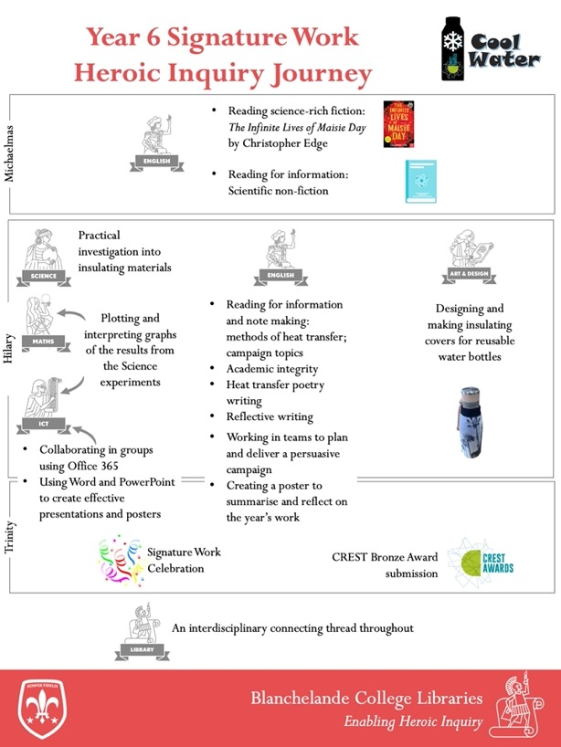
How can we encourage school children to drink more water in a sustainable way?
Year 6 interdisciplinary Signature Work leading to UK Science Award (CREST)

Slide 55
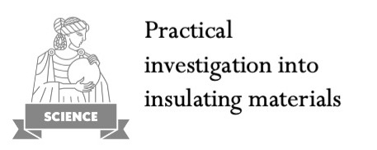
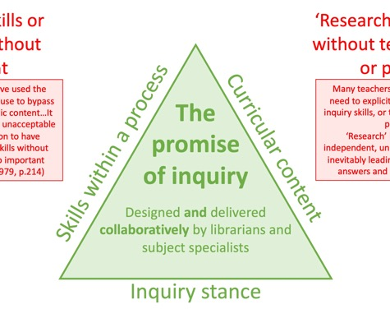
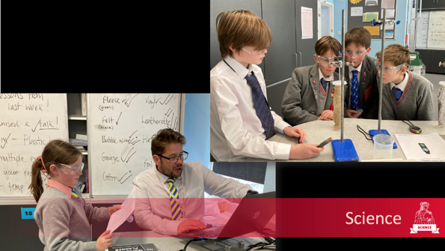
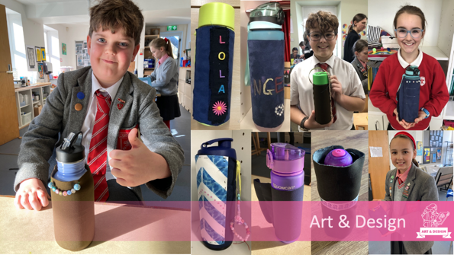
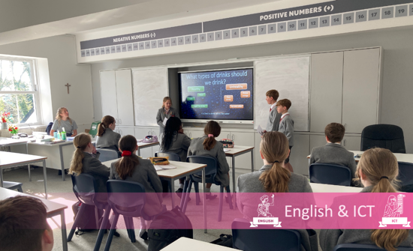
1. Embracing the curriculum content – knowledge and skills
Science curricular content
Heat transfer
Conductors and insulators: trapped air
Experimental skills
CREST Bronze Award
Connections to other subjects

Slide 56
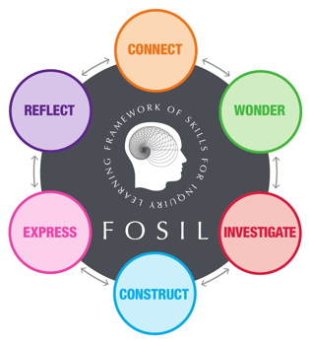
We’re better together
Interdisciplinary collaboration can be challenging but also hugely beneficial.
Students, parents and staff appreciate connections between subjects.
[X] finds maths hard and always struggled to see the point, but linking it to Science experiments and DT suddenly made it more relevant for her – Y6 Parent
Notes:
Hannah, Jo, Justine, Mel
Hugh, Mark, Katie

Slide 57
Inquiry planning is also inquiry
Kuhlthau, C. (1991). Inside the search process information seeking from the user’s
perspective. Journal of the American Society for Information Science, 42 (5), 361-71.

Slide 58
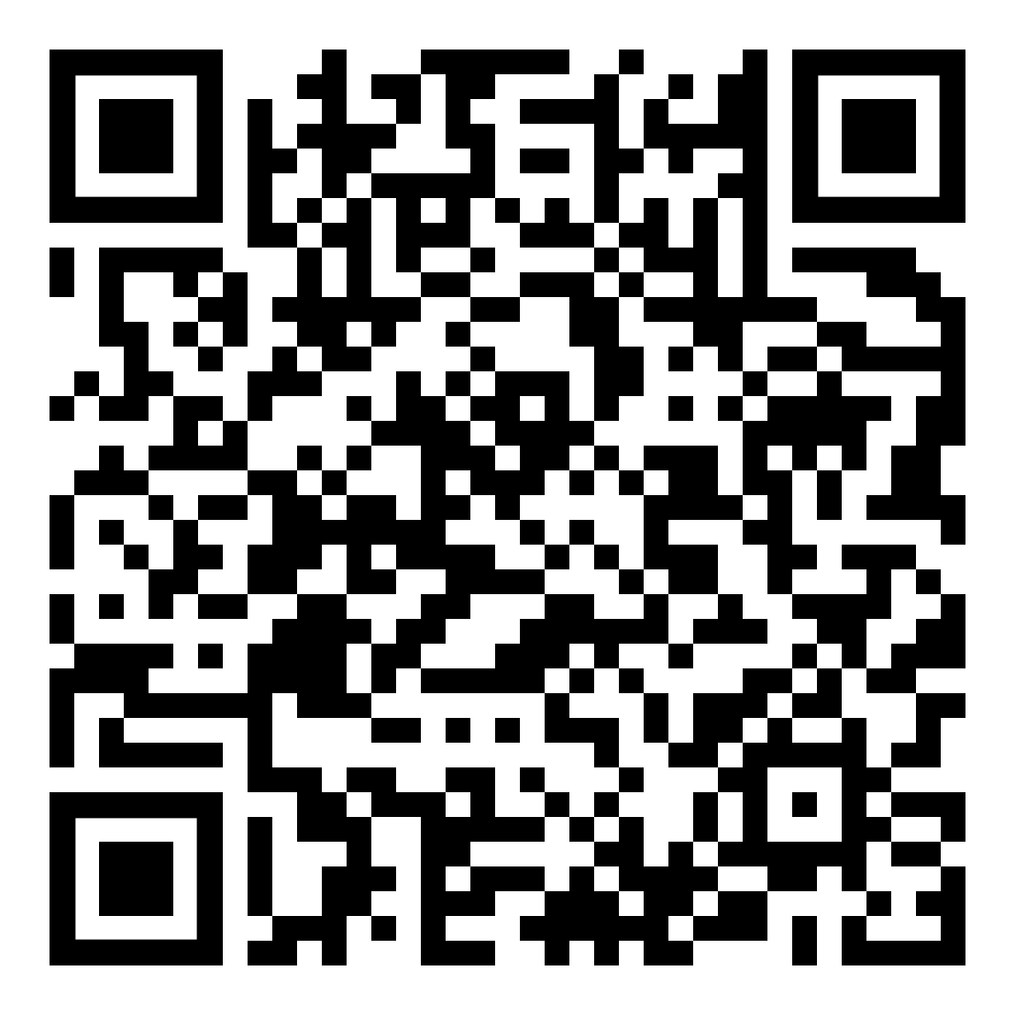
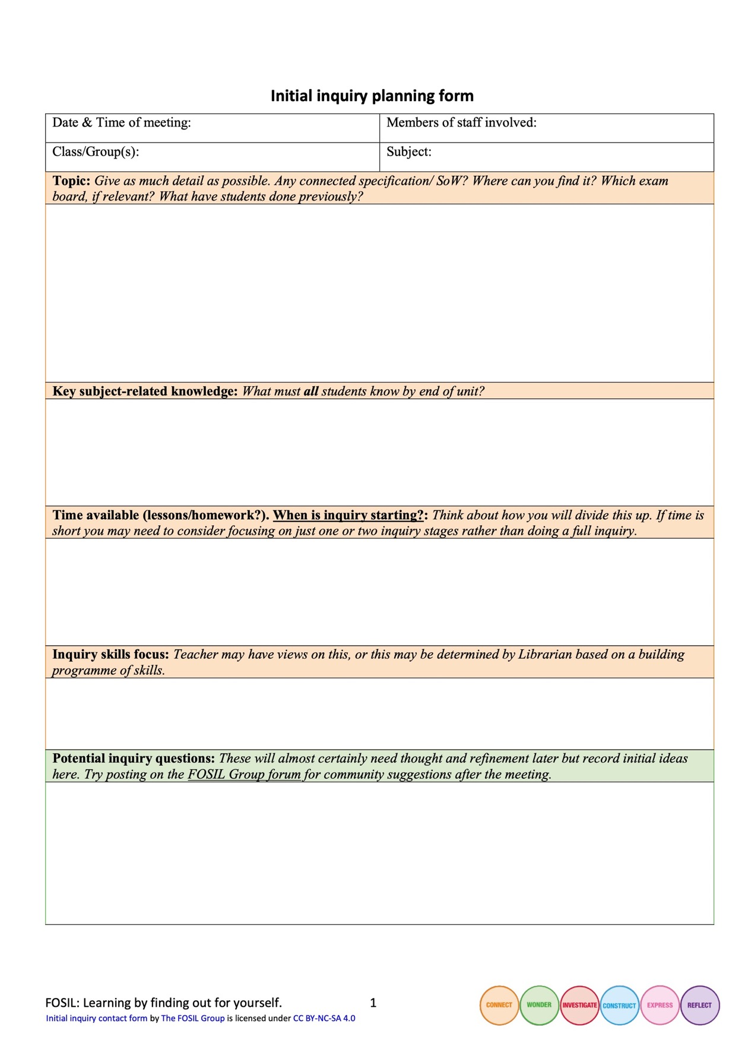
Initial inquiry planning form
Notes:
Hannah, Jo, Justine, Mel
Hugh, Mark, Katie

Slide 59
Initial inquiry planning form
Notes:
Hannah, Jo, Justine, Mel
Hugh, Mark, Katie

Slide 60
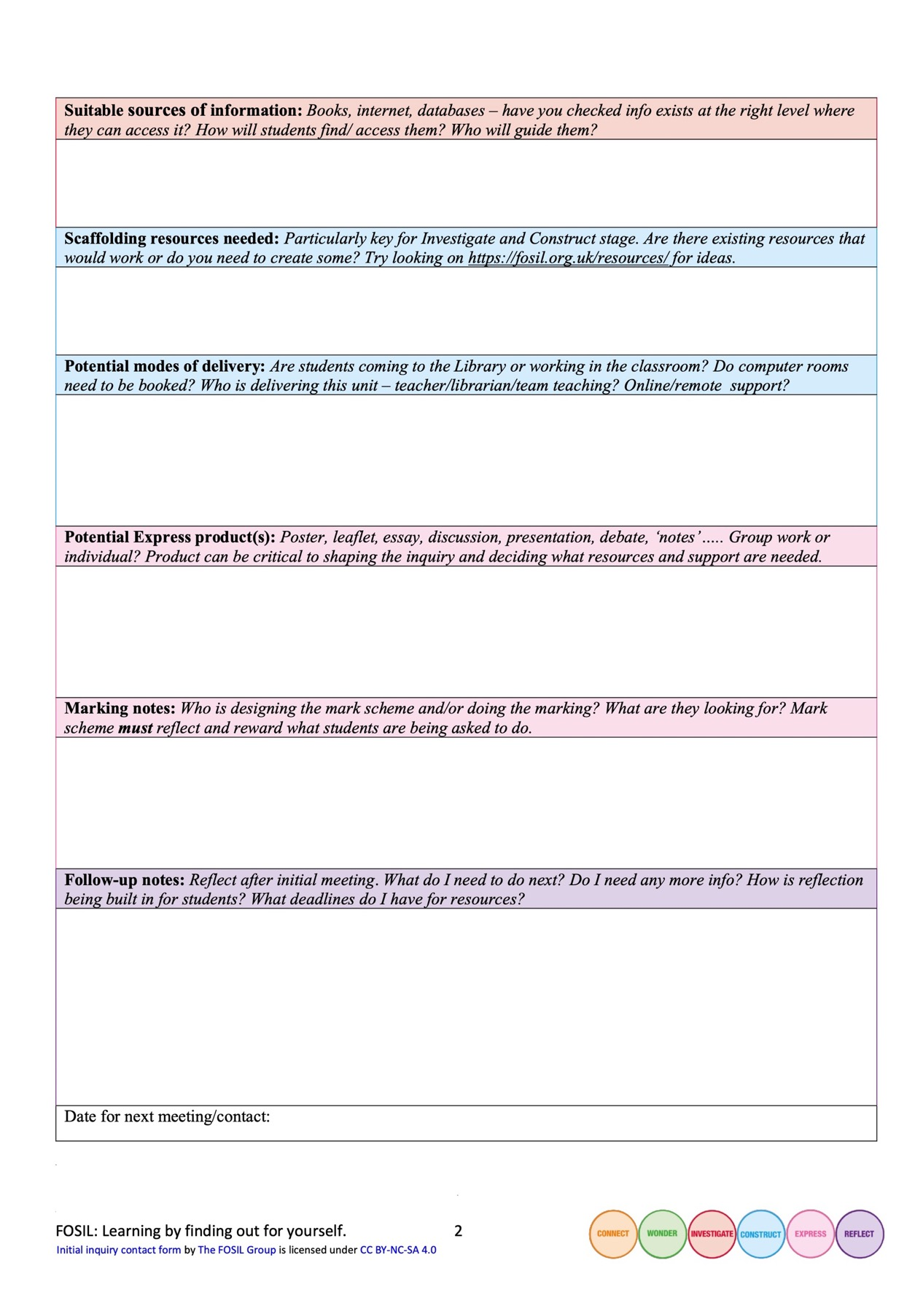
Initial inquiry planning form p.2
Notes:
Hannah, Jo, Justine, Mel
Hugh, Mark, Katie

Slide 61
Initial inquiry planning form
Notes:
Hannah, Jo, Justine, Mel
Hugh, Mark, Katie

Slide 62
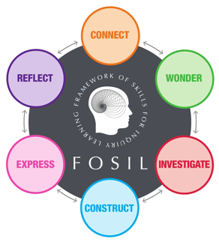
Your turn (1): Work with the living (Joyce Valenza?)
Who are your allies? Which departments/ subjects could you build relationships with to create showcase inquiries?
Do you already have any? How are you using them to draw other departments in?
Image by Clker-Free-Vector-Images from Pixabay

Slide 64
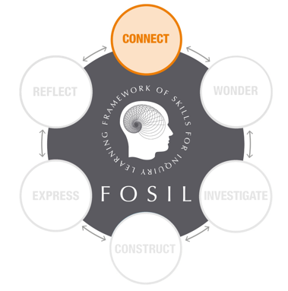
Why should I care?
Engaging intellect AND emotions
Notes:
Entry questions

Slide 65
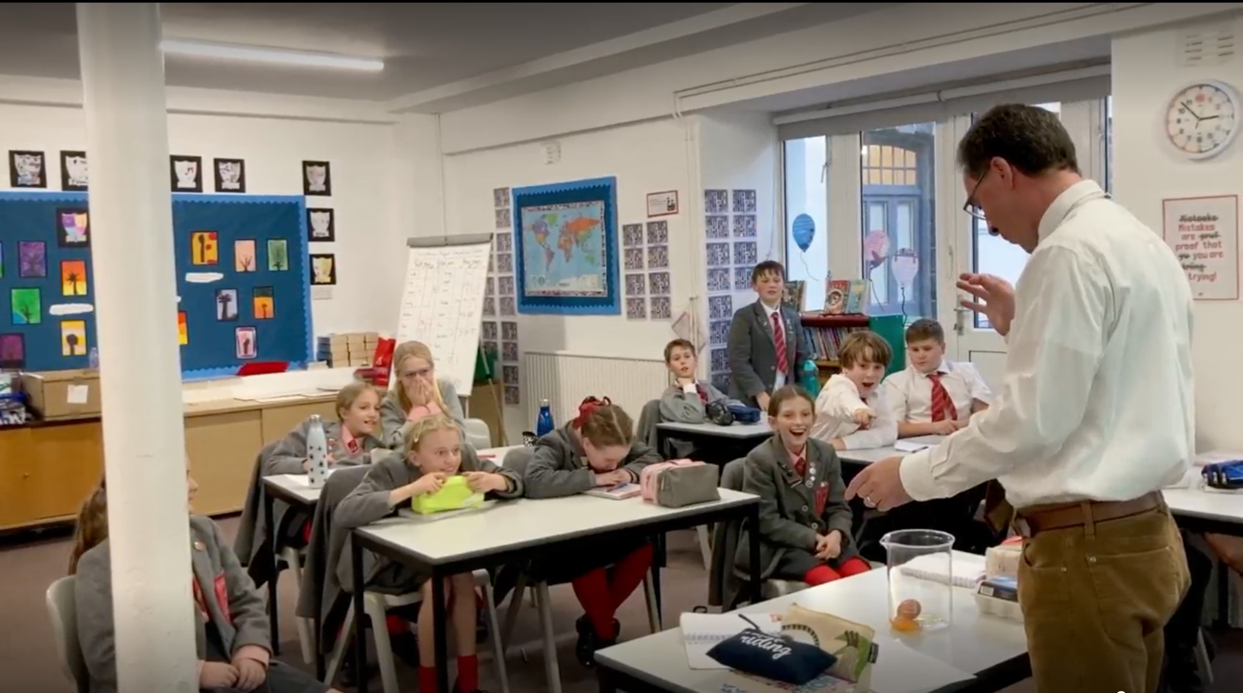
English

Slide 66
As we begin, so shall we go*
Use curated resources to connect with a topic
Without some background understanding, Investigate is very hard
Takes much longer than you might expect, especially if students have a high degree of choice
A bad topic choice here can waste a huge amount of time later
*The Medium is The Massage, Marshall McLuhan, p. 45
Notes:
Y6 SW
Y9 SW
Y12 EPQ

Slide 67
“Choose a topic you are thoroughly intrigued about. I started my project doing a different topic which I thought I was interested in but being interested in the topic isn't enough. You have to be passionate about it.”
- EPQ student

Slide 68
Your turn (2): The greatest showman?
How do we engage students’ hearts and minds with an inquiry? What dangers are there?
Image by Clker-Free-Vector-Images from Pixabay

Slide 69
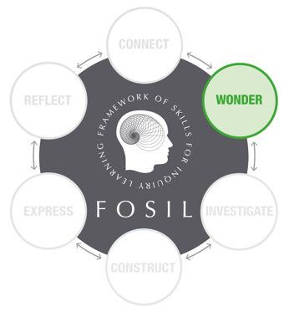
No such thing as a silly question?
Engaging through intriguing inquiry questions
Questions are easy, good questions are difficult
Questions emerge out of a growing understanding of a topic
Engaging through authentic products
Something they can see the value in – authentic audiences
Something they want

Slide 70
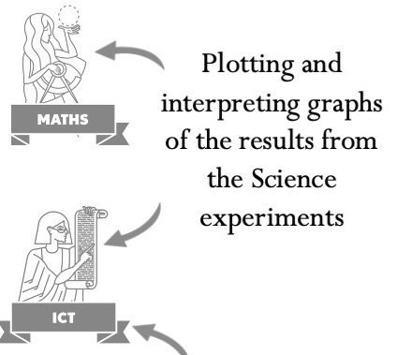
Making connections…
It made Maths lessons better. Instead of dreading them I looked forward to them.

Slide 71
Your turn (3): Questions, questions…
What makes a good inquiry question?
Do all inquiry questions need to come from students, or is it acceptable for teachers to provide them?
What ‘good questions’ can you think of linked to the subject/topic you identified in section 1?
Image by Clker-Free-Vector-Images from Pixabay

Slide 72
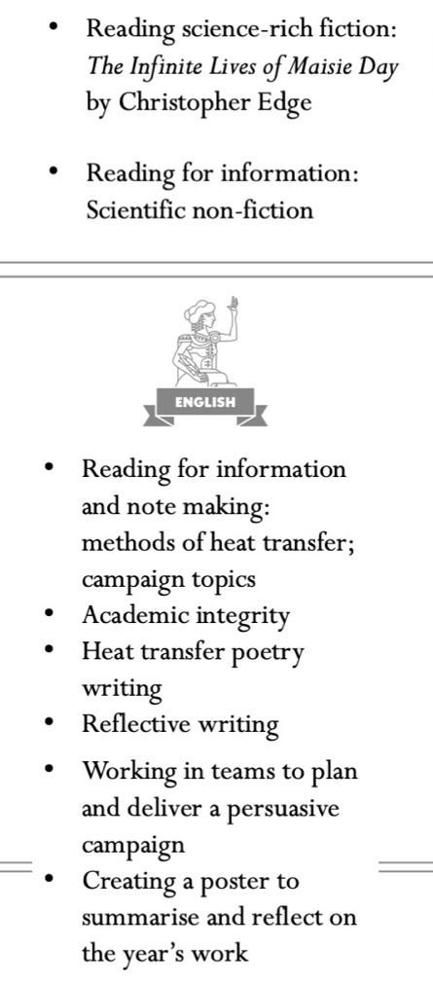
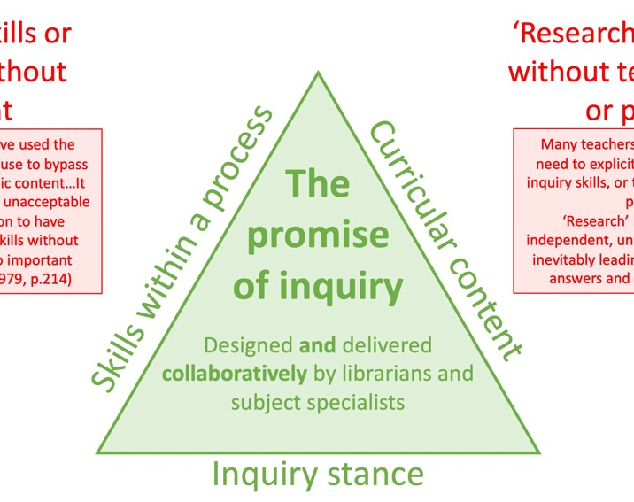
The skill of reading for information

Slide 73
Reading isn't just reading
Reading for intellectual and emotional engagement
Exploratory notetaking
Entering into dialogue with the text – what questions does this raise for me?
Reading for meaning and knowledge not just information
Investigative notetaking
Reading for understanding beyond the text
Constructive notetaking
Reading for communicating personal knowledge and understanding
Reading for reflection on learning

Slide 74
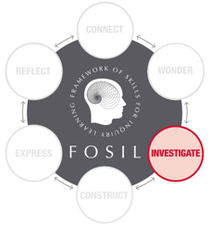
Books vs websites vs databases
EPQ taught course slide
Connect
Understanding and refining topic.
Gathering keywords
General reference books.
Skim and scan.
Use CONTENTS page.
General websites & encyclopaedias.
e.g., Stanford Encyclopaedia of Philosophy.
Encylopaedias & lower-level articles.
e.g., Britannica, The Day, Hodder Education, Global Issues, emagazine, Dialogue.
Investigate
Investigating and refining question
Gathering evidence
Mapping arguments
Books and book chapters relating directly to question.
Read carefully and make notes.
Use INDEX.
More technical websites and search engines.
E.g., use Google Scholar to search.
E.g., PubMed Central, JSTOR.
Databases that give access to journal articles and ebooks.
E.g., EBSCO databases, History Today.
Notes:
An independent academic research project on a topic of your choice that goes beyond your taught subjects
A 5,000 word research report (e.g. essay or scientific report)
Or a research based artefact (e.g. a piece of art or portfolio, a design product, a website, a presentation or a performance) and a 1,000 word report on the research process behind it
It should take you about 120 hours (just over 2 hours every week for a year, including holidays), which includes a 30-hour taught component (1 hour in every term-time week for a year)

Slide 75
What have you been doing!?
Takes longer than expected – have you tried?
Experimental planning is hard, needs firm guidance and takes as much time as other forms of investigation – hugely rewarding!
Know what sort of answers you expect them to find – can you find them? Where?
Notes:
Science tech experience

Slide 76
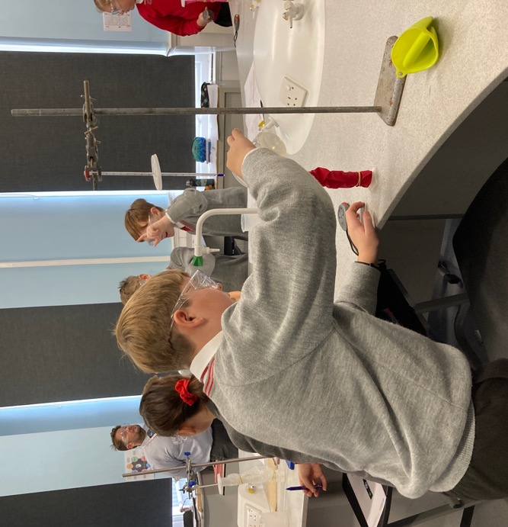
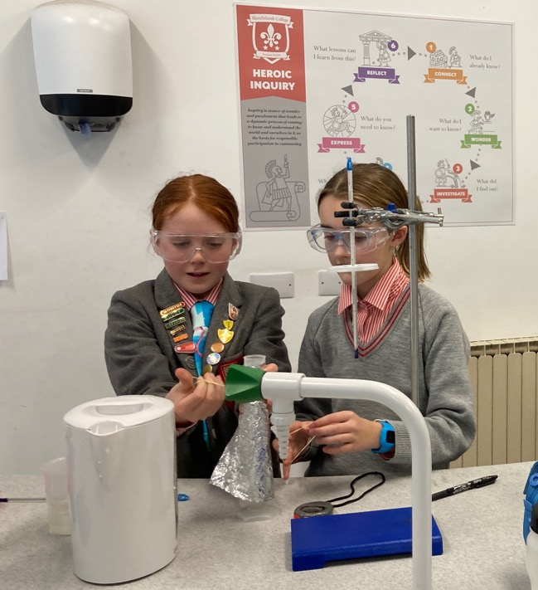
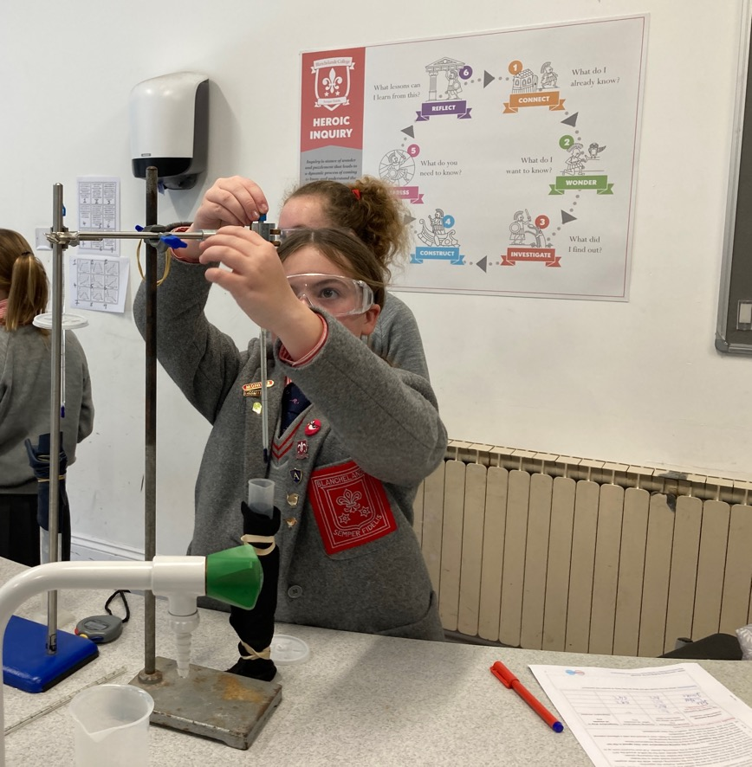
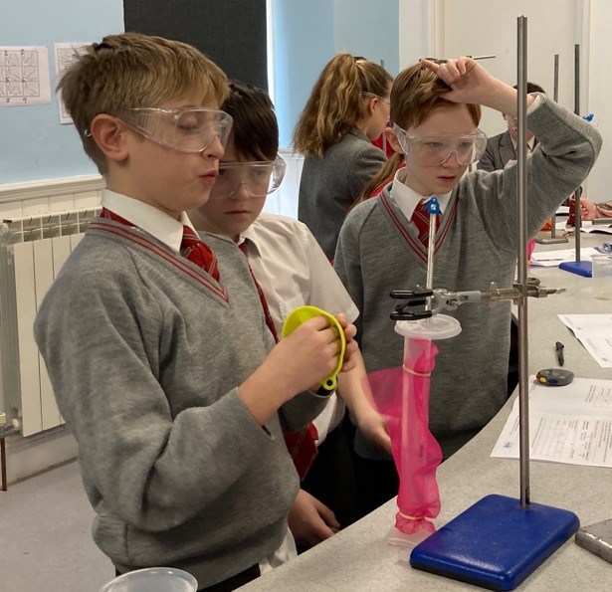
At first, I found the science experiment about heating water hard because I started the stopwatch at the wrong time, but I started again and didn’t give up.
Science

Slide 77
The internet said so
Students need support in finding resources – curated sets for younger students, jumping off points for older ones.
Students are generally not very discriminating.
Students do not collect referencing data as a matter of course, particularly for images.
Are we modelling and valuing this?

Slide 78
I don’t know what to write!
Students need age-appropriate support in notetaking (sometimes quite targeted).
Might even need live modelling!

Slide 79
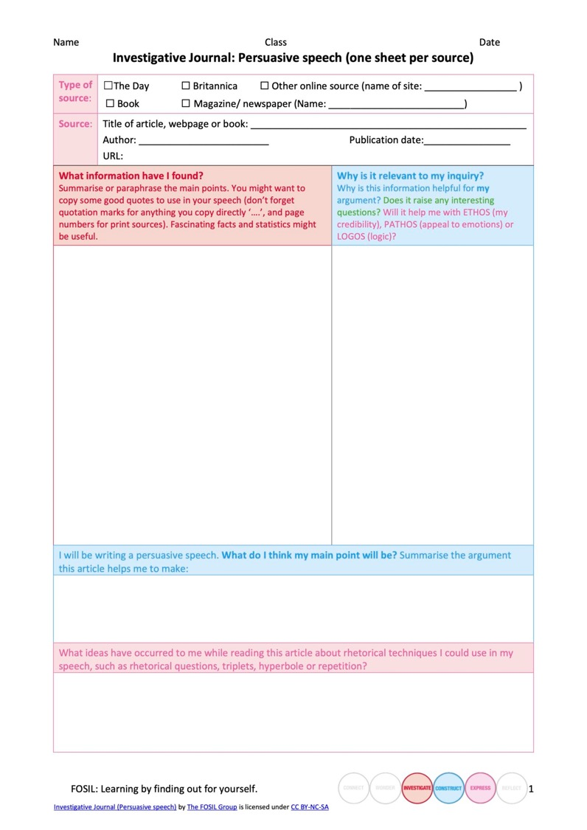
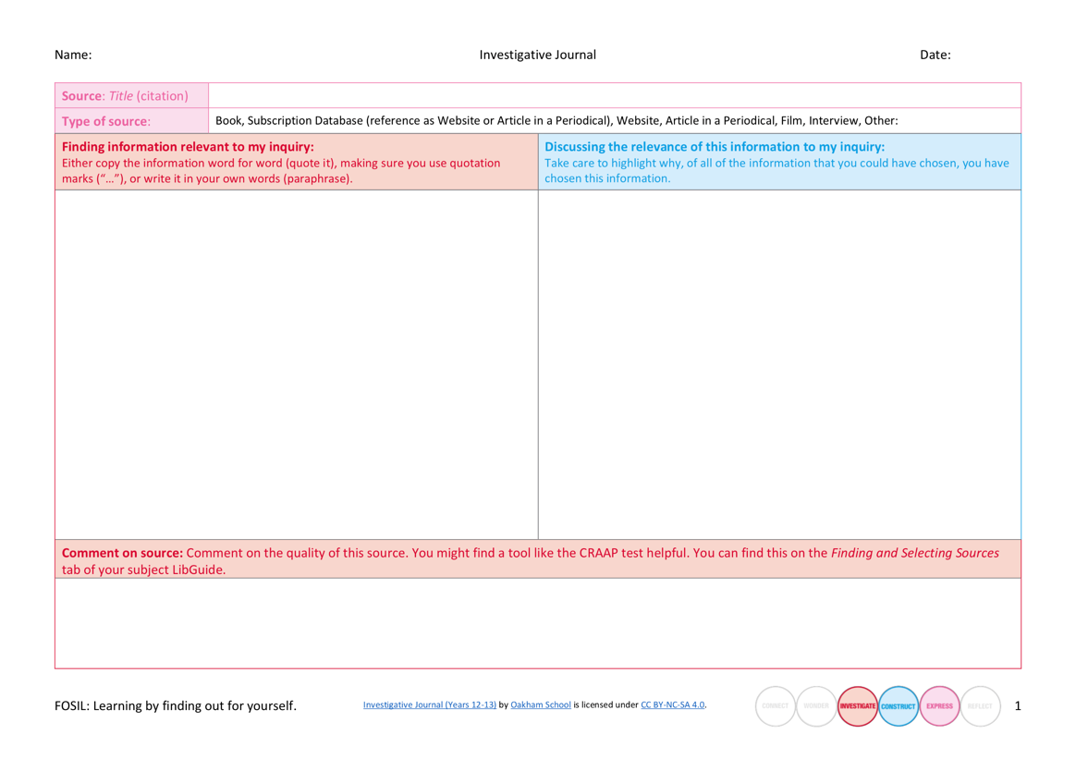

Slide 80
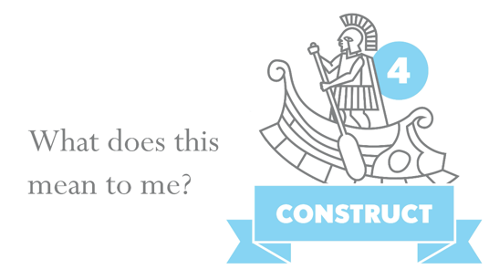
Yes, but what do YOU think?
Students need help applying what they have found out, particularly if they are switching format
Students need help constructing understanding
Notes:
Y6 example of students who spent 2 lessons collecting info then moved onto computers to make their products and ditched it all!

Slide 81
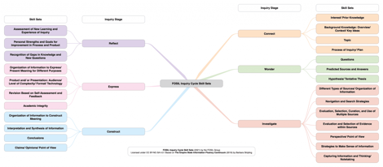
Your turn (4): Skilfully does it
Have a look at the skill sets. Are there particular skill sets that you as a librarian tend to focus on more than others? If so, why?
How do you scaffold reading for information and thoughtful note making?
Image by Clker-Free-Vector-Images from Pixabay

Slide 82
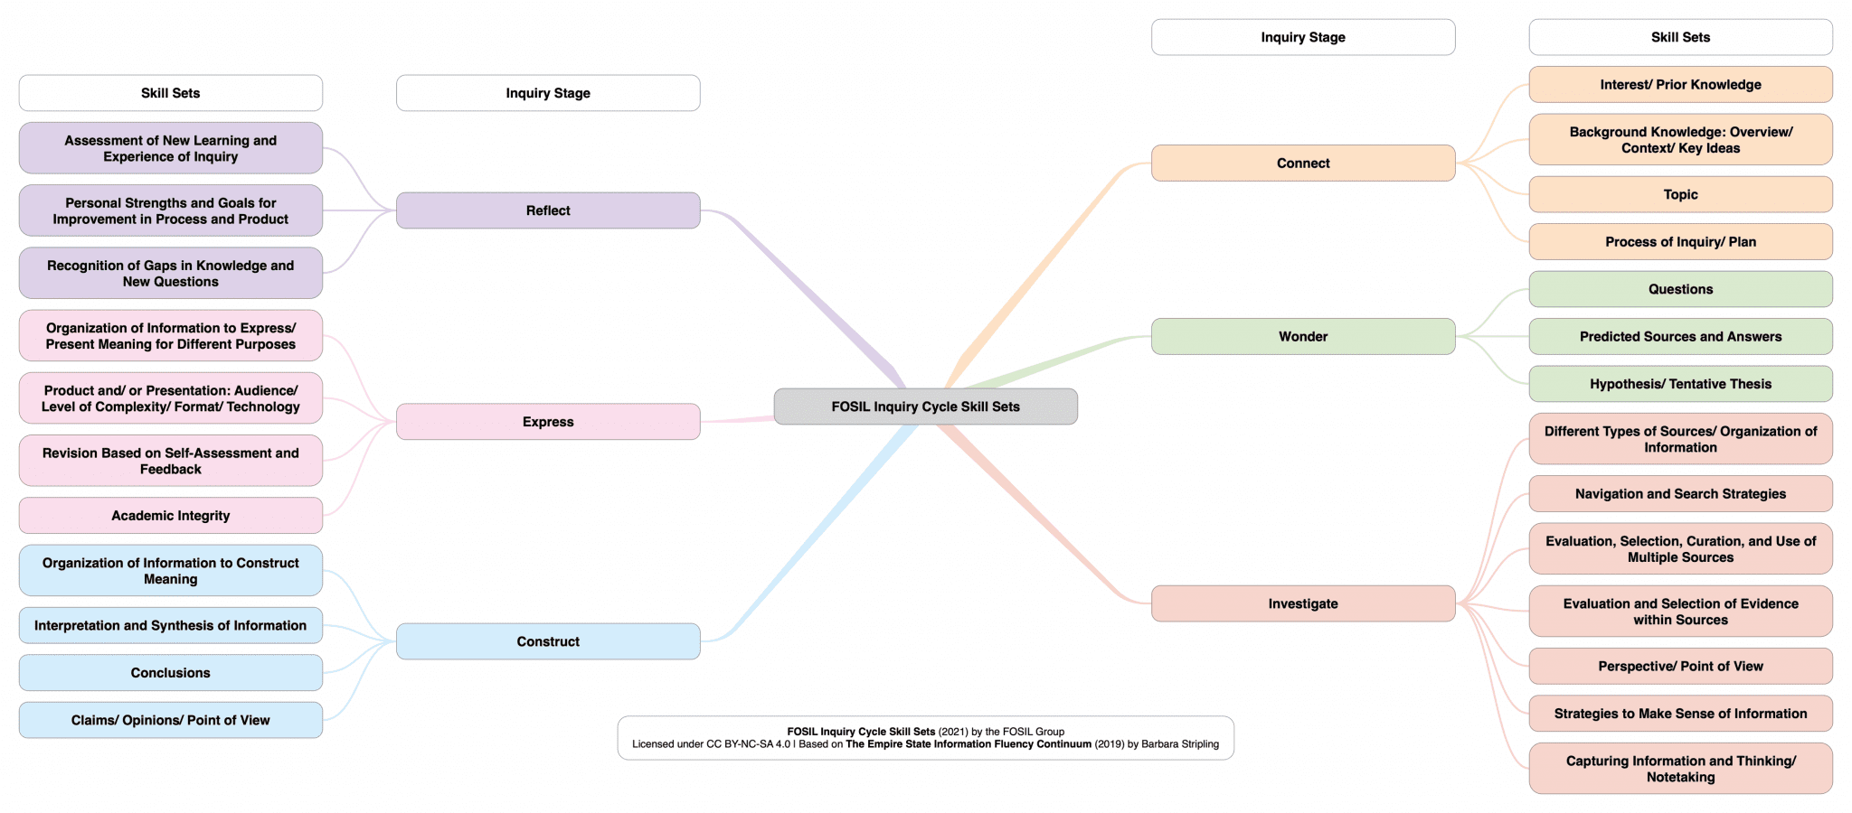

Slide 83
Oh no, not another presentation/poster!
Why this form of expression? A degree of choice in the form of expression increases engagement and is possible to manage and assess.

Slide 85
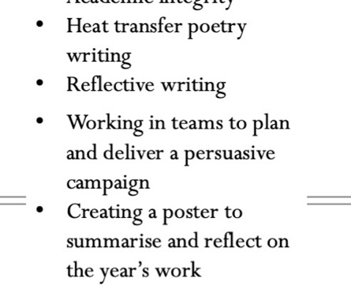
Eyes on the prize

Slide 86
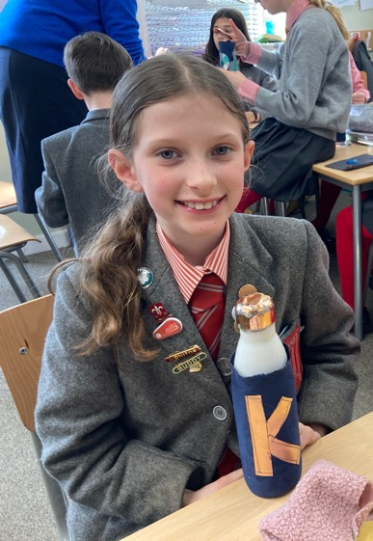
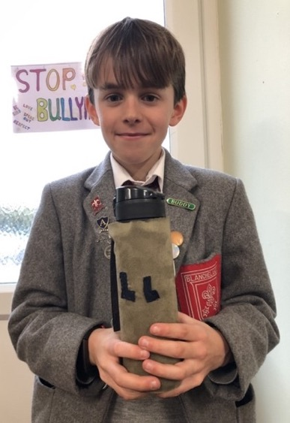
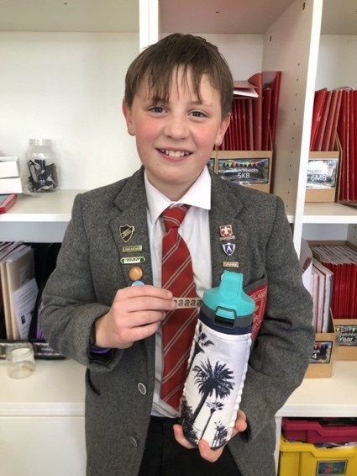
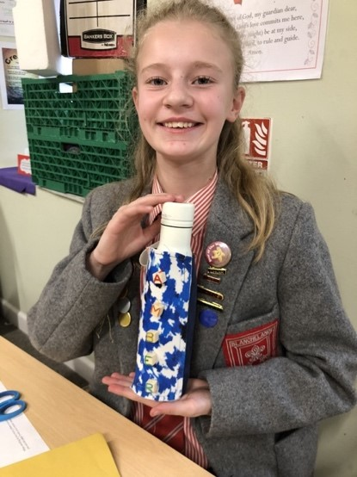
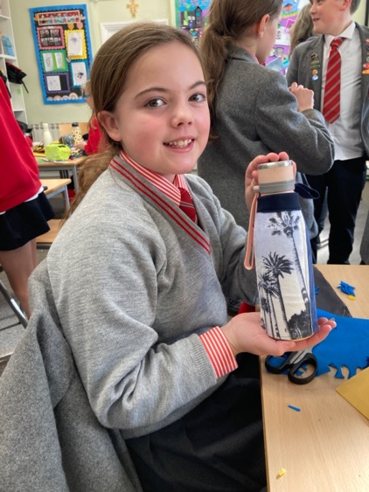
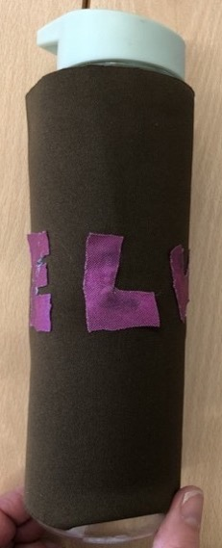
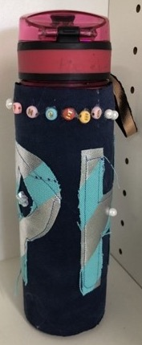
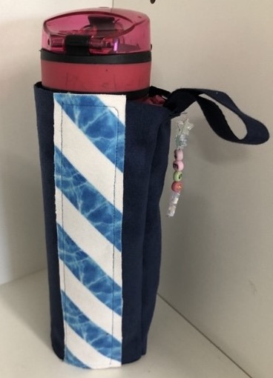
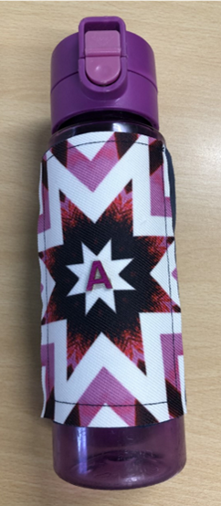
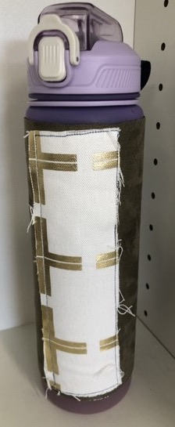
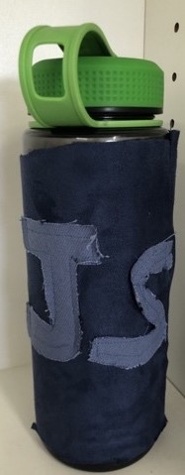
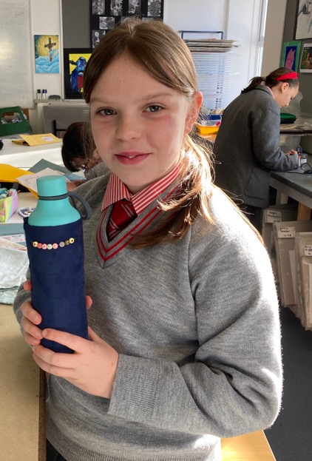
Art & Design

Slide 88
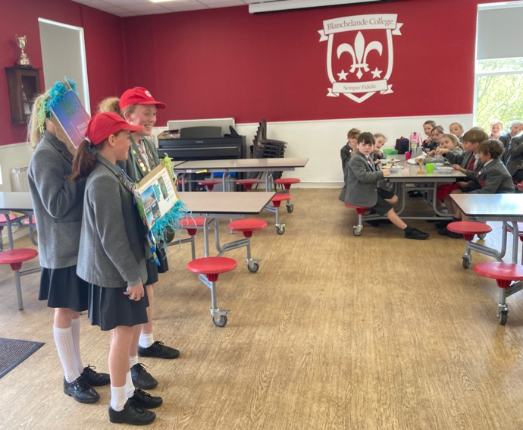
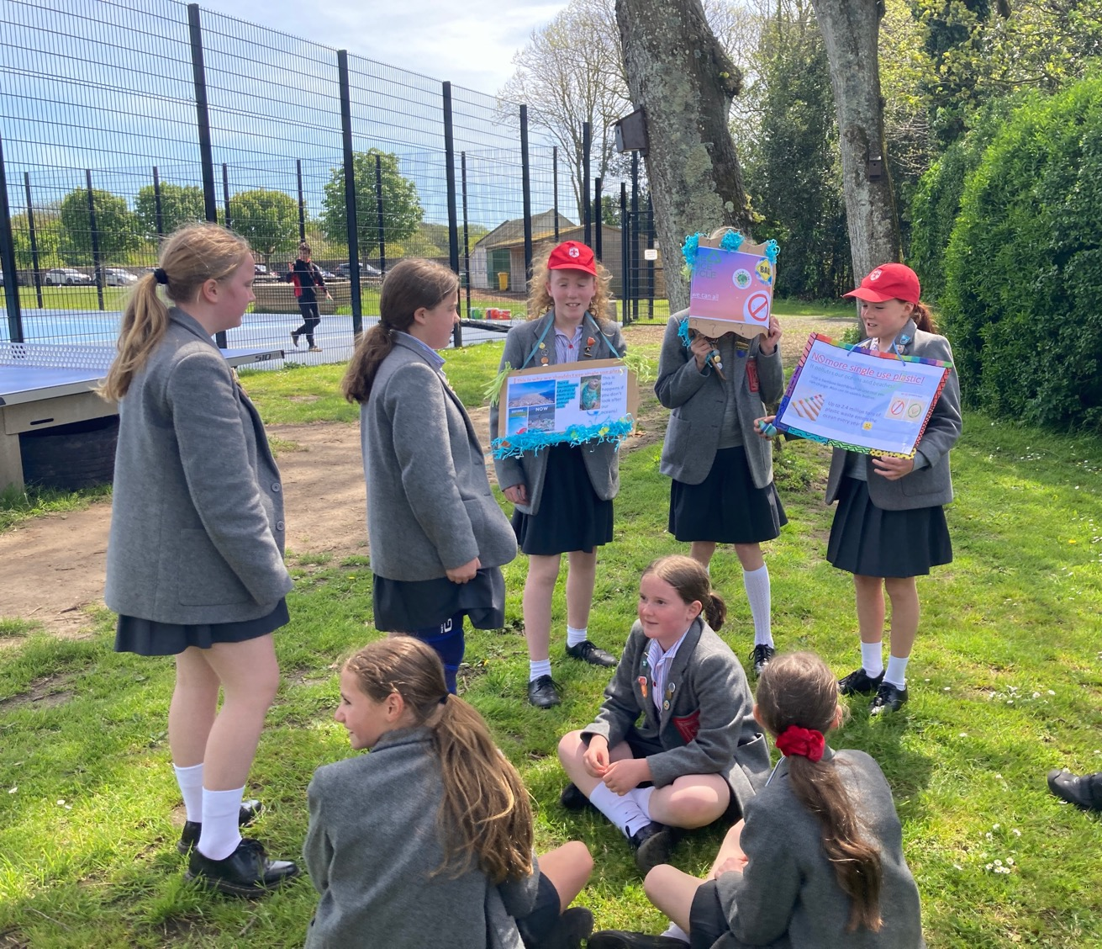
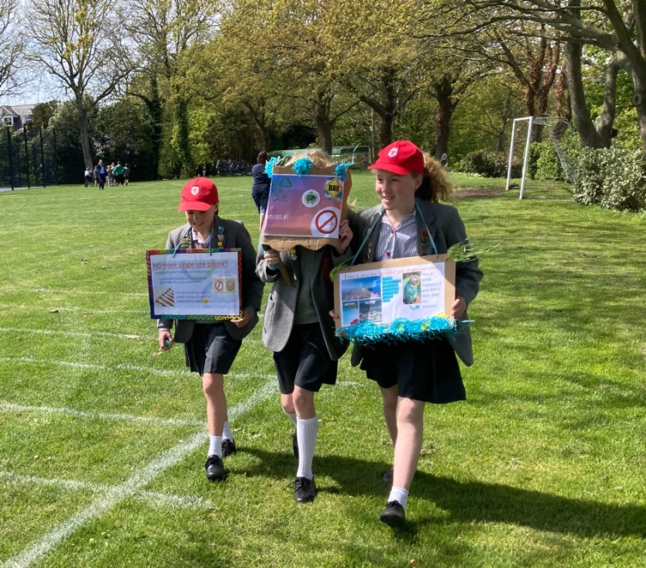
English & ICT

Slide 89
Oh no, not another presentation/poster!
Why this form of expression? A degree of choice in the form of expression increases engagement and is possible to manage and assess.
Less is more – students need guidance and support. Have you explained the assessment criteria?
I found making the script hard.
It was the amount of information I had and not my presenting.
I have learnt that I need to take more notes.

Slide 92
Oh no, not another presentation/poster!
Why this form of expression? A degree of choice in the form of expression increases engagement and is possible to manage and assess.
Less is more – students need guidance and support. Have you explained the assessment criteria?
Computers sometimes promote creativity, but sometimes stifle it!
Have you got time to assess presentations?

Slide 93
Who do you think you are talking to?
Authentic audiences increase accountability.
Students need to consider their audience carefully.
Students can be very mature about their audience.

Slide 94
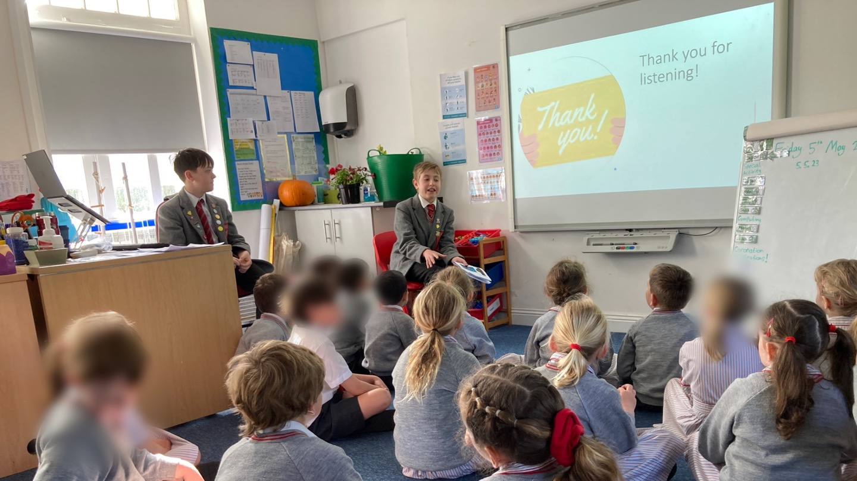
English & ICT

Slide 95
English & ICT

Slide 96
Your turn (5): Eyes on the prize
What interesting products have you used in the past? How have they enhanced the inquiry?
Have you had any occasions where the form of the product has become a distraction from your learning goals?
Image by Clker-Free-Vector-Images from Pixabay

Slide 97
“The better we get at getting better, the faster we will get better”*
Reflection is important at all stages.
Early reflection improves products.
Considered reflection can be very revealing: "I thought the problem was that I was bad at presenting, but I realised that it was because I didn't have enough information in my presentation” (Y6).
How do I know what they have learnt?
How do we carry these lessons forward?
*Douglas Engelbart <https://computerhistory.org/profile/doug-endelbart/>

Slide 98
“Formulating a plan doesn't account for daily life. Things simply go wrong. I think the biggest thing that I took from my EPQ was keeping my head above water and learning to adapt to change…I've seen an impact on the way I study for my other subjects now. The way I plan and the way I realize how long something is going to take me has a real impact on the way I work.”
- EPQ student
I would make it better again if I planned it out more.

Slide 99
Your turn (6): Reflecting on reflecting
How do you weave reflection into your inquiries (throughout? At the end? Mechanism?)?
How do you encourage students to take lessons forward into the next inquiry?
Do you collect teacher reflections?
How do you use these reflections to improve inquiries and/or to gather evidence of effectiveness?
Image by Clker-Free-Vector-Images from Pixabay

Slide 100
There’s more to life than this
Impact can go far beyond the classroom.
“I also uniquely learned about my family and stories I've never heard before. My project allowed me to open up those conversations which I otherwise may not have had.”
- EPQ student
I've learned about how much I care for Earth and its oceans. I learned how to sew which is a nice hobby…I found out that I can deal with hot water and use it sensibly and not get worried that it will burn me.
Through this project I learnt that if I put in effort, I can do it.

Slide 101
Final thought…
What one thing have you heard or discussed today that you want to use in your planning for next term?
Image by Clker-Free-Vector-Images from Pixabay

Slide 102
An Introductory and Concluding Question
What do you do that AI could not do, or could not do better.
Brother George Van Grieken
Secretary Coordinator of Lasallian Research and Resources for the Institute
https://lasallian.info/brother-george-van-grieken-to-lead-research-and-resources-in-rome/

