Slide 1
Lesson 1 CONNECT | Introduction to Fibonacci sequence. Constructing sequence. Drawing Golden Spiral.
Lesson 2 CONNECT & WONDER | USING RESOURCES: Exploration of instances of Fibonacci sequence in nature (and art?) Looking at pictures in Library books or printed
Lesson 3 INVESTIGATE | OUTDOOR LEARNING: How many instances of Fibonacci numbers can you find outside? Counting petals and leaves, looking for snail shells
Lesson 4 INVESTIGATE | Introduce the Golden Ratio PRACTICAL INVESTIGATION: The Golden Ratio in the human body
Lesson 5 CONSTRUCT & EXPRESS | Design and make poster to answer the question ’Can Maths help me get better at Art?’, using what you have found out about Fibonacci sequences. Must all be hand drawn but could use printed images to copy. If any posters aren’t completed could keep them in the Library to work on for prep?
Lesson 6 REFLECT | Showcase of completed posters. Reflection/ peer marking on each others’ work and on inquiry question. Extension ideas: Writing a Fib poem, videos on Fibanacci sequence, Fibonacci & music

Slide 2
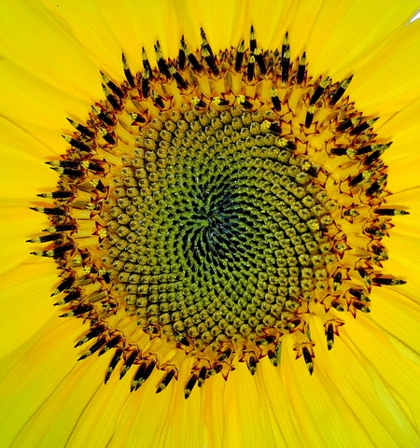
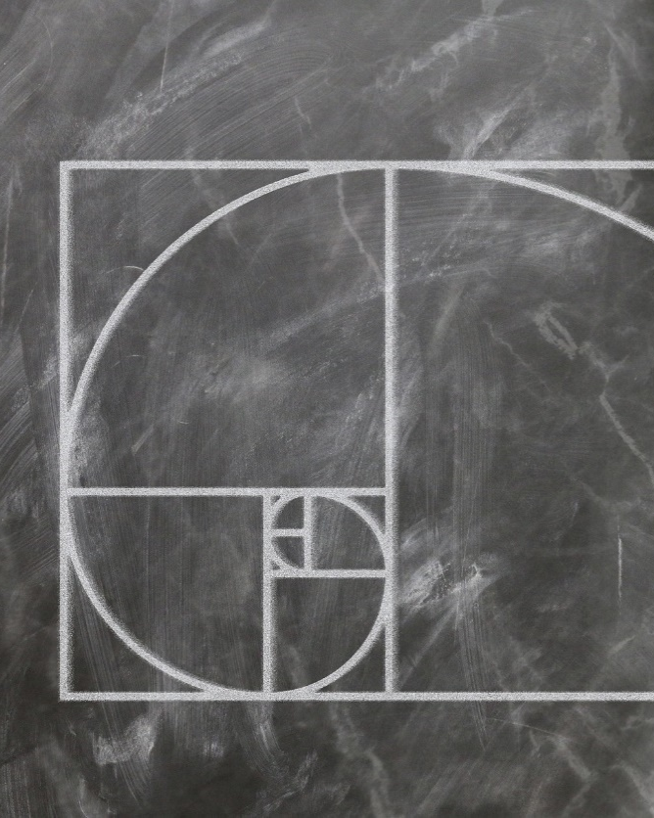
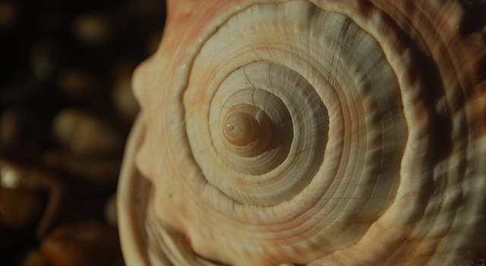
Can Maths help me get better at Art?
LO: Investigate the Fibonacci sequence in nature
Notes:
Image by Gerd Altmann from Pixabay, Harald Landsrath from Pixabay, Dean Marston from Pixabay

Slide 3
Starter: Complete the following sequences
8.6.23
7, 11, 15, 19, ___, ___
4, 9, 16, 25, ___, ___
25, 22, 19, 16, ___, ___
1, 3, 6, 10, 15, 21, ___, ___
Notes:
Images to arrange numbers
Main task

Slide 4
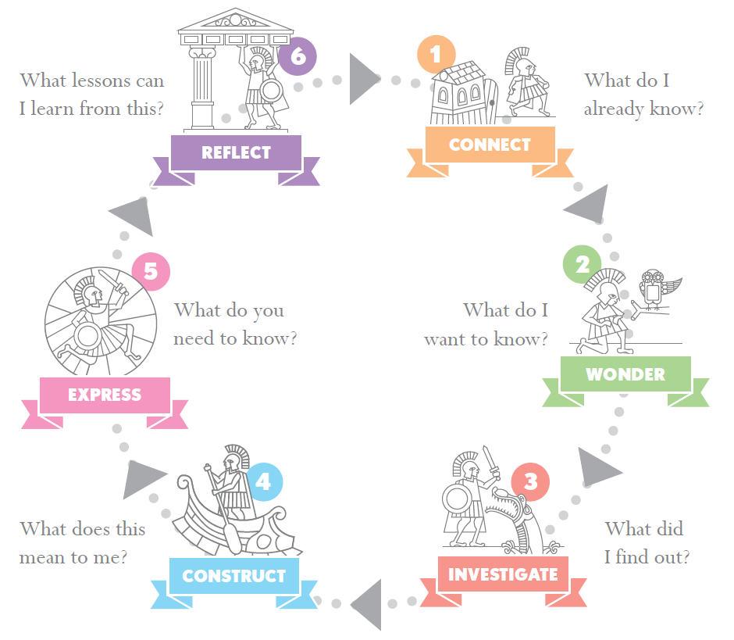
Can Maths help me get better at art? LO: Investigate the Fibonacci sequence in nature
Lesson 1 - Connect
What do we know about sequences?
Introduction to Fibonacci sequence.
Constructing the Fibonacci sequence.
Drawing the Golden Spiral.

Slide 5
Fibonnacci
Who, what, why?
Watch and Think:
What problem was Fibonacci trying to solve?
How do you construct a Fibonacci sequence?
Where is the Fibonacci sequence seen in nature?
What is the golden ratio and how does it relate to the Fibonacci numbers?
Share your answers
Do: Make a Fibonacci sequence in your book. How high can you go?
Reflect: How could this help me in Art?
The Mind-Blowing Mathematics of Sunflowers - Instant Egghead #59
https://www.youtube.com/watch?v=z9d1mxgZ0ag (2min 38)

Slide 6
Golden spiral
What How Why?
Watch the video, pausing at 1m40s. You might want to watch the bit from 1m08s to 1m40s again. Vi talks FAST!
Think:
How do I draw a golden spiral (Vi’s THIRD SPIRAL TYPE)?
How is this related to Fibonacci numbers?
Share your answers. How will you decide where on your page to start?
Do: Draw a golden spiral, using a whole page of your maths book (see next slide for help!)
Vi Hart Doodling in Math Class: Spirals, Fibonacci, and Being a Plant [1 of 3] (5m54s) https://www.youtube.com/watch?v=ahXIMUkSXX0
Reflect: Watch the rest of the video . How could this help me in Art?

Slide 7
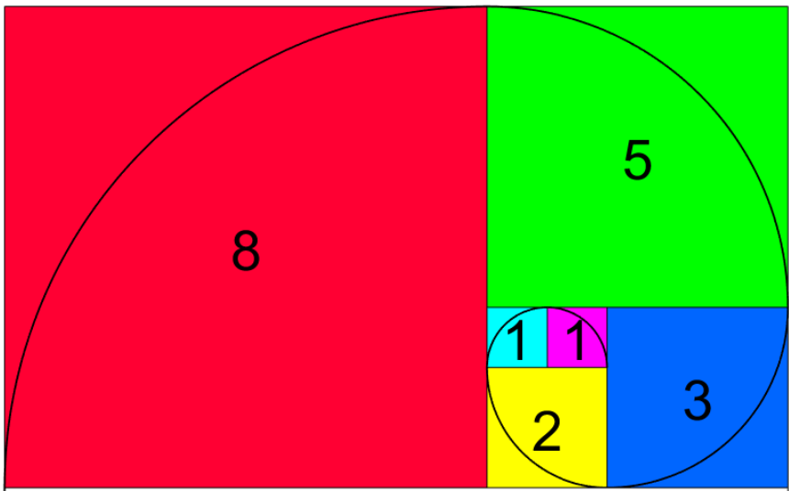
Do: Follow the pattern using the squares in your book. Can you fill your page with your spiral?
Reflect: Watch the rest of the video from the previous slide. How could this help me in Art?
Image credit: https://www.math.hkust.edu.hk/~machas/fibonacci.pdf Copyright ○c 2016-2022 by Jeffrey Robert Chasnov

Slide 8
Going beyond…
Keep your eyes open for Fibonacci numbers and Golden Spirals in unexpected places
Have a look at some of Vi Hart’s other maths videos
there are two more in the Doodling in Math Class: Spirals, Fibonacci, and Being a Plant series
but she’s got lots of other (completely unrelated) ones too. Hexaflexagons are one of Mrs Toerien’s favourites…
Practise doodling those Golden Spirals – or see how high you can get in the Fibonacci sequence

Slide 9
Can Maths help me get better at art? LO: Investigate the Fibonacci sequence in nature
Lesson 2 – Connect & Wonder
Can we spot Fibonacci sequences in nature?
What interesting questions do we have about Fibonacci sequences in art and nature?

Slide 10
Starter: If these were numbers in the Fibonacci sequence, what would the next numbers be?
8.6.23
2584, 4181, _____ , _____ , _____
Reveal answer?

Slide 11
Starter: If these were numbers in the Fibonacci sequence, what would the next numbers be?
8.6.23
2584, 4181, 6765 , 10,946 , 17,711

Slide 12
Can Maths help me to get better at Art?
What do you think now? Do you have other questions that might help you to answer this big question?

Slide 13
Investigating Fibonacci numbers in nature
Look at the pictures of flowers and fruit
What do you think the numbers mean? If a picture doesn’t have a number then you need to count.
Cut out the pictures. Don’t cut the numbers off!
Group the pictures by the number of petals/ seeds
Do they all have Fibonacci numbers of petals/seeds?
Divide them between you and stick them into your books. Think about how you will arrange them.
Fibonacci Flowers document

Slide 14
Investigating Fibonacci spirals in nature
Cut out the pictures of sunflowers, pinecones and cacti and share them between you
Can you draw spirals out from the centre like Vi did last lesson?
Count the spirals
Are they all Fibonacci numbers?
Stick the pictures into your book

Slide 15
Golden angle
What How Why?
Watch the video
Think:
Why does the angle between the plant’s leaves matter (to the plant)?
How does this help me to understand why Fibonacci numbers crop up in nature?
Could this help me to draw better flowers?
Share your answers.
Do: Use everything you have learnt in the last two lesson to draw flowers, plants and/or spirals ON A PIECE OF PLAIN PAPER that your teacher will give you. Put your name on it and give it.
Reflect: Did I draw those differently because of what I know about Fibonacci sequence?
Vi Hart Doodling in Math Class: Spirals, Fibonacci, and Being a Plant [2 of 3] (5m54s) https://www.youtube.com/watch?v=lOIP_Z_-0Hs
Notes:
They will use these on their poster so encourage them to do a good job!

Slide 16
Going beyond…
Keep your eyes open for Fibonacci numbers and Golden Spirals in unexpected places
Have a go at drawing/doodling some more plants, animals and spirals using your knowledge of the Fibonacci sequence. If you make any good ones, bring them in to use on a poster at the end of the project

Slide 17
Can Maths help me get better at art? LO: Investigate the Fibonacci sequence in nature
Lesson 3 - Investigate
Does this work in real life?
How many instances of Fibonacci numbers can you find outside?
Counting petals and leaves.

Slide 18
Can Maths help me get better at Art?
14.6.23
Homework on Teams
Your homework is to re-watch the video, make an 'angletron' and draw some flowers. Be as creative as you would like! I will need these in for Monday 19th to gain merit points. The video link is Doodling in Math Class: Spirals, Fibonacci, and Being a Plant [2 of 3] - YouTube’
Collect a piece of coloured paper from your teacher. Do not stick it in – you might want to cut your drawings out and use them on a poster at the end of the inquiry.
Notes:
Images to arrange numbers
Main task

Slide 19
How common are Fibonacci numbers in nature?
14.6.23
We are going to explore outside to find out how common Fibonacci numbers really are
Stick your record sheet in your book
Think about what you can count – you don’t just have to stick to petals! Look at the different parts of some flowers, and also look at leaves.
If you can’t identify a plant, just describe it. Your teacher might be able to help with an image recognition App.
EVERYONE should pick one daisy and count the petals on it. We will pull all this data together later.
Sepal
Petal
Stamen
Carpel
Image by Gini George from Pixabay (fuscia)
Notes:
Images to arrange numbers
Main task

Slide 20
Where are we going?
14.6.23
The field and the area by the apple trees by The Hut have lots of daisies
Lots of flowers in tubs just outside the main school building and by Victor House
Lots of trees!
Try the field and hedges behind the Infant playground (by Victor House) for wildflowers or the area by the Little Chapel
Nature trail: Meet Mrs Toerien by the cricket pitch/Eco Hut at these times:
Mrs Dorne – 14.50
Mrs Way – 15.05
Mr Lee – 15.20
STAY WITH YOUR CLASS
Sepal
Petal
Stamen
Carpel
Image by Gini George from Pixabay (fuscia)
Notes:
Images to arrange numbers
Main task

Slide 21
Ground rules
14.6.23
Stay with your class group. Don’t wander off and join another class.
Take care on the roads. Always use the crossings and look both ways for traffic yourself. Don’t assume someone else is looking.
On the way to the nature trail we will be on public roads. Keep your eyes open. Stay to one side and do not fill in your table until we get off the roads.
Watch your step on uneven ground. Stay away from and do not startle cows.
You should pick one daisy, do not pick any other flowers.
Watch out for nettles and brambles.
Let your teacher know BEFORE going out if you have a history of experiencing strong allergic reactions to bites or stings.
If you don’t know the name of a plant, just describe it. Ask your teacher for help.
Notes:
Images to arrange numbers
Main task

Slide 22
When we return (or next lesson)
Fill in your classes results in the daisy spreadsheet and look at the modal groups. Do they tend to be Fibonacci numbers?
How reasonable is it to say that Fibonacci numbers are common in nature?

Slide 23
Can Maths help me get better at art? LO: Investigate the Golden Ratio
Lesson 4 - Investigate
What is the Golden Ratio?
Find the Golden Ratio in the human body

Slide 24
Feedback from last lesson
Fill in your class results in the daisy spreadsheet and look at the modal groups. Do they tend to be Fibonacci numbers?
How reasonable is it to say that Fibonacci numbers are common in nature?

Slide 25
Can Maths help me get better at art? LO: Investigate the Golden Ratio
1
1 ÷1 =
2 ÷1 =
3 ÷2 =
5 ÷3 =
8 ÷5 =
13…
21…
34…
55…
89…
144…
233…
377…
610…
15.6.23
Starter activity
Write the first 15 Fibonacci numbers down the side of your page (take turns to read the list to your partner)
Use your calculator to divide each number by the one before it
What do you notice about your answers?
Notes:
They tend to 1.618

Slide 26
Golden ratio in humans
What How Why?
Watch and Think:
What is the golden ratio?
How many places can you remember where we can see the golden ratio?
Share your answers. List some things you would like to measure to confirm what she is saying.
Golden ratio=mind blown (Davidson Art Online)
https://www.youtube.com/watch?v=c8ccsE_IumM

Slide 27
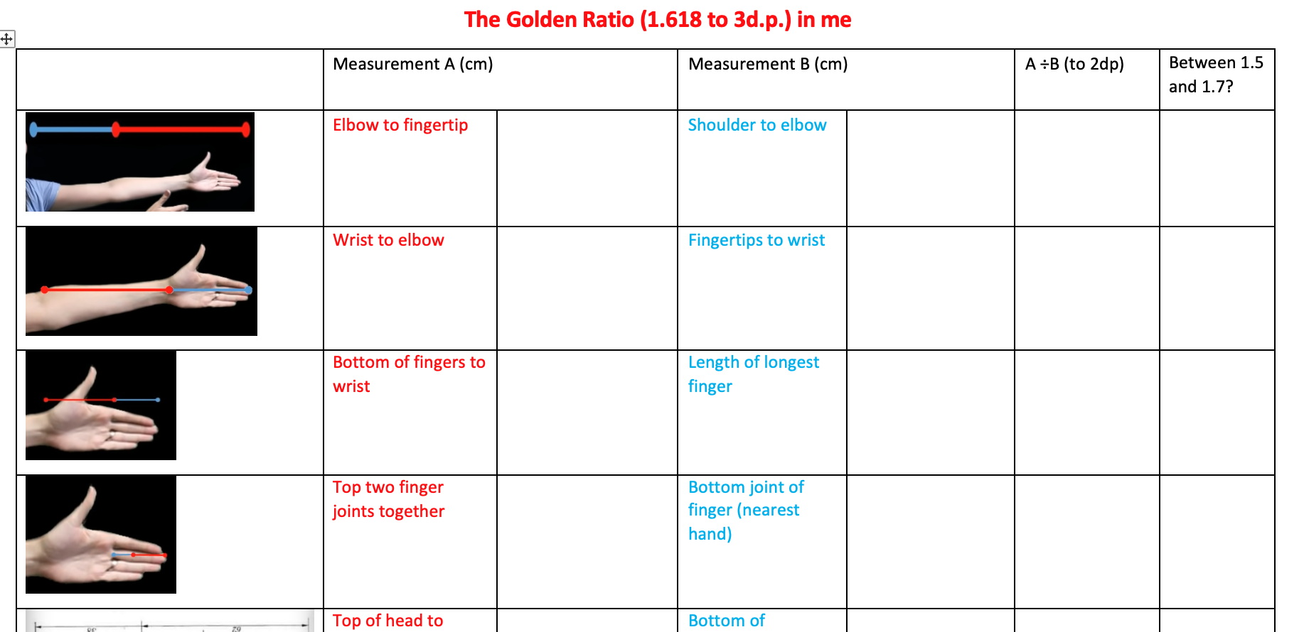
Now you investigate…
Do: Use In small groups, make some measurements of different parts of the body. How many examples of the Golden Ratio can you find?

Slide 28
Reflect
Could I use this to draw more realistic people? How?
Do you think the Golden Ratio is really everywhere, or do you think that if I chose a different ratio (e.g. 1:4) I could choose to measure parts of my body that would show that too?

Slide 29
Work in progress beyond this point!

Slide 30
Can Maths help me get better at art?
Lesson 5 – Construct & Express
What do I think now? Can Maths help people to draw better?
How can I best explain my view on a poster?

Slide 31
Can Maths help me get better at art?
Now produce an A3 poster in your group of 2-3.
You might want to produce different sections on small pieces of paper and stick them on. Your poster should have:
A large, clear, bold title (Can Maths help me get better at Art?)
Something about the Fibonacci sequence
Something about the Golden Spiral
Something about the Golden Ratio
The Fibonacci sequence and Golden spiral in nature
The Golden Ratio in the human body
Your group’s ANSWER to the question – focus on how some people might find Maths helpful in Art, then decide whether you think this inquiry has helped YOU.
Notes:
Images to arrange numbers
Main task

Slide 32
Can Maths help me get better at art?
Lesson 5 & 6 –Express & Reflect
Have a look at other group’s posters.
How can your constructive criticism of other groups’ posters help you to improve your own?

Slide 33
Can Maths help me get better at art? LO: Giving and receiving constructive criticism
Was their poster attractively presented? Was it clear and easy to read?
Have they explained the Fibonacci sequence, Golden Ratio and Golden Spiral clearly?
Have they discussed where these might be seen in nature?
What constructive advice would I give them on improving their product?
Does this give me any ideas for how my product could be improved?

Slide 34
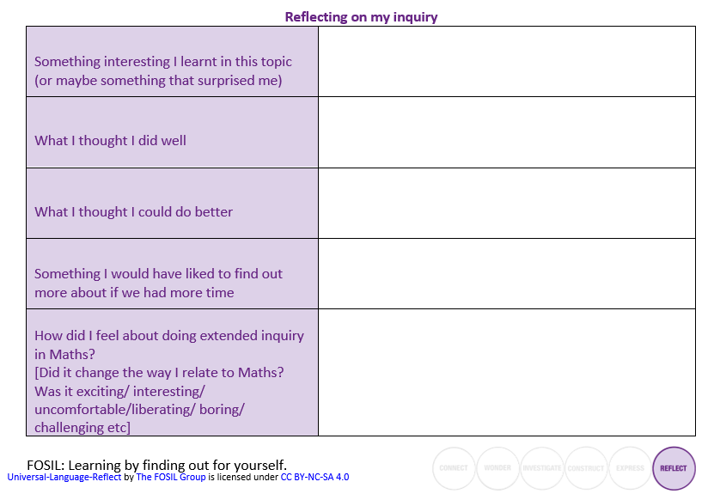
Can Maths help me get better at art?
The better we get at getting better, the faster we will get better.
Doug Englebart, inventor and pioneer of the computer mouse, hyperlinks and early Graphical User Interfaces

