Slide 1
Lesson 1 CONNECT & WONDER | Introduction to topic and generating questions. Investigating names for numbers in different languages. Could move on to different counting systems.
Lesson 2 CONNECT | Investigating different numerals and counting systems
Lesson 3 CONNECT & INVESTIGATE | Placing famous mathematicians from around the world on a map. Thinking about gender and time period as well. Choosing one mathematician to investigate (homework to gather resources – introduction to databases)
Lesson 4 INVESTIGATE | Investigating and making notes on their mathematician – how did their Maths influence the world? Do we still use it in our lives today?
Lesson 5 CONSTRUCT & EXPRESS | Use the evidence gathered to answer the question ‘Is maths a universal language?’ Produce a poster in a group (AND cue cards on their individual mathematician)
Lesson 6 EXPRESS & REFLECT | Poster showcase with short talks on each mathematician. Individual reflection.

Slide 2
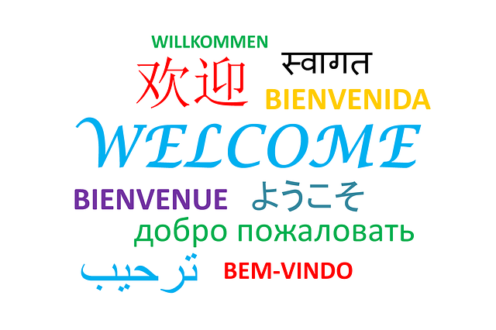
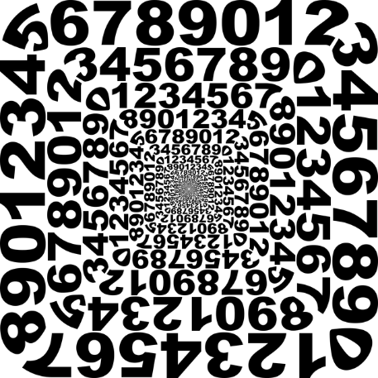
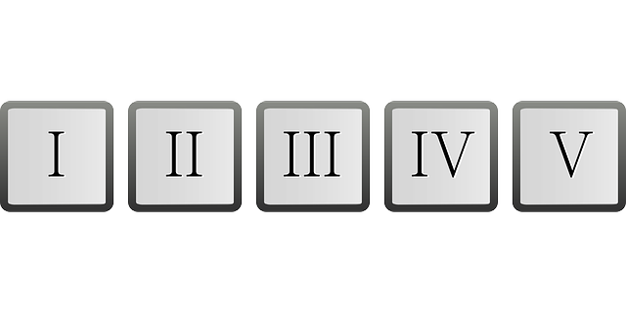
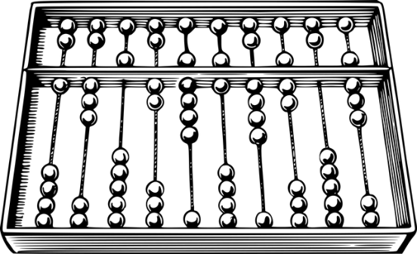
Year 8: International maths
Is Maths a universal language?
Notes:
Image by Yuri from Pixabay, Clker-Free-Vector-Images from Pixabay, Image by Tumisu from Pixabay, Image by OpenClipart-Vectors from Pixabay, Image by Gordon Johnson from Pixabay

Slide 3
Starter game
8.6.23
All five clues on each of the following slides represent the same number.
Think you know the number?
Turn your board face down
Put your hand up
Write it on your whiteboard

Slide 4
八
hachi
A
otte
B
shmona שְׁמוֹנָה‎
C
acht
D
E
huit
Reveal answer?
8
Notes:
A Japanese, B Danish, C Hebrew, D German, E French – answer is 8!

Slide 5
dau ddeg pedwar
A
amashumi amabili nane
B
ventiquattro
C
yirmi dört
D
24
E
XXIV
(vīgintī quattuor)
Reveal answer?
Notes:
A Welsh, B Zulu (South Africa), C Italian, D Turkish, E Latin

Slide 6
tchinze
A
quince
B
पंद्रह (pandhraa)
C
п'ятнадцять (p'jatnadcjat')
D
15
E
vijftien
Reveal answer?
Notes:
A Guernesiais, B Spanish, C Hindi (india), D Ukrainian, E Dutch

Slide 7
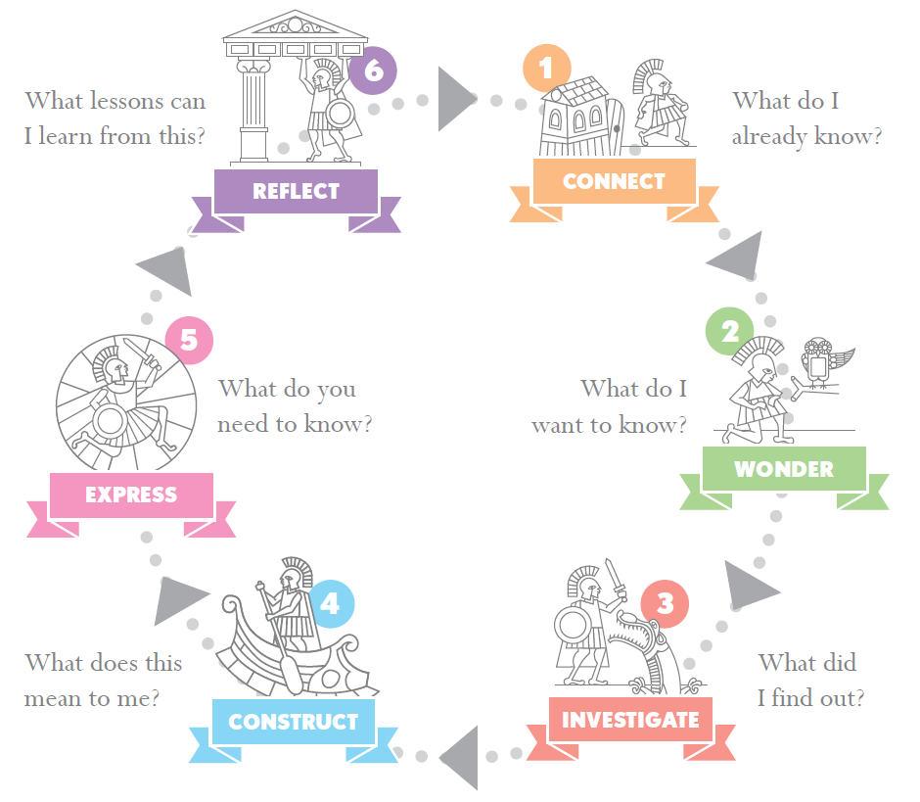
Is Maths a Universal Language? LO: Investigate Maths around the world
Lesson 1 – Connect & Wonder
Are there patterns in the way number names are formed across different languages?
What does it mean to be a universal language?

Slide 8
Is maths a universal language?
Discuss this big question as a group, then write one smaller question in your book that interests you about this topic.
Notes:
What does this mean? What questions would help us to explore this topic? How easy would it be to make yourself understood mathematically in a country where you didn’t know the language? Can mathematicians talk to each other using symbols instead of words? Do numbers follow the same patterns in different languages? Does the same sort of maths come out of different countries?

Slide 9
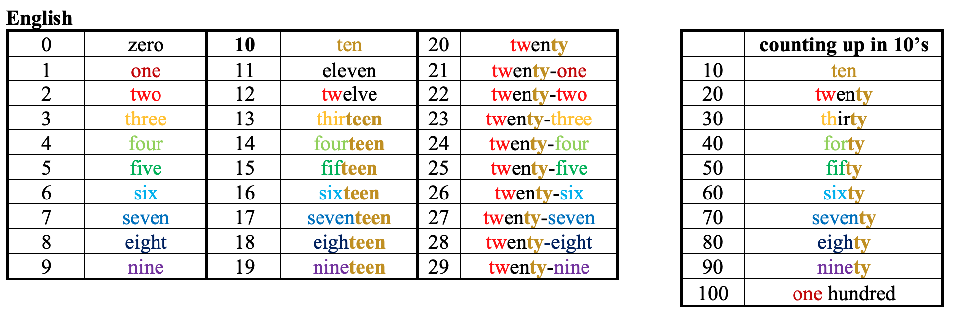
What patterns can you see in English?
Notes:
From 13 upwards very regular – word representing 0-9 number followed by ‘teen’
Very regular pattern from 20 upwards
10’s numbers would be easy to guess if you knew numbers below 10. ‘ty’ on end means ‘multiplied by 10’

Slide 10
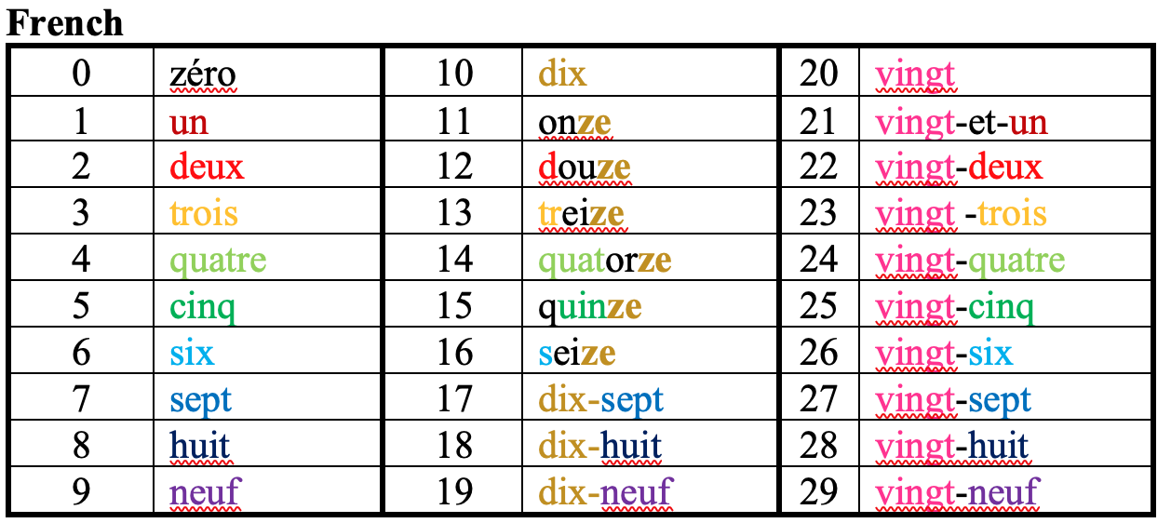
What about French?
Notes:
11-15 sound like number with –ze on the end (liken to our ‘teen’)
17-19 are literally 10-7, 10-8, 10-9
Twenties are very regular except for 21 which has an extra ‘and’

Slide 11
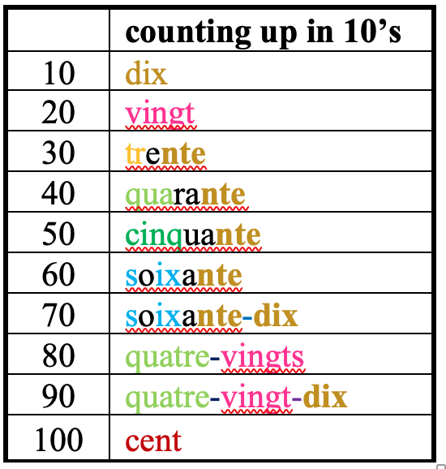
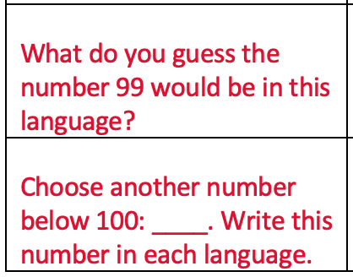
Notes:
Soixante = 6 tens
Soixante-dix = 6 tens (plus) ten
Quatre-vingts = 4 twenties
Quatre-vingt-dix = 4 twenties (plus) ten
99 = quatre-vingt-dix-neuf

Slide 12
Working in groups of 2 or 3, choose two more languages to look at
You must choose at one from each of the groups below
What patterns can you find?
Make notes on your sheet
Group A - White paper:
Navajo
Turkish
Welsh
Maori
Mandarin
Group B - Buff paper:
Yaruba
Danish
Hindi
Italian
German
Guernésiais
Notes:
White paper languages are very regular. Buff paper languages have idiosyncrasies:
Yaruba counts up to 14 then 15=20-5, 16=20-4 etc. Also tens units have a base of 20 e.g. 40=20*2, 60=20*3.
Danish also has a base 20 system: 50=2.5*20, 60=3*20, 70=3.5*20 etc
Hindi is massively irregular!
Italian, German and Guernésiais just have some irregularities in the teens then settle down

Slide 13
All the languages are different, but can you see similar patterns?
Given 1-20, would you be able to guess the English translations for bigger numbers in the languages you looked at?
Lots of languages have patterns going up in steps of:
10
20
5
Why?
Notes:
Fingers and toes! The other pattern that occurs very rarely (and almost all languages using it have died out) is 12, based on the joints in fingers!

Slide 14
Is maths a universal language? LO: Investigate historical mathematicians around the world
Lesson 3 - Investigate
Did people from all over the world shape mathematics?
How have political, social and cultural issues affected the spread of mathematical ideas?

Slide 15
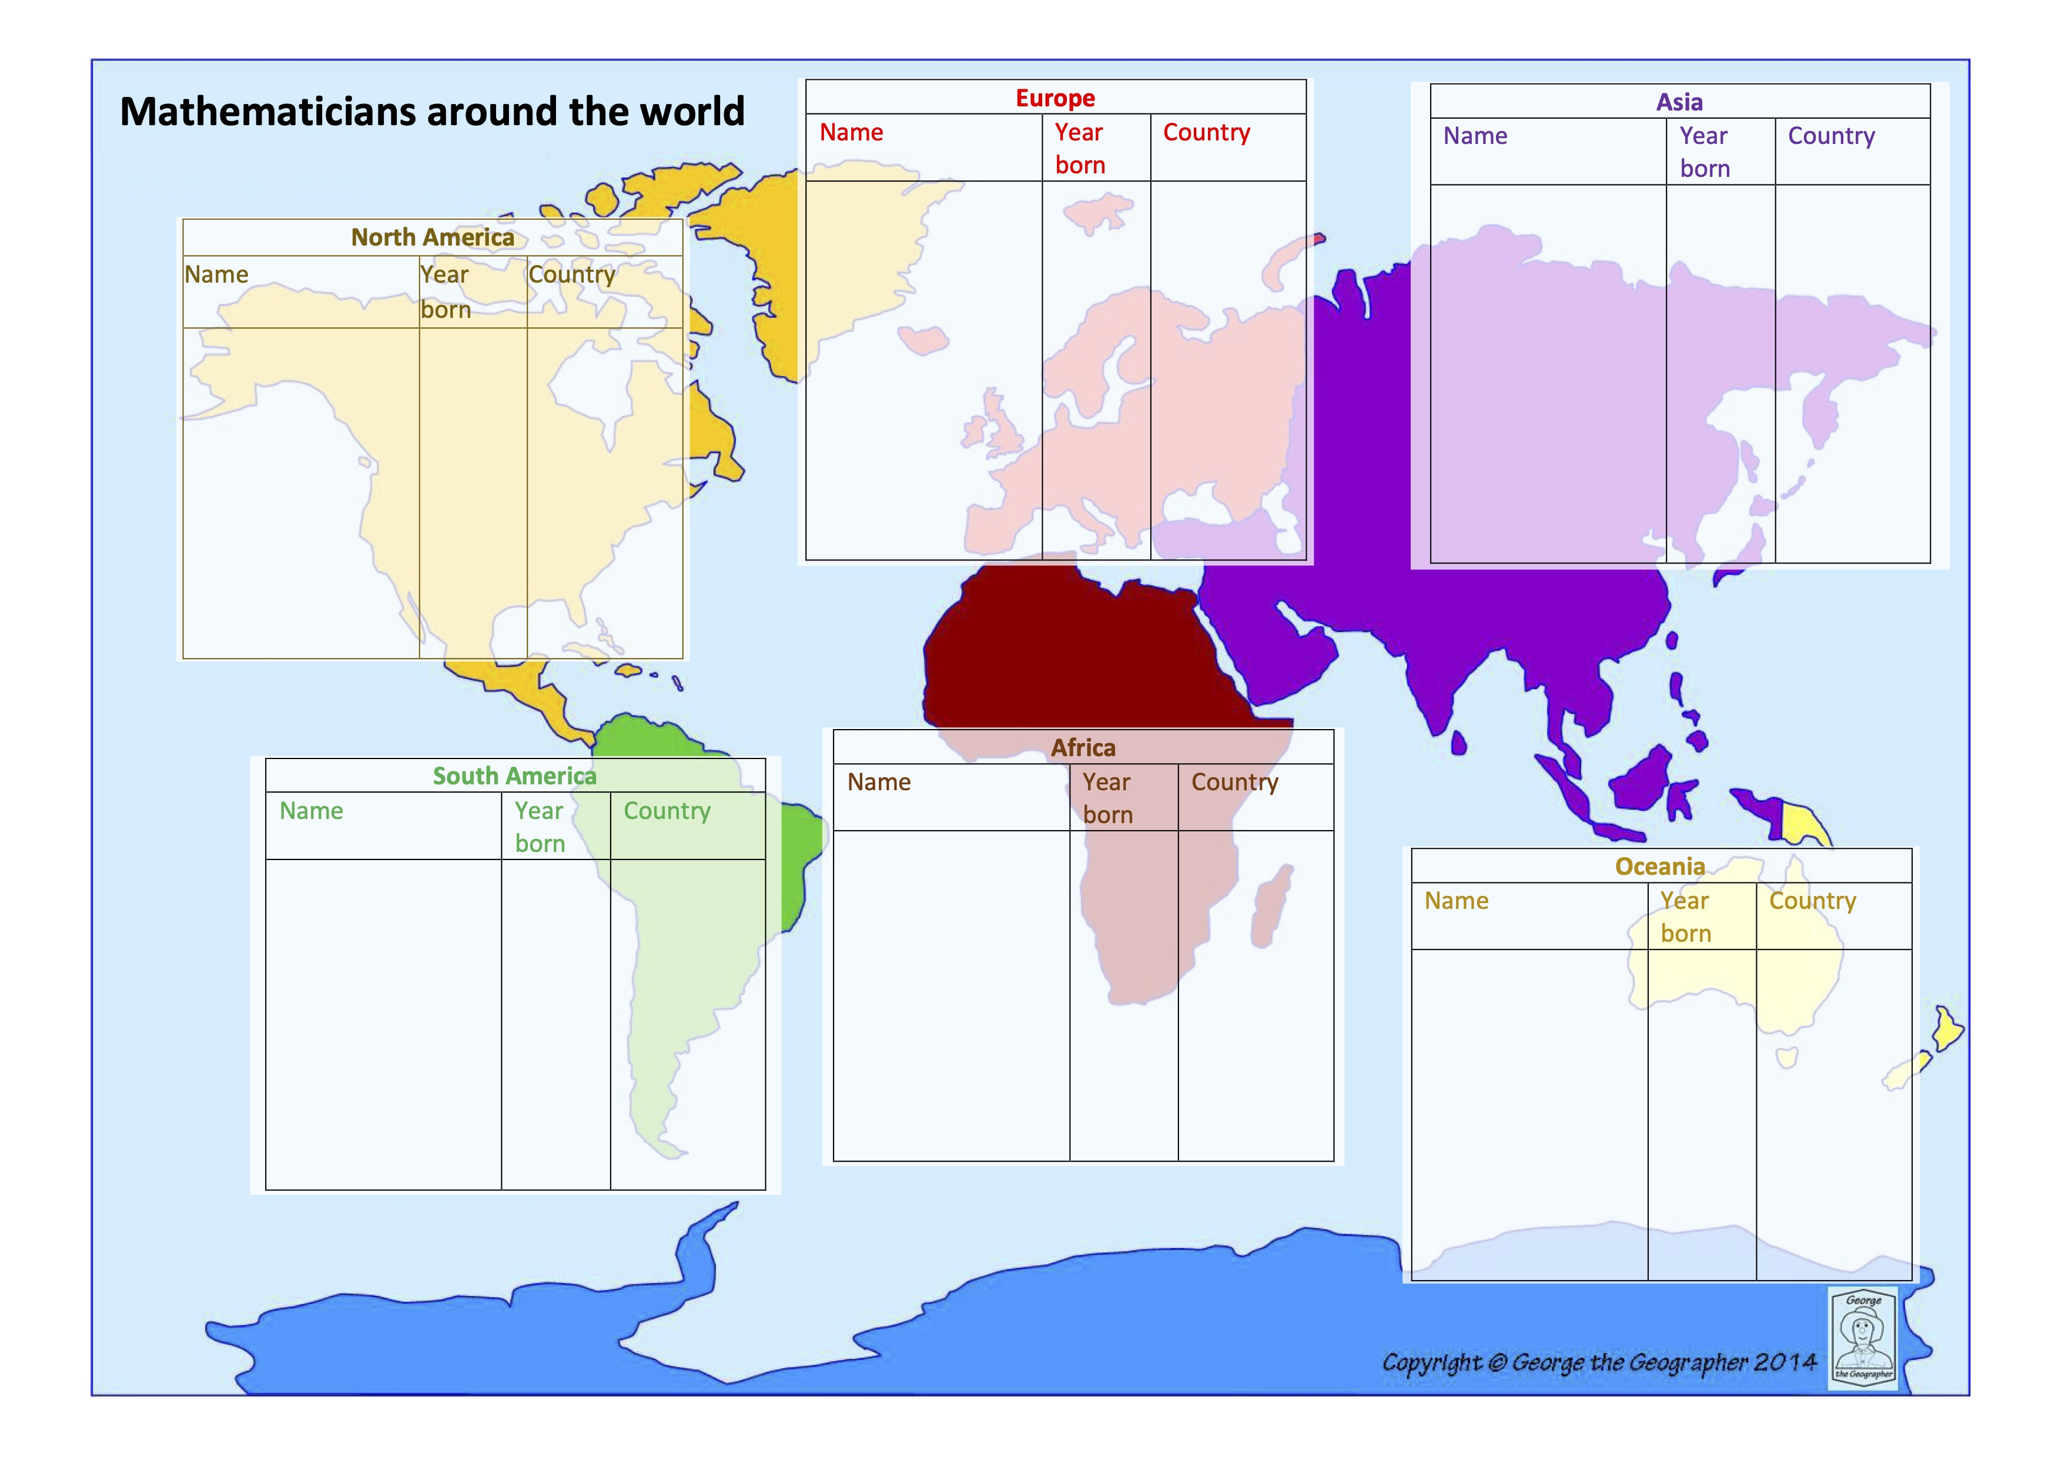
Where does our maths come from?
12.6.23
Do:
In small groups of 2 or 3, collect a ‘card’ from the pile
Record the name, birth year and birth country of your mathematician on your map
Write men and women in different colours
Take your card back and collect another
Try to get a spread of mathematicians across different continents
Tip:
For homework you will be finding out about a mathematician of your choice. Use this opportunity to find one you are interested in.
Notes:
Images to arrange numbers
Main task

Slide 16
Where does our maths come from?
12.6.23
Think:
How evenly are the mathematicians distributed across the continents?
Does date make a difference?
Do you notice any patterns in the gender distribution?
Think:
WHY do you think there are these differences?
Notes:
Images to arrange numbers
Main task

Slide 17
What did we notice?
12.6.23
Most of the mathematicians came from Europe or Asia
The mathematicians from North America were relatively recent
There were very few mathematicians from South America and Oceania and they were very recent
Most of the mathematicians from Africa came from North Africa
Notes:
Images to arrange numbers
Main task

Slide 18
Why?
It’ complicated! History is written by the victors?
Barriers to Southern Hemisphere maths history?
Oral tradition?
Slave trade?
Empire?
Oceania very cut off
Advantages for Western mathematicians
Exchange of ideas on Silk Road trade route and Roman Empire?
Printing press
Other mathematicians ‘migrate’ to European and US universties
Notes:
Image by Pete Linforth from Pixabay

Slide 19
Homework (due Friday)
9.6.23
Find at least on article about an important historical mathematician of your choice AND the kind of maths they studied. PRINT the article and bring it to your lesson on FRDAY. You will need a small picture of the mathematician or their work too.
Use the Y8 Maths LibGuide to access:
MacTutor site and/or
Britannica School
You do not need to make notes - you will do that in Friday's lesson.
Notes:
Images to arrange numbers
Main task

Slide 20
https://blanchelande.libguides.com/Y8Maths

Slide 21
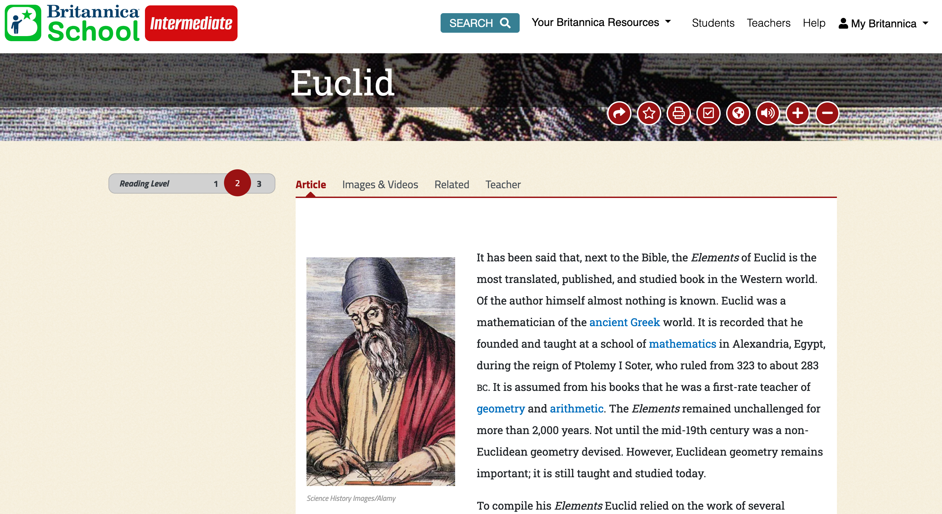

Slide 22
LO: Is maths a universal language? Lesson 3
13.6.23
FOSIL - Connect
Investigating different numerals and counting systems
Notes:
Images to arrange numbers
Main task

Slide 23
Is Maths a universal language? LO: Investigate an important mathematician
Lesson 4 - Investigate
What do mathematicians do?
What have you discovered about your mathematician?

Slide 24
LO: Is maths a universal language?
16.6.23
Next lesson you are going to be making an A3 poster in small groups of 2 or 3 on the topic ‘Is Maths a universal language?’. Your poster will need to include:
A small information panel on each of your mathematicians
Some ideas about language – perhaps with the same number expressed in several different languages, with interesting facts about those languages
Some ideas about number systems – perhaps with the same number expressed in several different languages, with interesting facts about those languages
Your group’s answer to the question!
You will also need to speak briefly about your mathematician
When your teacher puts you into groups, try to avoid being with someone who has investigated the same mathematician as you.
Notes:
Images to arrange numbers
Main task

Slide 25
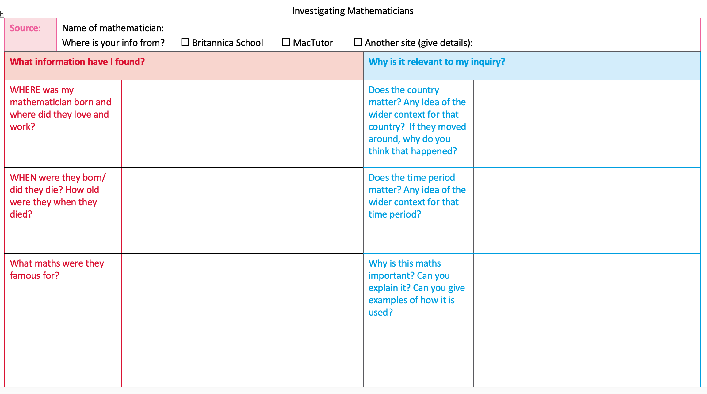
LO: Is maths a universal language?
16.6.23
Notes:
Images to arrange numbers
Main task

Slide 26
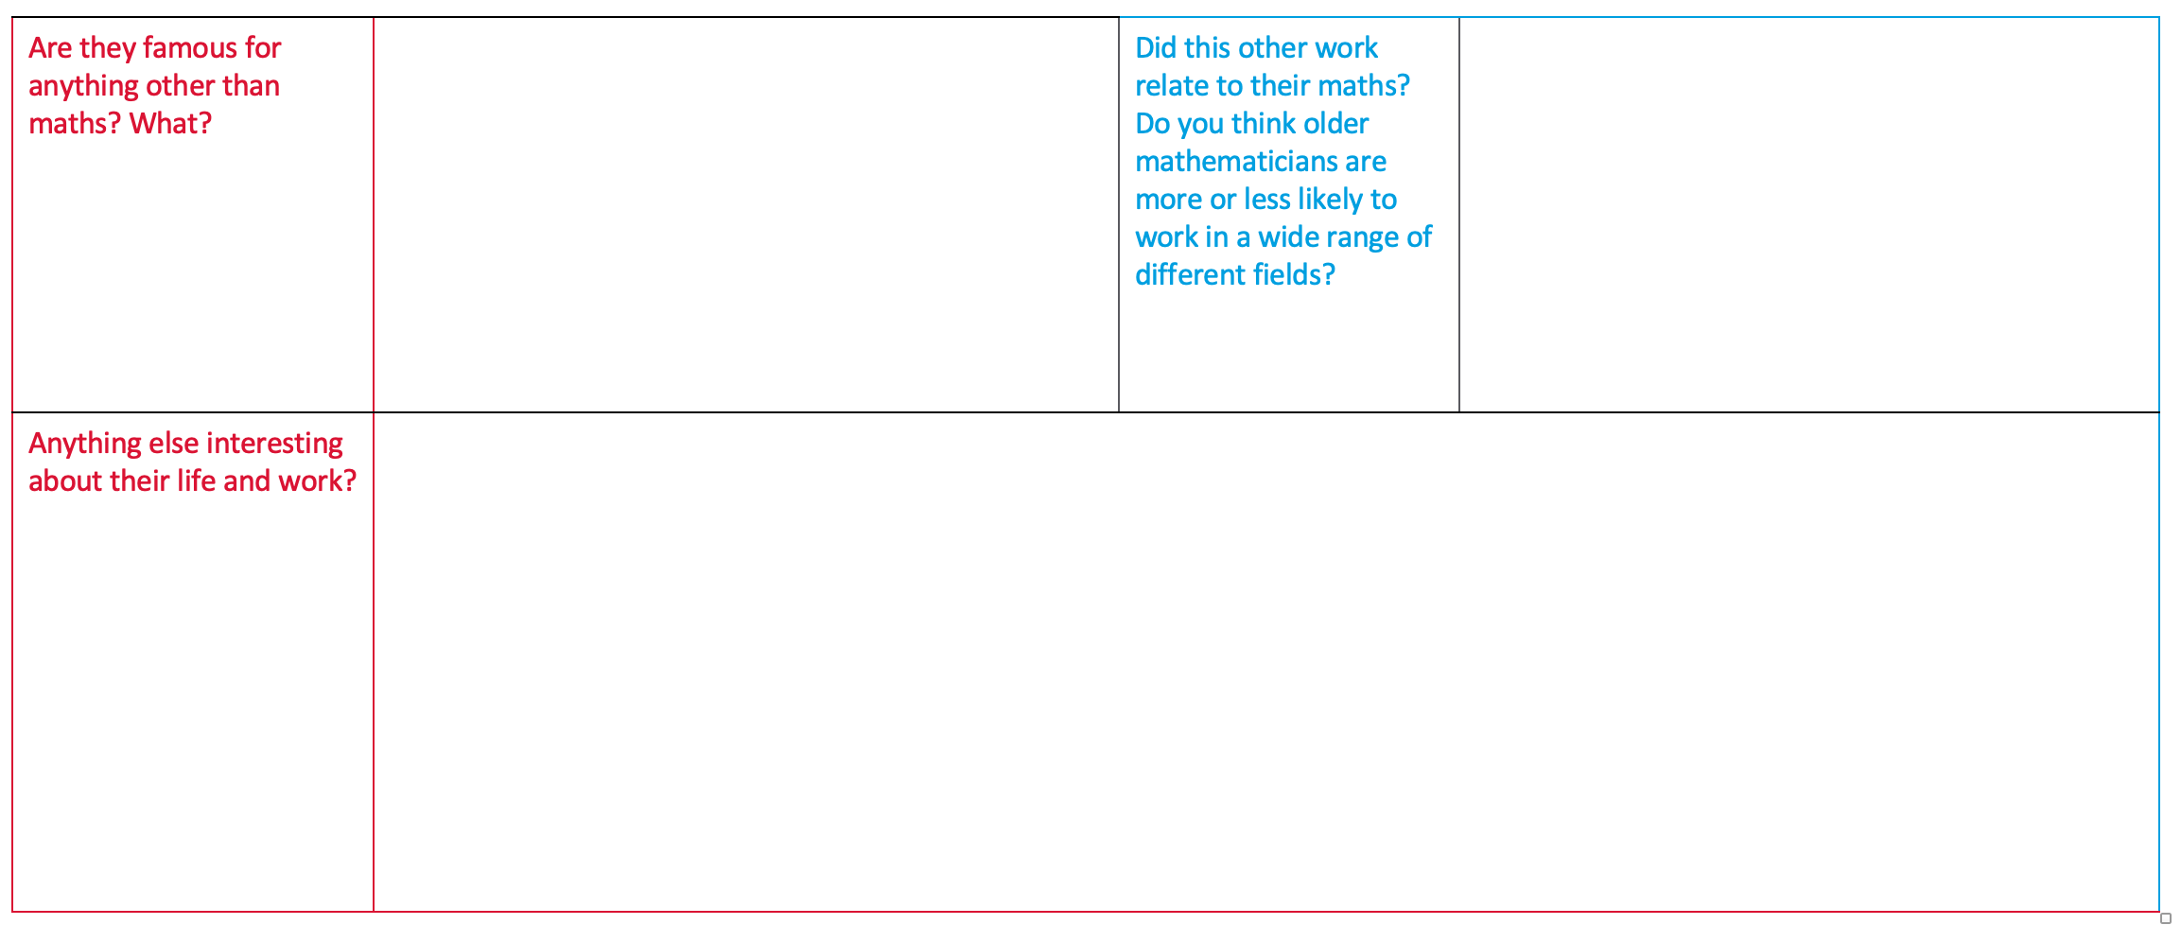
LO: Is maths a universal language?
16.6.23
Notes:
Images to arrange numbers
Main task

Slide 27
LO: Is maths a universal language?
16.6.23
Today’s tasks:
Make notes on your mathematician, focussing on the questions in the blue column
Compare your notes with the person next to you. Can you improve them?
Make a small (1/4 A4 coloured paper) information panel about your mathematician ready to stick on your poster. Make it BOLD and LEGIBLE – you don’t need to get all your info on here. If you already know who you will be making a poster with, try to use a different coloured piece of paper.
Make some ‘Cue card’ notes (white paper) for your short talk about your mathematician
HAND ANY SMALL BITS OF PAPER IN TO YOUR TEACHER AT THE END OF THE LESSON SO THEY DON’T GET LOST
Notes:
Images to arrange numbers
Main task

Slide 28
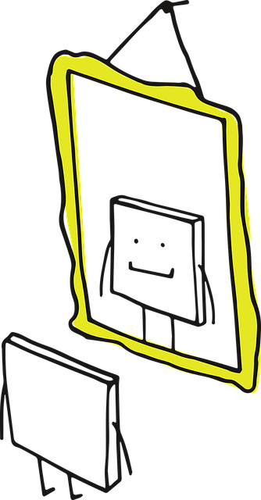
Reflection
16.6.23
Is Maths a universal language?
What have we learnt from looking at numbers, number systems and Mathematicians from around the world?
Image by Manfred Steger from Pixabay
Notes:
Images to arrange numbers
Main task

Slide 29
Is Maths a universal language?
Lesson 5 – Construct & Express
What do I think now? Is Maths a universal language?
How can I best explain my view?

Slide 30
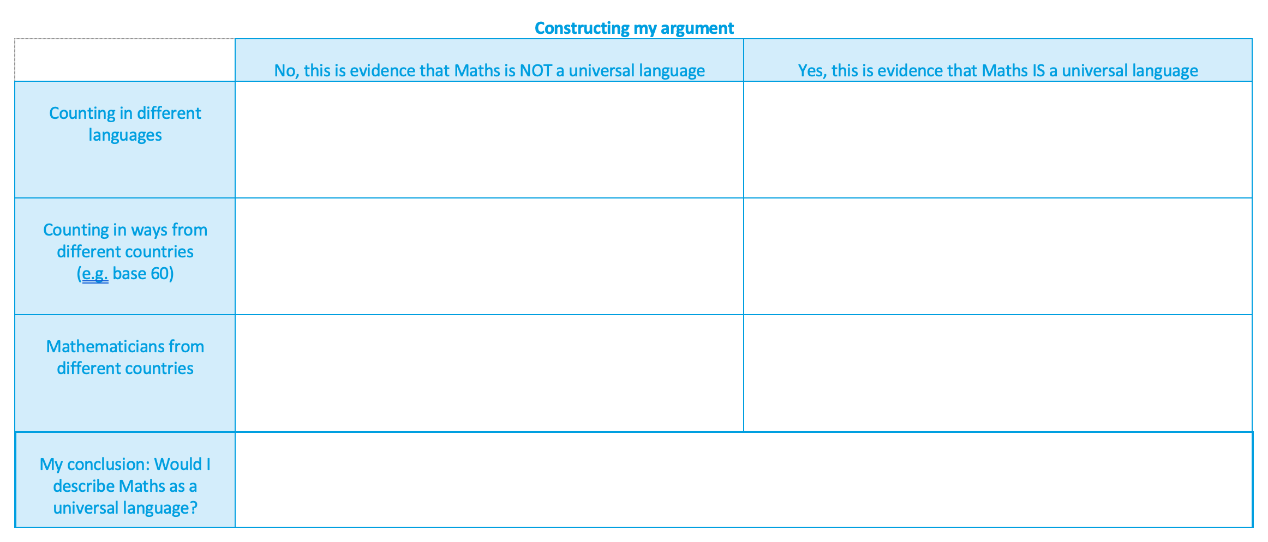
LO: Is maths a universal language?
All the languages are different. Knowing one language does not necessarily help you with any of the others.
Most languages are structured in a very similar way. If you understand the structure of the language and know the numbers 1-20, you can often guess the rest.
Counting has been a universal human activity from very early times. Although we count in different ways, it is easy to understand each other’s counting systems.
There are so many different counting systems!
Mathematicians are not evenly spread over the world, and Maths did not develop in the same way with Southern hemisphere indigenous cultures as it did in the Northern hemisphere.
Maths is studied all over the world and mathematicians and mathematical ideas move fairly freely between different countries and cultures.
What do YOU think?
Notes:
Images to arrange numbers
Main task

Slide 31
LO: Is maths a universal language?
Now produce an A3 poster in your group of 2-3.
You might want to produce different sections on small pieces of paper and stick them on. Your poster should have:
A large, clear, bold title (Is Maths a universal language?)
Something about counting in different languages (could you write the same number in several languages?)
Something about different systems of counting (again, could you write the same number in several systems?)
A panel on each of your mathematicians
Your group’s answer to the question
You will also need to talk about your mathematician, so make sure you have each produced some cue cards.
Notes:
Images to arrange numbers
Main task

Slide 32
Is Maths a universal language?
Lesson 5 & 6 –Express & Reflect
Present your poster to the class
How can your constructive criticism of other groups’ posters help you to improve your own?

Slide 33
Is Maths a universal language?
LO: Giving and receiving constructive criticism
What is interesting about the mathematicians they have chosen?
Have they explained what maths these mathematicians are famous for and why it matters?
Have they answered the question? Did they make a good case for their answer?
Have they included some information about counting in different languages and number systems?
Was their poster attractively presented? Was their talk engaging?
What constructive advice would I give them on improving their product?
Does this give me any ideas for how my product could be improved?

Slide 34
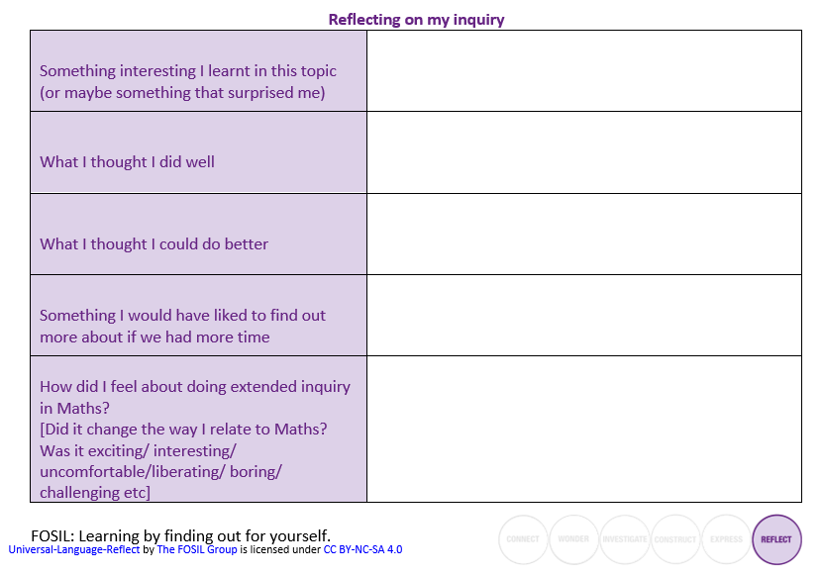
Is Maths a universal language?
The better we get at getting better, the faster we will get better.
Doug Englebart, inventor and pioneer of the computer mouse, hyperlinks and early Graphical User Interfaces

