Slide 1
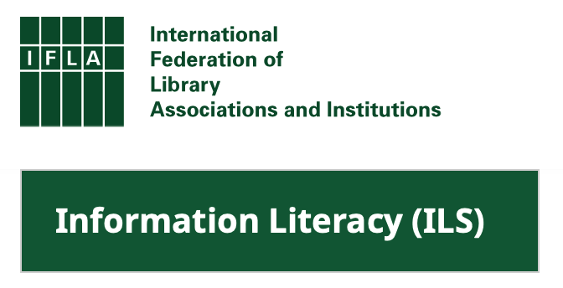
“Digital Literacy: Necessary but Not Sufficient for Life-wide and Life-Long Learning” IFLA Information Literacy Section Book Launch Libraries Empowering Society through Digital Literacy Education WLIC Satellite Meeting | 18 August 2023 Darryl Toerien​ toeriend@blanchelande.sch.gg
Blanchelande College Libraries
Enabling Heroic Inquiry
Notes:
Good afternoon from Guernsey. I regret that I am not able to join you in person and wish you a most productive Congress. Thank you to Ning and her colleagues from the Information Literacy Section who have made this event possible, and to our hosts at TU Delft.

Slide 2
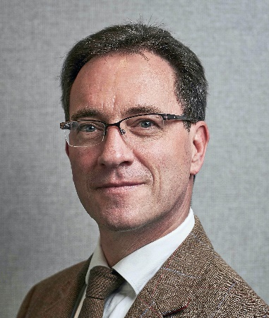
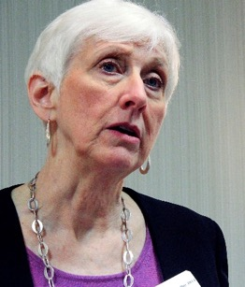
Author and Collaborator(s)
Darryl Toerien and FOSIL
FOSIL and Barbara Stripling
Head of Inquiry-Based Learning, Blanchelande College, Guernsey (since 2021)
MA equivalent Philosophy​ (1991)
Teacher of Computer Science and Religion / Philosophy​
School Librarian (since 2003)
MA Information & Library Management (2006)
Originator of FOSIL (2011), based on the Empire State Information Fluency Continuum
Originator of the FOSIL Group (2019)
Co-opted Board Member of the UK School Library Association (since 2018)
Elected member of the Standing Committee of the IFLA School Libraries Section (2019 – 2023)
Member of the International Association of School Librarianship (since 2019)
FOSIL is based on the work of Barbara Stripling, Professor Emerita, School of Information Studies, Syracuse University, NY
Co-originator of the Research as a Thinking Process model and REACTS Taxonomies (1988)
Originator of Stripling’s Model if Inquiry (2003)
Originator of the Empire State Information Fluency Continuum (2009, reimagined 2019)
FOSIL Group member (2020)
Weekly meetings (since 2020)
Global Action for School Libraries: Models of Inquiry (IFLA, 2022)
The Stripling Model of Inquiry
FOSIL: Developing and Extending the Stripling Model of Inquiry
Deep Collaboration by Teacher and Librarian to Develop an Inquiry Mindset [using FOSIL]
Notes:
By way of introduction, I highlight four things. Firstly, I have been a school librarian since 2003, and professionally qualified since 2006. For practically all of my time as a school librarian I have served on the National Committee of the CILIP School Libraries Group and/ or the Board of the UK School Library Association. Secondly, by 2011 I had developed FOSIL – which stands for Framework Of Skills for Inquiry Learning – and which is an instructional model of the inquiry process that is based on the work of Barbara Stripling as reflected in the Empire State Information Fluency Continuum. To more effectively support growing interest in FOSIL, both within the UK and beyond, I led the establishment of the FOSIL Group in 2019, whose membership, which is free, now represents more than 35 countries. Thirdly, Barbara Stripling developed her instructional model of the inquiry process in 2003, which is central to the ESIFC, and which was published along with a Pre-Kindergarten to Grade12 continuum of inquiry skills – metacognitive, cognitive, emotional, social and cultural – in 2009 and re-imagined in 2019. The ESIFC serves more than 3.2 million children in 4,236 schools in New York State alone, and has been widely adopted and adapted beyond New York State and the US. Fourthly, since early in 2020, Barbara and I have meeting weekly to collaborate on the ongoing development of both the ESIFC and FOSIL, which are two of the five models included in the recent IFLA book, Global Action for School Libraries: Models of Inquiry.

Slide 3
The End of the World As We Know It!?
Our multifaceted existential crisis is epistemological in nature – a breakdown of the knowledge-building process, which is the inquiry process.
Jonathan Rauch (2021)
Notes:
Jonathan Rauch is not alone in pointing out that our very real existential crisis is epistemological in nature, a breakdown of the knowledge-building process, which is the inquiry process.

Slide 4
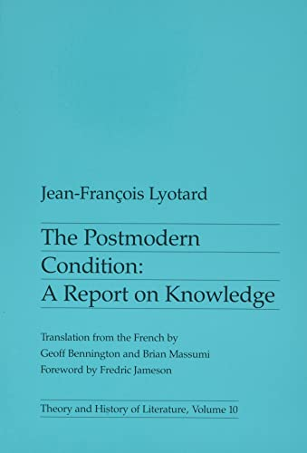
“The Unhinging of the American Mind: …”
Knowledge* and the knowledge-building / inquiry process in the various academic disciplines becomes suspect, as ‘reported’ by Lyotard (1984)
*To know is to be able to think of things as they are {reality}, as distinct from how they only seem or are taken to be, and to be able to do so on the appropriate basis of experience or thought.**
**Also what it means to be educated at least since Aristotle.
Dallas Willard (1999)
Notes:
The epistemological roots of this existential crisis reach far back. Dallas Willard – in his paper, The Unhinging of the American Mind - Derrida as Pretext – makes the point that already by 1984 Jean-Francois Lyotard was able to ‘report’ that knowledge and the knowledge-building/ inquiry process in the various academic disciplines had become suspect. Not only did this development break the connection between knowledge and reality, it also broke the connection between knowledge and being educated that had held since Aristotle.

Slide 5
Inquiry as Integral to Liberal Democracy
This imperils the Constitution of Knowledge* upon which liberal democracy depends and which depends upon a vital reality-based community of error-seeking inquirers.
* Our social system and its underlying values for turning information into knowledge, and arguments into facts.
Jonathan Rauch (2021)
Notes:
This weakening of the reality-based community of error-seeking inquirers who uphold and are upheld by the Constitution of Knowledge leaves us without the means to turn information into knowledge and argument into facts.

Slide 6
Consequences of an Unhinged Mind
Growing vulnerability to “desire and will/ brute force…as social processes come to be managed by people who simply know how to get their way among a mass of those who no longer…can [or care to], with the aid of their culture’s texts and the traditional disciplines, determine how things are…”.
Dallas Willard (1999)
Notes:
Consequently, we are increasingly vulnerable to those who merely know how to get their own way among a growing number of people who are unable to recognise and so call out bullshit, as Neil Postman so bluntly puts it in his timeless essay, Bullshit and the Art of Crap Detection.

Slide 7
Inquiry: An Overarching Educational Imperative
“Upon this first, and in one sense this sole, rule of reason
– that in order to learn you must desire to learn, and in so desiring not be satisfied with what you already incline to think –
there follows one corollary which itself deserves to be inscribed upon every wall of the city of philosophy:
Do not block the way of inquiry.”
Charles Sanders Pierce (1955, p. 54)
Notes:
This establishes inquiry as an overarching imperative, which Charles Sanders Peirce articulates so powerfully in terms of both stance and process. If we are to achieve this in society, then we need school.

Slide 8
The Questionable Value of School
“School, after all, is the one institution in our society that is inflicted on everybody, and what happens in school makes a difference – for good or ill.”
Neil Postman & Charles Weingartner (1969, p. 36)
Notes:
The reason for this, as Neil Postman and Charles Weingartner point out, is that “school…is the one institution in our society that is inflicted on everybody, and what happens in [the many years of a child’s time] in school makes a difference – for good or ill.”

Slide 9
The Reality of School!?
“Our system of education turns young people out of the schools able to read, but for the most part unable to weigh evidence or to form an independent opinion. They are then assailed, throughout the rest of their lives, by statements designed to make them believe all sorts of absurd propositions…”
Bertrand Russell (1922)
Notes:
Rauch makes no mention of schools in strengthening the reality-based community of error seeking inquirers, which is unsurprising to the extent that schools continue to turn out students who, as Bertrand Russell observed more than a century ago, for the most part are unable to weigh evidence or to form an independent opinion.

Slide 10
Inquiry as a [most] Potent Survival Strategy
“Of all the ‘survival strategies’ education has to offer, none is more potent or in greater need of explication than the ‘inquiry environment.’”
Neil Postman & Charles Weingartner (1969, p. 36)
Notes:
While perhaps unsurprising, it is, nevertheless, alarming, given the many years of schooling that the majority of children are subjected to, and doubly so given the educational promise of inquiry to school more than half a century ago. So how was this promise sapped of its potency?

Slide 11
Breaking the Promise of Inquiry #1, #2 and #3
Divorcing inquiry as a dynamic process and/ or skills from learning important content.
Reducing inquiry to a mechanical process by divorcing it from a spirit of wonder and puzzlement.
Neil Postman (1979, p. 214)
Divorcing inquiry from both a spirit of wonder and puzzlement and a dynamic process, thereby reducing it to a thoughtless fact-finding activity.
Notes:
By 1979, Postman had identified two debilitating tendencies that had sapped inquiry of its educational potency, from which we identified a third.

Slide 12
Breaking the Promise of Inquiry #4
The “engineering of learning” through ever-more technical teaching methods based on ‘hard evidence’ from the field of cognitive science.
Neil Postman (1996)
Notes:
By 1996, Postman had identified a fourth debilitating tendency, which, if anything, has gained in its potency since then. Now, Postman makes no mention of school libraries and/ or school librarians in this history of inquiry, which is alarming and perplexing, because by 1996 the evolution from research process models to inquiry process models in and through the library was already underway, and because it reveals a disconnect between school librarianship and the larger education community, or a progressive element within it, that stretches back to at least the 1960s.

Slide 13
Consequences of an Educational Disconnect
“The [ongoing] losses of school librarians [in the United States] are not solely based on school finances — a common reason for eliminating [them] ... a major contributor to those losses has been a ‘disconnect’ between school librarianship and the larger education community.”
Keith Curry Lance & Debra E. Kachel (2021)
Notes:
This persistent “disconnect” requires further investigation if its disastrous consequences for school librarians and the larger education community, especially our students, are to be reversed.

Slide 14
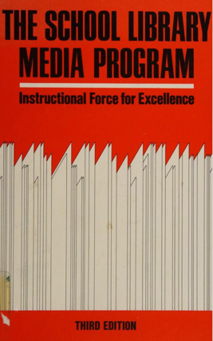
(Re)Establishing an Educational Connect
“a teacher of sense-making skills”
Barbara Stripling (2020)
"a teacher whose subject is learning itself”
Douglas M. Knight (1968) in Davies (1969)
Notes:
As Ruth Ann Davies points out, “the library media program and the educational program are interdependent and inseparable. … Therefore, perspective in viewing the function and role of the school library media program begins logically by building a historical understanding of education itself.” An essential first step is for school librarians to recognise that they are specialist teachers whose subject is, as Douglas Knight observes, the learning process itself, which is the inquiry process.

Slide 15
Inquiry: An Educational and Moral Imperative
Recovering the Educational Promise of Inquiry
UK School Library Association 2021 Keynote Address
12 June 2021
Barbara Stripling | Darryl Toerien
Notes:
An important tool in the work of recovering the educational promise of inquiry is the second edition of the IFLA School Library Guidelines (2015), which draws together more than 50 years of international research into effective school libraries. The Guidelines establish an educational and moral purpose for school libraries, which is the only reason why school libraries exist, and a keynote address at the UK School Library Association Conference in 2021 gave Barbara Stripling and me the opportunity to argue that inquiry is the means to this educational and moral end.

Slide 16
The Means to an Educational & Moral End
Without a instructional program – a planned comprehensive offering of teaching and learning activities – a school library will not accomplish is educational purpose, and therefore, its moral purpose.
IFLA School Library Guidelines (p. 18)
Notes:
The means through which the library achieves this educational and moral end is through its instructional program, which is a planned comprehensive offering of teaching and learning activities.

Slide 17
An Inquiry-Centred Instructional Program
Core instructional activities:
Literacy & reading promotion
Media & information literacy
Can be included in inquiry-based learning
Inquiry-based learning
Includes media & information literacy
Encompasses all instructional activities
Technology integration
Professional development for teachers
IFLA School Library Guidelines (p. 8)
Notes:
The Guidelines identify five core instructional activities, central to which is inquiry. We argued, and have gone on to demonstrate, that an inquiry-centred instructional program both encompasses all of the librarian’s core instructional activities and ensures a balanced instructional program. Also, and of particular relevance to the chapter under discussion, while MIL can be approached as a discrete instructional activity, the Guidelines strongly advocate for the development of MIL skills and strategies within an inquiry-based approach to learning and teaching.

Slide 18
Development of MIL Within Inquiry Process
“Like other learning programs at school, inquiry-based learning activities should be designed to promote progression and continuity in students’ learning…skills must be introduced progressively through stages and levels. A school librarian should take a leadership role in ensuring there is a systematic approach to teaching an inquiry process that is guided by a school-based continuum of media and information skills and strategies.”
IFLA (2015, p. 43)
Notes:
An outstanding feature of the ESIFC, which also makes it unique, is the highly detailed continuum of MIL and other skills within a sound instructional model of the inquiry learning process. This continuum of Pre-Kindergarten to Grade12 inquiry skills – metacognitive, cognitive, emotional, social and cultural – was first developed in 2009, and re-imagined in 2019 in large part to take into account the increasingly digital nature of the inquiry environment.

Slide 19
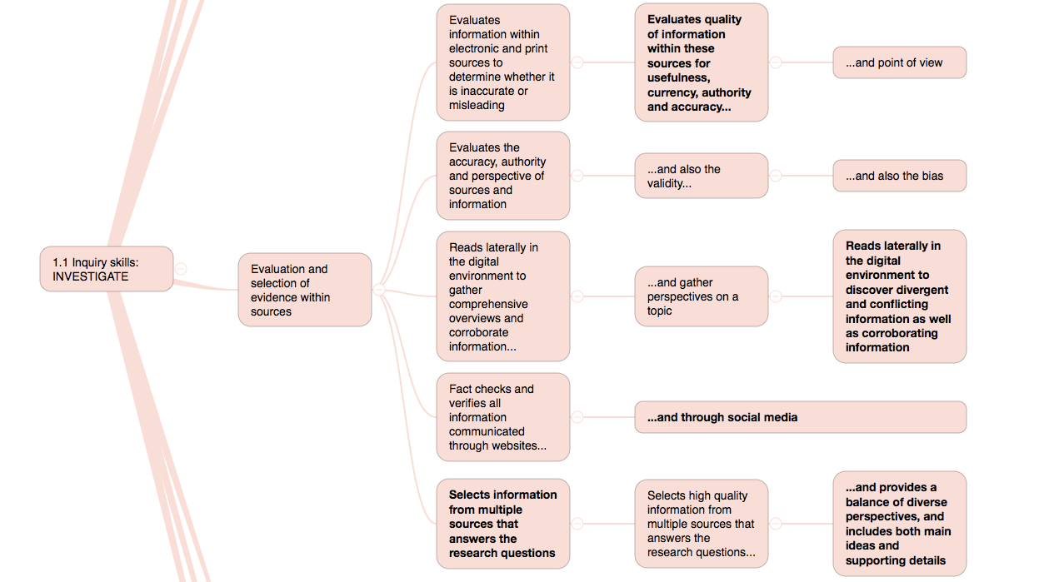
Grade 6 / Year 7
Grade 7 / Year 8
Grade 8 / Year 9
Notes:
Some of these inquiry skills are IT-dependent by definition – for example, reading laterally in the digital environment in Grades 6-8 – and some are so in use – for example, citing and referencing.

Slide 20
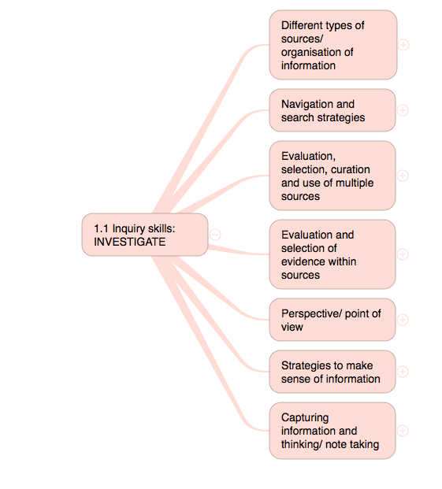
FOSIL as PK-12 Continuum of Inquiry Skills
Notes:
Another outstanding feature of the ESIFC/ FOSIL, is the systematic grouping of these discrete skills – developed progressively over time – into functional skill sets…

Slide 21
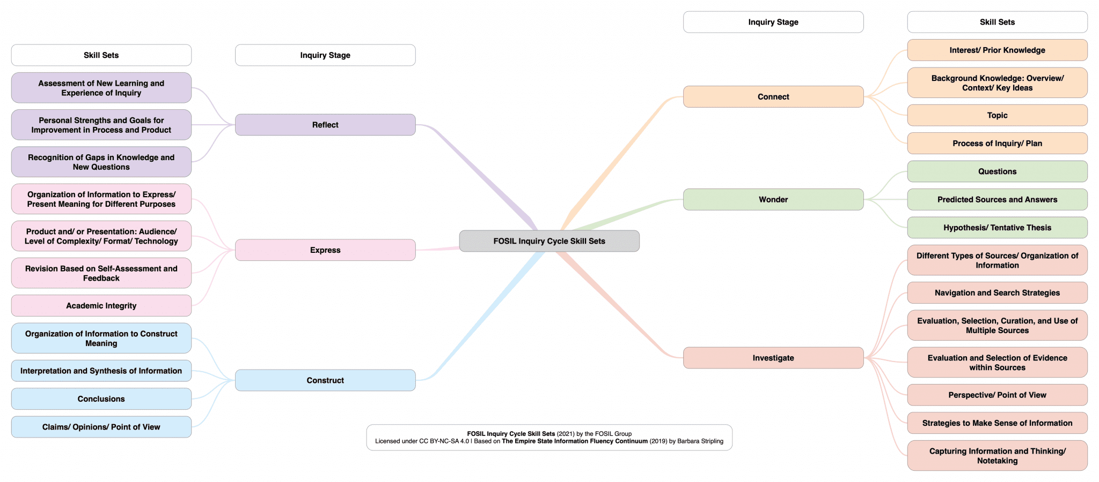
FOSIL Inquiry Cycle Skill Sets
Notes:
…that are located logically within the stages of the inquiry learning process: Connect -> Wonder -> Investigate -> Construct -> Express -> Reflect.

Slide 22
Instructional Models of the Inquiry Process
Stripling’s Model of Inquiry (2003)
Framework Of Skills for Inquiry Learning
(2011 & Primary below in 2022)
Notes:
While no model can fully describe the reality it represents, another outstanding feature of the ESIFC/ FOSIL is how simply it describes the inquiry process without the resulting model losing any of its explanatory power.

Slide 23
Inquiry Process Directed at Subject Knowledge
“Providing a model of the inquiry process is only the first step in empowering students to pursue inquiry on their own. The next step is to structure teaching around a framework of the [inquiry] skills that students must develop at each phase of inquiry over their years of school and in the context of content area learning.”
Barbara Stripling (2017, p. 52)
Notes:
In Empowering Students to Inquire in a Digital Environment (2017), Barbara directly addresses two of the debilitating tendencies that sap inquiry of its educational potency, namely, (1) divorcing inquiry as a dynamic process and/ or skills from learning important content, and (3) divorcing inquiry from both a spirit of wonder and puzzlement and a dynamic process, thereby reducing it to a thoughtless fact-finding activity.

Slide 24
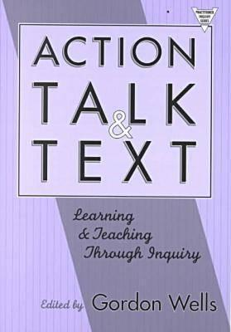
Inquiry as a Primal Learning Process
Inquiry is “a dynamic process of being open to wonder and puzzlement and coming to know and understand the world and ourselves in it as the basis for responsible participation in community” (Stripling & Toerien, 2021).
Galileo Educational Network (professional learning arm of the School of Education at the University of Calgary, 1999-2022)
Developing Inquiring Communities in Education Project (led by the Ontario Institute for Studies in Education at the University of Toronto, 1991-2001)
Notes:
Our keynote at the UK School Library Association Conference in 2021 gave Barbara and me the opportunity to develop a shared definition of inquiry, which directly addresses the debilitating tendency to (2) reduce inquiry to a mechanical process by divorcing it from a spirit of wonder and puzzlement. Our definition is rooted in and enlarges the definition developed by the Galileo Educational Network, the professional learning arm of the School of Education at the University of Calgary from 1999-2022. The outstanding work of the GEN is itself rooted in the equally outstanding work of the Developing Inquiring Communities in Education Project, which was led by Gordon Wells from the Ontario Institute for Studies in Education at the University of Toronto from 1991-2001. It is worth noting here Wells’ concluding reflection on the decade's work of DICEPS: “the force that drives the enacted curriculum must be a pervasive spirit of inquiry, and the dominant purpose of all activities must be an increase in understanding … teacher and students together must become a community of inquiry with respect to all aspects of the life of the classroom and all areas of the curriculum” (p. 7).
Neither DICEPS nor GEN make mention of school librarians, underscoring the educational disconnect already noted, as well as the ongoing and urgent need for explication of the inquiry environment.

Slide 25
Portrait of an Engaged and Empowered Inquirer at Grade 12 (Year 13)
Notes:
Finally, the development of the Portrait of an Engaged and Empowered Inquirer at Grade 12 [and also Grade 8, Grade 5 and Grade 2] – which inquiry has as its end, and which is the means to this end – enables us to begin addressing the fourth, and arguably most, debilitating tendency, which is the “engineering of learning” through ever-more technical teaching methods based on ‘hard evidence’ from the field of cognitive science. The Portraits do so by enlarging this reductionist, and harmful, view of what it means to be educated.

Slide 26
Building a Reality-Based Community of Inquiry
While inquiry necessarily involves “personal struggles to find the right questions and assemble mosaic tiles of information to tell the tale coherently … acquiring knowledge is a conversation, not a destination ... a process [or] journey we take together, not alone [because] others are always involved {both living and dead}.”
Jonathan Rauch (2021, pp. 3-4)
Notes:
This identifies a vital role for schools, and school librarians as integral to this educational process within schools, in equipping their students for their vital role in strengthening the reality-based community of error-seeking inquirers upon whom our liberal democracy depends. The question is, do we embrace it?

Slide 27
Information Literacy ≠ Inquiry
"Inquiry requires information literacy skills. When library media specialists and teachers collaborate to create an inquiry approach to learning, students develop dual competencies in subject content and information literacy.”
Carol Kuhlthau (1999, p. 11)

