Slide 1
Building Communities of Inquiry “Curriculum as Groups of Communities” (Young, 2022)
Blanchelande College Staff INSET
5 September 2023
Darryl Toerien | Jenny Toerien
toeriend@blanchelande.sch.gg | toerienj@blanchelande.sch.gg
Blanchelande College Libraries
Enabling Heroic Inquiry
Notes:
“The curriculum is not just a body of knowledge; it’s a group of communities we must encourage our students to join.”
Young, M. (2022, September 21). What we’ve got wrong about knowledge & curriculum. (G. Duoblys, Interviewer) Tes Magazine.

Slide 2
Our High Calling to Inquiry
“Upon this first, and in one sense this sole, rule of reason
– that in order to learn you must desire to learn, and in so desiring not be satisfied with what you already incline to think –
there follows one corollary which itself deserves to be inscribed upon every wall of the city of philosophy: Do not block the way of inquiry.”
Charles Sanders Pierce (1955, p. 54)
Notes:
Pierce’s rule of reason and its corollary capture the essence of a liberal education.
“I would remind them of a point [Russian psychologist] Lev Vygotsky made: that acquiring knowledge in school has to be the voluntary act of a learner. You can’t actually teach anybody anything; they have to learn it. You can help them, but they’ve got to have that desire to know.”
Young, M. (2022, September 21). What we’ve got wrong about knowledge & curriculum. (G. Duoblys, Interviewer) Tes Magazine.

Slide 3
DICEP (Developing Inquiring Communities…)
DICEP (1991-2001) foundational to GEN (1999-2022)
The force that drives the enacted curriculum must be a pervasive spirit of inquiry, and the dominant purpose of all activities must be an increase in understanding
However, no straightforward, universal method of achieving these goals
If classrooms were to become places where students were actively and enthusiastically attempting to construct answers to questions that were of real interest to them…more would be needed than the introduction of prepackaged inquiry activities, taken from teachers' manuals or downloaded from the Internet
Really interesting questions rarely had simple answers
Each classroom is thus unique. And so, if teachers are to create communities that work collaboratively toward shared goals while valuing diversity of opinion and personal learning style and, at the same time, are to foster individual initiative and creativity, they also must approach the task in a spirit of inquiry....In fact, teacher and students together must become a community of inquiry with respect to all aspects of the life of the classroom and all areas of the curriculum
Notes:
Developing Inquiring Communities in Education Project (led by the Ontario Institute for Studies in Education at the University of Toronto, 1991-2001) and Galileo Educational Network (professional learning arm of the School of Education at the University of Calgary, 1999-2022).
DICEP and GEN provide us with 30 years of theory-informed practice and practice-refined theory.
Recall Young’s point about the curriculum being a group of communities we must encourage our students to join.

Slide 4
Recovering the Educational Promise of Inquiry IASL 2023 Extended Workshop 17 July 2023 Darryl Toerien​ | Jenny Toerien toeriend@blanchelande.sch.gg | toerienj@blanchelande.sch.gg
Blanchelande College Libraries
Enabling Heroic Inquiry
Notes:
Our specific focus was the Year 6 interdisciplinary inquiry.
More broadly…

Slide 5
Breaking the Promise of Inquiry #1, #2, #3, #4
Divorcing inquiry as a dynamic process and skills from learning important content.
Reducing inquiry to a mechanical process by divorcing it from a spirit of wonder and puzzlement.
Neil Postman (1979, p. 214)
Divorcing inquiry from both a spirit of wonder and puzzlement and a dynamic process, thereby reducing it to a thoughtless fact-finding activity – FOFO (INSET dated 2023.01.04).
The “engineering of learning” through ever-more technical teaching methods based on ‘hard evidence’ from the field of cognitive science.
Neil Postman (1996, pp. 26-27)
Notes:
Regarding point 4, recall Michael Young’s warning [almost 30 later!] that “if you haven’t encouraged students to engage in the process of acquiring knowledge, which is a very difficult process, then all you get is memorisation and reproduction in tests.”
Young, M. (2022, September 21). What we’ve got wrong about knowledge & curriculum. (G. Duoblys, Interviewer) Tes Magazine.

Slide 6
Thinking/ acting locally/ globally
IASL
President (Canada)
Vice President: Operations (Sweden)
Regional Directors
Africa (Nigeria)
North America (Barbara Stripling / Pennsylvania)
AASL National Conference (Tampa Bay, Florida)
Latin America / Caribbean (Brazil | Also IFLA)
Europe (Croatia)
Oceania (Australia / Charles Sturt University)
International Schools (Switzerland)
Lasallian Institute
Brother George Van Grieken (Secretary Coordinator)
Archivist (Rome and Paris)

Slide 7
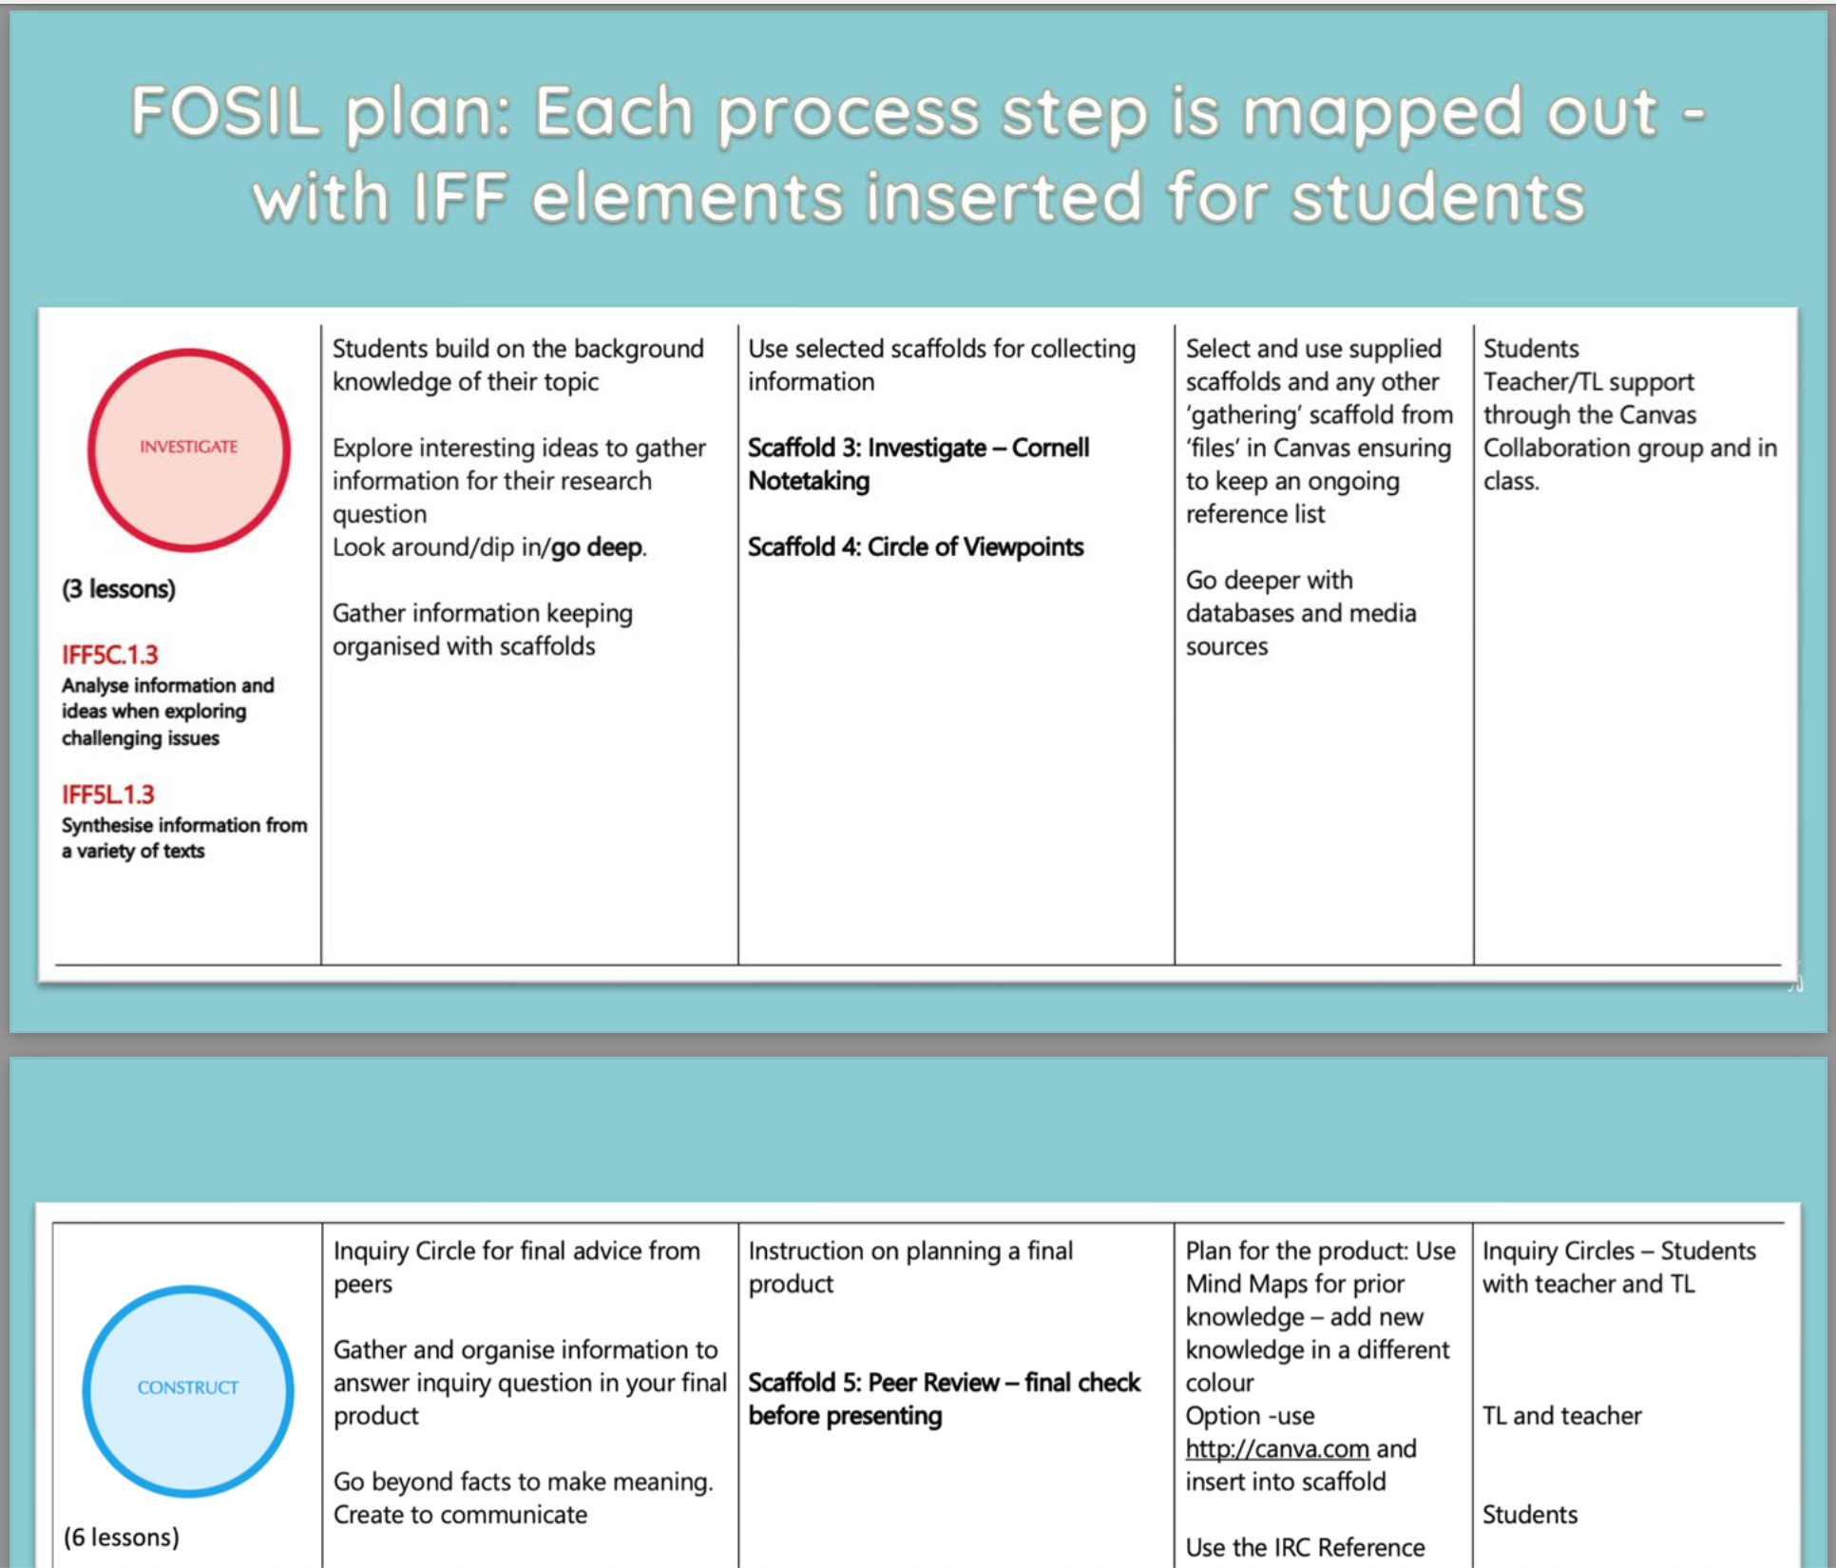
FitzGerald, Sheerman & Garrison (IASL, 2023)
NSW DoE / Charles Sturt University
Information Fluency Continuum
Loreto Kirribilli (Year 12 History) and
Broughton College (Year 8 Commerce)
Notes:
Lee FitzGerald and Alinda Sheerman travelled back to Australia via Guernsey, specifically to visit Blanchelande College because of the concept of heroic inquiry developed here and its implementation.

Slide 8
“Digital Literacy: Necessary but Not Sufficient for Life-Wide and Life-Long Learning” IFLA Information Literacy Section Book Launch Libraries Empowering Society through Digital Literacy Education WLIC Satellite Meeting | 18 August 2023 Darryl Toerien​ toeriend@blanchelande.sch.gg
Blanchelande College Libraries
Enabling Heroic Inquiry

Slide 9
Inquiry as Integral to Living, Moving and Being
Our existential crisis is epistemological in nature – a breakdown of the knowledge-building / inquiry process.
Establishing a critical role for schools in strengthening the “reality-based community of error-seeking inquirers” upon which democracy depends.
Note: The constitution of knowledge is “our social system and its underlying values for turning information into knowledge, and arguments into facts” (Rauch, 2021).

Slide 10
Inquiry as Integral to Non-Trivial Schooling
“Non-trivial schooling can provide a point of view from which what is {reality} can be seen clearly, what was as a living present, and what will be as filled with possibility.”
Neil Postman (1996, p. x)
Notes:
Our children desperately need credible/ practicable hope for the future.

Slide 11
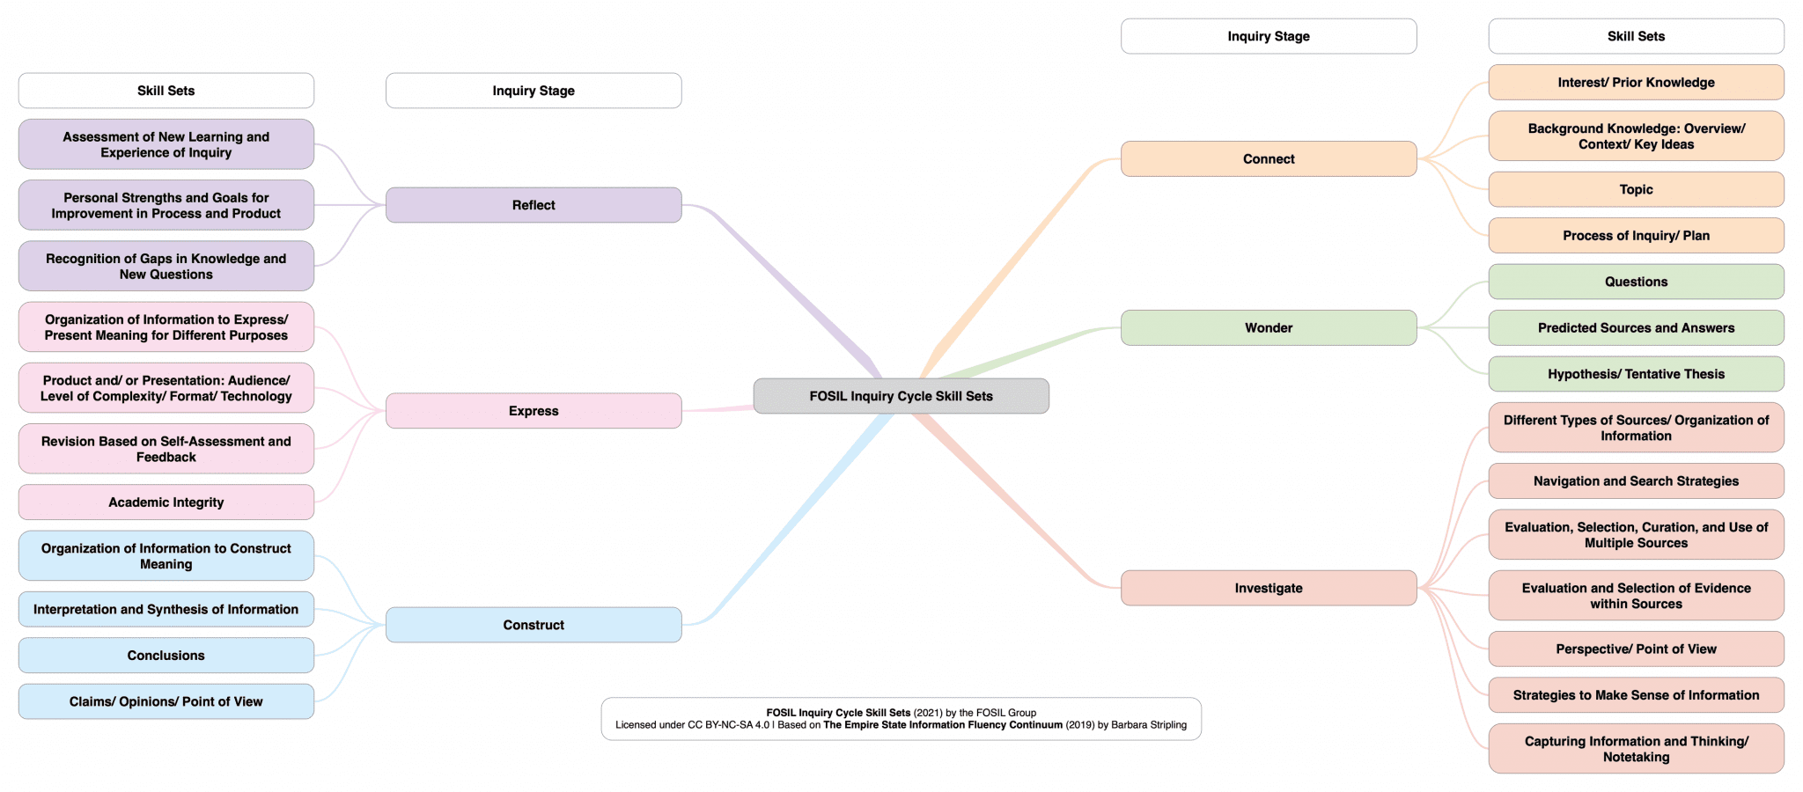
Recovering the Promise of Inquiry #1, #2, #3
Definition, plus
FOSIL as instructional model, plus
FOSIL as framework of skills
Notes:
Our definition of inquiry, a sound instructional model of the inquiry process, and underlying framework of PK-12 inquiry skills address the first three debilitating tendencies that rob inquiry of its educational potency.

Slide 12
Recovering the Promise of Inquiry #4
Attributes of an Engaged and Empowered Inquirer at Year 13, 9, 6, 3
Independent Learning Competencies
Inquiry stance and process
Strong Self-Identity
Social and Emotional Attributes
Cultural Responsiveness
Voice and Agency
Growth Mindset
Inquiry has this as its end and is the means to this end
Notes:
The attributes of an Engaged and Empowered Learner at Year 13, 9, 6, and 3 address the fourth debilitating tendency that robs inquiry of its educational potency.

Slide 13
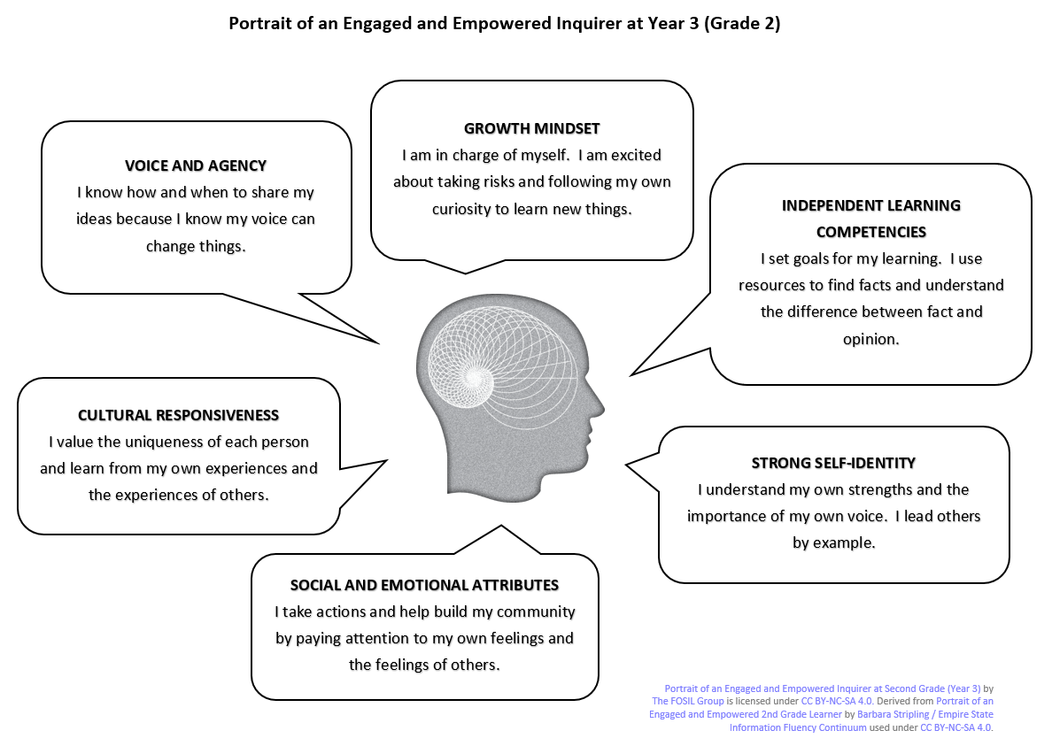
Year 1-3 Portrait Attributes
Notes:
Transitions:
Attributes
Attributes expressed in an age-appropriate way
An inquiry involving all stages of the inquiry process develops attribute-typical skills in each stage of the inquiry process
However, age-appropriate skills that are…
…attribute-typical, and that may not be taught or developed within an inquiry…
…inevitably still contribute vitally to developing an inquiry stance and process

Slide 14
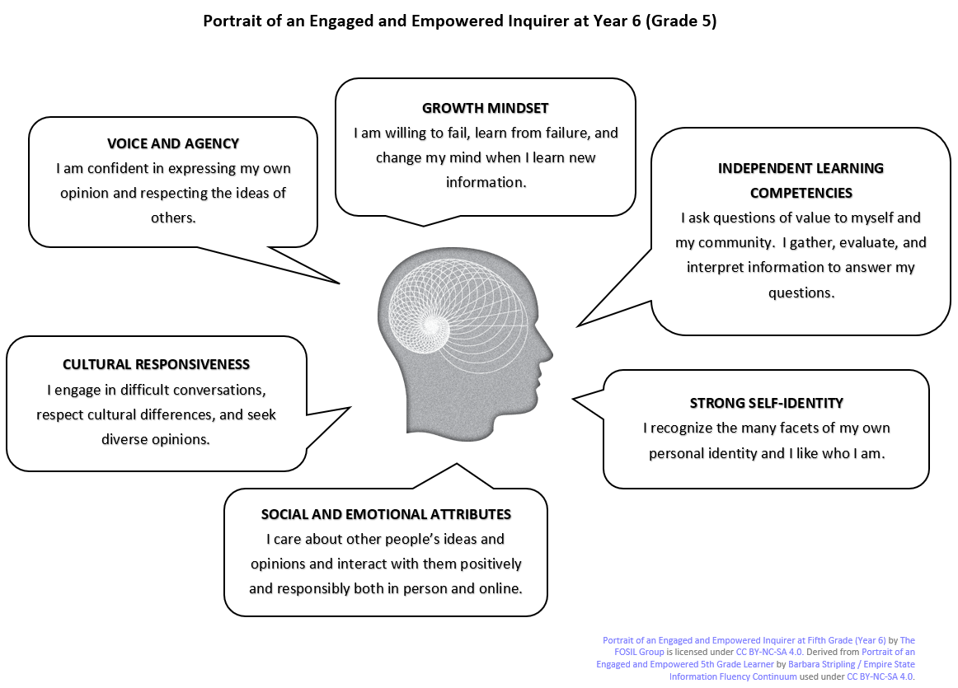
Year 4-6 Portrait Attributes

Slide 15
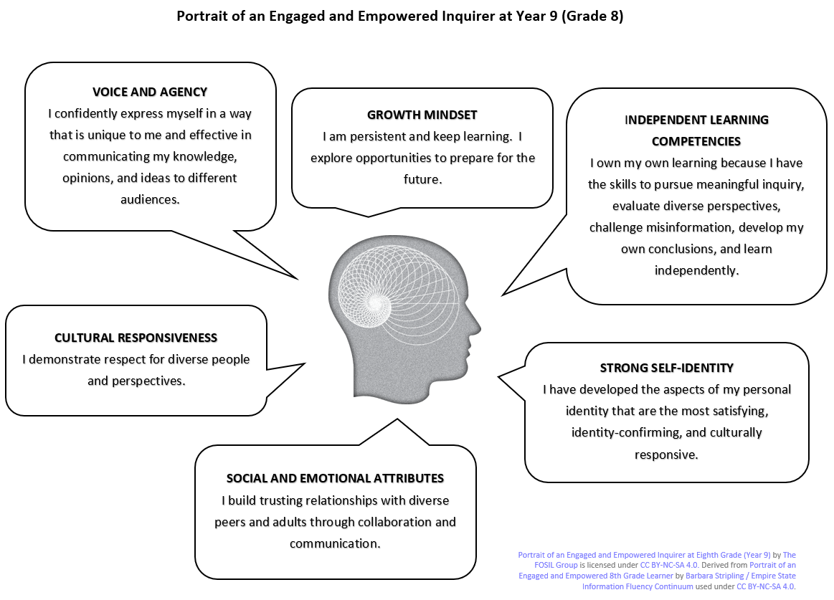
Year 7-9 Portrait Attributes

Slide 16
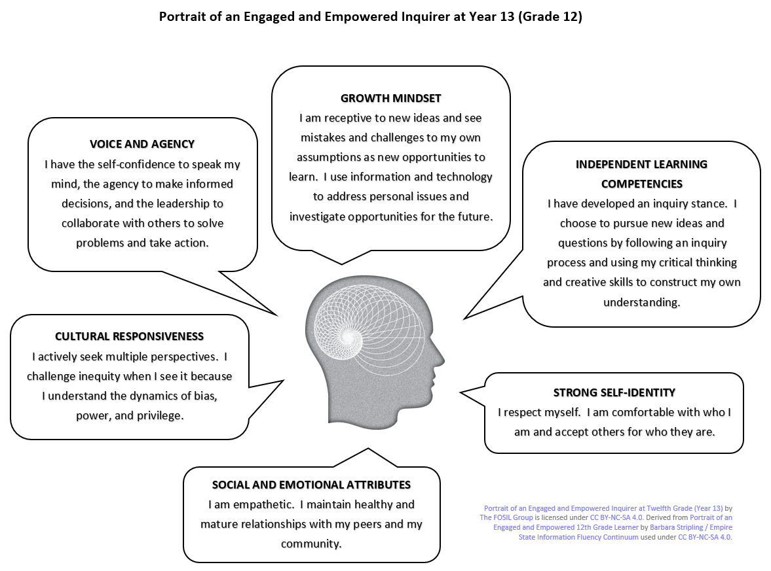
Year 10-13 Portrait Attributes

Slide 17
Building communities of inquiry [Through full inquiries that develop all attributes]
Minimal Library involvement
Year 2 Herm
Year 3 Classics/ History
Year 12-3 English, History & French coursework
Some Library input at design stage
Year 1 interdisciplinary Signature Work: Guernsey
In planning: Year 4 Geography
Year 7 English
Year 10 English
Library led
Year 7 Maths
Year 9 Signature Work in English &ICT leading to optional HPQ (1/2 GCSE)
Year 12 Signature Work linked to Thought and Culture leading to optional EPQ (1/2 A-level)
Year 6 interdisciplinary Signature Work leading to UK Science Award (CREST)
Year 8 Maths
Age 4
Age 18
Notes:
Image by Pete Linforth from Pixabay

Slide 18
Year 1 Inquiry-Based Learning
Key Question
Who might want to visit Guernsey?

Slide 19
Curriculum Links
Geography
Maths
English
Science
Computing
History
Art

Slide 20
FOSIL Structure
Connect – initially a homework task was set for the children to find out 5 facts about Guernsey.
Wonder- Would everyone want to visit Guernsey?
Investigate – Grand Day Out –first-hand experience. Second survey of families - asking what people look for in a holiday destination.
Construct - use facts and data collected on the trip and combine with additional knowledge gained through texts generated by me to form personal opinions.
Express – Guernsey Exhibition – Lucy, Locate Guernsey guest visitors.
Reflect - children, parent feedback, me.

Slide 23
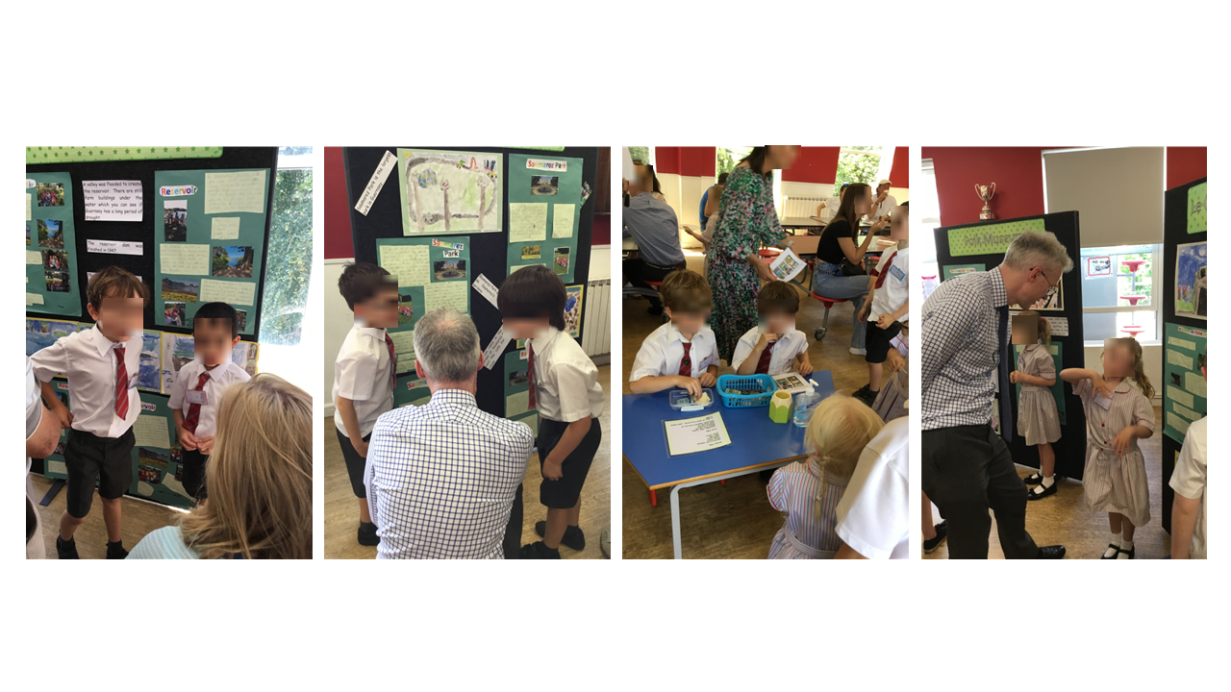

Slide 24
Building Communities of Inquiry…
…through full inquiries [in each phase that develop all attributes]
Year 1 (Guernsey)
Year 6 (Art & Design, English, Library, Maths, Science)
RE?
Year 7 (Maths)(English)
Year 8 (Maths)
Year 9 (English, ICT plus Geography?)
Year 10 HPQ
Year 10 English (Jane)
Year 12 (PDC, Thought & Culture)
Year 12/13 EPQ
…through attributes [in phases/ subjects and stages]
Year 12 Psychology

Slide 25
Inquiry-Based Learning
Entry, Topical and Overarching Questions
An Example From Psychology

Slide 26
Reminder
Entry questions – the ‘hook’ – getting the student interested and debating the topic before you start the unit.
Topical questions – these relate closely to the specification and refer to what students should be able to answer at the end of the unit.
Overarching questions – these are open-ended and relate to the topic as a whole but are not answered per say within the unit. The hope is that your unit will spark interest and they may want to investigate questions such as this further.

Slide 27
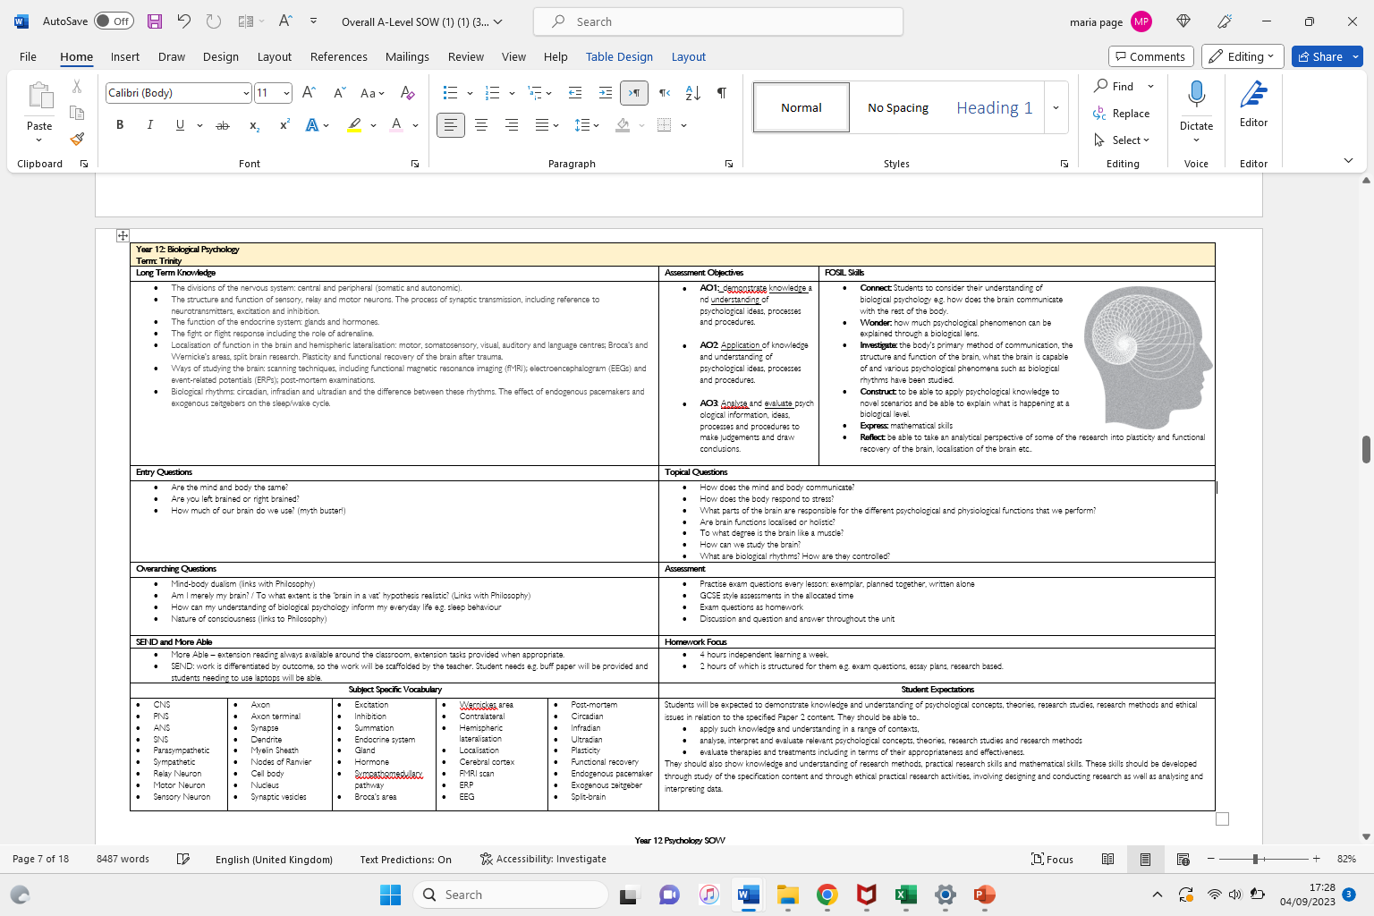

Slide 28
Entry Questions – Taster Days
Is Psychology a Science?
Do our early attachment experiences set us for life?
Do our memories define us?
Is every violent person a bad person?
What constitutes a normal person?
Is everything psychological at first biological?​

Slide 29
Overarching Questions – stretch and challenge

Slide 30
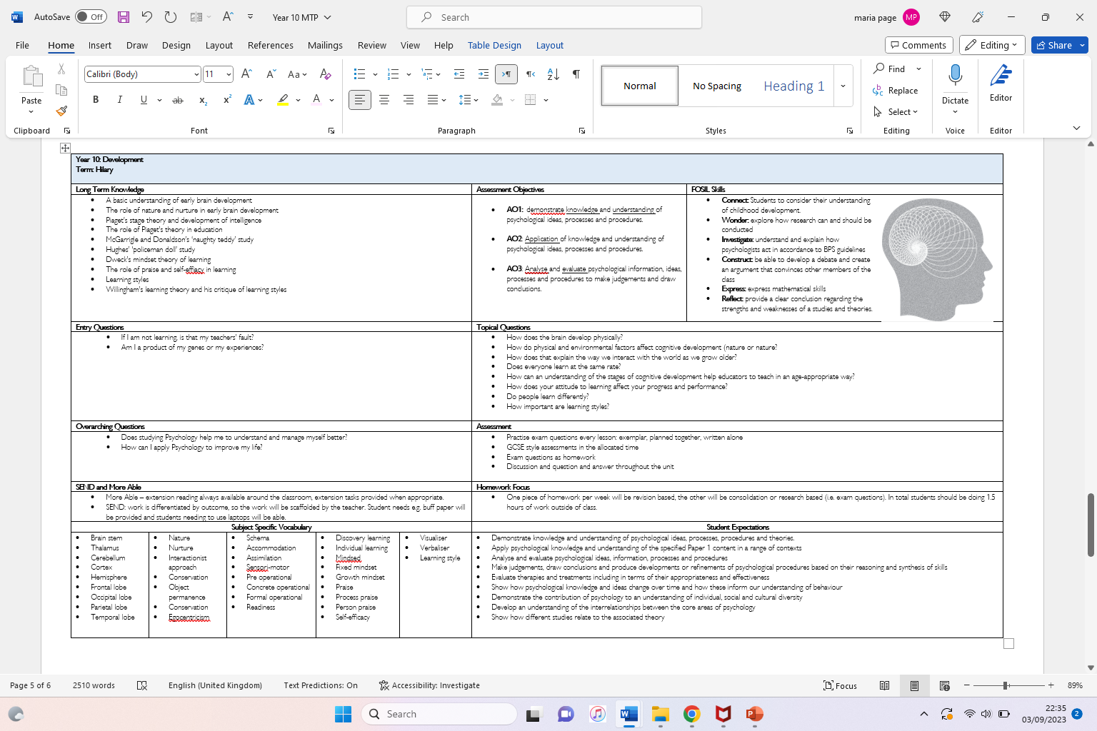

Slide 31
Topical Questions – incorporating them into the start and end of every lesson

Slide 32
Topical Questions – incorporating them into the start and end of every lesson

Slide 33
GCSE

Slide 34
Topical Questions - incorporating them into introduction lessons

Slide 35
Accessing FOSIL Resources

Slide 37
References
Covington, N., & McNutt, C. (2022, December 1). fighting back against the future. Retrieved from Human Restoration Project: https://www.humanrestorationproject.org/writing/fighting-back-against-the-future
Peirce, C. S. (1955). The Scientific Attitude and Fallibilism. In J. Buchler (Ed.), Philosophical Writings of Peirce (pp. 42-59). New York, NY: Dover Publications.
Postman, N., & Weingartner, C. (1971). Teaching as a Subversive Activity. Harmondsworth: Penguin Books.
Russell, B. (1922). Free Thought and Official Propaganda. Retrieved from Project Gutenberg: https://www.gutenberg.org/files/44932/44932-h/44932-h.htm
Wells, G. (2001). The Case for Dialogic Inquiry. In G. Wells (Ed.), Action, Talk, & Text: Learning and Teaching Through Inquiry (pp. 171-194). New York, NY: Teachers College Press.
Young, M. (2022, September 21). What we’ve got wrong about knowledge & curriculum. (G. Duoblys, Interviewer) Tes Magazine.

