Slide 1
Leading an Inquiry-Based School: Discovering the Promise

Slide 2
Hello!
I am Barbara Stripling.
Former school librarian, library administrator, library educator
Creator of Stripling Model of Inquiry; Developer of Empire State Information Fluency Continuum
bstripli@syr.edu

Slide 3
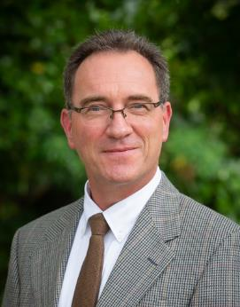
Hello!
I am Darryl Toerien.
Head of Inquiry-Based Learning, Blanchelande College, Guernsey
Creator of FOSIL, an Inquiry Model and Framework of Skills, adapted from Stripling Model of Inquiry
toeriend@blanchelande.sch.gg

Slide 4
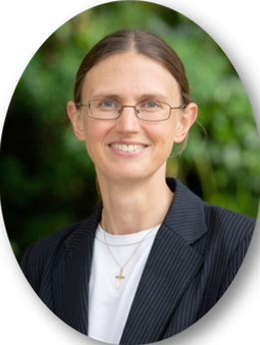
Hello!
I am Jenny Toerien.
College librarian and Project Qualifications Coordinator, Blanchelande College, Guernsey
Co-Developer of FOSIL, an Inquiry Model and Framework of Skills, adapted from Stripling Model of Inquiry
toerienj@blanchelande.sch.gg

Slide 5
Learning Goals for Today
Explore the promise of inquiry by recognizing and rejecting common misconceptions
Recognize the characteristics and benefits of an inquiry stance, inquiry process, and inquiry-based school
Trace the development of priority inquiry and whole-child learning skills through the grades
Examine the integration of inquiry skills into important curriculum content

Slide 6
How Is the Promise of Inquiry Broken?
Inquiry as a dynamic process and skills is divorced from learning important content.
Neil Postman (1979, p. 214)
Inquiry is reduced to a mechanical process with no spirit of wonder and puzzlement.
Neil Postman (1979, p. 214)
Without both a spirit of wonder and puzzlement and a dynamic process, inquiry is reduced to a thoughtless fact-finding activity.
Increasing emphasis on the “engineering of learning” based on ‘hard evidence’ from the field of cognitive science endangers the possibility of inquiry.
Neil Postman (1996, pp. 26-27)
Notes:
Postman, N. (1979). Teaching as a Conserving Activity. New York, NY: Delta.
Postman, N. (1996). The End of Education: Redefining the Value of School. New York, NY: Random House.

Slide 7
An Inquiry Stance
“In order to learn you must desire to learn, and in so desiring not be satisfied with what you already incline to think. …
Do not block the way of inquiry.”
Charles Sanders Peirce (1955, p. 54)
“It is wrong always, everywhere, and for any one, to believe anything upon insufficient evidence.”
William Kingdon Clifford (1877, p. 295)
Graphic by Leo Clipartcow
Notes:
Peirce, C. S. (1955). The Scientific Attitude and Fallibilism. In J. Buchler (Ed.), Philosophical Writings of Peirce (pp. 42-59). New York, NY: Dover Publications.
Clifford, W. K. (1877). The Ethics of Belief. The Contemporary Review, 289-309.

Slide 8
Foundational Models of the Inquiry Process and Continuum of Skills
Stripling Model of Inquiry
Empire State Information Fluency Continuum
Framework of Skills for Inquiry Learning (FOSIL)

Slide 9
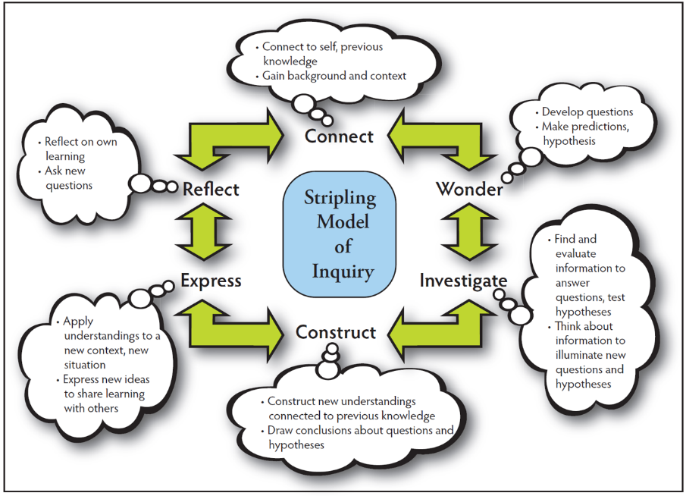
Stripling Model of Inquiry: https://slsa-nys.libguides.com/ifc

Slide 10
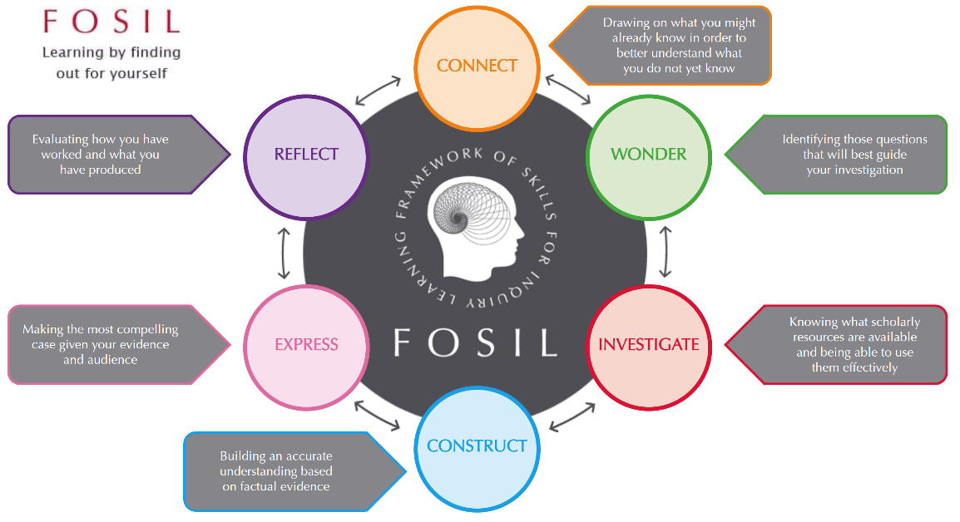
FOSIL: Framework of Skills for Inquiry Learning: https://fosil.org.uk/fosil-cycle/

Slide 11
Empire State Information Fluency Continuum: https://slsa-nys.libguides.com/ifc

Slide 12
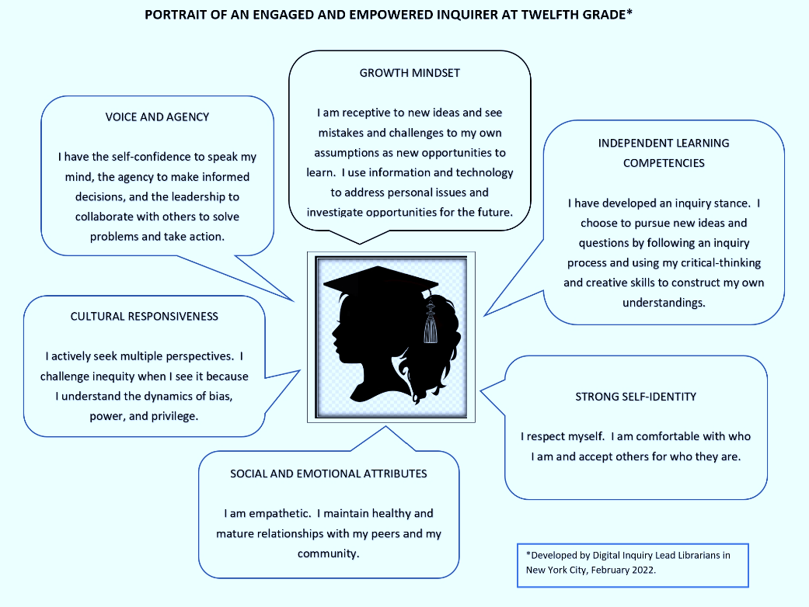
Empowering the Whole Child

Slide 13
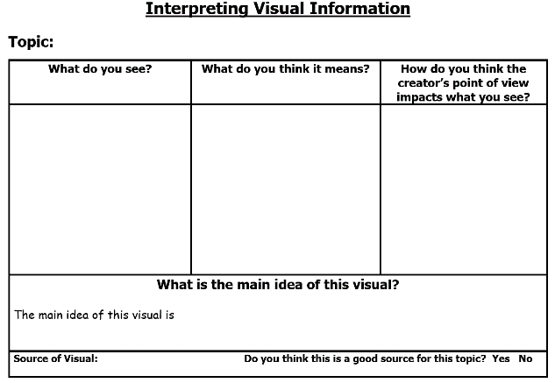
Literacy: Making Sense of Information
Sensemaking of visual and print text
Interpret meaning presented through visual representations (e.g., pictures, infographics) - Independent Learning
Determine main ideas, supporting details, point of view, and both explicit and implicit meaning - Cultural Responsiveness
Participates in shared research and exploration about a topic - Social and Emotional Attributes
Verbalizes and clearly describes thoughts and ideas - Self-Identity
Graphic Organizer K-2.21

Slide 14
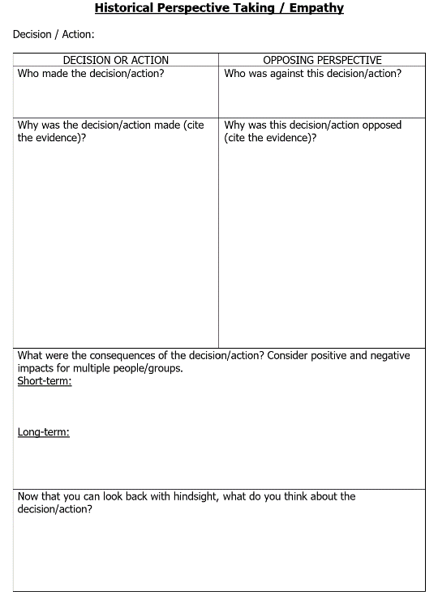
Deep Reading
Draws meaning from digital and print text by employing literacy and inquiry skills, interpreting meaning, interacting with the text, and reading laterally - Independent Learning
Develops own opinion, perspective, or claim and supports with evidence and a clear line of reasoning - Self-Identity; Agency
Demonstrates respect and empathy for diverse people and perspectives - Cultural Responsiveness; Social and Emotional Attributes
Graphic Organizer 9-12.18

Slide 15
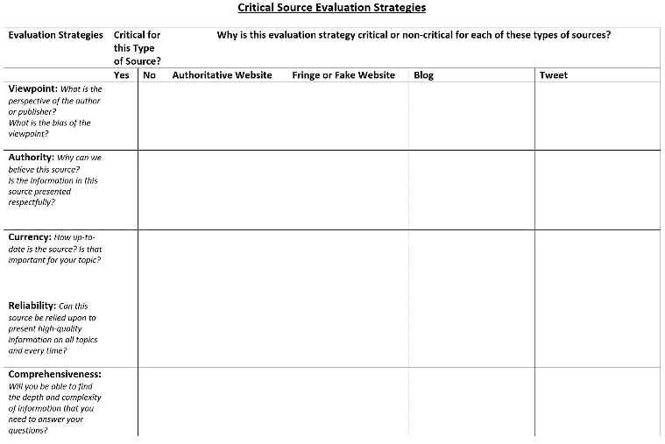
Digital Inquiry Skills
Demonstrates critical evaluation strategies for different types of digital sources - Independent Learning
Evaluates the effect of different perspectives and points of view on information - Cultural Responsiveness
Identifies and challenges misinformation and own assumptions - Self-Identity
Demonstrates leadership and self-confidence by facilitating collaborative decision-making - Agency
Graphic Organizer 6-8.13

Slide 16
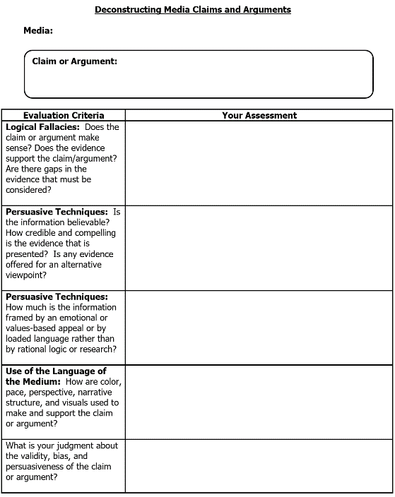
Media Literacy
Deconstructs media claims and arguments - Independent Learning
Evaluates the accuracy, authority, validity, perspective and bias of sources of information - Independent Learning; Cultural Responsiveness
Forms opinions, judgments, and claims backed up by supporting evidence and clear reasoning - Self-Identity; Cultural Responsiveness
Exhibits effective skills in sharing knowledge gained - Agency
Listens carefully to the ideas of others, engages in a discussion, and changes own opinion when those ideas have merit - Social and Emotional Attributes; Self-Identity
Graphic Organizer 6-8.26

Slide 17
Building Communities of Inquiry
“The curriculum is not just a body of knowledge; it’s a group of communities we must encourage our students to join.”
Michael Young (2022)
“Each classroom is thus unique. And so…teacher and students together must become a community of inquiry with respect to all aspects of the life of the classroom and all areas of the curriculum.”
Gordon Wells / Developing Inquiring Communities in Education Project (2001, p.7)
Notes:
Young, M. (2022, September 21). What we’ve got wrong about knowledge & curriculum. (G. Duoblys, Interviewer) Tes Magazine.
Wells, G. (2001). The Case for Dialogic Inquiry. In G. Wells (Ed.), Action, Talk, & Text: Learning and Teaching Through Inquiry (pp. 171-194). New York, NY: Teachers College Press.

Slide 18
Recovering the Broken Promise of Inquiry
Breaking the Promise
Recovering the Promise
Inquiry is:
a stance of wonder and puzzlement that leads to
a dynamic process of coming to know and understand the world and ourselves in it as
the basis for responsible participation in community
Stripling & Toerien (2021), UK School Library Association Keynote
ESIFC/FOSIL is a sound instructional model of this dynamic process and a deeply considered PK-12 framework of associated skills
In school, this dynamic process is directed towards learning disciplinary knowledge/subject area content in an interdisciplinary way/as a coherent whole
ESIFC/FOSIL has engaged and empowered inquirers – as reflected in the Portraits & Attributes – as its end and is the means to this end
Inquiry as a dynamic process and skills is divorced from learning important content.
Inquiry is reduced to a mechanical process with no spirit of wonder and puzzlement.
Without both a spirit of wonder and puzzlement and a dynamic process, inquiry is reduced to a thoughtless fact-finding activity.
Increasing emphasis on the “engineering of learning” based on ‘hard evidence’ from the field of cognitive science endangers the possibility of inquiry.

Slide 19
Blanchelande College
PK-12 Independent Catholic Day School
Fully coeducational
450 students
Guernsey, Channel Islands
Secondary (Grade 6-12) Library opened in September 2020 along with first cohort of Sixth Form (Grade 11-12)
First professionally qualified Teacher-Librarian September 2021
Second professionally qualified Teacher-Librarian February 2023

Slide 20
Heroic Inquiry Journey
Hero’s Journey
Journey of Heroic Inquiry

Slide 21
Signature Work
A Signature Work is
an inquiry-based exploration
of a significant issue, problem or question
that the student identifies & defines
that involves substantial reading, writing and reflection
called Signature Work because it
reflects the high level of personalization and individual initiative involved
and so bears the student’s distinctive imprint

Slide 22
Signature Work in Each Key Stage
Grade 11-12: Extended Project Qualification (optional ½ A-Level extended inquiry)
Independent inquiry with a 30-hour taught component AND 90-hour self-study component
5,000-word research report OR artefact and minimum 1,000-word research report PLUS research log PLUS oral presentation and Q&A
Grade 11: Library, Personal Development Curriculum, Thought & Culture
Grade 9: Higher Project Qualification (optional ½ GCSE extended inquiry)
Independent inquiry with a 30-hour taught component AND 30-hour self-study component
2,000-word research report OR artefact and minimum 500-word research report PLUS research log PLUS oral presentation and Q&A
Grade 8: Computing, English, Geography, Library, Theology
Grade 5: Art & Design, English, Library, Maths, Theology, Science – subject specialist teachers who teach in both primary and secondary phases
Grade K: Art, Computing, English, Geography, History, Maths, Science

Slide 23
Signature Work in Each Key Stage
Grade 11-12 EPQ
(optional extended inquiry)
Grade 11 Signature Work
Grade 9 HPQ
(optional extended inquiry)
Grade 8 Signature Work
Grade 5 Signature Work
Grade K Signature Work

Slide 24
Signature Work – Backbone for Inquiry-Based Education
Embedded inquiries developing skills acquired through Signature Work
Grade 11-12 EPQ
(optional extended inquiry)
Grade 12: French speaking assessment
Grade 12: History coursework
Grade 11 Signature Work
Grade 10: English (Shakespeare)
Grade 9 HPQ
(optional extended inquiry)
Grade 9: Maths (vocational Maths)
Grade 7: Maths (international Maths)
Grade 8 Signature Work
Grade 6: Maths (Fibonacci)
Grade 6: English (rhetoric)
Grade 5 Signature Work
Grade 3: Geography
Grade K Signature Work
Grade 2: History & Classics (Ancient Greeks)
Grade 1: Local study (Herm Island)
Image by Gordon Johnson from Pixabay

Slide 25
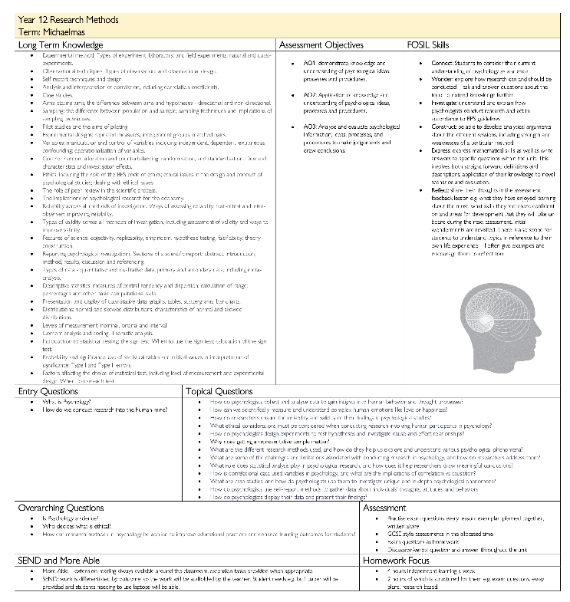
Unit Template (Grade 6-12): Grade 12 Psychology

Slide 26
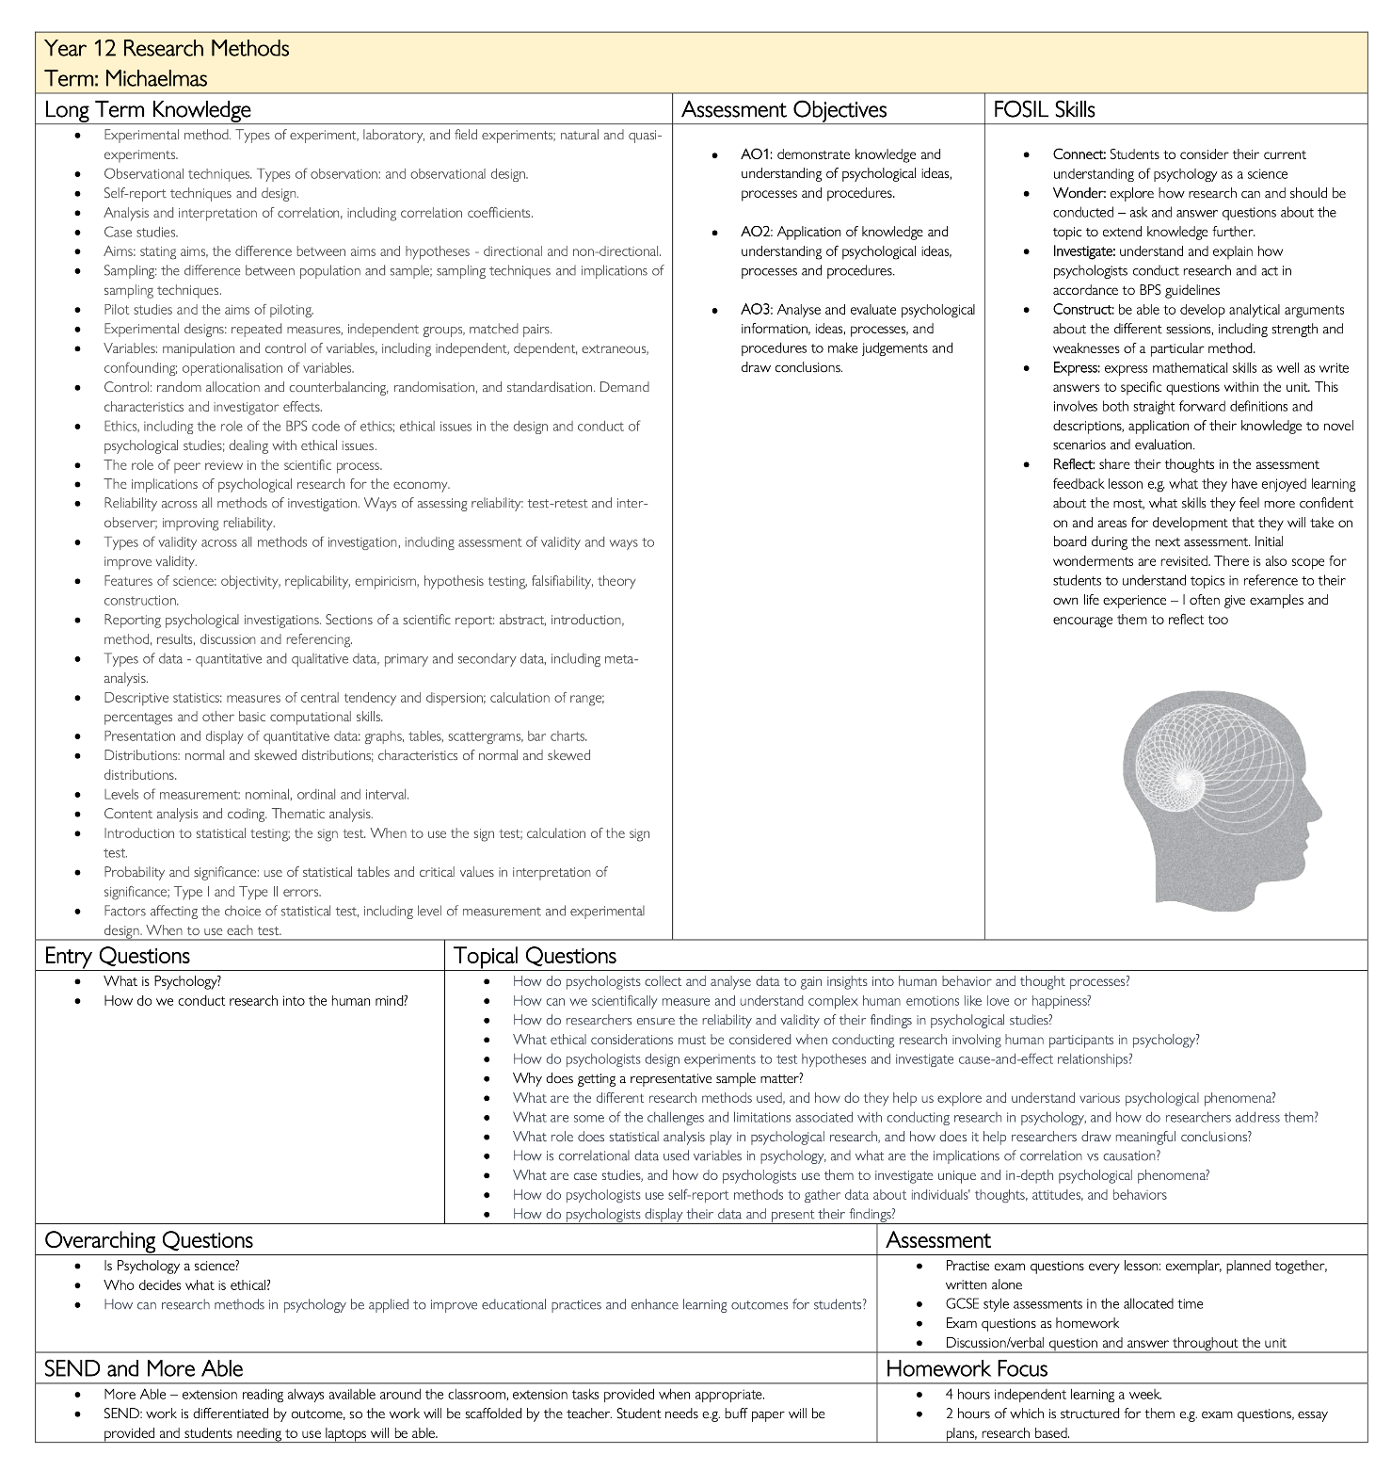
Unit Template (Grade 6-12): Grade 12 Psychology

Slide 27
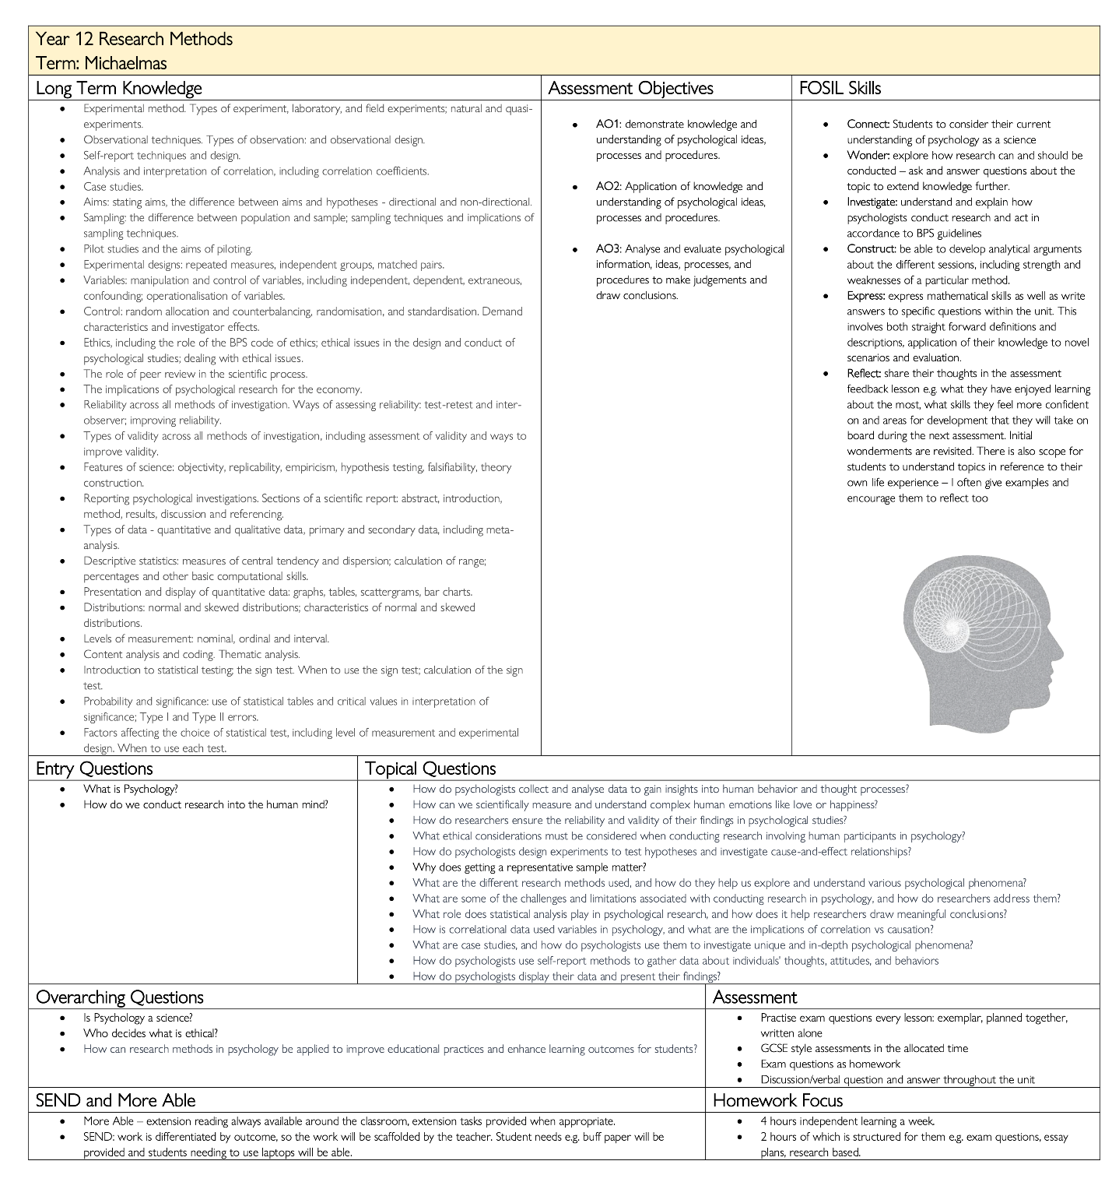
Policy? and Unit template ->

Slide 28
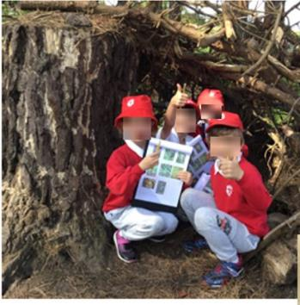
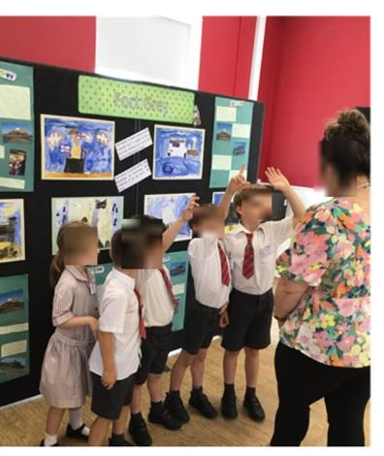
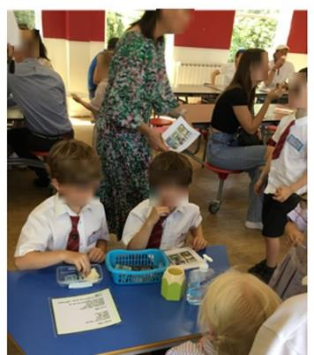
Grade K Signature Work Inquiry
Class topic over 6 weeks
Who would want to visit Guernsey?
Visited a range of local attractions to gather information
Surveyed family members to find out what they wanted in a holiday destination and presented data visually
Produced a work of art and an information poster about each destination
Put on an exhibition for parents and special visitors from the local Tourist Board
Sold tickets and snacks at the exhibition

Slide 29
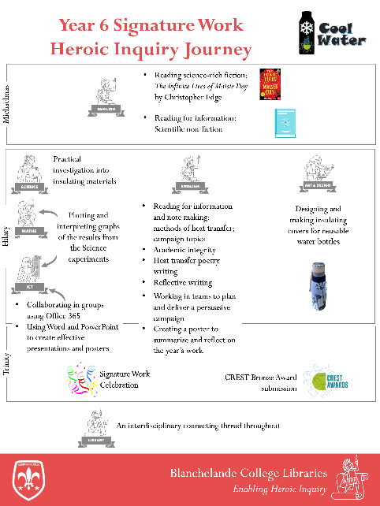
Grade 5 Signature Work Inquiry
8-month inquiry journey over a variety of subjects
Cool Water: Taking care of our own health and the health of our planet
Grew out of a Science investigation into conductors and insulators
Developed a linked Art & Design project to make insulating covers for water bottles
Framed as a dual-purpose inquiry to persuade pupils to drink more water AND to reduce their use of single-use plastic bottles
Concluded with persuasive campaigns along these two themes, followed by a public ‘celebration evening’ for parents

Slide 30
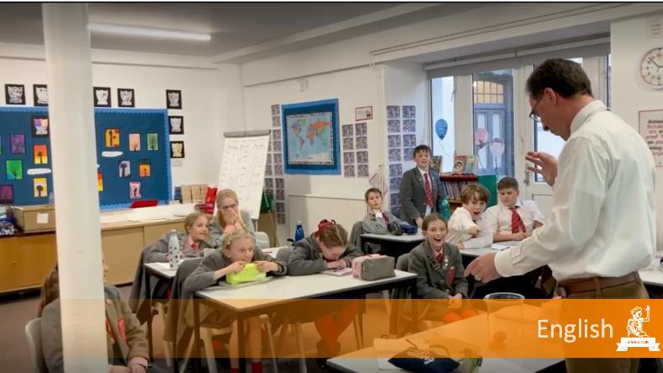
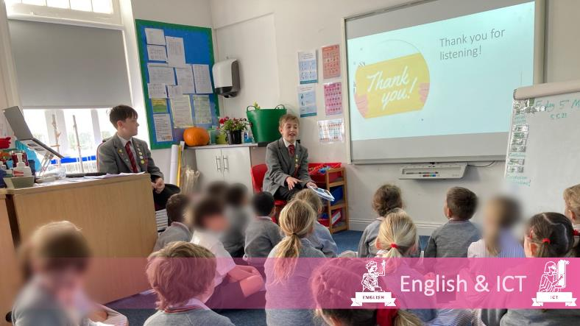
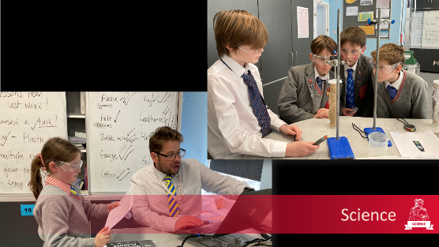
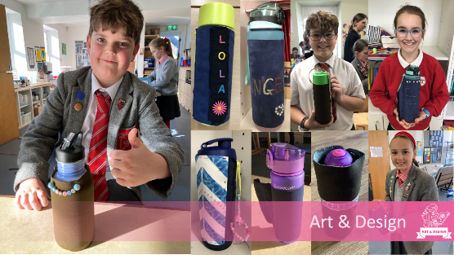

Slide 31
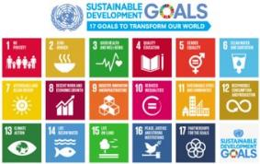
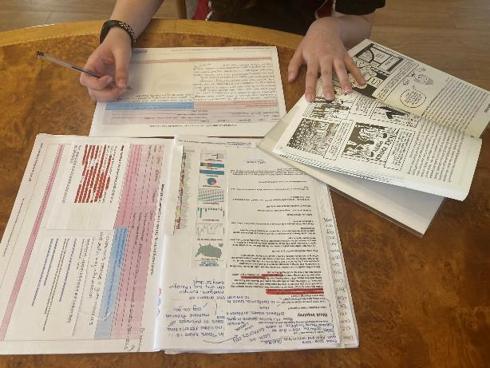
Grade 8 Signature Work Inquiry
6 ICT lessons
Weekly English lesson for a year
The Future Needs YOU: Living Well in a World Worth Living in
Rooted in the UN Sustainable Development Goals
Choose a focus SDG and associated Target to narrow focus and further personalize
Six-week ICT course on digital inquiry skills plus word processing and citing and referencing
Weekly English lesson to read for learning
Culminates in GCSE English Language Speaking & Listening Non-Examined Assessment
Leads into Higher Project Qualification for some

Slide 32
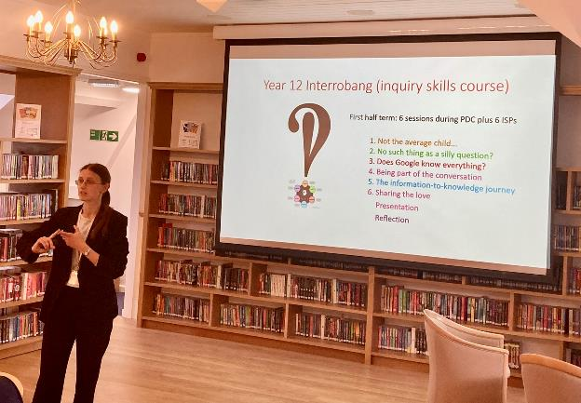
Grade 11 Signature Work Inquiry
6 lessons plus homework
Interrobang!? Lenses on the world
Introductory inquiry course for start of A-Level studies
Choose a topic from within an A-Level subject and consider how that perspective informs us about the world
Links into Thought and Culture (Theology/Philosophy)
Culminates in public poster exhibition
Leads into Extended Project Qualification for some

Slide 33
What are you thinking?
Graphic by Leo Clipartcow

Slide 34
Thank you! Barbara Stripling – bstripli@syr.edu Darryl Toerien – toeriend@blanchelande.sch.gg Jenny Toerien – toerienj@blanchelande.sch.gg

