Slide 2
What Is the Promise of Inquiry?
Learners will develop the skills and attitudes of an inquiry stance.
Learners will be able to learn independently by connecting with what they already know, asking intriguing questions about what is not known, investigating the answers, constructing new understandings, and communicating to share those understandings with others.
Learners will acquire the durable skills that enable them to grow academically, socially, emotionally, and culturally and thrive both in school and beyond.
Engaging and Empowering Learners for Life

Slide 3
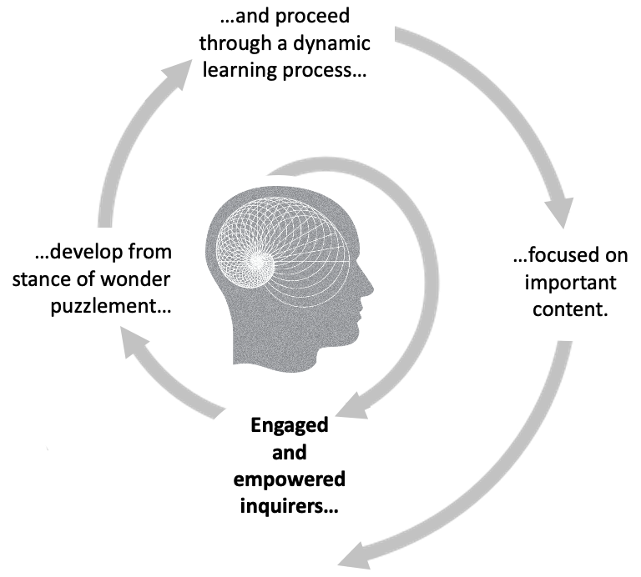
Keeping the promise of inquiry

Slide 4
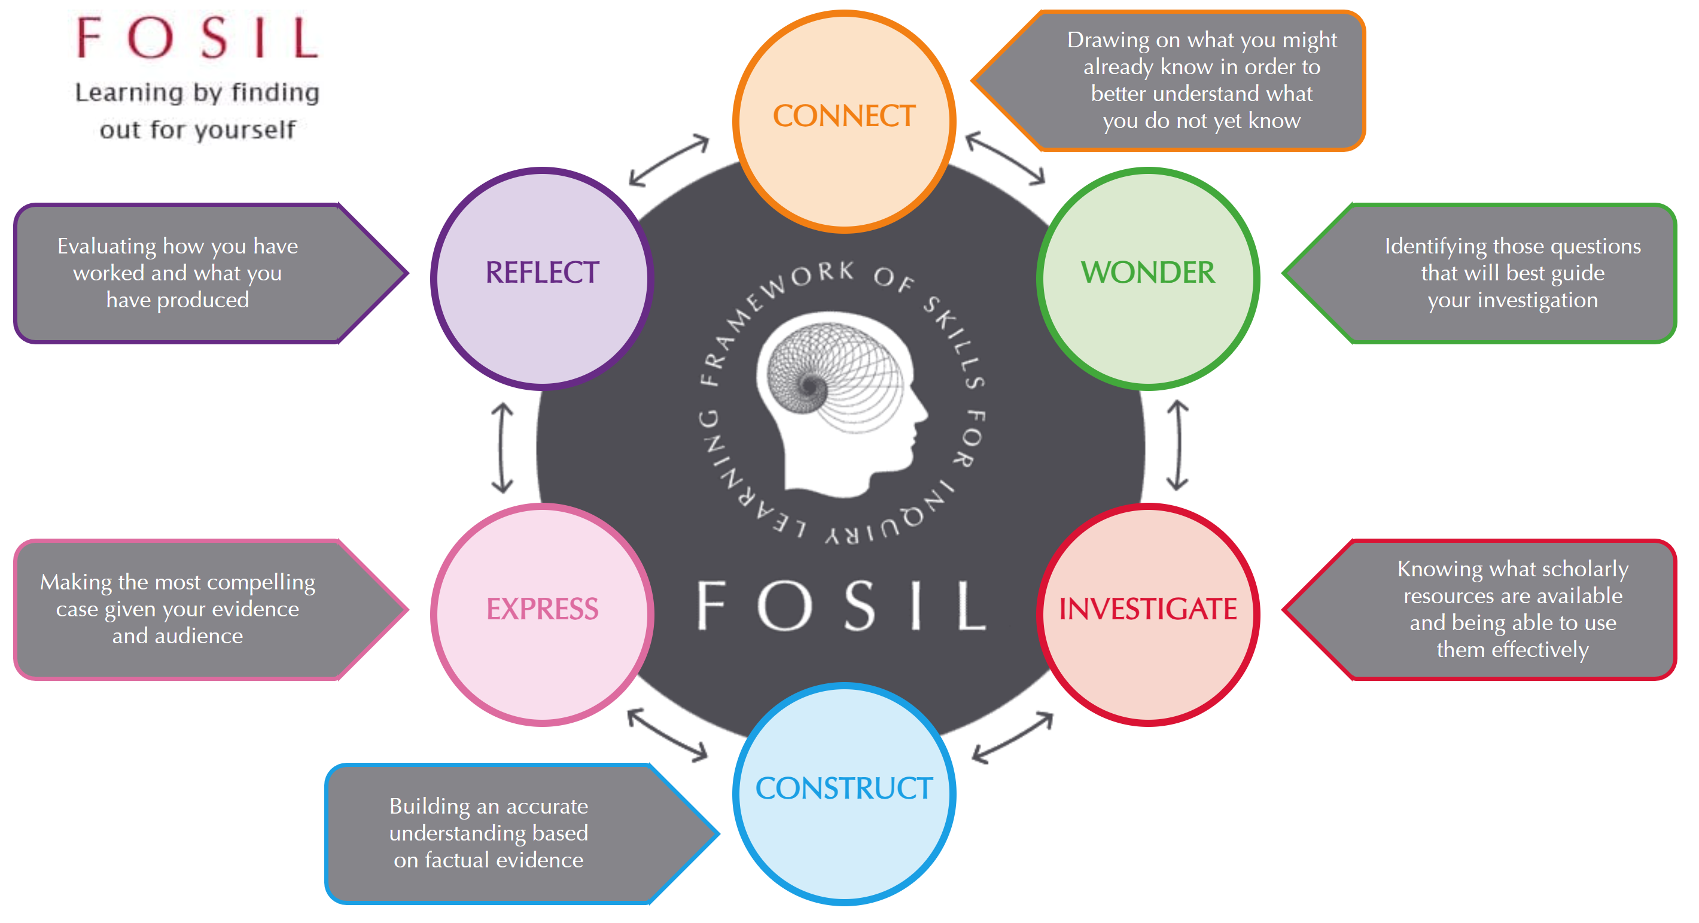
FOSIL: Framework of Skills for Inquiry Learning: https://fosil.org.uk/fosil-cycle/

Slide 5
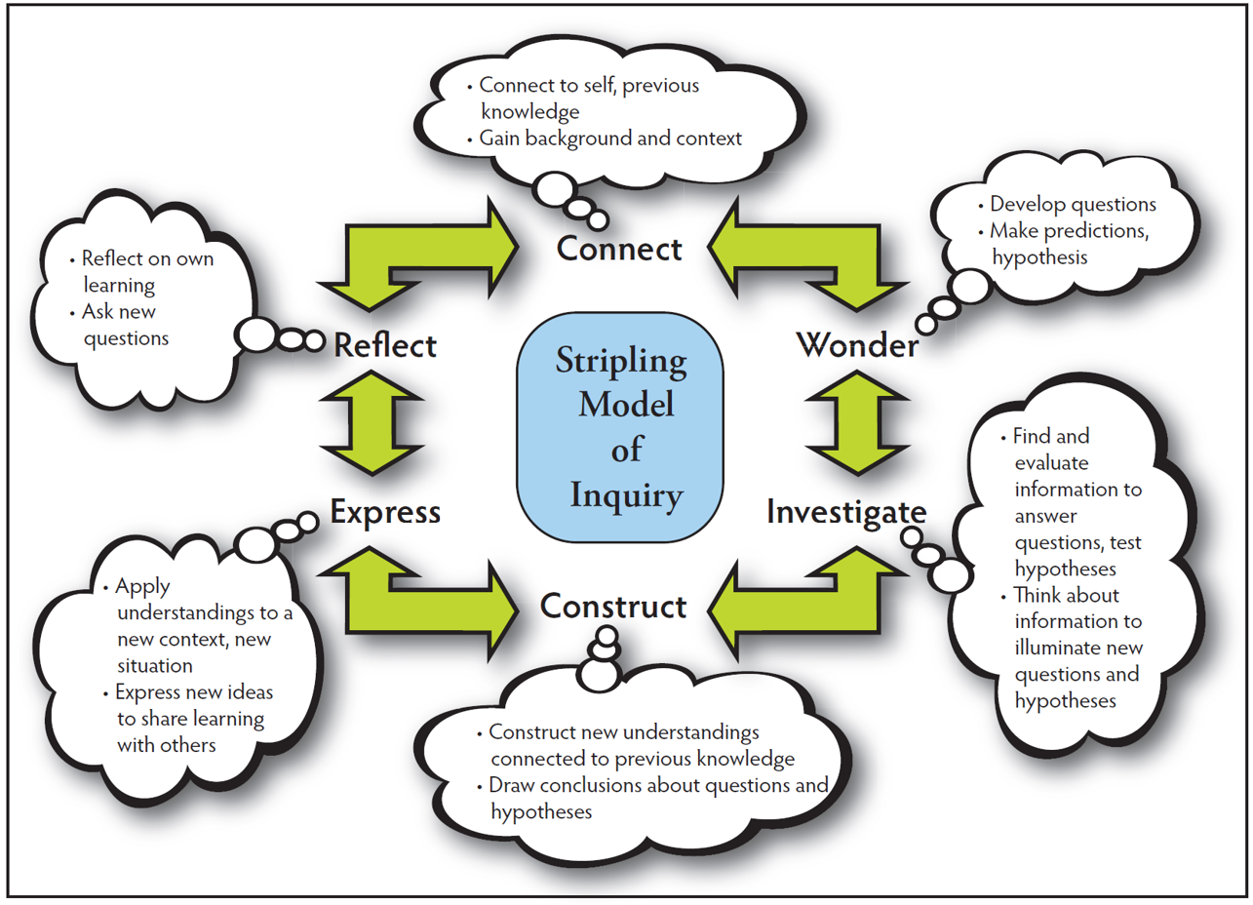
Stripling Model of Inquiry: https://slsa-nys.libguides.com/ifc

Slide 6
How Is the Promise of Inquiry Fulfilled?

Slide 7
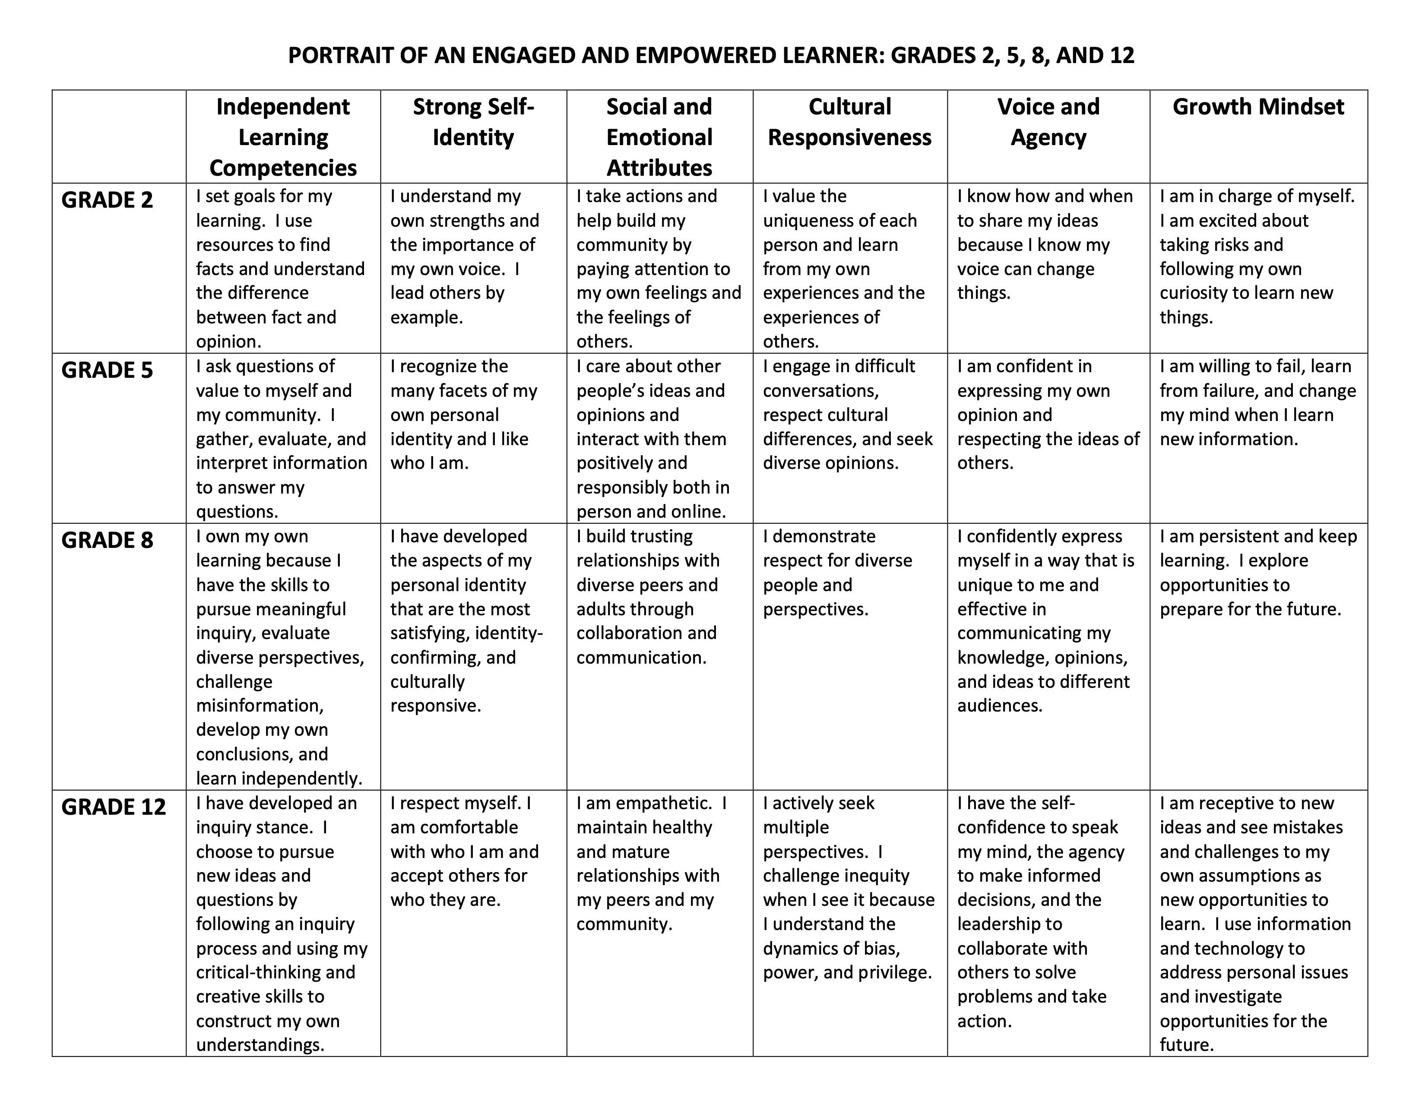
Portrait Attributes
PORTRAIT OF AN ENGAGED AND EMPOWERED LEARNER: GRADES 2, 5, 8, AND 12
Grade level

Slide 8
Independent Learning Competencies Vertical Alignment
Grade 2
Grade 5
I ask questions of value to myself and my community. I gather, evaluate, and interpret information to answer my questions.
Grade 8
I own my own learning because I have the skills to pursue meaningful inquiry, evaluate diverse perspectives, challenge misinformation, develop my own conclusions, and learn independently.
I set goals for my learning. I use resources to find facts and understand the difference between fact and opinion.
Grade 12
I have developed an inquiry stance. I choose to pursue new ideas and questions by following an inquiry process and using my critical-thinking and creative skills to construct my own understandings.

Slide 9
Social and Emotional Attributes Vertical Alignment
Grade 2
I take actions and help build my community by paying attention to my own feelings and the feelings of others.
Grade 5
I care about other people’s ideas and opinions and interact with them positively and responsibly both in person and online.
Grade 8
I build trusting relationships with diverse peers and adults through collaboration and communication.
Grade 12
I am empathetic. I maintain healthy and mature relationships with my peers and my community.

Slide 10
Horizontal Alignment of Portrait Attributes Grade 2
Independent Learning Competencies
I set goals for my learning. I use resources to find facts and understand the difference between fact and opinion.
Strong Self-Identity
I understand my own strengths and the importance of my own voice. I lead others by example.
Social and Emotional Attributes
I take actions and help build my community by paying attention to my own feelings and the feelings of others.
Cultural Responsiveness
I value the uniqueness of each person and learn from my own experiences and the experiences of others.
Voice and Agency
I know how and when to share my ideas because I know my voice can change things.
Growth Mindset
I am in charge of myself. I am excited about taking risks and following my own curiosity to learn new things.

Slide 11
Horizontal Alignment of Portrait Attributes Grade 12
Independent Learning Competencies
I have developed an inquiry stance. I choose to pursue new ideas and questions by following an inquiry process and using my critical-thinking and creative skills to construct my own understandings.
Strong Self-Identity
I respect myself. I am comfortable with who I am and accept others for who they are.
Social and Emotional Attributes
I am empathetic. I maintain healthy and mature relationships with my peers and my community.
Cultural Responsiveness
I actively seek multiple perspectives. I challenge inequity when I see it because I understand the dynamics of bias, power, and privilege.
Voice and Agency
I have the self-confidence to speak my mind, the agency to make informed decisions, and the leadership to collaborate with others to solve problems and take actions.
Growth Mindset
I am receptive to new ideas and see mistakes and challenges to my own assumptions as new opportunities to learn. I use information and technology to address personal issues and investigate opportunities for the future.

Slide 12
Translation of Competencies to Durable Skills Empire State Information Fluency Continuum: https://slsa-nys.libguides.com/ifc

Slide 13
Vertical Continuum of Skill Development for Cultural Responsiveness 5th Grade Competency: “I engage in difficult conversations, respect cultural differences, and seek diverse opinions”
Grade 3
Third graders might be taught to contribute to group discussions; to form their own opinion and use evidence to back it up; and to engage in conversations with peers to share their opinion and listen to the opinions of others
Grade 4
Fourth graders can begin to compare two points of view, noting the differences and similarities; to assess the evidence for each point of view and form their own opinion; and to actively solicit and listen with an open mind to the ideas of others
Grade 5
Fifth graders can be taught the qualities of empathy; to identify, respect, and empathize with the perspectives of others; and to exchange ideas about social and civic issues with a willingness to change their own opinion

Slide 14
Horizontal Integration of Portrait Skills and Attitudes Inquiry Unit on Volcanoes – Grade 4
Unit: Grade 4 Geography

Slide 15
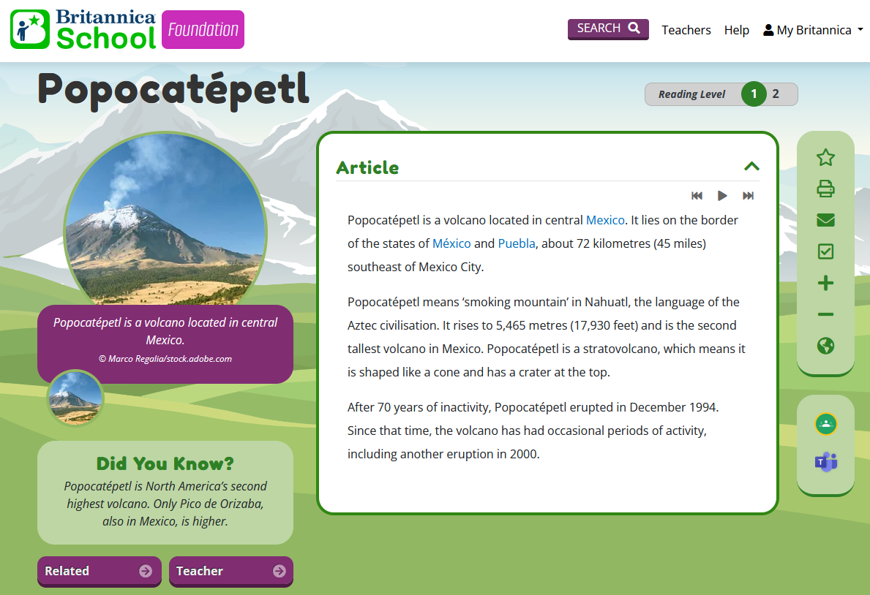
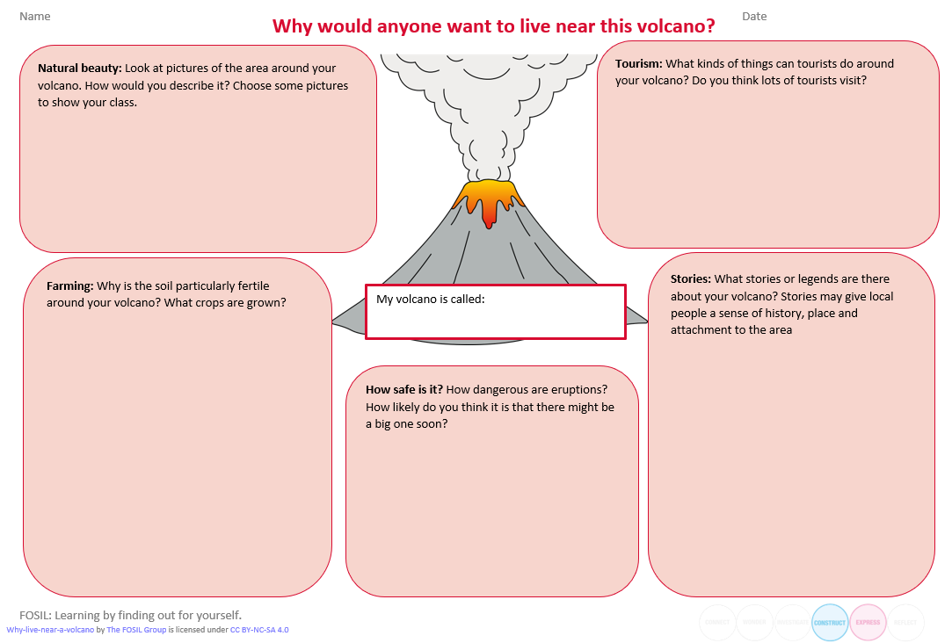
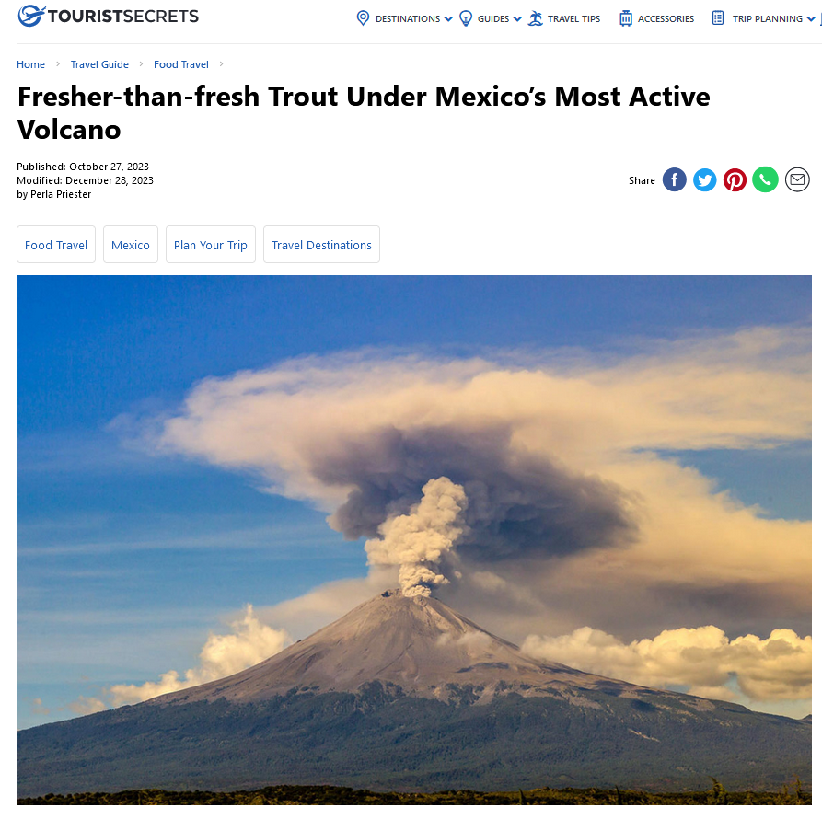
Horizontal Integration of Portrait Skills and Attitudes Inquiry Unit on Volcanoes – Grade 5
Unit: Grade 4 Geography
Notes:
Traditional ‘school’ sources like Britannica didn’t work for this. Lots of facts but not much information about what it is like to live near a volcano. Gave some generic reasons for volcanoes in general but nothing specific for most of our named volacanoes. Had to look further afield. Really hard to find info at the right level – so needed to use curated sources.

Slide 16
Grade K Signature Work Inquiry
Class topic over 6 weeks
Who would want to visit Guernsey?
Visited a range of local attractions to gather information
Surveyed family members to find out what they wanted in a holiday destination and presented data visually
Produced a work of art and an information poster about each destination
Put on an exhibition for parents and special visitors from the local Tourist Board
Sold tickets and snacks at the exhibition

Slide 17
Grade 5 Signature Work Inquiry
8-month inquiry journey over a variety of subjects
Cool Water: Taking care of our own health and the health of our planet
Grew out of a Science investigation into conductors and insulators
Developed a linked Art & Design project to make insulating covers for water bottles
Framed as a dual-purpose inquiry to persuade pupils to drink more water AND to reduce their use of single-use plastic bottles
Concluded with persuasive campaigns along these two themes, followed by a public ‘celebration evening’ for parents

Slide 18
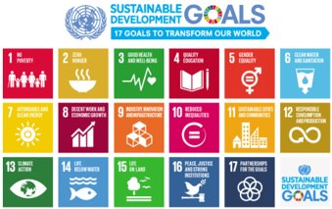
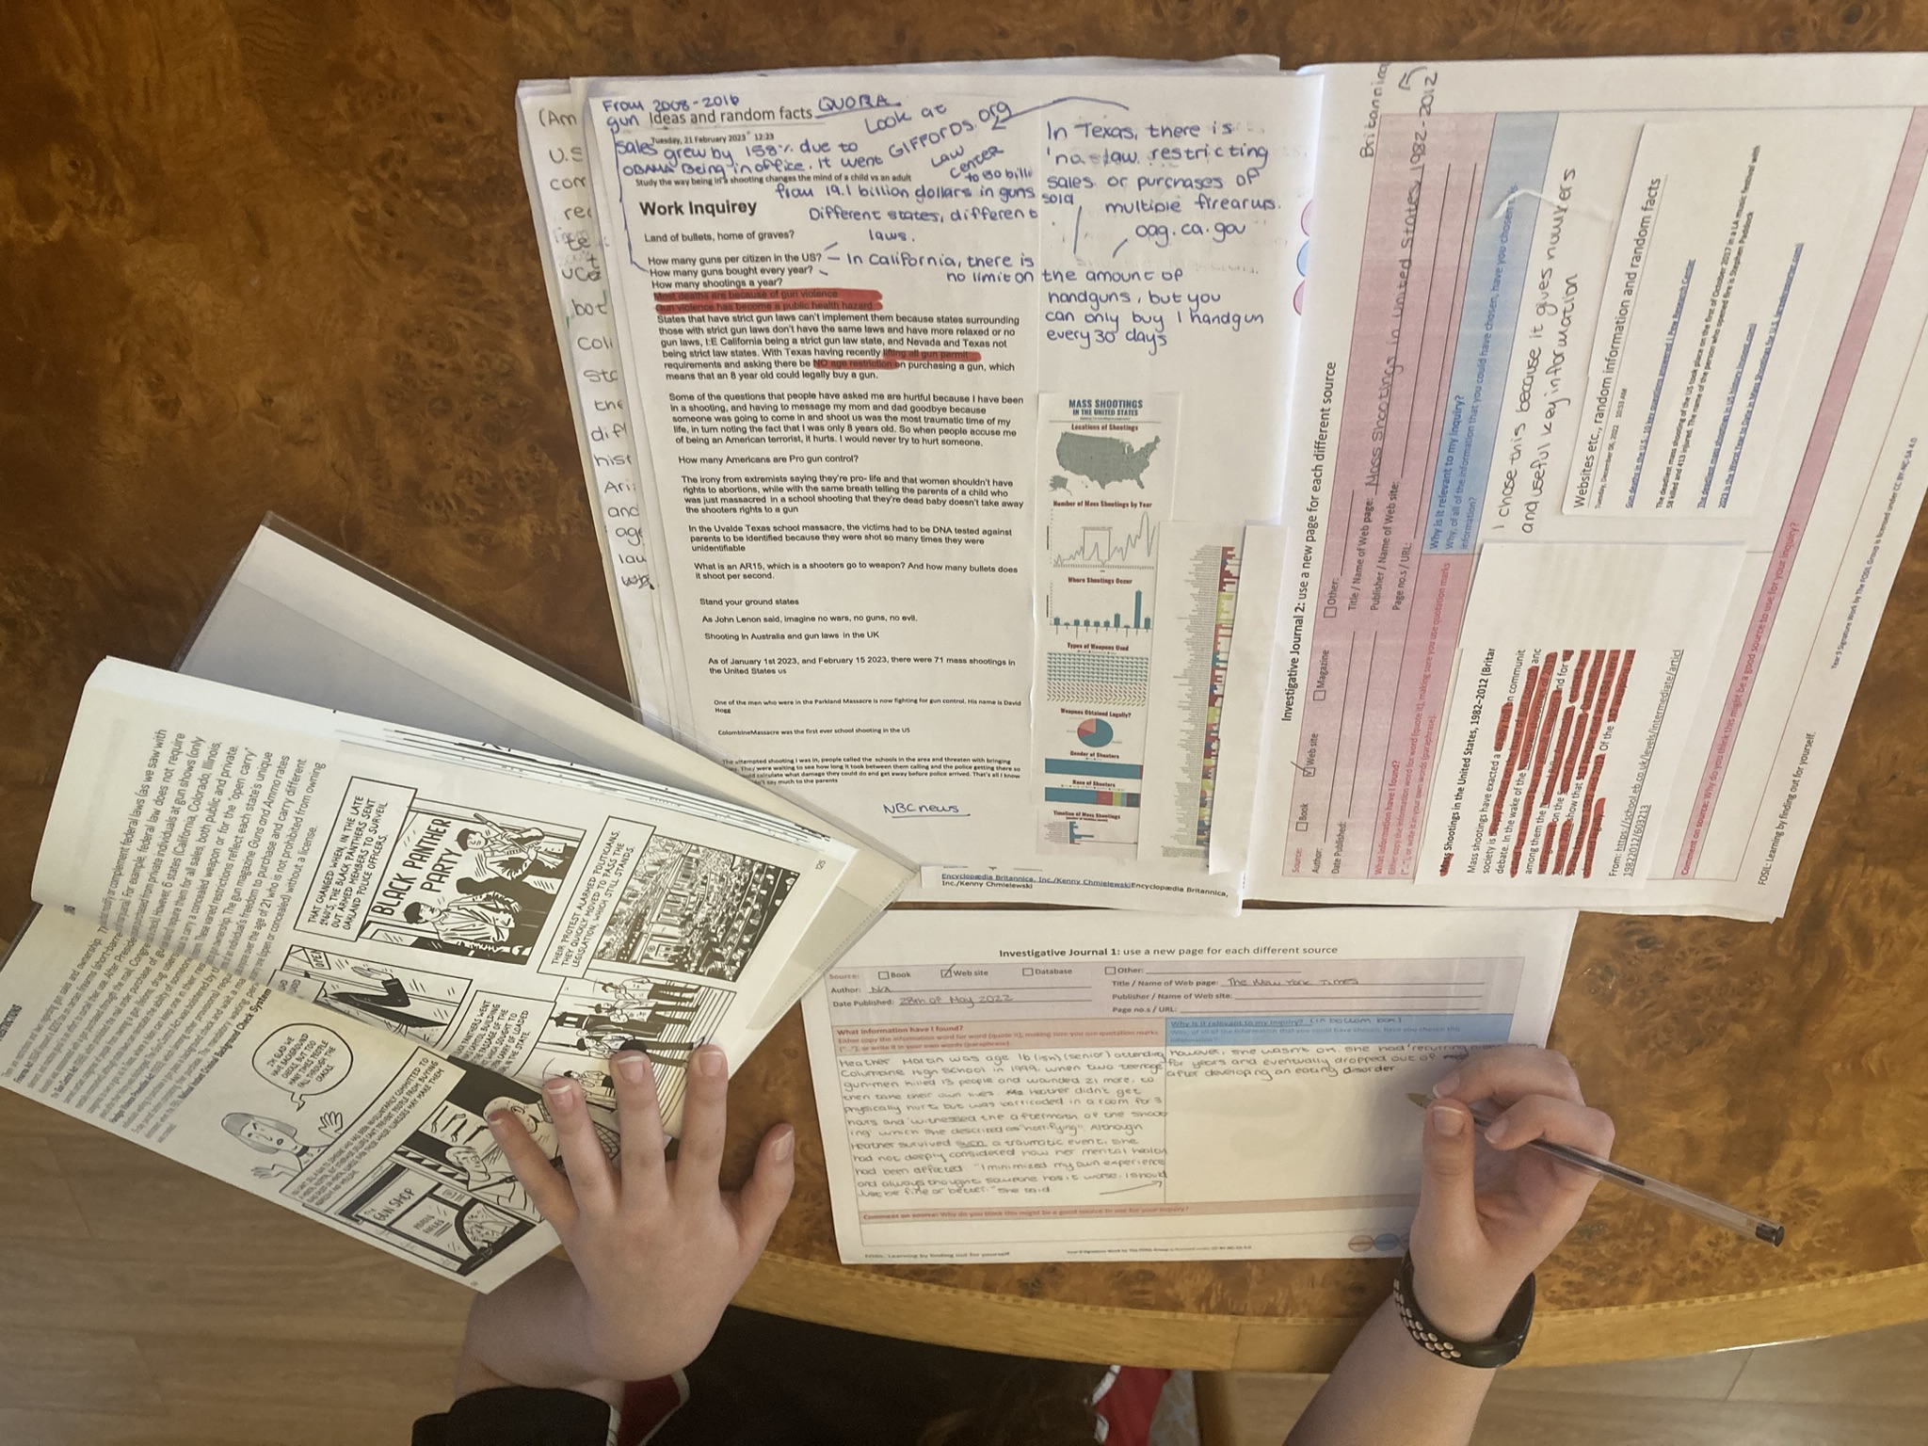
Grade 8 Signature Work Inquiry
6 ICT lessons
Weekly English lesson for a year
The Future Needs YOU: Living Well in a World Worth Living in
Rooted in the UN Sustainable Development Goals
Choose a focus SDG and associated Target to narrow focus and further personalize
Six-week ICT course on digital inquiry skills plus word processing and citing and referencing
Weekly English lesson to read for learning
Culminates in GCSE English Language Speaking & Listening Non-Examined Assessment
Leads into Higher Project Qualification for some

Slide 19
Building Communities of Inquiry
Thank you!
Barbara Stripling
bstripli@syr.edu
Darryl Toerien
toeriend@blanchelande.sch.gg
Jenny Toerien
toerienj@blanchelande.sch.gg
“The curriculum is not just a body of knowledge; it’s a group of communities we must encourage our students to join.”
Michael Young (2022)
“Each classroom is thus unique. And so…teacher and students together must become a community of inquiry with respect to all aspects of the life of the classroom and all areas of the curriculum.”
Gordon Wells / Developing Inquiring Communities in Education Project (2001, p.7)
Notes:
Young, M. (2022, September 21). What we’ve got wrong about knowledge & curriculum. (G. Duoblys, Interviewer) Tes Magazine.
Wells, G. (2001). The Case for Dialogic Inquiry. In G. Wells (Ed.), Action, Talk, & Text: Learning and Teaching Through Inquiry (pp. 171-194). New York, NY: Teachers College Press.

Slide 20
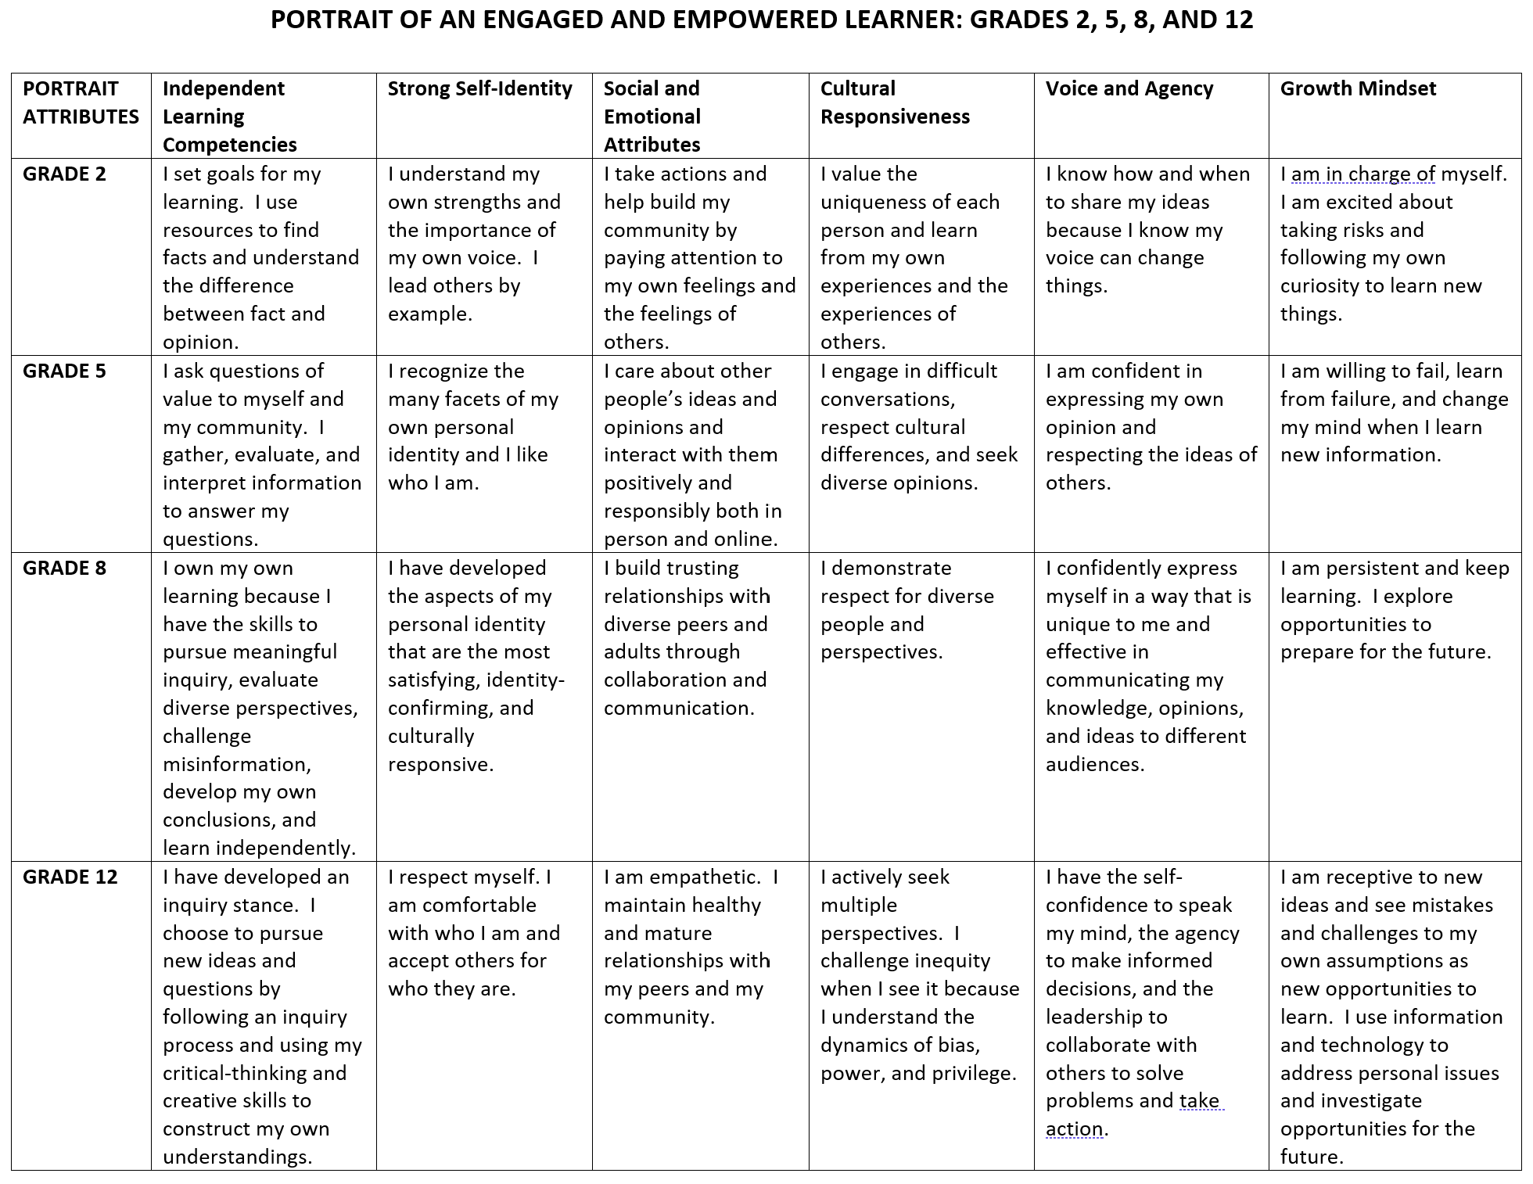

Slide 21
How Is the Promise of Inquiry Broken?
Inquiry as a dynamic process and skills is divorced from learning important content.
Neil Postman (1979, p. 214)
Inquiry is reduced to a mechanical process with no spirit of wonder and puzzlement.
Neil Postman (1979, p. 214)
Without both a spirit of wonder and puzzlement and a dynamic process, inquiry is reduced to a thoughtless fact-finding activity.
Increasing emphasis on the “engineering of learning” based on ‘hard evidence’ from the field of cognitive science endangers the possibility of inquiry.
Neil Postman (1996, pp. 26-27)
Notes:
Postman, N. (1979). Teaching as a Conserving Activity. New York, NY: Delta.
Postman, N. (1996). The End of Education: Redefining the Value of School. New York, NY: Random House.

