Slide 1


Engaging and Empowering Inquirers
(Some Thoughts)
Hartland International School
16 March 2024
Darryl & Jenny Toerien
toeriend@blanchelande.sch.gg & toerienj@blanchelande.sch.gg
Blanchelande College Libraries
Enabling Heroic Inquiry

Slide 2

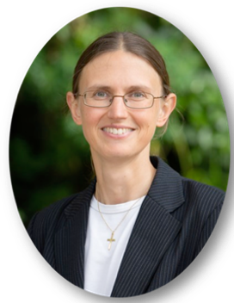
Introduction
Darryl Toerien
Jenny Toerien
Head of Inquiry-Based Learning at Blanchelande College
MA (equivalent) in Philosophy​
Taught Computer Science and Religion & Philosophy​
MA Information & Library Management
Originator of FOSIL (2011), based on the ESIFC
Originator of the FOSIL Group (2019)
Member of the UK School Library Association (SLA), and former Member of the Board
Former member of the CILIP School Libraries Group, and former member of the National Committee
Member of the IFLA School Libraries Section, and former Member of the Section Standing Committee
Member of the International Association of School Librarianship
College Librarian and Project Qualifications Coordinator at Blanchelande College
MA in Mathematics​
Taught Physics​
MSc Information Science​
Collaborator on FOSIL (2011)
Founding member of the FOSIL Group (2019)
Member of the UK School Library Association (SLA)
Notes:
Thank you for sharing your time with us. We are here because Mary-Rose is a colleague who we hold in the highest regard, and we are as excited about your amazing work as she is.
Note: IFLA and IASL view the librarian as a specialist teacher – i.e., a qualified teacher who is also qualified as a school librarian – who is responsible for an inquiry-centred instructional program.

Slide 3
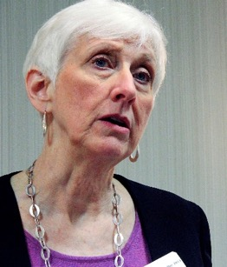
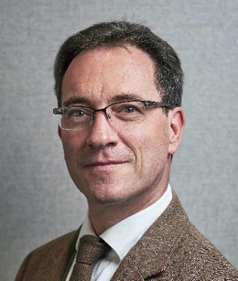
Collaboration
Barbara Stripling …
… Darryl Toerien
Professor Emerita, School of Information Studies, Syracuse University
Past President of the Freedom to Read Foundation and the American Library Association
Co-originator of the Research as a Thinking Process model and REACTS Taxonomies (1988)
Originator of Stripling’s Model (2003)
Originator of the Empire State Information Fluency Continuum (2009/12, reimagined 2019)
  Endorsed by the New York State Education Department and New York State Library
  3.2+ million children in 4,236 schools
FOSIL Group member (2020)
Weekly meetings (2020 – Present)
The Day 2021
  Thoughtful REACTionS to The Day: Framing Inquiry-Based Learning​
CILIP School Libraries Group 2021
  Reading and the Information-to-Knowledge Learning Process​
UK School Library Association 2021 Keynote
  Inquiry: An Educational and Moral Imperative
IFLA School Library Section Midyear Meeting 2022 Keynote
  Our Evolving Understanding of Inquiry: 1988-Present
Global Action for School Libraries: Models of Inquiry (2022)
  The Stripling Model of Inquiry
  FOSIL: Developing and Extending the Stripling Model of Inquiry
  Deep Collaboration by Teacher and Librarian to Develop an Inquiry Mindset (Jenny Toerien with Joseph Sanders)
AASL 2023
  Leading an Inquiry-Based School (with Jenny Toerien)
SJSU 2024
  Engaging and Empowering Learners for Life (with Jenny Toerien)
Bloomsbury Libraries Unlimited
  Inquiry as Conversation (working title for book proposal)
Notes:
Approached by Bloomsbury about writing a book about our work on inquiry due to interest in the countries where they are headquartered, namely, US, UK, Australia and India.

Slide 4
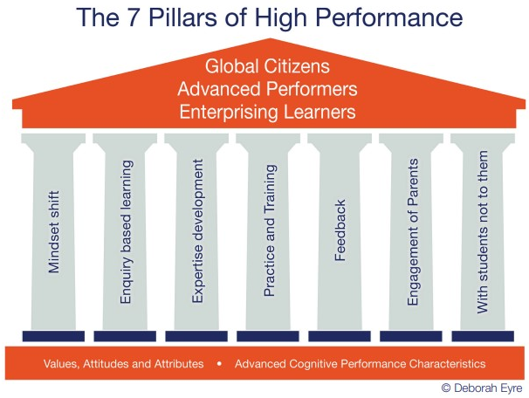
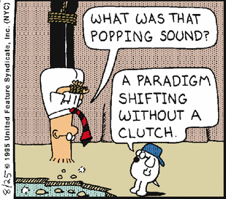
Start with why
Notes:
The inclusion of inquiry-based learning as one of the seven pillars of HPL makes it necessary, but that alone is not sufficient if inquiry-based learning is to actually produce engaged and empowered inquirers.
Furthermore, the pillars, as presented, do not dictate order or priority, unless you read from left to right, or relationship. However, from our perspective, a mindset/ paradigm shift must precede, or at the very least accompany, the shift to inquiry-based learning, which then frames the other pillars. If not, then be prepared for an uncomfortable journey. – Oakham School.
Points about enquiry-based learning:
Internationally, almost exclusively inquiry-based learning, and not just within IB.
Seems to have been used more interchangeably in the UK in the early 2000s.
Distinction between enquiry as "the act or an instance of asking or seeking information", which is narrower than inquiry, which is "an investigation", with "investigation" being "a formal examination or study".

Slide 5
Inquiry as essential learning stance and process
“Upon this first, and in one sense this sole, rule of reason
– that in order to learn you must desire to learn, and in so desiring not be satisfied with what you already incline to think –
there follows one corollary which itself deserves to be inscribed upon every wall of the city of philosophy: Do not block the way of inquiry.”
Charles Sanders Pierce (1955, p. 54)
Peirce, C. S. (1955). The Scientific Attitude and Fallibilism. In J. Buchler (Ed.), Philosophical Writings of Peirce (pp. 42-59). New York, NY: Dover Publications.

Slide 6
“What we’ve got wrong about knowledge & curriculum”
Q: Bearing all of that in mind, what advice would you give to teachers interested in applying your ideas about powerful knowledge to how they interpret their school’s curriculum?
  [A: The curriculum is not just a body of knowledge; it’s a group of communities we must encourage our students to join.]
  [A: powerful knowledge is just a signpost towards some very difficult questions that everyone needs to think hard about.]
  A: I would remind them of a point [Russian psychologist] Lev Vygotsky made: that acquiring knowledge in school has to be the voluntary act of a learner. You can’t actually teach anybody anything; they have to learn it. You can help them, but they’ve got to have that desire to know. …
  A: If you haven’t encouraged students to engage in the process of acquiring knowledge, which is a very difficult process, then all you get is memorisation and reproduction in tests. …
  A: The current interest in the curriculum overlooks this point. It’s so concerned with saying, “Have we got the knowledge?” that it forgets to ask, “How is the knowledge being acquired?”
Young, M. (2022, September 21). What we’ve got wrong about knowledge & curriculum. (G. Duoblys, Interviewer) Tes Magazine.
Notes:
Implications:
Body of knowledge is more accurately bodies of knowledge, or fields/ branches, or discipline/ subjects that cohere meaningfully. It is unlikely that our students view and/ or experience the curriculum as a meaningfully coherent whole, which is unfortunate. As Alfred North Whiteheads (1929, p. 10) puts it, “There is only one subject-matter for education, and that is life in all its manifestations. Instead of this single unity, we offer children …. Can such a list be said to represent Life, as it is known in the midst of the living of it?” | Whitehead, A. N. (1929). The Aims of Education and Other Essays. New York, NY: Macmillan.
These communities of knowledge-acquisition more or less overlap for their student members, in that the students belong to more than one of them, but almost certainly don’t overlap for their teacher members, which is unfortunate, as it reinforces the above view and/ or experience of the curriculum.
Even powerful knowledge, which, according to Young, is knowledge that enables students to understand and think beyond the limits of their own experience, is neither self-evident nor an end in itself.
Learning, which is the process of acquiring knowledge, is the voluntary act of the learner, and it cannot be forced by the teacher. This is humbling. As John MacBeath (1993, p. ?) pointed out forty years ago, one of the most important lessons to come out of more than forty years of literature on school failure is that "teachers must recognise the limitations of teaching and become much more sophisticated in their understanding of learning.“ | MacBeath, J. (1993). Learning for your self: supported study in Strathclyde schools. Strathclyde: Strathclyde Regional Council.
However, the process of acquiring knowledge is not the same as memorization and reproduction in tests. This is sobering, because it raises questions about the extent to which we mistake memorization and reproduction in tests for learning, and the extent to which our efforts are directed at memorization and reproduction in tests.
Our first and foremost task is to engage students in the learning process of acquiring knowledge, which is fundamentally an inquiry process. This is challenging, as it inverts much of what we do.

Slide 7
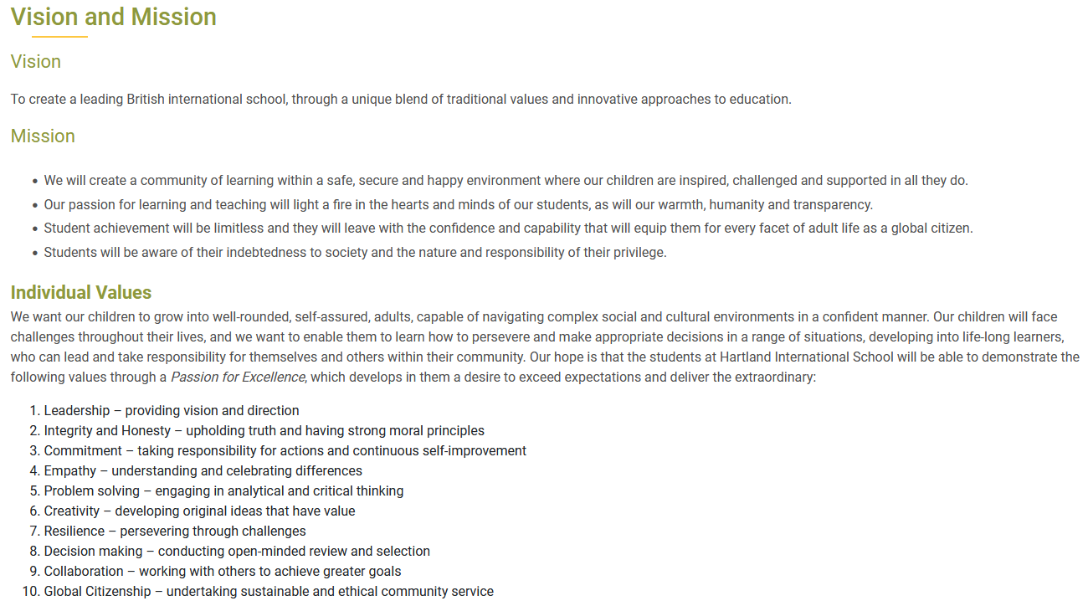

Why not just memorisation & reproduction?
Notes:
Learning is more than just memorisation & reproduction, and education broader still.
John Dewey (1956, p. ?): The fundamental issue is not that of "new versus old education, not of progressive against traditional education, but a question of what anything whatsoever must be to be worthy of the name of education."
Jacques Maritain (1952, p. 3): “Nothing is more important than the events which occur within that invisible universe which is the mind of [a person]. And the light of that universe is knowledge. If we are concerned with the future of civilization we must be concerned primarily with a genuine understanding of what knowledge is, its value, its degrees, and how it can foster the inner unity of the human being.“ | Maritain, J. (1952). The Range of Reason. New York, NY: Charles Scribner's Sons.
So, what does this look like?

Slide 8
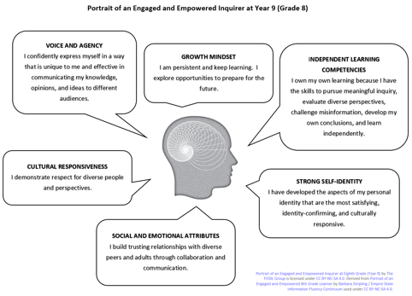
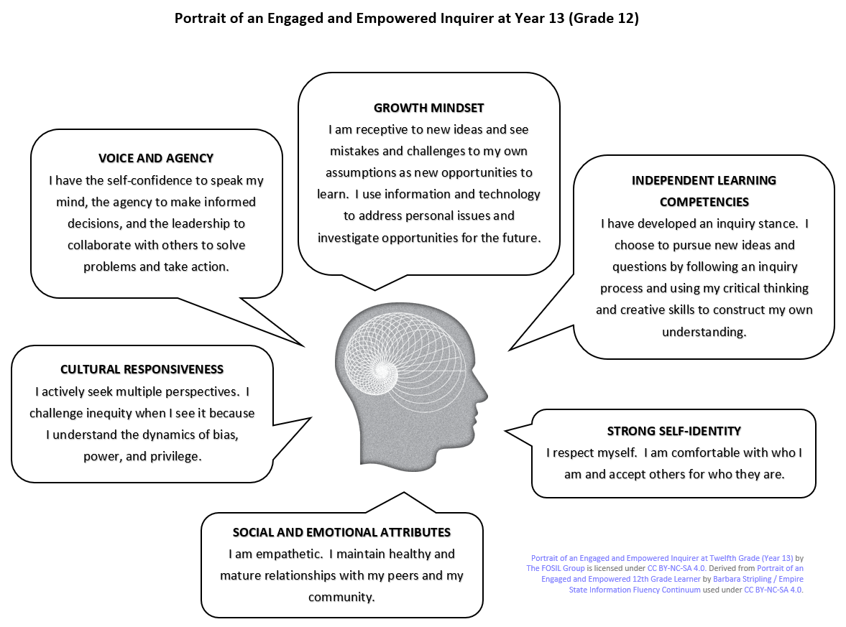
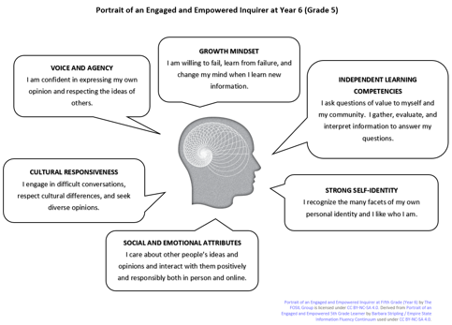
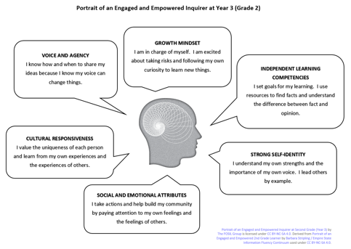
Notes:
Inquiry is about the inquirer.
Visualising an engaged and empowered inquirer in the first person at Year 13, 9, 6 and 3. The measure of our success if the extent to which our students can honestly describe themselves in this way.
No gap between inspection claims and evidence.

Slide 9
Independent Learning
Year 1-3 | I set goals for my learning. I use resources to find facts and understand the difference between fact and opinion.
Year 4-6 | I ask questions of value to myself and my community. I gather, evaluate, and interpret information to answer my questions.
Years 7-9 | I own my own learning because I have the skills to pursue meaningful inquiry, evaluate diverse perspectives, challenge misinformation, develop my own conclusions, and learn independently.
Years 10-13 | I have developed an inquiry stance. I choose to pursue new ideas and questions by following an inquiry process and using my critical-thinking and creative skills to construct my own understandings.
Mapping FOSIL Portrait Attributes to Hartland Values
Vision
To create a leading British international school, through a unique blend of traditional values and innovative approaches to education.
Strong Self-Identity
Year 1-3 | I understand my own strengths and the importance of my own voice. I lead others by example.
Year 4-6 | I recognize the many facets of my own personal identity and I like who I am.
Year 7-9 | I have developed the aspects of my personal identity that are the most satisfying, identity-confirming, and culturally responsive.
Year 10-13 | I respect myself. I am comfortable with who I am and accept others for who they are.
Mission
We will create a community of learning within a safe, secure and happy environment where our children are inspired, challenged and supported in all they do.
Our passion for learning and teaching will light a fire in the hearts and minds of our students, as will our warmth, humanity and transparency.
Student achievement will be limitless, and they will leave with the confidence and capability that will equip them for every facet of adult life as a global citizen.
Students will be aware of their indebtedness to society and the nature and responsibility of their privilege.
FOSIL Portrait Attributes
Developed
Through
Inquiry
Social and Emotional
Year 1-3 | I take actions and help build my community by paying attention to my own feelings and the feelings of others.
Year 4-6 | I care about other people’s ideas and opinions and interact with them positively and responsibly both in person and online.
Year 7-9 | I build trusting relationships with diverse peers and adults through collaboration and communication.
Year 10-13 | I am empathetic. I maintain healthy and mature relationships with my peers and my community.
Individual Values
We want our children to grow into well-rounded, self-assured, adults, capable of navigating complex social and cultural environments in a confident manner. Our children will face challenges throughout their lives, and we want to enable them to learn how to persevere and make appropriate decisions in a range of situations, developing into life-long learners, who can lead and take responsibility for themselves and others within their community. Our hope is that the students at Hartland International School will be able to demonstrate the following values through a Passion for Excellence , which develops in them a desire to exceed expectations and deliver the extraordinary:
Cultural Responsiveness
Year 1-3 | I value the uniqueness of each person and learn from my own experiences and the experiences of others.
Year 4-6 | I engage in difficult conversations, respect cultural differences, and seek diverse opinions.
Year 7-9 | I demonstrate respect for diverse people and perspectives.
Year 10-13 | I actively seek multiple perspectives. I challenge inequity when I see it because I understand the dynamics of bias, power, and privilege.
1. Leadership – providing vision and direction.
2. Integrity and Honesty – upholding truth and having strong moral principles.
3. Commitment – taking responsibility for actions and continuous self-improvement.
4. Empathy – understanding and celebrating differences.
Voice and Agency
Year 1-3 | I know how and when to share my ideas because I know my voice can change things.
Year 4-6 | I am confident in expressing my own opinion and respecting the ideas of others.
Year 7-9 | I confidently express myself in a way that is unique to me and effective in communicating my knowledge, opinions, and ideas to different audiences.
Year 10-13 | I have the self-confidence to speak my mind, the agency to make informed decisions, and the leadership to collaborate with others to solve problems and take action.
5. Problem solving – engaging in analytical and critical thinking.
6. Creativity – developing original ideas that have value.
7. Resilience – persevering through challenges.
8. Decision making – conducting open-minded review and selection.
Growth Mindset
Year 1-3 | I am in charge of myself. I am excited about taking risks and following my own curiosity to learn new things.
Year 4-6 | I am willing to fail, learn from failure, and change my mind when I learn new information.
Year 7-9 | I am persistent and keep learning. I explore opportunities to prepare for the future.
Year 10-13 | I am receptive to new ideas and see mistakes and challenges to my own assumptions as new opportunities to learn. I use information and technology to address personal issues and investigate opportunities for the future.
9. Collaboration – working with others to achieve greater goals.
10. Global Citizenship – undertaking sustainable and ethical community service.

Slide 10
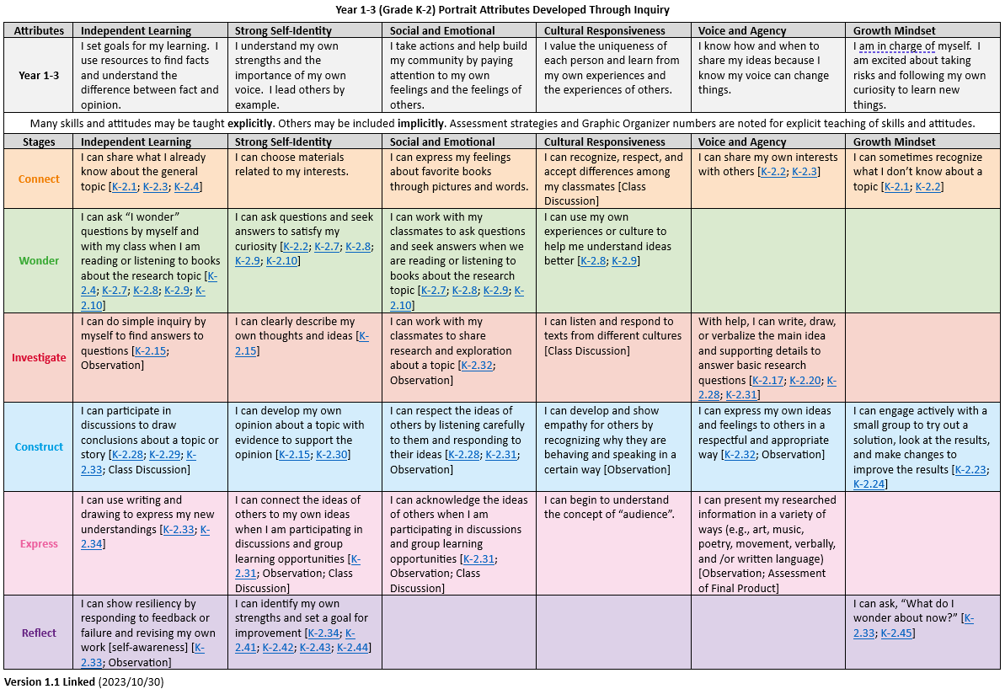
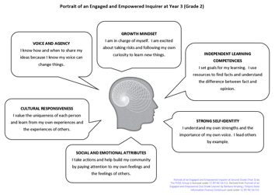
Portrait
Attributes
Years 1-3
Notes:
Note: Instructional use of colour.

Slide 11
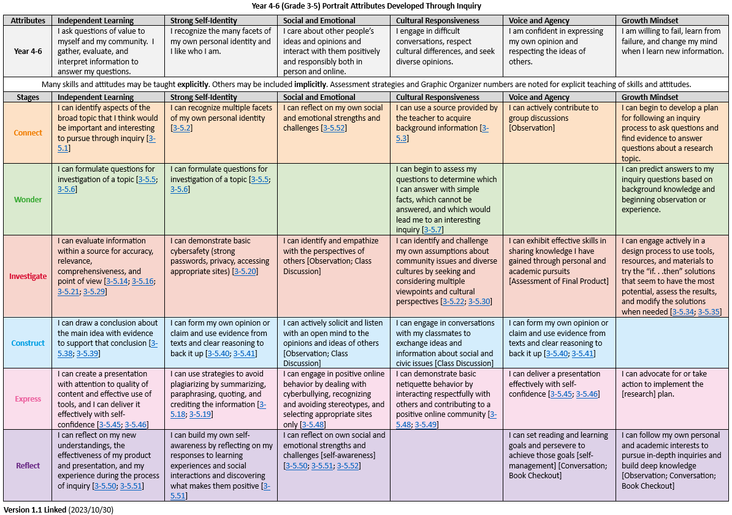
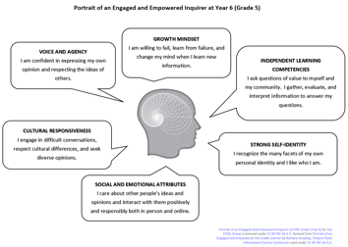
Portrait
Attributes
Years 4-6
Notes:
Reminder about powerful knowledge as difficult conversations.
Gordon Wells (2001, p. 8): “If classrooms [are] to become places where students [are] actively and enthusiastically attempting to construct answers to questions that were of real interest to them - rather than simply going through the routines of 'doing school' - more would be needed than the introduction of prepackaged inquiry activities, taken from teachers' manuals or downloaded from the Internet.” | Wells, G. (2001). The Development of a Community of Inquiry. In G. Wells (Ed.), Action, Talk & Text: Learning and Teaching Through Inquiry (pp. 1-22). New York, NY: Teachers College Press. Developing Inquiring Communities in Education Project (led by the Ontario Institute for Studies in Education at the University of Toronto, 1991-2001).

Slide 12
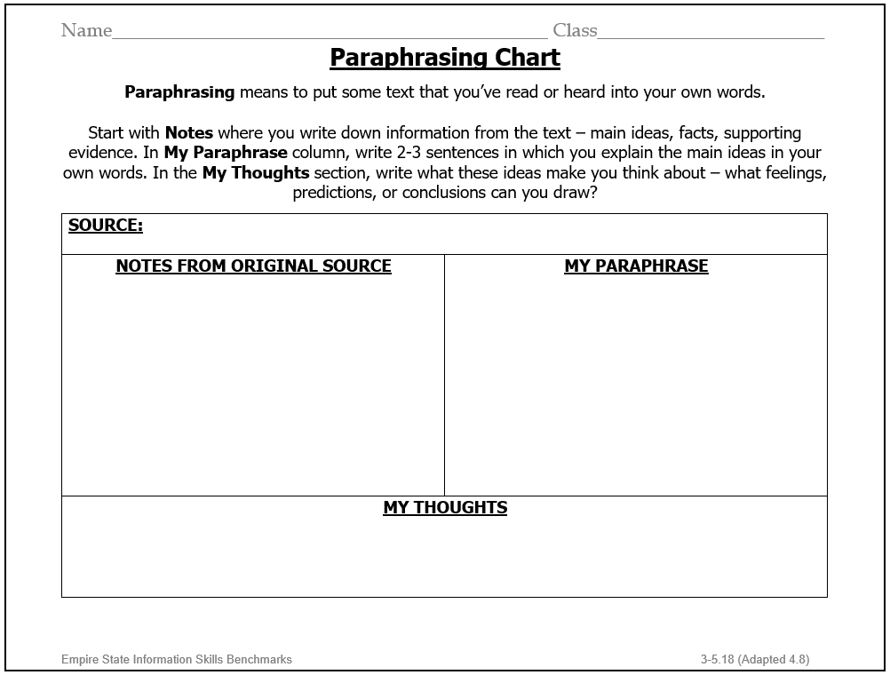

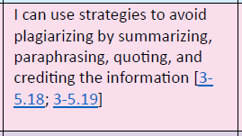
Learning Skills and Attributes
(Years 4-6)
Notes:
Learning skills and skills for learning … something.
Note: Instructional use of colour locates this skill set in the Express stage of the process

Slide 13
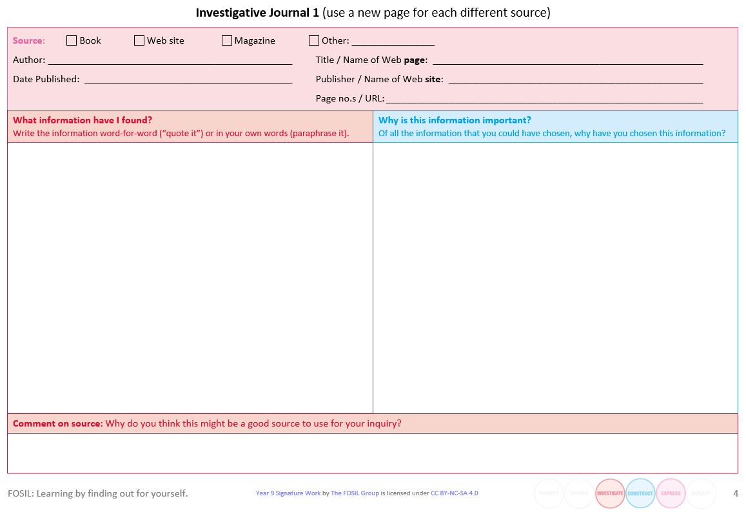
Reading for information and meaning

Slide 14
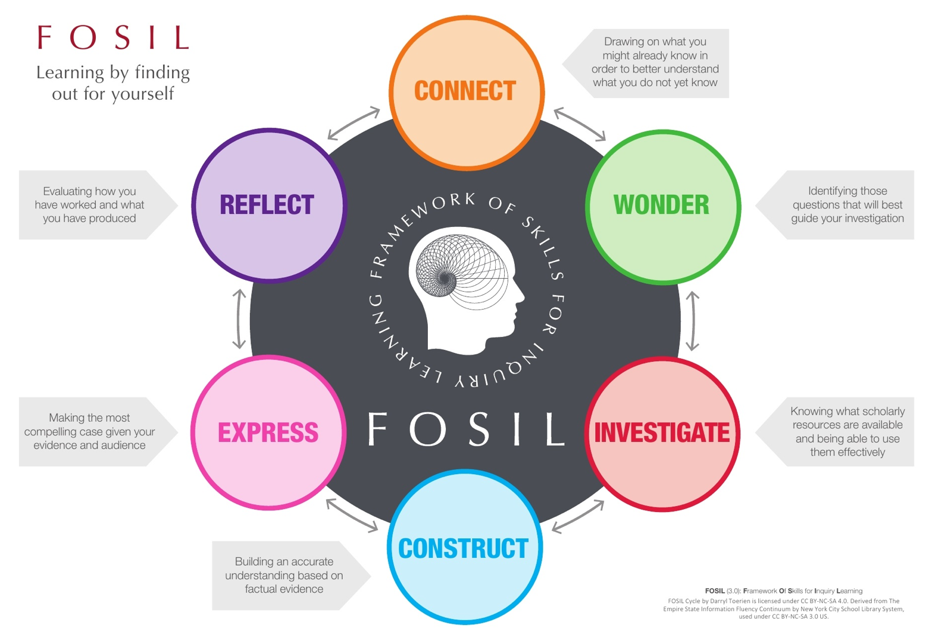
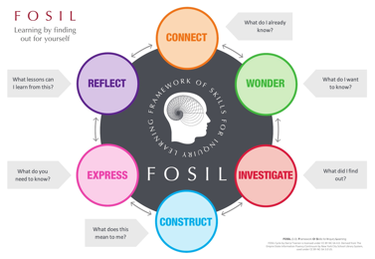
What does this look like?
Notes:
Note: Learning by finding out for [not by] yourself.
Features:
Third iteration of FOSIL. Stage descriptions are my best effort to describe what is happening in each stage – only change might be “scholarly” -> reliable.
Head represents a thoughtful person.
Thought grows outward iteratively.
Reminder that, even though there is formal reflective stage, reflective thought is a feature of each stage.
The double-headed arrows between stages remind us that the process is not linear.
Colours, while not a science, was thoughtfully chosen.

Slide 15


What does this look like?
Notes:
Note: Learning by finding out for [not by] yourself.
Features:
Third iteration of FOSIL. Stage descriptions are my best effort to describe what is happening in each stage – only change might be “scholarly” -> reliable.
Head represents a thoughtful person.
Thought grows outward iteratively.
Reminder that, even though there is formal reflective stage, reflective thought is a feature of each stage.
The double-headed arrows between stages remind us that the process is not linear.
Colours, while not a science, was thoughtfully chosen.

Slide 16
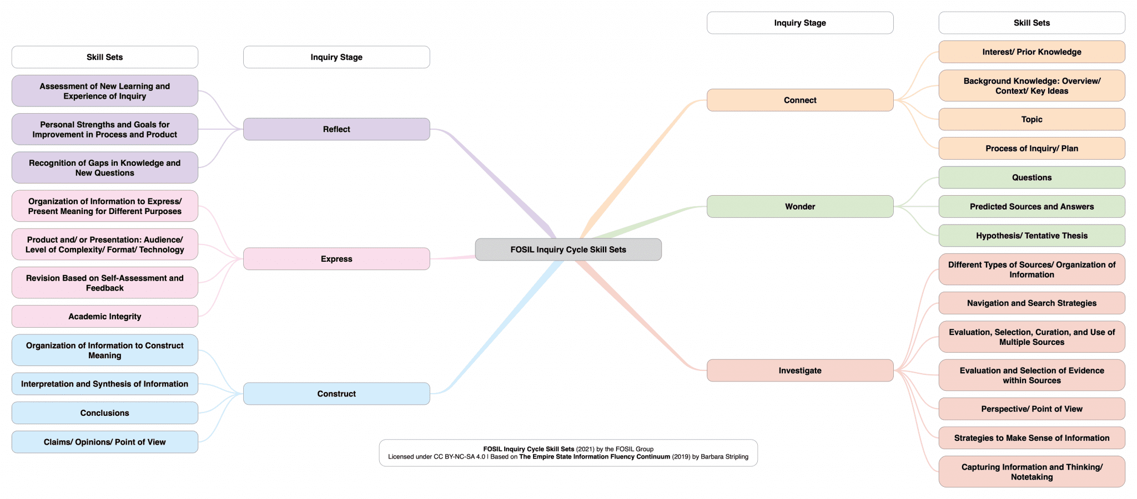

Slide 17
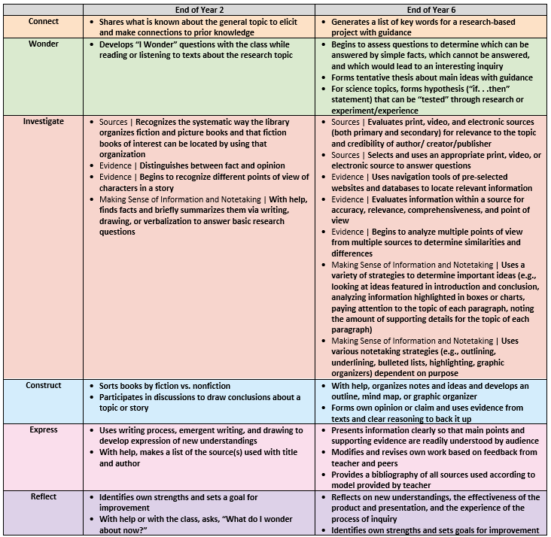
FOSIL Inquiry Priority Skills in Transition Years
(2 and 6)
Notes:
Most, if not all, of these skills will have ESIFC graphic organisers, which I should link to.

Slide 18
Inquiry Within and Beyond the Curriculum
Curricular Inquiry
Extracurricular Inquiry
“Providing a [model] of the inquiry process is only the first step in empowering students to pursue inquiry on their own. The next step is to structure teaching around a framework of the [inquiry] skills that students must develop at each phase of inquiry over their years of school and in the context of content area learning.” (1)
Can be a full inquiry/ Signature Work
Appropriate for all students
Inquiry that falls outside of content/ subject area learning, even though timetabled
Always a full inquiry/ Signature Work
For example, EPQ in Year 12/13
  Worth half an A-Level
  Requires 30 guided/ taught hours
    Timetabled
  Requires 90 independent hours
    Structured accountability, including but not limited to Independent Study Periods
  Not appropriate for all students
Also, for example, HPQ in Year 10
References
Barbara Stripling, Empowering Students to Inquire in a Digital Environment (2017, p. 52), in S. W. Alman (Ed.), School Librarianship: Past, Present, and Future.

Slide 19
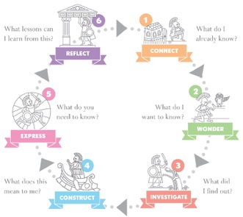
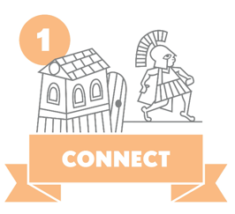





Reading for inquiry
Reading for intellectual and emotional engagement
Exploratory notetaking
Entering into dialogue with the text – what questions does this raise for me?
Reading for meaning and knowledge not just information
Investigative notetaking
Reading for understanding beyond the text
Constructive notetaking
Reading for communicating personal knowledge and understanding
Reading for reflection on learning

Slide 20
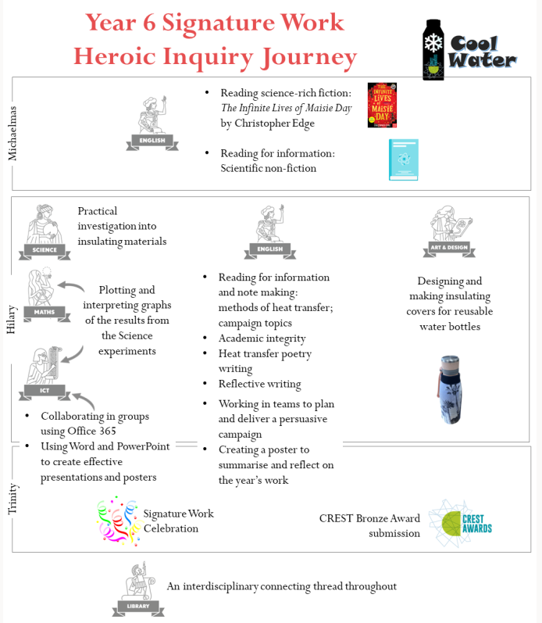
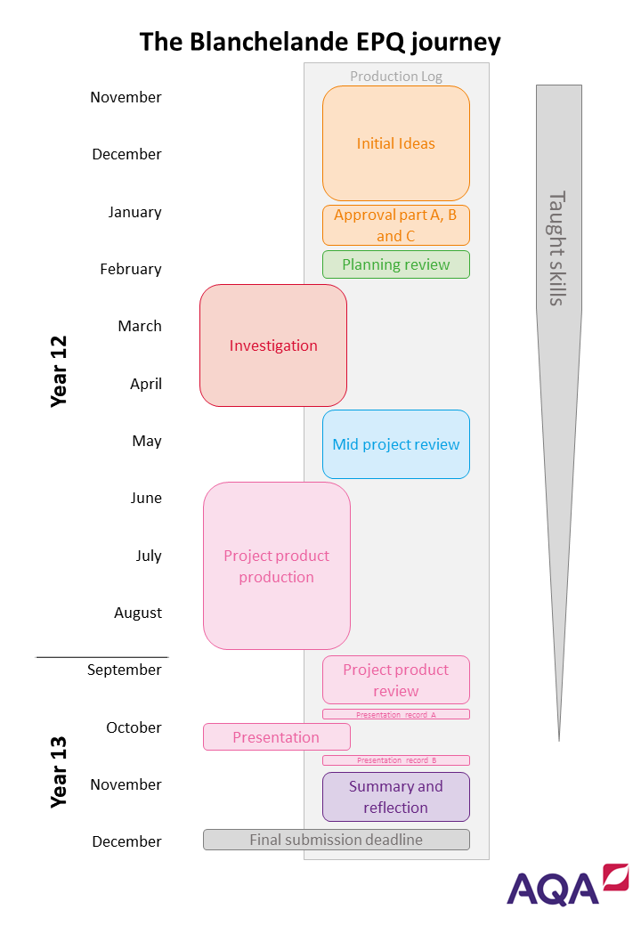
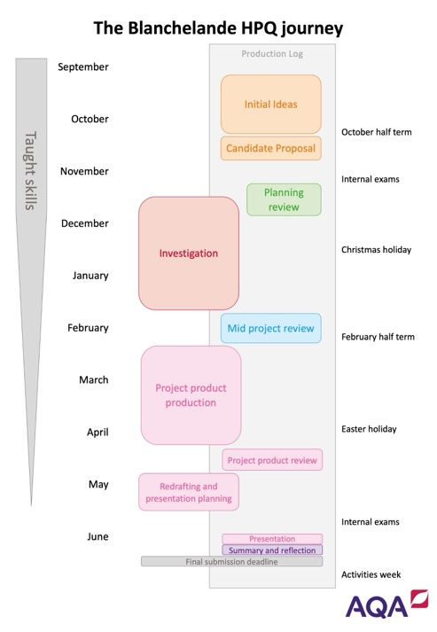
Planning for teaching Inquiry

Slide 21
Inquiry as an approach to learning & teaching
By definition, inquiry is “a dynamic process of being open to wonder and puzzlement and coming to know and understand the world and ourselves in it as the basis for responsible participation in community” (Stripling & Toerien, 2021). Rooted in work of…
  Developing Inquiring Communities in Education Project (led by the Ontario Institute for Studies in Education at the University of Toronto, 1991-2001)
    Conclusion: (p. 7). “the force that drives the enacted curriculum must be a pervasive spirit of inquiry, and the dominant purpose of all activities must be an increase in understanding … teacher and students together must become a community of inquiry with respect to all aspects of the life of the classroom and all areas of the curriculum”
  Galileo Educational Network (professional learning arm of the School of Education at the University of Calgary, 1999-2022)
  ESIFC (2009, 2019-present) & FOSIL Group (2011, 2019-present)

Slide 22
Standards for British Schools Overseas (2023)
Part 1: Quality of education provided
Emphasis on pupils’ experience of the curriculum and programme of activities
Teaching enables all pupils to acquire new knowledge, increase their understanding, and develop their skills in the subjects taught
  Are interested in their work
  Apply intellectual, physical and creative effort
  Act responsibly
  Are self-motivated, thinking and learning for themselves
Triangulation is the process of looking for connected evidence from a wide range of sources in order to determine typicality
Notes:
https://assets.publishing.service.gov.uk/media/6501c2e097d396000d482e0c/Standards_for_British_Schools_Overseas.pdf

