Slide 1
Truth Matters Academic Integrity: Augmented vs Artificial Intelligence?
“Understanding a question is half an answer.”
Attributed to Socrates
Blanchelande College INSET
29 May 2024
Darryl Toerien
toeriend@blanchelande.sch.gg
Blanchelande College Libraries
Enabling Heroic Inquiry
Notes:
Notes
Slides are A3 because of the handout (visible slide 4), so some of the other slides may look a little odd.
Given the importance and complexity of the subject matter, this presentation can only really serve as an overview of the slides for further consideration and discussion.
The presentation contains only as many slides as I needed to make sense of what of what I am saying, and due to time constraints some slides contain more information than we can give our full attention to here. Where slides aren’t self-explanatory, they have notes.
The presentation first aims to understand the question, or problem, and then explores the answer, or solution, in increasingly practical terms.

Slide 2
TL;DL
Understanding the Question
Starting to Formulate an Answer
Our existential crisis is epistemological in nature – a breakdown in the knowledge-building process.
Our work is teaching the process of knowledge-building.
The process of knowledge-building – learning – is being reduced to information storage and retrieval.
If learning is allowed to become information storage and retrieval, then we cannot compete with machines (AI), either as teachers or as students.
This makes the development of academic integrity, which is a question of character, impossible.
It is game over by the end of primary, but our work is not over by the end of primary.
“The reason why students cheat in exams is because we value their grades more than they [and we] value their learning.” (Attributed to Richard Feynman)
Engaging students in their learning, while necessary, is not sufficient, because they must also be empowered to learn with increasing independence.
From the perspective of academic integrity, then, we share responsibility with students for growing in their desire to act with integrity and in their ability to do so.
FOSIL is a vital means to this end.
Notes:
Notes
Too Long; Didn’t Listen
Information storage and retrieval undermines and works against academic integrity, because it is effectively copying and pasting information without reference to sources.

Slide 3
Results reveal a system’s design
Engineering adage: Your system is perfectly designed to achieve the results that you are getting.
In school, “results” has a broad and narrow meaning
Broad – the kind of students who graduate
Narrow – the grades students graduate with
“A university is…an Alma Mater, knowing her children one by one, not a foundry or a mint or a treadmill.” (John Henry Newman, 1873/2015, p. 104)
Question: Which kind of results is [our] school optimized for?

Slide 4
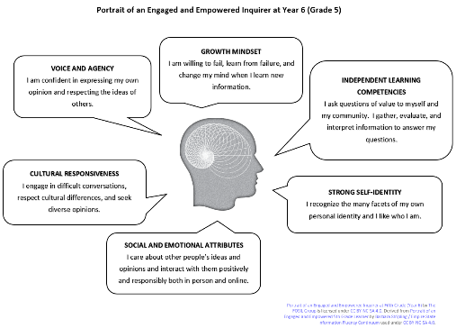
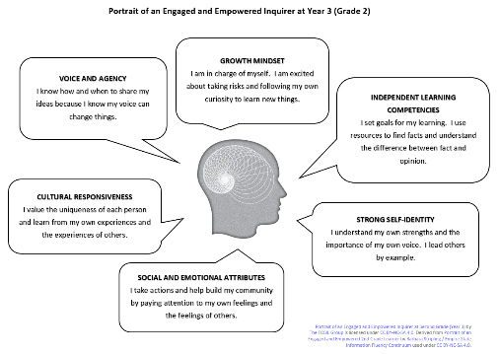
Visualising an Engaged and Empowered Inquirer at Year 13, Year 9, Year 6 and Year 3
Notes:
Notes
Inquiry has as its end an engaged and empowered inquirer. This is visualised at Year 13, 9, 6 and 3. The measure of our success is the extent to which our students can realistically describe themselves in this way.

Slide 5
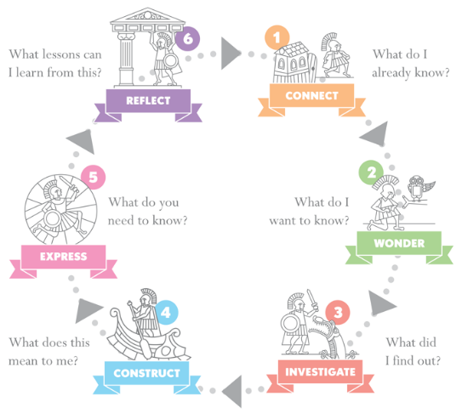
Independent Learning
Year 1-3 | I set goals for my learning. I use resources to find facts and understand the difference between fact and opinion.
Year 4-6 | I ask questions of value to myself and my community. I gather, evaluate, and interpret information to answer my questions.
Years 7-9 | I own my own learning because I have the skills to pursue meaningful inquiry, evaluate diverse perspectives, challenge misinformation, develop my own conclusions, and learn independently.
Years 10-13 | I have developed an inquiry stance. I choose to pursue new ideas and questions by following an inquiry process and using my critical-thinking and creative skills to construct my own understandings.
Mapping FOSIL Portrait Attributes of an Engaged and Empowered Inquirer to Blanchelande Aims Through Heroic Inquiry
Strong Self-Identity
Year 1-3 | I understand my own strengths and the importance of my own voice. I lead others by example.
Year 4-6 | I recognize the many facets of my own personal identity and I like who I am.
Year 7-9 | I have developed the aspects of my personal identity that are the most satisfying, identity-confirming, and culturally responsive.
Year 10-13 | I respect myself. I am comfortable with who I am and accept others for who they are.
Social and Emotional
Year 1-3 | I take actions and help build my community by paying attention to my own feelings and the feelings of others.
Year 4-6 | I care about other people’s ideas and opinions and interact with them positively and responsibly both in person and online.
Year 7-9 | I build trusting relationships with diverse peers and adults through collaboration and communication.
Year 10-13 | I am empathetic. I maintain healthy and mature relationships with my peers and my community.
Ethos
The motto of Blanchelande College is ‘Semper Fidelis’ meaning ‘Always Faithful’.
Mission
Blanchelande College, as a Catholic school, seeks to be a family always faithful to the example of Our Lord Jesus Christ, learning to become all that God wants us to be.
Aims
Cultural Responsiveness
Year 1-3 | I value the uniqueness of each person and learn from my own experiences and the experiences of others.
Year 4-6 | I engage in difficult conversations, respect cultural differences, and seek diverse opinions.
Year 7-9 | I demonstrate respect for diverse people and perspectives.
Year 10-13 | I actively seek multiple perspectives. I challenge inequity when I see it because I understand the dynamics of bias, power, and privilege.
1. That the Blanchelande family experiences a safe environment where each young person flourishes.
2. That, by fostering their gifts and talents, each pupil develops their personal vocation.
3. That the intellectual life of inquiry is directed by the search for truth, beauty and goodness.
4. That pupils learn to communicate with accuracy, logic and style.
Voice and Agency
Year 1-3 | I know how and when to share my ideas because I know my voice can change things.
Year 4-6 | I am confident in expressing my own opinion and respecting the ideas of others.
Year 7-9 | I confidently express myself in a way that is unique to me and effective in communicating my knowledge, opinions, and ideas to different audiences.
Year 10-13 | I have the self-confidence to speak my mind, the agency to make informed decisions, and the leadership to collaborate with others to solve problems and take action.
5. That pupils engage in service and charity, helping others and preserving God’s creation.
6. That pupils extend their cultural horizons and have opportunities to experience and participate in the arts.
7. That pupils nurture their health, growing in endeavour and enjoyment of true leisure.
Three Rules for Life
Growth Mindset
Year 1-3 | I am in charge of myself. I am excited about taking risks and following my own curiosity to learn new things.
Year 4-6 | I am willing to fail, learn from failure, and change my mind when I learn new information.
Year 7-9 | I am persistent and keep learning. I explore opportunities to prepare for the future.
Year 10-13 | I am receptive to new ideas and see mistakes and challenges to my own assumptions as new opportunities to learn. I use information and technology to address personal issues and investigate opportunities for the future.
1. Use your talents to pursue what is good.
2. Treat other people as you would like them to treat you.
3. Be tolerant and open to respectful debate.
‘Lord, help me to grow into the person you have made me to become.’
Notes:
Notes
Our statement of Purpose – our distinctive reason for being – strongly suggests that our system is designed for the former.
This is vitally important, because integrity is [or ought to be] a natural expression of who we are in the process of uniquely becoming [in Christ] – putting on the character of Christ.
Because academic integrity manifests itself in academic work, this then raises the question of the classroom’s direct contribution to achieving our Aims, which are [shared] familial characteristics.
If the classroom does not contribute directly to achieving our Aims, and more broadly our Purpose, then we cannot succeed in developing academic integrity, which is the only sure way to counter academic dishonesty / malpractice.
Inquiry is a stance and process that is directed towards learning disciplinary content. In doing so, students develop as engaged and empowered inquirers, which builds Blanchelande character.

Slide 6
“As we begin, so shall we go.” (Marshall McLuhan, 1967/1996 pp. 46-47)
Broadening “results”
Narrowing “results”
“There is no other foundation for the educational task than the eternal saying It is truth which sets man free – education is fully human education only when it is liberal education, preparing the youth to exercise their power to think in a genuinely free and liberating manner – that is to say, when it equips them for truth and makes them capable of judging accordingly to the worth of evidence, of enjoying truth and beauty for their own sake, and of advancing, when they have become adults, towards wisdom and some understanding of those things which bring to them intimations of immortality.” (Jacques Maritain, 1962, pp. 47-48)
“Science, and especially empirical psychology, [which provides us with invaluable and ever-growing information], by itself, can neither primarily found nor primarily guide education, for education needs primarily to know what man is – what are the constituent principles of his being, what are his place and value in the world what is his destiny.“ (Jacques Maritain, 1962, p. 51)
Notes:
Notes
Inquiry, especially in the form of Signature Work, is a distinguishing feature of a contemporary liberal education.

Slide 7
The Law of Unintended Consequences
Learning as storing [and retrieving] knowledge
Learning as engagement in the process of acquiring knowledge
“Memorization is good. ‘Storing new knowledge in long term memory’ is essentially all that learning is.” (Daniel Buck, 2022)
“The curriculum is not just a body of knowledge; it’s a group of communities we must encourage our students to join.” (Michael Young, 2022)
“If you haven’t encouraged students to engage in the process of acquiring knowledge…then all you get is memorisation and reproduction in tests.” (Ditto)
“Acquiring knowledge is a conversation, not a destination ... a journey we take together, not alone [because] others are always involved.” (Jonathan Rauch, 2021)
Notes:
Notes
I question whether “knowledge” as it is used here means the same thing, and whether Buck more accurately means “information” (or, in Young's terms, merely a body of knowledge).
Ironically, Buck would, I think, present his view of learning as traditional, and, I suspect, Young’s view as progressive (which is not a compliment), whereas Young’s view is more accurately how knowledge has traditionally been understood and knowledge-building practised.

Slide 8
Atrophication of Intelligence
Artificial Intelligence
Augmented Intelligence
Google becomes search
Popular opinion is best
Wikipedia becomes the default source of all potential knowledge
Copy-and-Paste becomes the default information storage and retrieval strategy – ‘easy’ to detect
Google breaks search
Money is better
Enshitification (Doctorow) buries knowledge
Ditto, but complicated by rise of human paper-mills
Google kills search
Money is best
AI becomes the oracle
Ditto, but increasingly difficult to detect
Cory Doctorow
Even if you think AI search could be good, it won't be good (2024.05.15)
AI makes it even easier for Google et al to cheat
Hallucination – making stuff up – creates an epistemological, moral and legal “crumple zone”
AI makes it near-impossible for us not to cheat
Unless…
“By 'augmenting human intellect' we mean increasing the capability of a man to approach a complex problem situation, to gain comprehension to suit his particular needs, and to derive solutions to problems. Increased capability in this respect is taken to mean a mixture of the following: more-rapid comprehension, better comprehension, the possibility of gaining a useful degree of comprehension in a situation that previously was too complex, speedier solutions, better solutions, and the possibility of finding solutions to problems that before seemed insoluble.” — Doug Engelbart (1962), in his Introduction to Augmenting Human Intellect.
No Mo FOFO: Developing Inquirers Through Thoughtful Research Homework (INSET on 2023.01.04)
Notes:
Notes
Google becomes the default search engine because it works well.
We fail to teach thoughtful search.
Most popular becomes best, which is more or less good.
Wikipedia is more or [increasingly] less epistemologically unstable.
We fail to concern ourselves to action with factual accuracy, reassuring ourselves that students will use Wikipedia as a starting point for further research using the references provided.
FOFO encourages and legitimizes copy-and-paste without attribution as learning in the information storage and retrieval sense, except that the information is stored externally.
This undermines academic integrity and is academic dishonesty and/ or malpractice, and we become complicit.
AI makes the situation impossibly worse.
Our system is not optimized for broad results / academic integrity, AI copy-and-paste will become increasingly difficult to ‘detect’ and deal with, and AI opinion – bought and paid for – will increasingly be our opinion (“When you trust someone to summarize the truth for you, you become terribly vulnerable to their self-serving lies.” – Doctorow).

Slide 9
Engaging Students in the Process of Acquiring Knowledge
“Only a person who has questions can have [real understanding].” (Hans-Georg Gadamer, 1994, p. 365)
Medium Term Plans: Foster intellectual and emotional engagement through Entry & Overarching Essential Questions directed at process of acquiring the disciplinary knowledge necessary for answering Topical EQs. EQs “stimulate a searching effort of the mind, an anxiety to know [and understand],” and so shift focus from Investigate to Construct, which weakens the incentive to copy & paste. (Maritain, 1962, p. 57)
MTPs: Explicitly reference FOSIL skill sets, which enable the knowledge-building process (see next slide).
MTPs: Explicitly reference possible sources of knowledge for knowledge-building: from teacher (authority) to notes/ textbooks, to original texts (print or online).
“The force that drives the enacted curriculum must be a pervasive spirit of inquiry, and the dominant purpose of all activities must be an increase in understanding.” (Wells, 2001, p. 7)
Notes:
Notes
Heroic Inquiry poster should be in every classroom, both as a point of reference and instructional tool.
John Archibald Wheeler: “We live on an island surrounded by a sea of ignorance. As our island of knowledge grows, so does the shore of our ignorance. Scientific American (1992), Vol. 267, Num. 6, page 20.

Slide 10
FOSIL Skill Sets
Skill sets provide a useful, high-level overview of the kinds of skills that enable the knowledge-building process, and so also locate us within the process.
Work on FOSIL started in 2011 in the Academic Integrity skill set.
They are not a substitute for the underlying framework of skills if we are going to systematically and progressively develop engaged and empowered inquirers (see following slides).
Notes:
Notes
FOSIL is an evolving response to the question of how to teach for academic integrity, which requires students both to will and [be able to] do.

Slide 11
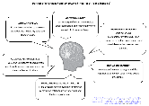
Portrait Attributes Year 1-3
Notes:
Notes
Reminder about powerful knowledge as difficult conversations.
Gordon Wells (2001, p. 8): “If classrooms [are] to become places where students [are] actively and enthusiastically attempting to construct answers to questions that were of real interest to them - rather than simply going through the routines of 'doing school' - more would be needed than the introduction of prepackaged inquiry activities, taken from teachers' manuals or downloaded from the Internet.” | Wells, G. (2001). The Development of a Community of Inquiry. In G. Wells (Ed.), Action, Talk & Text: Learning and Teaching Through Inquiry (pp. 1-22). New York, NY: Teachers College Press. Developing Inquiring Communities in Education Project (led by the Ontario Institute for Studies in Education at the University of Toronto, 1991-2001).

Slide 12
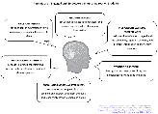
Portrait Attributes Year 4-6

Slide 13
Portrait Attributes Year 7-9

Slide 14
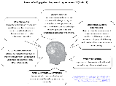
Portrait Attributes Year 10-13

Slide 15
Transition Year Signature Work Overview FOSIL Group Forum Links
Infants
Year 2 (Grade 1) Signature Work Inquiry @ Blanchelande College
Juniors
Year 6 (Grade 5) Interdisciplinary Signature Work Inquiry @ Blanchelande College
Seniors
Year 9 (Grade 8) Interdisciplinary Signature Work Inquiry @ Blanchelande College
Sixth Form
Year 12 (Grade 11) Interrobang!? Inquiry Course @ Blanchelande College
Notes:
Notes
We are community of inquiry.
Signature Work in transition years provide whole-school benchmarks that we build up to and on.

Slide 16
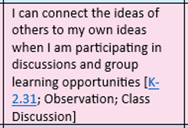
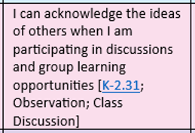
Learning Skills and Attributes (Years 1-3)
Notes:
Notes
The instructional use of colour locates this skill set in the Express stage of the inquiry process.

Slide 17
Learning Skills and Attributes (Year 4-6)

Slide 18
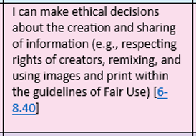
Learning Skills and Attributes (Year 7-9)

Slide 19
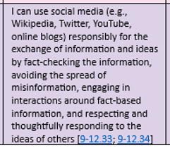
Learning Skills and Attributes (Year 10-13)

Slide 20
The Future Needs You to Be Present Living Well in a World Worth Living In
Year 9 Signature Work Inquiry
2023-2024
Blanchelande College Libraries
Enabling Heroic Inquiry

Slide 21
Reading for information and meaning

Slide 22
Reading for information and meaning

Slide 23
Reading for information and meaning

Slide 24
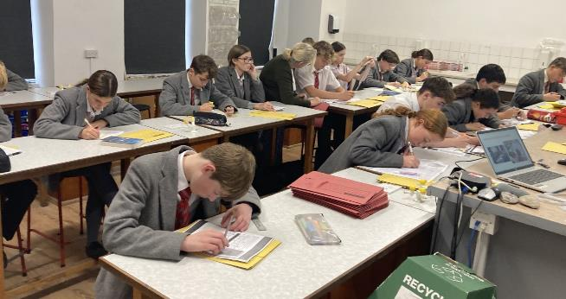
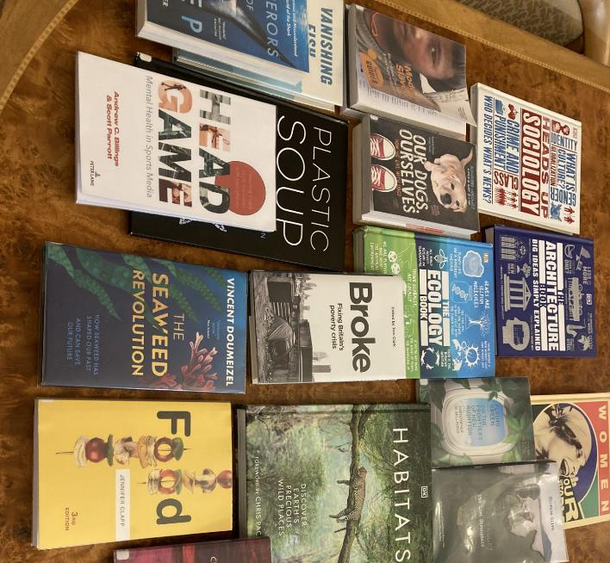
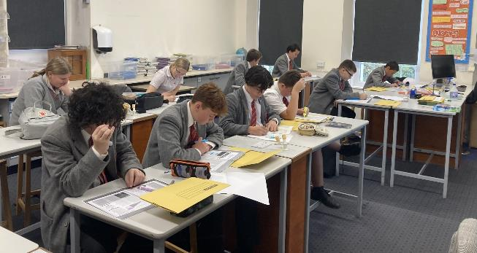
Reading for information and meaning

Slide 25
Essay Plan

Slide 26
Essay Draft

Slide 27
Essay Draft

Slide 28
Year 9 Signature Work Essay Drafting

Slide 29
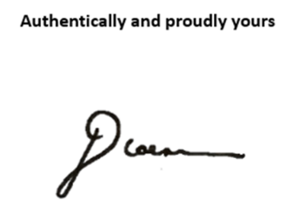
Signature Work Inquiry Celebration Thursday 20 June, 7-8pm De La Salle Hall

Slide 30
Reflecting on Learning

Slide 31
GCSE English Spoken Language Endorsement
Tasks
Candidates must undertake a prepared spoken presentation on a specific topic. As a guide, the duration of the whole assessment should be no more than ten minutes. The key requirements are: …

Slide 32
Signature Work: Necessary But Not Sufficient
“The reason why students cheat…is because they [and we] value their grades more than they value their learning.” (Feynman)
“For there is no contemplative learning if it does not respond to and stimulate a searching effort of the mind, an anxiety to know. Truth, in education, can be betrayed in two ways : either by substituting mechanical drill, and skill in solving difficulties, for the élan toward knowledge; or by putting the intellect of the student to sleep in ready-made formulas, which he accepts and memorizes without engaging his own self in the grasping of what they supposedly convey to him.” (Maritain, 1962, pp. 57-58)

Slide 33
Academic Integrity Policy
Notes:
Notes
AI poses the greatest threat to the development and expression of academic integrity, so INSET in September will explore this specifically and practically.

