Slide 1
Responsible use of AI
Departmental meeting INSET
12th November 2024
Darryl Toerien | Jenny Toerien
toeriend@blanchelande.sch.gg | toerienj@blanchelande.sch.gg
Blanchelande College Libraries
Enabling Heroic Inquiry
Notes:
This INSET on responsible use of AI is only intended to be the beginning of a conversation. It should take about half an hour to forty minutes, and I make no excuses for the fact that we can’t cover everything, so we will move quite fast and I will often direct you to external links if there are things that you might want to investigate further. So let’s get started!

Slide 2
Tools you need
Video guide
PowerPoint slides
Feedback document
Notes:
You will need this video guide, a copy of the PowerPoint, which contains all the links, and a copy of the feedback document to type your notes in. Don’t try to answer all the questions during the discussion sections, choose those which particularly interest the group you are with.

Slide 3
Format of the session
Video introductions
AI in the context of school and JCQ policies
Further resources and training
Student use of AI
Staff use of AI
Short pauses for departmental discussion and feedback
Notes:
This video will give the session structure, but there will be three opportunities for you to pause the video and discuss your thoughts in your group. You may find it helpful to set a timer for the discussion sections. Don’t forget to provide some feedback in the Word document. The session will be divided into the following sections:
1. An overview of AI in the context of school policies and Joint Council for Qualifications policies
2. Student use of AI
3. Staff use of AI
4. Further resources and training

Slide 4
1. School & JCQ policies
Blanchelande College Libraries
Enabling Heroic Inquiry
Notes:
So let’s begin with the formal policies

Slide 5
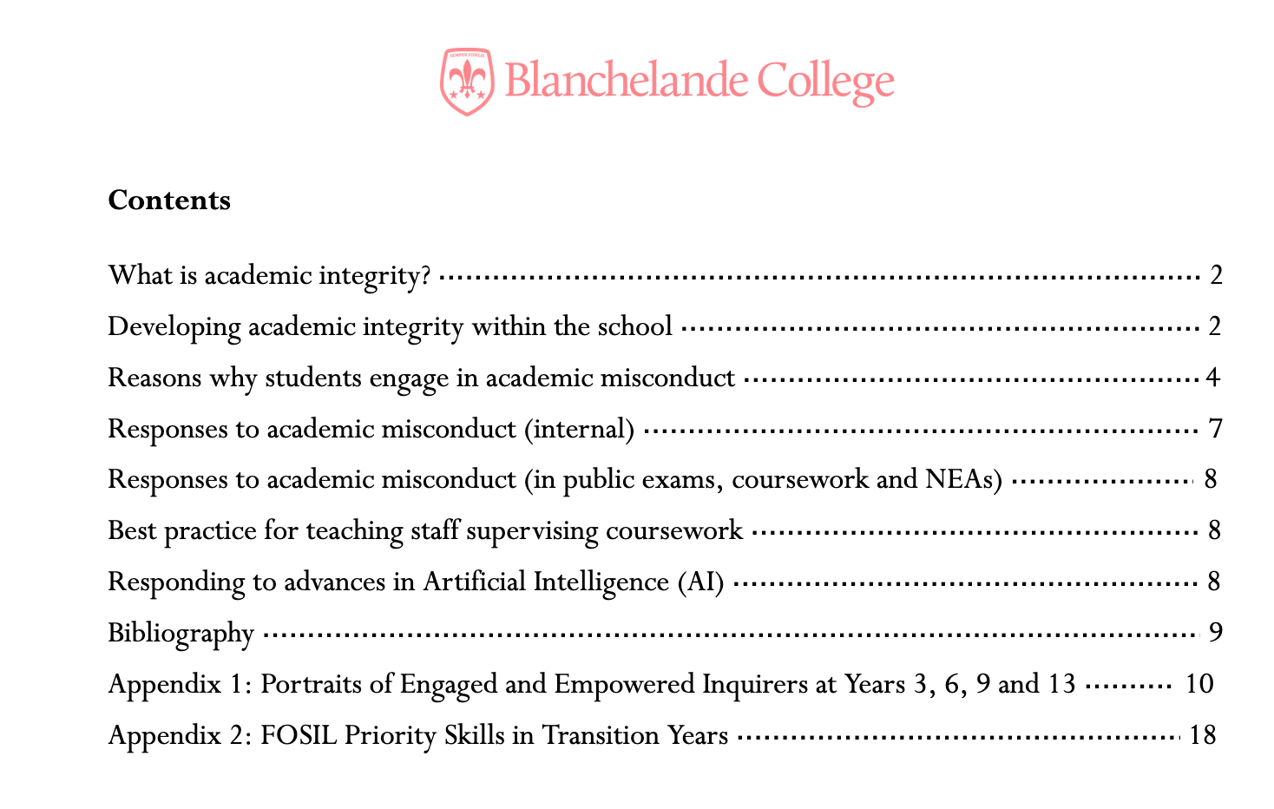
Academic Integrity Policy – on Staff Links
Notes:
The most relevant school policy for AI is the Academic Integrity Policy, which is available on Staff Links and linked directly from this presentation. I don’t have time to go through the whole policy now but please do read it through.

Slide 6
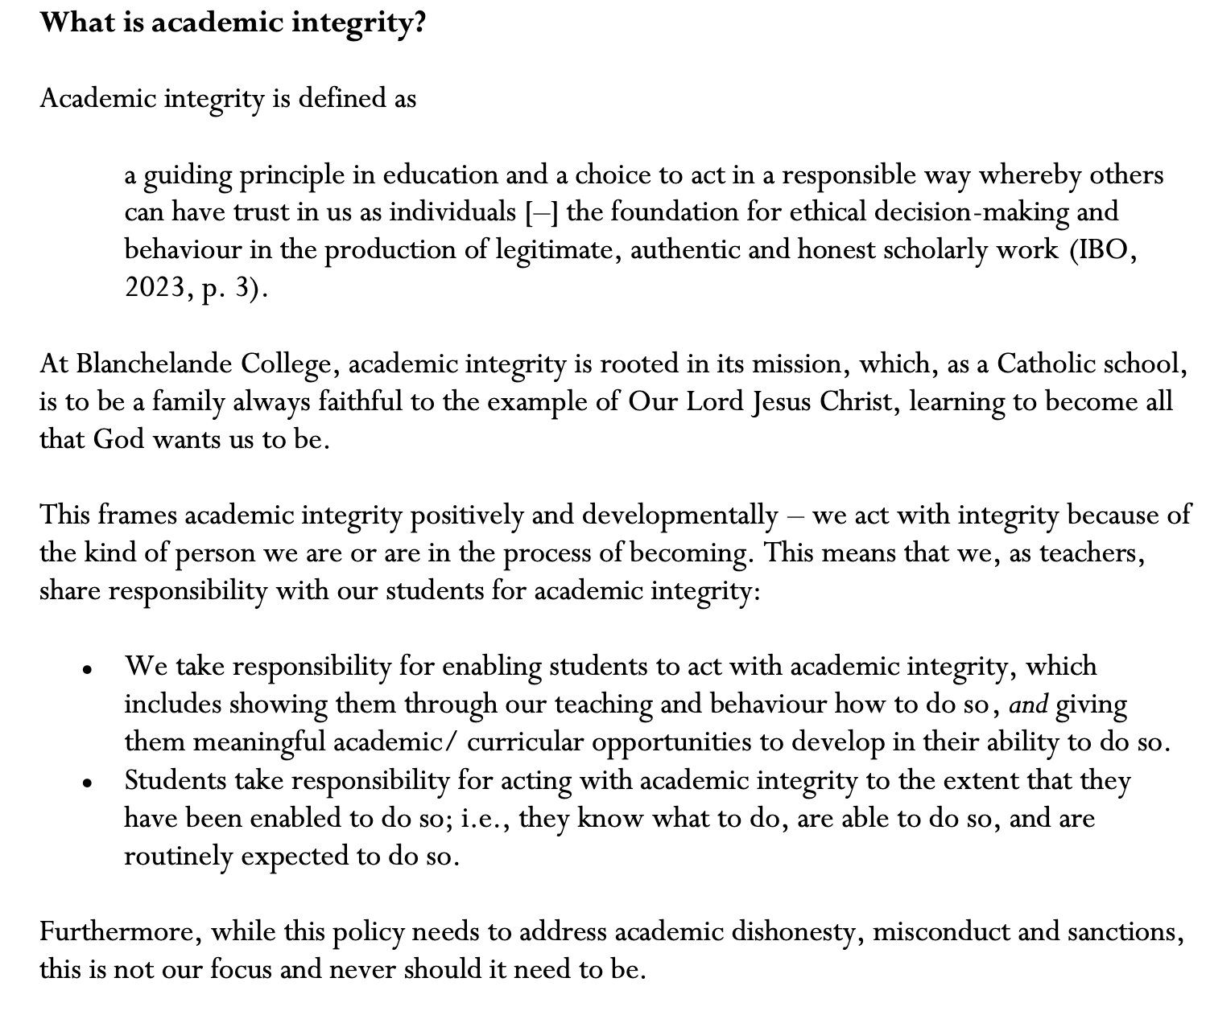
Academic Integrity Policy – on Staff Links
Notes:
Our definition of academic integrity is really about being responsible and trustworthy – the kind of people who produce legitimate, authentic and honest scholarly work just because it is the right thing to do. This is a character that we need to actively build in our students through modelling and safe, structured learning opportunities all the way up the school from the start of Primary. It is important to note that while the policy addresses academic dishonesty and misconduct the starting point and focus should always be positively building academic integrity.

Slide 7
Academic Integrity Policy – on Staff Links
Notes:
In terms of AI itself, the policy focuses on the principle that “work produced by AI is not your own” and that it needs to be suitably acknowledged. There are many other ethical and legal issues with AI which we don’t have time to deal with here, but consistently approaching AI from a standpoint of academic integrity will help us to make the right decisions. Please come and talk to us in the Library if you have questions or concerns.

Slide 8
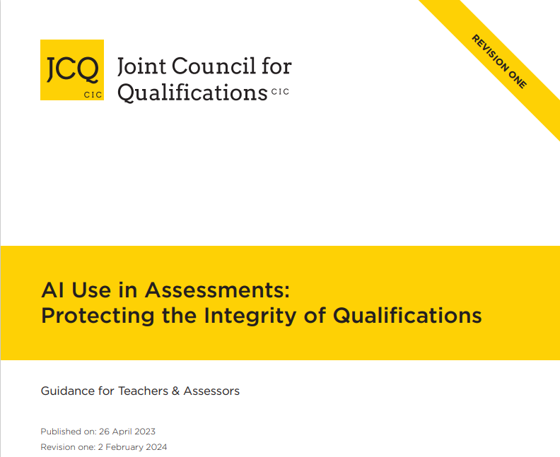
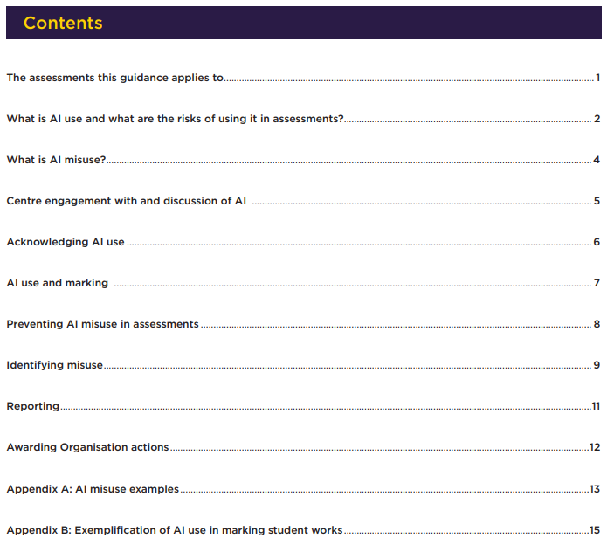
JCQ AI Policy
AI-Use-in-Assessments_Feb24_v6.pdf
Notes:
For those subjects with coursework elements, JCQ have produced this very helpful guide (linked here) which is definitely worth reading, particularly for those cases where students might have legitimate uses for AI and need to acknowledge those appropriately.

Slide 9
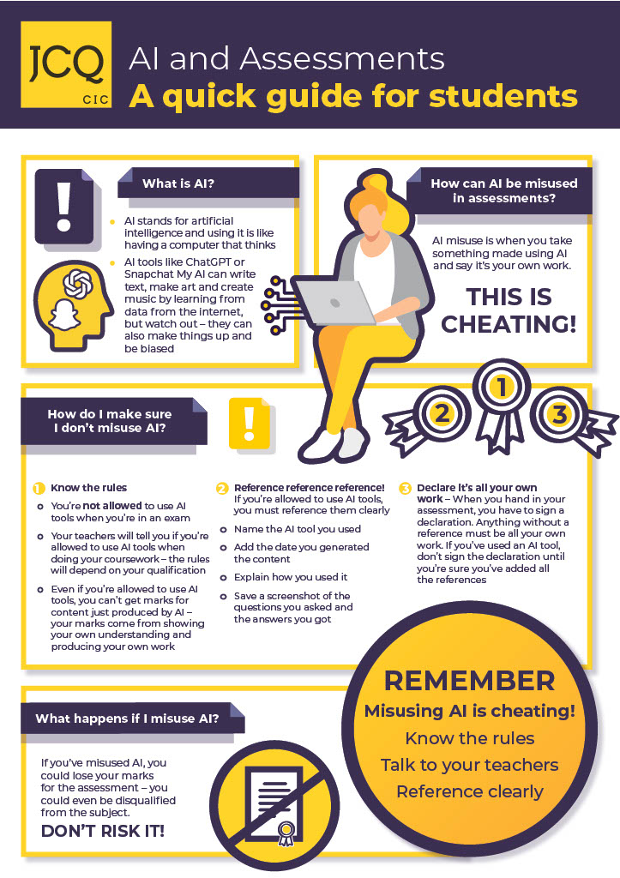
JCQ AI for students
Notes:
JCQ have also produced this helpful guide for students (linked), which covers AI in both coursework and exam situations.

Slide 10
2. Student use of AI
Blanchelande College Libraries
Enabling Heroic Inquiry
Notes:
This section on student use of AI will be the longest, as I suspect it is what concerns colleagues the most.

Slide 11
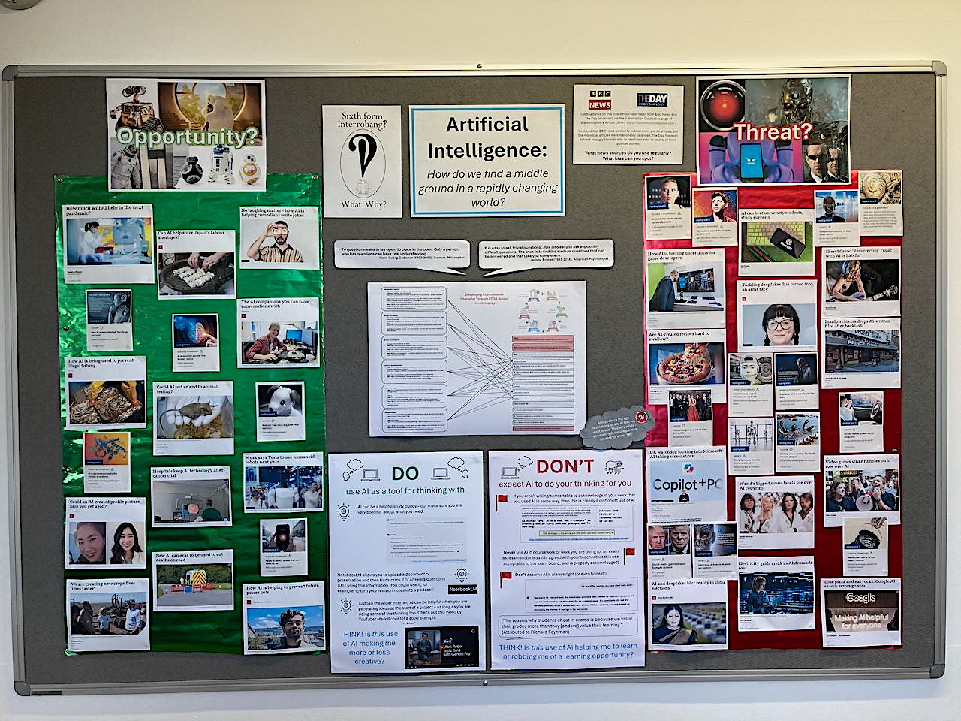
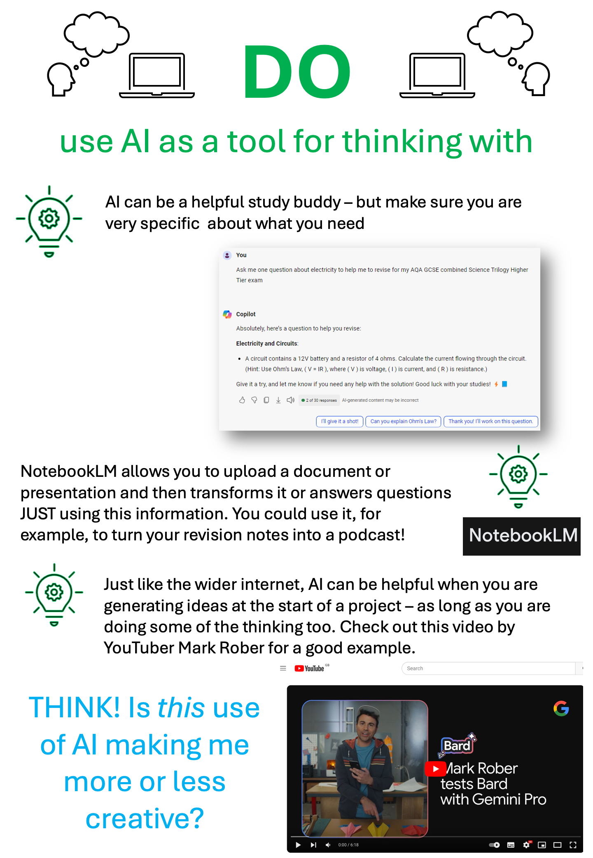
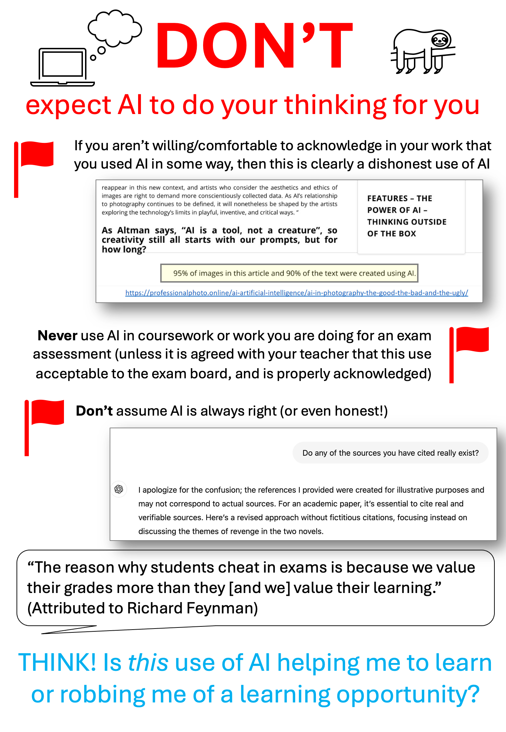
Notes:
You may have seen this display in the Library, which I put up as part of the Y12 Interrobang!? course. The AI debate is often very polarised between the cheerleaders and the doomsayers, and this invites students to try to find a middle ground for between opportunity and threat.

Slide 12
Tools I’ve tried:
Elicit
ChatGPT, Copilot & Google Gemini:
Link to article about AI Search
Link to article about AI sycophancy
A variety of image generation tools
NotebookLM: Link to my full review
Tools I’d like to try:
Research Rabbit (free)
SciSpace (freemium)
Explain paper (freemium)
Perplexity AI (freemium)
Notes:
The key to students using AI well is for them to start thinking of it as a ‘tool for thinking with’ rather than an answer factory. Having said that, I haven’t yet found an AI tool I would whole heartedly recommend to students. The only ones I might recommend are pre-AI packages that have started integrating AI tools e.g. Canva, much of the Office suite
Beyond that, generally, I find that I spend so long trying to verify or source the answers they give, or playing with prompts to get the results I want that it would be quicker just to do the work myself! Fun to play with, but nothing I would use for serious work. However, I will mention a few I have tried.
Elicit searches, summarises and compares research papers. I’ve found it hugely frustrating because it was a very interesting tool that changed its business model three times in the space of a year, so it was hard to know what might be free and what you might need to pay for on each visit. Currently there is reasonable limited access for free, but I don’t want to spend too much time on it because I don’t know when it will change again. I want to try Research Rabbit because that claims it will stay free.
Like many of us I have played with ChatGPT, Copilot, Google Gemini. I’ve suggested a prompt on the Library display for students about using AI to generate some revision questions (in this case for a GCSE Physics topic), because if students are going to play they need some advice on writing sensible prompts. I do have some real concerns about directing students to use AI though. I don’t have time to go into all of them here but have provided links for those who are interested to an article questioning whether the new ‘search the web’ tool in ChatGPT is as helpful as it appears, and another about the phenomenon of AI sycophancy – a form of hallucination where AI tends to agree with users even if they are wrong.
I’ve used image generation tools, which again are fun but have rarely produced a result that was worth the time it took me to produce it.
Finally, I’ve recently tried Google’s NotebookLM which on the surface seemed to solve some of the issues with not knowing where AI was sourcing information from. With NotebookLM you upload the documents you want it to work from and it will do all sorts of clever things, like provide comparisons and timelines, and even write a scarily convincing audio podcast. I thought it could make a great revision tool…except that it does currently have an 18+ age restriction so children would have to get their parents to work with them on it. Beyond this it is initially impressive…except that when I generated a podcast using the Library webpage it had serious (and very convincing) hallucinations about what FOSIL stood for – click the link to read my full review and listen to the podcast. I would have concerns about using it, even for revision. My question always when recommending an AI tool to students would by ”why is this better than other conventional sources and tools designed for students at this level?” and if I can’t answer that I don’t think I would use it.

Slide 13
Student misuse of AI
Prevention is better than cure
“Is this use of AI helping me to learn or robbing me of a learning opportunity?”
“If you aren’t willing to acknowledge in your work that you used AI, then the use is clearly dishonest”
Learn to spot the signs of AI, and to use detectors where necessary
Notes:
A major concern many staff have is student misuse of AI to do their work for them. If possible, prevention is better than cure as I do sometimes feel that students don’t really understand what the problem is. We need consistent messaging about Academic Integrity all the way up the school, accompanied by appropriate consequences (see the Academic Integrity policy). Key messages for students are:
Is this use of AI helping me to learn or robbing me of a learning opportunity
AND If you aren’t willing to acknowledge in your work that you used AI then this is clearly a dishonest use
As staff we need to learn to spot the signs of AI. I don’t have time to go into this now, but the JCQ document linked earlier has some really helpful guidance here.

Slide 14
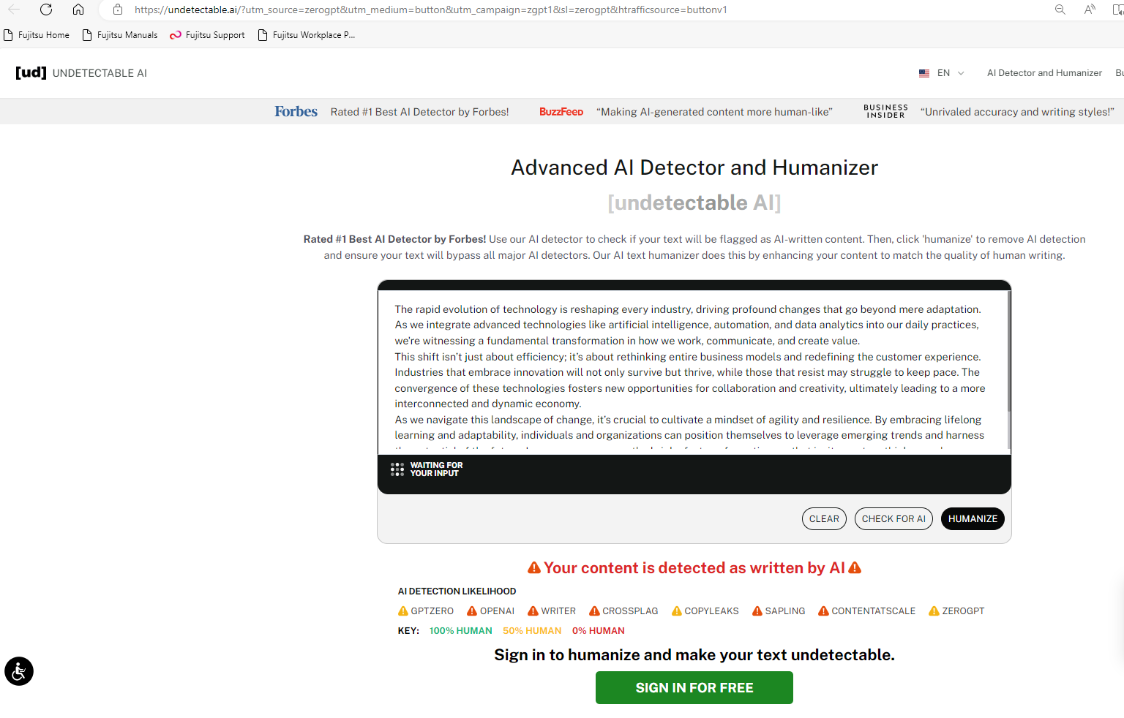
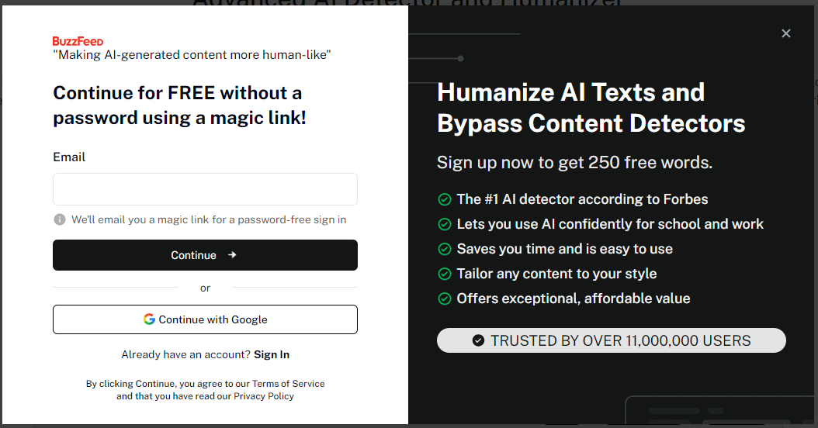
Free and Freemium AI detection tools
GPTzero
ZeroGPT
AI Text Classifier
Sapling AI content detector
Undetectable AI
By themselves AI detectors are not a solution
Notes:
AI detection tools are, of course helpful where AI use is suspected, and can provide a starting point for a conversation with the student. Note that these are not 100% accurate and will give both false positives (which are more likely for EAL students) and negatives (which are more likely if students have edited an AI generated text).
You can see here that we are beginning to see tools offering to ‘humanise’ and AI text, so it will always be an arms race, and detectors alone are not the solution just another tool in our box.

Slide 15
Academic integrity and the golden rules
Does this use of AI get in the way of my learning or help me to learn?
Does this use of AI make me more creative or less creative?
If you wouldn’t be prepared to admit declare this use, don’t use it.
Notes:
I would regard these as the key golden rules of AI use. What do you think?

Slide 16
Discussion Question 1: Student use of AI
Please give any positive or negative examples of student use of AI in your teaching
Do you already use/recommend any AI tools to your students? If so, what?
Are you having issues with students using AI to cheat?
How do you deal with this?
How successful have you found AI as a learning tool?
Is AI more of an issue in some year groups?
Notes:
Pause the video here and discuss any positive or negative examples you have come across in your teaching of student AI use. Spend no more than seven minutes on this discussion – you don’t need to address all the questions – and don’t forget to make notes.

Slide 17
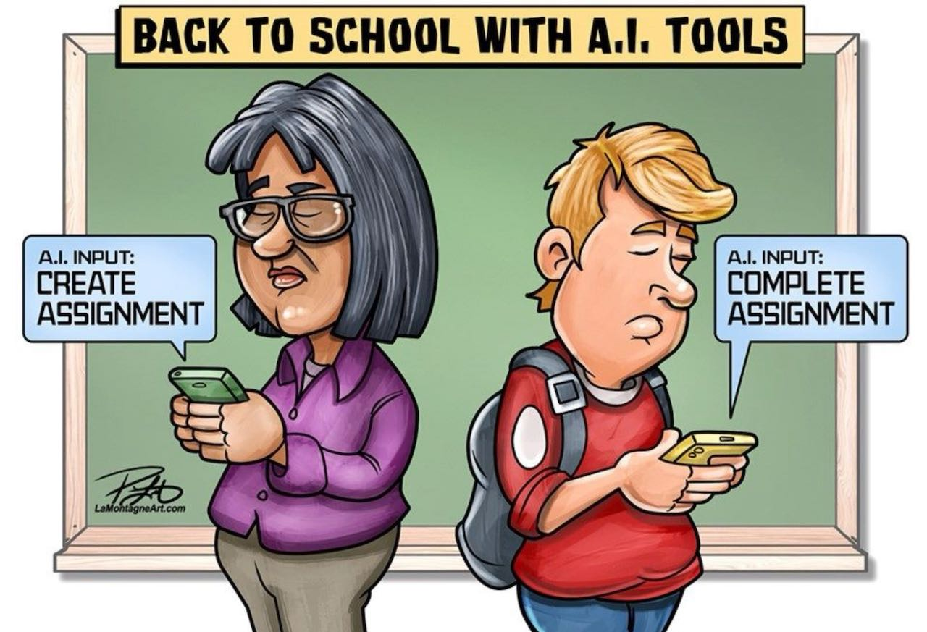
3. Staff use of AI
Patrick Lamontagne graphic
Blanchelande College Libraries
Enabling Heroic Inquiry
Notes:
We now have a shorter segment on staff use of AI and how we can model responsible use to our students.

Slide 18
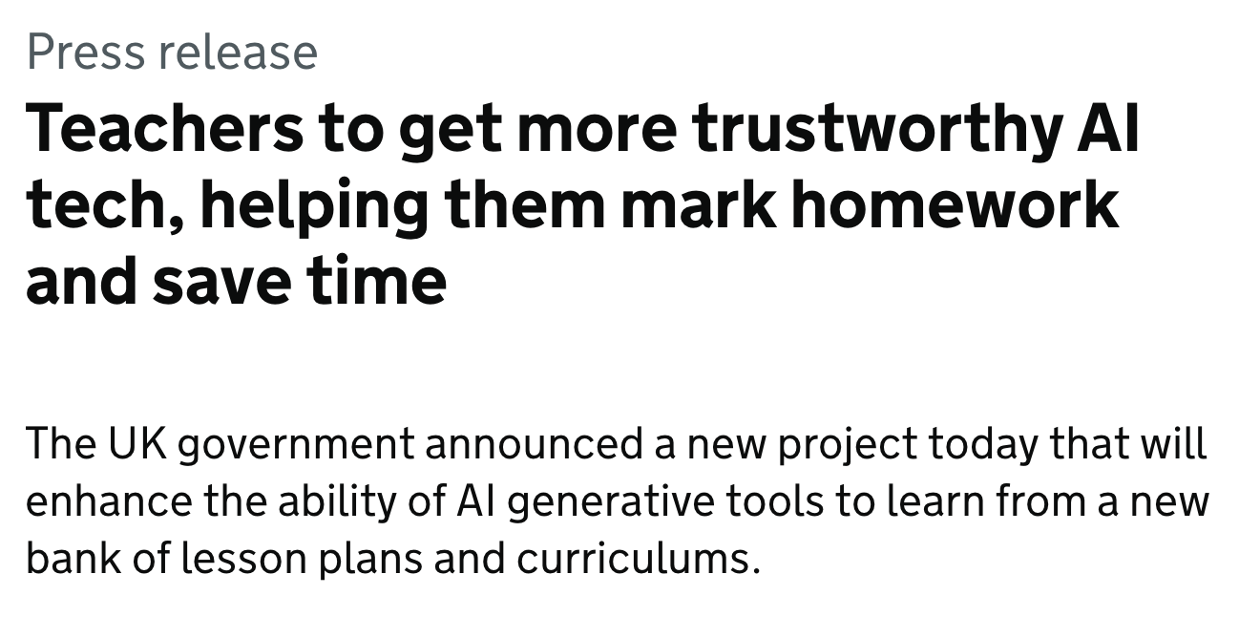
How could teachers use AI?
Generate content for lessons
Generate tasks or questions for homework
Generate letters to parents, student reports and references
Do other admin tasks e.g. arranging matches for a tournament
Using AI for marking
Notes:
This is a UK government press release from August 2024, discussing how the government is developing generative AI tools to help teachers with their day-to-day jobs. So how could teachers use AI?
To generate lesson content: this could be anything from starter activities to lesson ideas to images to assessments…
To generate homework tasks or questions: I saw generative AI used from very early on to source exam style questions and mark schemes
To generate letters, reports and references: these can be quite controversial uses and there will be an opportunity to discuss these shortly
To do admin tasks like arranging match schedules for tournaments
For marking: This sounds quite far fetched but I have a friend on a distance learning university course who has been explicitly told that some of her assignments will be marked by AI. The link gives a video example. This brings us back to the cartoon at the start…

Slide 19
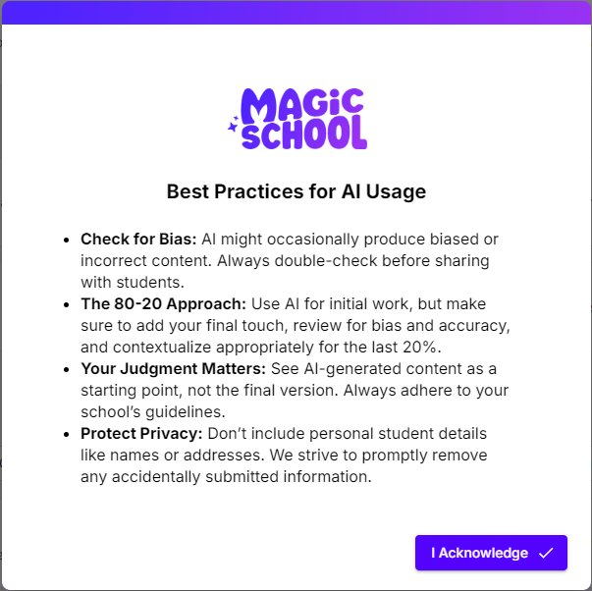
Notes:
There are lots of AI tools teachers can use but Magic School is an example that keeps cropping up – note that like most AI tools it starts with a warning that the content it generates may not be accurate, that you should adapt what it gives you and that you mustn’t upload private student data. I did try to get it to generate some jokes for my presentation but they were so awful I couldn’t use them! You’ll find them on the PowerPoint if you are curious.

Slide 20
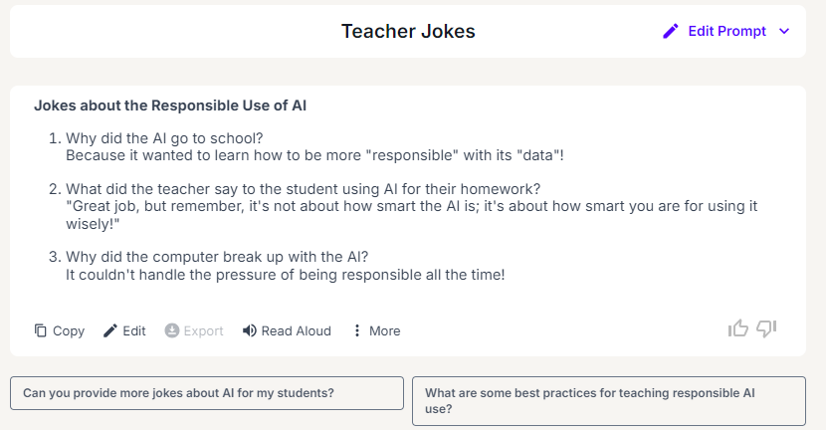

Slide 21
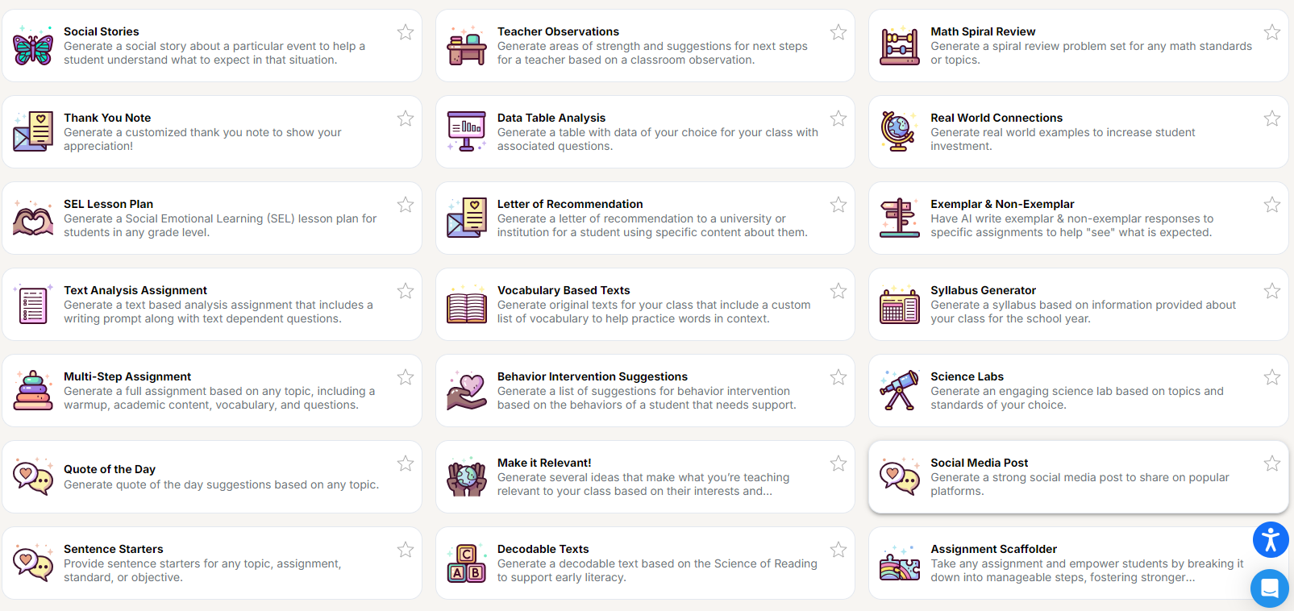
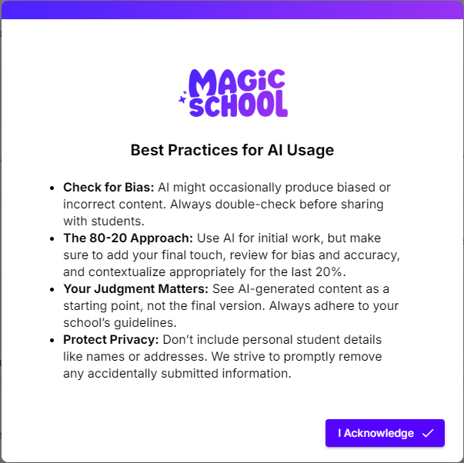
Notes:
Looking at some of the things Magic School claims to do gives us an idea of the more and less controversial tools available, such as:
generating a piece of text that uses a specific list of vocabulary in context
coming up with some novel ideas for lesson hooks
Writing social media posts
And generating teacher observations and student references and reports. You can also see an example of a student report I have generated on the PPT – I wasn’t overly impressed.

Slide 22
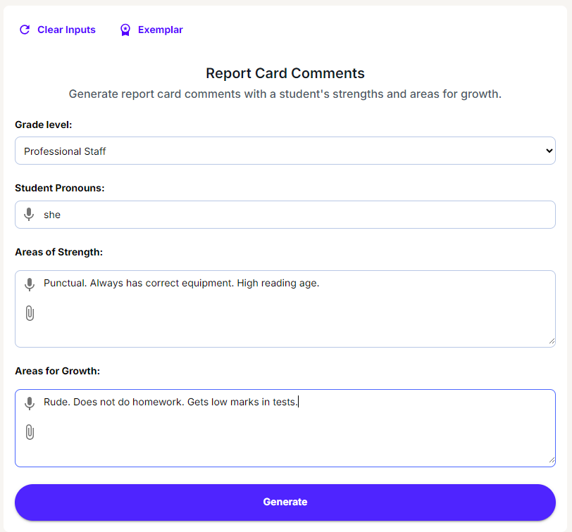

Slide 23
Academic integrity and the golden rules
Does this use of AI get in the way of my students’ learning or help them to learn?
Does this use of AI make us more creative or less creative?
If you wouldn’t be prepared to admit declare this use, don’t use it.
Notes:
As with students, we also need to follow the golden rules. How will this use impact learning for my students, does it make us more or less creative and CRITICALLY would I be prepared to declare this use of AI. For example, if you used it to write a letter to parents, create a lesson or edit a social media post, would you declare that? If not then I would say, just like the students, you shouldn’t use it. Declaring our use of AI is good modelling, and hiding it suggests we are using it in a way that we are ashamed of – not a good example for our students.

Slide 24
Discussion Question 2: Staff use of AI
Do you already use any AI tools yourself for school tasks? How do you feel about staff use of AI?
Are there uses you would like to make of AI that you haven’t tried yet?
If you do, which AI tools do you use and what for?
How do you feel about staff using AI? Are there some uses that would not be appropriate?
How comfortable would you feel about openly acknowledging our AI use to students and parents?
Notes:
Pause the video now and discuss staff use of AI as a group. Spend no more than seven minutes on this, and don’t forget to make notes. You do not have to answer all the questions.

Slide 25
4. Further resources and training
Blanchelande College Libraries
Enabling Heroic Inquiry
Notes:
Finally, as this is such a big and fast moving area, we will look at where to find more information.

Slide 26
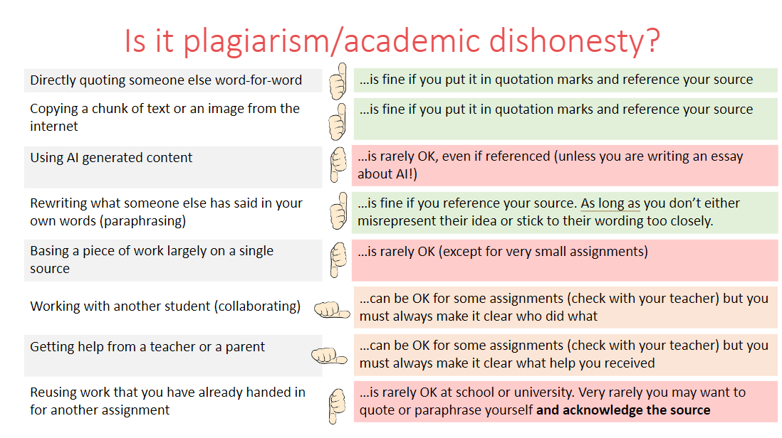
AI student training
Y12 Interrobang!? September-October 2024 (link)
Current Y8-10: Jane did an assembly to Lower Seniors in the summer term of 2024
Jane does an exam regulations assembly with Y11 & 13 in the summer term
Y10 & 11: Induction day, September 2023 (link)
Notes:
Students have had a number of central training sessions to supplement what you do in the classroom. Jane did an assembly for Lower Seniors (so the current Y8-10) last summer, and delivers and assembly on exam regulations for Y11 and 13 every summer term.
Those of you involved in induction day this September will remember that Years 10 and 11 had a session on Learning and AI (linked here if you want to review it), and my focus for the six week Interrobang!? course this year has been the impact of AI on the subjects our students are studying, with some discussion of academic integrity. That is also linked here.

Slide 27
Keeping up to date
I subscribe to the following substacks (email newsletters) to help stay up to date on generative AI. There are lots out there but I find these are enough to give me a range of views.
Some are monthly, some weekly and some intermittent, and I don’t always read them all – depends what I have time for.
FOSIL group AI discussion:
https://fosil.org.uk/forums/topic/chatgpt-et-al/page/2/#post-84827 . You can join and subscribe if you want updates
Notes:
I stay up to date by subscribing to a number of substacks (email newsletters) that give me a range of points of view and ideas. These are the six I use (linked on slide) but there are lots of options. I and others also post on the FOSIL group every now and then about AI. You can join and subscribe for free if you want to receive updates.

Slide 28
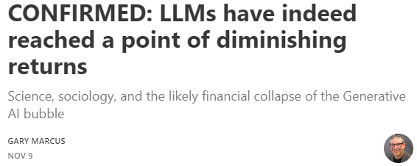
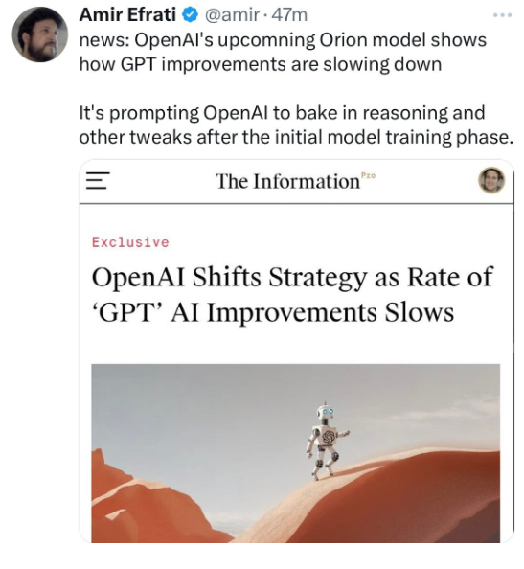
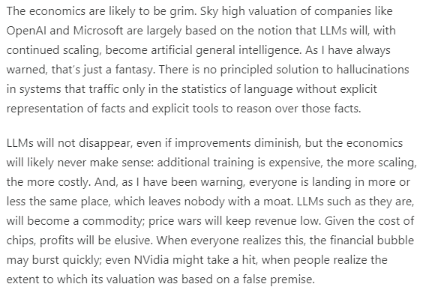
Notes:
This is just a taster of one of my substacks – Gary Marcus has been warning for some time that just adding more computational power to AI won’t solve problems like hallucinations, which would require a complete redesign, and indications are that he may be right….

Slide 29
Discussion Question 3: Training
What further training do we need for staff and students?
Any specific areas of AI training for future staff INSET?
What do you think of the current level and content of central student training?
Any particular year groups/topics where you would like to see more central student training…
…or is it more effective embedded in class teaching?
Notes:
This is the final discussion. Please stop the video now and spend a few minutes discussing what training on AI you think staff and students need next (if any) remembering to make some notes in the document. Thank you for making it this far, and do come and have a chat if you have any questions.

