Slide 1
FOSIL-based Heroic Inquiry at Blanchelande College
Blanchelande College New Staff Induction
18 October 2024
Darryl Toerien | Jenny Toerien
toeriend@blanchelande.sch.gg | toerienj@blanchelande.sch.gg
Blanchelande College Libraries
Enabling Heroic Inquiry

Slide 2
Our High Calling to Inquiry
“Upon this first, and in one sense this sole, rule of reason
– that in order to learn you must desire to learn, and in so desiring not be satisfied with what you already incline to think –
there follows one corollary which itself deserves to be inscribed upon every wall of the city of philosophy: Do not block the way of inquiry.”
Charles Sanders Pierce (1955, p. 54)
Notes:
Pierce’s rule of reason and its corollary capture the essence of a liberal education.
Michael Young almost 70 years later: “[recalling Lev Vygotsky] … acquiring knowledge in school has to be the voluntary act of a learner. You can’t actually teach anybody anything; they have to learn it. You can help them, but they’ve got to have that desire to know.” Young, M. (2022, September 21). What we’ve got wrong about knowledge & curriculum. (G. Duoblys, Interviewer) Tes Magazine.
The question, then, is how does what we do in the classroom stimulate in our students, as Maritain puts it, a searching effort of the mind, a [burning desire] to know such that the students engage themselves wholly in the grasping of what [their lessons] supposedly convey to them. Maritain, 1962, pp. 57-58

Slide 3
FOSIL-based Inquiry in Policy Documents
Curriculum Planning and Prep Policy
1.2 Curriculum Design
Independent Learning
2.3 Content Planning
Intent Statement & Subject Essential Questions
Medium Term Plans (see Appendix 1)
2.8 The Learning Experience
FOSIL as a structure for the information to knowledge and understanding journey
Appendix 1: Medium-Term Plan Front Sheet Proforma
Inquiry Stance: Entry, Topical and Overarching Essential Questions
Key Sources of Information [on the information to knowledge and understanding journey]
FOSIL Skill Set(s)
Appendix 2: Individual Lesson Plan Proforma
FOSIL Skill Set(s)
Resources
Extension Policy
Provision Within the Classroom [and beyond]
Extend student thinking through inquiry-based challenges, either whole-year Signature Work or subject-based
Academic Integrity Policy (including Digital and MIL with reference to AI)
FOSIL has academic integrity as an end is an essential means to that end
Appraisal Self-evaluation Form
Part 2: College Appraisal | 5. Inquiry-based learning
Enabling students to practise inquiry-led learning
Notes:
Michael Young: “The curriculum is not just a body of knowledge; it’s a group of communities we must encourage our students to join.” Young, M. (2022, September 21). What we’ve got wrong about knowledge & curriculum. (G. Duoblys, Interviewer) Tes Magazine.
Blanchelande is at the centre of a growing collection of tools with which to build communities of interdisciplinary knowledge. Why interdisciplinary - “The solution which I am urging, is to eradicate the fatal disconnection of subjects which kills the vitality of the modern curriculum. There is only one subject-matter for education, and that is life in all its manifestations.” (Whitehead, 1929, p. 10).

Slide 4
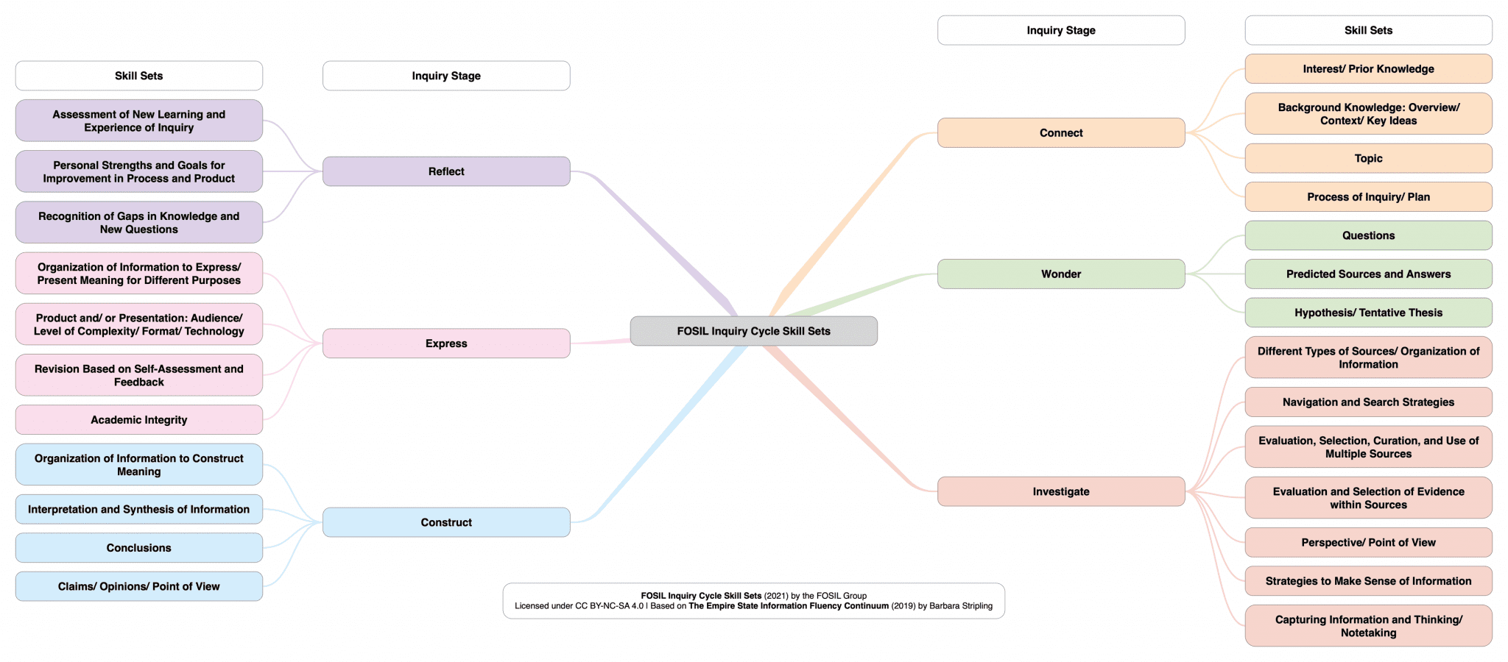
Heroic Inquiry as Stance, Process and Skills
Definition, plus
FOSIL as instructional model, plus
FOSIL as framework of skills
Notes:
Heroic Inquiry is based on FOSIL, using iconography of Hero’s Journey.
In school, this inquiry stance, process and framework of skills is directed toward acquiring disciplinary knowledge in an interdisciplinary way.

Slide 5
Portraits of Engaged and Empowered Inquirers
Portrait Attributes at Year 3
(also, for Years 6, 9 and 13)
Attribute Inquiry Skills for Years 1-3
(also, for Years 4-6, 7-9 and 10-13)
Notes:
However, inquiry has engaged and empowered inquirers as it end and [th]is the systematic and progressive means to this end.

Slide 6
Medium-Term & Individual Lesson Plans
To question means to lay open, to place in the open.
Only a person who has questions can have [real understanding].
Hans-Georg Gadamer, Truth and method, 1994, p. 365.
Notes:
Michael Young: “If you haven’t encouraged students to engage in the process of acquiring knowledge, which is a very difficult process, then all you get is memorisation and reproduction in tests.” Young, M. (2022, September 21). What we’ve got wrong about knowledge & curriculum. (G. Duoblys, Interviewer) Tes Magazine.

Slide 7
Year 10 Psychology

Slide 8
Quality Direct Teaching and Guided Inquiry
Shared features
deliberative structuring and framing of activities
clarity of intended outcomes
continuous monitoring of students’ inputs and ideas
overt scaffolding through task design and targeted questioning
Key differences
greater trust in the generative nature of students’ ideas and the weight given to these
invitation of students into the purposes of the knowledge
openness to variation in student practices
opportunities for imaginative projection and robust discussion leading to communal agreement on key ideas
orchestration, critique and revision of students’ invented representations
attention to the purposes of modeling and representational work compared to presentation of ideas as pre-packaged practice
Requires
significant [disciplinary] knowledge
command of a pedagogy involving negotiation and refinement of student ideas, compared to ‘telling’
time
Notes:
Russell Tytler | Chair of Science Education | Science Technology Engineering Mathematics and Environmental Education Research Group (2015?-current) | Deakin University (Victoria, Australia)
Consistent with Developing Inquiring Communities in Education Project (led by the Ontario Institute for Studies in Education at the University of Toronto, 1991-2001) and Galileo Educational Network (professional learning arm of the School of Education at the University of Calgary, 1999-2022).
Not many colleagues in the UK would associate the shared features with inquiry, which is an indication of how poorly inquiry is understood in the UK.

Slide 9
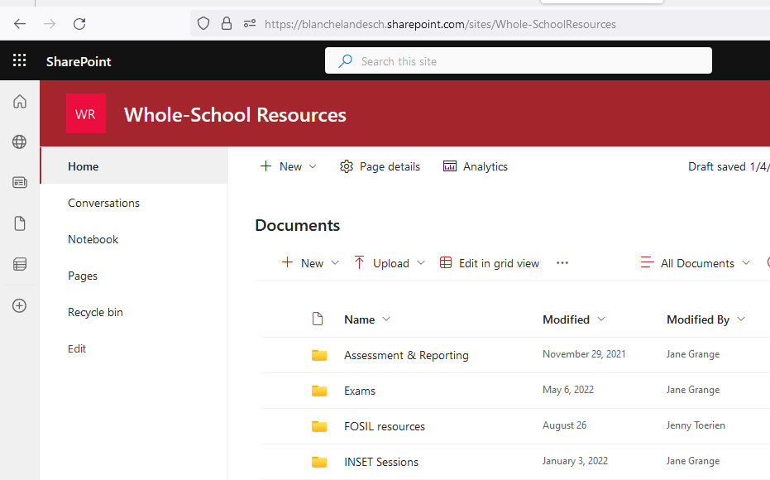
Accessing FOSIL Resources

Slide 10
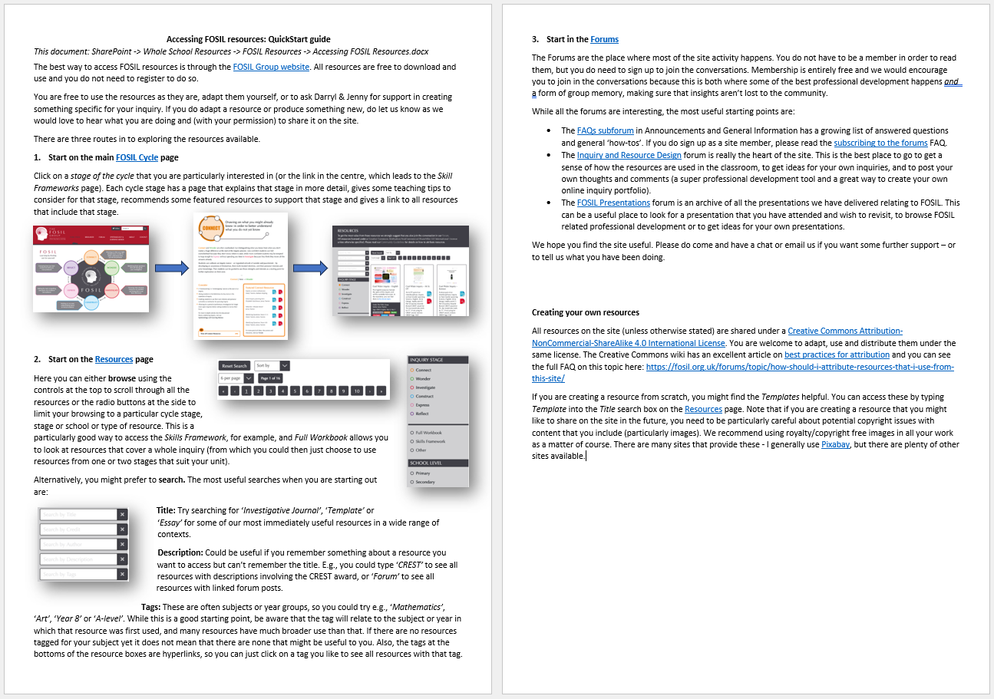
Accessing FOSIL Resources

Slide 11
Resources (in order of appearance)
FOSIL-based Heroic Inquiry Cycle <https://tinyurl.com/yfsavhdy>
FOSIL Inquiry Cycle & Stage <https://fosil.org.uk/fosil-cycle/>
FOSIL Skill Sets & Framework of Skills <https://tinyurl.com/6p9a8tcs>
Portraits and Portrait Attributes <https://tinyurl.com/4s9wxm6w>
Blanchelande INSET on Framing the Curriculum Through Essential Questions (PPT and PDF) <https://tinyurl.com/ywpvvbne>
Accessing FOSIL Resources <https://tinyurl.com/2e65e64e>

