Slide 1

The revolution will not be televised
.
An Australian inquiry journey
https://www.behance.net/gallery/12236473/The-Revolution-Will-Not-Be-Televised

Slide 2
Presented by:
Joanne Bleby, History teacher and Wellbeing Coordinator, Loreto Kirribilli, Sydney
and
Lee FitzGerald, SICS, Charles Sturt University, Editor of ACCESS

Slide 3

We are speaking to you from Gadigal lands in Sydney, Australia
I created this painting design “Gadigal, Acknowledgement Respect” to acknowledge and honour the Gadigal people of the Eora Nation and to pay my respects to their Elders past and present.
Jeffrey Samuels, artist

Slide 4

Loreto Kirribilli, Sydney

Slide 5
Darryl’s questions underpinning Our Inquiry story
What is school for?
Why inquiry?
Our inquiry story
What are our obstacles to inquiry?
Nevertheless, how are we engaging and empowering learners?

Slide 6
What is school for?
Thinking Big with Darryl!
Does he ever think small???

Slide 7
What is school for?
Is it for good results in exams? Yes, but also to enable:
student potential to be full human beings
acquisition of knowledge and understanding.
Inquiry is the way we come to know and understand the world.
Such a view of the purposes of school lying in inquiry makes it essential that there is collaboration between classroom-based teachers and library-based teachers.
.

Slide 8
The Whole Learner Report
Currently, learning success is largely focused on academic performance and standardised testing. Australia is the only country in the world that still ranks our students at the end of their schooling. In other countries, students are given a score, but they are not placed in rank order.
‘While the ATAR remains our dominant form of recognition in secondary schooling, more than 75% of our young people do not utilise their rank to pursue post-school pathways ‘. P3 Learning Creates Australia research

Slide 9
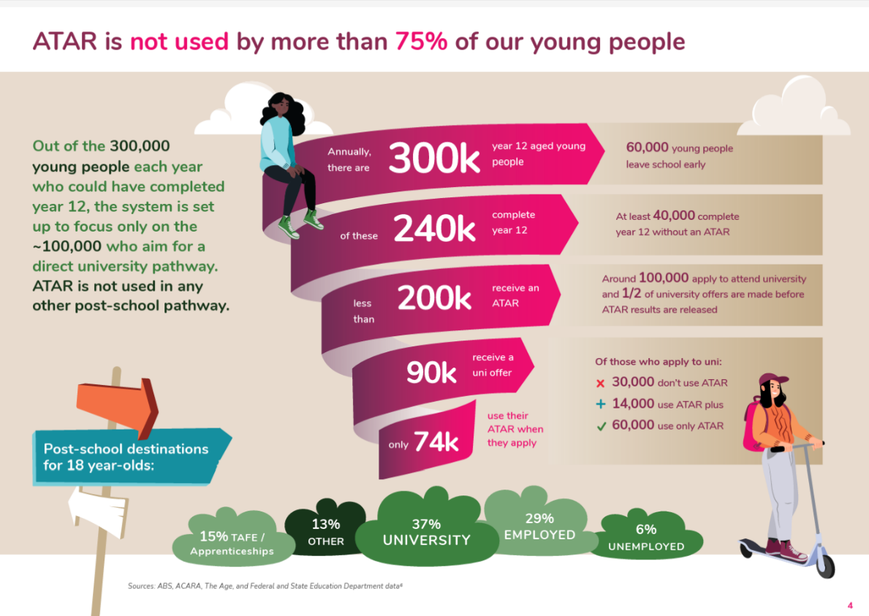


Slide 10
Why inquiry?

Slide 11
What is inquiry and what is inquiry learning ?
Inquiry is “a stance of wonder and puzzlement that gives rise to a dynamic process of coming to know and understand the world and ourselves in it as the basis for responsible participation in community” (Stripling & Toerien, 2021), which is a fundamental human response to the world we find ourselves in.
Inquiry learning is more than a set of skills, more than an information literacy model, but rather, is a pedagogical model aligning the content taught in a school to one of a very limited number of models that truly deal with inquiry learning as a whole school pedagogy.
.

Slide 12
Why does it matter?
Inquiry is pervasive in the Australian curriculum.
“Total noise” and tsunami of available fact, context and perspective (Wallace, 2007).
Artificial intelligence.
Misgivings amongst educators:
You can’t force students to learn.
Rote learning inadequacy.

Slide 13
An urgent global challenge
The Australian Council for Educational Research Strategic Plan (ACER) (2022) notes the following urgent global education challenge:
Transmissive teaching
Passive, reproductive learning taking precedence.
Limited time and space for deep understanding, critical and creative thinking and skills in applying knowledge.
ACER notes a high level of interest in all countries in broadening education to help students be prepared for their future.

Slide 14
Why Inquiry Learning Models?
Examples:
Stripling Model of Inquiry
FOSIL
The Alberta Model of Inquiry
Guided Inquiry Design.
An inquiry learning model is ideally a whole school pedagogical approach which is focused on inquiry, such as may be found in IB schools.
.

Slide 15

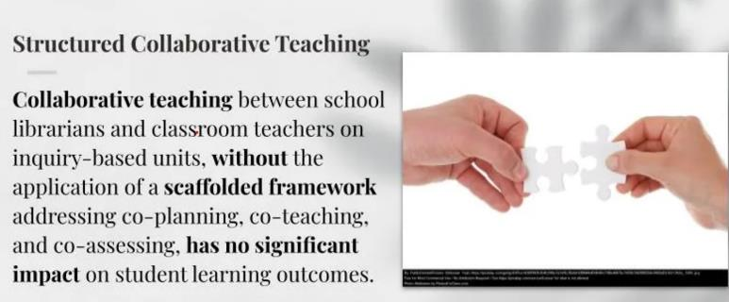
The impact of collaboration in inquiry
Green, L. S., & Chassereau, K. (2023). Modeling Guided Inquiry and school librarian instructional partnerships to pre-service teachers through digital video production. Journal of Education for Library and Information Science, 62(2), 185–205. https://doi.org/10.3138/jelis-2022-0015
Santos-
Green, L.(2023) Instructional partnerships and Guided Inquiry: How to plan and prepare for long-term collaborations. AASL, 2023.
Notes:
.

Slide 16
Collaboration in inquiry in Australia
Monteil-Overall overall research (2005, 2010) suggests Level D collaboration between TL and teachers where an inquiry program based on an inquiry learning model is embedded throughout the school.
Research (Garrison & FitzGerald, 2021) surveyed 109 Australian TLs – Many are involved in inquiry learning, but not at Level D. Why?
Content-driven syllabuses and perceived gap between inquiry learning and explicit teaching.
Teachers are time poor and accountable at every step.
Notes:
.

Slide 17
Our inquiry story

Slide 18
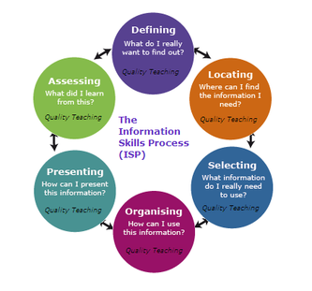
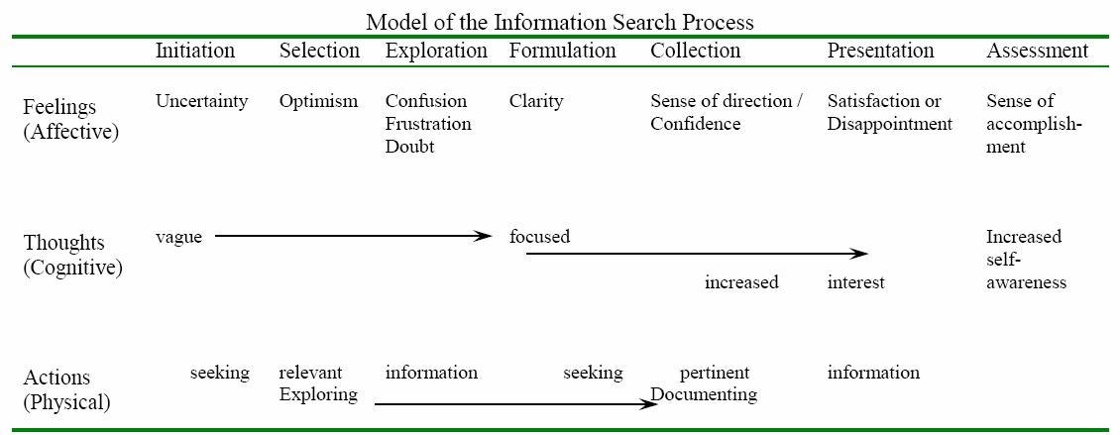

My inquiry learning journey
Student of Ross J. Todd – 1988 – the Information Revolution is coming!
NSW Information Process.
Carole Kuhlthau – The Information Search Process and research on inquiry
GID.
Just Do It.

Slide 19

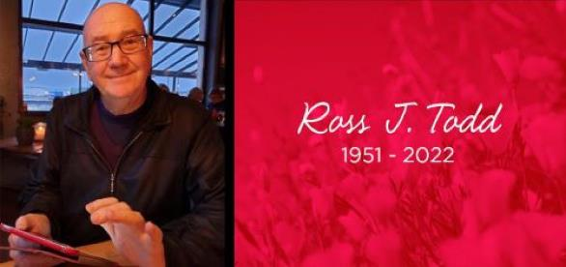
Let us be grateful to the people who make us happy. They are the charming gardeners that make our souls blossom.
Marcel Proust . From Carol Gordon’s Remembering Ross Todd

Slide 20
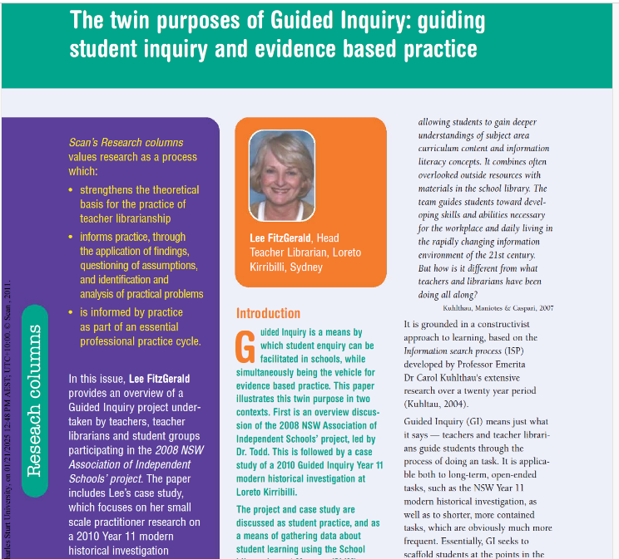
Enter the Lee and Jo Loreto Kirribilli Inquiry journey….
2003-2013 – Head of library. Principal wants ‘something different’ from the library. Inquiry in History, Geography, French, Music and PDHPE, using GID as model.
2008 – Quality Teacher Project, led by Ross Todd, coordinated by me.
My partnership was strongest with History and especially with Jo Bleby.
We worked especially on Year 11 Ancient Historical Investigations, and have a long history there.

Slide 21
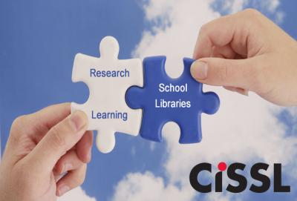
More Lee and Jo Loreto Kirribilli Inquiry journey….
We won the 2012 Loreto Teachers’ Scholarship and went to New York.
There we presented at a CISSL Summer session, visited American schools, heard the stories about overseas inquiry communities .
Hung out and ate ice-cream with Ross Todd and saw The Book of Mormon!

Slide 22


And after Loreto,
I wrote many articles for TL journals and developed Guided Inquiry Oz
2014 – present – Lecturer and researcher at SICS, CSU university – now an adjunct
2021 – present – Editor of ACCESS. Wrote book GIGFG.
2020 – present – part-time teacher in the library at Loreto Kirribilli. More Jo collaboration.

Slide 23
And time went by…. Lee to CSU and ACCESS, and then back to Loreto, 2021
Research on Guided Inquiry with Kasey Garrison and Alinda Sheerman, who provided the students as well as being an inquiry friend and colleague! See reference list.
Just let me go at it: Exploring students’ use and perceptions of guided inquiry(2018)
One interested teacher at a time (2019)
They should be called Guiders: Teachers and Teacher Librarians developing inquiry learners (2019)
It trains your brain: Student reflections on using the GID process (2019)

Slide 24
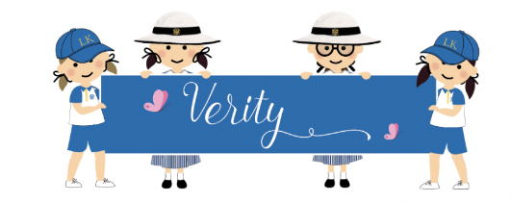
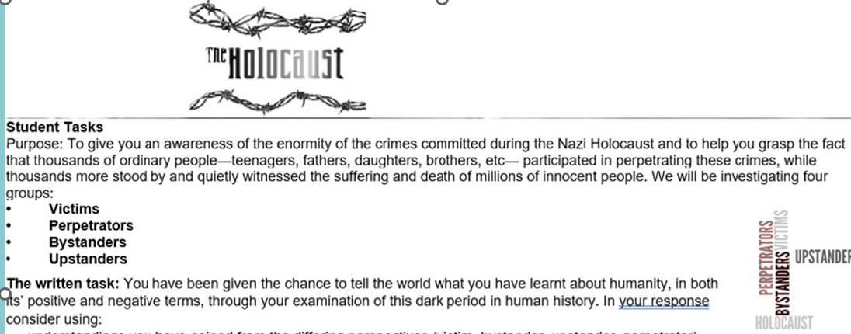
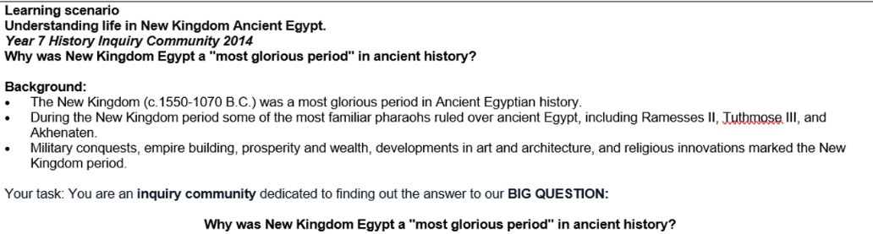
Collaborative GI projects at LK
The Holocaust – Year 9
New Kingdom Egypt – Year 7

Slide 25
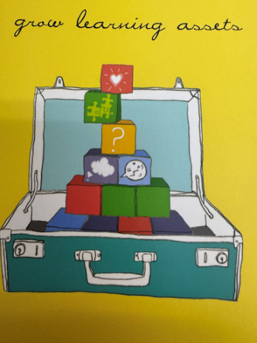
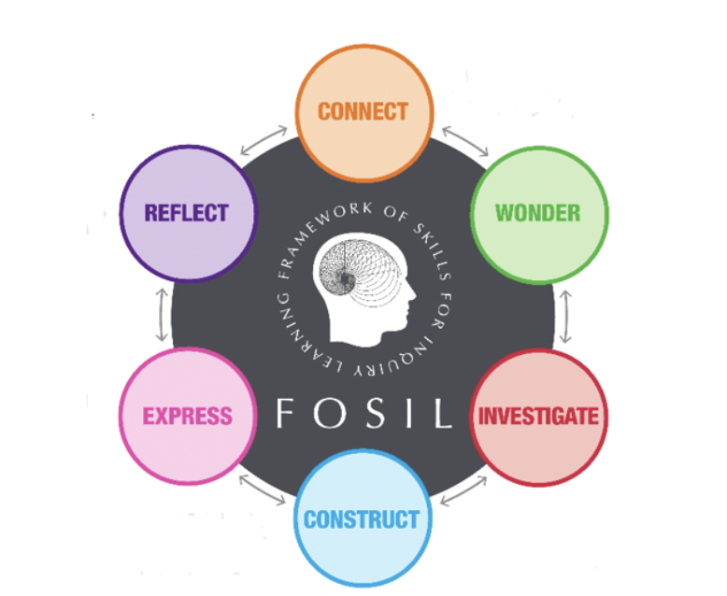

FOSIL-ising the Yr 11 Historical Investigation in my Ancient History classroom
How does learning happen?
Through reflection
finding out for yourself how to construct knowledge ad meaning
It is gradual
Understanding your own learning process
Inquiry process is not linear - rather it is messy!

Slide 26
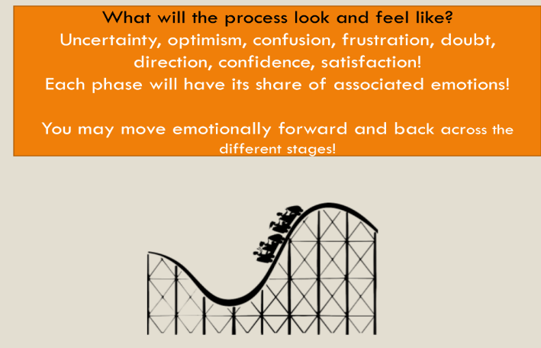

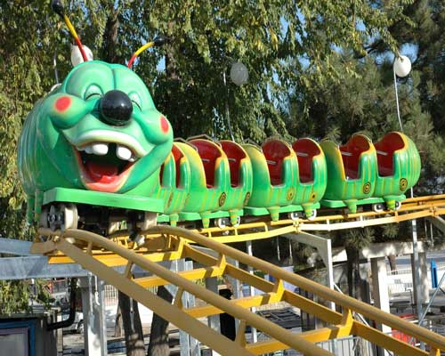

Inquiry learning:
It’s a bumpy old ride!

Slide 27
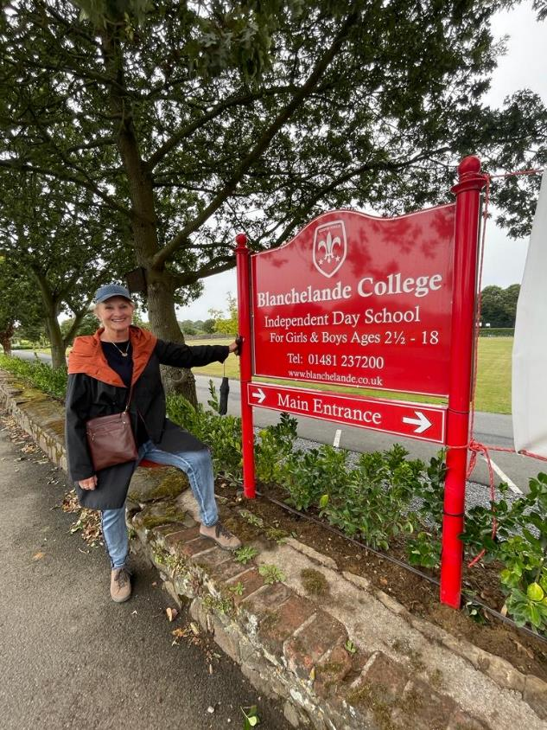
Why FOSIL?
Darryl Toerien
Using FOSIL model to underpin the learning of Blanchelande College.
The wealth of resources on FOSIL website.
The link with Empire State Information Fluency Framework.
Making a link with the NSW Information Fluency Framework.
Notes:
.

Slide 28
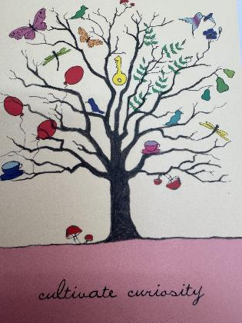
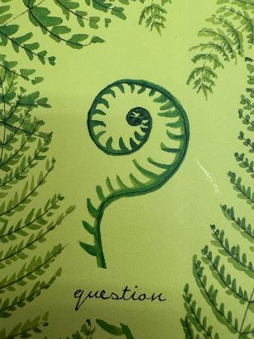


How the Ancient Historical Investigation looked to students:
Stages of the HI: 2024_Historical Investigation_11AH_FINAL.docx
10 practices for inquiry teaching and learning – ©Kath Murdoch, 2019

Slide 29
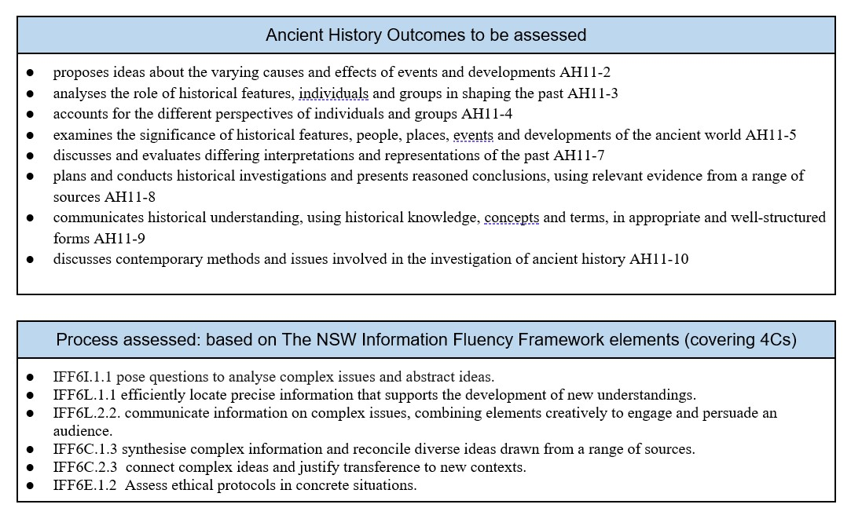
Consumers
Creators
.

Slide 30
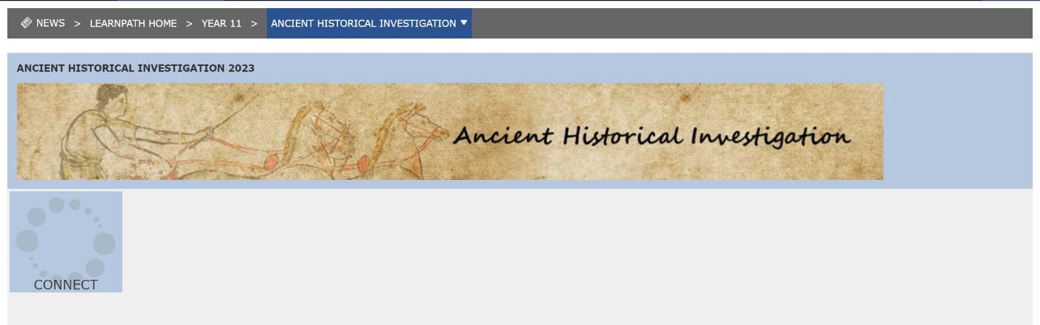
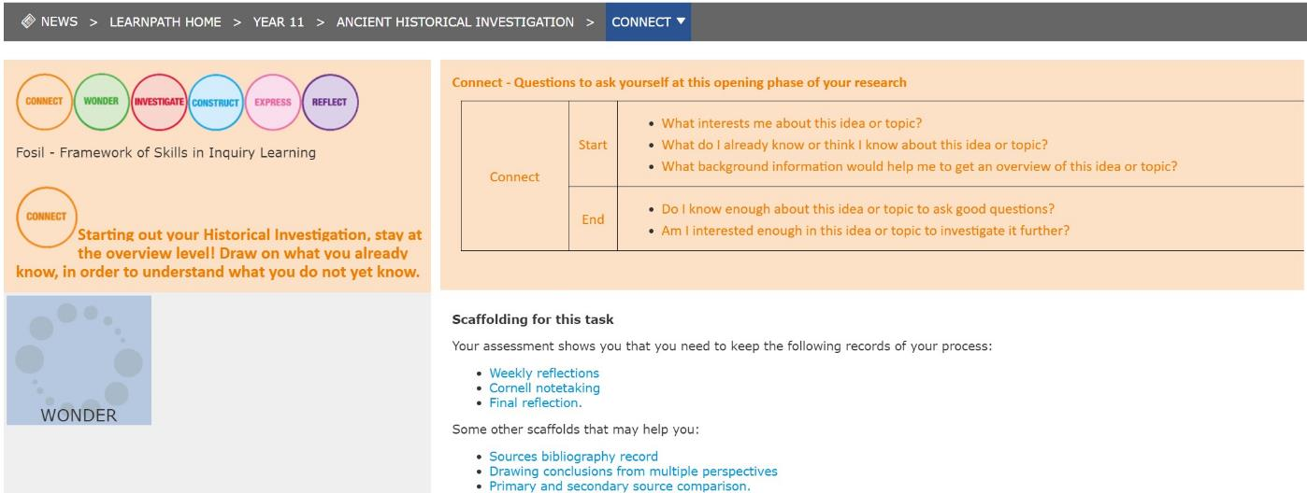
.

Slide 31
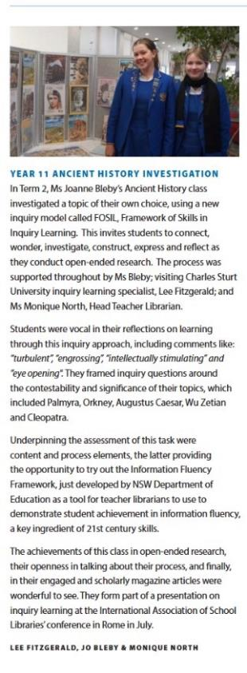
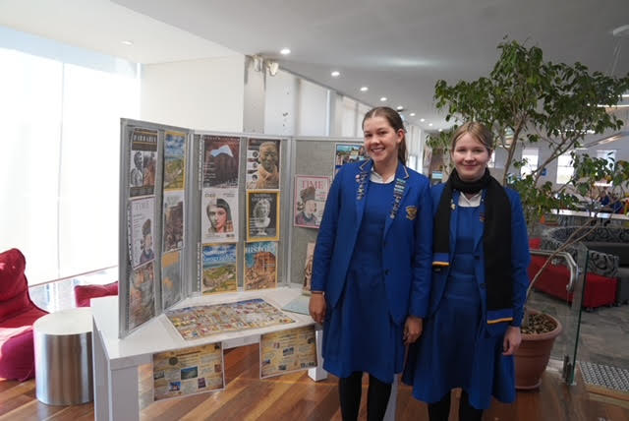
.
LK Ancient Historians

Slide 32
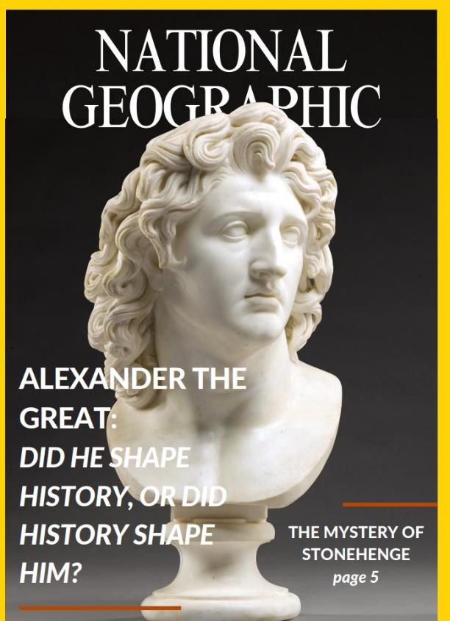
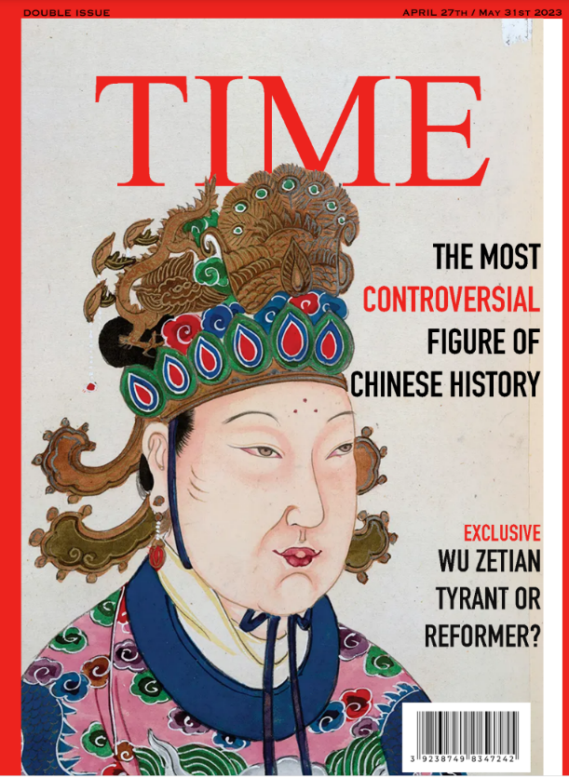
.

Slide 33
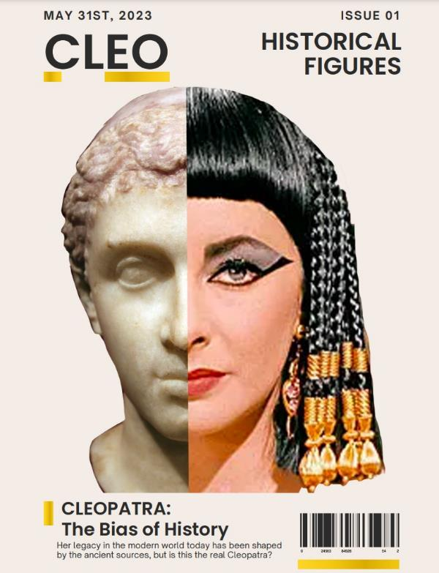
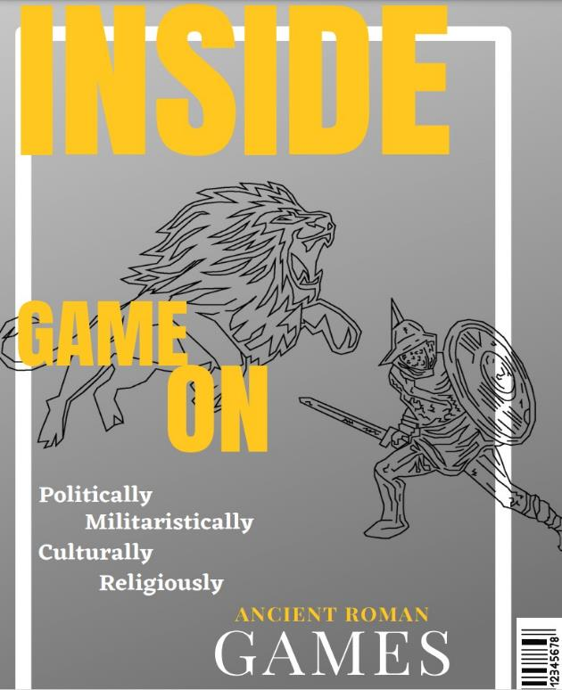
.

Slide 34
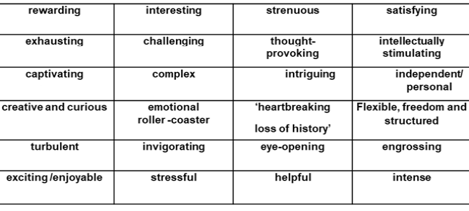
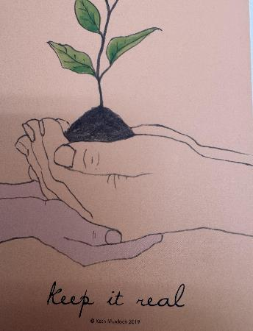
Reflections on Ancient Historical Investigation
.
10 practices for inquiry teaching and learning – ©Kath Murdoch, 2019
Notes:
.

Slide 35

What the students said:
What did I learn?
time management / organisation/ taking bite size chunks as an approach for a lengthy task
Importance of reflection - weekly achievements and setting goals.
moving from simply ‘getting /giving information’ to making ‘historical judgements’.
why a staged process - (not jumping straight into express/ create!)
CONNECT phase
I couldn’t procrastinate
feelings as a learner/investigator are normal!
format → less stress - ‘best I have done!’
retained knowledge
skills

Slide 36

What the students said - I liked:
having power over my own learning - ‘master of my project’.
being able to outpour my emotions on the weekly reflection.
staged ‘to do’ list.
the Express/Reflect phase - rewarding to bring all my research together.
confident to share my work/ edit /help others
a sense of accomplishment – and relief!
‘Knowing there was reason’ behind the stages of ‘doing’
Having some trial and error moments and ease of feedback..
Safe environment to operate in – ‘sitting cross-legged in a corner..’
Finally….. would like to see more FitzGerald/ Bleby collaborative tasks.

Slide 37
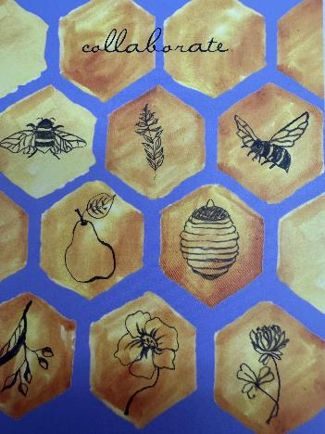
Collaboration between teacher and teacher librarian: why?
Modelling ‘real world’ learning
Aids in planning, assessing, supporting both students and teacher.
Realities of teacher life: number of students, time poor.
Having two guides on the side - the blend between self-guided approach and teacher intervention – so ‘I was never lonely!’
allows us to act/intervene ‘at student need’.
acts as counsellor, supporter, adviser, finder of obscure resources - for often the obscure topics chosen
Integrating skills of both experts in their fields to optimise student learning and self-confidence - win /win for all - trs also learning - just makes sense!
.
10 practices for inquiry teaching and learning – ©Kath Murdoch, 2019
Notes:
.

Slide 38

What can the Teacher Librarian do as part of a collaborative inquiry unit?
Why can Teacher Librarians do this?
Because in Australia, all TLs are trained teachers, as well as getting post graduate qualifications in teacher librarianship, training them in information literacy and inquiry learning, amongst other aspects of the role.
Collaborate to
Design
Resource
Teach
Provide feedback
Share assessment.
https://www.nicepng.com/maxp/u2t4t4y3q8y3u2u2/

Slide 39
What are/were our obstacles to inquiry?

Slide 40
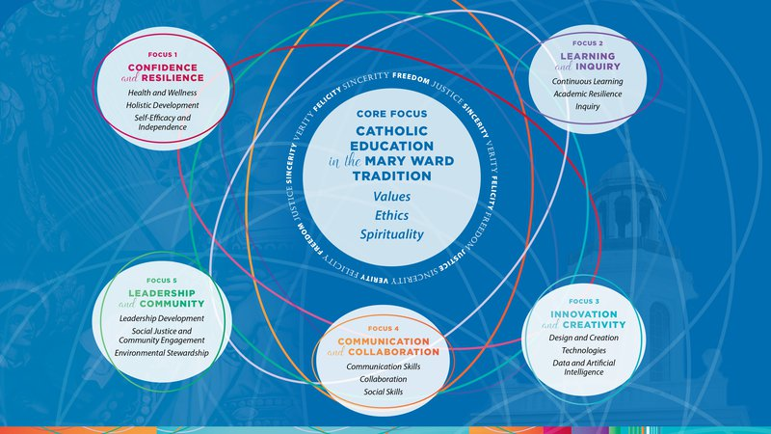
Obstacles at the school itself
High ranking school – 20th in the state.
Top NSW Catholic school.
Loss of a tradition of inquiry.
.

Slide 41
Wider obstacles
The strong focus in Australian Curriculum on inquiry.
Divisions between theorists –Inquiry vs Explicit instruction(Barshay, 2024).
Overload of teachers
Overload of curriculum content
Artificial Intelligence – an opportunity for TLs.
Oddone, K. (2023) Empowering school library staff to navigate the AI frontier Connections (2023) 126 p.1-2
Oddone, Kay ; Garrison, Kasey ; Gagen-Spriggs, Krystal (2024) Navigating Generative AI : The Teacher Librarian's Role in Cultivating Ethical and Critical Practices Journal of the Australian Library and Information Association, 2024-03, Vol.73 (1), p.3-26

Slide 42
Wider obstacles
Pervasive misunderstanding of the role of the TL, leading to:
Severe decline in job vacancies for TLs
Confusion over the staffing of school libraries
Close to zero expectation that TLs will be involved in the curriculum.
Inequality of funding - private vs government schools.
In Australian private schools especially, enormous pressure to achieve well (top ATAR), to keep up the status of the school
Notes:
.

Slide 43

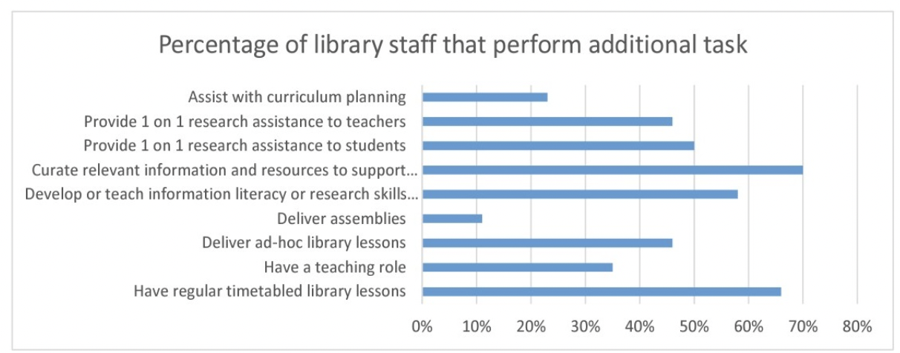
Softlink survey shows the work of Australian TLs.
Amongst TLs, different priorities for the role.

Slide 44
Wider obstacles
New international research:
Merga, M. & Roni, S. M.(2025) School library professionals’ perspectives on current and future workforce challenges. Journal of Librarianship and Information Science, 0(0). https://78f56959-dc6c-40e6-9a8d 8891524437af.usrfiles.com/ugd/e4591c_e57a5affdc4147bf84ce10e155b01fc8 - Still unpublished.
Lack of understanding of the role - students, teachers, library staff.
Different provisions in different states.
Critically, very few advertisements for TL jobs recently.
The journal Scan produced by NSW Department of Education has had its last issue in July, 2024.
What is causing this? Is it because TLs can’t demonstrate their contribution to student learning, because inquiry learning is not embedded in their schools?
.

Slide 45
The way forward?

Slide 46

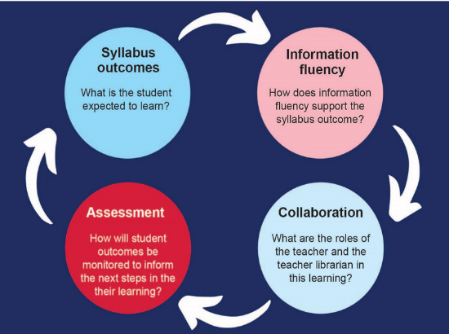
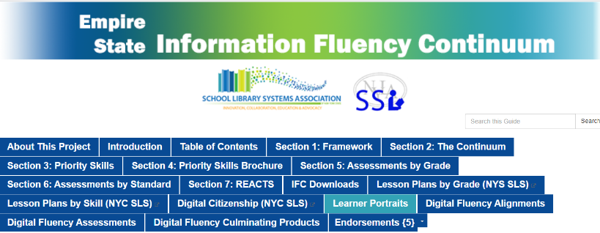
The Empire State Information Fluency Framework
The School Library Association of NSW working parties are developing and sharing expertise in using IFF to demonstrate achievement of learning.
The NSW Information Fluency Framework

Slide 47
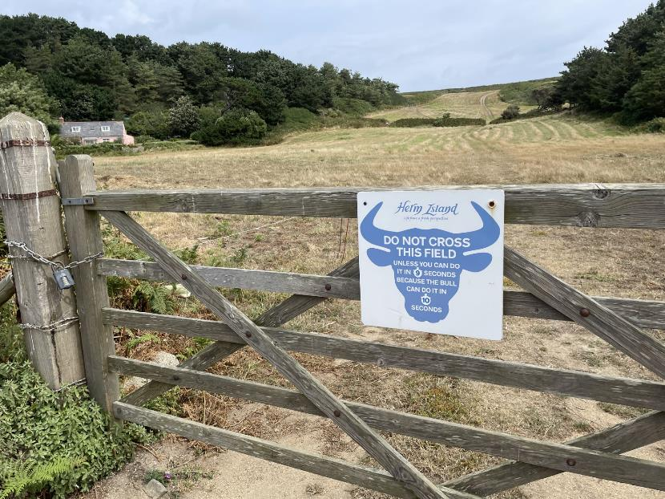
The way forward?
An inquiry learning model in our schools – but how?
Using the enormous resources of the school library to underpin inquiry learning.
Using the teaching and information fluency skills of the Teacher Librarian.
FOSIL, of course!
(Though I still like Guided Inquiry Design, as well!)
The revolution will not be televised!
(because it’s taking WAY too long -
unlike the Bull on Herm Island!)

Slide 48
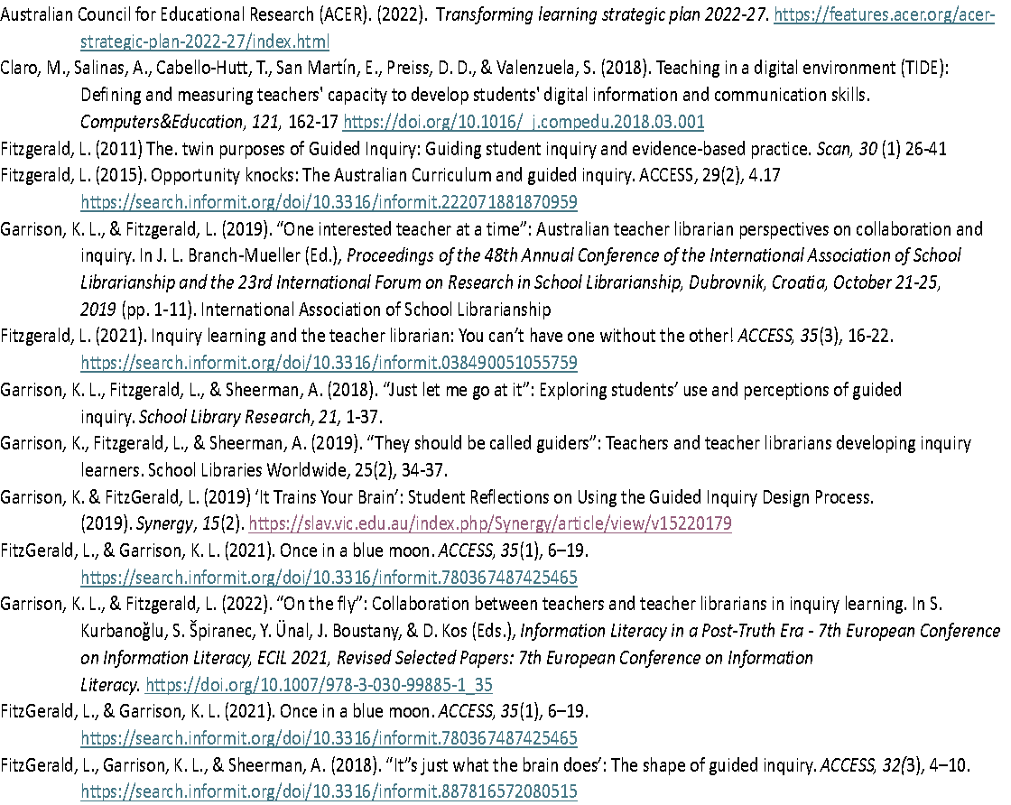
References

Slide 49
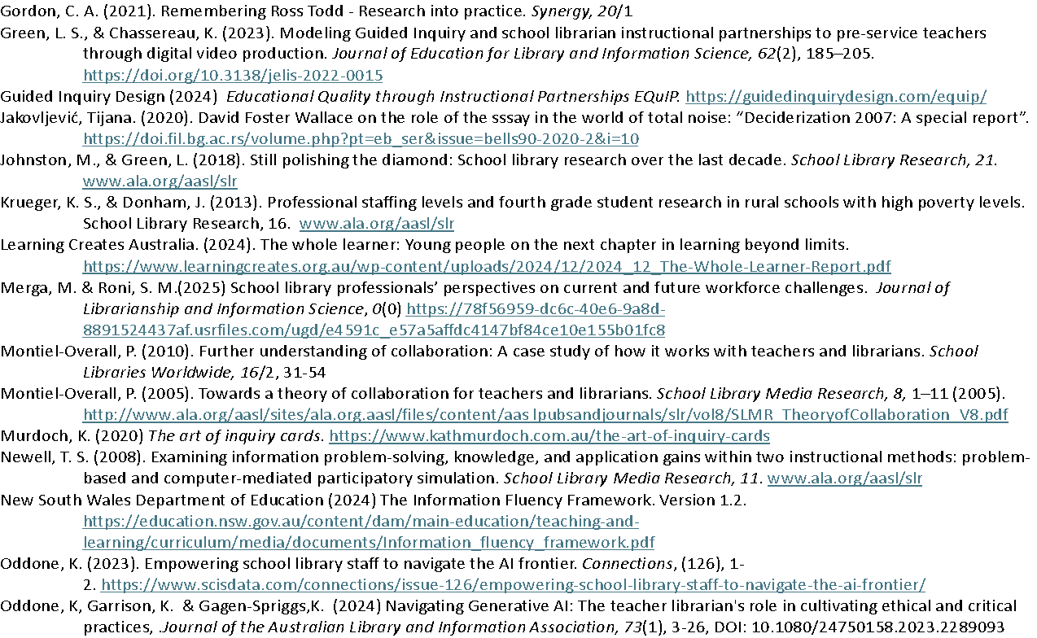
References

Slide 50
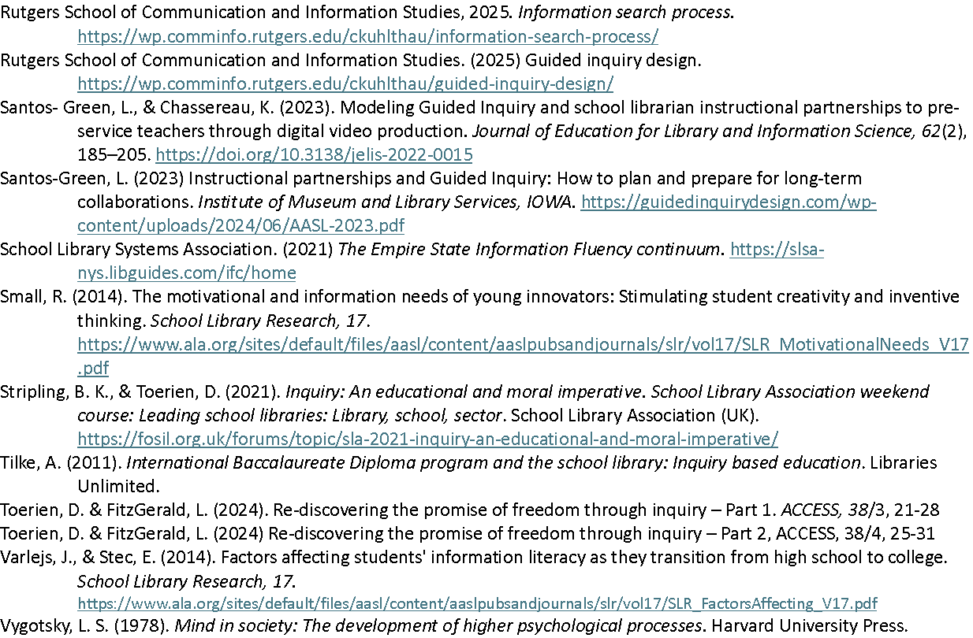
References

