Slide 1
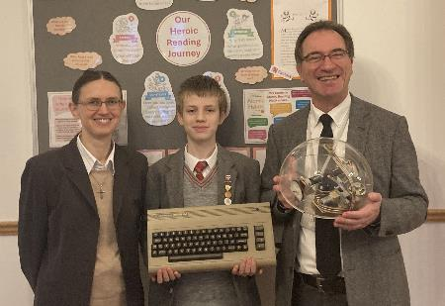
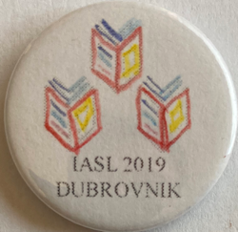
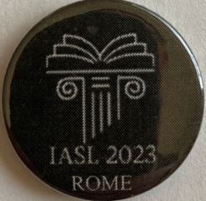
FOSIL 2025 Symposium | Saturday 8 February
LILAC
2019.04.24-26

Slide 2
Defining the IAI
The purpose of the Institute is to initiate and support efforts, formal and informal, that foster the development of school-age children as engaged and empowered inquirers.
This both enables them to fulfil the deepest potentialities of their being human in the world, and strengthens the liberal-democratic fabric of society.

Slide 3
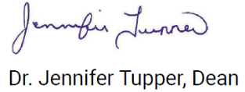
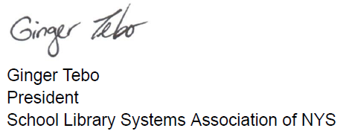
Endorsing the IAI
Notes:
Plus journal.

Slide 4
Naming the IAI
Logo Design Inspiration
An Idea Takes Shape
IAI
Institute for the Advancement of Inquiry
Augmentation of [Human] Intellect (Doug Engelbart, 1962)
Not Atrophication of [Human] Intellect
IBM Plex Typeface
IBM as medium between humankind and machine
Balance of natural and engineered is backbone of Plex
IBM rebus by Paul Rand (1981) for IBM THINK motto
Notes:
*Augmenting the Human Intellect: A Conceptual Framework* (1962) is Doug Engelbart’s most seminal work, in which he considers how we might enhance human capability to solve increasingly complex, extinction-level problems <see Field Guide to 'Augmenting the Human Intellect' - Doug Engelbart Institute>.
This is not to be confused with Artificial Intelligence and the Atrophication of [Human] Intellect.

Slide 5
Symbolising the IAI
A Logo Emerges
Layered Meaning
Monogram logo made from elements of name
Distinct elements but not separate
Reinforced in colour-bleed
Augmentation versus Atrophication of the human Intellect
Drawing compass
A precision technical instrument
Requires human intellect and hand
Two figures embracing – unity in diversity
Construct blue – the point of inquiry

Slide 6
Integrating and Hosting the IAI
Jane Grange
Director of Studies, Blanchelande College
Alexa Yeoman
Principal, Blanchelande College

Slide 7
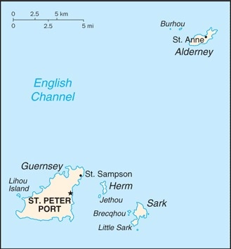
Valuing the IAI
Director
IAI LBG
Mark Le Page
MD of Orthoginian Limited

Slide 8
The Value of the Institute
The facts
“A state of wonder and puzzlement…”
Love is wise: hatred is foolish

Slide 9
The International Value of the Institute
Guernsey
International Finance Centre
AuM: £288.8 billion
In any one office, 20 nationalities
We are Whigs!

