Slide 1
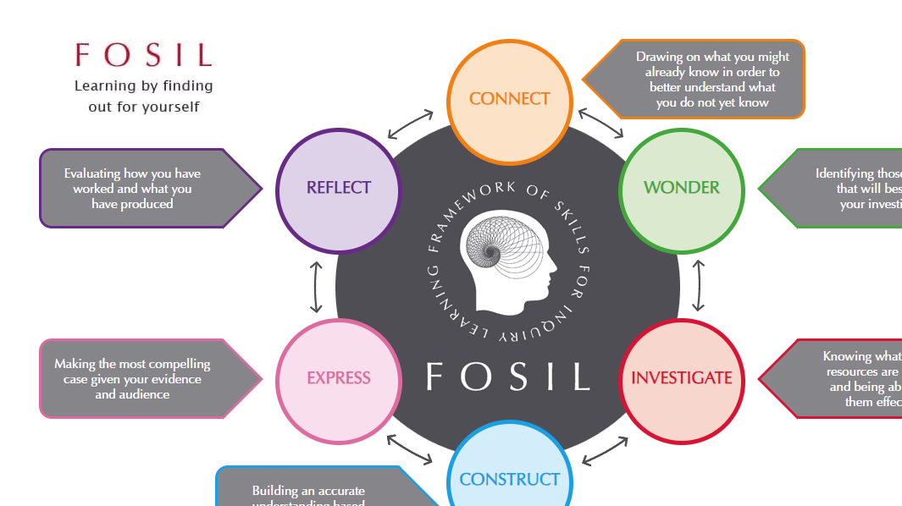
FOSIL Symposium
February 8th, 2025
Ruth Maloney
Librarian
Tonbridge Grammar School
Notes:
This presentation is a combination of my experiences with school Libraries, Inquiry Learning and FOSIL and some specific work that I have carried out at TGS using or attempting to use FOSIL.
I decided to present using the FOSIL structure working through my own inquiry and illustrating my journey with projects I have run at TGS
I will be considering these questions
Why Inquiry?
What are my obstacles to inquiry?
How am I engaging and empowering inquirers?

Slide 2
Why Inquiry?
What are your obstacles to inquiry?
How are you engaging and empowering inquirers?
Notes:
The fist question to ask was ‘Why I think inquiry is essential in education’
What I already know
When I began my role at TGS I knew about Libraries –
B&H public Libraries
Oxford
Law firms
I had educational experience
BA, PGDip, Sconul Traineeship, MSc (Information Science)
I had a lot of experience of education from the learning point of view
I had 2 children in the UK education system which gave me more recent experience of the UK school system
What I didn’t know yet / am still learning
Much about being a school librarian
The IB requirements for school libraries
The IFLA school library guidelines
Anything about pedagogy
The combination of this experience led me to Wonder how I was going to convert what I already know into a new setting and fulfil my IB obligations as mine is an IB school.

Slide 3
Why Inquiry?
What are your obstacles to inquiry?
How are you engaging and empowering inquirers?
Notes:
These are the questions that I Wonder about- some I feel I have answered and some remain live.
What do I need to understand in order to get started at least?
Because we are an IB school a good place to start is with their requirements for both programs (MYP 7-9 & DP 12&13)
The school’s curriculum UK based curriculum (GCSE)
What other requirements the school places on the Library and the Librarian
The FOSIL Framework
The resources available on the FOSIL website
Which are the teachers most open to engagement with the Library and me as the Librarian.
Then I wanted to understand how using FOSIL is better than just teaching library skills?
I have grappled with his question a lot – I feel intuitively that it is but I sometimes feel that its an ideal that I am not achieving.
I understand that FOSIL is a complete set of skills and the relationships mapped between them which allows students to understand the research process and the place of the skills within it leading them to be better, more independent researchers.
FOSIL requires the integration of skills into content and moves away from ‘library lessons’ thereby giving a context for the skills
What would I like FOSIL look like in my school?
I'd like all staff to be using the terminology as they use the IB terminology so that when teaching through inquiry, as they do, they are using this framework and are therefore being consistent in their approach and knowing clearly where the associated skills should be taught.
When does what we do start begin FOSIL and stop being standalone skills?
When we teach the place of the skill in a larger inquiry process even if we are only teaching one skill – referencing for example. (I will think about this again when I demonstrate the Year 7 referencing material)
How can I engage my school?
Through conversation, if you ever have a chance to see what is happening in the classroom or see unit plans and can see an opportunity then take an idea back to that teacher or department and see if they are interested in collaborating.
I found referencing was a great starting point as no one else in the school wanted to teach it so I only had to find a department willing to let me add it in to their scheme of work (Yr 7 Geography)
What are the obstacles?
Time
Teacher engagement and planning time
I am not a teacher – I would be happier if I had a teaching qualification

Slide 4
Why Inquiry?
What are your obstacles to inquiry?
How are you engaging and empowering inquirers?
Notes:
Next I need to look for some answers, find the material that would support my investigation.

Slide 5
Ideal Libraries: A Guide for schools
‘Inquiry is more expansive than research, and facilitating it requires expertise beyond research methods (Callison, 2015 and Levitov 2016) cited in (IBO, 2018 Pg. 9))
MYP From Principles into Practice with the appendix: ATL skills framework
IFLA School Library Guidelines
Empire State Information Fluency Continuum (ESIFC)
FOSIL Group
Notes:
Having stated, at interview, my intention to teach ‘library skills’ in the curriculum and not as standalone lessons I had to research what that might actually look like.
I started by finding out what the IB thought their Librarians should do and what IFLA thought
I came across Barbara Stripling’s work and then by association the FOSIL Group and found that my ideas about teaching skills embedded in the curriculum were, of course, nothing new.

Slide 6
Ideal Libraries: A Guide for schools (IBO, 2018)
‘The library/ian supports all learners’ and teachers’ progress towards becoming better inquirers, consumers and creators of information.
This support requires a solid vision, good planning and consistent collaboration.
It also requires clear communication of how inquiry in particular is promoted in the school community, and how the library/ian fits into it.’ (Pg2.)
Notes:
Ideal Libraries- IBO document
As this quote shows the IB clearly anticipate the Library and Librarian being central to inquiry which put me in a very strong position and is the reason I would prefer to work with IB schools. However Daryl is demonstrating that it is more than possible to carry out Inquiry Led Learning) outside the IB system.

Slide 7
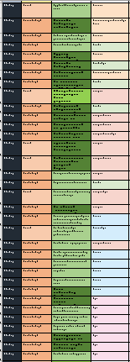
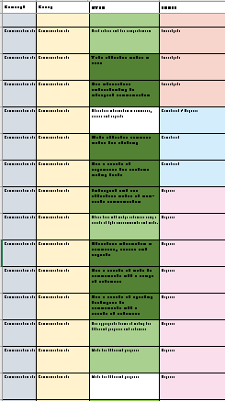
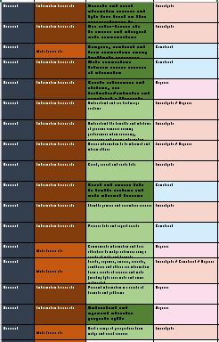
Thinking Skills
Communication skills
International Baccalaureate – Approaches to Teaching & Learning
The five approaches to learning (developing thinking skills, social skills, communication skills, self-management skills and research skills) along with the six approaches to teaching (teaching that is inquiry-based, conceptually focused, contextualized, collaborative, differentiated and informed by assessment) encompass the key values and principles that underpin IB pedagogy. (IBO, 2024)
Research Skills
Notes:
My nest step was to understand the IB Approaches to learning. These permeate all of their Programs – student become Acquainted in PYP, skills are Acquired in MYP and Applied in DP
At MYP the IB is not a curriculum more of a pedagogy, it focuses primarily on skills, there is no specific content until DP/CP.
I have been discovering, with the support of Darryl and FOSIL, how the Inquiry skills of FOSIL map onto the ATLs and how I should be working to bridge the gap, to group the ATLs by stage in the Inquiry process.
Images show the 3 ATLs which touch on Inquiry most often and the parts FOSIL they relate to. The colours on the far left of the images relate to the ATL group, the green, middle column shows the ATL skill itself and the column on the right shows the part or the FOSIL cycling within which they sit.
Understanding the relationship between FOSIL and ATLs is vital

Slide 8
IFLA School Library Guidelines
(IFLA School Libraries Section Standing Committee , 2015)
The instructional work of a qualified school librarian should focus on core activities, including:
• literacy and reading promotion;
• media and information literacy (e.g., information literacy, information skills, information
competences, information fluency, media literacy, trans literacy, transmedia literacy);
• inquiry-based learning (e.g., problem-based learning, critical thinking);
• technology integration;
• professional development for teachers; and
• appreciation of literature and culture.
The process approach to inquiry-based learning goes beyond the location of information to the use of information, beyond the answering of a specific question to the seeking of evidence to shape a topic. It considers the process of a search for information as well as the product of the search. It calls for an awareness of the complexity of learning from information: Learning from information is not a routine or standardized task, and it involves the affective as well as the cognitive domains.
Notes:
I also looked at the IFLA school guidliens, although I am not an IFLA member I do think these provide us all with useful material to support the case for inquiry and our involvement in it.
The more I read the more interested I became in Inquiry lead learning and the more confirmed in my view that this was at the heart of the role wanted as the TGS librarian

Slide 9
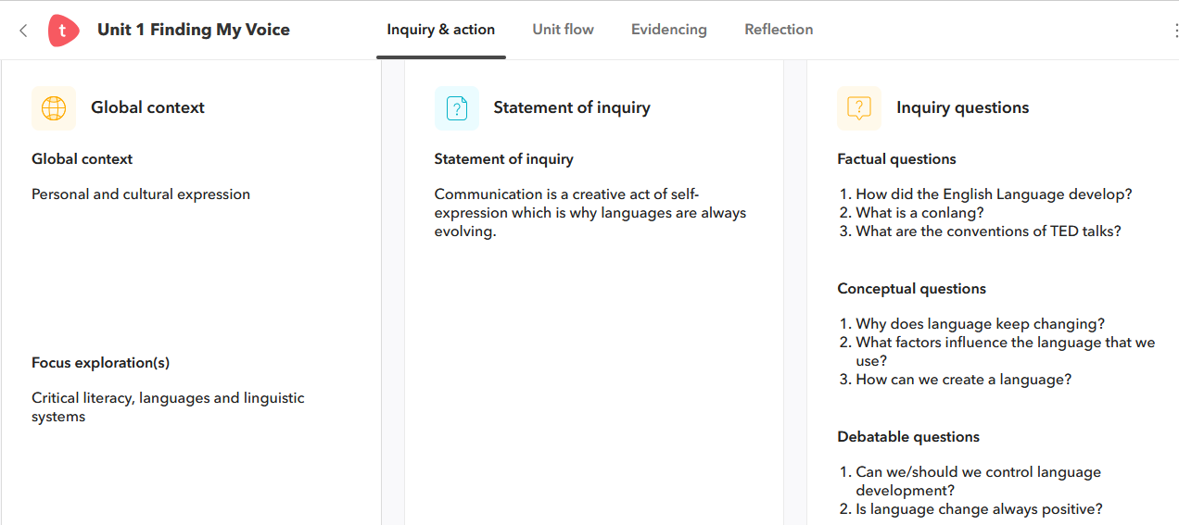
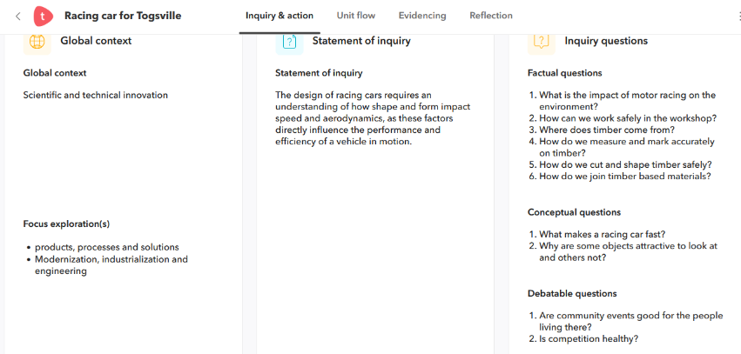
Notes:
Our school is teaching through inquiry
This is an extract from Toddle (Learning Management System) The Inquiry statement is shown in the central part of theses screen shots and the related Inquiry questions are shown on the right.
These are both Year 7 units. Over the 5 years at TGS students are taught to find their own inquiry questions. Culminating in fully open inquiry throught the compulsory Extended Essay in Year 12.
So what do I have to add?

Slide 10
Why Inquiry?
What are your obstacles to inquiry?
How are you engaging and empowering inquirers?
Notes:
‘Construction’ is still in underway. I am still trying to transform what I have learned about FOSIL, Inquiry and School Libraries into knowledge.
I showed part of my process earlier, mapping the ATLs and working with our IB Co-ordinators and the Assistant Head responsible for teaching and learning.
I am trying to understand how far we can take FOSIL in school and what the barriers are to embedding it fully. I ned to consider that
TGS is a large school – 75+ staff
Many staff have been there a long time and have well established existing ways of working
There is NEVER ENOUGH TIME – this has been ongoing on my Performance Management for a number of years

Slide 11
Why Inquiry?
What are your obstacles to inquiry?
How are you engaging and empowering inquirers?
Notes:
Now I want to discuss specific projects I have run using the theory of FOSIL, if you like my Investigations into using FOSIL
Small project
Referencing Year 7 – I have changed this several time to integrate more FOSIL over the years and to work more collaboratively with the teachers involved.
This year I have reconfigured it again and am going to teach referencing as an inquiry working through the stages of FOSIL as a way to learn how to reference – FOSIL with a twist –
For the first time I have added in the use of Teams ‘Search Coach’
Larger Project
Year 12 Induction Project – Intro to IB and the research skills needed to undertake the course
Worked with Elizabeth through her Masterclass program to build this project
Look at each in turn

Slide 12
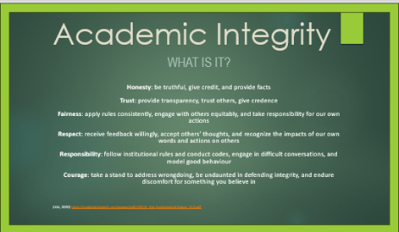
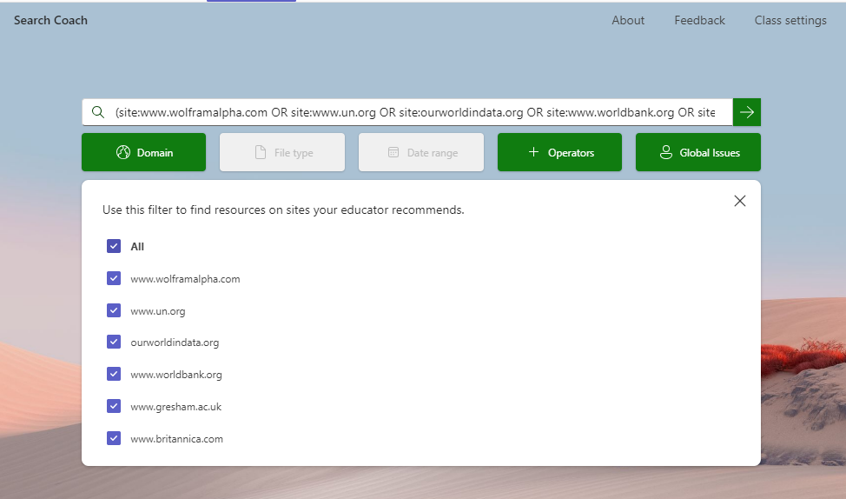
Notes:
Referencing Year 7 – I have changed this several time to integrate more FOSIL over the years and to work more collaboratively with the teachers involved.
The unit has changed this year with a change of Head of Department but this remains the point in Year 7 where we Introduce referencing in the wider context of Academic Integrity
This year I asked myself can you teach inquiry skills using and inquiry model?
I created this 1 hour lesson based around the Inquiry cycle – my way to ‘serve’ students some FOSIL
The steps are as follows
Students will be asked to Connect with the wider issue of Academic Integrity – I need to embed referencing within this broader idea before I explain that we are focusing on. They are asked to consider Definitions, Purpose, What is included? – Focus on referencing today
Wonder – why does referencing matter and what would a reference look like
Investigate – what terminology do you need to understand and , what is needed for a Havard reference? - game
What are the differences required for different sources – open discussion (this is not ideal but time is so limited
Construct – Work together to create a table of requirements for the most commonly referenced sources, drawing their knowledge together.
Express- The expression stage will happen as part of their formative assessment
IQ: Why is X a global problem
I have taken the opportunity to integrate Search coach in Teams Click to activate the animation this has two benefits – I am confident that the students are using reliable sources and it is much easier to assess the referencing as they are restricted to 6 sites and no more.
We are very clear with students that they are not expected to be experts after 1 lesson – this is a skill they need to become familiar with and practice over the coming years are TGS
Reflect: For me not for students
Did this way of working FOSIL into the lesson work? Was is successful? Why / Why not?

Slide 13
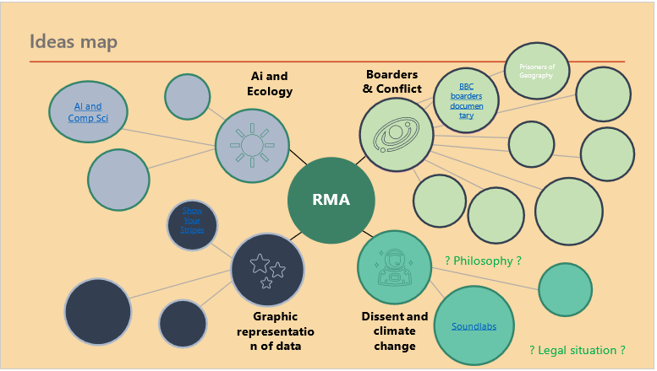
Step | What | How
1. | Find 2/3 ideas that interest you. These do not need be related to the course you are studying. They should, at this stage, be anything that sparks interest and can be very vague. | Begin by looking at My Super Curriculum, browse through and see if anything catches your eye. You may also want to try sites such as Ted talks, The Conversation, Medium.com, Visualcapitalist.com, magazines, newspapers etc
2. | Begin to explore the ideas further. Make sure that you are asking questions as you research. Note the questions that arise from you reading and see if you can find answers to them in the sources you find. When you have found 5/6 good sources that help you answer some of your questions move on to the next idea. Some ideas may draw a blank much sooner or arrive at an answer too fast. That is an interesting result for this project as it teaches you about your original idea. | Use the Library Research Portal, Kent Libraries, the internet or any of the databases we have on trial (Login details here)
3. | Try a variety of note taking and recording methods, to keep track of, record and reflect on the research you carry out. Try some of the AI research tools and see whether they are beneficial. | Try OneNote, Mind maps, Cornell notes or any other method you would like to trial. You may find some of the Graphic Organisers that are in the Class OneNote are helpful if only to help you clarify your thinking
4. | Reflect on the sources you have used, where did you find the best information to answer your questions, did you find any great resources you want to share, did you use AI and if so was it helpful / trustworthy? Reflect on the methods you used to record your research. What do you like, paper and pen, visual methods, electronic notes or some combination? | Use the evaluation forms for the Databases we have on trial and make note of the pros and cons of the sources and methods that you have used.
5. | Prepare for the presentation you will give to your form about your research. This is very short 2 /3 mins with no slides. There will be no need for you to explain what you have found out in detail, the general area of your research might be useful (engineering, design, music etc) but nothing substantial. What you will be explaining is how you progressed your research. | Use the Attitudes to Learning listed on the presentation template to guide you when you are planning your presentation. You should be aiming to demonstrate how you have implemented the skills listed.
Carrot2
Notes:
Yr. 12 project –
This is a much larger project. It ran over a whole month and had the support of the sixth form team.
My Purpose:
To teach our students how to approach research thoroughly rather than diving straight in. The steps are shown on this slide
Sixth form purpose:
To build the students use and understanding of the ‘My Super Curricula’ package that we subscribe to.
To demonstrate that the DP and all that students do in the 18 months of the course make a complete package not a collection of parts
My aim was to teach students to slow their research process. I wanted to focus on Connect, Wonder and Investigate in order to stop them starting from a question and working backwards. I want the questions to arise from the reading not for them to be reading in order to find the answers.
Running of the project - Taster Day – intro
Induction Day – 1 hour to explain and get started
Form Time - delivery of specific skills through prerecorded slides & FTs
Use the whole of September for independent research supported by FT sessions and the Library. I had little delivery time and large group sizes (220 students)
My thinking – At this time of year students do not have much homework but are enthusiastic and keen to get started with something new and a more independent approach
I wanted them to approach their inquiry more slowly and thoughtfully.
What did they actually do?
Their aim was to find 3 very broad areas of interest using the My Super curricula platform. I asked them to find anything that sparked interest, not necessarily connected to their choice of diploma subjects.
I did this because once they had done some research into whatever they found, I wanted them to think about the relationship between the topic and their IB choices – to think about themselves and their interests as a whole, not that they are the 6 subjects they are studying and their interests are inevitably connected.
We spent time looking at the resources available – focusing on the free resources I recommend including websites like Carrot2 which support students to see find relevant material and how to follow a spider’s web of research picking up skills, using a variety of sources and making connections as they worked.
I did run a month long trial with JCS or a large number of their databases in order to give students a broader research experience but we do not have budget for any of them usually.
I created this example (on the slide) of three topics and then where the investigate stage might take me with Wonder questions added in green
This really summarized the project.
They found it too amorphous – they needed something more concrete – they struggled to carry out the activity of research for its own sake. To support them – click to change slide I gave them the breakdown shown here.
The original output was going to be a reflective presentation using the IB’s ATLs we will look at this shortly
I was given a large degree of autonomy over this project and had the support of the sixth form staff team however because of the group size and the time constraints I was reliant on the tutors to deliver sessions looking at:
AI, Non-fiction reading, Planning and note taking, Referencing, Reliable sources

Slide 14
Research Project Presentation The discussion or presentation should focus on thinking about the following Approaches to Learning (ATLs) and how you have demonstrated these when researching or how these skills have been developed through this project. We are interested the issues you faced as well as the successes you had.
Year 12 IBDP TGS
Name
Apply existing knowledge to generate new ideas, products or processes
Use brainstorming and visual diagrams to generate new ideas and inquiries
Formulate factual, topical, conceptual and debatable questions
Preview and skim texts to build understanding
Find information for disciplinary and interdisciplinary inquiries, using a variety of media
Inquire in different contexts to gain a different perspective
Locate, organize, analyse, evaluate, synthesise and ethically use information from a variety of sources and media
Access information to be informed and inform others
Create references and citations, use footnotes/endnotes and construct a bibliography according to recognized conventions
FOSIL: Learning by finding out for yourself
Induction Presentation template by TGS Library is licensed under CC BY-NC-SA 4.0
FOSIL: Learning by finding out for yourself
Induction Presentation template by TGS Library is licensed under CC BY-NC-SA 4.0
Notes:
Project outcome
The outcome was to be a reflective presentation on the research process
The prompts for the presentation (shown on this slide) are selected from the IB’s ATLs and colour coded according to FOSIL
However - Students did not want to do a presentation this was putting them off from engaging. We changed it to a group reflection.
My Reflections
I am keen to run this again next year but I will make some changes, primarily to the start and the end. I will not offer a session on the Taster Day as it doesn’t fit in with the rest of the activities.
I will make sure Form Teachers engage with the Induction Day session so that they can support the Form Times better
- rolling tutor program
The end product needs to be reconsidered – maybe just a research map of some kind? I will be asking for teacher input into what would work better
A large number of students were very reluctant to engage in presentations although this needs to be addressed as an Oracy issue for Year 12. Assessed presentations are essential in at least 2 subjects and to support this I wanted to build oracy practice into this project.

Slide 15
Why Inquiry?
What are your obstacles to inquiry?
How are you engaging and empowering inquirers?
Notes:
I am always learning and reconstructing my understanding.
As I mentioned the Year 7 project has been substantially tweaked every year.
I do think that the Year 12 project will need less change and hopefully will run again next year in a similar format.

Slide 16
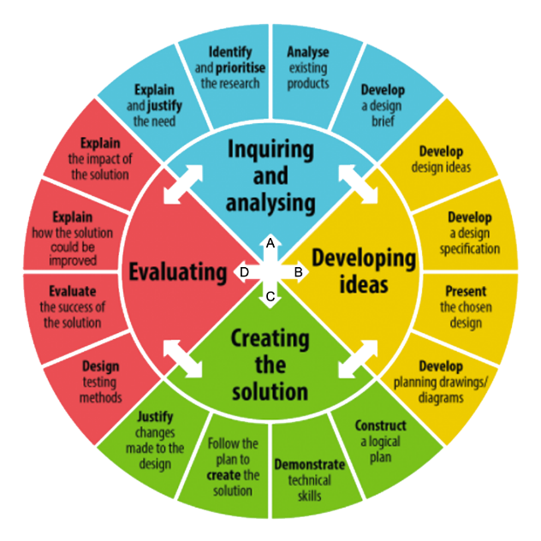
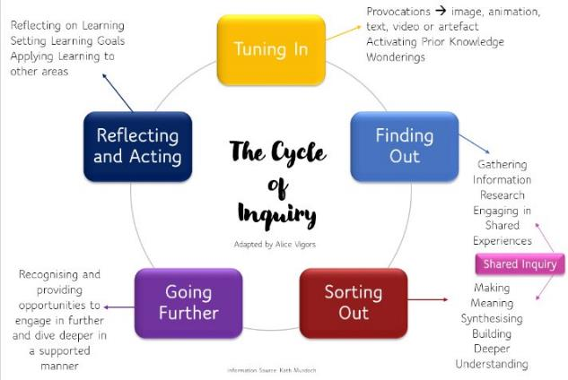
(vistathinkstem, 2020)
(Unpacking the Cycle of Inquiry, no date)
Notes:
How am I going to take this journey forward
Our school is teaching through inquiry but I remain peripheral to the thinking sadly
This is viewed as a teaching project and despite having shared FOSIL widely it was not part of the thinking and teaching in September’s INSET where the focus was inquiry.
The school seems to be working using cycles that are similar but different for each department – Left IB PYP cycle of inquiry, Right Design cycle
In conversation with our Assistant Head (responsible for Teaching and Learning) it became apparent that the use of FOSILs unifying terminology would be beneficial but that this is not small mountain to climb. I now need to try and introduce this one department or IB group at a time, a layer on top of what they are already doing.

Slide 17
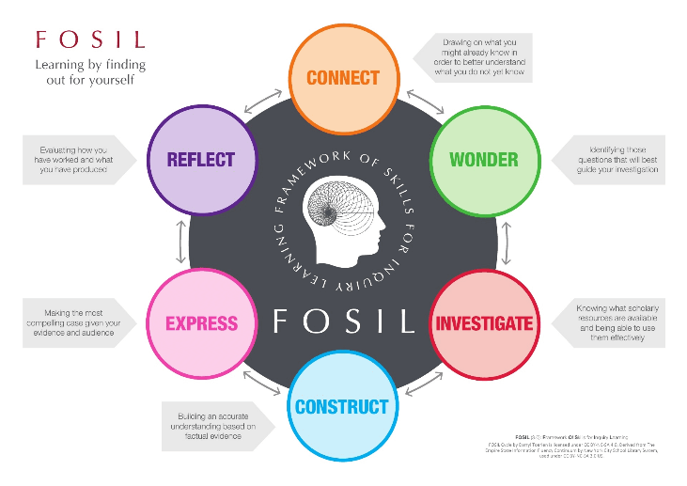
Completing the cycle?
Notes:
Wrap-Up and Q&A
I will continue to work away at TGS to teach the ATLs and embed them into the FOSIL Cycle, sharing that with colleagues and students
BUT
If Inquiry using FOSIL is going to become the norm, sadly Librarians are not the ones in the driving seat. I believe we need to take our advocacy to the IB and to UK policy makers
Questions?

Slide 18
References
IBO, 2016. Programme standards and practices. [Online] Available at: https://www.ibo.org/globalassets/new-structure/become-an-ib-school/pdfs/programme-standards-and-practices-en.pdf
IBO, 2018. Ideal Libraries, a guide for schools. [Online] Available at: https://uaeschoollibrariansgroup.wordpress.com/wp-content/uploads/2018/06/ideal-libraries-for-ib.pdf [Accessed 10 Jan 2024].
IBO, 2024. Extended Essay Guide. [Online] Available at: https://xmltwo.ibo.org/publications/DP/Group0/d_0_eeyyy_gui_1602_1/files/Guide_Extended_essay_en.pdf [Accessed 10 Jan 2025].
IBO, 2024. Logos and programme models. [Online] Available at: https://www.ibo.org/globalassets/new-structure/icons-and-logos/images/myp-model-en.png [Accessed 10 Jan 2025].
IFLA School Libraries Section Standing Committee , 2015. IFLA School Library Guidelines, 2nd revised edition. [Online] Available at: https://repository.ifla.org/items/e61cb0b6-8d19-45e8-9be1-24b45309464e [Accessed 2025 Jan 10].
New York School Library System, 2009. The Empire State Information Fluency Continuum. [Online] Available at: https://nycdoe.libguides.com/librarianguidebook[ Accessed 10 Jan 2025].
The FOSIL Group, n.d. [Online] Available at: https://fosil.org.uk/fosil-cycle/ [Accessed 29 October 2024].
vistathinkstem (2020) MYP Design Basics - One Perspective, VistaThink. Available at: https://www.vistathink.com/myp-design-basics-one-perspective/ (Accessed: 26 January 2025).
Unpacking the Cycle of Inquiry (no date) THINKING PATHWAYS. Available at: https://thinkingpathwayz.weebly.com/unpackingthecycleofinquiry.html (Accessed: 26 January 2025).

