Slide 1
Introducing Inquiry through the Literacy Curriculum.
Jannath Khanom, LRC Manager and Learning and Research Coordinator
Connaught School for Girls

Slide 2
Context
Librarian for 10 years.
CILIP certified for 5 years, MSc Information Science and Library Management with Northumbria University.
Worked in link sixth form and noticed the needs of the students
Advocating for research and information literacy skills with line managers. Found FOSIL through serendipity and current Headteacher was on board.
Extra responsibilities were given. Mainly, the creation of dedicated KS3 Literacy lessons (one lesson every two weeks with each year group form.)
Connaught School for Girls
Context

Slide 3
Introducing Inquiry through the Literacy Curriculum: the stages.
Confirm role, expectations and aims.
Attend training with Elizabeth Hutchinson
Create curriculum aims, intent and modules.
Create Literacy Criteria
Create resources.
Jannath Khanom
Introducing Inquiry

Slide 4
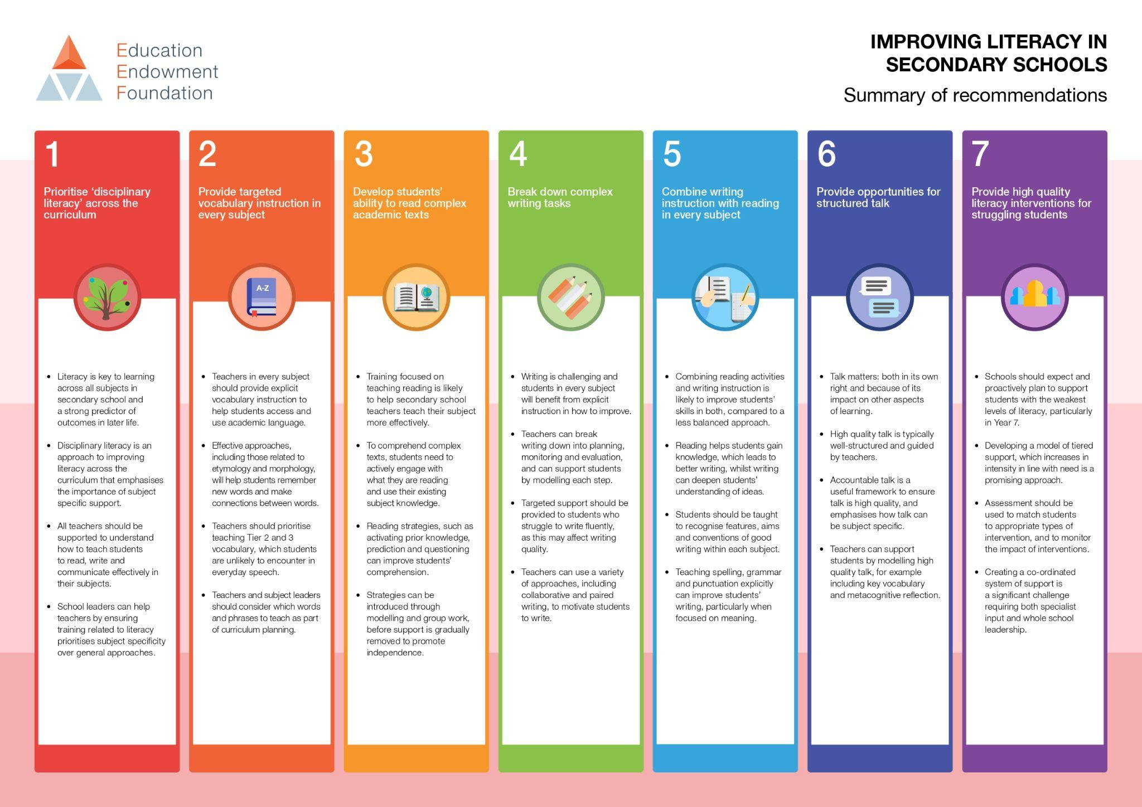
We got here
How
Connaught School for Girls
EEF Improving Literacy in Secondary Schools

Slide 5
Training focused on teaching reading is likely to help secondary school teachers teach their subject more effectively.
To comprehend complex texts, students need to actively engage with what they are reading and use their existing subject knowledge.
Reading strategies, such as activating prior knowledge, prediction and questioning can improve students’ comprehension.
https://educationendowmentfoundation.org.uk/education-evidence/guidance-reports/literacy-ks3-ks4

Slide 6
Writing is challenging and students in every subject will benefit from explicit instruction in how to improve.
Teachers can break writing down into planning, monitoring and evaluation, and can support students by modelling each step.
https://educationendowmentfoundation.org.uk/education-evidence/guidance-reports/literacy-ks3-ks4

Slide 7
Combining reading activities and writing instruction is likely to improve students’ skills in both, compared to a less balanced approach.
Reading helps students gain knowledge, which leads to better writing, whilst writing can deepen students’ understanding of ideas.
Students should be taught to recognise features, aims and conventions of good writing within each subject.
https://educationendowmentfoundation.org.uk/education-evidence/guidance-reports/literacy-ks3-ks4

Slide 8
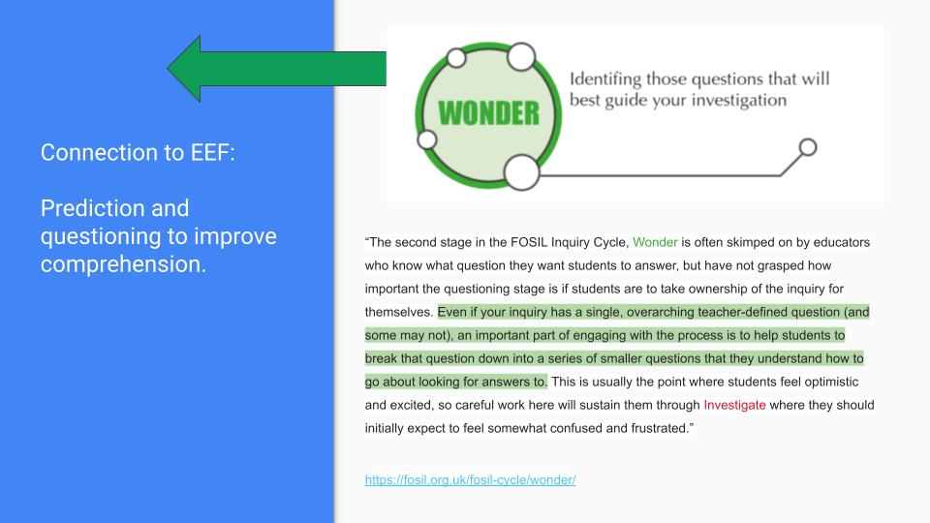
Jannath Khanom
EEF Connection to FOSIL

Slide 9
Curriculum highlights
Comprehending Complex Information Texts
Information Analysis
Inquiry led projects
Reading non-fiction for pleasure
SPaG

Slide 10
Literacy Criteria
What works
Challenges I came across
FOSIL Skills Breakdown
Differentiating the skills
Teacher and student copy
Using clear and accessible language
Using whole school success descriptors
Determine how these skills will be assessed.
Connaught School for Girls
Literacy Criteria

Slide 11
https://docs.google.com/document/d/1lt4qcCzhyB0kO0Sq_LQJFMb7EsnNVsfXXpfQ4BEaxHQ/edit?usp=sharing
Jannath Khanom
Descriptors of Success

Slide 12
https://docs.google.com/document/d/1mUDu-9WltVO5vMkAT9CohV9mFDmlBQCU5Wm8pbGPVIg/edit?usp=sharing
Connaught School for Girls
Literacy Criteria for Students

Slide 13
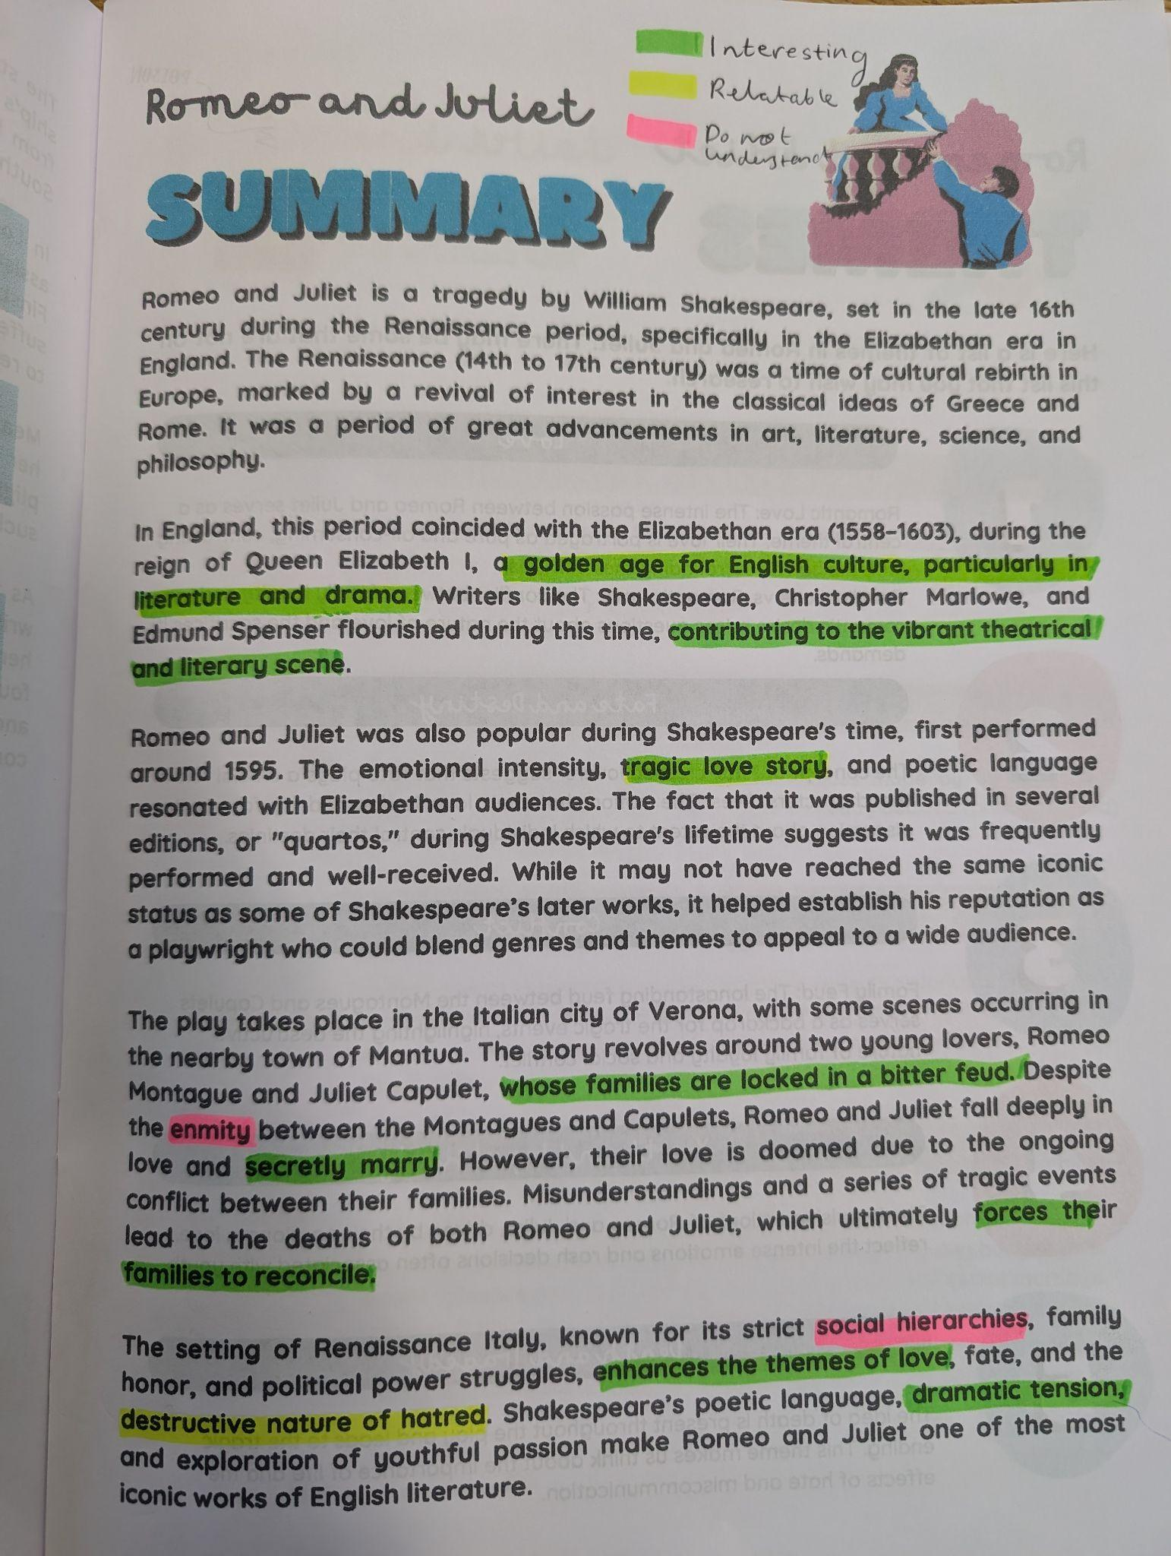
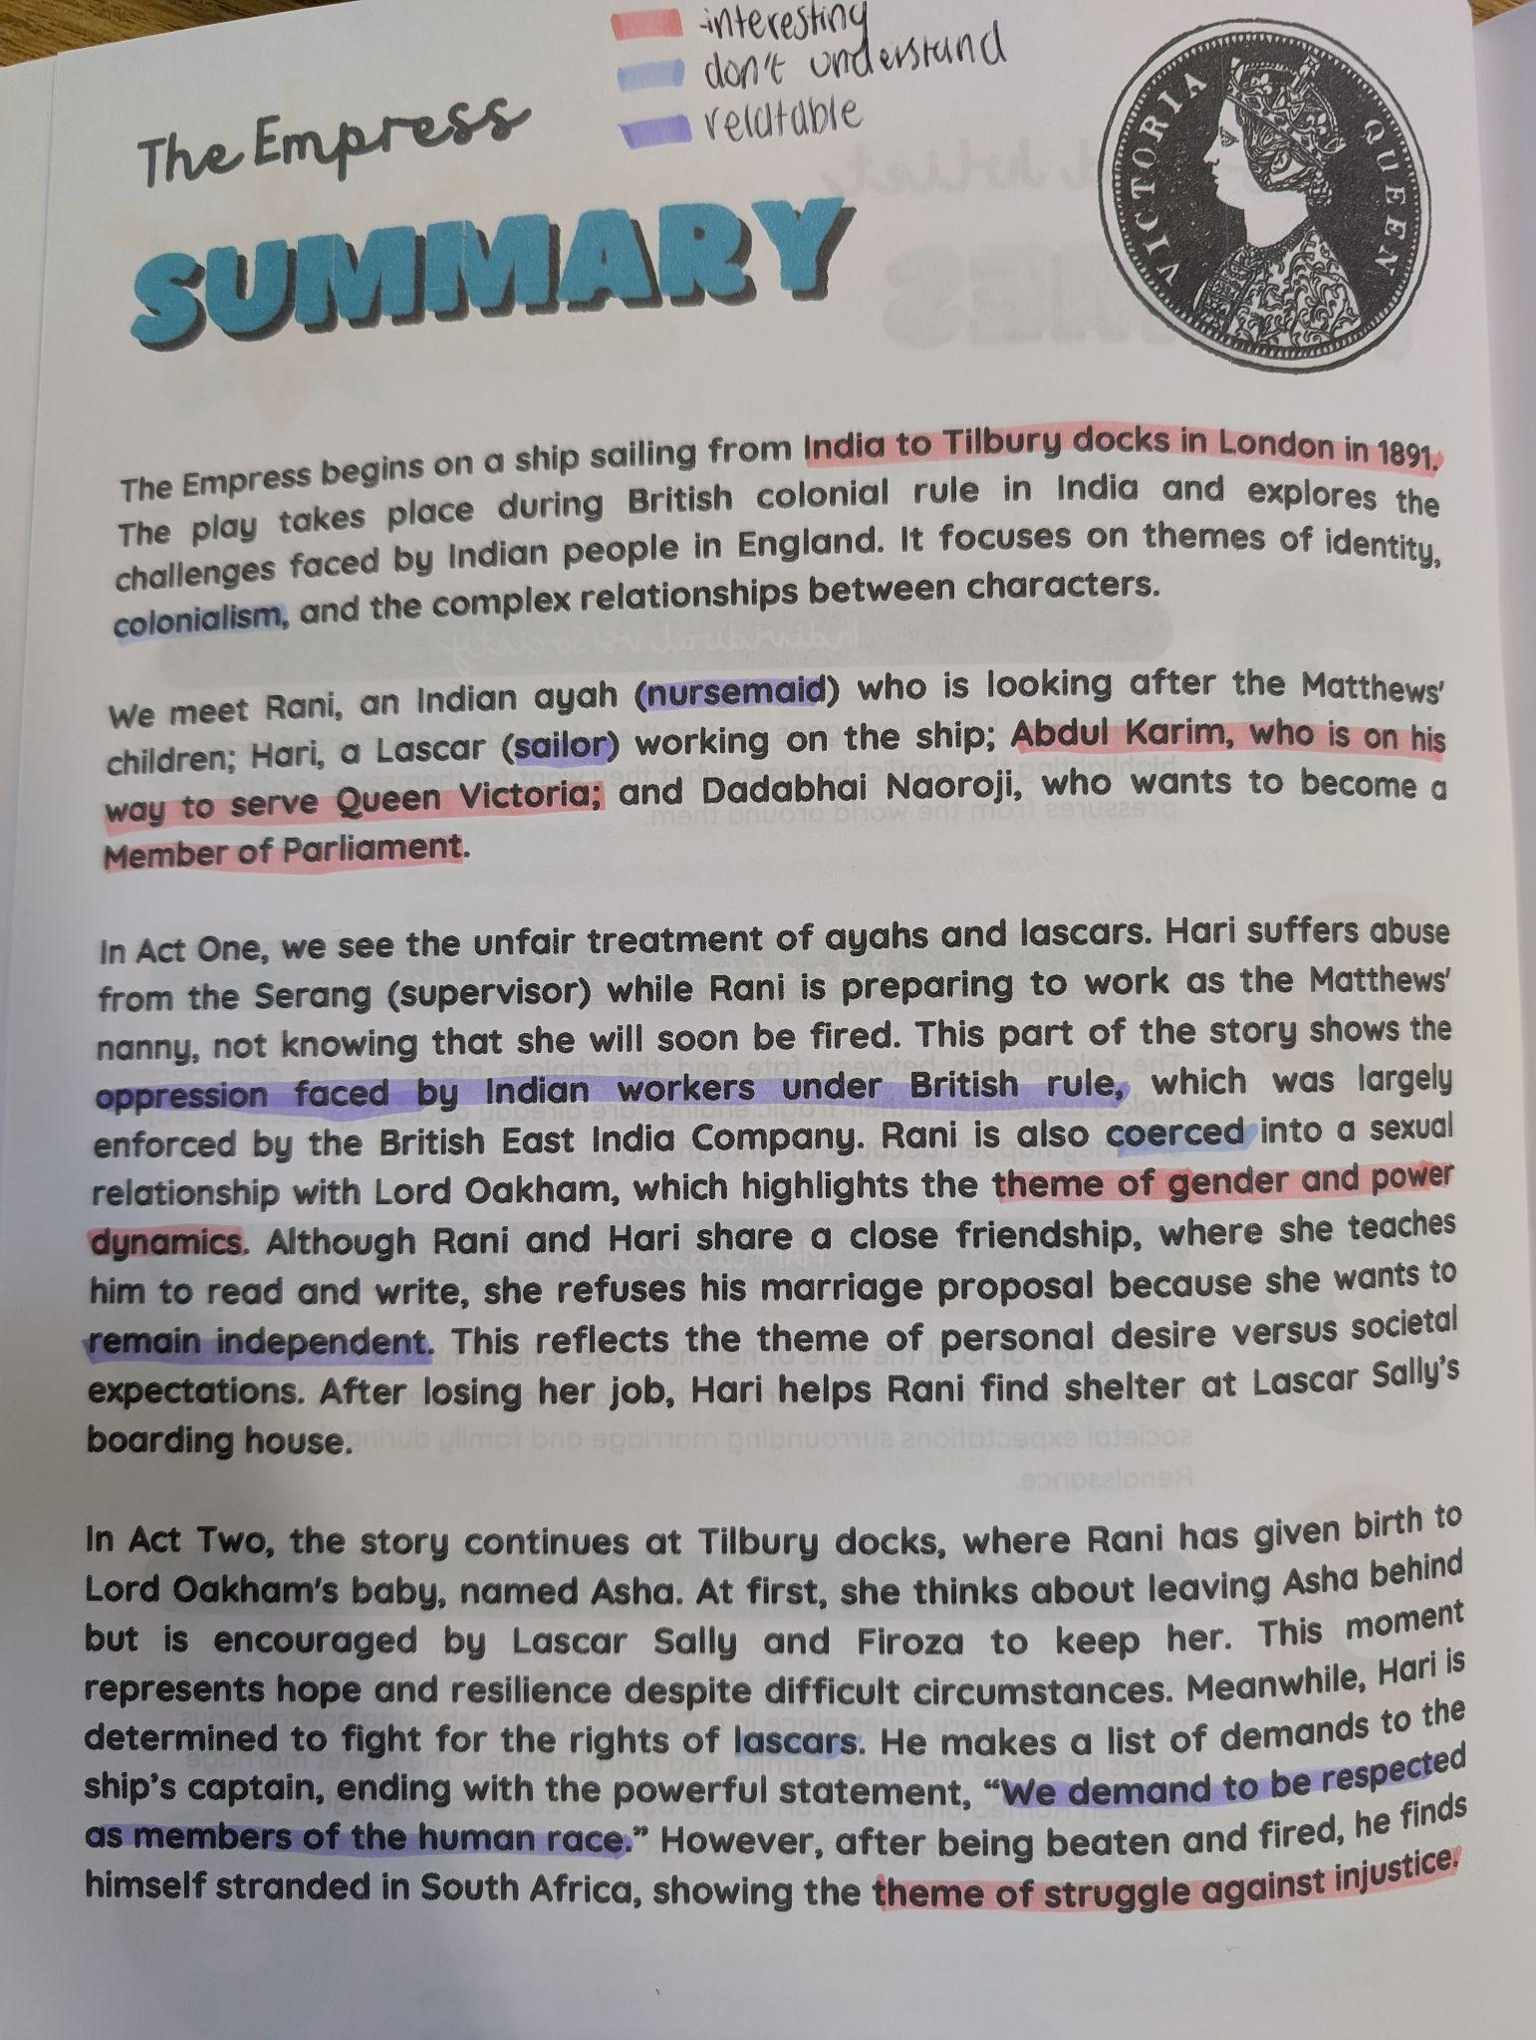
Resources
Connaught School for Girls
Reading Strategies

Slide 14
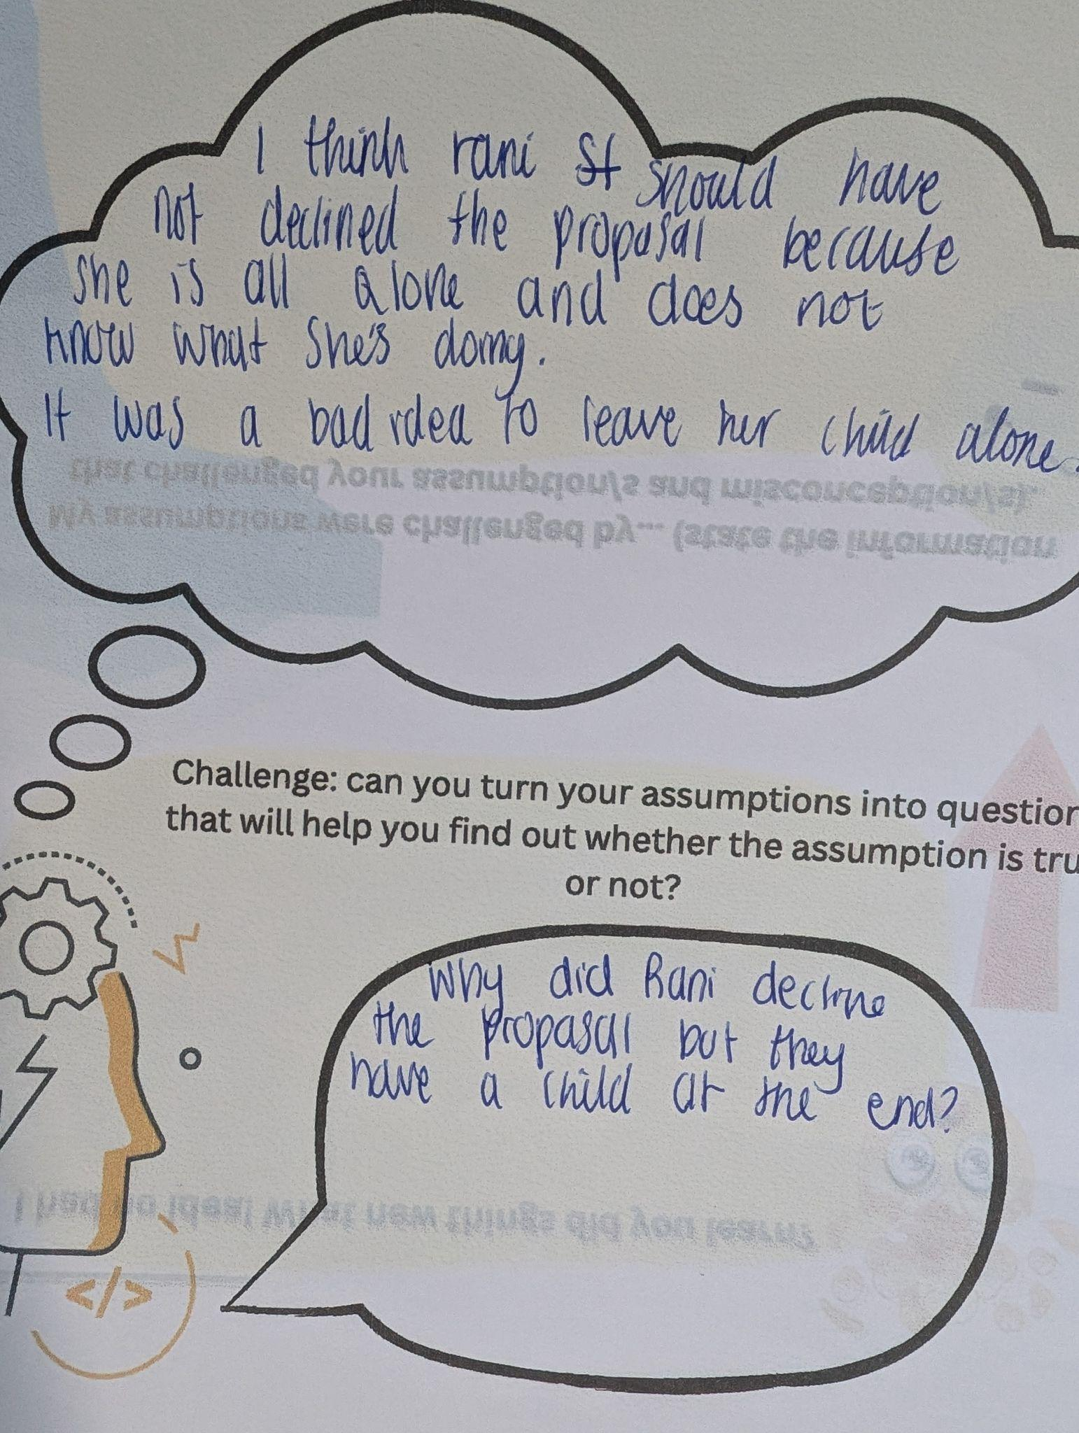
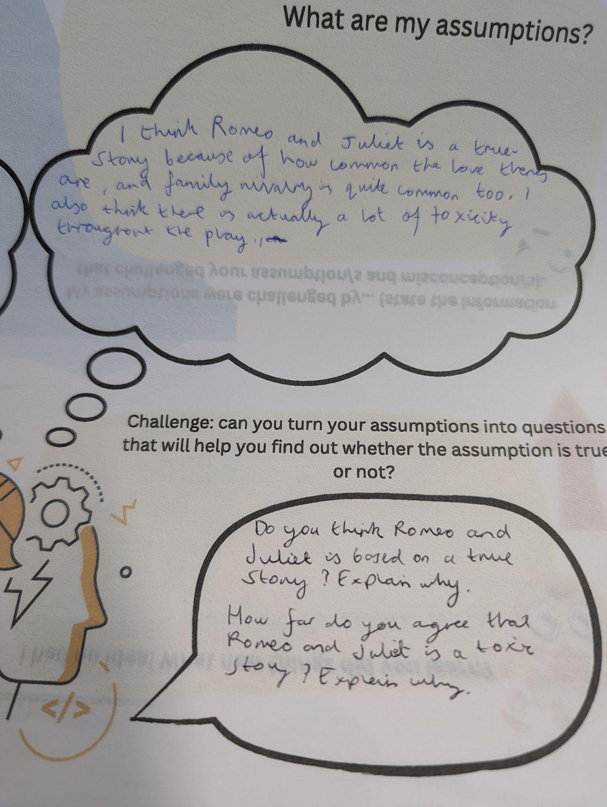
Jannath Khanom
Connect and Wonder

Slide 15
Connaught School for Girls
Year 9 EPQ Style Project

Slide 16
Jannath Khanom

Slide 17
https://drive.google.com/file/d/1eiqAa5AgZFSDmgVXUbY21M2VVcG38c0P/view?usp=sharing
Connaught School for Girls
Years 7 and 8 Conspiracy Theory Unit

Slide 18
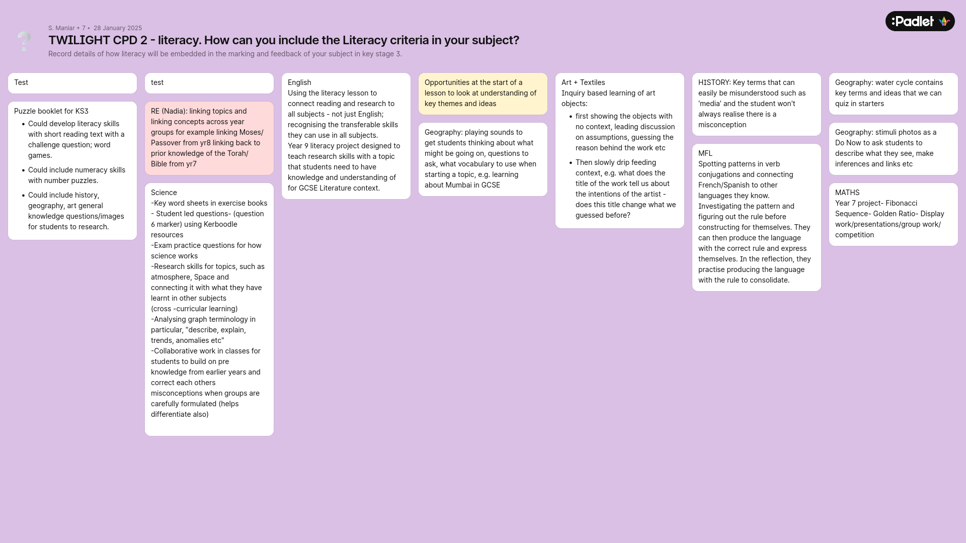

Slide 19
Project Summary

Slide 20
What went
Criteria well received
Readily available for teachers to view specific skills along with resources in the FOSIL Skills Breakdown excel sheet
Resources are now easier to plan/create.
Literacy and Inquiry are on the map.
Members of staff are using FOSIL terminology (the cycle).
Head of Art and Geography have had follow up conversations: Art in regards to a trip and where in the cycle (Connect/Investigate) they wish to place the visit.
Well?
Jannath Khanom
Project Summary

Slide 21
What could be
Teacher talk:
Using the same proforma and documents other teaching staff use.
Understand how the assessment cycles work.
Understand how marking and feedback works in the school.
Lead by example and ensure all work is shared with line managers.
Discuss change management before starting something new.
Better?
Connaught School for Girls
Project Summary

Slide 22
Thank You

