Slide 2
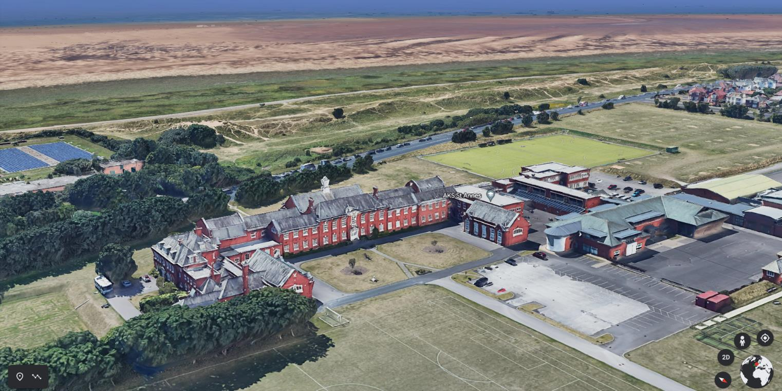

Slide 4
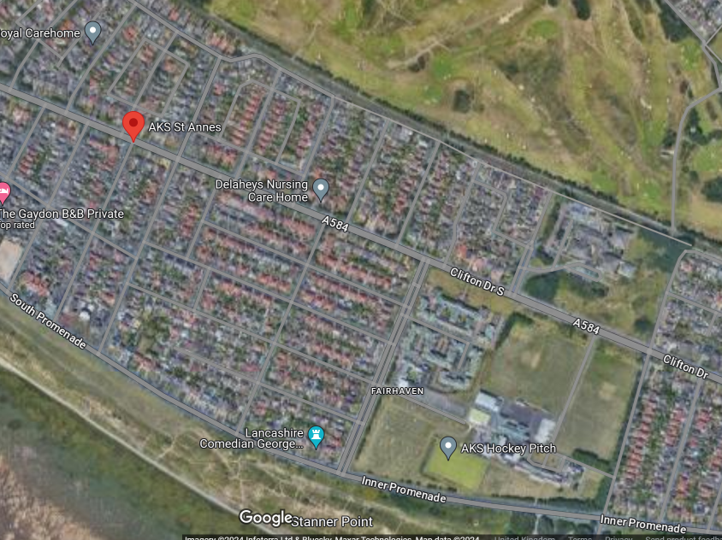

Slide 5
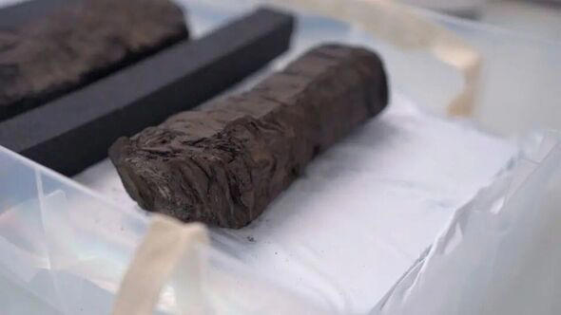

Slide 6
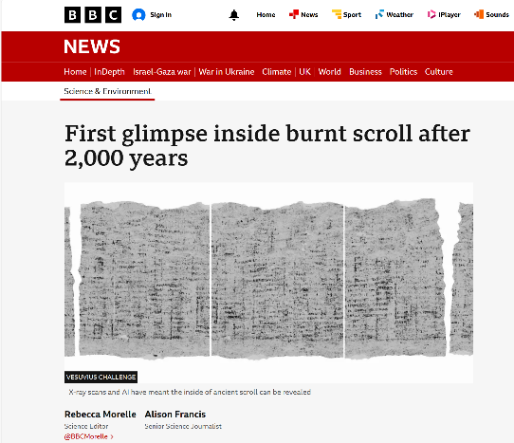

Slide 7
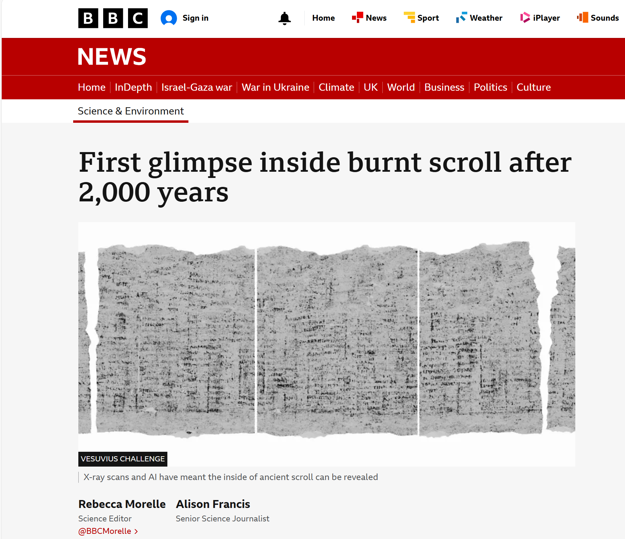

Slide 8
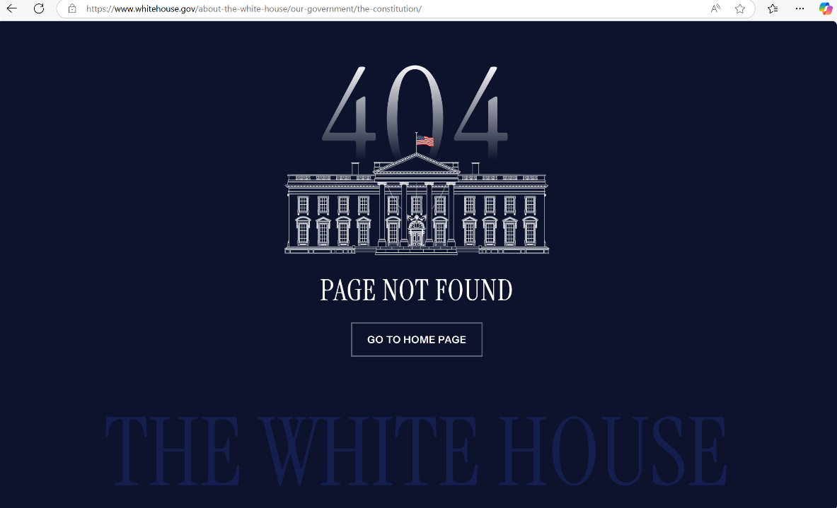

Slide 9
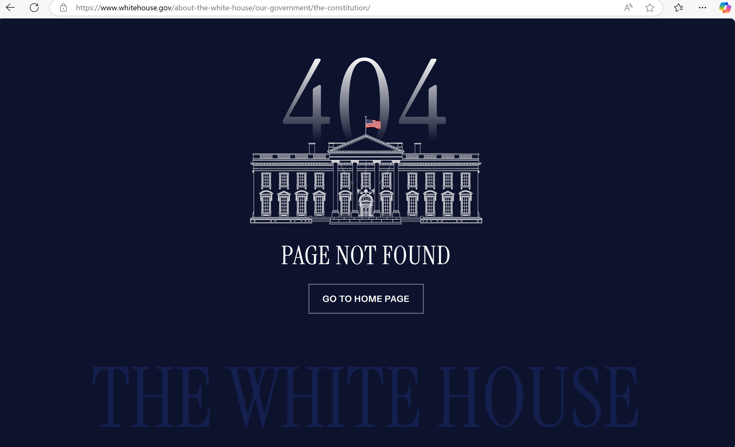

Slide 10
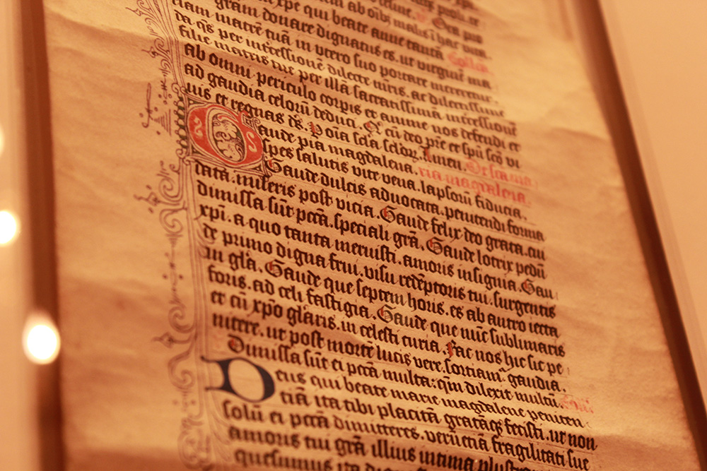
leornung-cniht
lārēow
m.n: a youth engaged in study, scholar, disciple. (LEH-or-nung-K’NIH’T / ˈlɛɔr-nʌŋ-ˌknɪxt)
m.n: teacher. (LA-ray-oh / ˈlaː-reːɔw)
‘The Word Hord’ Hanna Videen 2021

Slide 11
lārēow
m.n: teacher. (LA-ray-oh / ˈlaː-reːɔw)
lār
(lore, teaching, instruction, knowledge)
þēow
(servant, enslaved person)
‘The Word Hord’ Hanna Videen 2021

Slide 12
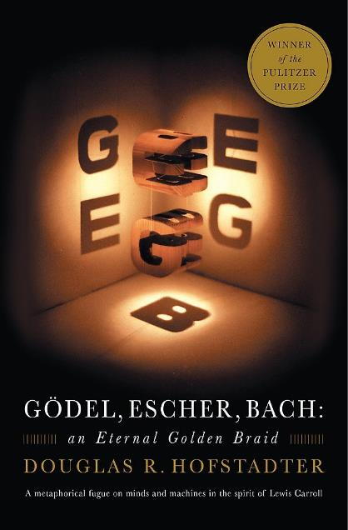
‘…finally, I realised that to me, Gӧdel and Escher and Bach were only shadows cast in different directions by some central solid essence. I tried to reconstruct the central object, and came up with this book.’
Douglas R Hofstadter
Gödel, Escher Bach: an Eternal Golden Braid (1979)

Slide 13
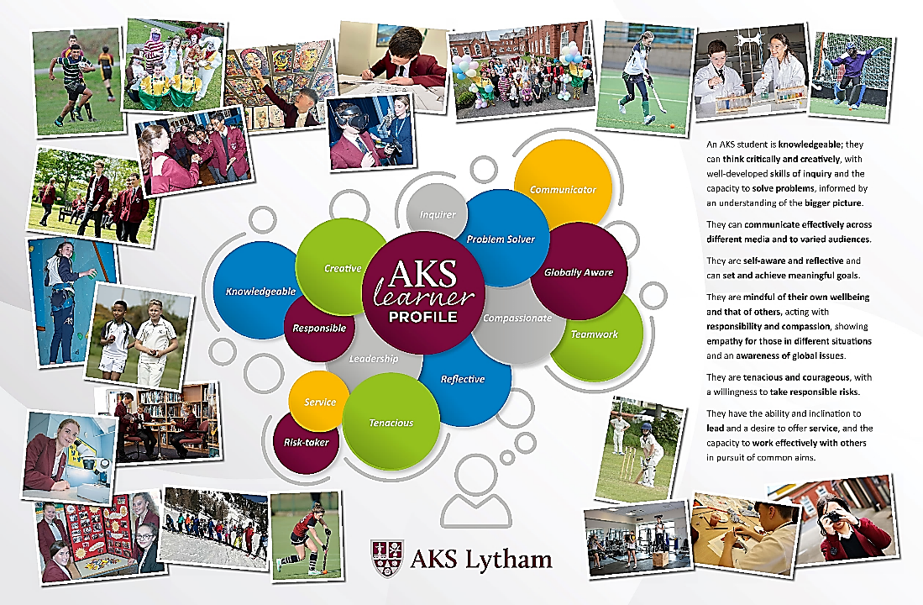

Slide 14
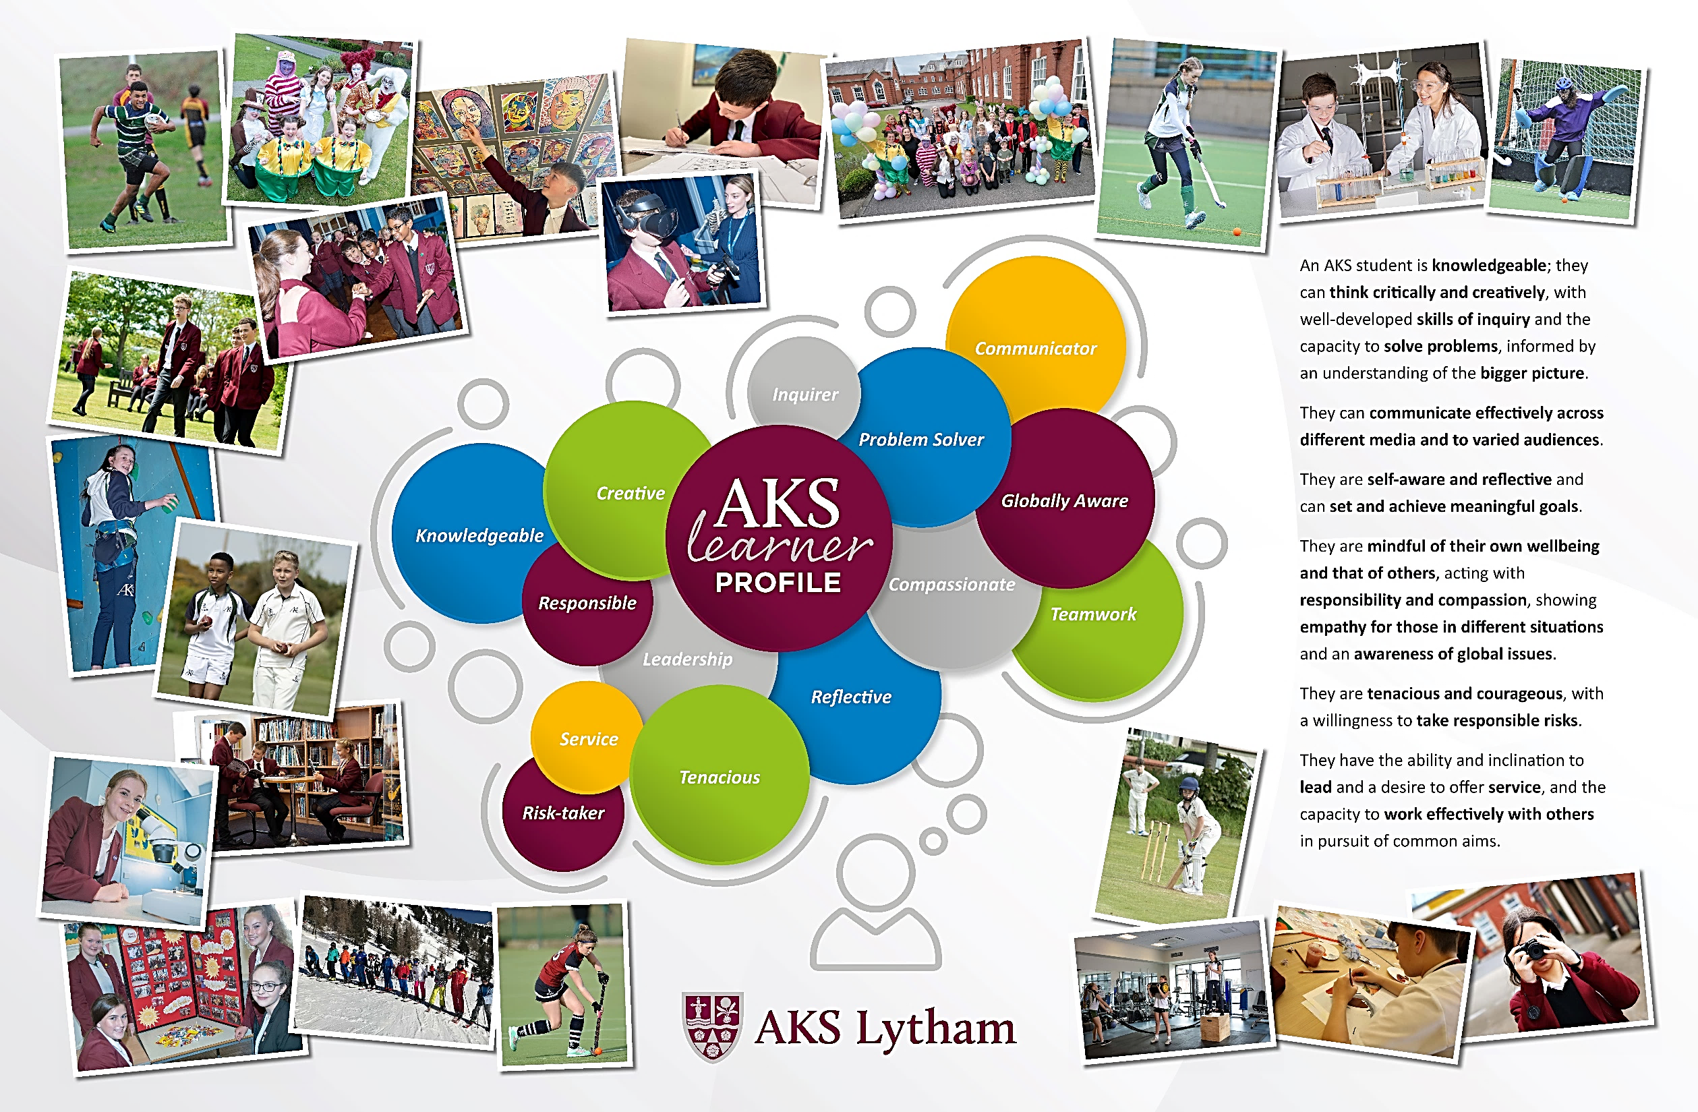

Slide 17
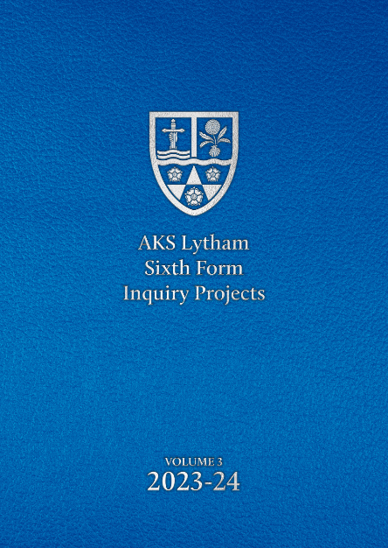

Slide 18
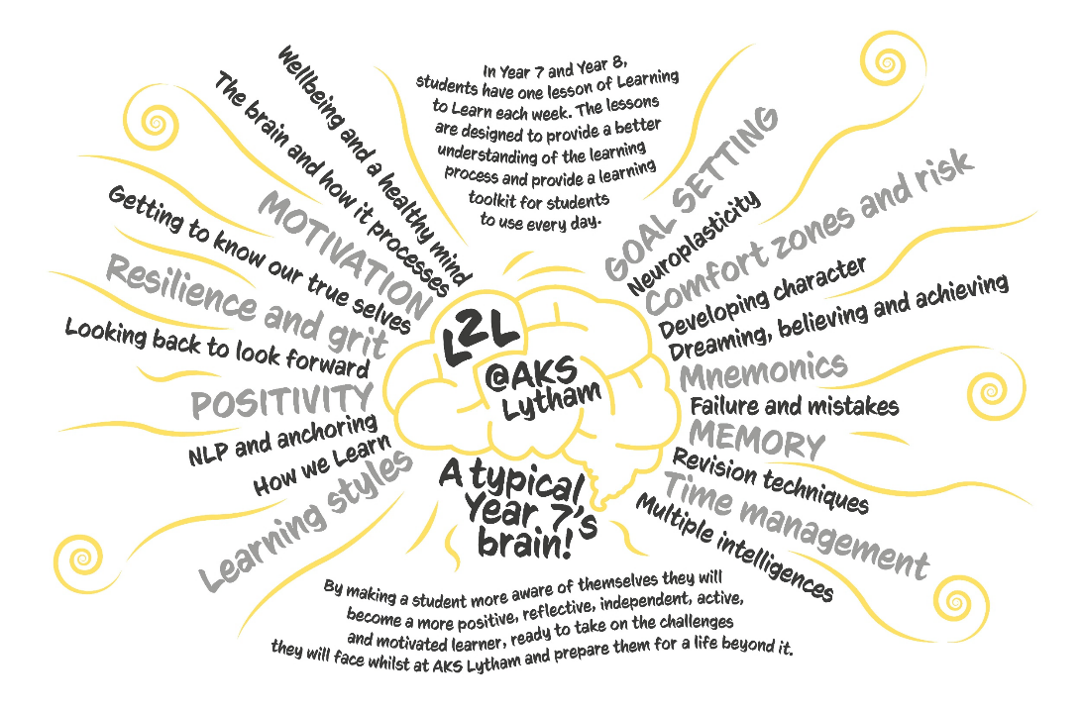

Slide 19
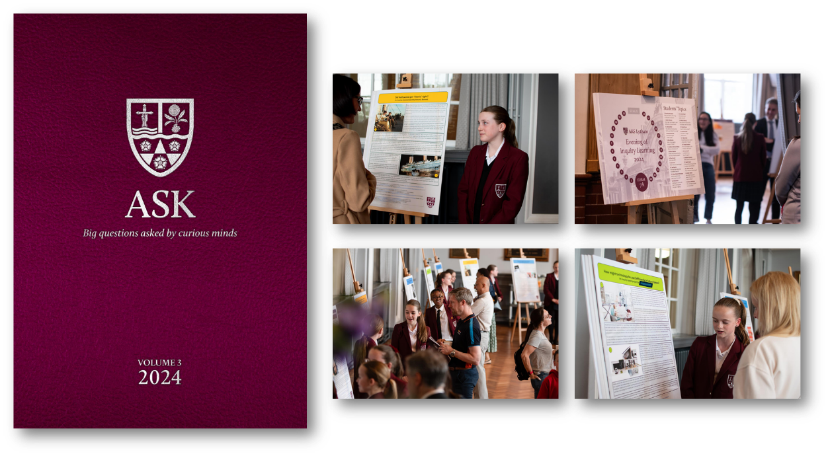

Slide 20
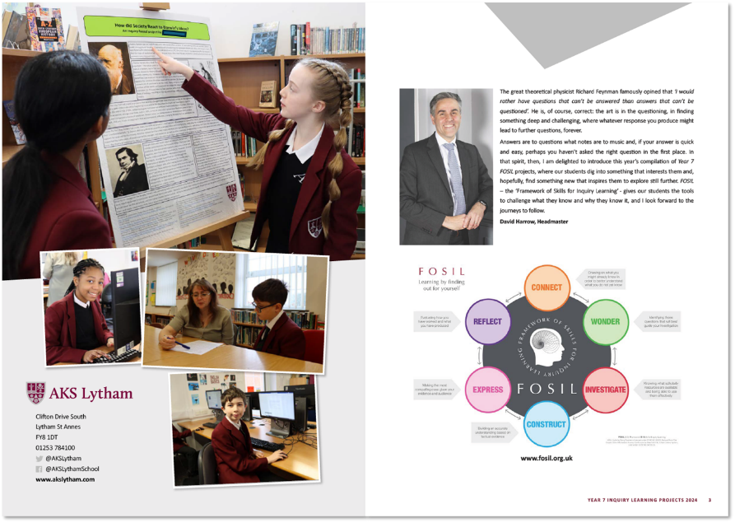

Slide 21
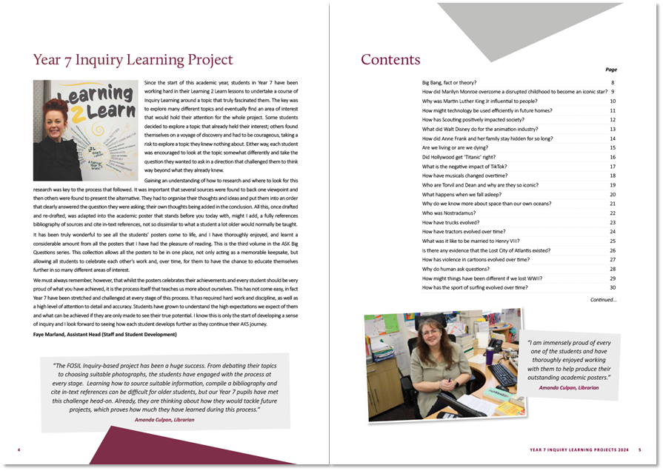

Slide 22
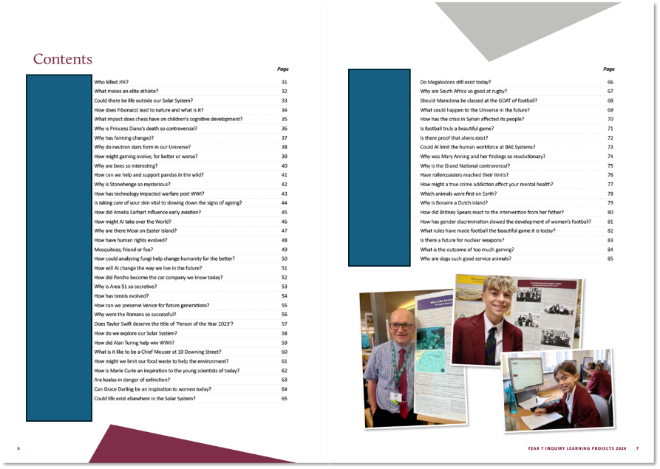

Slide 23
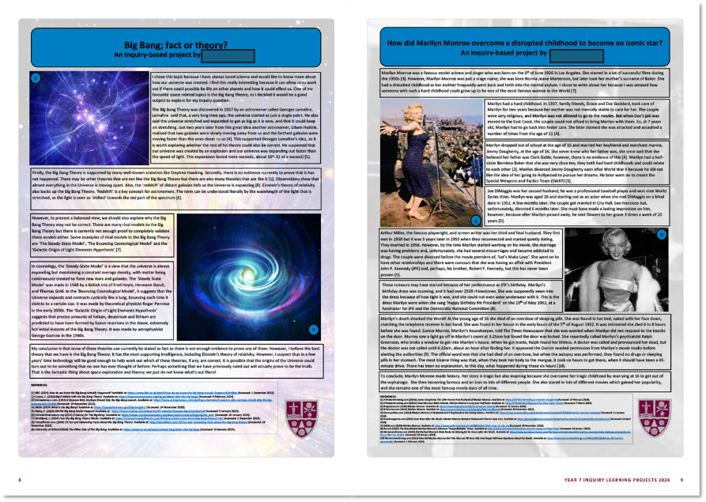

Slide 24
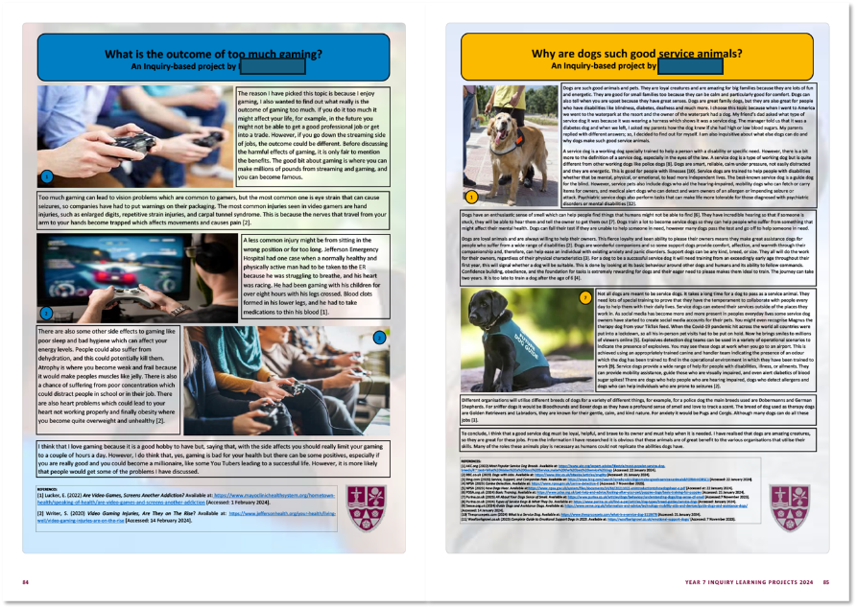

Slide 26
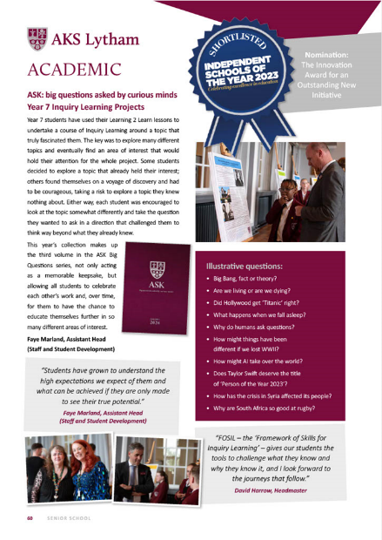

Slide 28
At AKS we encourage and support academic achievement amongst our scholars. In order to highlight the academic potential of our Sixth Form students, Year 12 scholars undertake a piece of personal inquiry learning.
Introduction

Slide 29
What do we hope to achieve?
Beyond the curriculum
Expand study skills
Enhance research capabilities
Encourage independent learning
Introduction
Academic achievement
Stand out from the rest on competitive applications for university

Slide 30
Influences
EPQ
Introduction
International Baccalaureate:
extended essay
FOSIL
Background

Slide 31
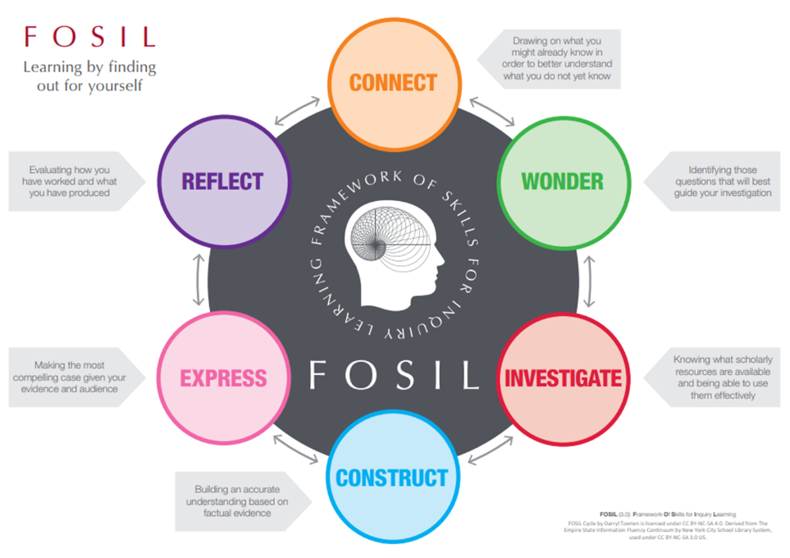
Introduction
Background

Slide 32
A 2,500 word essay on a topic of their choice
(linked to potential university course)
Introduction
Fully researched and referenced undergraduate level academic work
Background
Accompanying academic poster, highlighting the learning achieved through the process
What is involved?
An Evening of Inquiry Learning, to showcase to parents and staff their essays and posters
Presenting your research as a lunchtime lecture to the rest of the AKS community

Slide 33
Introduction
Background
What is involved?
Start
Just before October half term, Year 12
Finish
Easter holiday, Year 12
Timeline

Slide 34
Introduction to FOSIL approach
Introduction to research skills
Collation of research
Writing of essay
November
January
Evening of Inquiry Learning
March
Timeline
October
December
February
Completion of essay
Construction of academic poster
Research and planning
Introduction to Inquiry Project
Half term- consider the topic

Slide 35
Background
Will China follow the USA and Great Britain in the role of the next Global Policeman?
Is Dark Matter the most significant unsolved mystery in science?
How are prime numbers distributed?
Exploring the influence Thelonious Monk had on Jazz Music.
Should patients with self-inflicted illnesses have equal access to health resources?
The role the French Revolution had in the transformation of 18th Century art from the style of Rococo to Neoclassical.
Are parental expectations influential in their adolescent’s performance in Secondary School?
The bilateral influences of the Feminist Movement and Gothic Literature.
Is it ever justifiable to covertly administer medication?
What is a cult and why do people join them?
What is involved?
Timeline
Recent essay titles

Slide 36
What is involved?
Timeline
Recent essay titles
Evening of Inquiry

Slide 37
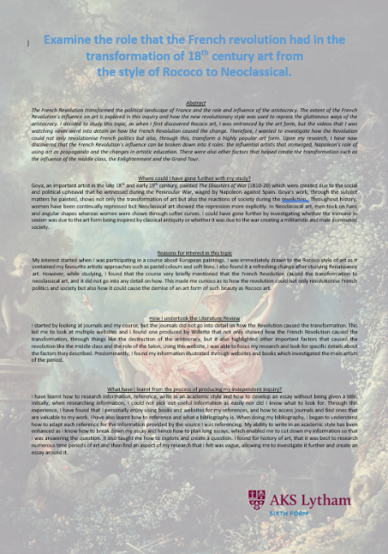
What is involved?
Timeline
Recent essay titles
Evening of Inquiry

Slide 39
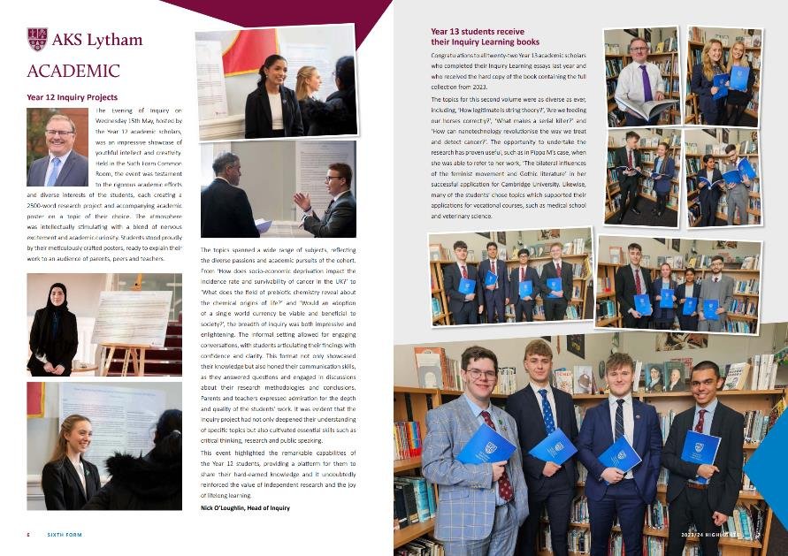

Slide 40
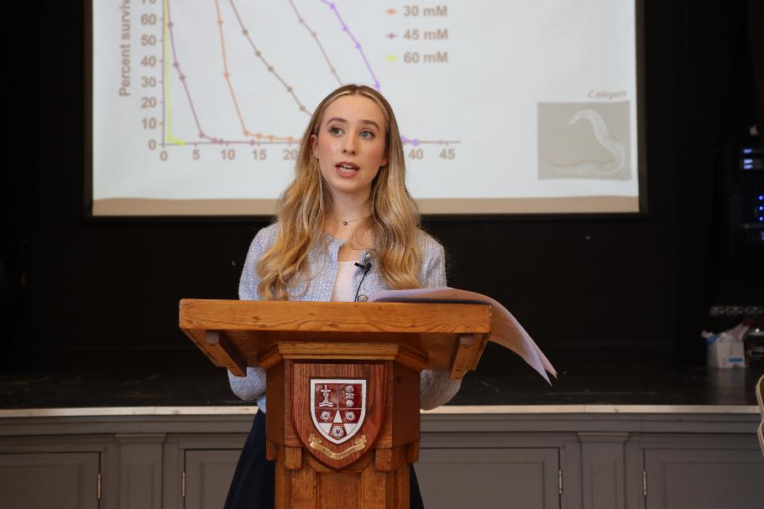

Slide 41
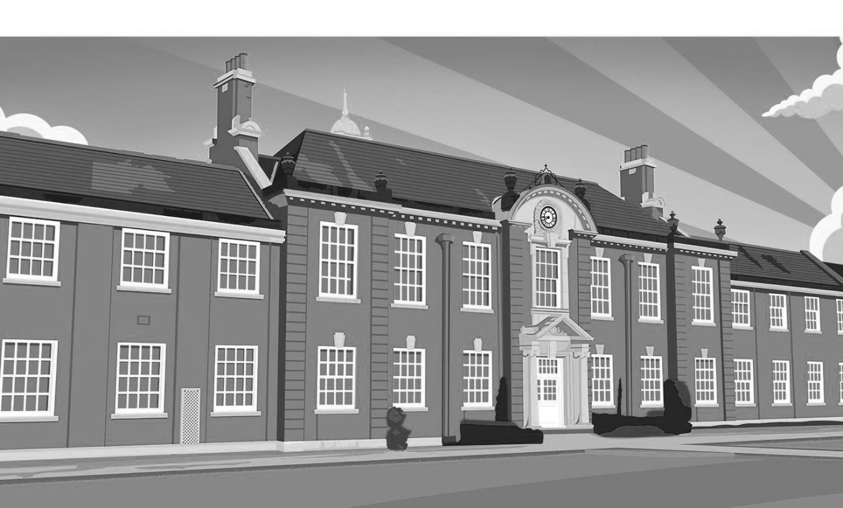

Slide 42
Why?
Flourish as
Humans
Make a Positive
Impact on Society
Change Your World

Slide 43
How?
Wellbeing and
Mental Health
Future Proofing
Leadership
Inquiry
Oracy
Digital Literacy

Slide 44
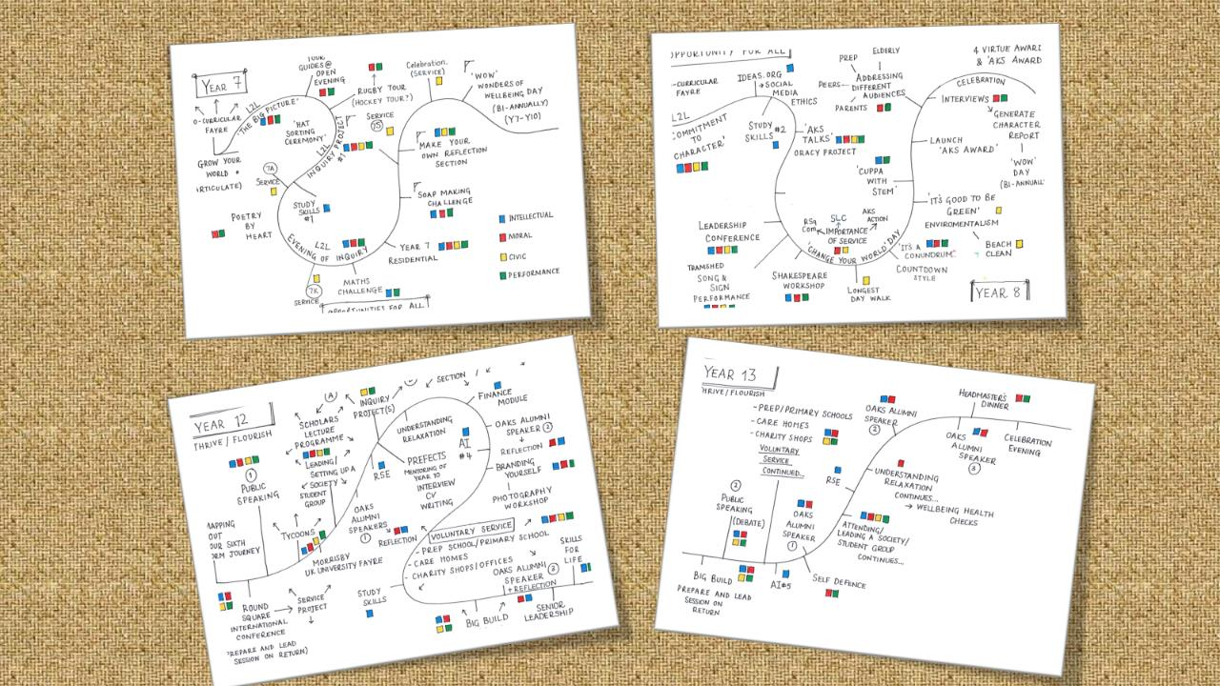

Slide 45
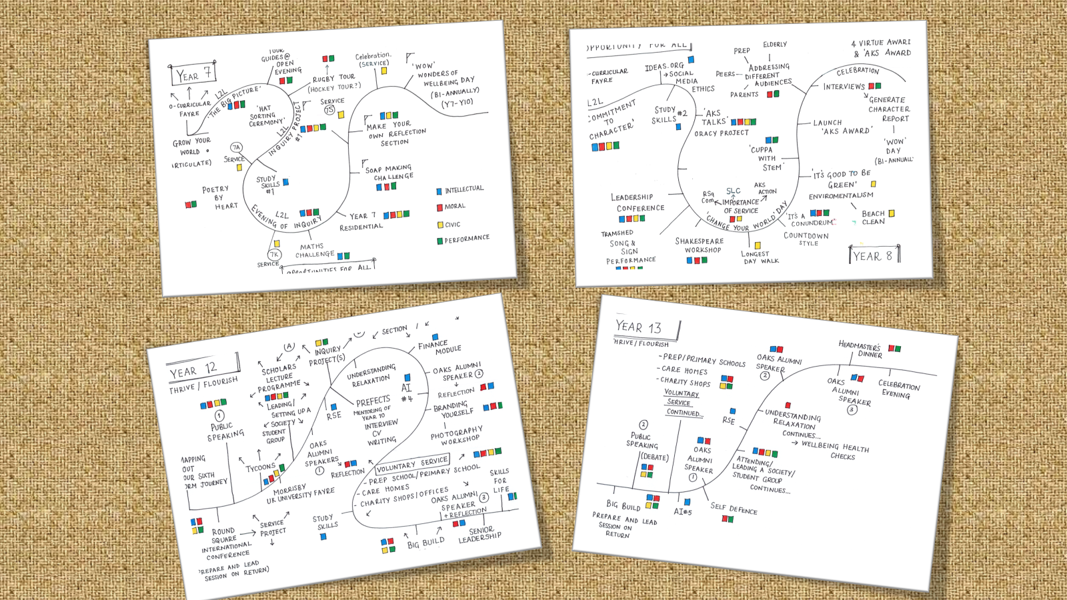

Slide 49
