Slide 1
Inquiry Reflections and Ongoing Conversation

Slide 2
Why?

Slide 3
Impact of Inquiry on Learners

Slide 4
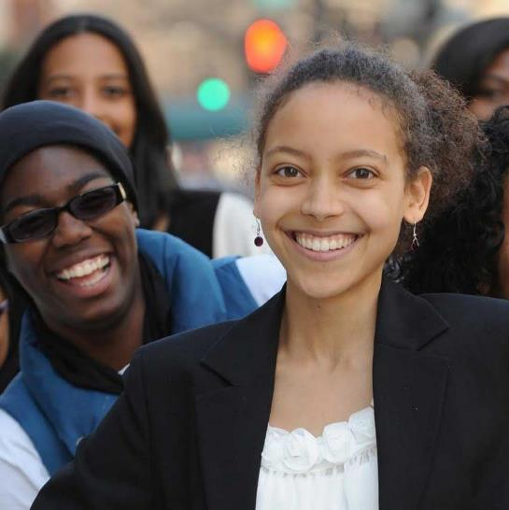
“I’m an expert!” “I know how to learn on my own!” “I love being able to listen to my friends’ ideas and express my own ideas!”

Slide 5
Characteristics of Student Empowerment Through Inquiry
Challenge
Choice
Exportable Expertise
Confidence / Competence
Voice / Socializing
Cultural Responsiveness

Slide 6
How?

Slide 7
Deeper Reflection New Questions
How does inquiry lift up the whole child?
What do our learners look like as they develop whole-child attributes over time?
How can librarians transform their teaching to engage and empower their learners through inquiry?
How can we foster the idea of inquiry as a continuing conversation?
What questions will lead us into the future of inquiry-based teaching and learning?

Slide 8
How does inquiry lift up the whole child?

Slide 9
Independent Learning
Motivation to learn on own
Honoring own curiosity, using inquiry to find answers
Self-confidence in own ability to learn
Taking risks in learning, failing, learning from failure, and changing approach, conclusions, or opinions based on new or more accurate information
Ability to take a stance
Developing an opinion, drawing a conclusion, constructing a line of argument or claim based on evidence

Slide 10
Social and Emotional Skills & Attitudes
Self-awareness
Developing awareness of themselves, their multi-faceted identities, and their personal interests and prior knowledge
Social awareness
Demonstrating respect and empathy for diverse people and perspectives
Relationship skills
Building trusting relationships with diverse peers and adults through collaboration and communication

Slide 11
Personalization, Choice, Voice, and Agency
Personalization
Connected to student’s own identity, interests, and authentic questions
Choice
Student choices throughout academic investigations and personal learning
Voice
Forming and sharing own opinion and ideas and questioning ideas that are different from or conflict with own
Agency
Self-confidence to make an impact
Notes:
Identifies an authentic problem or issue, researches and shares research information to raise awareness of the issue or the changes needed, identifies effective ways to address the issue, and collaborates to advocate or take action to implement those ideas
Delivers presentations to authentic audiences and peers with self-confidence, clarity, attention to the intended impact on the audience, and an “expert” or “professional” stance

Slide 12
What do our learners look like as they develop whole-child attributes over time?
Grade 2
Grade 5
Grade 8
Grade 12

Slide 17
How can librarians transform their teaching to engage and empower their learners through inquiry?
Fostering
Fostering commitment of whole school to inquiry stance
Building
Building caring relationships with teachers and students
Planning
Planning collaboratively with classroom teachers to integrate inquiry throughout curriculum
Teaching
Teaching inquiry-based, whole-child skills and attitudes

Slide 18
Independent Learning Competencies Developed Through Inquiry Over the Years of Schooling
Grade 2
Grade 5
I ask questions of value to myself and my community. I gather, evaluate, and interpret information to answer my questions.
Grade 8
I own my own learning because I have the skills to pursue meaningful inquiry, evaluate diverse perspectives, challenge misinformation, develop my own conclusions, and learn independently.
I set goals for my learning. I use resources to find facts and understand the difference between fact and opinion.
Grade 12
I have developed an inquiry stance. I choose to pursue new ideas and questions by following an inquiry process and using my critical-thinking and creative skills to construct my own understandings.

Slide 19
Social and Emotional Attributes Developed Through Inquiry Over the Years of Schooling
Grade 2
I take actions and help build my community by paying attention to my own feelings and the feelings of others.
Grade 5
I care about other people’s ideas and opinions and interact with them positively and responsibly both in person and online.
Grade 8
I build trusting relationships with diverse peers and adults through collaboration and communication.
Grade 12
I am empathetic. I maintain healthy and mature relationships with my peers and my community.

Slide 20
Vertical Continuum of Skill Development for Cultural Responsiveness 5th Grade Competency: “I engage in difficult conversations, respect cultural differences, and seek diverse opinions”
Grade 3
Third graders might be taught to contribute to group discussions; to form their own opinion and use evidence to back it up; and to engage in conversations with peers to share their opinion and listen to the opinions of others
Grade 4
Fourth graders can begin to compare two points of view, noting the differences and similarities; to assess the evidence for each point of view and form their own opinion; and to actively solicit and listen with an open mind to the ideas of others
Grade 5
Fifth graders can be taught the qualities of empathy; to identify, respect, and empathize with the perspectives of others; and to exchange ideas about social and civic issues with a willingness to change their own opinion

Slide 21
Horizontal Alignment of Portrait Attributes Grade 2
Independent Learning Competencies
I set goals for my learning. I use resources to find facts and understand the difference between fact and opinion.
Strong Self-Identity
I understand my own strengths and the importance of my own voice. I lead others by example.
Voice and Agency
I know how and when to share my ideas because I know my voice can change things.

Slide 22
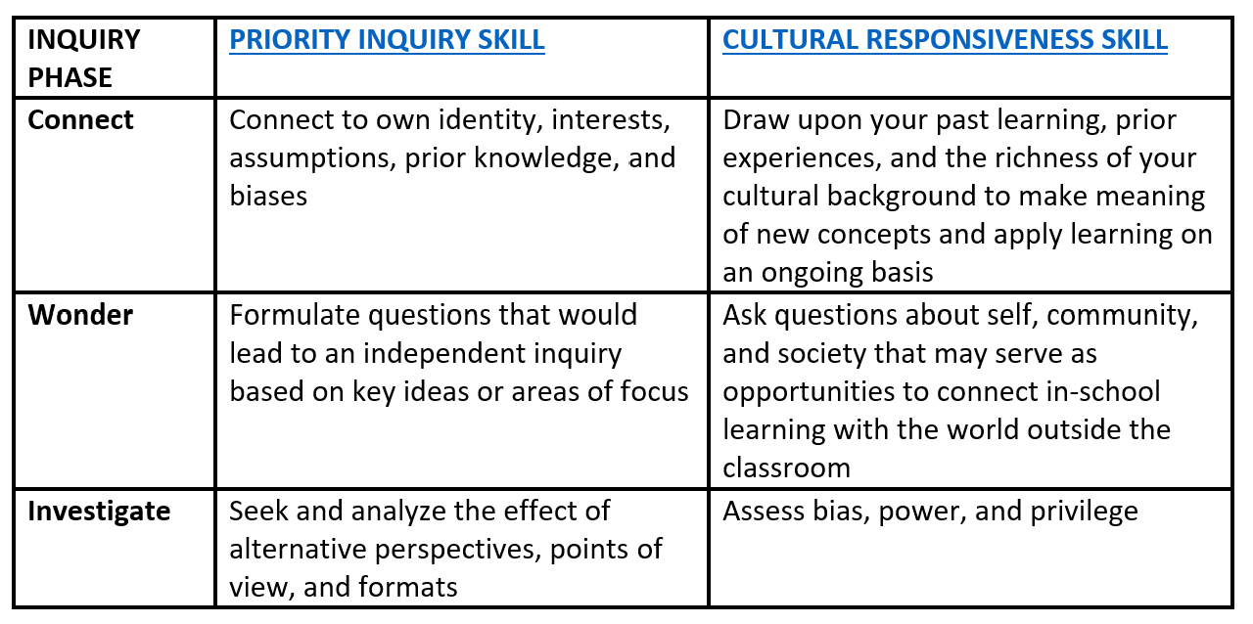
Integration of Multiple Attributes Within an Inquiry Experience – Grade 8
Alignment of Independent Learning and Cultural Responsiveness

Slide 23
How can we foster the idea of inquiry as a continuing conversation?
Teaching Inquiry as Conversation: Bringing Wonder to Life
by Barbara Stripling and Darryl Toerien
Chapter 1: How does inquiry enable a liberal education?
Chapter 2: Why is inquiry more like a conversation than a research process?
Chapter 3: What were the thought processes that drove the formation of the Stripling model and the FOSIL model?
Chapter 4: What skills and responsibilities are embodied in inquiry, especially in this increasingly digital age?
Chapter 5: Why should we think of inquiry as a whole-child approach to learning?

Slide 24
Teaching Inquiry as Conversation: Bringing Wonder to Life
by Barbara Stripling and Darryl Toerien
Chapter 6: How can we make the teaching of inquiry more digestible and continual?
Chapter 7: Why is there no magic formula for teaching inquiry?
Chapter 8: What is the role of collaboration in building a schoolwide culture of inquiry?
Chapter 9: What guidelines and strategies lead to effective teaching of inquiry as conversation?
Chapter 10: How do we create broad buy-in to teaching and learning through inquiry?

Slide 25
What’s Next?

Slide 26
What questions will lead us into the future of inquiry-based teaching and learning?
What are the implications of Artificial Intelligence in terms of ethics, independent thought, inquiry skills?
How do we make sure that our learners have “freedom of thought” in this technology-driven information environment?
How do we effect international change in school librarianship?

Slide 27
Your Questions?

Slide 28
Thank you
Barbara Stripling
+1 484 445-2181
bstripli@syr.edu
linkedin.com/in/barbarastripling

