Slide 1

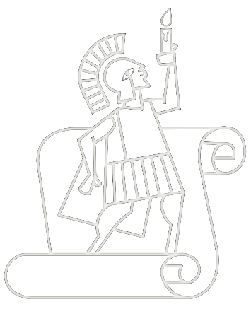
Reflecting on Inquiry: Practical Lessons
Blanchelande College Staff INSET
30 May 2023
Darryl & Jenny Toerien
toeriend@blanchelande.sch.gg & toerienj@blanchelande.sch.gg
Blanchelande College Libraries
Enabling Heroic Inquiry

Slide 2
ISI (UK) 2023 Framework
Section 2: Pupils’ Education, Training and Recreation
Emphasis on pupils’ experience of the curriculum and programme of activities
Teaching enables all pupils to acquire new knowledge, increase their understanding, and develop their skills in the subjects taught
  Are interested in their work
  Apply intellectual, physical and creative effort
  Act responsibly
  Are self-motivated, thinking and learning for themselves
Triangulation is the process of looking for connected evidence from a wide range of sources in order to determine typicality

Slide 3
Inquiry as an approach to learning & teaching
By definition, inquiry is “a dynamic process of being open to wonder and puzzlement and coming to know and understand the world and ourselves in it as the basis for responsible participation in community” (Stripling & Toerien, 2021). Rooted in work of…
  Developing Inquiring Communities in Education Project (led by the Ontario Institute for Studies in Education at the University of Toronto, 1991-2001)
    Conclusion: (p. 7). “the force that drives the enacted curriculum must be a pervasive spirit of inquiry, and the dominant purpose of all activities must be an increase in understanding … teacher and students together must become a community of inquiry with respect to all aspects of the life of the classroom and all areas of the curriculum”
  Galileo Educational Network (professional learning arm of the School of Education at the University of Calgary, 1999-2022)
  ESIFC (2009, 2019-present) & FOSIL Group (2011, 2019-present – 35 plus countries)

Slide 4
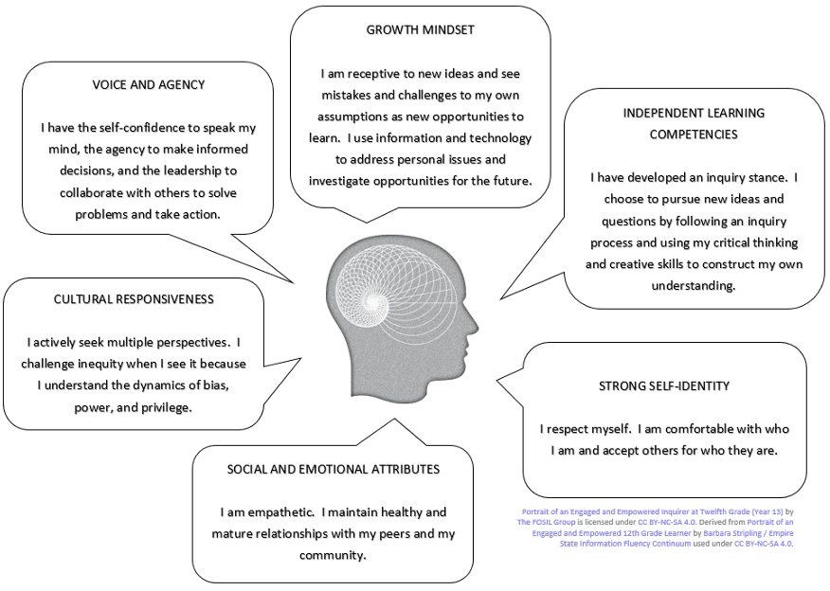
What does this look like?
Portrait of an Engaged and Empowered Inquirer (Year 13)
FOSIL - learning by finding out for yourself – is
  an instructional model of this dynamic process
  a systematic/ coherent and progressive continuum of skills…
    metacognitive, cognitive, emotional, social and cultural
  …that enable this process
Michael Young
  The curriculum is not just a body of knowledge, but a group of communities our students must be encouraged to join
  Acquiring knowledge in school has to be the voluntary act of a learner
  If we haven’t encouraged students to engage in the process of acquiring knowledge…then all you get is memorisation and reproduction in tests

Slide 5
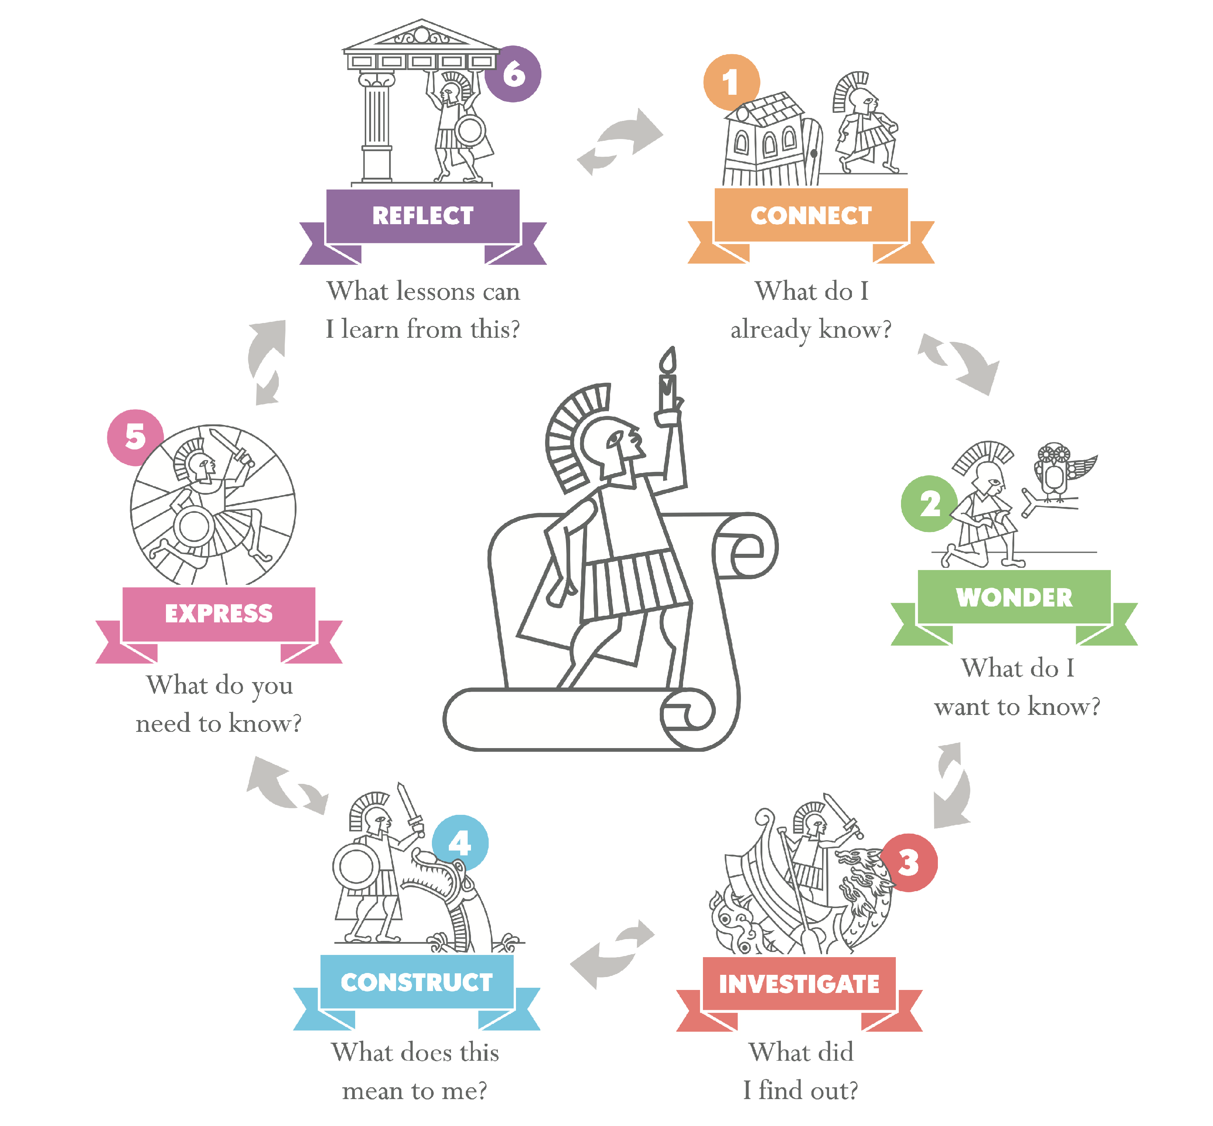
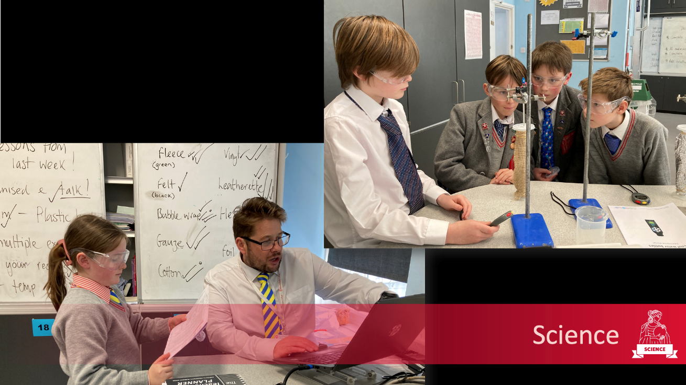

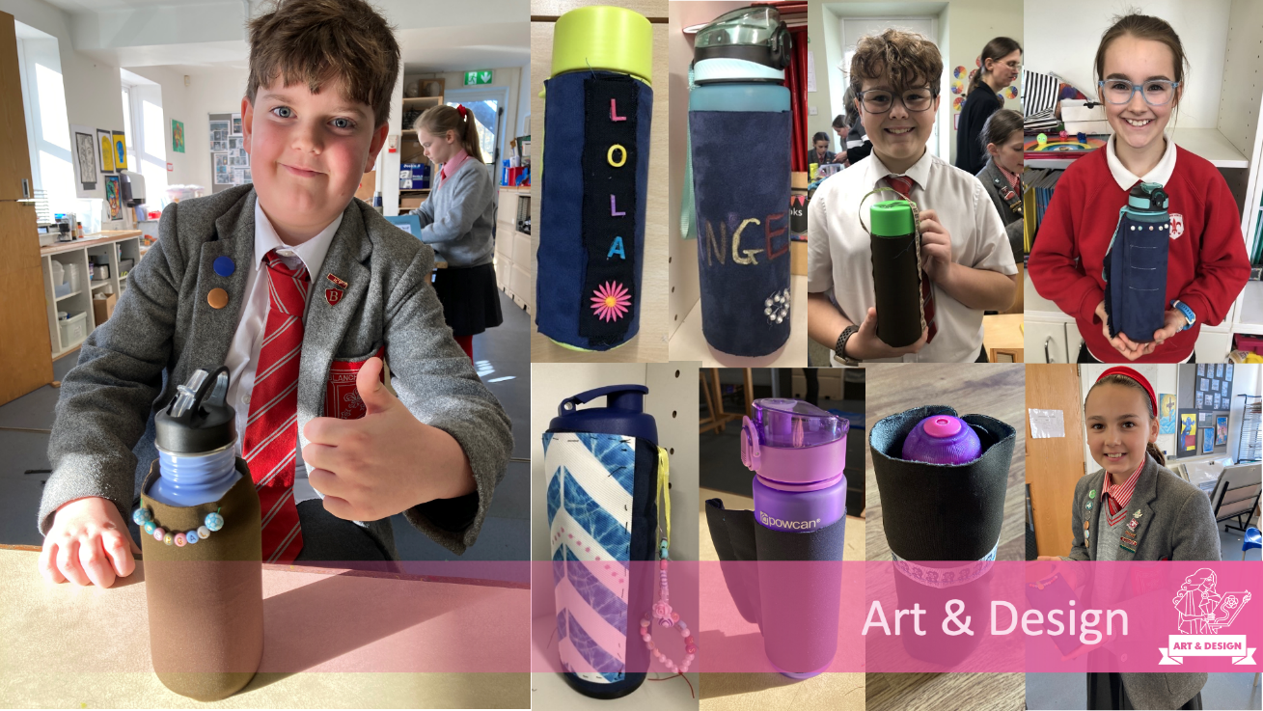
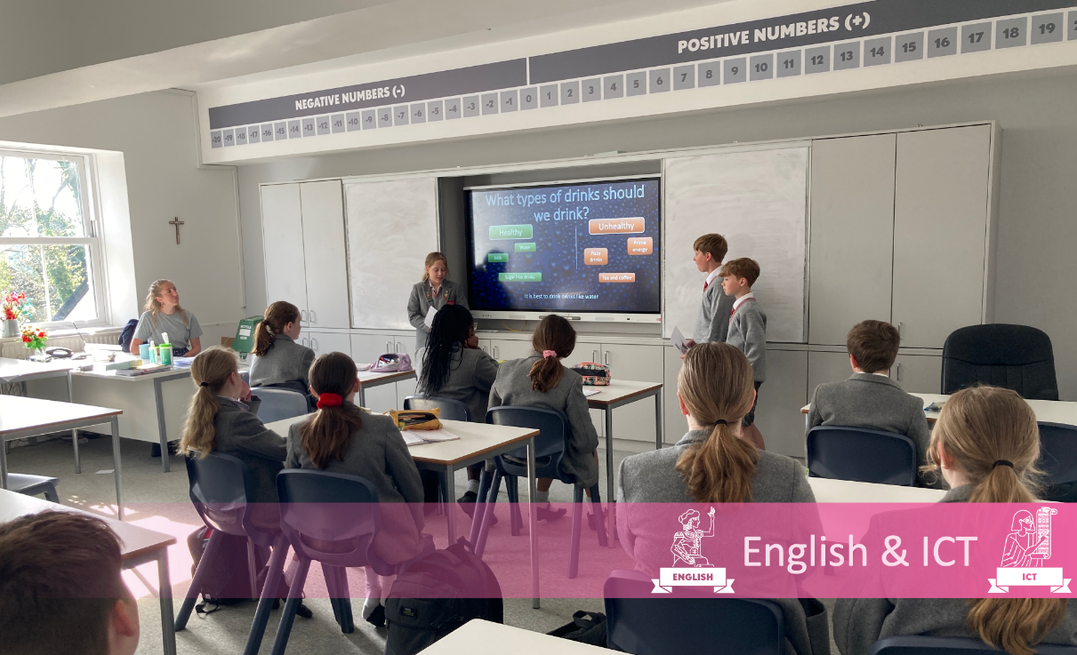
We’re better together
Interdisciplinary collaboration can be challenging but also hugely beneficial. [FEEDBACK FROM Y6 TEACHERS]
Students, parents and staff appreciate connections between subjects.
  Y6 parent: ”X finds maths hard and always struggled to see the point, but linking it to Science experiments and DT suddenly made it more relevant for her”.
Notes:
Hannah, Jo, Justine, Mel
Hugh, Mark, Katie

Slide 6
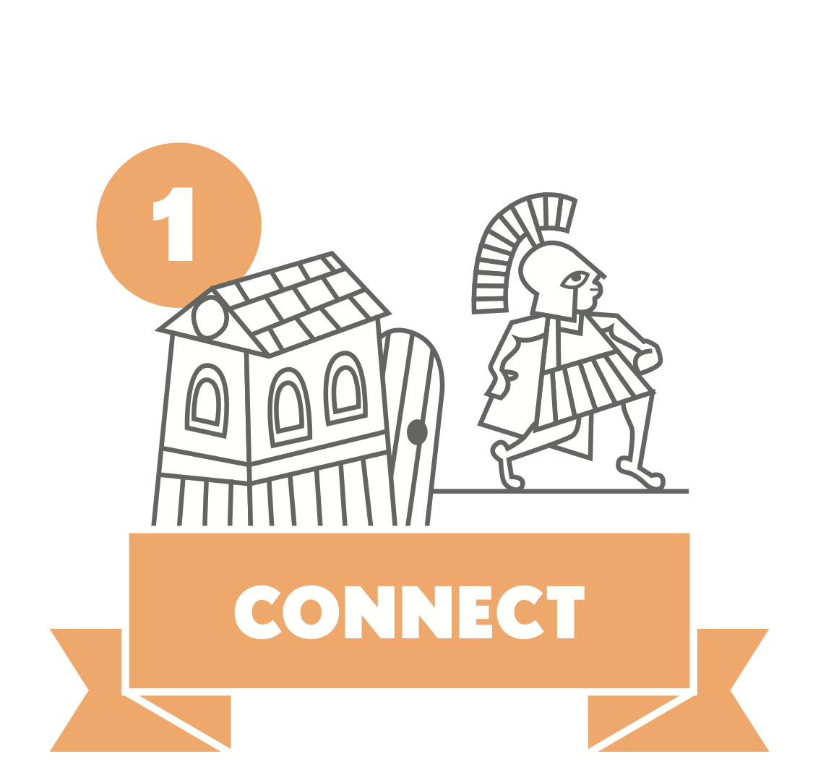
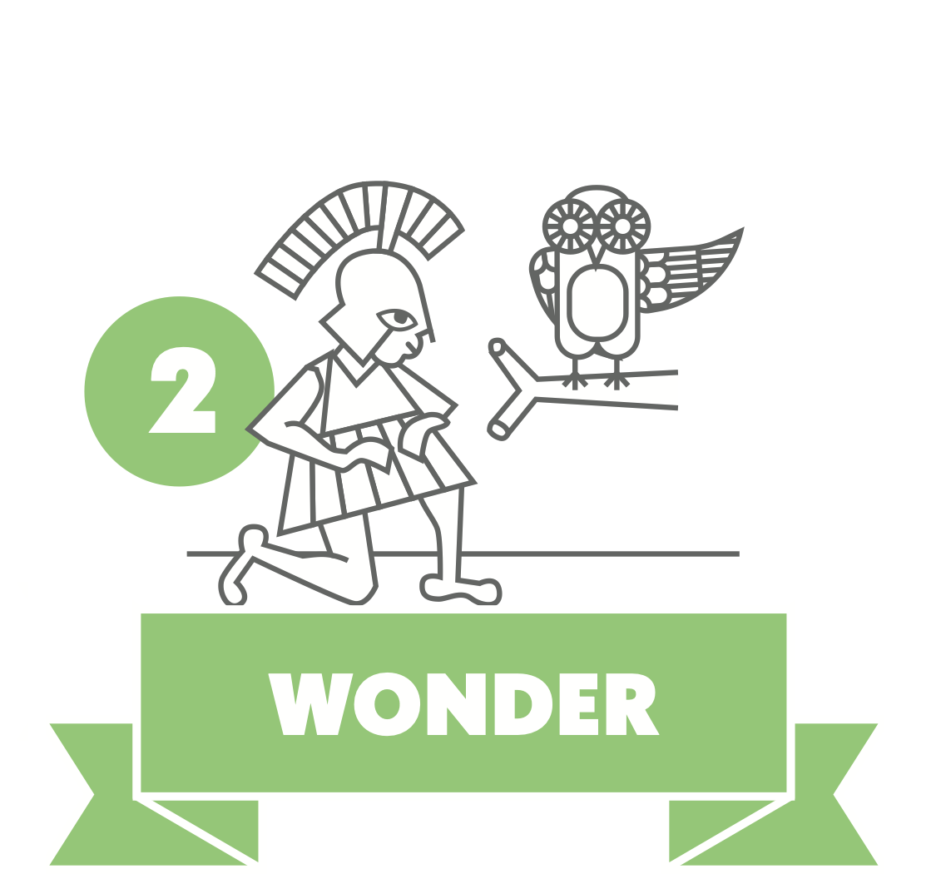




Reading isn't just reading
Reading for intellectual and emotional engagement
Exploratory notetaking
Entering into dialogue with the text – what questions does this raise for me?
Reading for meaning and knowledge not just information
Investigative notetaking
Reading for understanding beyond the text
Constructive notetaking
Reading for communicating personal knowledge and understanding
Reading for reflection on learning

Slide 7


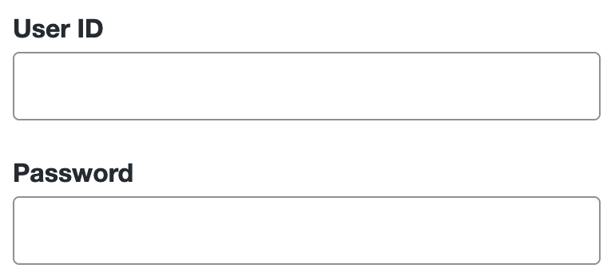
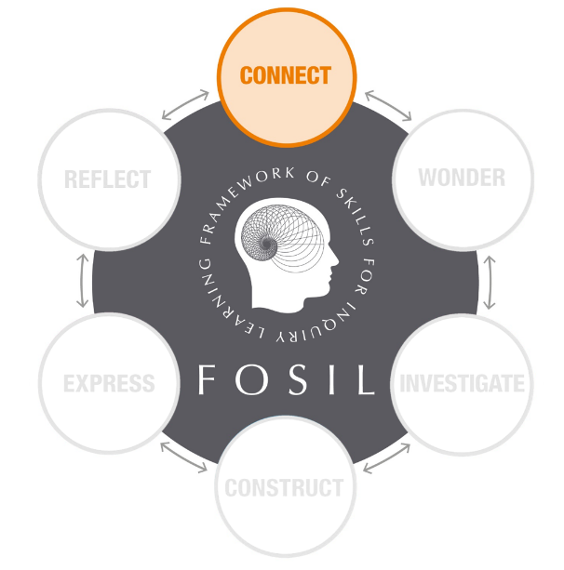
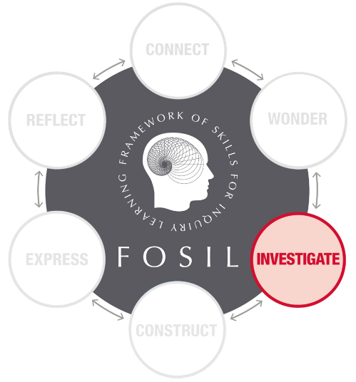
Books vs websites vs databases
EPQ taught course slide
Connect
Understanding and refining topic.
Gathering keywords
General reference books.
Skim and scan.
Use CONTENTS page.
General websites & encyclopaedias.
e.g., Stanford Encyclopaedia of Philosophy.
Encylopaedias & lower-level articles.
e.g., Britannica, The Day, Hodder Education, Global Issues, emagazine, Dialogue.
Investigate
Investigating and refining question
Gathering evidence
Mapping arguments
Books and book chapters relating directly to question.
Read carefully and make notes.
Use INDEX.
More technical websites and search engines.
E.g., use Google Scholar to search.
E.g., PubMed Central, JSTOR.
Databases that give access to journal articles and ebooks.
E.g., EBSCO databases, History Today.
Notes:
An independent academic research project on a topic of your choice that goes beyond your taught subjects
A 5,000 word research report (e.g. essay or scientific report)
Or a research based artefact (e.g. a piece of art or portfolio, a design product, a website, a presentation or a performance) and a 1,000 word report on the research process behind it
It should take you about 120 hours (just over 2 hours every week for a year, including holidays), which includes a 30-hour taught component (1 hour in every term-time week for a year)

Slide 8
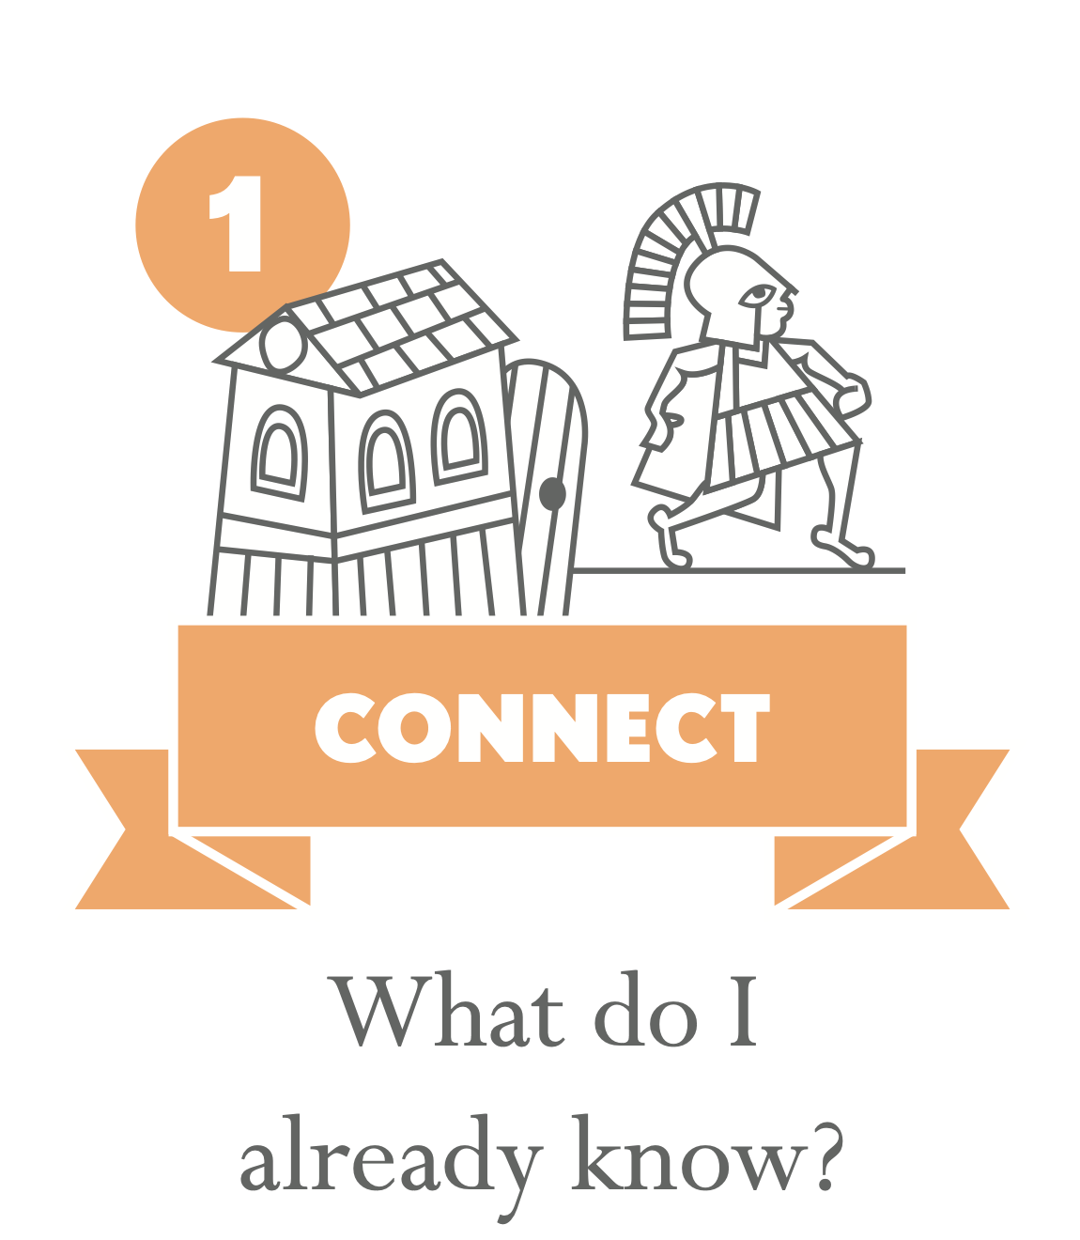
Why should I care?
Engaging intellect AND emotions
Notes:
Entry questions

Slide 9
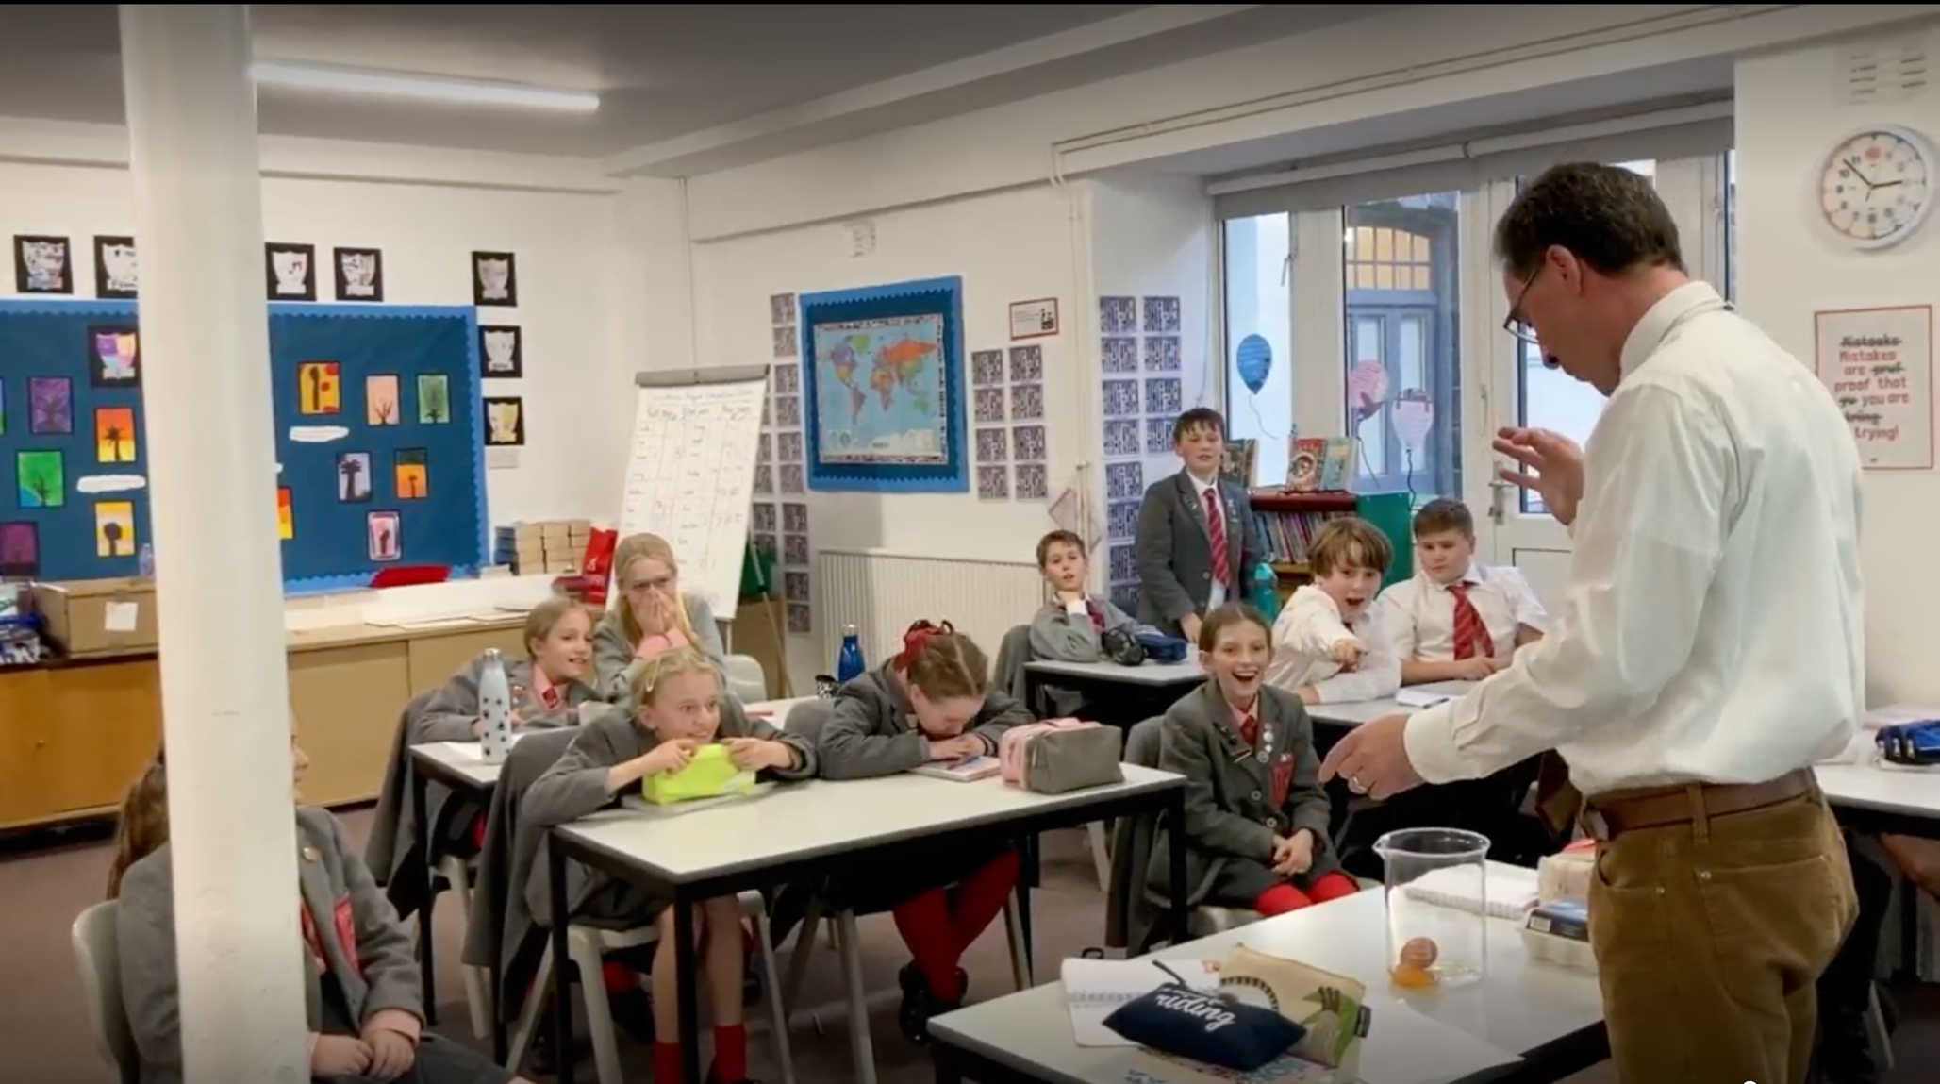

English

Slide 10
As we begin, so shall we go*
Use curated resources to connect with a topic
Without some background understanding, Investigate is very hard
Takes much longer than you might expect, especially if students have a high degree of choice
A bad topic choice here can waste a huge amount of time later
*The Medium is The Massage, Marshall McLuhan, p. 45
Notes:
Y6 SW
Y9 SW
Y12 EPQ

Slide 11
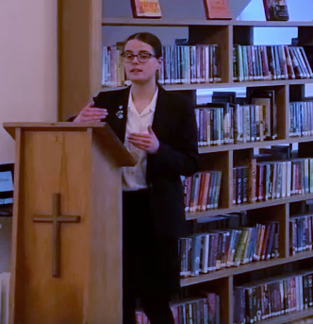
“Choose a topic you are thoroughly intrigued about. I started my project doing a different topic which I thought I was interested in but being interested in the topic isn't enough. You have to be passionate about it.”
- Charlotte

Slide 12
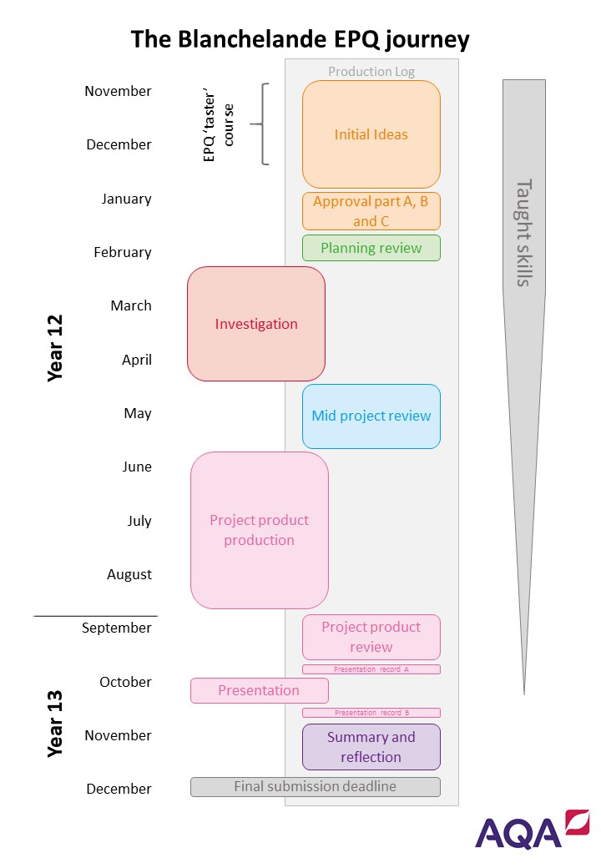
Notes:
Coursework: history, French, Art…

Slide 13

No such thing as a silly question?
Questions are easy, good questions are difficult
Questions emerge out of a growing understanding of a topic

Slide 14

What have you been doing!?
Takes longer than expected – have you tried?
Experimental planning is hard, needs firm guidance and takes as much time as other forms of investigation – hugely rewarding!
Know what sort of answers you expect them to find – can you find them? Where?
Notes:
Science tech experience

Slide 15
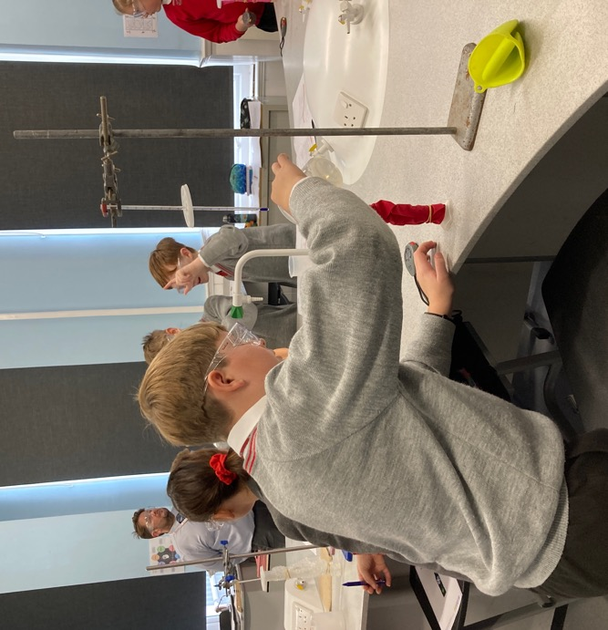
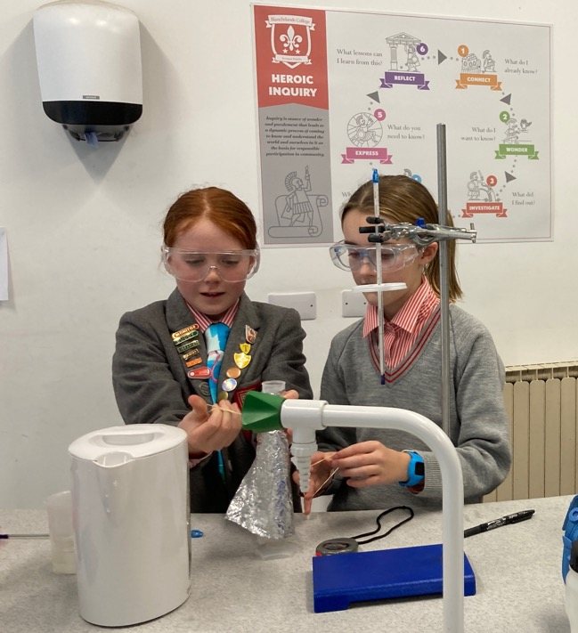
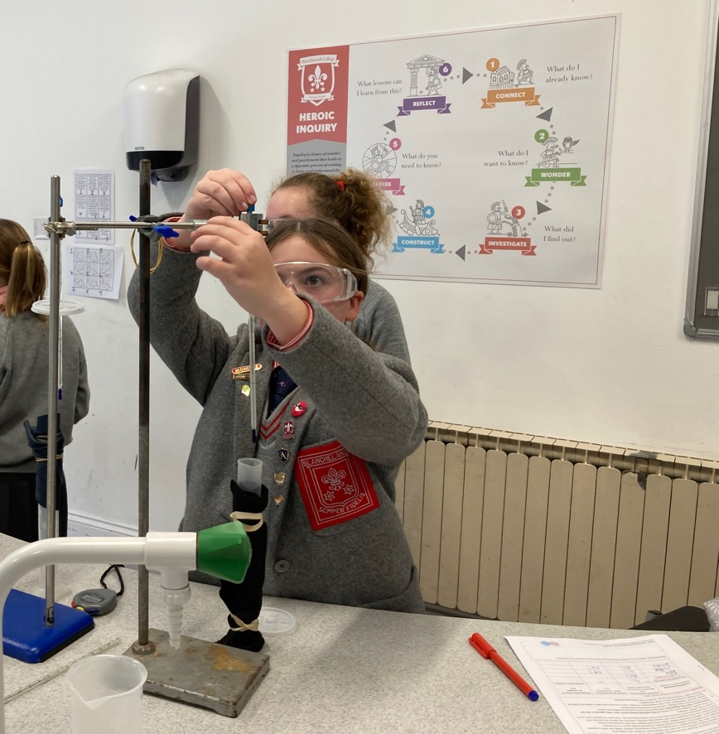
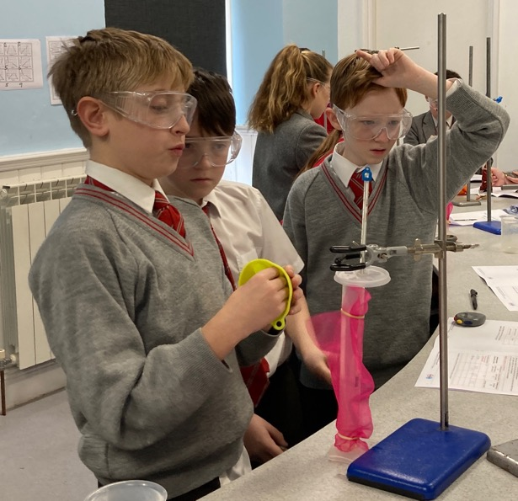

Science

Slide 16
The internet said so
Students need support in finding resources – curated sets for younger students, jumping off points for older ones.
Students are generally not very discriminating.
Students do not collect referencing data as a matter of course, particularly for images.
Are we modelling and valuing this?

Slide 17
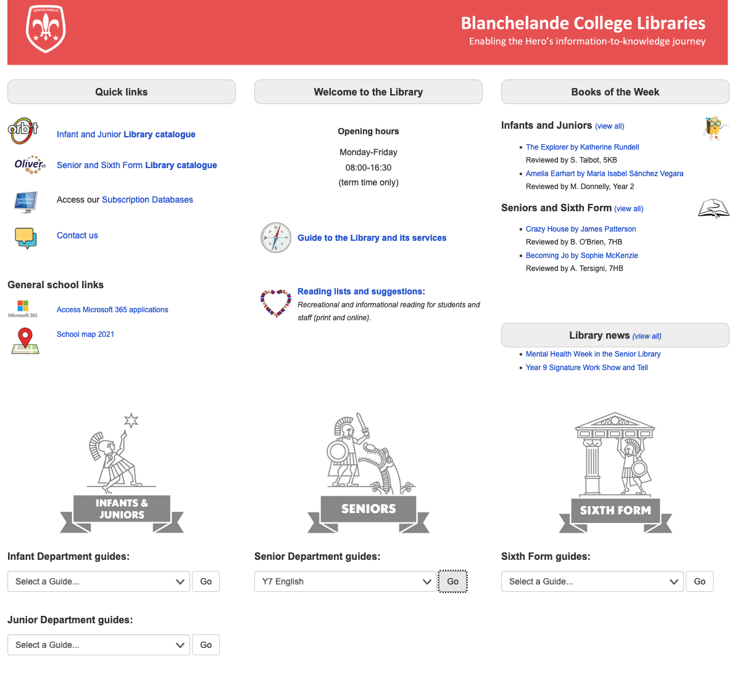
https://blanchelande.libguides.com/Library/Home
On Staff Links, all student desktops & Library page on main school website

Slide 18
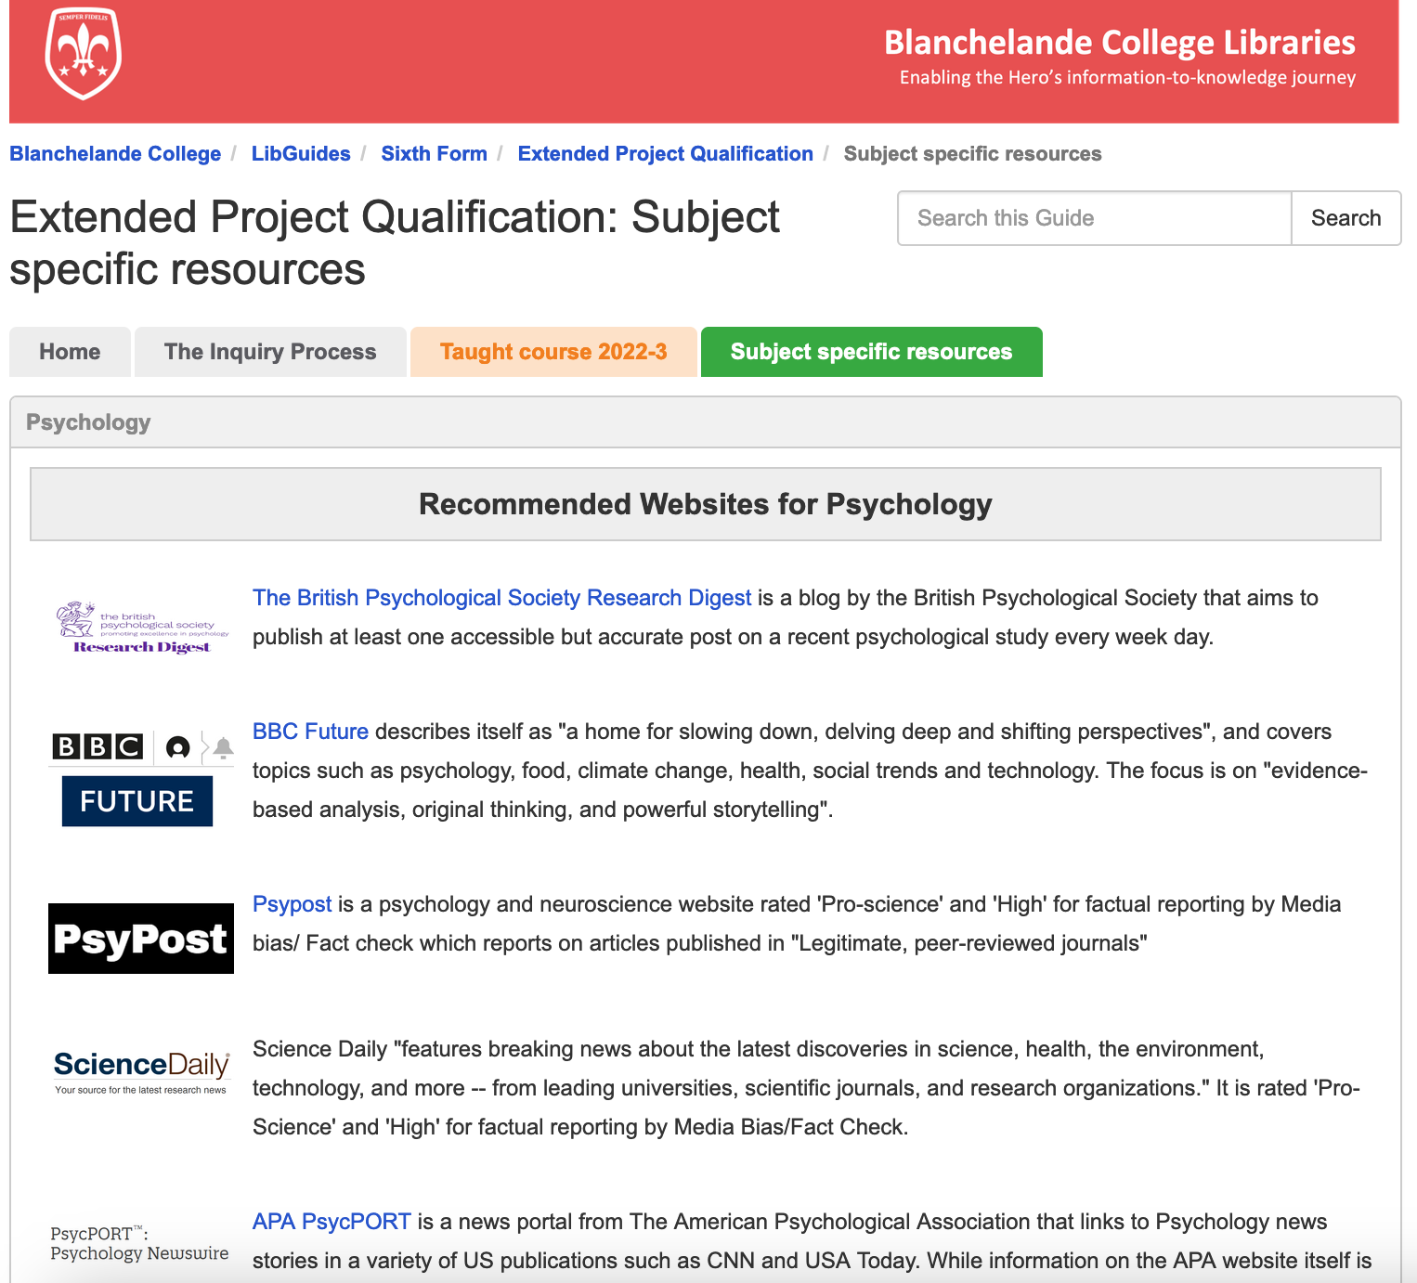

Slide 19
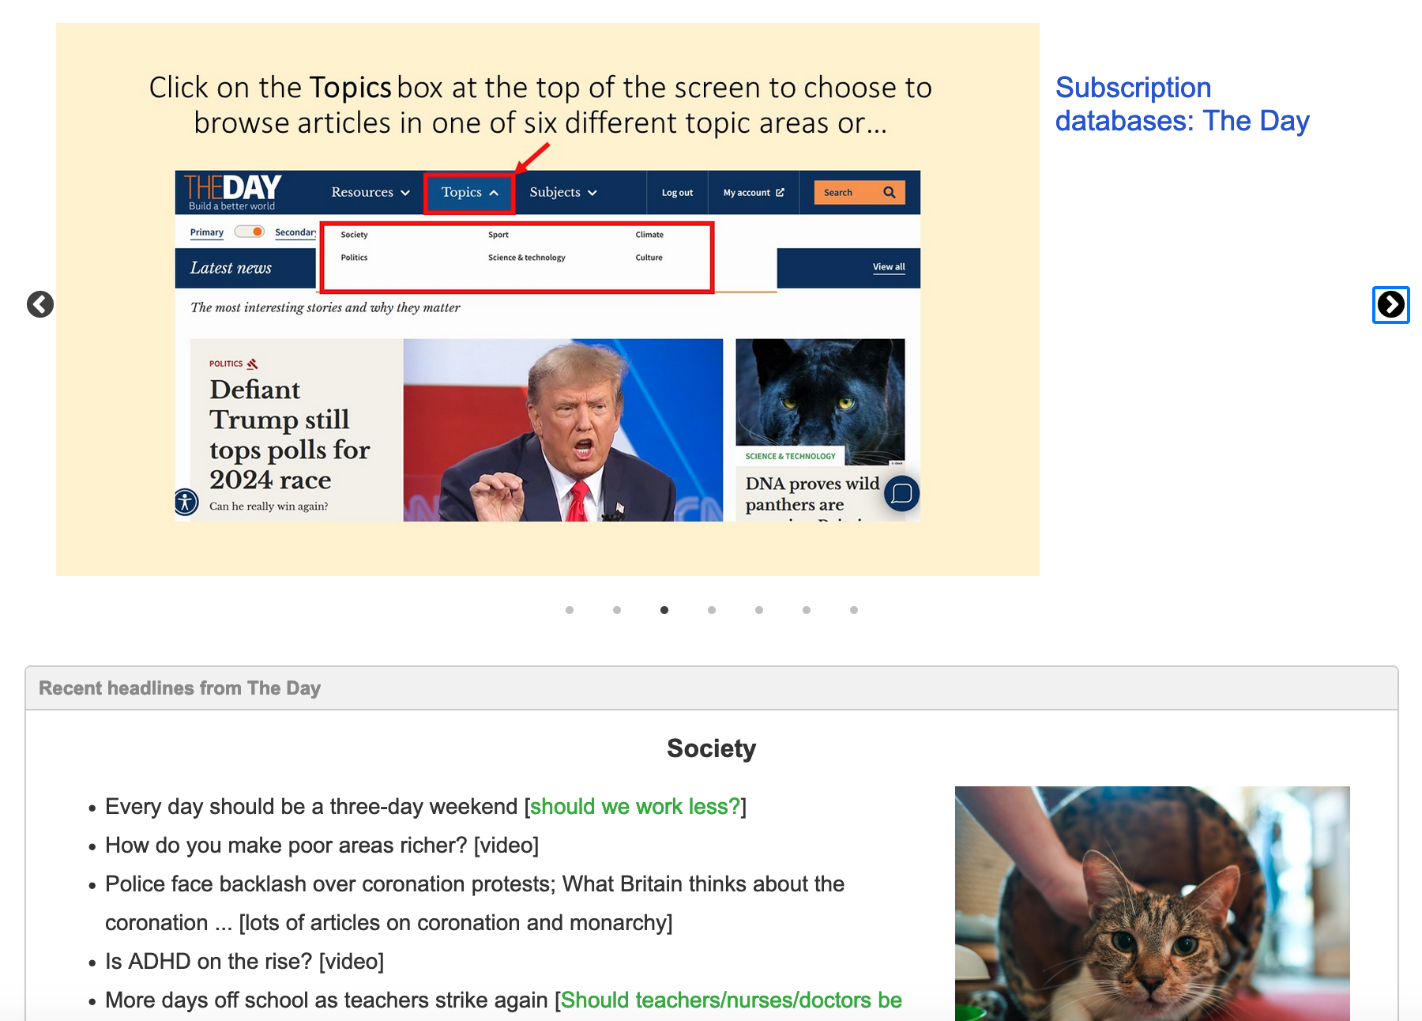

Slide 20
I don’t know what to write!
Students need age-appropriate support in notetaking (sometimes quite targeted). Might even need live modelling!

Slide 21
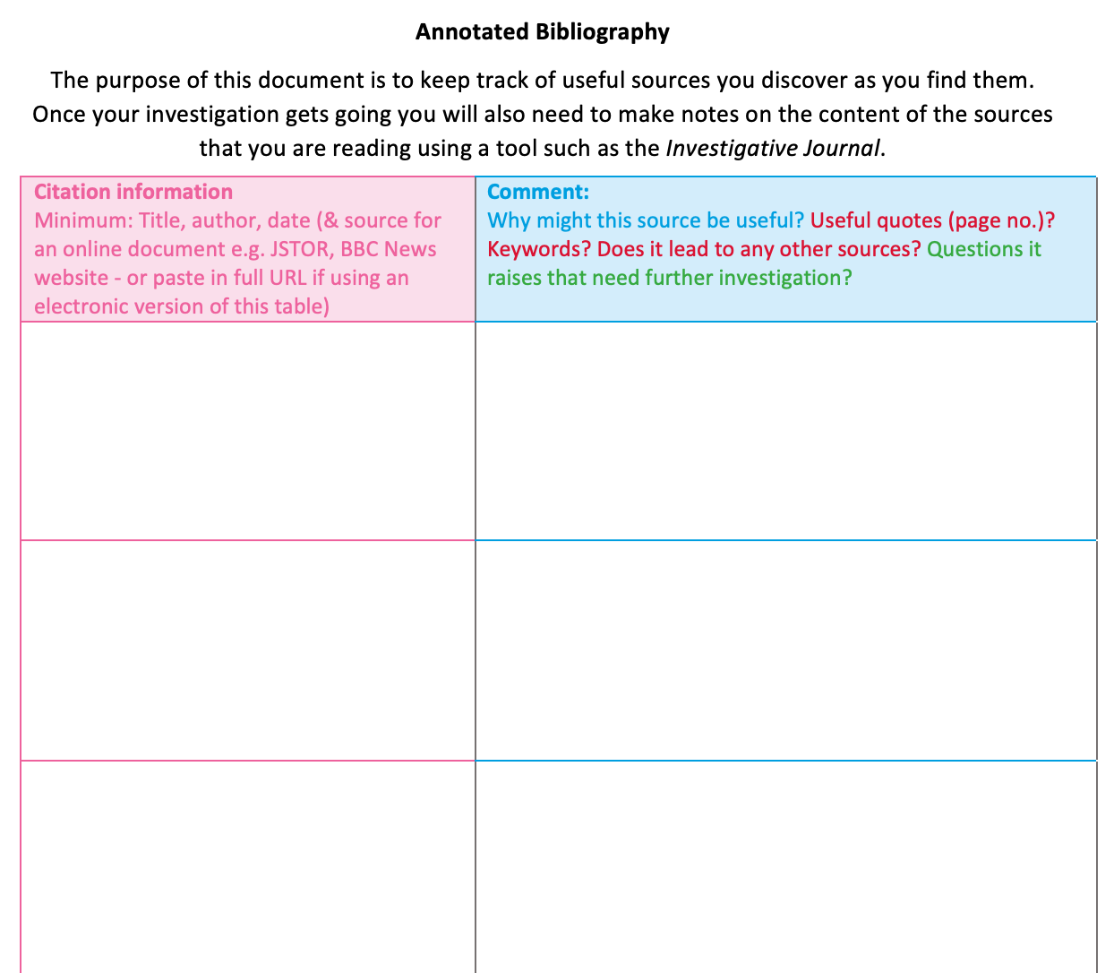
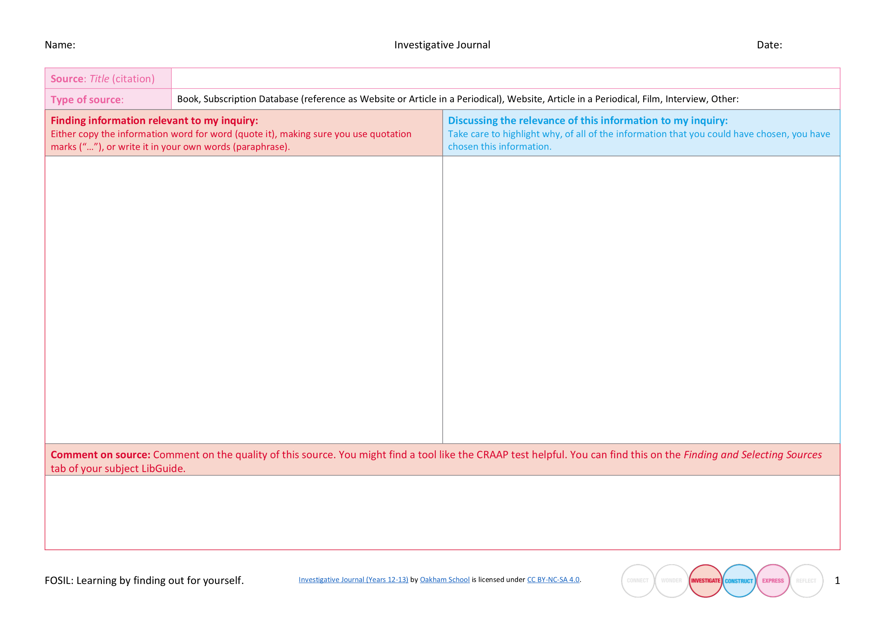

Slide 22

Your turn!
Briefly discuss either:
An instance where an inquiry went really well. How did you set it up to promote learning?, or
An instance where you have been disappointed in an inquiry. How could you set it up better next time?
Image by Clker-Free-Vector-Images from Pixabay

Slide 23
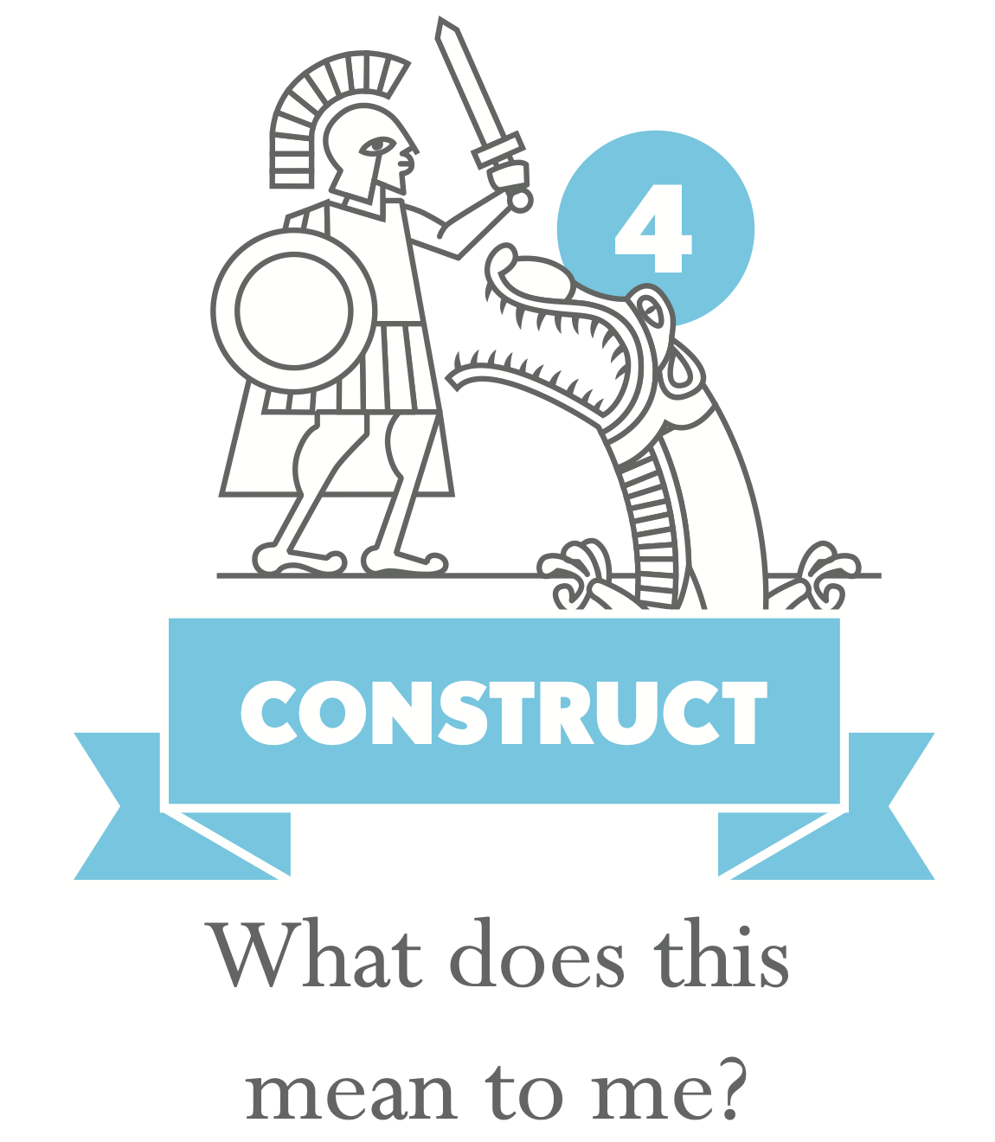
Yes, but what do YOU think?
Students need help applying what they have found out, particularly if they are switching format
Students need help constructing understanding
Notes:
Y6 example of students who spent 2 lessons collecting info then moved onto computers to make their products and ditched it all!

Slide 24

Oh no, not another presentation/poster!
Why this form of expression? A degree of choice in the form of expression increases engagement and is possible to manage and assess.

Slide 25
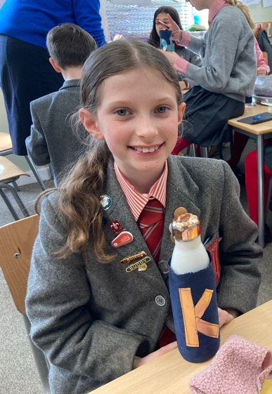
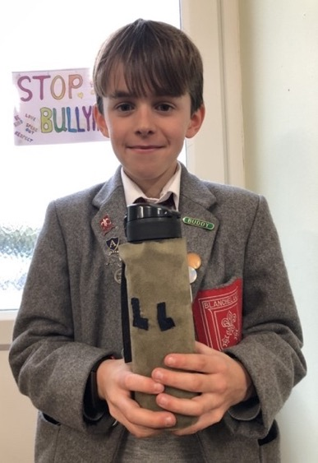
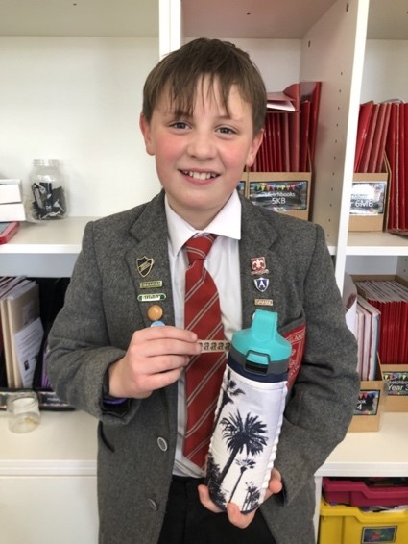
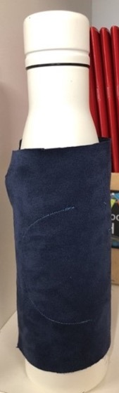
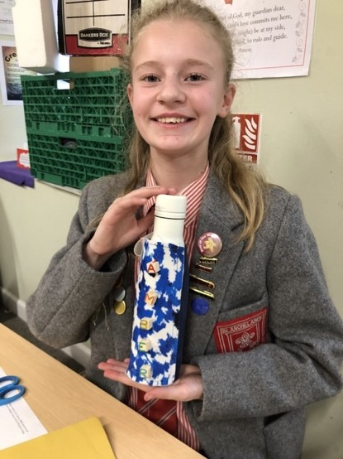
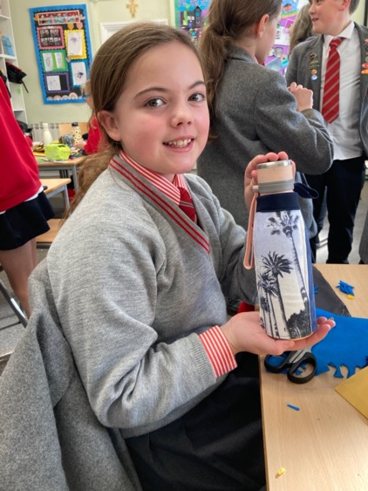
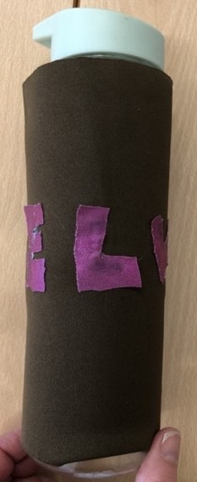
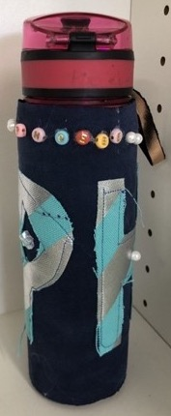
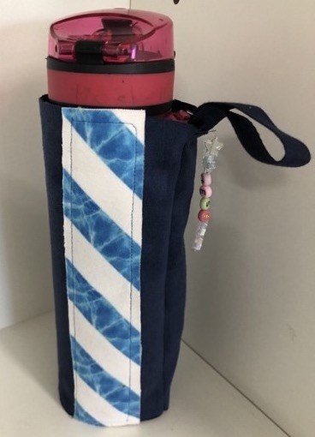
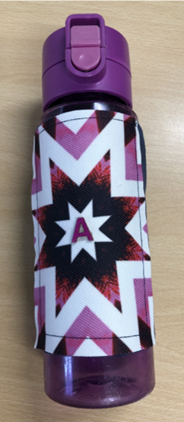
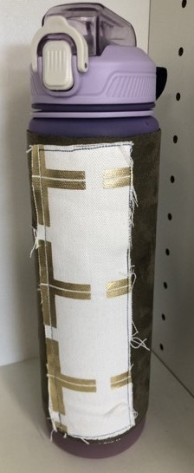
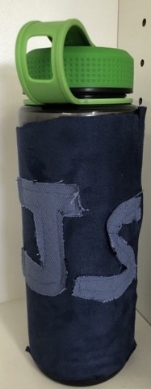
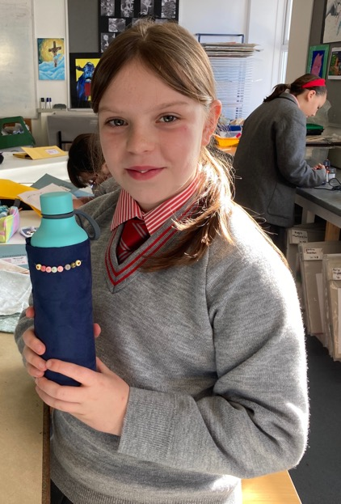

Art & Design

Slide 26
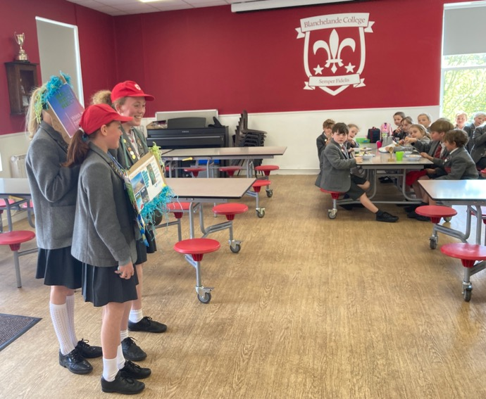
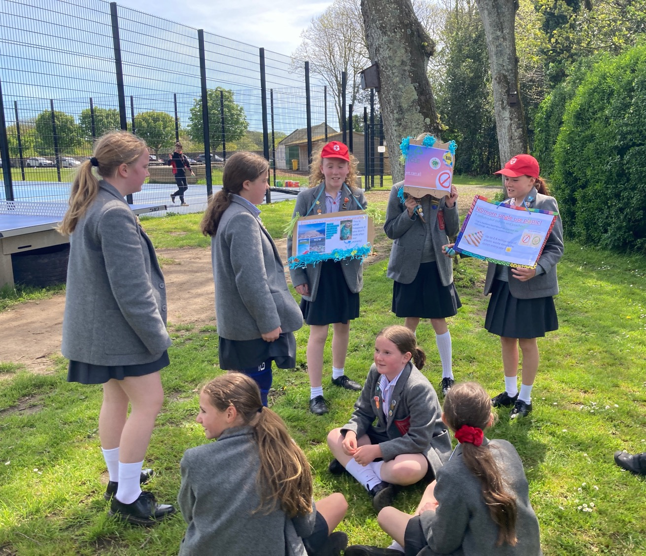
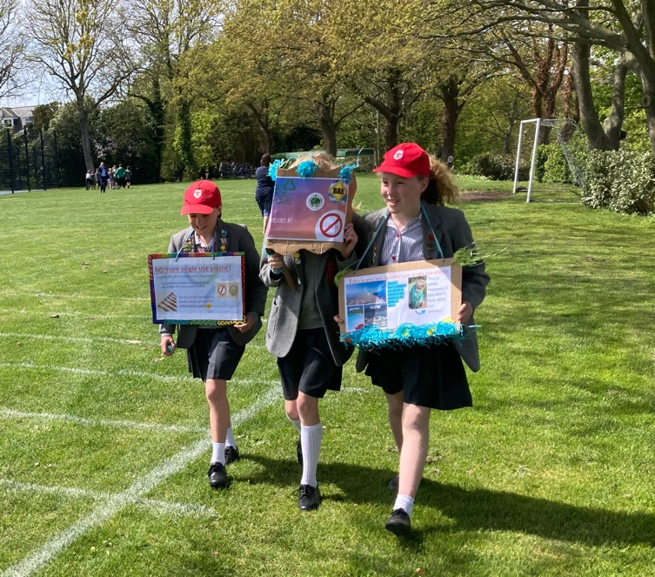


English & ICT

Slide 27
Oh no, not another presentation/poster!
Why this form of expression? A degree of choice in the form of expression increases engagement and is possible to manage and assess.
Less is more – students need guidance and support. Have you explained the assessment criteria?

Slide 28
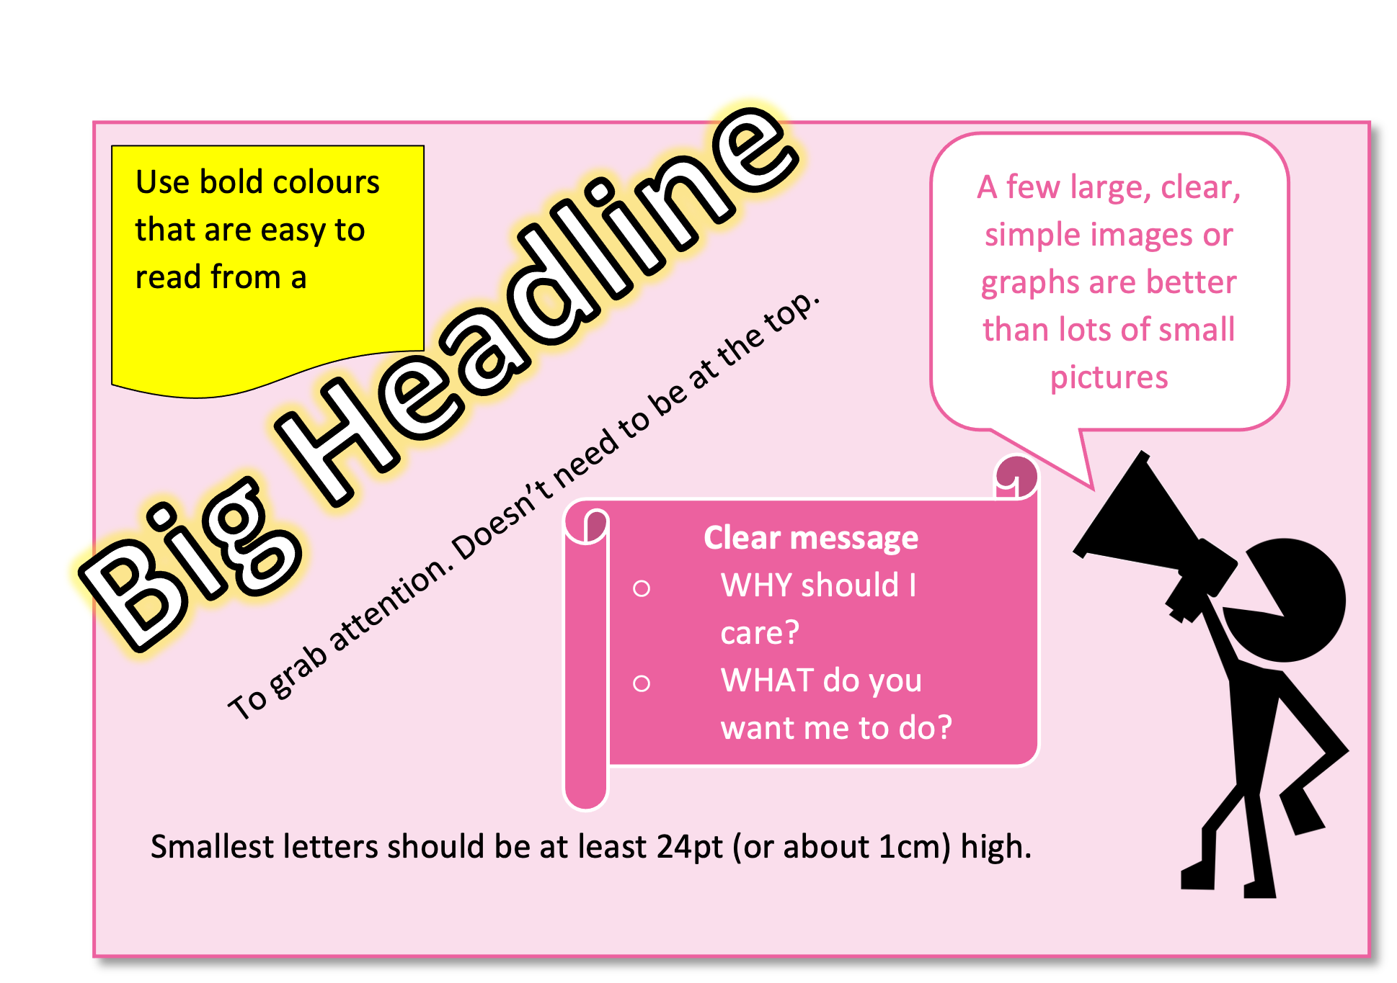

Slide 29
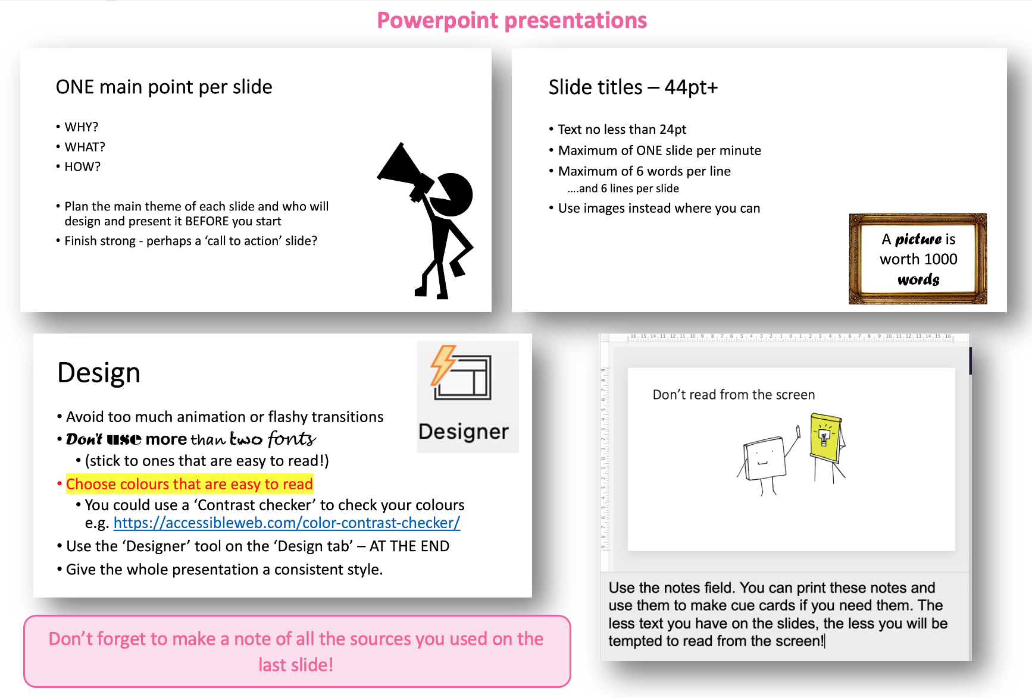

Slide 30
Oh no, not another presentation/poster!
Why this form of expression? A degree of choice in the form of expression increases engagement and is possible to manage and assess.
Less is more – students need guidance and support. Have you explained the assessment criteria?
Computers sometimes promote creativity, but sometimes stifle it!
Have you got time to assess presentations?

Slide 31

Who do you think you are talking to?
Authentic audiences increase accountability.
Students need to consider their audience carefully.
Students can be very mature about their audience.

Slide 32
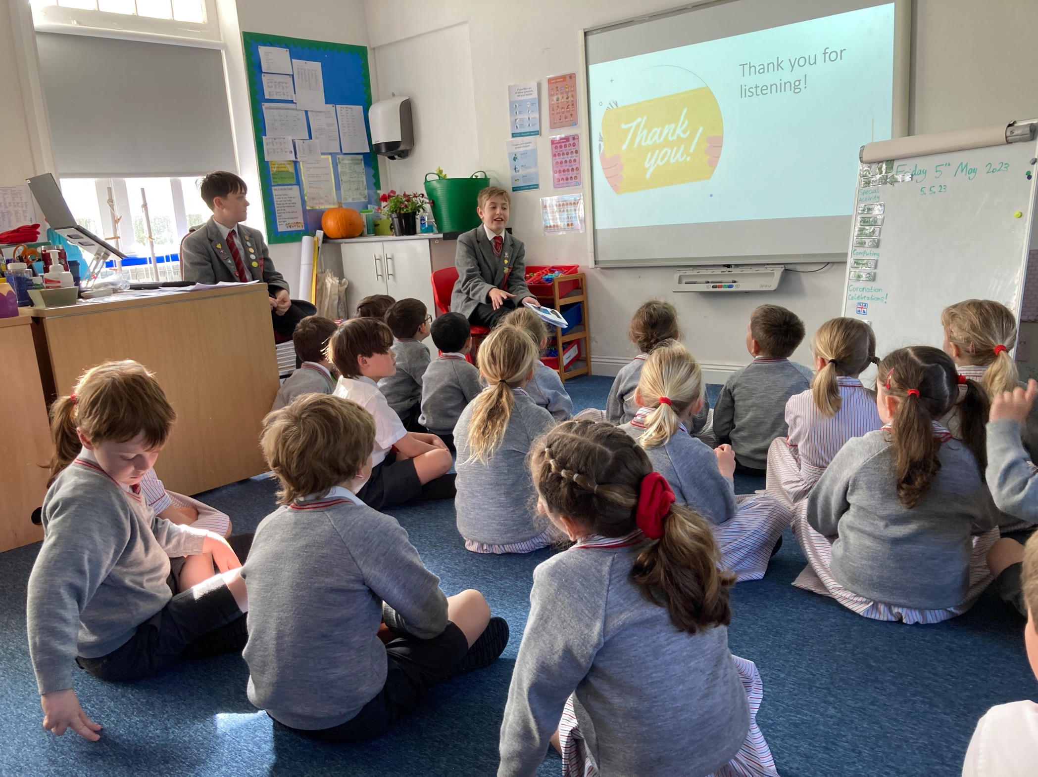
English & ICT

Slide 33
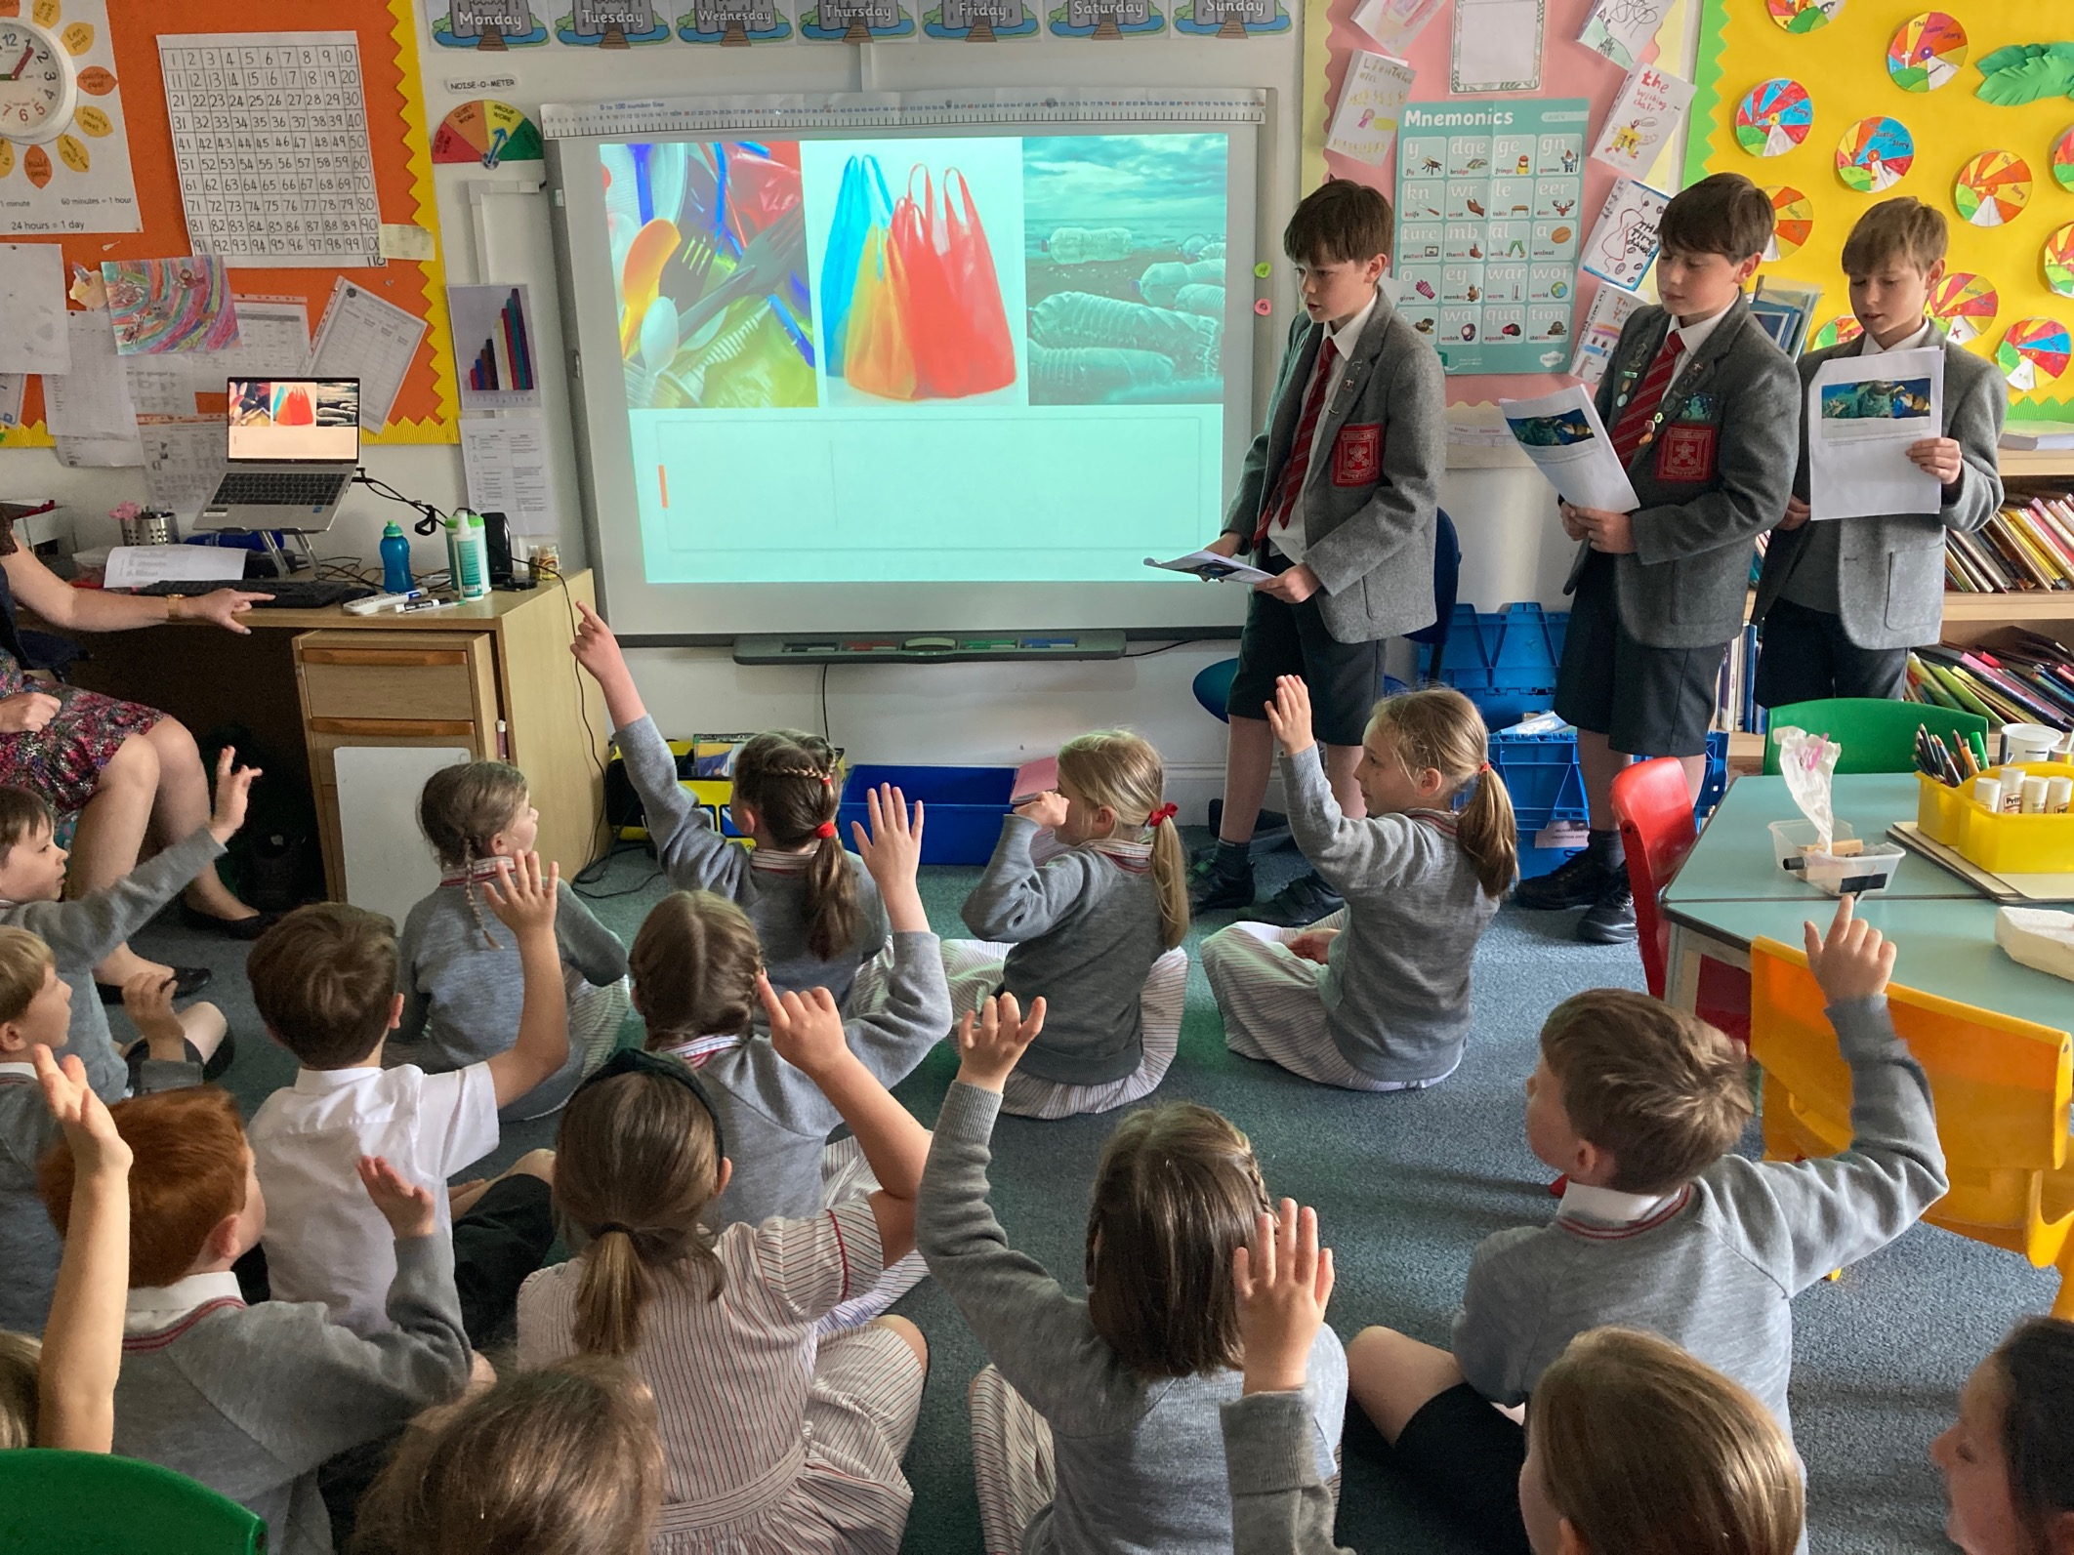
English & ICT

Slide 34
As good as it gets?
Peer feedback is hugely valuable.
Practice, practice, practice!
Knowing their topic really well helps even the shyest presenters.
Making time for redrafting.
Do they understand the assessment criteria?

Slide 35
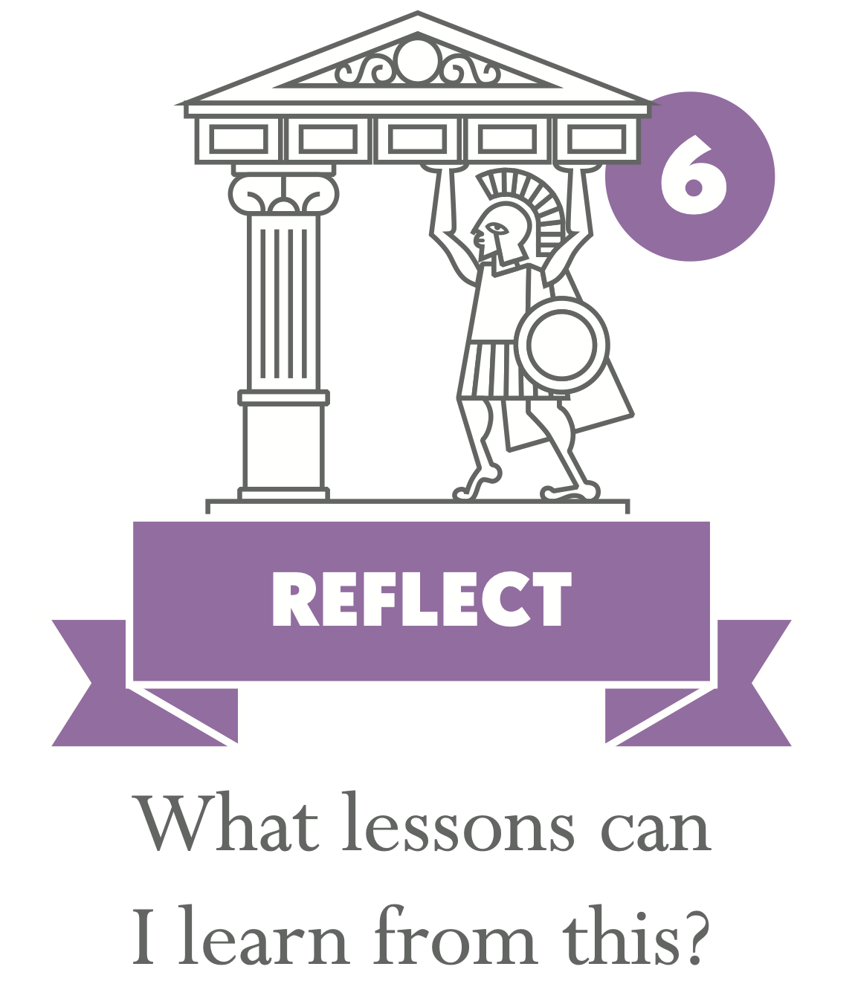
“The better we get at getting better, the faster we will get better”*
Reflection is important at all stages.
Early reflection improves products.
Considered reflection can be very revealing: "I thought the problem was that I was bad at presenting, but I realised that it was because I didn't have enough information in my presentation” (Y6).
How do I know what they have learnt?
How do we carry these lessons forward?
*Douglas Engelbart <https://computerhistory.org/profile/doug-endelbart/>

Slide 36
I have learnt that I need to take more notes.
Through this project I learnt that if I put in effort, I can do it.
At first, I found the science experiment about heating water hard because I started the stopwatch at the wrong time, but I started again and didn’t give up.
I found making the script hard.
It was the amount of information I had and not my presenting.
I've learned about how much I care for Earth and its oceans. I learned how to sew which is a nice hobby…I found out that I can deal with hot water and use it sensibly and not get worried that it will burn me.
Year 6
I would make it better again if I planned it out more.

Slide 37
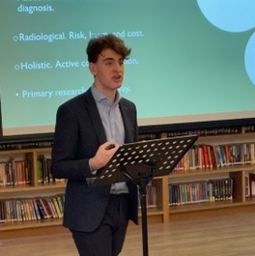
“Formulating a plan doesn't account for daily life. Things simply go wrong. I think the biggest thing that I took from my EPQ was keeping my head above water and learning to adapt to change…I've seen an impact on the way I study for my other subjects now. The way I plan and the way I realize how long something is going to take me has a real impact on the way I work.”
- Will

Slide 38
Accountability
Longer projects (like Signature Work, HPQ, EPQ & coursework) need structured interim deadlines and accountability.
Expect to keep copies of drafts for academic honesty purposes.
‘Vivas’ and presentations make academic honesty verification easier.

Slide 39
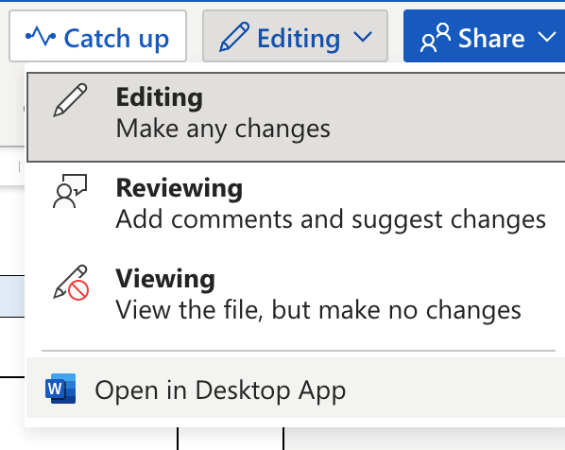
IT opportunities and challenges
Teams can be a great group collaboration tool – but students don't understand the need to work in the app.
Booking IT rooms makes access to resources in school hard. Online support needed for homework.
Class access to books is possible but takes planning!

Slide 40
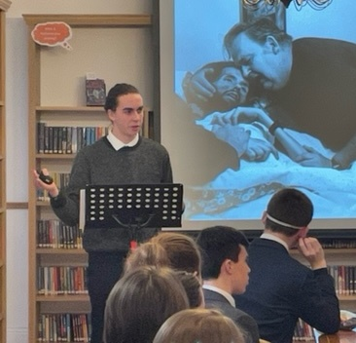
There’s more to life than this
Impact can go far beyond the classroom.
“I also uniquely learned about my family and stories I've never heard before. My project allowed me to open up those conversations which I otherwise may not have had.”
- Jude

Slide 41
Your turn!
What one thing have you heard or discussed today that you want to use in your teaching this term – or planning for next term?
Image by Clker-Free-Vector-Images from Pixabay

