Slide 1
Teaching Inquiry as Conversation
Bringing Wonder to Life
Barbara Stripling
Darryl Toerien
Notes:
Perhaps a further incentive to Jessica might be replacing this image with the book cover!?

Slide 2
Why Inquiry as Conversation?
Personalized
Driven by Questioning
Leads to Interaction
Leads to Independent, Critical Thinking
Engenders Agency and Voice
Demands Continual Reflective Thinking
Leads to an Inquiry Stance

Slide 3
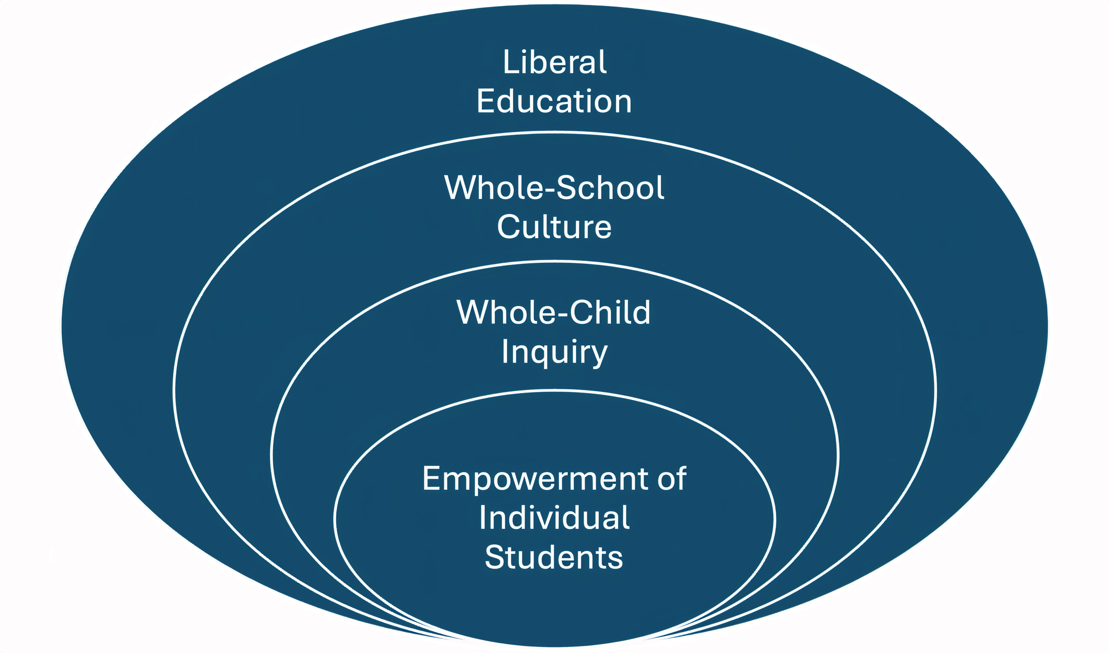
Four Factors of Inquiry to Consider

Slide 4
Empowerment of Individual Students
Teaching the skills and attitudes of the process of learning
Collaborative planning and teaching with classroom teachers to enable students to learn academic content
K-12 continuum that builds in complexity
Direct instruction, guided practice, independent learning
Learning from written record and interactive experiences
Formative feedback through graphic organizers and other strategies
Notes:
This reinforces the idea that students are becoming less dependent on teaching for their learning.

Slide 5
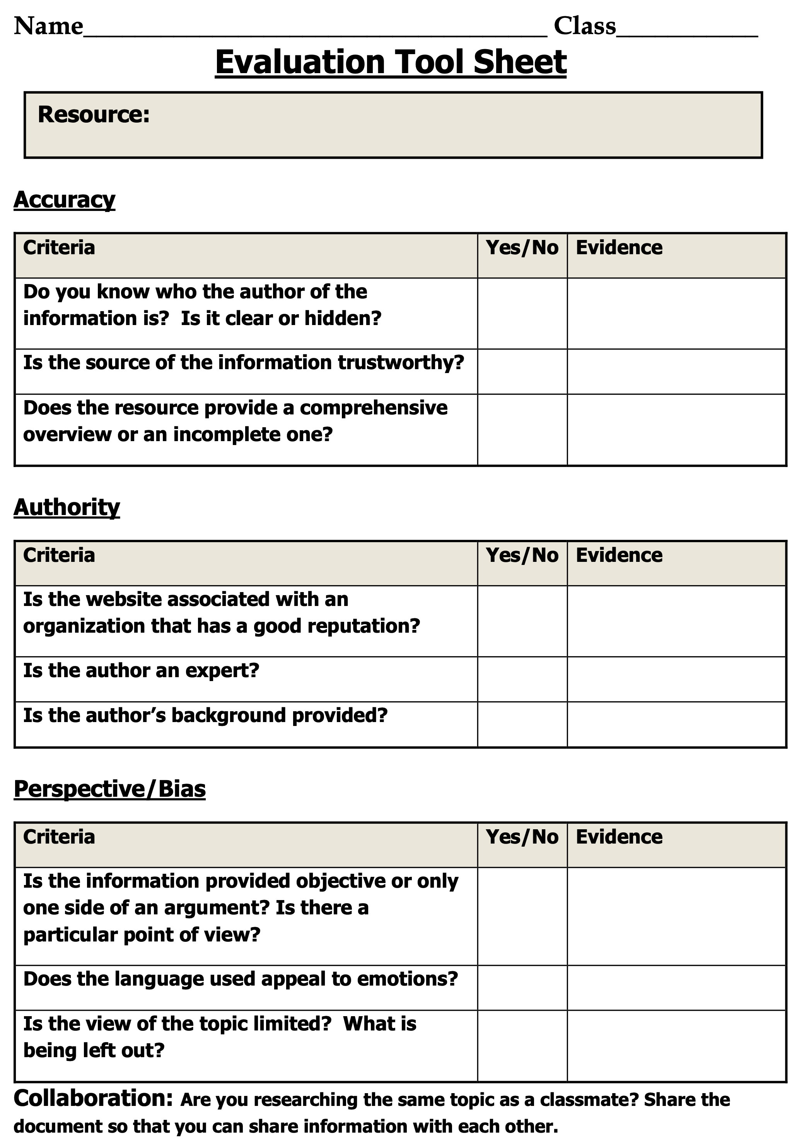

Slide 6
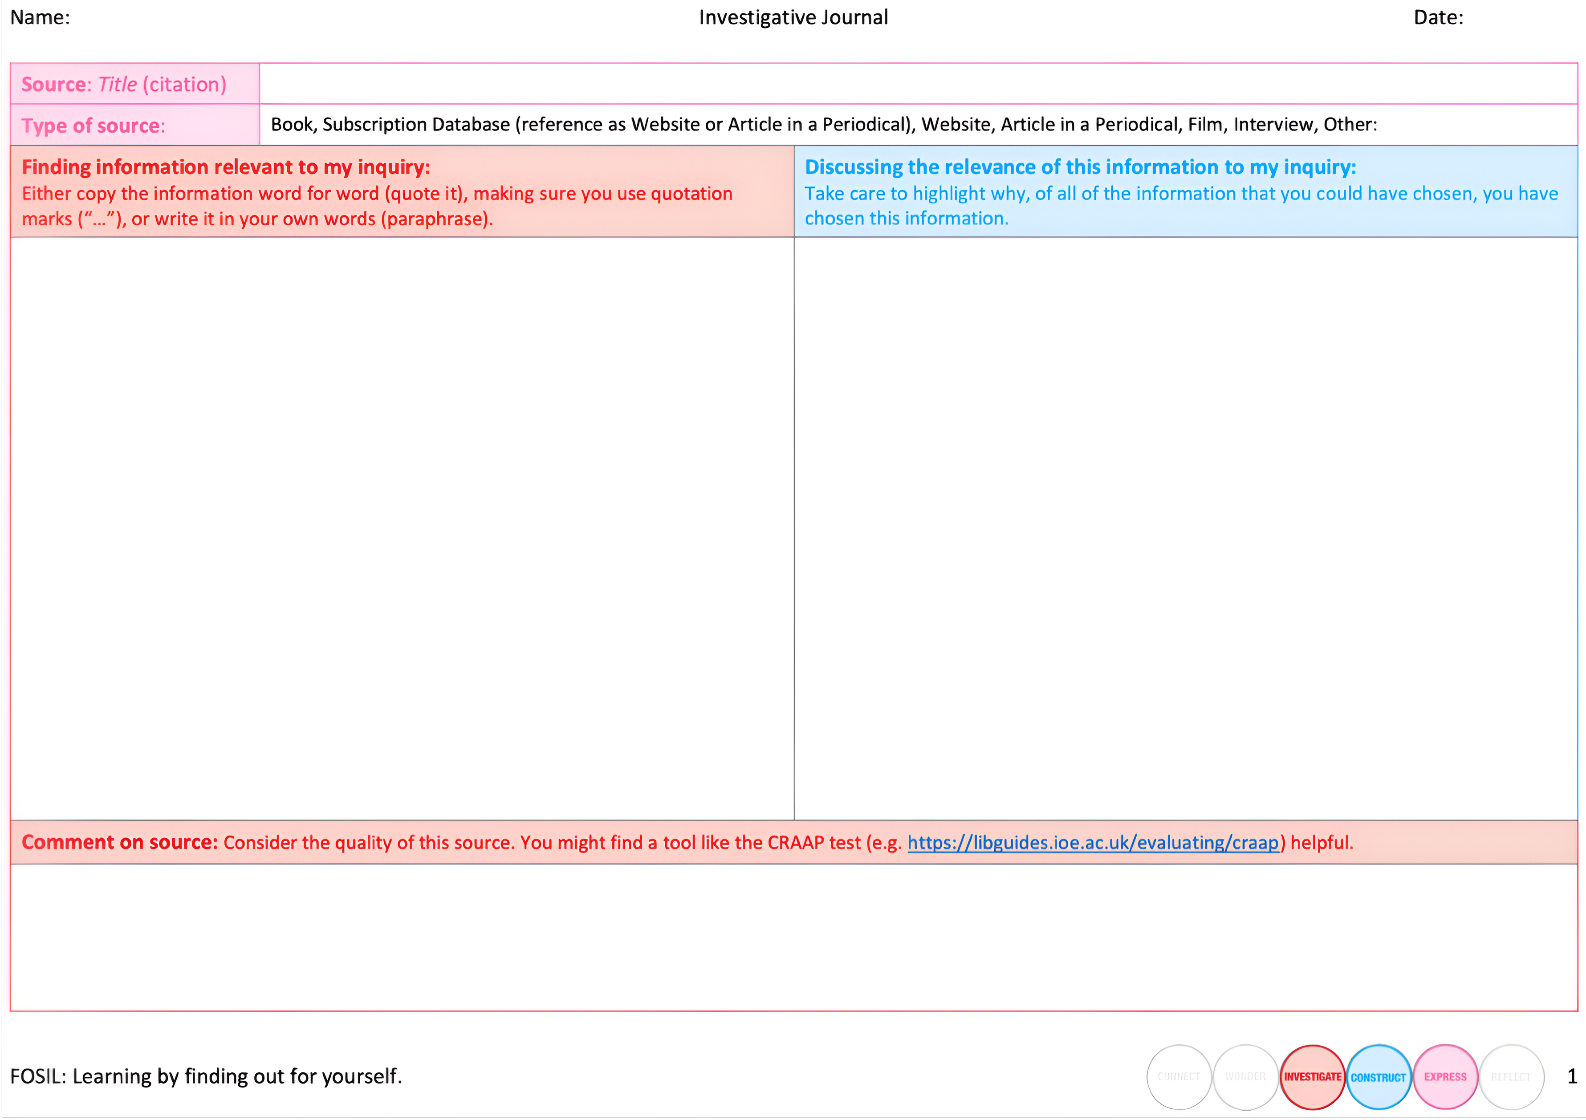
Notes:
It might be worth explicitly noting here that while there are differing views on the value of the CRAAP test, we find still find it very effective as it is intuitive and becomes instinctual.

Slide 7
Whole-Child Inquiry
Personal, social, cultural competencies in addition to academic skills
Important, real-life skills:
  Ability to learn on own
  Understanding of own identity and strengths
  Ability to control own emotions and relate well to others
  Empathy and respect for cultural differences
  Self-confidence and agency to express own ideas
  Motivation to continue learning beyond school

Slide 8
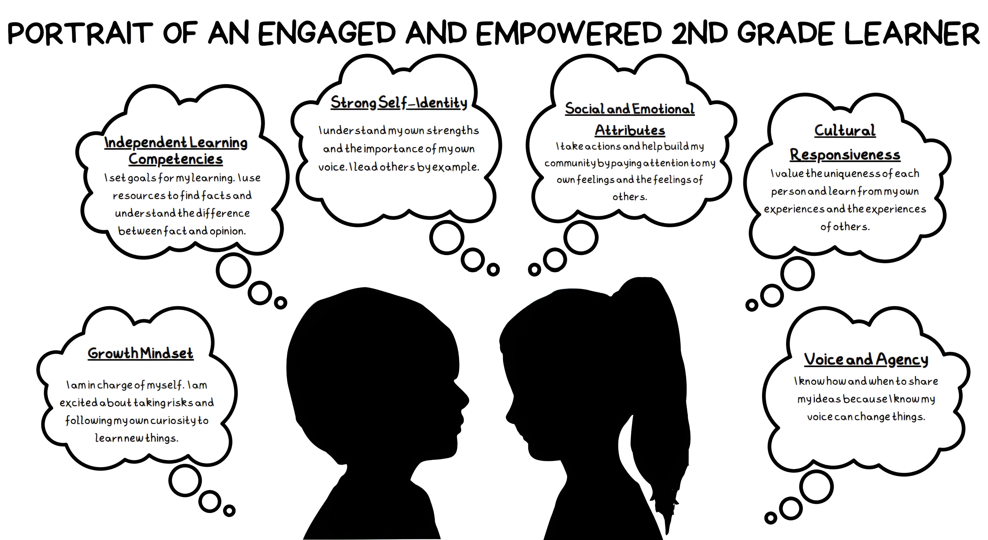

Slide 9
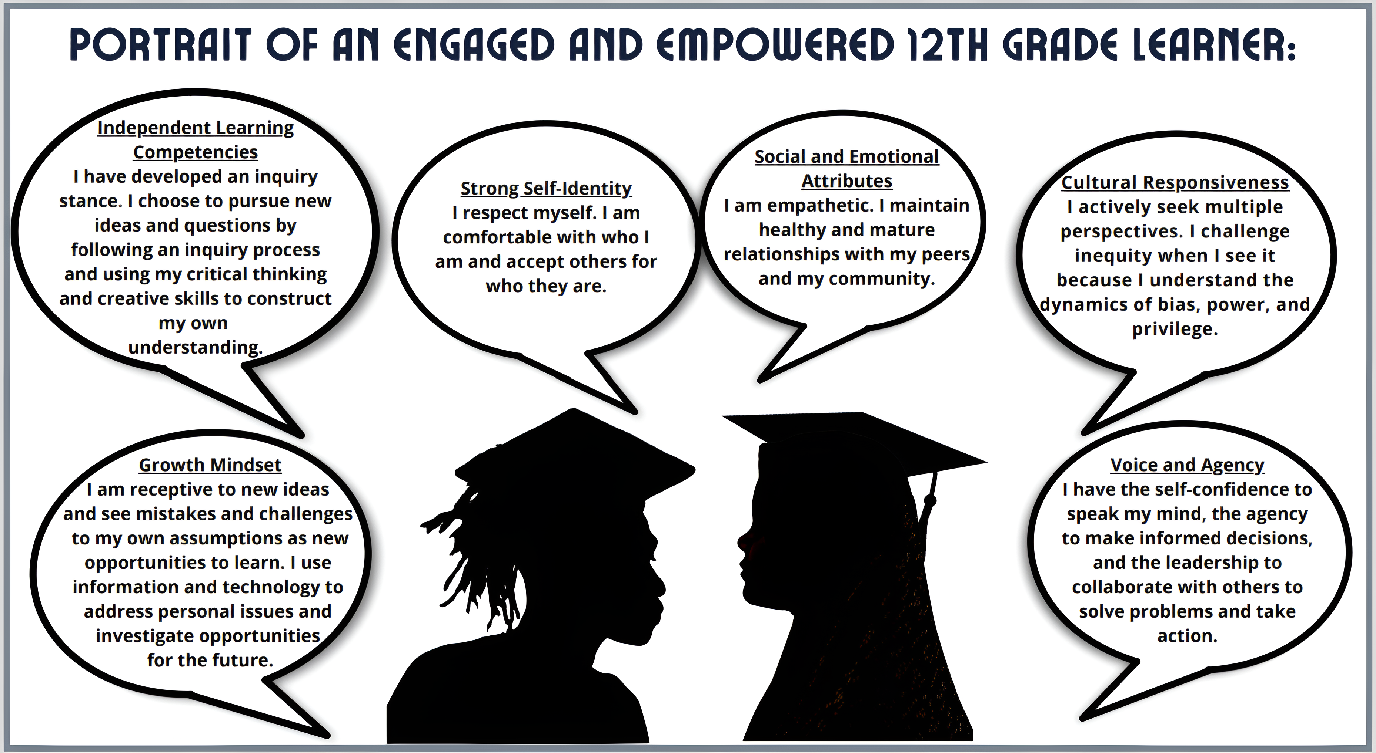

Slide 10
Whole-School Culture
Factors to be considered:
  School and district priorities
  School and district policies
  Trusting relationships
  Inclusive climate
  Equitable support for individual students
Extension of inquiry across the curriculum
  Disciplinary questioning, which is interdisciplinary in nature
  Backbone of signature works
Notes:
I think this would be worth adding, because the boundaries around school subjects are unnaturally hard, which are then also obstacles to conversation and collaboration.

Slide 11
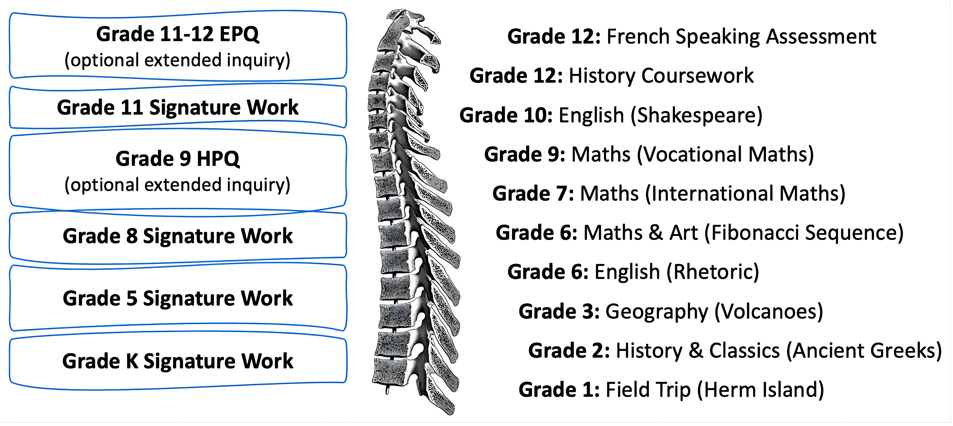

Slide 12
Goal of Liberal Education
To prepare all of our youth for full and productive participation in society by enabling them to develop fully in all areas of their lives.
To enable individuals. . .
To develop their own humanness
To think and be free to form their own opinions
To judge what is true based on credible evidence
To develop their own humanity

Slide 13
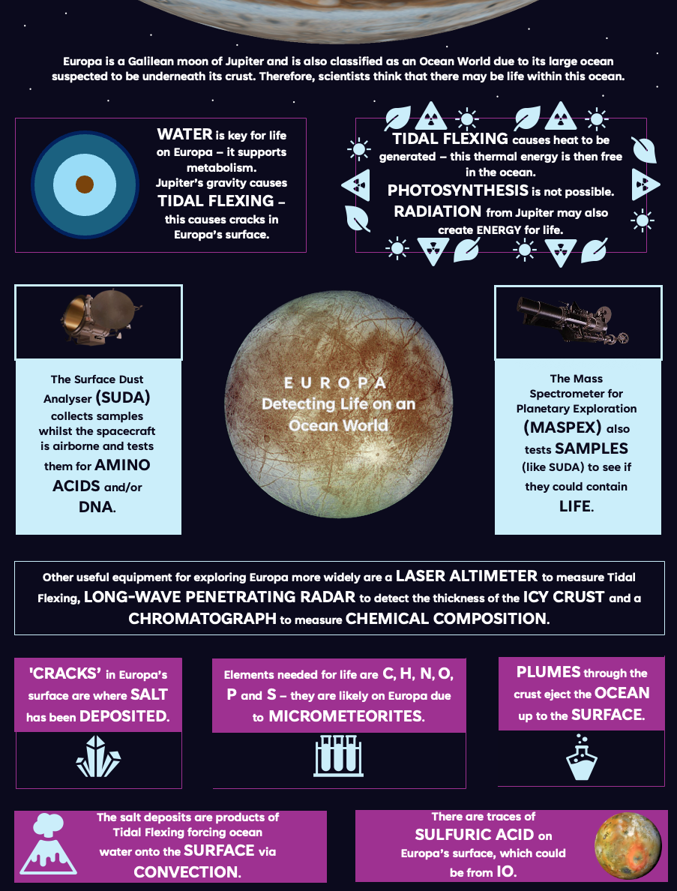


Hugo (Grade 9)
Notes:
Hugo -- like all students, given half a chance -- has hidden depths that School too often leaves unexplored. Hugo also -- like many students -- has Special Educational Needs, which in his case, fortunately, is diagnosed as ASD. This presented Hugo with some specific obstacles in his Grade 8 Signature Work, and subsequently in his Grade 9 HPQ, not least of which is the compulsory oral component. Not only did Hugo overcome these obstacles, but he did also so spectacularly, going on to be awarded the prize for Heroic Inquiry in a Signature Work for the investigation into the sustainability of Guernsey’s Fish and Chip shops. This came as an unexpectedly pleasant surprise to Hugo's mother, who was then a Head of Special Educational Needs. Hugo went on to pleasantly surprise all of us further, with his Grade 9 HPQ investigation into which of the outer planets are worth exploring. Not only did he successfully present the results of investigation to his cohort in Grade 9, he also asked whether he might present a revised version to all of Grade 6 and 7 in a special assembly. To crown this achievement, he developed an aspect of his HPQ into an entry for a competition being run by the Royal Society of Chemistry centred on the question of whether there is life on Europa, which he won, using the proceeds to buy himself a telescope. A liberal education is a fully human education, in which the acquisition of disciplinary knowledge through the inquiry process of learning serves the purpose of students discovering and realising their full potential as being human in the world.

Slide 14
How can practicing librarians be effectively enabled to teach inquiry as conversation and so prepare our students to deal successfully with reality, now and in their future lives?

