Slide 1


AI and Academic Integrity
Whoever walks in integrity walks securely, but he who makes his ways crooked will be found out. (Proverbs 10:9)
05 January 2026
Jenny Toerien
Projects Qualifications Coordinator and Senior Librarian
Blanchelande College Libraries
Enabling Heroic Inquiry

Slide 2
What?
Notes:
AI is a huge – and emotional – topic. As a parent I’m anxious about AI chatbots that have encouraged children to commit suicide and damaged their mental health, as a Scientist and Science Fiction fan I’m curious to see where AI driven breakthroughs go, as a Librarian I have huge concerns about intellectual property theft causing actual harm to content creators and AI slop drowning out reputable sources, as a teacher I’m very uncertain about the impact of AI on my profession as a whole – for better or worse - and as a human being I am very worried about the potential environmental, political and social impacts…but those are all conversations for another day. Our focus today will be on the impact of student use of AI in our classrooms and how we can support them and each other in navigating this period of change in an ethical way that advances their learning.

Slide 3
Why?
Notes:
Why me? Why now – particularly in the lunchtime graveyard slot when you all just want to get into your classrooms to get ready for tomorrow? Why should you care? I’ve read that it is often a good idea to start with a story, so here goes. Mine is a story of three students – two of my Projects Qualification students and a Y11 student.
One of these students submitted a draft report to me that was blindingly obviously written by AI. I didn’t even need to put it through a detector to know. When we met with his mother, she was horrified and said she wasn’t aware that they weren’t allowed to use AI in this way because it is so common in the workplace now, and that when he had asked her for help she had suggested he ask AI instead. She was very apologetic and the work had been redone under supervision.
My second student was coming to me with AI summaries of research and clearly asking it to assist her with her work at every step of the way. When I told her she couldn’t do this, I had a complaint from and long conversation with her father who had an incomplete understanding of exam board regulations and felt I was being unfair in denying her use of these tools. Because I have worked really hard to know what I am talking about here, I did manage to convince him of my position, but there was a huge amount of pushback.
The third student is a GCSE student who spends many study periods in the Library and has been using AI very successfully (with some support from me to ask the right questions) for GCSE revision, and has found this a very positive and enabling experience.
Over the course of this term, in part because I run a 100% coursework subject, understanding the regulations around AI especially in relation to exams and coursework – and making sure that students and parents do too - has become a pressing issue for me in particular and for the school in general. The AI working group has developed a guide for students and parents, which we will talk about later, and on February 6th the use of AI more generally will be a part of the Parent Partnership evening, so we thought it was really important for all staff – whether your subject involves coursework or not – to understand what is being communicated to parents.

Slide 4
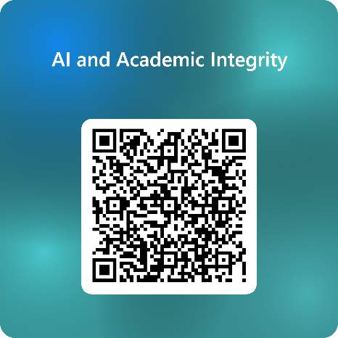
How has AI changed my subject?
Give one opportunity that student use of AI in your subject brings (if you use an AI driven app, name it)?
What is the main challenge that student use of AI presents in your subject?
Please complete this Form now (then discuss): https://tinyurl.com/Blanche-AI-2026
Answer in one or two words, not full sentences!
Results: AI and Academic Integrity – Results
Notes:
All our subjects are different and are affected differently by AI.

Slide 5
Opportunities
Challenges
Focus on subject-related skills
Personalisation (new apps)
Increasing autonomy
Increasing creativity
Shortcutting learning
Reducing thinking
Cheating harder to detect
Reducing creativity

Slide 6
What the research says
Notes:
https://www.forbes.com/sites/danfitzpatrick/2025/12/30/8-ai-research-papers-published-in-2025-that-every-educator-should-read/

Slide 7
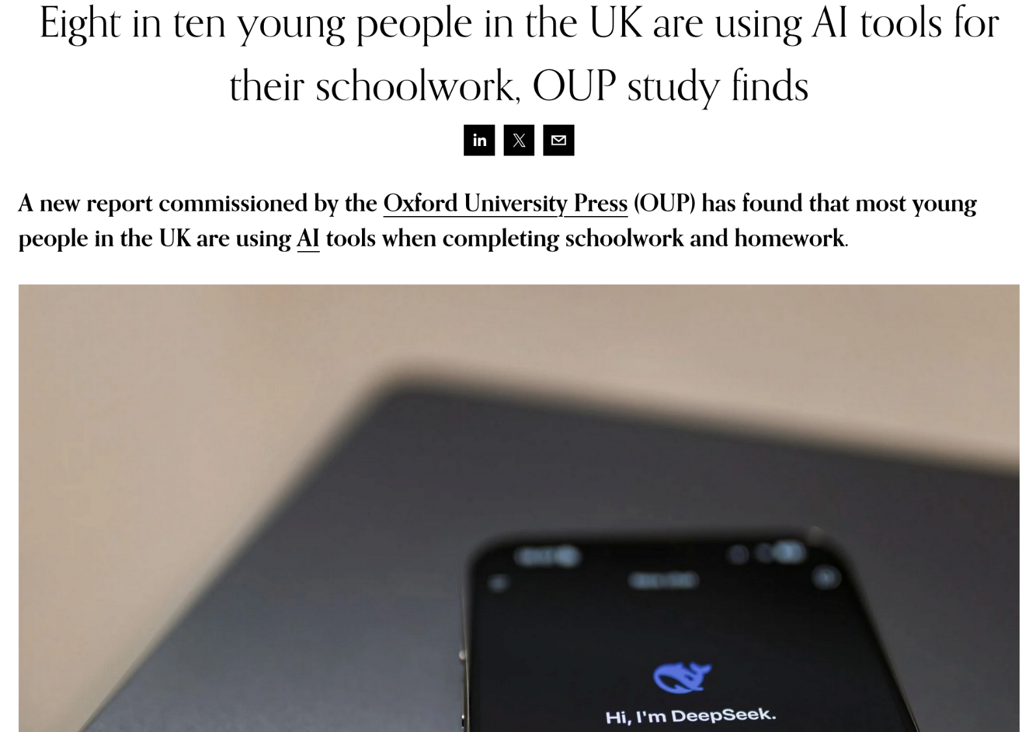
Notes:
https://newsroom.collegeboard.org/new-research-majority-high-school-students-use-generative-ai-schoolwork
The library is full of students we support every break and lunchtime doing their homework, with and without AI – but also playing with AI as a toy. My son is in Y8, and they have a running joke that one of his friends is ‘an extension of ChatGPT’.

Slide 8
<50% said they could confidently tell which information provided by AI was true
32% thought they could confidently identify misinformation
90% thought it had helped them to develop a schoolwork related skill
26% thought AI made it too easy for them to find answers without doing any work

Slide 9
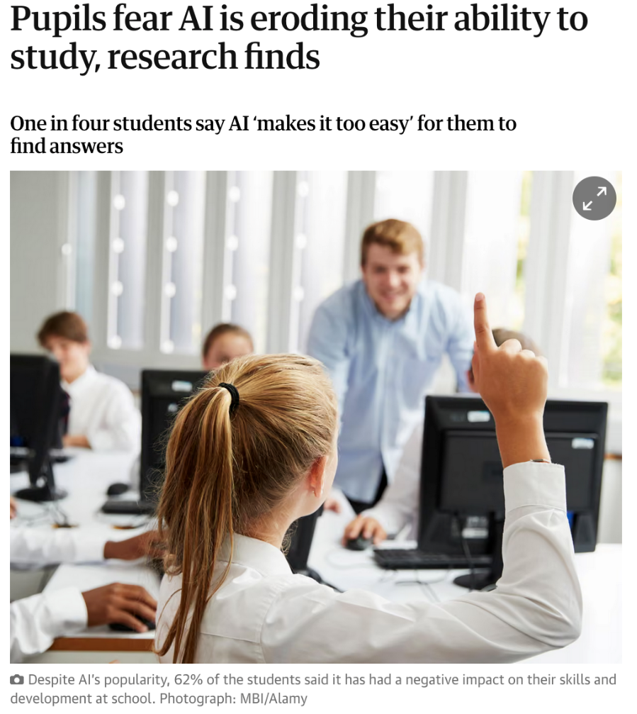
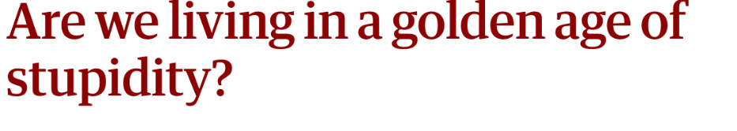

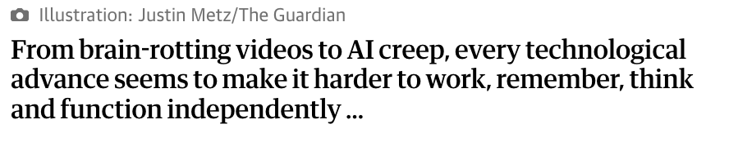
Notes:
https://www.theguardian.com/technology/2025/oct/15/pupils-fear-ai-eroding-study-ability-research
https://www.theguardian.com/technology/2025/oct/18/are-we-living-in-a-golden-age-of-stupidity-technology
A study from MIT showed that students who used ChatGPT to help them to plan and write an essay showed significantly less activity in areas of the brain associated with cognitive processing, attention and creativity and remembered far less of the material after handing it in.

Slide 10
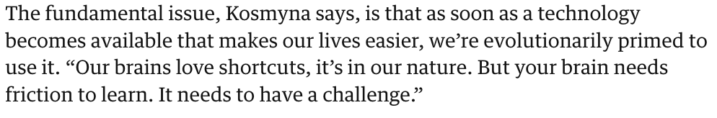
Notes:
https://www.theguardian.com/technology/2025/oct/18/are-we-living-in-a-golden-age-of-stupidity-technology

Slide 11
Why academic integrity?
“…(academic) integrity is much more than just about (academic) honesty. Academic honesty smacks of citing sources because if we do not do this, we get punished.
…Researchers with integrity are honest, whatever the situation, whatever the context. They cannot do other, they cannot be other. Integrity is what they are, it is who they are.
…Integrity, as C.S. Lewis is said to have said, is doing the right thing even when nobody is looking.”
John Royce (July 2020) https://www.read2live.com/2020/07/29/the-integrity-of-integrity/
Together, learning to become all that God wants us to be.

Slide 12

It takes a village...
Notes:
This isn’t just a problem for coursework subjects…or essay subjects…or teachers from exam years. Academic integrity is an issue for all of us because it is about character formation. It is about raising young men and women of integrity.

Slide 13
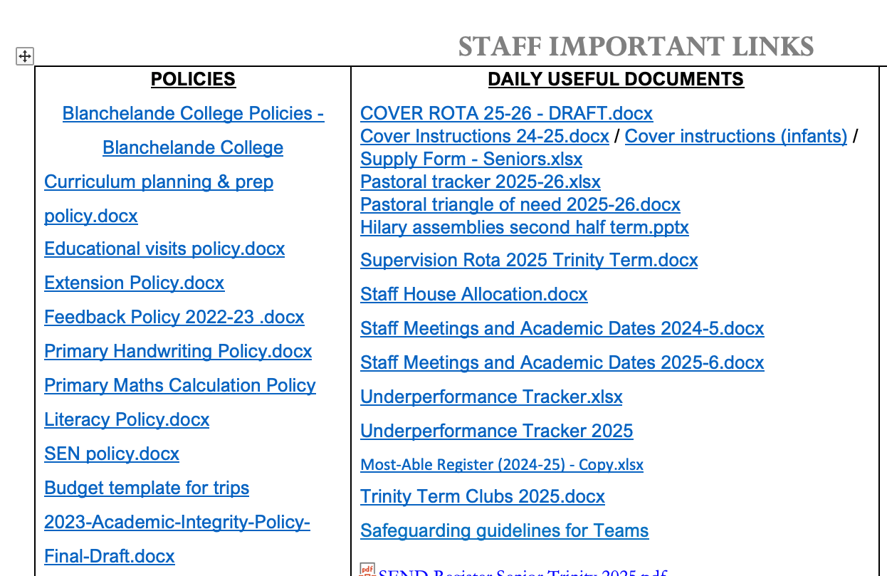
Academic Integrity Policy
2023-Academic-Integrity-Policy-Final-Draft.docx

Slide 14
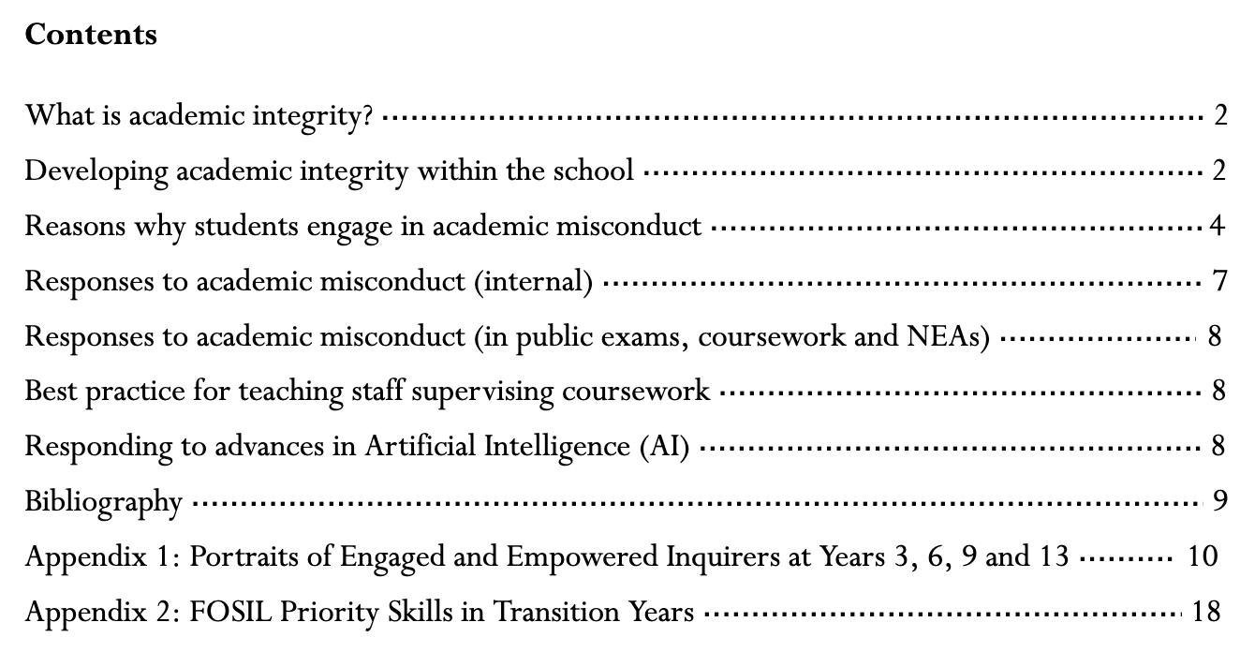

Slide 15
Why do students cheat (using AI or otherwise)?
Don’t realise they are cheating
Inconsistent messages
Underestimate consequences
Not enough opportunities to practise
Poor time management
Cheating is easy
Pressure to succeed

Slide 16

Preventing AI Misuse in Assessments
A summary for teachers

Slide 17
Know your school or college’s approach to managing AI in assessments
1
Plan how to prevent AI misuse in assessments
2
Communicate the approach to students and parents/carers
3
If you suspect AI misuse…
4
Notes:
JCQ AI Use in Assessments
Academic integrity policy and NEA and coursework policy. Read JCQ guidance for your subject.
Make sure students complete some work in class so that you know their ‘voice’ and capability. Talk to them about their work. Get them to submit drafts along the way. Report any concerns to Susie.
Make sure students and their parents understand the requirements – Student document linked and on staff links. Parent partnership meeting. Get them to sign a copy in your subject at the start of coursework.
Use your knowledge of the student. Use AI detectors. Talk to Susie. If AI use is detected before the Candidate Declaration is signed it can be dealt with internally. If it is after then it has to go to the exam board.

Slide 18

For more details, see the JCQ booklet – AI Use in Assessments: Protecting the Integrity of Qualifications

Slide 19
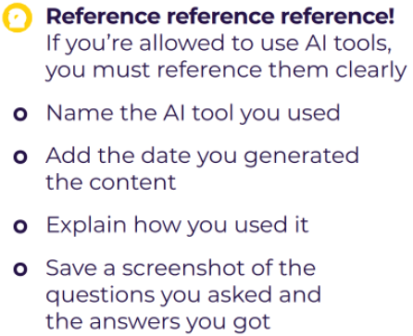
JCQ AI rules summary
AI may not be used at all in exams
It may be used under some circumstances in coursework…
…but you can’t get marks for any ‘thinking’ that AI does for you

Slide 20
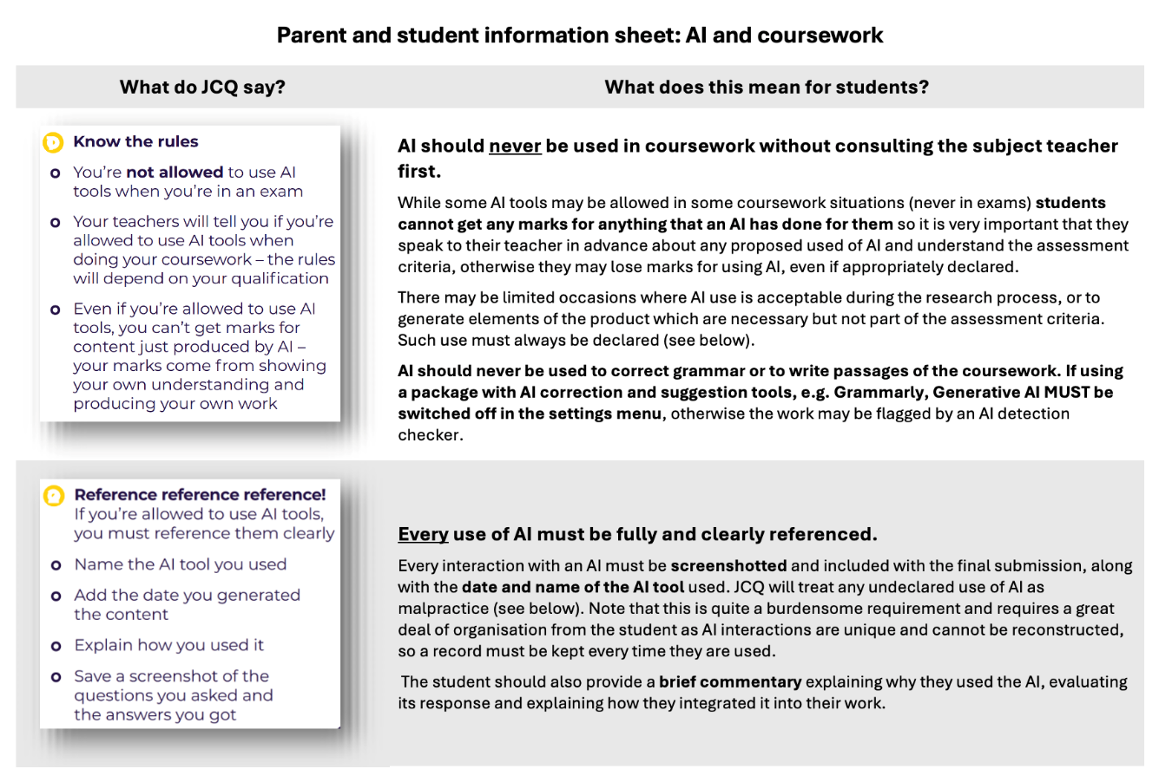
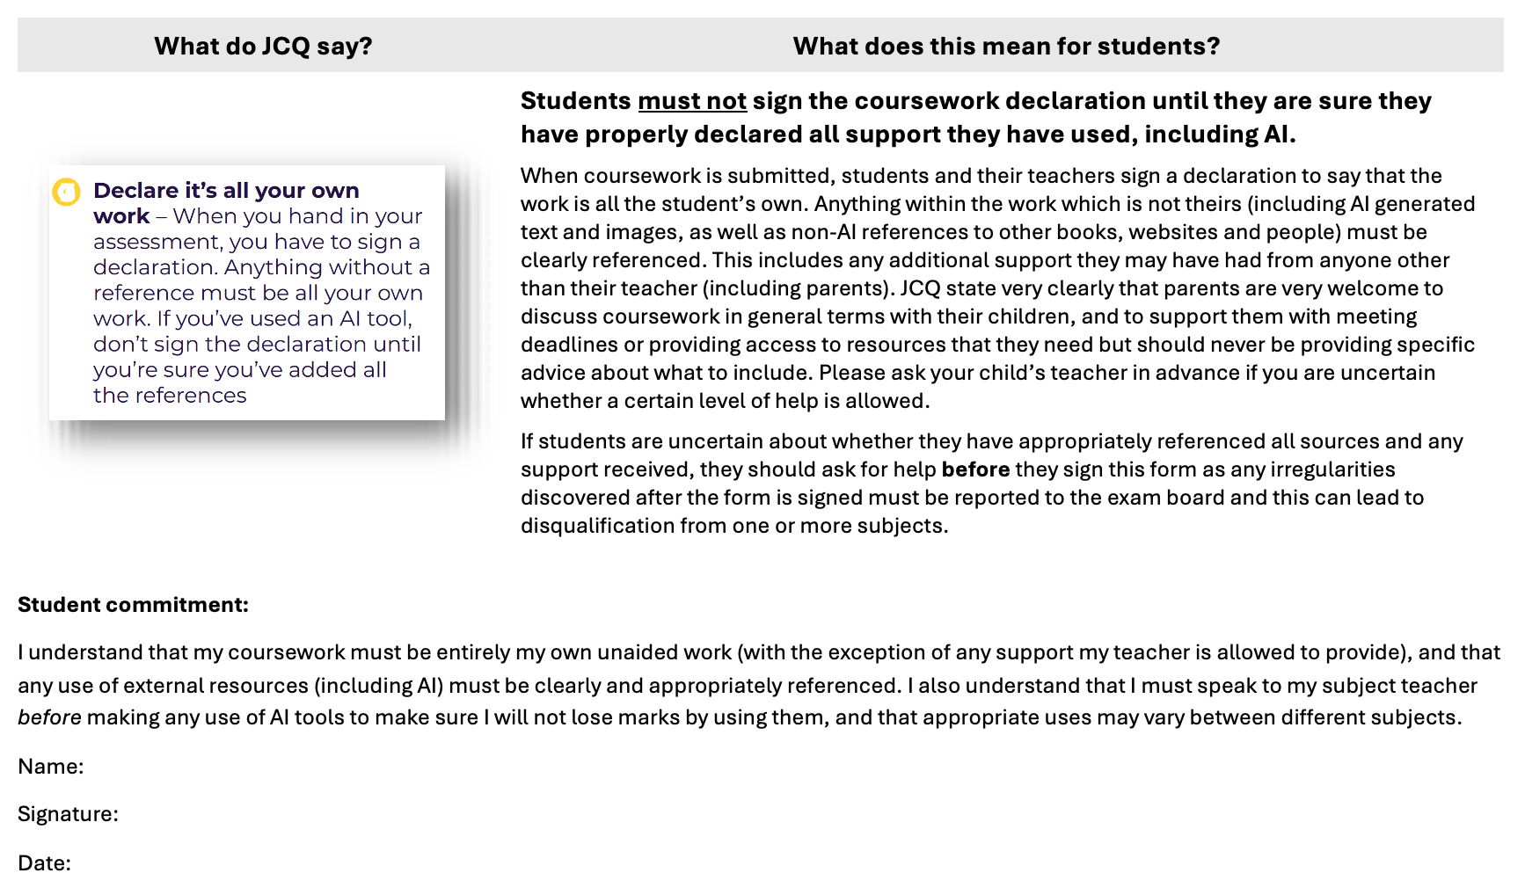

Slide 21
It takes a village...

Slide 22
Key messages: Academic Integrity
Is this use of AI helping me to learn or robbing me of a learning opportunity?
Is this use of AI making me more or less creative?
Would I be comfortable to openly acknowledge this use of AI?
Do I have regular opportunities to practise doing that?

Slide 23

Notes:
https://www.rappler.com/entertainment/series/sparking-joy-with-marie-kondo-trailer-netflix/
Do you know who this is?

Slide 24

Notes:
https://pixels.com/featured/marie-kondo-spark-joy-matthews-oliver.html
Marie Kondo. The Life Changing Art of Tidying Up.
She wants us to ask about everything we own, does this spark joy? If not, we should let it go. If you’ve seen the area around my desk, you will know I’m clearly an exceptionally joyful person! Part of our job as teachers is to instil a sense of joy in learning in our students – if they are interested and engaged then they may well still use AI, but to engage their curiosity not to shortcut their learning. Our best defence is for them to care! Do our subjects spark joy? In them? In us?

Slide 25

Every system is perfectly designed to get the results it gets
– Dr. W. Edwards Deming
Show yourself in all respects to be a model of good works, and in your teaching show integrity... (Titus 2:7)
Notes:
Image credit: https://www.youtube.com/watch?v=MblOLWInezc

Slide 26
Every system is perfectly designed to get the results it gets
– Dr. W. Edwards Deming
Are we promoting integrity in:
The resources we use?
The assignments we set?
The conversations we have?
Our responses to the work our students produce?
Show yourself in all respects to be a model of good works, and in your teaching show integrity... (Titus 2:7)

