Slide 1


AI, online safety and academic integrity
Parent Partnership Evening
Whoever walks in integrity walks securely, but he who makes his ways crooked will be found out. (Proverbs 10:9)
10 February 2026
Jenny Toerien
Projects Qualifications Coordinator and Senior Librarian
Blanchelande College Libraries
Enabling Heroic Inquiry

Slide 2


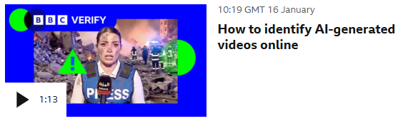


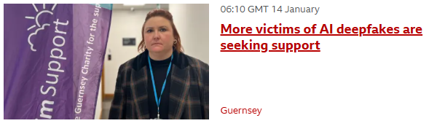

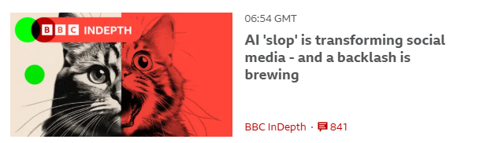

AI is evil!

Slide 3
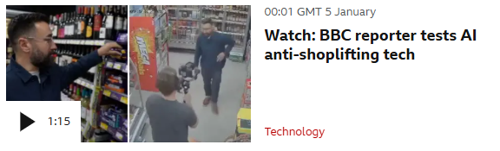
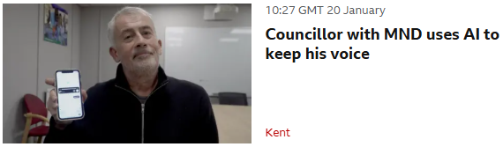


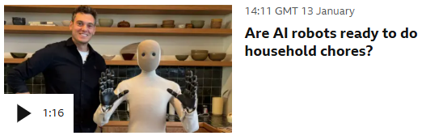
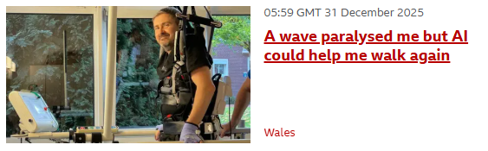



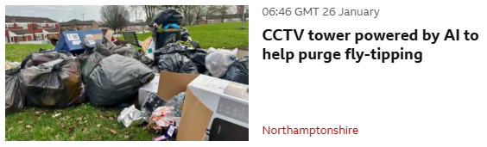
AI is amazing!

Slide 4



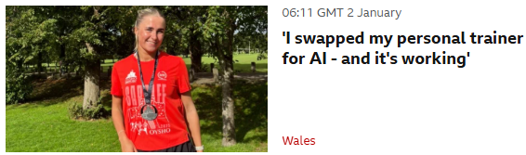



You’ll need AI to get a job

Slide 5
Do you use Artificial Intelligence tools either at work or at home fairly regularly?

Slide 6
Does your job require you to take ‘closed book’ assessments?

Slide 7

Notes:
Image by Peggy und Marco Lachmann-Anke from Pixabay
Many of us will use calculators – or even spreadsheets – in our everyday lives or our jobs, and I think we all agree that children should leave school knowing how to use a calculator. HOWEVER if you give a primary school child a calculator as soon as they start doing maths and they never learn how to do mental arithmetic, they never develop the kind of number sense that they need, both to be able to function without a calculator when necessary and to use a calculator well.
AI tools are similar except the cognitive skills they replace are more sophisticated, and are skills that need to be developed throughout secondary education, so while AI needs to and will become one among many tools that we teach students to use, if they adopt it wholesale too early on and for too many things then they will stunt other vital skills.

Slide 8
Adolescence [ages 10-25] is a critical period for brain development, when adolescents are experiencing greater developmental changes than any other period in life besides infancy.
American Psychological Association (2025) Artificial intelligence and adolescent well-being
Notes:
This is why the way children use AI matters so much – they are not just ‘tiny adults’. Their brains are still developing and the tools they use and the way they use them can have an impact on that development.

Slide 9
What the research says
Notes:
https://www.forbes.com/sites/danfitzpatrick/2025/12/30/8-ai-research-papers-published-in-2025-that-every-educator-should-read/

Slide 10
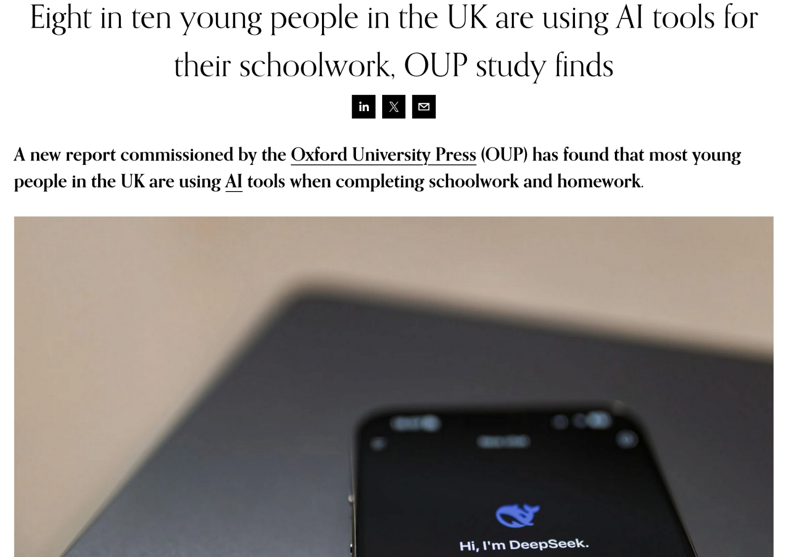
Notes:
The library is full of students we support every break and lunchtime doing their homework, with and without AI – but also playing with AI as a toy. My son is in Y8, and they have a running joke that one of his friends is ‘an extension of ChatGPT’.
https://www.edtechinnovationhub.com/news/eight-in-ten-young-people-in-the-uk-are-using-ai-tools-for-their-schoolwork-oup-study-finds
https://global.oup.com/education/press/oup-ai-native-generation-research-report/?region=international&srsltid=AfmBOopY18-bWUI3uSx-KKgw11lzvQiWeWipYgASl_jsxrDGyDafqeyI
https://fdslive.oup.com/www.oup.com/oxed/secondary/Teaching_the_AI_Native_Generation.pdf?region=international
https://newsroom.collegeboard.org/new-research-majority-high-school-students-use-generative-ai-schoolwork
https://research.collegeboard.org/technology-learning
https://www.mdpi.com/2227-7102/15/3/343?utm_source=chatgpt.com&utm_medium=email (The Impact of Artificial Intelligence (AI) on Students’ Academic Development)

Slide 11

<50% said they could confidently tell which information provided by AI was true
32% thought they could confidently identify misinformation
90% thought it had helped them to develop a schoolwork related skill
26% thought AI made it too easy for them to find answers without doing any work
Notes:
In the study, children’s own self-reporting of the level of their skills and impact of the tools was very mixed. Less than half could work out whether or not to believe what the AI said, less than a third thought they could identify active misinformation and although 90% felt it was helping them to develop schoolwork related skills, more than a quarter recognised that it was making the work too easy and impacting their learning.
https://fdslive.oup.com/www.oup.com/oxed/secondary/Teaching_the_AI_Native_Generation.pdf?region=international
Image by Jose Alexis Correa Valencia from Pixabay

Slide 12
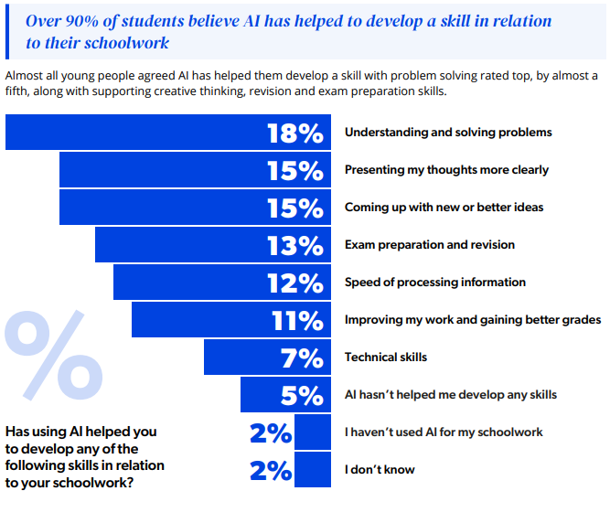
Notes:
If we dig a bit deeper it is interesting to see how children felt AI supported their learning.
Teaching_the_AI_Native_Generation.pdf

Slide 13
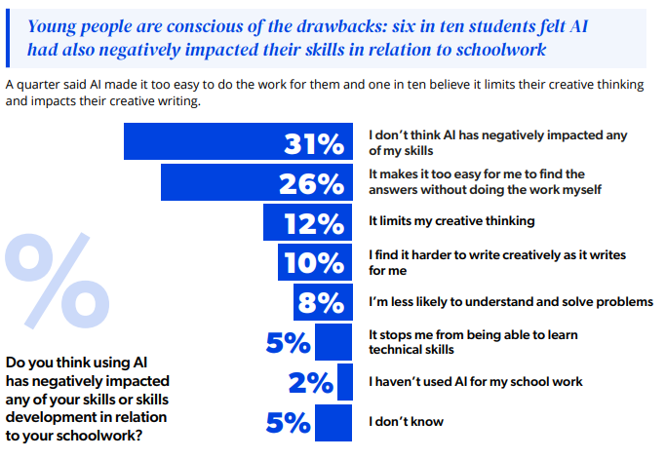
Notes:
Teaching_the_AI_Native_Generation.pdf
A very mixed picture!

Slide 14
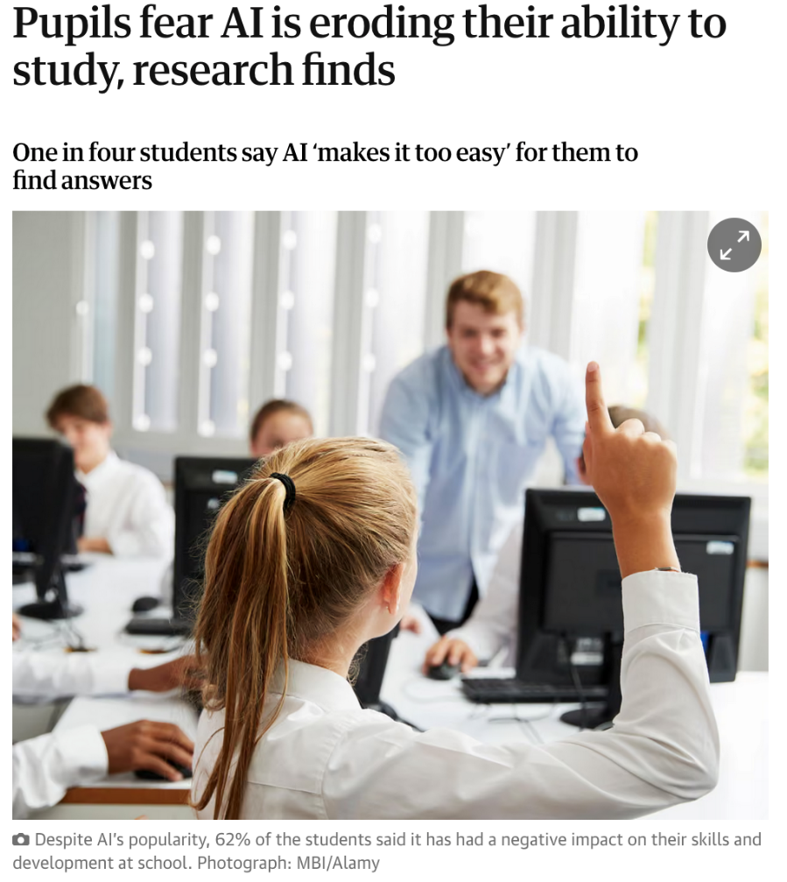
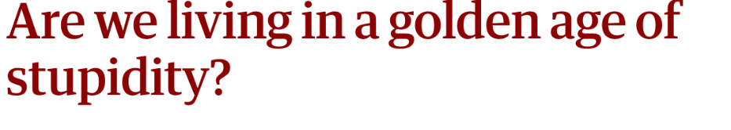

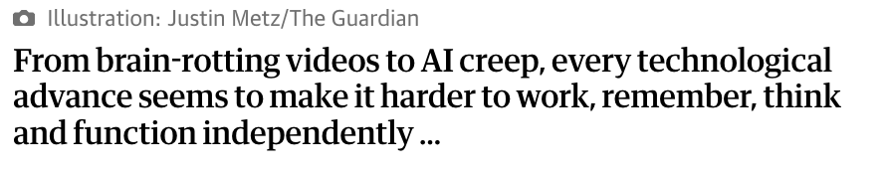
Notes:
https://www.theguardian.com/technology/2025/oct/15/pupils-fear-ai-eroding-study-ability-research
A small scale 2025 study from MIT showed that students who used ChatGPT to help them to plan and write an essay showed significantly less activity in areas of the brain associated with cognitive processing, attention and creativity and remembered far less of the material after handing it in.
“In other words, whatever the people using ChatGPT felt was going on inside their brains, the scans showed there wasn’t much happening up there.”
Another, larger study from the Swiss Business School found those who used AI more frequently scored lower on critical thinking – although it’s possible that people with lower critical thinking abilities are more likely to trust AI, for example.) He does go in to remind us however that “There is also the bigger issue that adults who use AI as a shortcut have at least benefited from going through the education system in the years before it was possible to get a computer to write your homework for you. And wonders “Are schools and universities still equipped to produce creative, original thinkers who will build better, more intelligent societies – or is the education system going to churn out mindless, gullible, AI essay-writing drones?”
The article goes on to point out how important it is to have some background knowledge and understanding of any topic you are researching so that you can weed out false information – and this is why developing background knowledge is a key stage in Blanchelande’s Heroic Inquiry cycle.
https://www.theguardian.com/technology/2025/oct/18/are-we-living-in-a-golden-age-of-stupidity-technology (quotes are from this article)

Slide 15
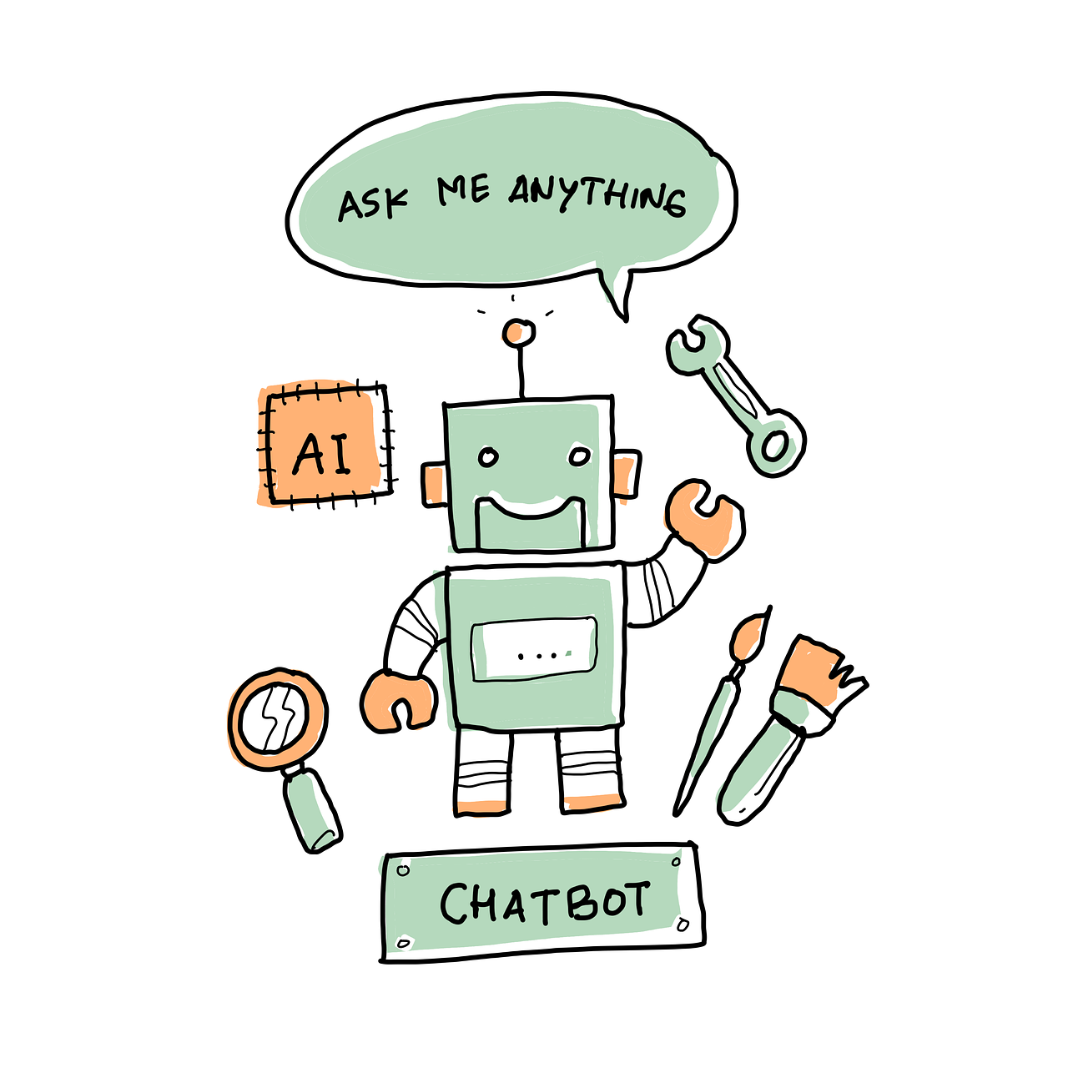
Opportunities
Challenges
Focus on subject-related skills
Personalisation of learning
Increasing autonomy
Increasing creativity
Shortcutting learning
Reducing thinking
Cheating harder to detect
Reducing creativity
Process centred
Product centred
Notes:
So AI presents both opportunities and challenges and it is important to look at both.
For example, by allowing students to use AI to shortcut parts of a task that are not the learning focus – e.g. generating images for a poster or website - we allow them to focus on subject related skills and knowledge that was the point of the task.
However, it is also easy and tempting for the students to use AI to shortcut the learning itself, reduce the amount of thinking they need to do and even just do the work for them.
AI can offer exceptional personalisation of learning, from practise questions and tutoring to personalised projects.
But it can also make ‘copy and paste’ cheating much harder to detect
Finally AI can both increase and decrease creativity, depending on whether it is used as an inspiration and a springboard to something else, or as a final product.
The key difference between the two sides is whether the students view their learning a process centred – that the important thing is not the final product but about what they learn in the process of doing the work – or product centred – about just churning out a piece of work as quickly as possible. We need students to understand that the product of their education is not actually the work they produce but themselves!
Image by pencil parker from Pixabay
Centre process on integrity – focus on learning not product.

Slide 16





Notes:
AI is changing the way we interact with technology, information and each other in workplaces, homes and education. It has the potential for both enormous benefit and serious harm and we need to teach and support our children to navigate this – learning to think, create and live both with and without AI. AI needs to become one tool in their toolbox, not their default solution.
Image by Peggy und Marco Lachmann-Anke from Pixabay

Slide 17




Golden questions
Is this use of AI helping me to learn or robbing me of a learning opportunity?
Would I be comfortable to openly acknowledge this use of AI?
Is this use of AI making me more or less creative?
Notes:
Image by R-Lee from Pixabay
Ultimately student AI use is about integrity. Are they invested in the learning process or are they just trying to get the work done as quickly as possible? Do they understand that the product is not the piece of work? It is them. The best way for all of us to approach AI is through three golden questions:
Is this use of AI helping me to learn or robbing me of a learning opportunity?
Is this use of AI making me more or less creative?
Would I be comfortable to openly acknowledge this use of AI?
This last one is actually very important for all of us. If we would be embarrassed if someone found out that we had used AI for something then we probably shouldn’t use it!
I had a conversation with a Y10 student yesterday who had done really well in an assignment for which he had used AI without citing it, and wasn’t sure how to feel about that because he didn’t know if he really deserved the mark. If students are up front about the use they make of AI, it helps them and their teachers to understand the learning that is happening – which is actually the point, and to talk about what is productive and what is not.

Slide 18
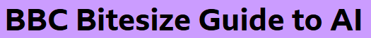
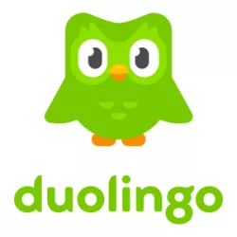
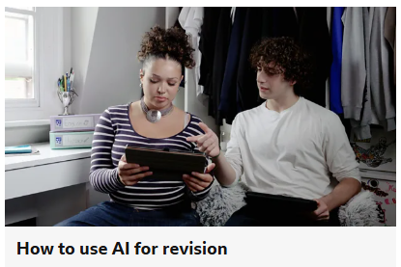
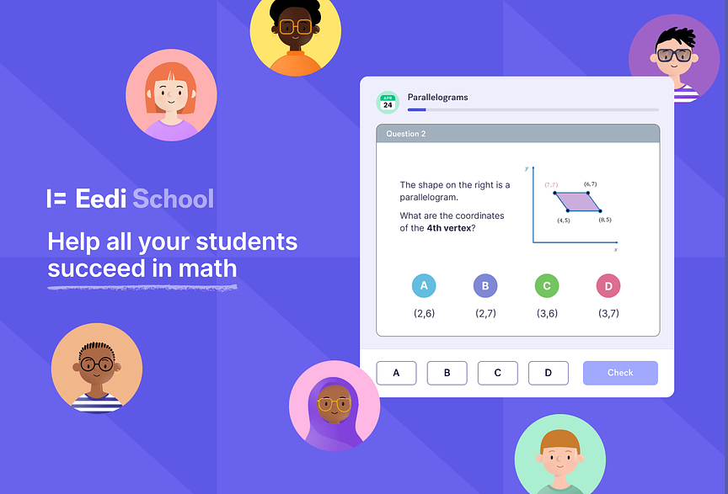
1. Is this use of AI helping me to learn or robbing me of a learning opportunity?
Notes:
Subject specialist packages recommended by teachers, e.g. Eedi or Duolingo.
Revision help – generating questions and answers. But make sure you are very specific in your prompt to stay on topic.
Asking for alternative explanations of concepts you are finding tricky.
Think about:
Using AI purely as a search engine. Think about why you are doing this. AI summaries often disguise the source of the information, making it harder to determine accuracy and understand bias. How will you guard against this?
Summarising longer documents. Sometimes this is fine, but if you never practise skimming and scanning skills to extract relevant information, you will never learn these. Remember too that AI summaries are not always accurate.
Revision. Would you be better off using revision materials provided by your teacher, tailored revision sites (like BBC Bitesize) and past papers? How certain are you that your AI revision is sufficiently focussed on what you need to learn?

Slide 19

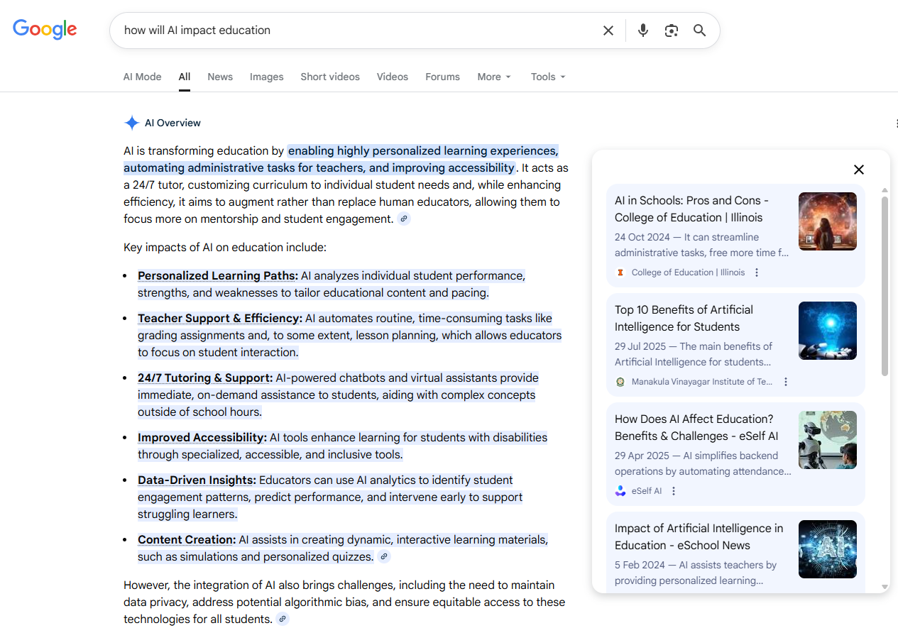
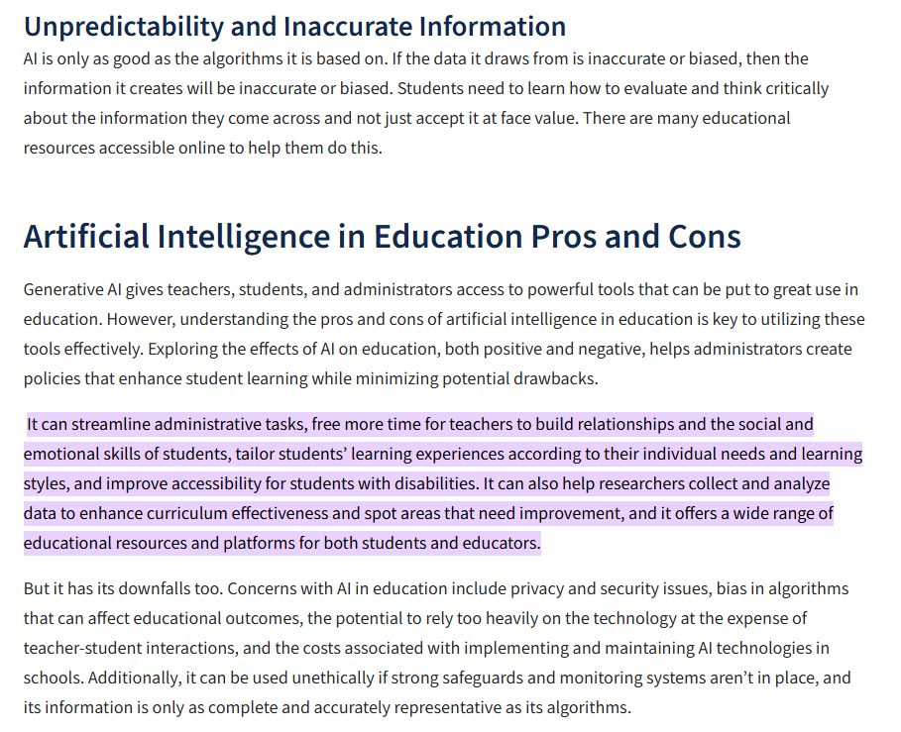
1. Is this use of AI helping me to learn or robbing me of a learning opportunity?
Notes:
Think about:
Using AI purely as a search engine. Think about why you are doing this. AI summaries often disguise the source of the information, making it harder to determine accuracy and understand bias. How will you guard against this? One way to do that is to follow the links that many AI summaries give and look at the original sources. In this example from Google, the link shows info is based on some College and University sources but also some AI companies, who are likely to be biased. If you follow the link into the source itself, Google even helpfully highlights for you which part of the article the summary was based on so you can see if it is representative of the article as a whole.
Summarising longer documents. Sometimes this is fine, but if you never practise skimming and scanning skills to extract relevant information, you will never learn these. Remember too that AI summaries are not always accurate.
Revision. Would you be better off using revision materials provided by your teacher, tailored revision sites (like BBC Bitesize) and past papers? How certain are you that your AI revision is sufficiently focussed on what you need to learn?

Slide 20
1. Is this use of AI helping me to learn or robbing me of a learning opportunity?
Our brains love shortcuts. It’s in our nature. But your brain needs friction to learn. It needs to have a challenge.
Alex Kosmyna, MIT
Notes:
When we talk about AI robbing us of learning opportunities, the danger is that it is just too easy. Alex Kosmyna of the MIT study that I mentioned earlier puts it very eloquently like this: “Our brains love shortcuts. It’s in our nature. But your brain needs friction to learn. It needs to have a challenge.” Without challenge we don’t learn anything.

Slide 21
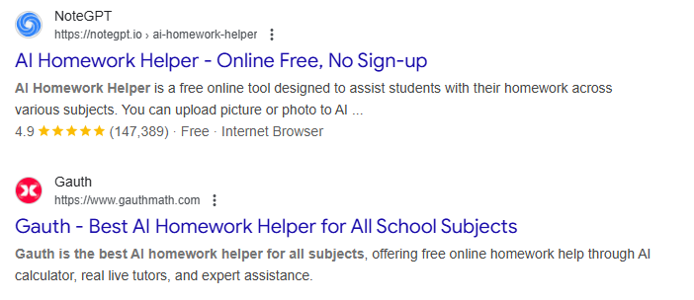
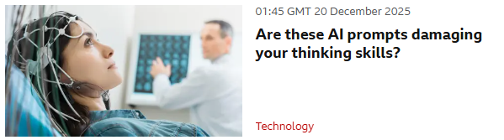
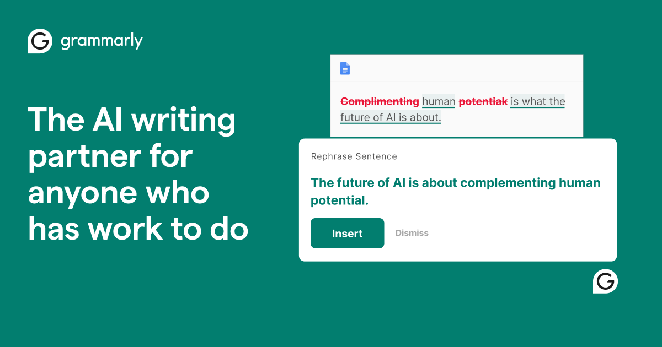
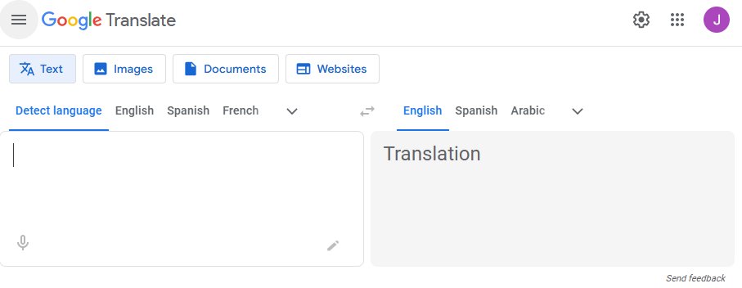
1. Is this use of AI helping me to learn or robbing me of a learning opportunity?
Notes:
Putting homework questions into AI and copying out the answers that it gives – whether shorter answers or longer ‘research’ projects. This term I came across a Y9 boy in the Library answering some Science questions using a textbook page and it was clear to me that the answers were on the page, so I suggested we look together to find them, but he said he’d rather just put the questions into ChatGPT to get the answers quickly, because for him the answers were the point not the learning.
Using AI to write for you (or even rewrite for you). Tools like Grammarly can be helpful if you are using them as a learning tool rather than routinely writing with them and accepting their corrections without thought. When used routinely and thoughtlessly they can cause us to become dependent and incapable of writing clearly without them. Any AI tools embedded within these packages MUST be switched off for coursework. It is worth noting that the age restriction for a Grammarly account is 16+.
Languages teachers also tell me that it is increasingly common for students to put large chunks of text into online translation tools and just copy out the answers. They say that using a computer as a dictionary is fine, but as soon as you are using it to do the whole translation, it shortcuts the learning.
https://www.bbc.co.uk/news/articles/cd6xz12j6pzo

Slide 22
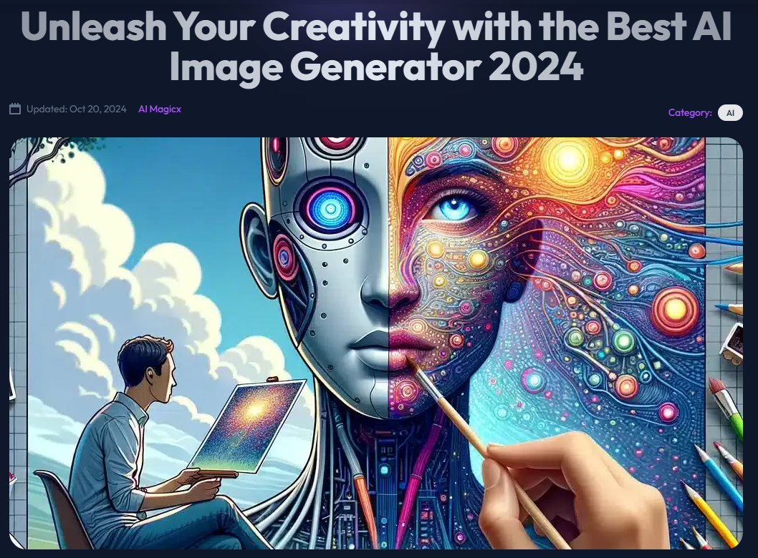

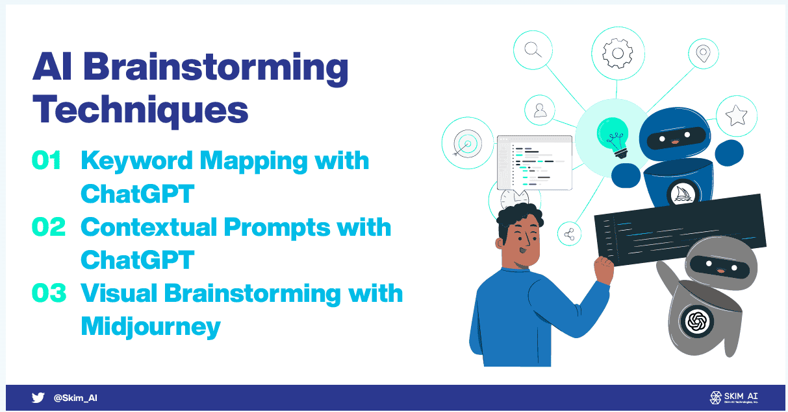
2. Is this use of AI making me more or less creative?
“When, as has happened in many workplaces, companies roll out tools such as the chatbot Copilot without offering decent AI training, they risk producing teams of passable candle-makers in a world that demands high-efficiency lightbulbs.” Michael Gerlich
Notes:
Brainstorming ideas for new projects (but check with your teacher if this is something you are marked on).
Shortcutting (with permission) a task that is not central to the main learning aim of the homework so that you can focus your time on the learning.
https://skimai.com/5-ways-to-use-generative-ai-for-brainstorming/
https://aimagicx.com/blog/unleash-your-creativity-with-the-best-ai-image-generator/
HPQ example
Impact on Art and music
Historical figure chat – like reading a historical novel
“I always use the example: imagine a candle. Now, AI can help you improve the candle. It will be the brightest ever, burn the longest, be very cheap and amazing looking, but it will never develop to the lightbulb,” he says. To get from the candle to a lightbulb you need a human who is good at critical thinking, someone who might take a chaotic, unstructured, unpredictable approach to problem solving. When, as has happened in many workplaces, companies roll out tools such as the chatbot Copilot without offering decent AI training, they risk producing teams of passable candle-makers in a world that demands high-efficiency lightbulbs. Michael Gerlich, head of the Centre for Strategic Corporate Foresight and Sustainability at SBS Swiss Business School

Slide 23


We need to Chat(GPT)
Olivia Han, aged 16
Notes:
We Need to Chat(GPT) - The New York Times
Award winning letter from a 16 year old girl in the New York Times, who wrote a break up letter to ChatGPT
…At first, I told myself I was being resourceful and efficient. It was working smarter to have you articulate my thoughts, so why should I work harder when you always had the answer? But slowly, your voice started to replace my own, and I couldn’t write a paragraph without wondering how you would say it. The more I relied on you, the less I challenged myself….
…Originality is hard, flawed, and messy, but that’s what makes it real. If me and 400 million weekly users rely on you for every spark, every idea, and every sentence, then eventually we’ll leave our own voices behind, and you will speak for us all. I don’t want every good idea in the world to come from the same blueprint, so I’m stepping away right now…
Olivia Han, aged 16

Slide 24
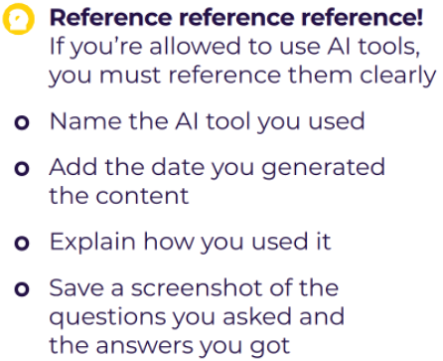

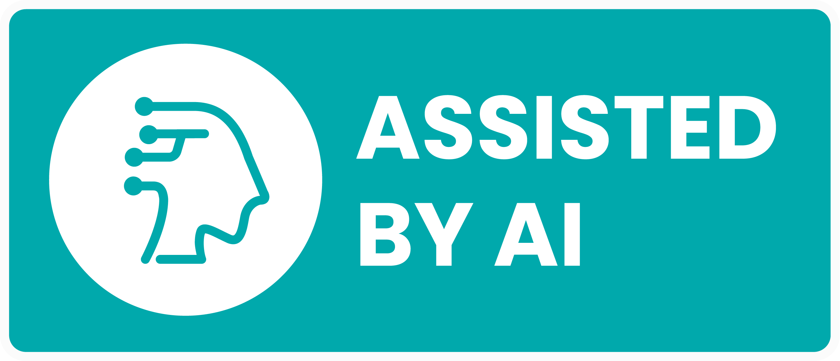
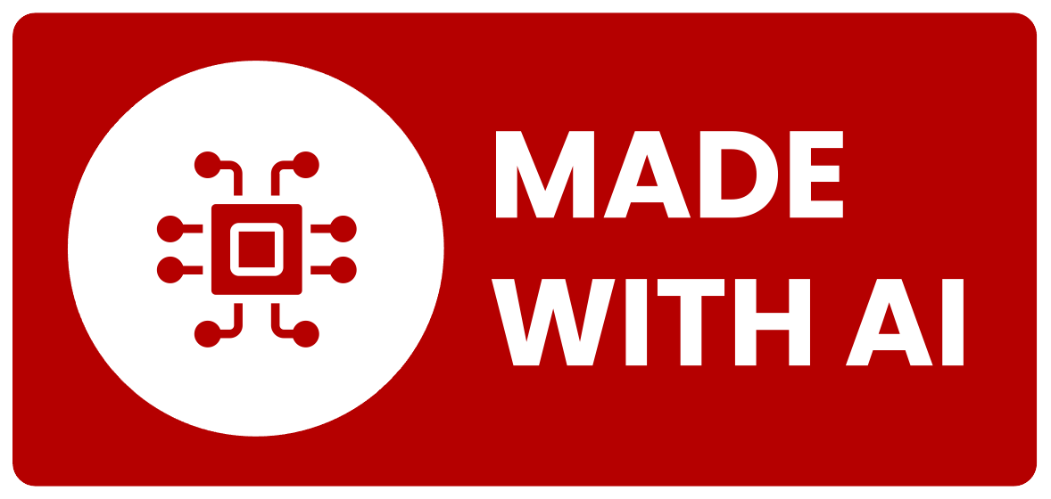
3. Would I be comfortable to openly acknowledge this use of AI?
Do I practise doing that every time I use it?
Notes:
I had a conversation with a Y10 student yesterday who had done really well in an assignment for which he had used AI without citing it, and wasn’t sure how to feel about that because he didn’t know if he really deserved the mark. If students are up front about the use they make of AI, it helps them and their teachers to understand the learning that is happening – which is actually the point, and to talk about what is productive and what is not.
As far as coursework is concerned, all uses of AI MUST be referenced (with screenshots) and students should be practising that right from the start so that it becomes second nature. But more than that, for their own academic integrity we should be having open conversations about when AI use is and is not appropriate and always referencing it when used, as we should for any other source. AI use would be much less of a problem all round if there wasn’t something furtive and guilty about it. Either we are comfortable with the use we are making, or we shouldn’t do it!
https://library.concordia.ca/help/ai/acknowledging-ai.php

Slide 25
JCQ AI rules summary
AI may not be used at all in exams
It may be used under some circumstances in coursework…
…but you can’t get marks for any ‘thinking’ that AI does for you
Notes:
In terms of coursework itself, the rules are very clear. Students may not use AI in exams but can under some circumstances in coursework as long as it is clearly cited using the rules shown, which include a screenshot of every interaction.
It is worth remembering though that students won’t get marks for any ‘thinking’ that the AI has done for them so it is vital to be guided by teachers and be open with them in advance about planned uses so that they don’t lose marks and it is helpful if these conversations are starting further down the school so they are natural.

Slide 26

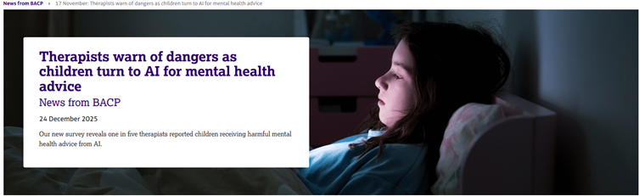

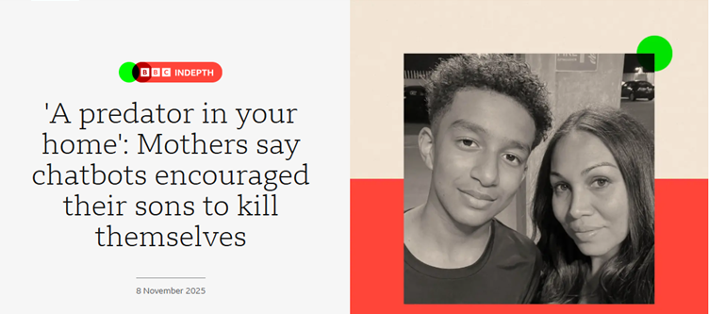
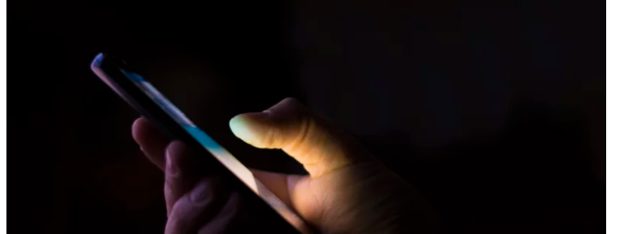
Keeping our children safe
Notes:
There is serious global concern, alongside that about social media use, about the impact of extensive use of AI chatbots on some children, from generation of inappropriate images and bullying to chatbots encouraging suicidal thoughts. How do we get behind the hysteria to allow our children to explore in relatively safe ways?
https://www.npr.org/2025/12/29/nx-s1-5646633/teens-ai-chatbot-sex-violence-mental-health

Slide 27
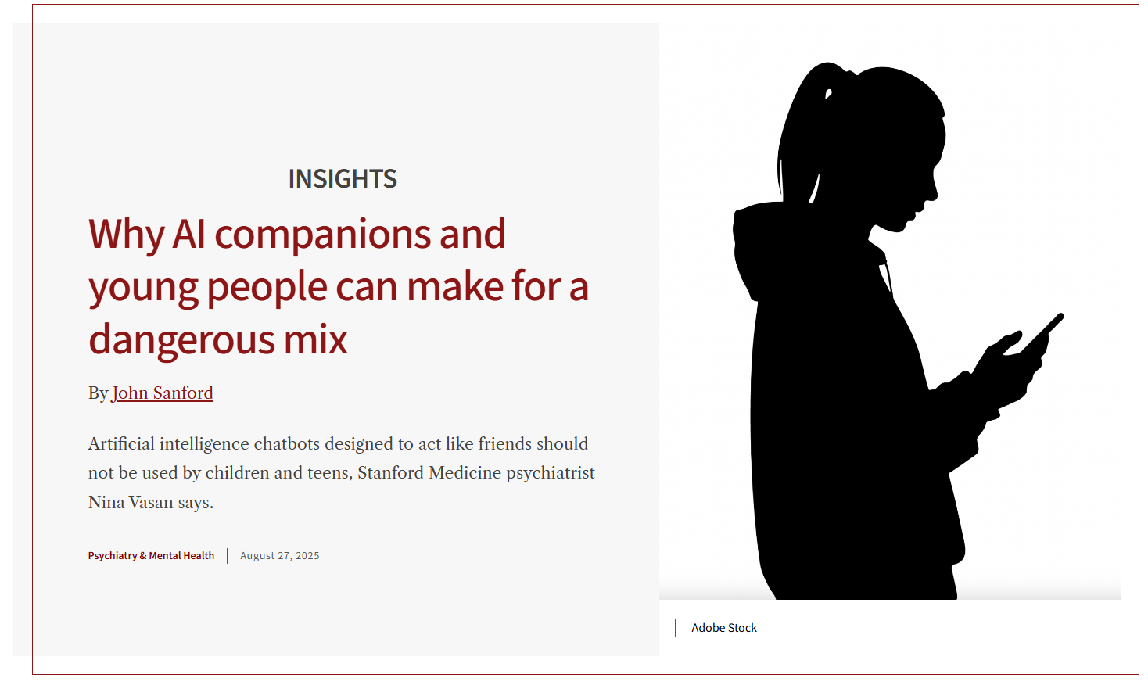

Brains not fully mature
Tend to:
  Act impulsively
  Form intense attachments
LLMs are sycophantic
Frictionless relationships
Notes:
This article from Stanford Medicine summarised clearly why AI companions can be more dangerous for children than adults.
The blurring of the distinction between fantasy and reality that chatbots create can be especially potent for young people because their brains haven’t fully matured. The prefrontal cortex, which is crucial for decision-making, impulse control, social cognition and emotional regulation, is still developing.
Tweens and teens are more likely to act impulsively, form intense attachments, compare themselves with peers and challenge social boundaries.
One key difference is that the large language models that form the backbone of these companions tend to be sycophantic, giving users their preferred answers.
These chatbots offer “frictionless” relationships, without the rough spots that are bound to come up in a typical friendship.
https://med.stanford.edu/news/insights/2025/08/ai-chatbots-kids-teens-artificial-intelligence.html

Slide 28





How do I keep my child safe?
Watch out for behaviour changes
Be curious about children’s online lives
Discuss the risks and benefits of AI
Set reasonable time limits
Set up children’s accounts
Notes:
So what can we do? A lot of the advice is similar to other online safety advice and centres on clear communication.
Be aware of personal risks and watch out for key indicators, such as social withdrawal and overdependence on chatbots.
Be curious about children’s online lives and make their online world part of everyday conversation.
Discuss the risks and benefits of AI (both personal and societal) in a neutral, curious way. Include discussions about sharing of personal data and images.
Set up children’s accounts with parental controls where possible. Avoid sharing accounts. Note that companies are increasingly using AI profiling to predict the age of the user in order to put safeguards in place, and sharing accounts confuses this.
Set reasonable time limits.
https://www.npr.org/2025/12/29/nx-s1-5646633/teens-ai-chatbot-sex-violence-mental-health

Slide 29
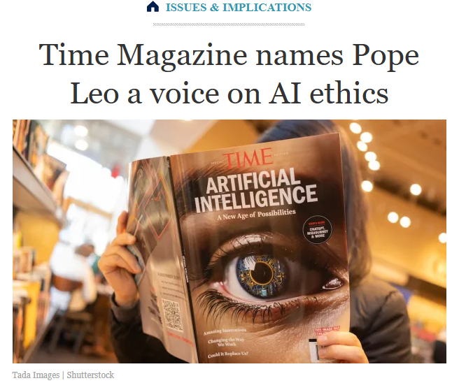

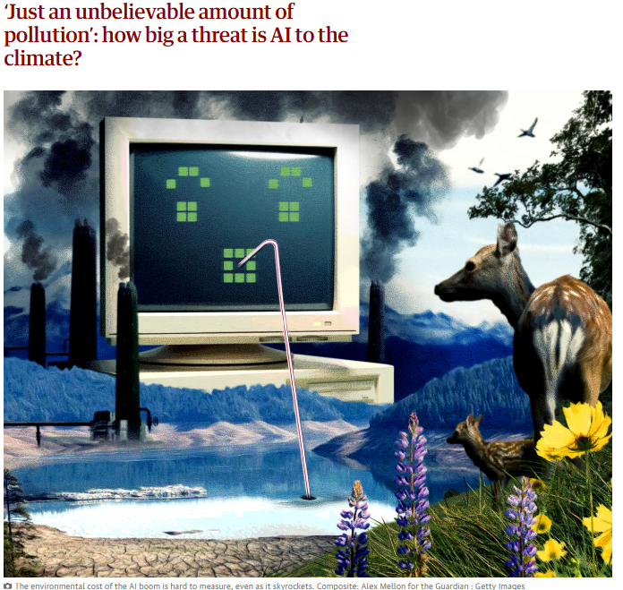
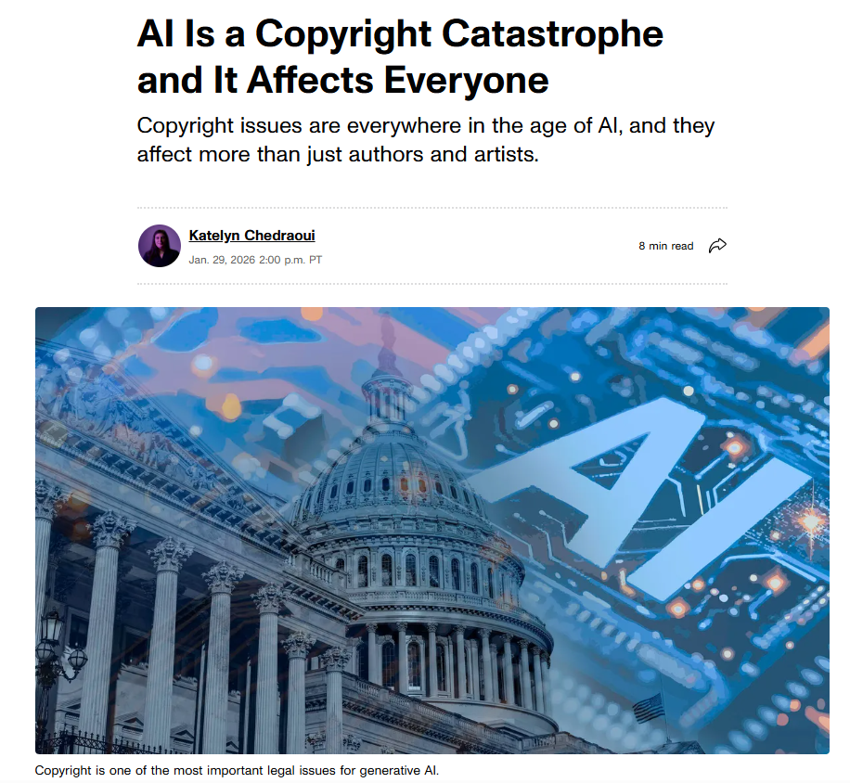
Privacy, Environment & Ethics
Notes:
Privacy, Environment & Ethics
Beyond all of the educational challenges, there are huge societal issues with the rapid development of AI that are beyond the scope of this presentation but are exceptionally important and need to be part of the ongoing conversation. In particular:
data privacy, security and ownership
environmental issues with energy and water use, particularly for image and video generation – generating an AI image can use as much as 30 times the energy of generating text, and one study I read said that generating a 30second AI video used as much energy as running an electric over for nearly three days
there are widespread ethical concerns, some relating to intellectual property but others relating to the impact of long hours of viewing unpleasant and violet content on poorly paid workers in the third world to make AI tools safer for everyone else
and the proliferation of AI ‘slop’ that makes it harder to find valuable, authentic content.
Children need to be part of the conversation about how AI is changing the world – for better as well as for worse – because this is the world they are inheriting, so let’s have those conversations.
Images:
‘Just an unbelievable amount of pollution’: how big a threat is AI to the climate? | AI (artificial intelligence) | The Guardian
Time Magazine names Pope Leo a voice on AI Ethics
AI Is a Copyright Catastrophe and It Affects Everyone - CNET

Slide 30
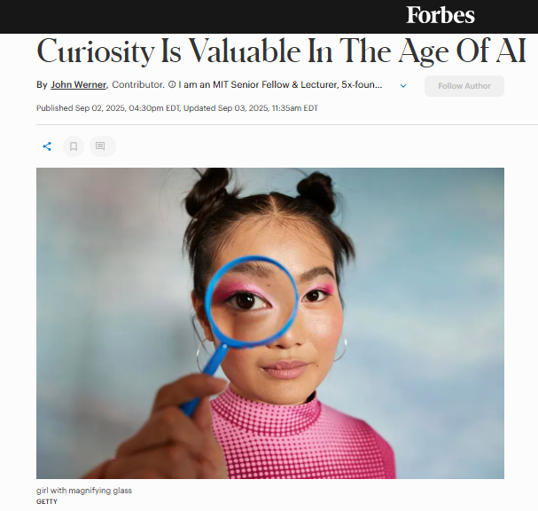
In addition to the use of AI by adolescents’ peers, the use of AI by adults (e.g., parents and teachers) can be highly influential in adolescents’ own attitudes and practices around AI; it is critical that adults model healthy behavior and critical thinking for adolescents.
American Psychological Association (2025) Artificial intelligence and adolescent well-being
College Mission Statement: Together, learning to become all that God wants us to be.
Notes:
We spoke at the start about academic integrity, and about the role of education in shaping character, equipping children to deal with whatever they will face in life. Curiosity is hugely valuable in learning to deal with new ideas and tools, and it’s fine to encourage our children to explore within safe limits – but we also need to be very aware that their attitudes and responses will be shaped by what they see us doing and the conversations we have with them around that. Children will develop the healthiest relationships with tools like AI if we are all exploring and discussing openly together – and paying particular attention to long term consequences (which children find it harder to consider) and the wider social, ethical, environmental and moral implications. We must constantly remind ourselves in the business of everyday life that product of education is not the work that is produced but the young people themselves.
https://www.forbes.com/sites/johnwerner/2025/09/02/curiosity-is-valuable-in-the-age-of-ai/

