Slide 1
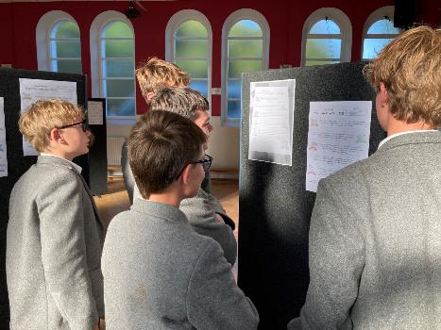
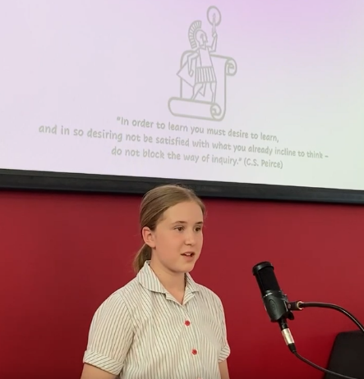
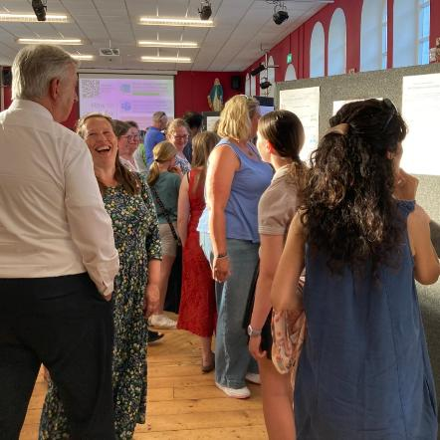


Year 9
Signature Work Inquiry
9 March 2026
Darryl Toerien | Head of Inquiry-Based Learning
toeriend@blanchelande.sch.gg
Blanchelande College Library
Enabling Heroic Inquiry
Notes:
Good evening. We are here to celebrate our Year 9 students, and I don’t want to take time away from that. However, I would like to briefly highlight the significance of what the students have done and place that in its broader context.

Slide 2



Housekeeping
In the event of a fire please exit the building via the nearest door and assemble by the Pink Cottage (exit the building and follow the road to the right)
Photos taken during this event may be used on the Library website or in the school newsletter or social media.
If you do not wish your photo to be used in this way, please speak to Mr or Mrs Toerien.
Notes:
…this notice is aimed at adults in the room – we are already aware of the photo permission choices for students.

Slide 3

The Chief Task of Education
Guiding the dynamic process through which a person becomes fully and truly themself.
Image Source: Amazon
Notes:
What would education – especially a Catholic one – and indeed the world, look like if we took this task seriously?
Jacques Maritain – who, in terms of the breadth and depth of his work, was arguably the most influential Catholic philosopher of the 20th century – remains uniquely positioned to help us answer this vital and urgent question. Not only did Maritain make a profound contribution to the philosophy of education, but also Vatican II – Pope Paul VI fondly referred to him as “my teacher” – and is considered the godfather of the process leading to the Universal Declaration of Human Rights, which many Year 9s referenced in the speeches.

Slide 4
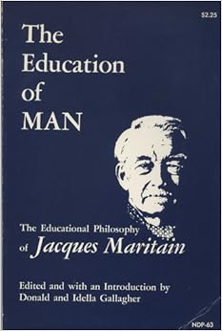
Towards a Fully Human Education
Inquiry is a distinguishing feature of a contemporary liberal education.
A fully human education because its end is “the fulfilment of the deepest potentialities of human being”.
This requires us to prepare our students “to exercise their power to think in a genuinely free and liberating manner – equipping them for truth and making them capable of judging accordingly to the worth of evidence…”
Image Source: Amazon

Slide 5
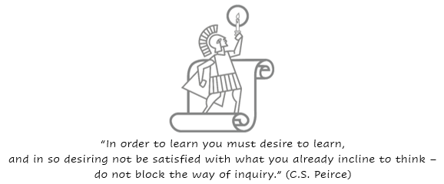
Inquiry: Spiritual, Moral & Educational Imperative
Notes:
This inquiry learning stance and process is encapsulated by C.S. Peirce in his first rule of reason and its corollary.

Slide 6
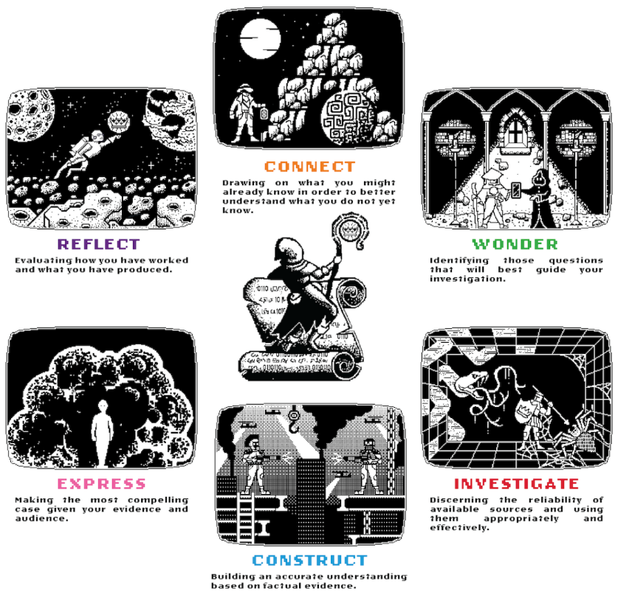
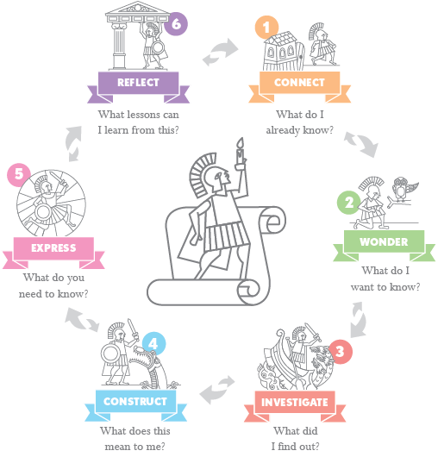
Inquiry & Heroic Inquiry
Inquiry is the process of learning about something by investigating it for yourself, and it is an essential human response to the world we find ourselves in.
This quest for knowledge and understanding is a heroic undertaking, so it is no surprise that the stages of the Hero's Journey are reflected in the stages of the Heroic Inquiry process.

Slide 7
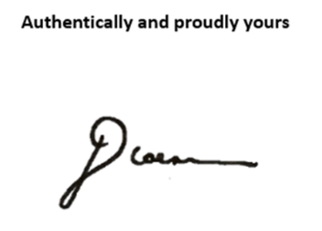

Signature Work Inquiry
Heroic Inquiry that is directed towards understanding a question or problem of personal interest
As such, it proudly bears its maker's mark in the form of their signature
Vouches for the maker's integrity
Guarantees the authenticity of their work

Slide 8
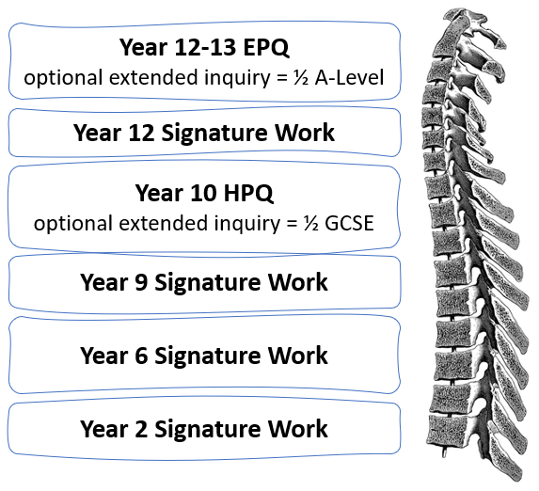
Interdisciplinary Signature Work in Transition Years
Not limited to transition years
For example, Year 1
Transition years benchmark the systematic and progressive development of skills, such as those enabling academic integrity
Backbone of inquiry-based learning throughout the school
Notes:
In less than three years:
Second Year 2 Signature Work Celebration, culminating in published Herm Island Field Guide.
Third Year 6 Signature Work Celebration, culminating in a CREST Bronze Award.
Third Year 9 Signature Work Celebration, culminating in GCSE Enlgish Language Speaking and Listening NEA –> 5-minute speech plus Q&A.
Second Year 10 HPQ Celebration –> 10-minute speech plus Q&A. Only school offering the HPQ.
Second Year 12 Signature Work.
Fourth Year 13 EPQ Celebration –> 15-minute speech plus Q&A.

Slide 9
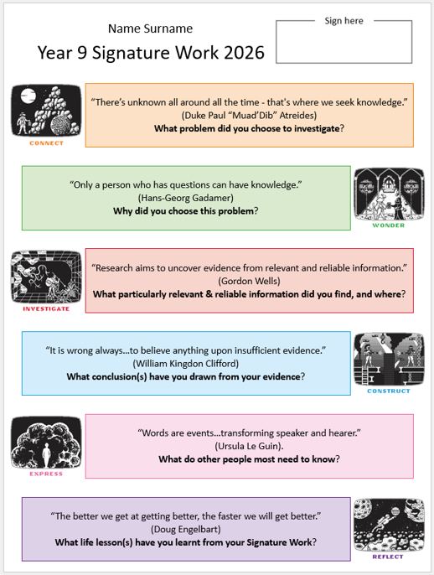


Signature Work Inquiry Celebration 9 March, 5.30-6.30pm De La Salle Hall

Slide 10
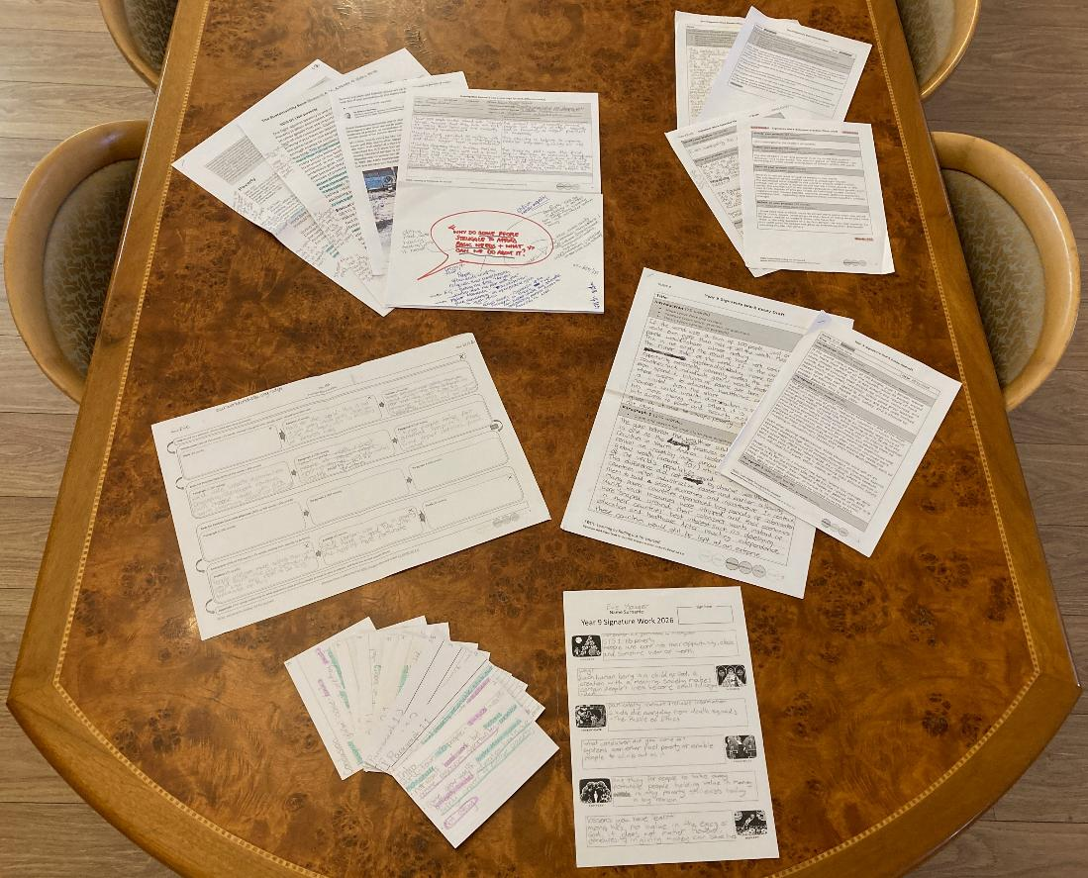
Enabling Thoughtful Readers, Writers and Speakers
Identifying and annotating relevant information
Extracting and reflecting on pertinent information
Drafting and redrafting a 1-minute speech for English (150 words)
Drafting and redrafting a 2-minute speech for Geography (300 words)
Planning a 750-word persuasive essay with or without a counter-argument
Drafting and redrafting a 750-word persuasive essay with or without counter-argument
Crafting a 5-minute speech for English for maximal intellectual and emotional engagement (750 words)
Summarising/ abstracting the learning process and outcome for a poster

Slide 11


Laudato si’: On care for our common home
Theology
Catholic Social Teaching
Geography
Development
Hearing “the cry of the earth and the poor”.
United Nations Sustainable Development Goals (2015)
Notes:
Raymond Friel, also CEO of Caritas.
The mission of a Catholic School must be a lived reality
Its curriculum, “a coherent and compelling expression of the Catholic understanding of reality”
Creation is a gift, not a commodity
Human beings are inherently dignified
Vocation as human beings is to love our neighbour as ourselves
Jacques Maritain also had a profound indirect influence on Laudato si’, which, in turn, shaped the UNSDGs.

Slide 12



Slide 13



Slide 14



Slide 15



Slide 16



Slide 17



Slide 18

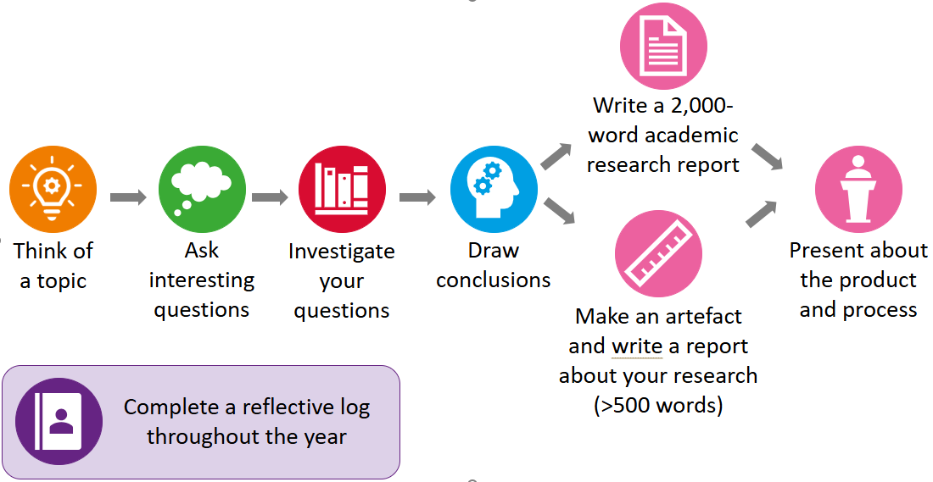
Where next…HPQ?
A one-year GCSE-level qualification* in whatever you are passionate about
For the Heroically Curious…
…who dealt well with the reality of Signature Work
*equivalent to ½ a GCSE
Notes:
All ability – but need to be able to cope with an extracurricular qualification
Reality – did you engage? Did you get your work in on time?
Artefact vs research report – social media strategy for Guernsey Cricket vs best way to terraform Mars. Can’t overlap too much with one of your GCSE subjects.

Slide 19






When would I do an HPQ?
One year course – finishes at the end of Year 10
15-hour taught inquiry skills course (building on the 15 hours of teaching you had in Y9)
30 hours of independent work
Weekly commitment (1.5h)
Taught course with Mrs Toerien during one form time every week (30 min)
Supported independent work with Mrs Toerien during a weekly lunchtime activity (30 min)
Individual independent work in your own time (30 min)

Slide 20
How to apply for an HPQ
Mrs Toerien will add successful applicants to the HPQ Team and let you know how to prepare over the summer.
Mrs Toerien will meet with applicants next term to discuss their applications and suitability for the course (max 15 spaces).
Complete the application Form that Mr Toerien will send out via Y9 English class Teams tomorrow. Deadline Monday March 23rd.
Note that there is a small fee for exam entries for additional qualifications – parents will be contacted to approve this before a place is confirmed on the course.

Slide 21
Notes:
Boasting, not about what I did, or what the school did. All we did was to create the opportunity for what your children did, and are doing, and, more importantly, who they are in the process of becoming. This is what taking the chief task of education seriously looks like <next slide>.

Slide 22

Engaging and Empowering Inquirers
Signature Work Celebration Speeches
2022-3
Maddie: Euthanasia
Yagmur: Gun control in America
2023-4
Amelie: Teenage violence and social media
2024-5
Flo: Global warming and climate change
2025-6
Evie: Poverty
“Nothing is more important than the events which occur within that invisible universe which is the mind of [a person].
And the light of that universe is knowledge.”
Jacques Maritain

