Slide 1




Teaching Inquiry as Conversation
Barb Stripling and Darryl Toerien
A Conversation with David Loertscher
30 April 2026
Notes:
Brief introductions.

Slide 2

Available
  14 May as Ebook
  11 June as Hardback & Softback
Cover centred on interrobang (‽)
  the inquiry stance of wonder (!) and puzzlement (?) that gives rise to the
  dynamic inquiry process of coming to know and understand the world and ourselves in it (💡) that is the
  basis for responsible participation in community
Inquiry is conversational in nature
Notes:
Book
Available for preorder.
We are excited that Bloomsbury intend to have a physical copy to preview at ALA.
Cover
The interrobang is a relatively new (conceptualised in 1962) and unconventional punctuation mark that combines an exclamation mark with a question mark.
For us it represents the inquiry stance of wonder (!) and puzzlement (?) that gives rise to the dynamic inquiry process of coming to know and understand the world and ourselves in it (💡) that is the basis for responsible participation in community.
Inquiry is conversational in nature—more on this to follow.
Like the interrobang, students who are engaged and empowered inquirers are unconventional, in that they are not stamped from a mould—I am reminded of Saint John Henry (1852): "A University is...an Alma Mater, knowing her children one by one, not a foundry, or a mint, or a treadmill". How much more so a school, then?

Slide 3
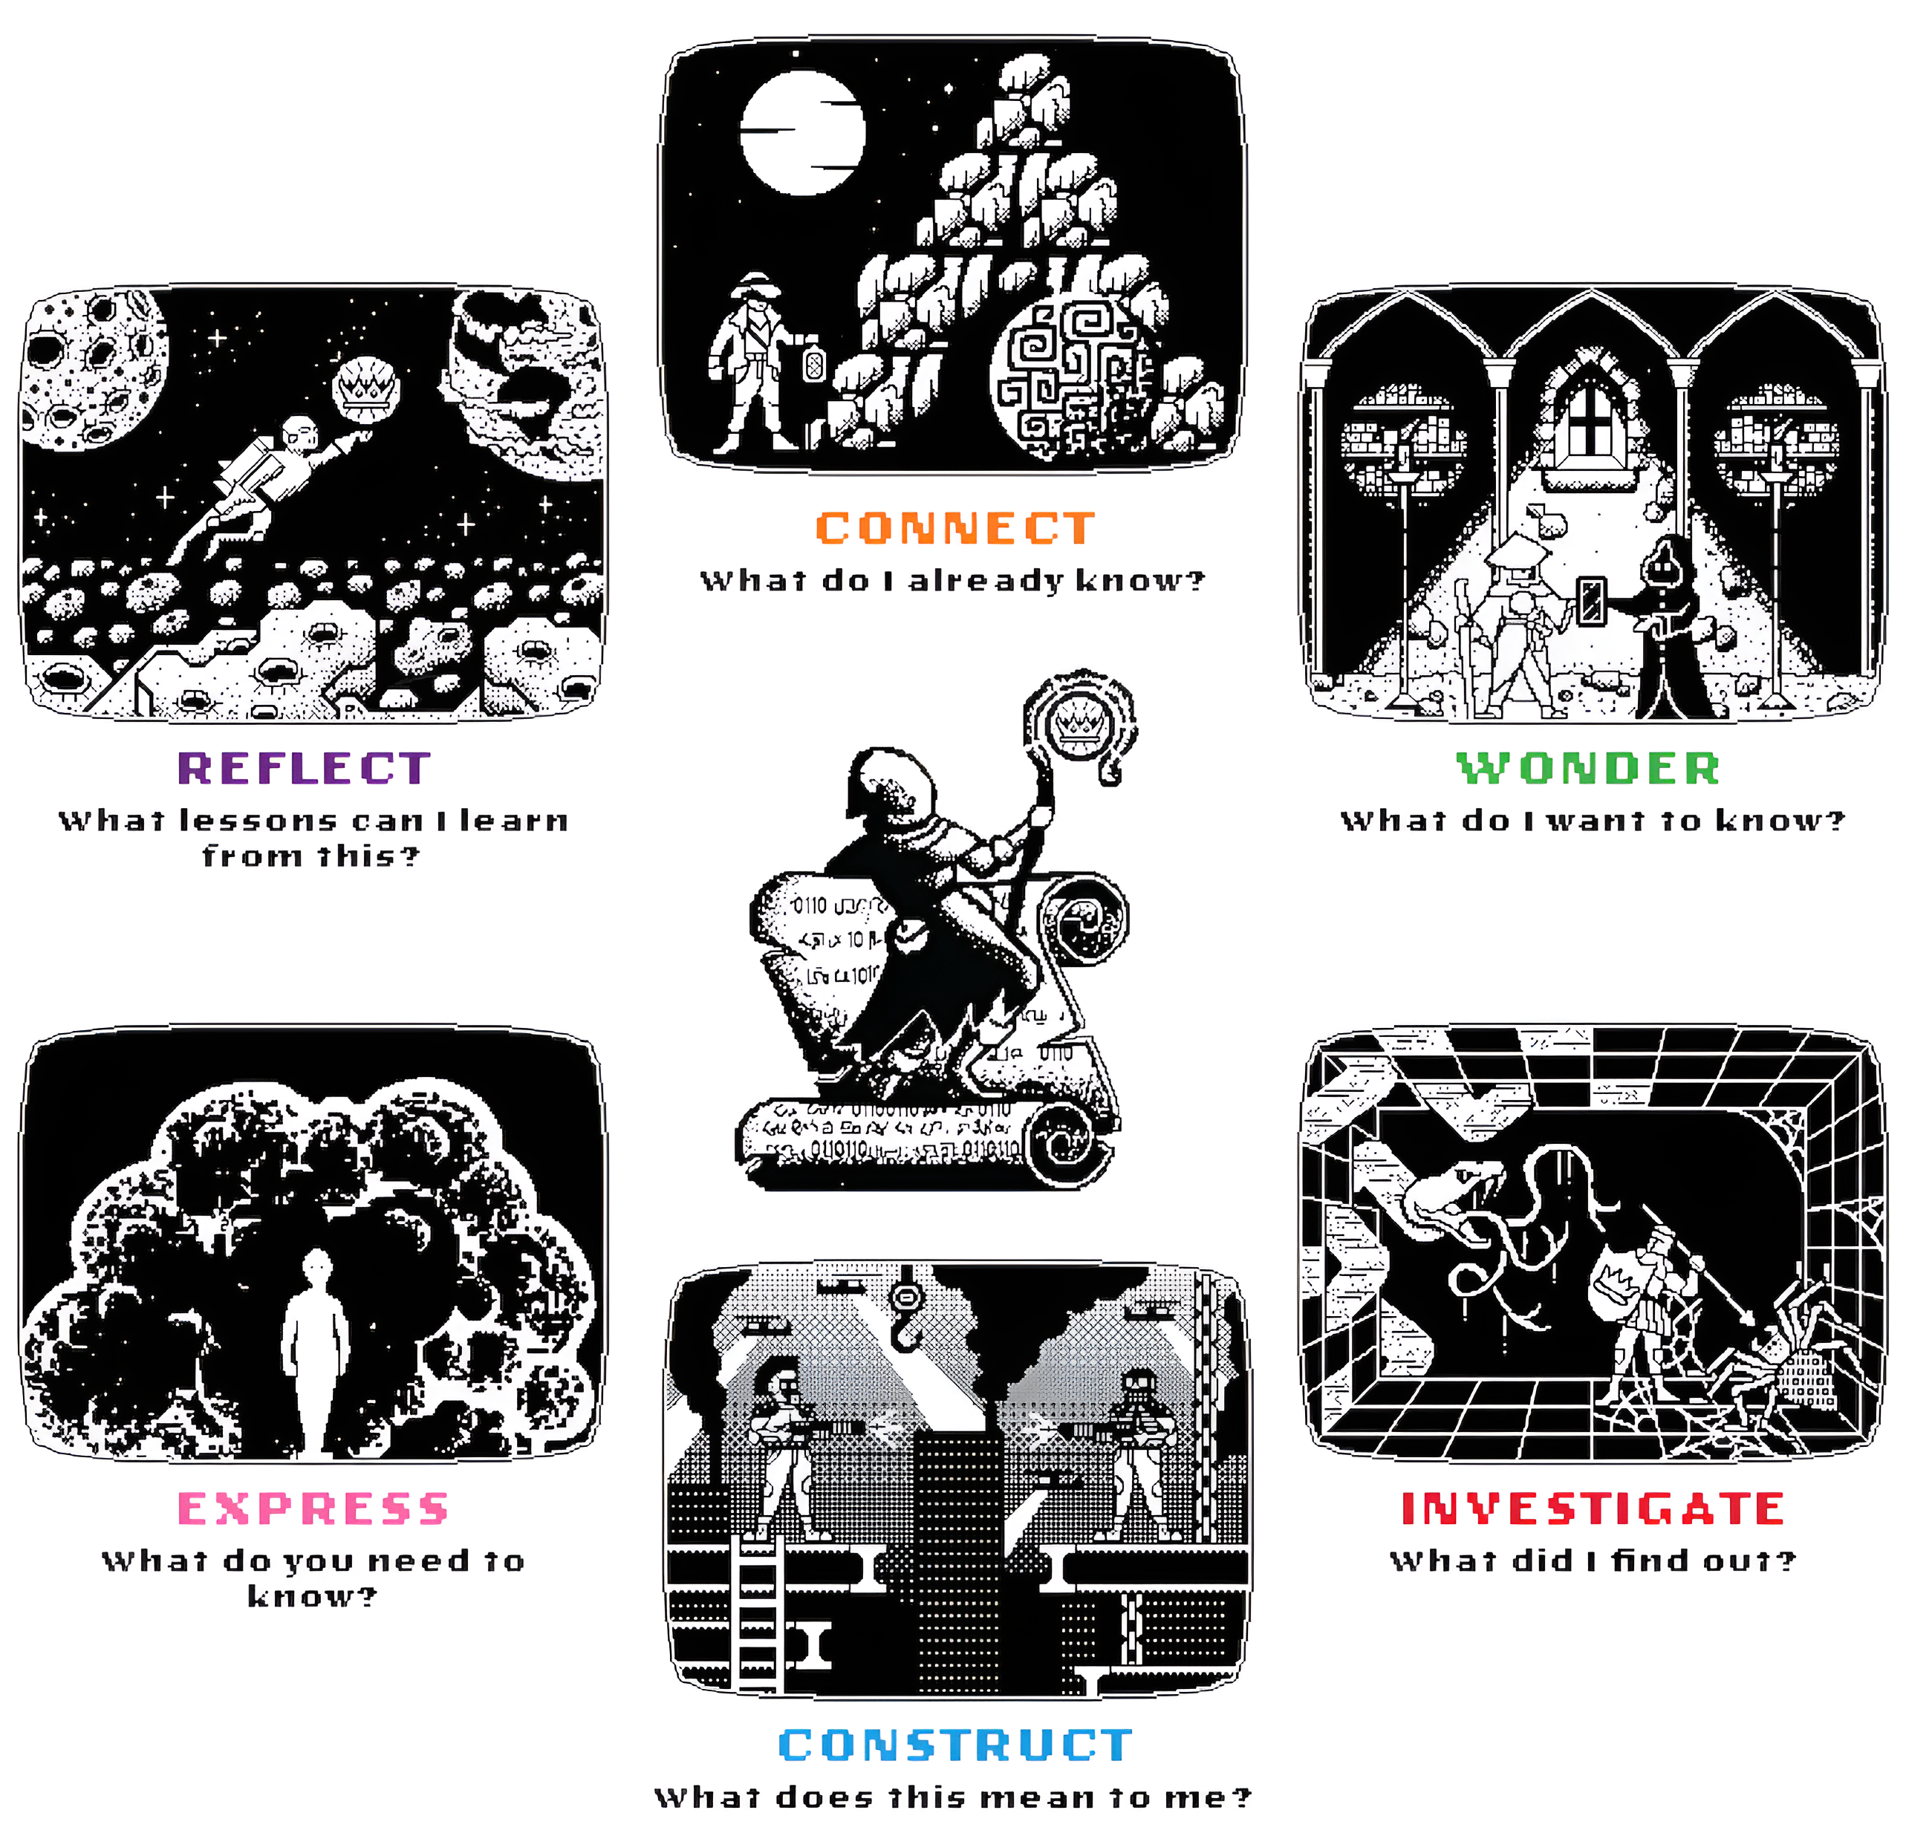
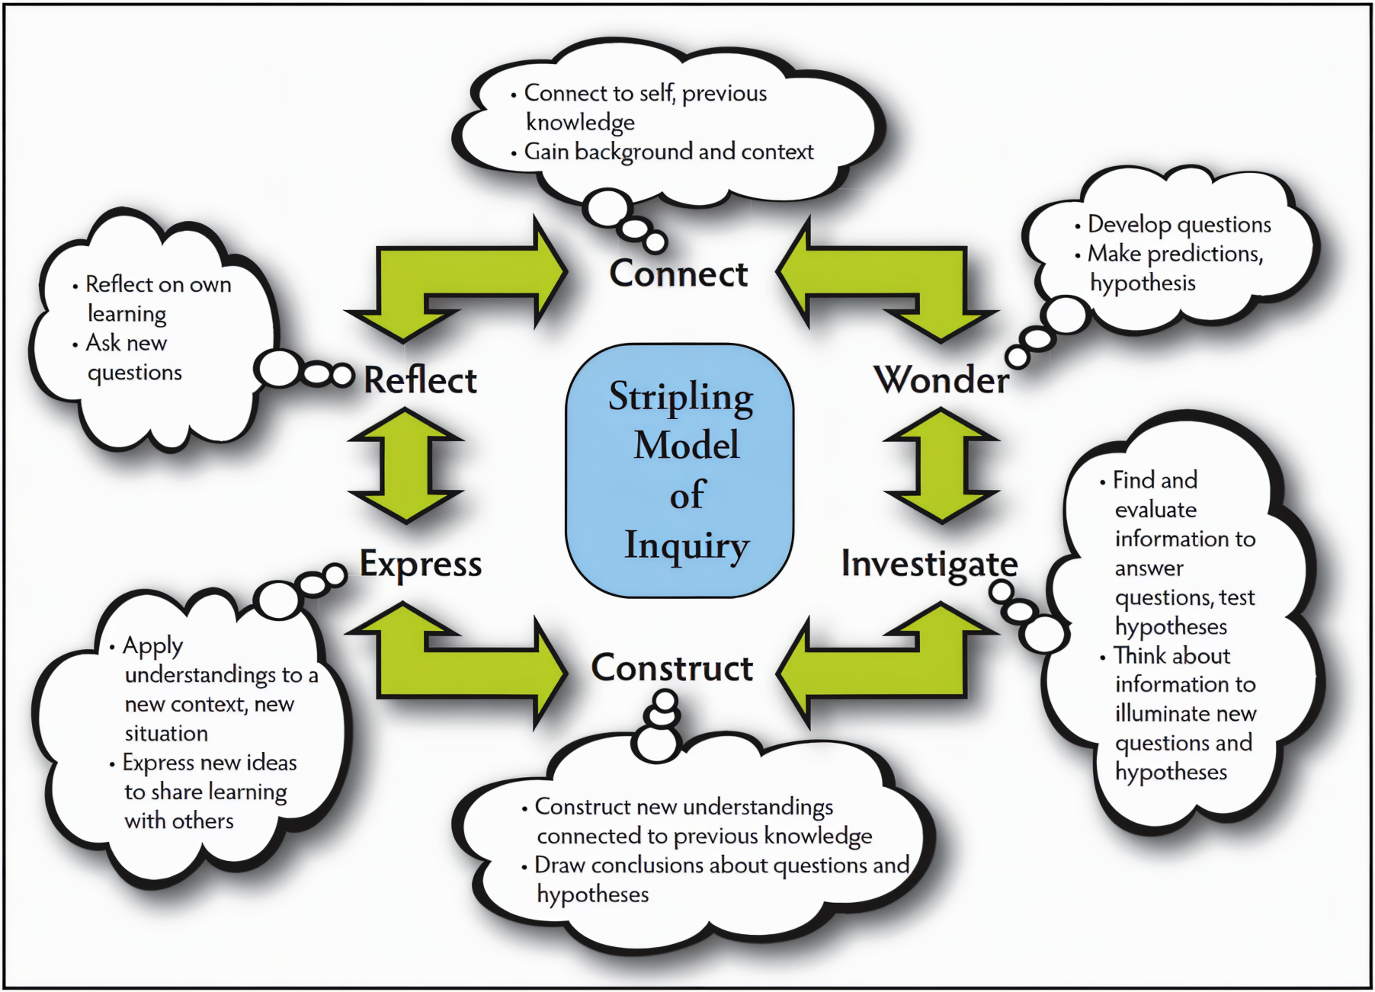
Open-Source Engagement and Empowerment
FOSIL Heroic Inquiry Cycle (Condensed)
Notes:
A distinguishing feature of Barb’s model (2003), and the accompanying Empire State Information Fluency Continuum (ESIFC, 2009/2012 and re-imagined in 2019), is that it is shared freely under Creative Commons.
This enabled me (Darry)l to freely engage with Barb’s work and empowered me (him) to adapt her work to meet my (his) specific needs.
This led to FOSIL (2010) and the FOSIL Group (2019), and the FOSIL-based Heroic Inquiry Cycle (2021/2025), all of which is also shared freely under Creative Commons.
This further meant that Barb and I were free to collaborate with each other—in weekly conversation since for the last 5 years—which has both broadened and depended our ongoing work.
And led to this book.

Slide 4
Inquiry is grasping reality
“Reading the world precedes reading the word, and the subsequent reading of the word cannot dispense with continually reading the world.”
Paulo Freire
The importance of the act of reading, 1983, p. 5.
Notes:
The first of four talking points
The inquiry process of coming to know and understand reality—things as they actually are—is a learning process.
Paulo Freire, who is sometimes deliberately misunderstood, and then vilified, puts it this way: “Reading the world precedes reading the word, and the subsequent reading of the word cannot dispense with continually reading the world.”
This underscores the unique and indispensable educational value of school librarians, which is that they are teachers whose specialist subject is the inquiry process of learning itself, which is dependent on reading both world and word, and who are then also specifically charged with safeguarding the word so that it may be read.

Slide 5
Grasping reality is communal
“For apart from inquiry, apart from the praxis, individuals cannot be truly human. Knowledge emerges only through invention and re-invention, through the restless, impatient, continuing, hopeful inquiry human beings pursue in the world, with the world, and with each other.”
Paulo Freire
Pedagogy of the oppressed, 2005, p. 72.
Notes:
The second of four talking points
Grasping things as they actually are—reality—is communal in that it requires community and produces community.
Paulo Freire again: “For apart from inquiry, apart from the praxis, individuals cannot be truly human. Knowledge emerges only through invention and re-invention, through the restless, impatient, continuing, hopeful inquiry human beings pursue in the world, with the world, and with each other.”
This underscores our high calling as school librarians, not only because of what we aspire to on behalf of our students, but also because we may be alone in aspiring to this for them.
This is why a Pedagogy of the oppressed (1968) is also a Pedagogy of hope (1992), for “without a minimum of hope, we cannot so much as start to struggle” (p.17).

Slide 6
Whole-Child Inquiry Empowers Students
Go beyond acquiring academic knowledge. . .
Discover who they are as humans and how they relate to others and the world outside of school
Notes:
The third of four talking points
Inquiry enables the learning of academic content because students are expected to think, not just memorize
Inquiry enables students to make connections to previous knowledge
Inquiry enables students to develop important personal qualities and social skills → whole-child learning

Slide 7
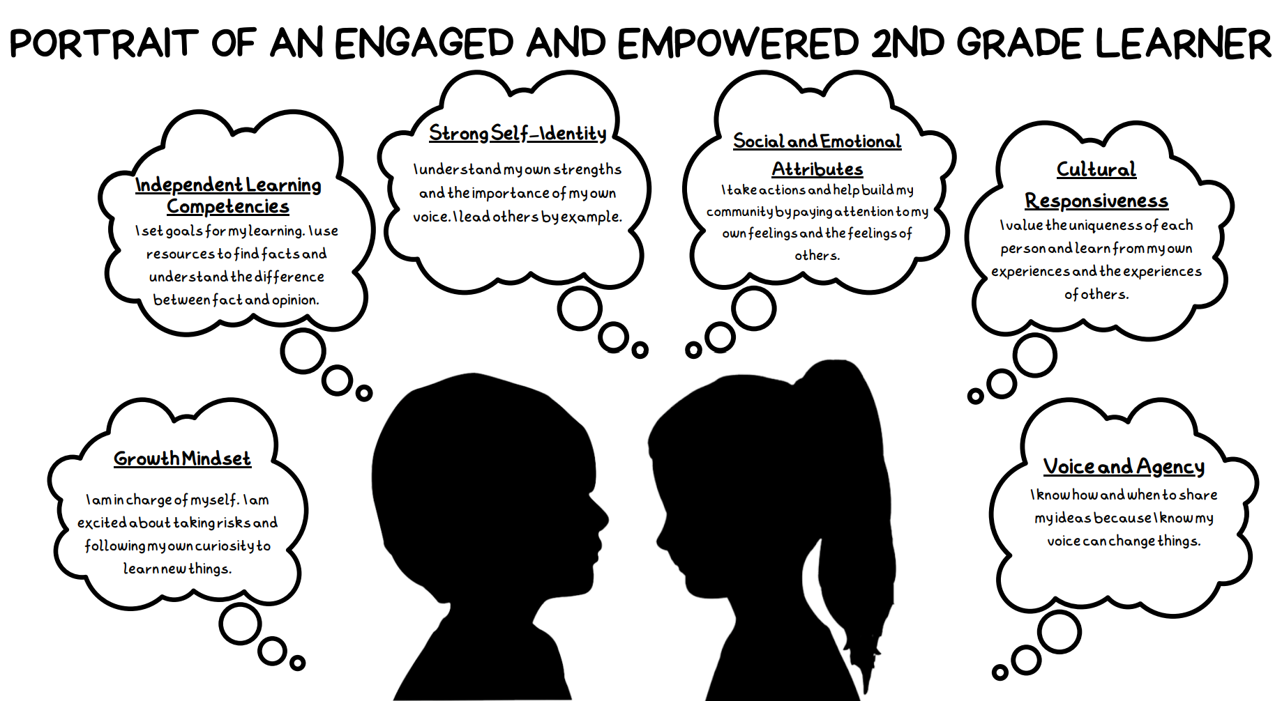
Notes:
Competencies of whole-child inquiry:
Academic – Independent learning
Personal – Self-identity; Voice and agency; Growth mindset
Social – Social and emotional skills and attitudes
Cultural – Cultural responsiveness
All of the attributes of engaged and empowered learners (whole-child inquiry) are developed over time, but we have benchmarks for their development at grades 2, 5, 8, and 12.
Example: Voice and agency
Students know how and when to share their voice; they recognize that their voice matters
Example: Strong Self-Identity
Students learn to see themselves through their strengths, not through their gaps or deficits
Students recognize the importance of their own voice
Students lead others by example

Slide 8
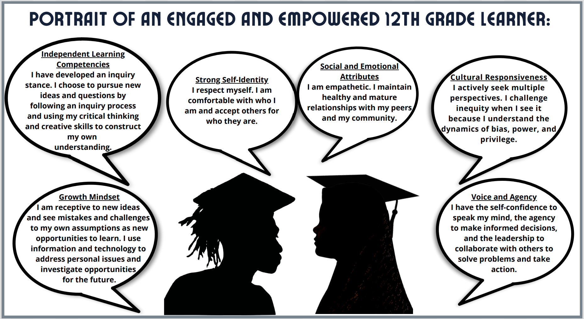
Notes:
What do we want our students to look like when they graduate? The 12th grade portrait provides a benchmark vision for the attributes they will have developed through whole-child inquiry.
Example: Voice and agency
Self-confidence
Agency to make decisions
Leadership (collaboration and solving problems)
Empowered to take action
Example: Strong-identity
Self-respect
Comfortable with who they are
Accept others for they are
Other important competencies at 12th grade:
Stance of inquiry
Use both critical and creative thinking skills
Empathize
Actively seek multiple perspectives
Challenge inequity

Slide 9
Whole-Child Inquiry at Construct Phase
Independent Learning | Strong Self-Identity | Social and Emotional Growth
Develops clear and appropriate opinions or conclusions supported by evidence and examples Develops a line of argument or claim with clear reasoning, supporting evidence, and attention to refuting counter claims | Recognizes when evidence requires correcting or changing a previous assumption or opinion Develops aspects of personal identity that are satisfying and identity-confirming | Actively solicits and listens with an open mind to the opinions, ideas, and feelings of others Participates in conversations and discussions to draw conclusions about a topic or story Builds trusting relationships with diverse peers and adults through collaboration and communication
Notes:
For each whole-child attribute, librarians can teach specific skills. For Independent Learning, we teach students in secondary school to develop a line of argument or claim, but at the same time, we can integrate teaching them to
Solicit and listen to the ideas of others
Be willing to change their own ideas
Build relationships through collaboration
Develop their own opinions based on evidence

Slide 10
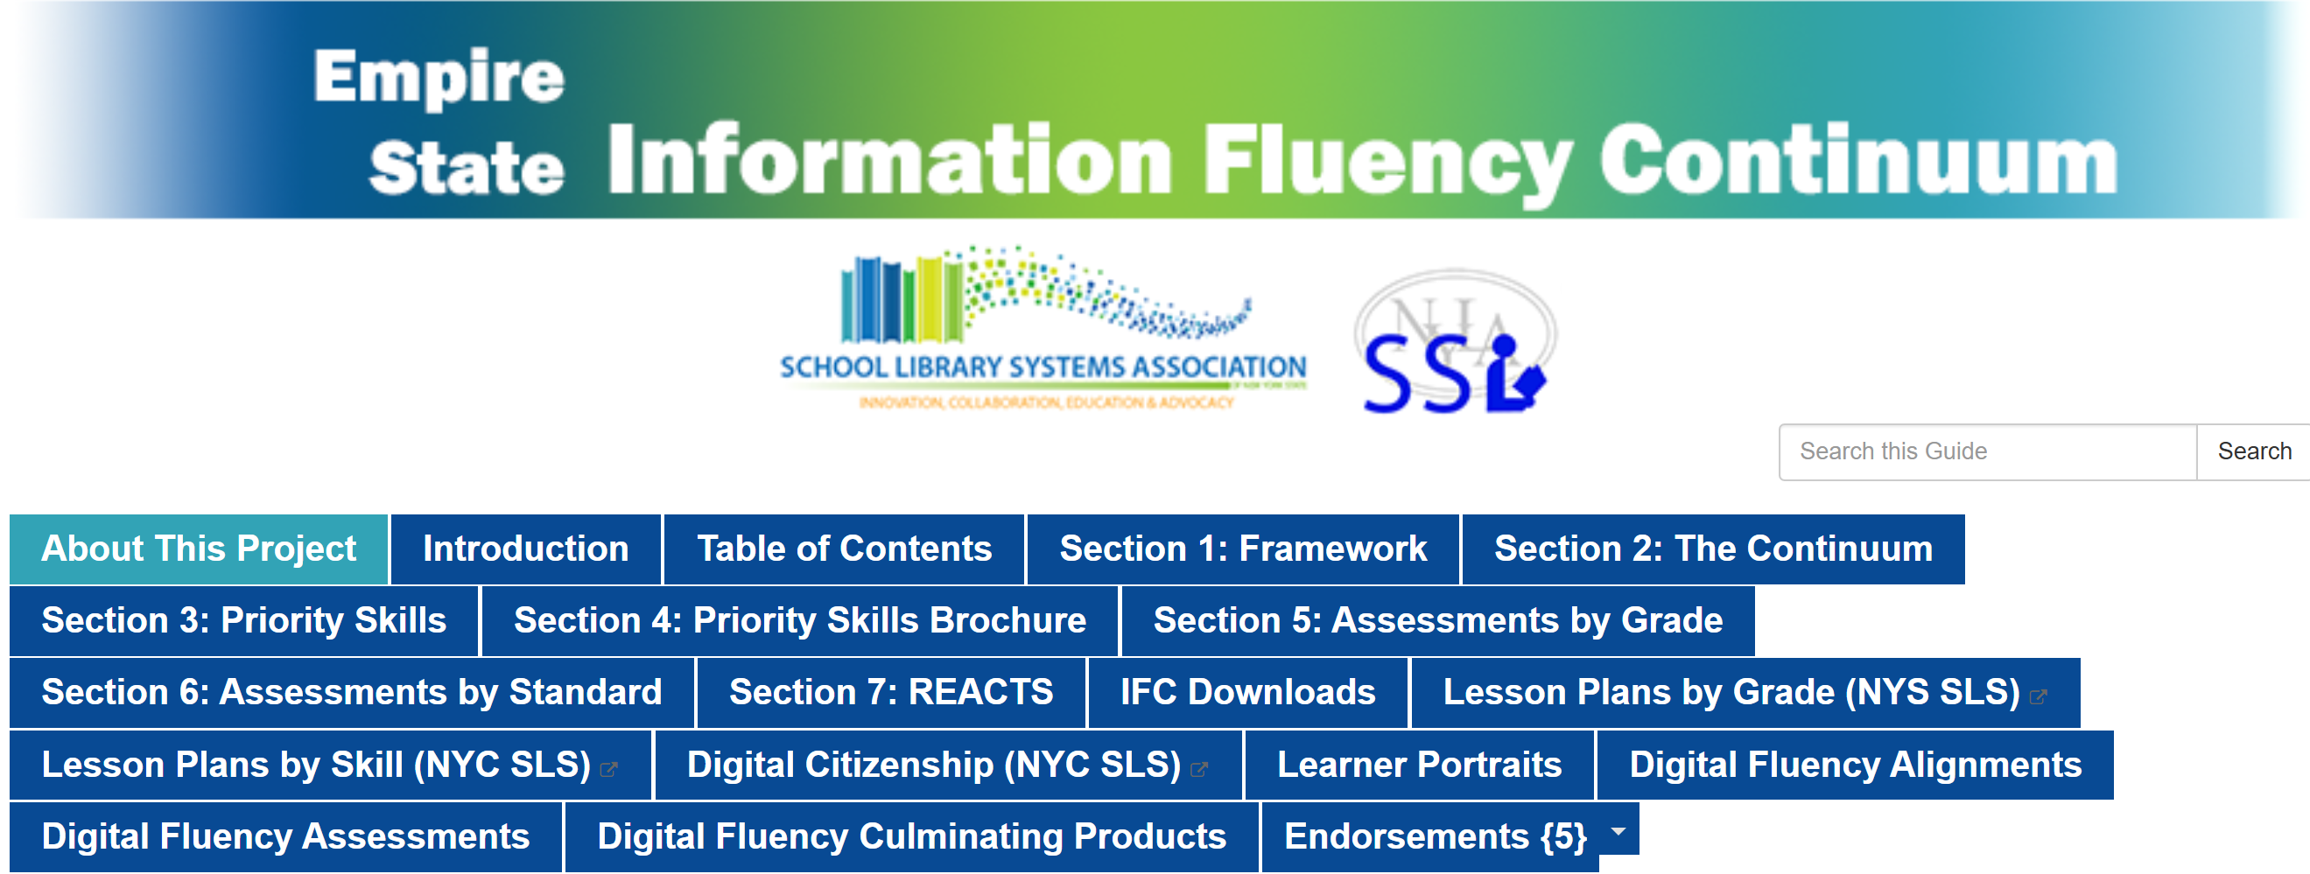
Skills Are Developed Through a Continuum
https://slsa-nys.libguides.com/ifc
Notes:
The fourth of four talking points
Skills are developed over time, preK-12
Librarians can be guided in selecting appropriate skills to teach as students progress through school by the Empire State Information Fluency Continuum (ESIFC), which is offered online through a Creative Commons license. (https://slsa-nys.libguides.com/ifc)
Priority skills for each grade
Articulated skills that define whole-child inquiry
Infused with critical and creative thinking skills, literacy and digital literacy skills, media literacy, and inquiry/research skills
Special attention to digital fluency and cultural responsiveness
Graphic organizers for formative assessment of priority skills during lessons and activities
Sample lessons, units, and project ideas

Slide 11
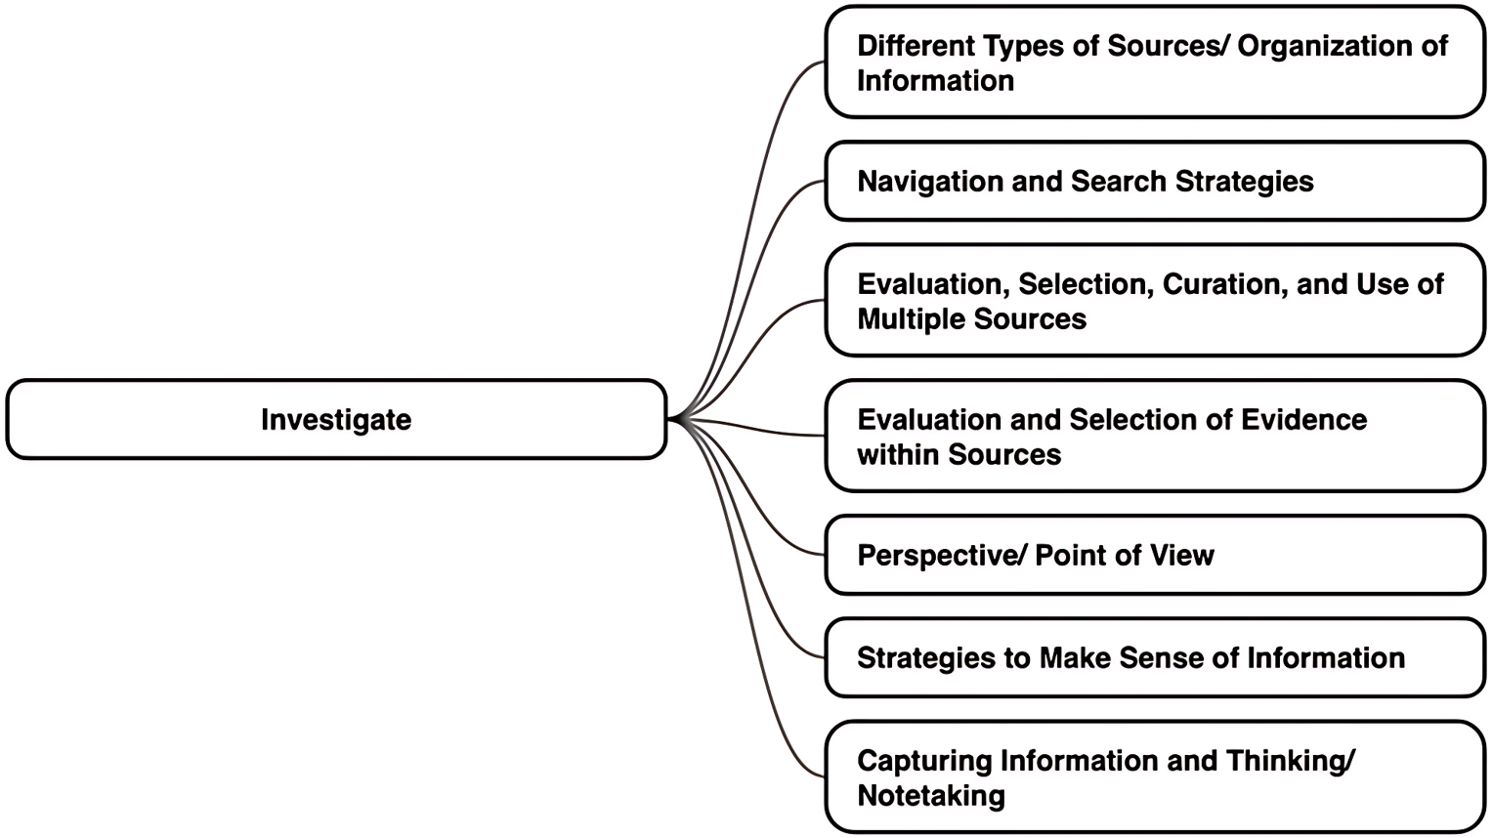
Skill Sets Provide a Frame for Skill Development
Making sense of information provided by others
Notes:
Priority skills are organized into Skill Sets → facilitates identifying the skills that are most needed by your students for any learning situation; also facilitates collaborative conversations with teachers about the skills to integrate into their content-based units.
The Skill Sets Framework is organized by the inquiry process. Skill Sets have been identified for each phase of inquiry.
Example: Investigate
Skill Sets include finding and evaluating sources, but, more importantly, evaluating and making sense out of the information in those resources
Skill Sets also include examining perspective and point of view

Slide 12
Investigate
Elementary
High School
Strategies to Make Sense of Information
Identifies main ideas, facts, details, and opinions that answer the research questions
Makes inferences about implicit meaning and interprets information found in all formats of text
Perspective / Point of View
Analyzes the impact of point of view and perspective on the information provided
Empathizes with the perspectives of others
Strategies to Make Sense of Information
Engages actively in a design process to take risks and try different solutions, modify the approach when needed, and try again
Makes inferences about implicit meaning and interprets information found in all formats of text
Capturing Information and Thinking / Notetaking
Uses evaluation criteria to select most relevant, credible, and valuable information
Explores opportunities and resources to address personal issues and prepare for the future
Perspective / Point of View
Analyzes the impact of point of view and perspective on the information provided
Analyzes and evaluates the motivation and purpose of information creators to assess misinformation and bias
Notes:
Making Sense of Information:
Elementary –
Identifying facts, details, opinions, simple inferences
Starting to examine the effect of point of view on the information (or characters in a fiction book)
Secondary –
Inferences, implicit meaning, interpretation of information
Impact of point of view, but also the motivation and purpose of the creator

Slide 13
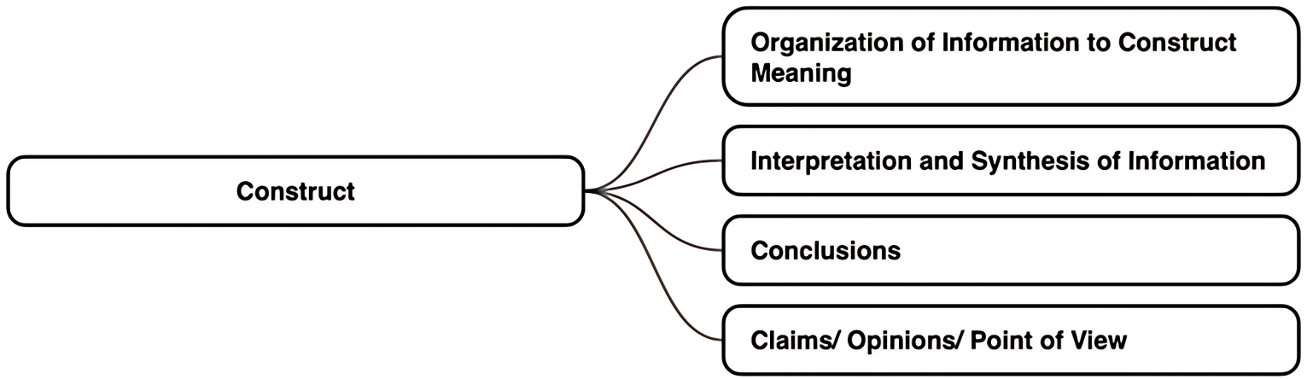
Skill Sets for Construct
Translating information into personal meaning and new understanding
Notes:
Skill Sets:
Organizing
Interpreting and synthesizing
Concluding
Developing opinions and own point of view
Construct is the heart of learning. What does this mean to you? What are the implications, impact, claims that you would make?

Slide 14
Construct
Elementary
Middle School
Claims / Opinions / Point of View
Develops clear and appropriate opinions or conclusions supported by evidence and examples
Actively solicits and listens with an open mind to the opinions, ideas, and feeling of others
Claims / Opinions / Point of View
Develops clear and appropriate opinions or conclusions supported by evidence and examples
Develops a line of argument or claim with clear reasoning, supporting evidence, and attention to refuting counter claims
Plans products to share newly constructed knowledge
Plans products to express personal voice and evidence-supported conclusions
Notes:
Elementary:
Have an open mind
Form opinions and conclusions based on evidence
Secondary
Forming one’s own personal opinion/conclusion based on evidence and personal perspective
Developing a line of argument to convince others to your point of view
Expressing personal voice

Slide 15
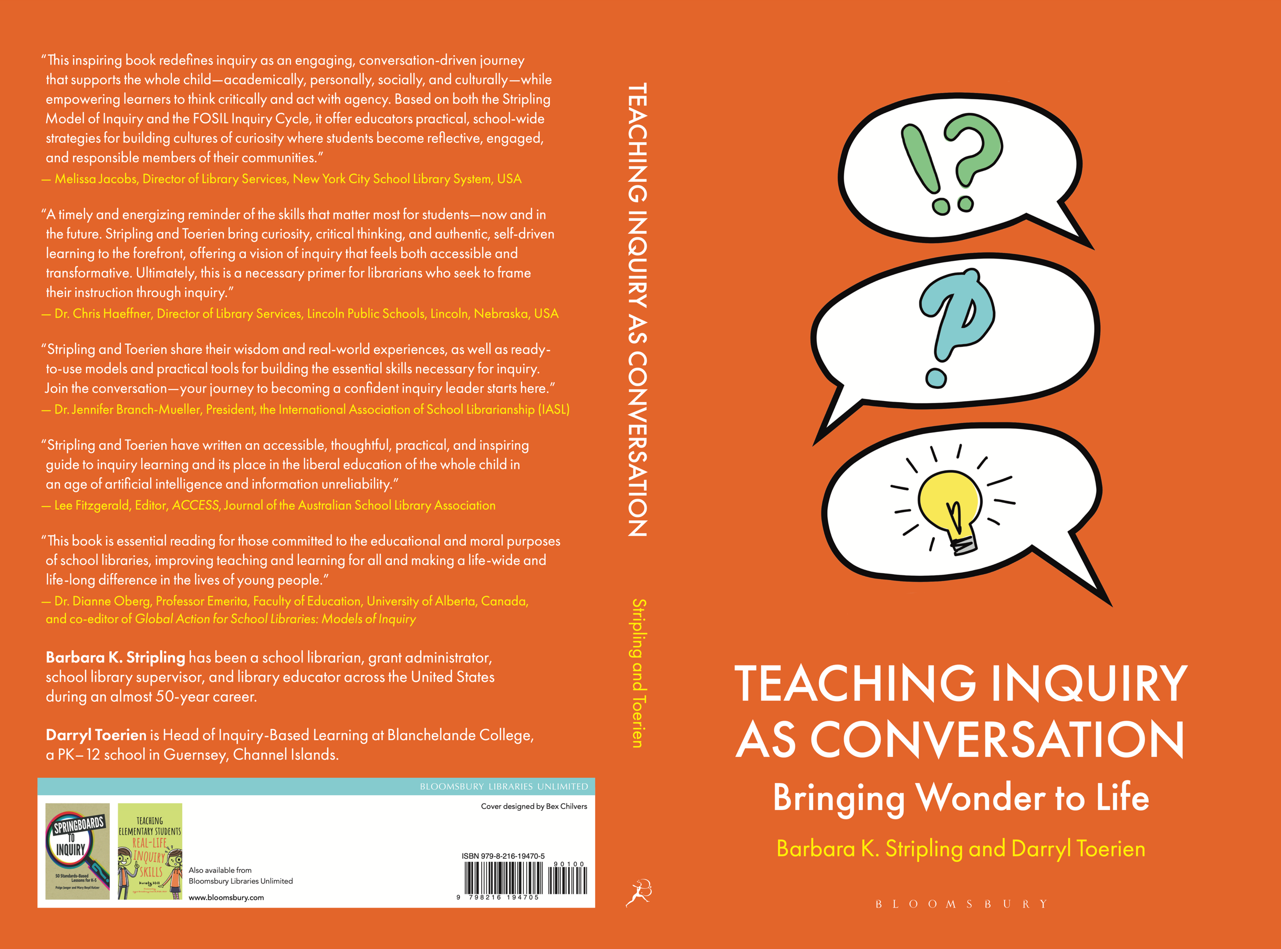
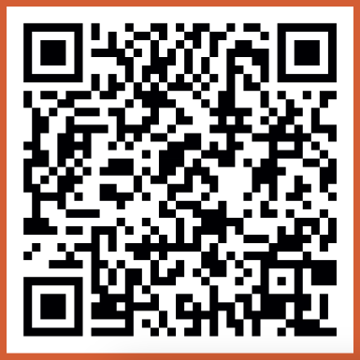
Join a Global Conversation
Barb
bstripli@syr.edu
slsa-nys.libguides.com/ifc
LinkedIn
Darryl
eloquent.mute@pm.me
fosil.org.uk
LinkedIn & Bluesky
Preview Chapter 2
Inquiry as Conversation
Notes:
Farewells.

