Slide 1
Be(com)ing Integral to the Educational Process
New Developments in School Libraries: The Latest Research
UK School Library Association
6 October 2026
Darryl Toerien

Slide 2
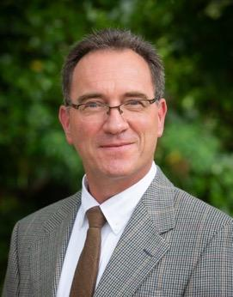
Introduction
Head of Inquiry-Based Learning at Blanchelande College
Originator of FOSIL (2010), based on the ESIFC (2009/12, 2019, 2027)
Founding Member of the FOSIL Group (2019)
Founding Director of the Institute for the Advancement of Inquiry (2025)
Member of the UK School Library Association (SLA), and former co-opted member of the Board
Former member of the CILIP School Libraries Group, and former member of the National Committee
Member of the IFLA School Libraries Section, and former elected member of the Section Standing Committee
Member of the International Association of School Librarianship
Notes:
My journey into school librarianship from teaching started unintentionally in 2003—a part-time job-share with no professional qualification or experience, but a Headmaster who viewed the Library as integral to the educational process. Not all Heads view their library in this way, of course, which is why Harold Howe’s (1967) observation is so profound, and has profound implications for us, that what a school thinks of its library is a measure of how it feels about education.

Slide 3
Idea(s) about education
Education is a practice, but before that it is an idea rooted in an uplifting belief…or at least that is the hope.
Simone Weil (1909–1943)
In The Value of ‘Failed Experiments’ in School Studies (2025), by Ronald K. L. Collins
  What is your idea about education?
  What uplifting belief is that idea rooted in?
  Now, what about the library?
Notes:
This is not just a problem for school librarians though. Ideas about what education is, who it is for, and how to achieve its ends are contested. This is why we need to be concerned with our own answers to these questions.

Slide 4

A global idea about education / the school library
The school library is integral to the educational process.
IFLA School Library Guidelines
Quoting the IFLA/UNESCO School Library Manifesto
Notes:
This idea is necessary if the educational process is to actually serve its true end of human flourishing.
This, however, is not necessarily the case, because, as we have said, educational ends and means are contested. Michael Young (2022), who continues to produce important work on the idea of powerful knowledge, provides insight into this unavoidable conflict by observing that without engaging students in the process of acquiring knowledge, which is a very difficult process, all we get memorization and reproduction in tests. You will, no doubt, be aware of which idea about education tends prevails in your school.

Slide 5
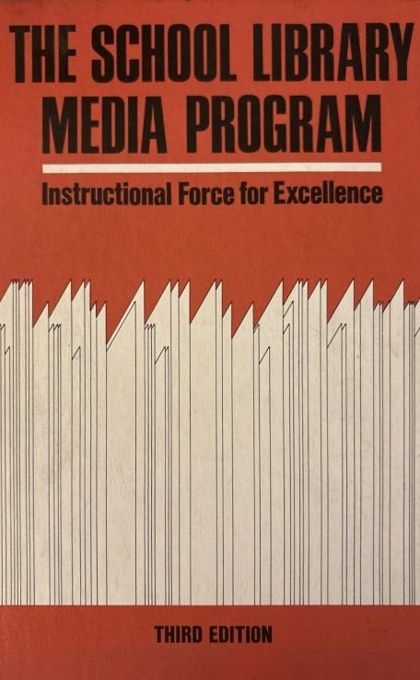
An instructional force for excellence
The library program and the educational program are interdependent and inseparable.
Therefore, perspective in viewing the function and role of the school library program must begin logically by building a historical understanding of education itself.
Notes:
As Ruth Anne Davies observes in her landmark work, The school library media program: Instructional force for excellence (1969/1979)…
It is worth noting in this regard, that Richard Colebourn (1986), in his personal survey of the first 50 years of the SLA, makes the point that from the outset “the Association…was clearly envisioned as an organisation of, and for, educationalists”. Cecil Stott, joint honorary secretary, underscored this view in his report for the inaugural meeting of the SLA in January 1937, that while efficiency and technique were important, they were only so “as a preliminary to the far more important use of the library as an instrument of education”. Yet, by 1986, Norman Beswick (1986), who Colebourn references in the highest regard, laments the passing of this idea—that the school library is a force for instructional excellence because, as Douglas Knight (1968) notes, the school librarian is a teacher whose subject is learning itself.

Slide 6
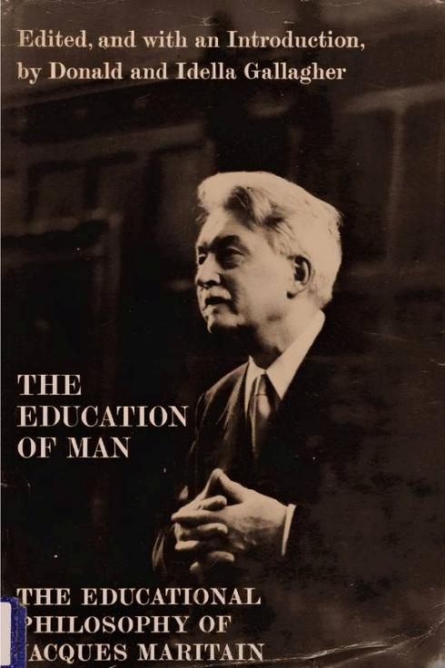
Fully human education is liberal education
Education is fully human education only when it is a [contemporary] liberal education, preparing the youth to exercise their power to think in a genuinely free and liberating manner.
Terminal freedom—the fulfillment of the deepest potentialities of the human being in the world.
Notes:
In gaining perspective on the function and role of the school library program by building a historical understanding of education itself, we discover that a fully human education is a liberal education (Jacques Maritain, 1962/1967, pp. 47-48).
For Maritain, a liberal education that is responsive to contemporary developments requires the reintegration of the liberal arts “so as to comprehend, as they once did, the physical sciences, the human sciences, the literary disciplines, and philosophy,” while “the physical sciences, and others patterned upon them, must regain their humanistic character” (p. 18).

Slide 7

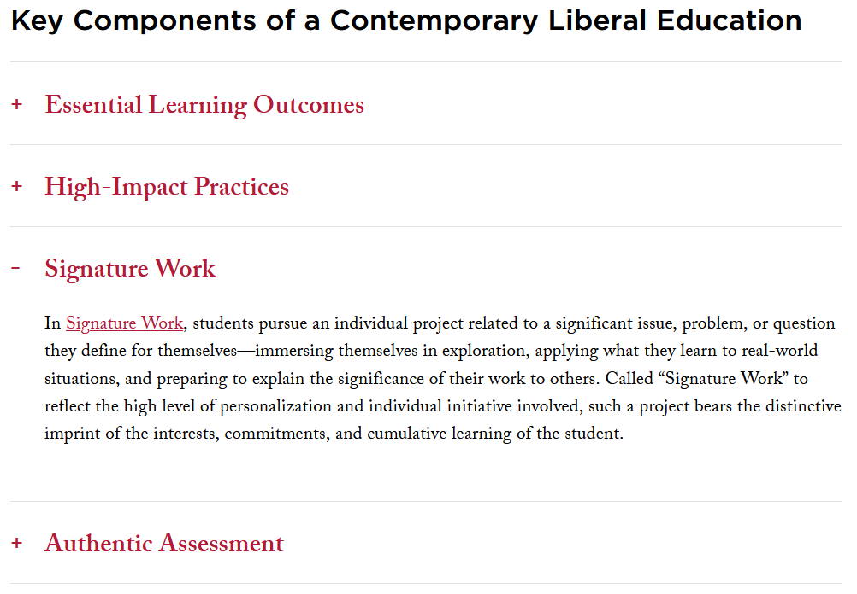
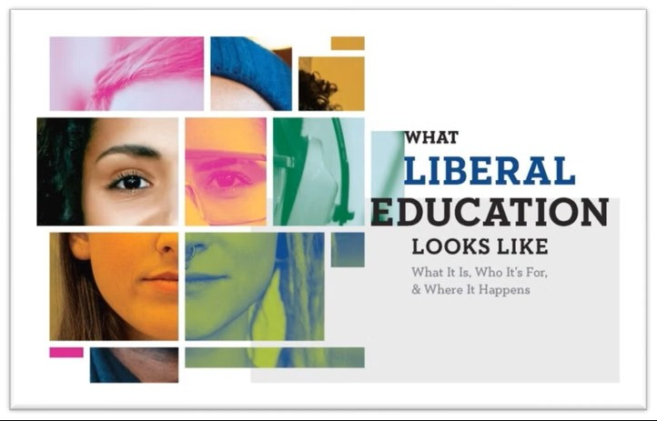
Inquiry is integral to liberal education
(2020)
Notes:
Inquiry, especially in the form of Signature Work, is integral to a contemporary liberal education.
I was drawn to Blanchelande College—and then appointed as Head of Inquiry-Based Learning, which includes responsibility for its libraries—by a Principal who had a vision for a liberal education that was characterised by inquiry, which was, in turn, inspired and supported by close collaboration between the Classroom and the Library. This work was shortlisted for the UK SLA 2023 Enterprise of the Year Award <https://fosil.org.uk/forums/topic/uk-sla-2023-enterprise-of-the-year-award/>, which demonstrated our thesis that the school library becomes integral to the educational process through its inquiry-centred instructional program.

Slide 8
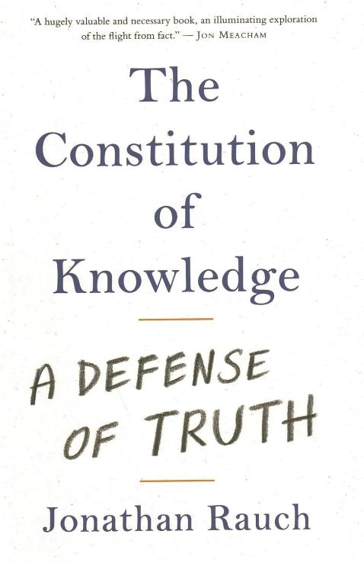
Liberal democracy requires liberal education
Our existential crisis is epistemological in nature, a breakdown of the knowledge-building process, which is the inquiry process.
A failure of the educational process to strengthen the reality-based community of error-seeking inquirers vital to the Constitution of Knowledge.
Notes:
This work that we all are engaged in, is of the utmost importance, because, as Jonathan Rauch points out, the Constitution of Knowledge, upon which our liberal democratic depends, require the ceaseless efforts of a reality-based community of error-seeking inquirers. Lamentably, schools have done little equip their students for their place and role in this community.

Slide 9
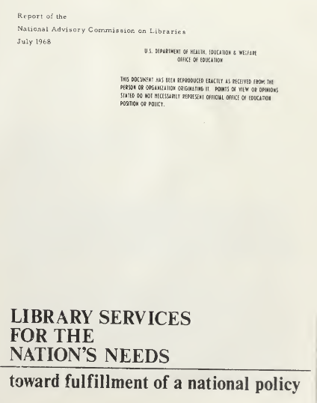
Teachers of the inquiry process of learning
Two major and unique functions
  Meeting of mind and ideas
  Extension of ideas in the mind
Collaboration between those who teach the mind to inquire and those who teach it how to inquire.
Therefore, the school librarian is a teacher of the inquiry process of learning itself.
Notes:
This brings our idea of the school librarian’s place and role in the educational process into sharper focus. Douglas Knight (1968), then President of Duke University and Chairman of the United States National Advisory Commission on Libraries, makes these timeless observations on libraries regardless of type…

Slide 10
An inquiry-centred instructional programme
Core instructional activities
  Literacy & reading promotion
  Media & information literacy
    Can be included in inquiry-based learning
  Inquiry-based learning
    Includes media & information literacy
  Technology integration
  Professional development for teachers
Notes:
This, then, makes the school librarian integral to an educational process that has human flourishing as its end, which requires school librarians to both recognise and advocate for this. This remains the importance and value of the IFLA School Library Guidelines.

Slide 11
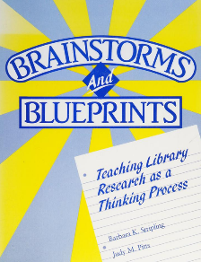
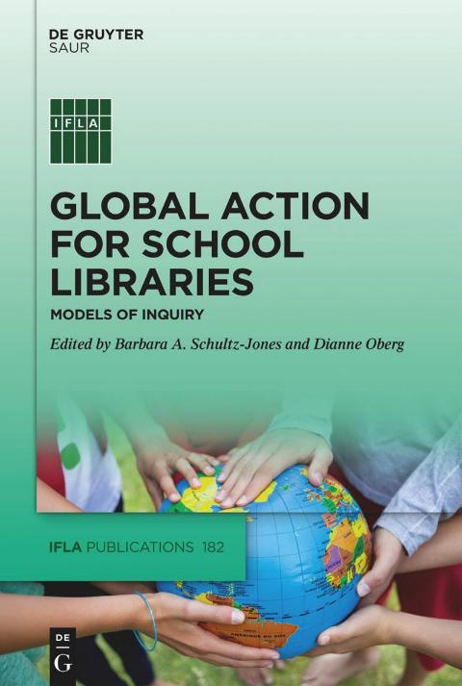
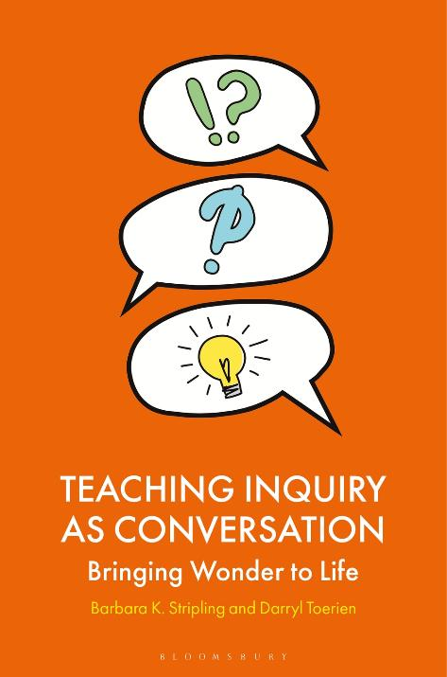
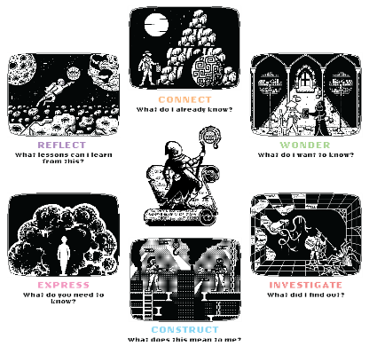
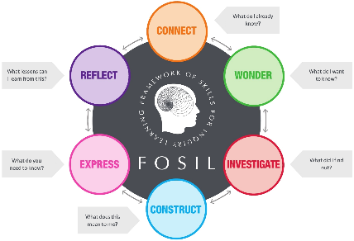
Teaching inquiry as conversation
1988
2022
2026
2025–
2010–2024
Notes:
This brings the evolution of my ideas about becoming integral to the educational process to the present.

Slide 12
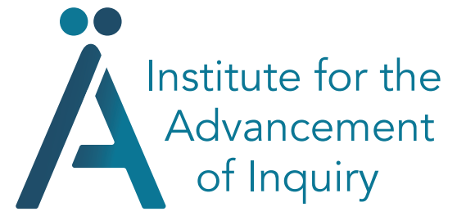




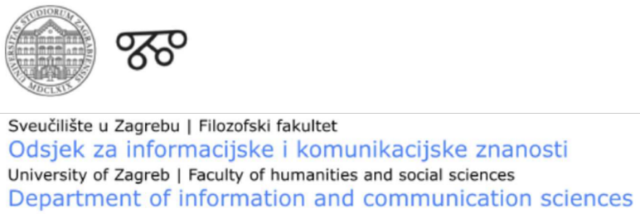



Inquiry as a vital global conversation
Notes:
This takes my thinking about becoming integral to the educational process into future.
The Institute, which was announced during the inaugural FOSIL Symposium in 2025, which drew together more than 200 colleagues from more than 20 countries, serves the following purpose: To initiate and support efforts, formal and informal, that foster the development of school-age children as engaged and empowered inquirers. This both enables them to fulfil the deepest potentialities of their being human in the world, and strengthens the liberal-democratic fabric of society.
It is also an invitation to join us in this vital and urgent conversation.

Slide 13
References (in order of slides)
Howe, H. (1967, February). On Libraries and Learning. School Library Journal, 13, p. 28.
Simone Weil in The Value of “Failed Experiments” in School Studies, by Ronald K. L. Collins (2025).
IFLA School Library Guidelines (2015).
  IFLA-UNESCO School Library Manifesto (1999). See also IFLA-UNESCO School Library Manifesto (2025).
Young, M. (2022, September 21). What we’ve got wrong about knowledge & curriculum. Tes Magazine.
Davies, R. A. (1969/1979). The school library media program: Instructional force for excellence. R. R. Bowker.
Colebourn, R. (1986). The School Library Association 1936-1986: A Personal Survey of Fifty Years. School Library Association.
Beswick, N. W. (1986). The Past As Prologue: Two Decades of Missed Chances. Library Review, pp. 155-162.
Maritain, J. (1962/1967). The education of man: The educational philosophy of Jacques Maritain. Doubleday & Company.
AAC&U (2020). What Is Liberal Education?.
  See also UK SLA 2023 Enterprise of the Year Award.
Rauch, J. (2021). The Constitution of Knowledge: A Defence of Truth. Institution Press.
Knight, D. M. (1968). Library services for the nation’s needs: Toward fulfillment of a national policy. United States National Advisory Commission on Libraries.
FOSIL Inquiry Cycle Releases (2010-2025).
Stripling, B. K., & Pitts, J. M. (1988). Brainstorms and blueprints: Teaching library research as a thinking process. Libraries Unlimited.
Toerien, D. (2022). FOSIL: Developing and extending the Stripling Model of Inquiry. In B. A. Schultz-Jones, & D. Oberg (Eds.), Global action for school libraries: Models of inquiry (pp. 62-76). De Gruyter Saur.
Toerien, D., and Rose, H. (2025). Creative Commons reboot of the FOSIL-based Heroic Inquiry Cycle. Learning Hub, pp. 1-6.
Stripling, B. K. & Toerien, D. (2026). Teaching inquiry as conversation: Bringing wonder to life. Bloomsbury.
FOSIL Symposium (2025).
  Session 2a: Institute for the Advancement of Inquiry.
Notes:
Thank you.

